Slide 1
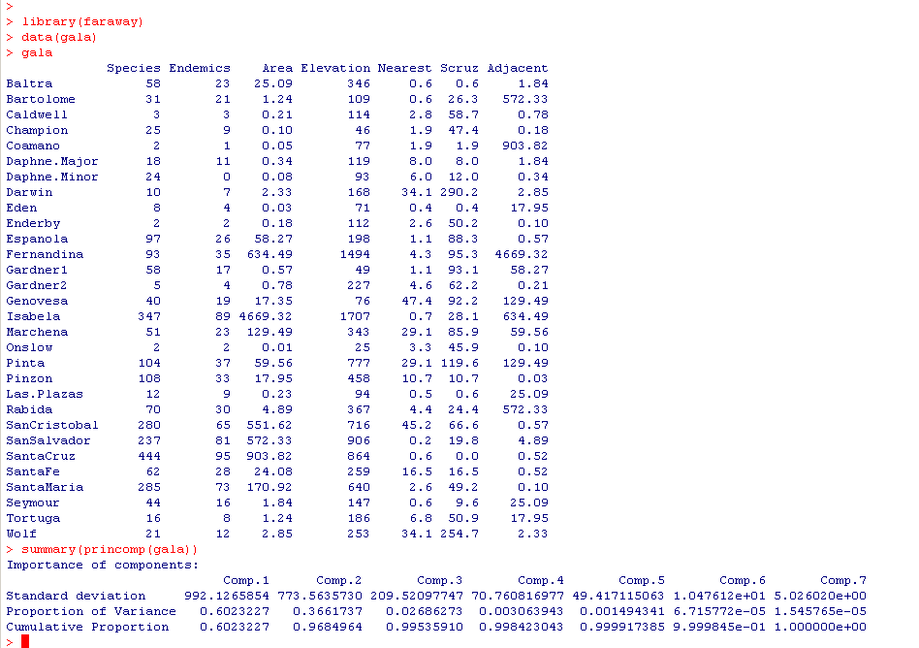
Let’s return to the gala dataset…
There are only 2-3 columns of non-redundant information

Slide 2
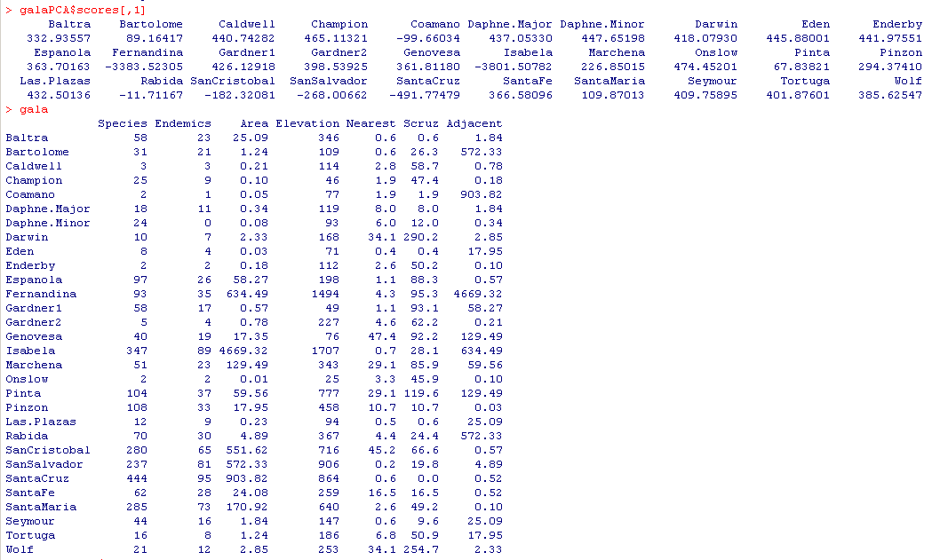
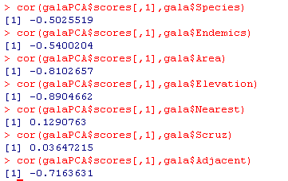
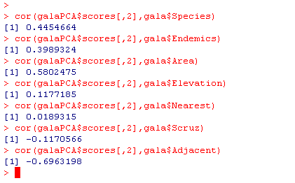

The first component correlates with many of the measured variables…
The second component has much
Less correlation with elevation
The two components, of course,
are not correlated with each other (that’s the point!):

Slide 3

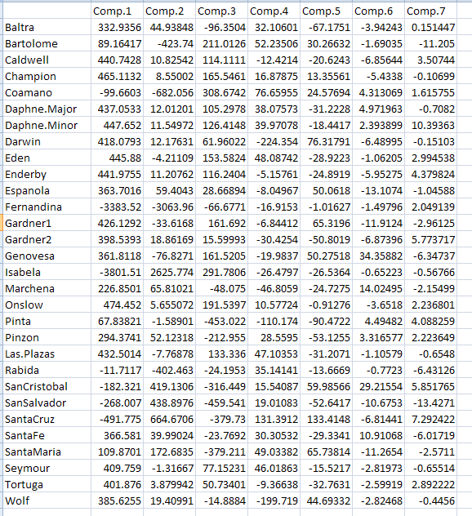

Slide 4
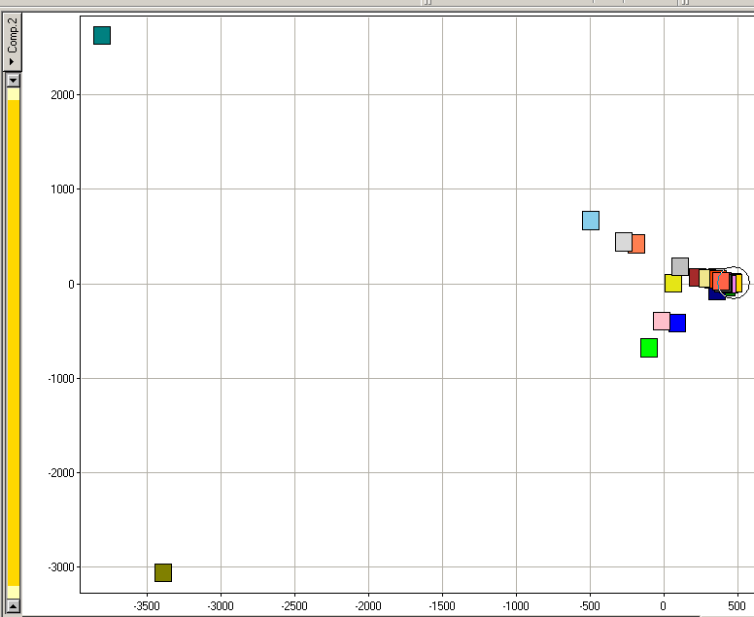
Isabella
Isabella and Fernandina seem really different…
Component 2
Fernandina
Component 1

Slide 5
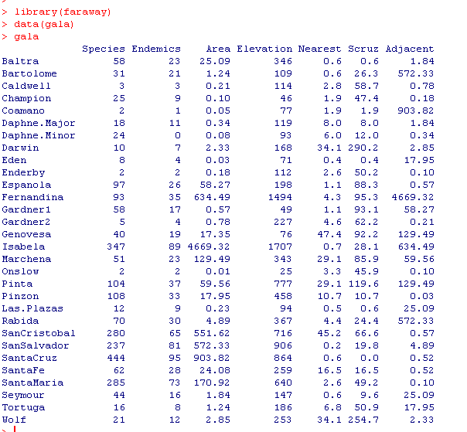
Fernandina is adjacent to Isabela.
The large area of Isabela causes both points to be outliers….
Limitations of PCA become apparent for this dataset…
A single datapoint drives the outliers

Slide 6
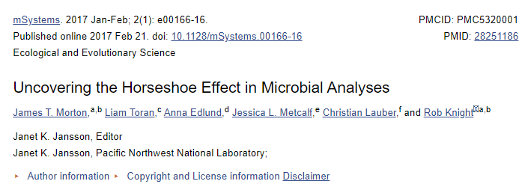
When the first axis dominates, you often get a “horseshoe effect”

Slide 7
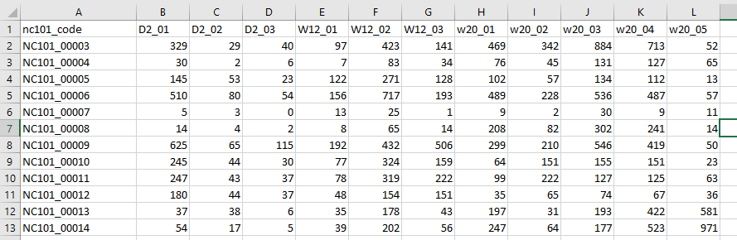
If we return to our RNA-seq dataset from previous lectures…

Slide 8
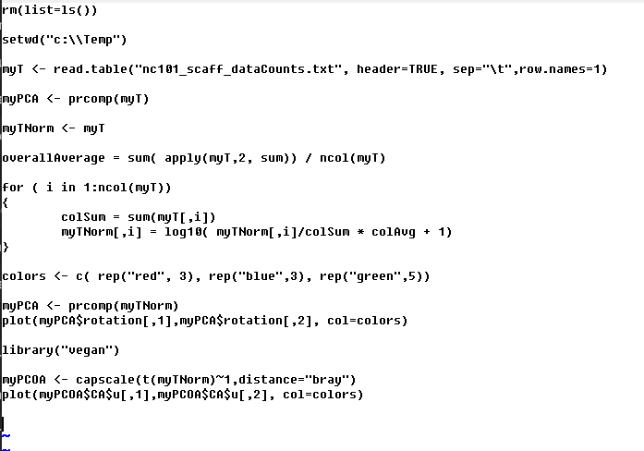
We can perform the ordination in a few lines of R code
https://github.com/afodor/metagenomicsTools/blob/master/src/classExamples/pcaForSlides.txt

Slide 9
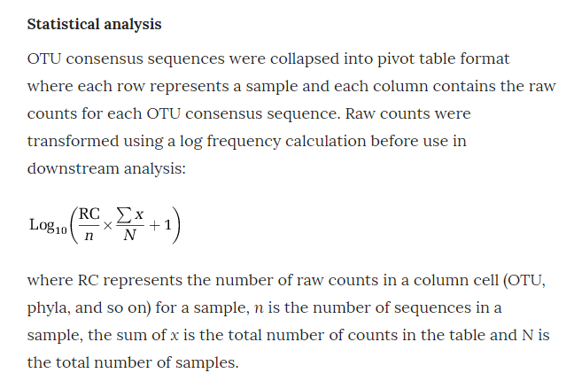
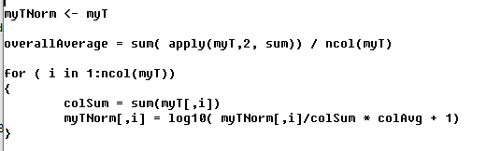
Our normalization strategy attempts to minimize the impact of the psuedo-count
https://www.nature.com/articles/ismej2013106/

Slide 10
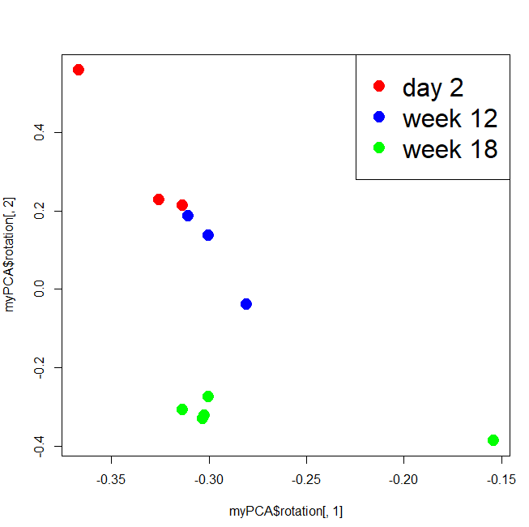
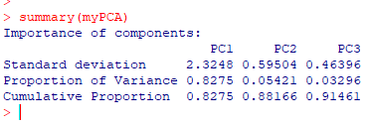
When you have more taxa than samples, you need to use prcomp
(and the PCA axes are identified by “rotation” in the return object”)
Our first axis is dominated
by a single outlier

Slide 11
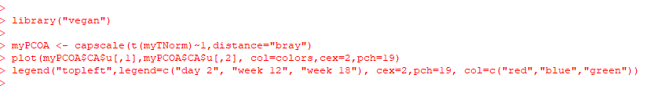
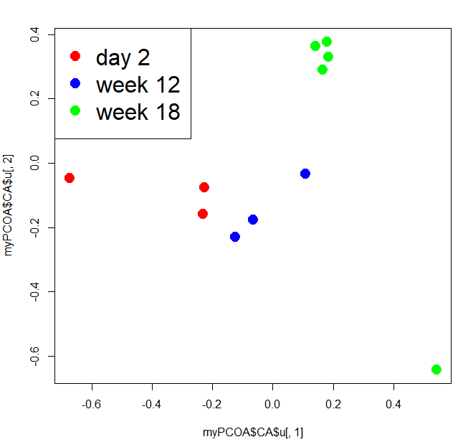

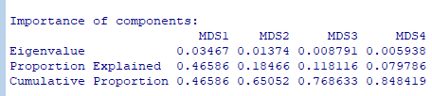
Often in ecology, we use other distance matrixes

Slide 12
