Slide 1
Generalized linear models – Poisson distribution
Generalized linear models – Negative binomial distribution
Generalized linear models – logistic regression (binomial distribution)

Slide 2
Consider this data set from section 9.5 of the Zuur book
(data from http://www.highstat.com/Book2/ZuurDataMixedModelling.zip
rm(list=ls())
setwd("C:\\books\\zuurData")
RK <- read.table("RoadKills.txt",header=TRUE, sep="\t")
plot(RK$D.PARK, RK$TOT.N, xlab = "Distance to park",ylab = "Road kills",ylim=c(-30,130))
https://github.com/afodor/metagenomicsTools/blob/master/src/classExamples/poissonVsNegativeBinomial

Slide 3
We can of course easily fit a linear model to these data…
plot(RK$D.PARK, RK$TOT.N, xlab = "Distance to park",ylab = "Road kills",ylim=c(-30,130))
M0 <- lm( RK$TOT.N ~ RK$D.PARK )
plot(RK$D.PARK, RK$TOT.N, xlab = "Distance to park",ylab = "Road kills",ylim=c(-30,130),main=paste( "linear AIC=", format(AIC(M0),digits=5)))
xRange<- seq(from = 0,to = 25000, by = 1000)
linearMeans <- coef(M0)[1] + coef(M0)[2] * xRange
lines( xRange, linearMeans)

Slide 4
The model, of course, assumes a constant variance of the residuals…
library("Hmisc")
meanR <- mean(residuals(M0))
standardError = sqrt(sum( (residuals(M0)-meanR)^2 / ( length(residuals(M0)) - 2 )))
errbar(xRange, linearMeans , linearMeans + standardError , linearMeans - standardError ,add=TRUE)
Here we add +/- SD to our graph…

Slide 5
Definitely some problems with this fit…
Variance doesn’t appear constant across whole range
Systematic bias in the residuals
The model predicts negative road kills
at high distance;
This doesn’t make a lot of sense…

Slide 6
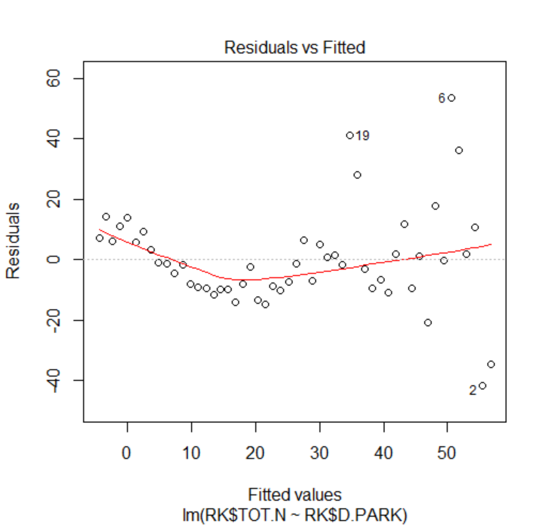
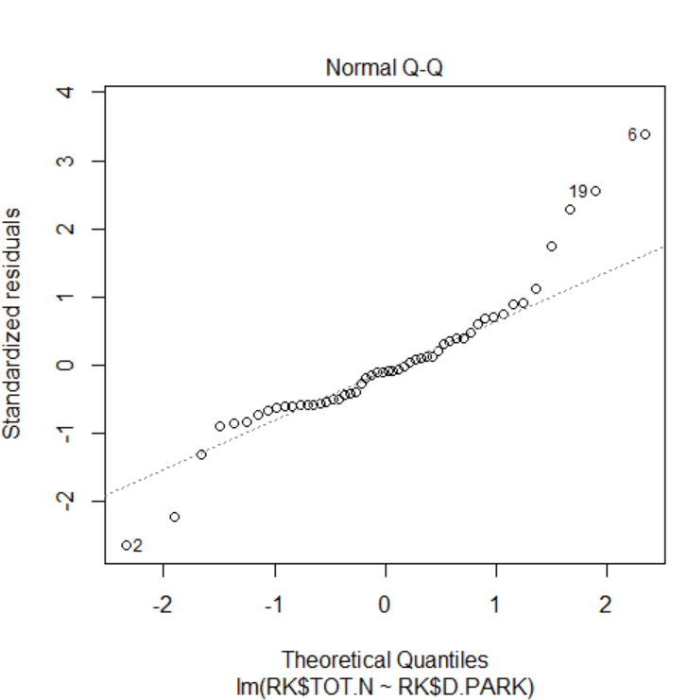
We can see the systematic variation in the residuals by typing “plot(M0)”

Slide 7
It would be nice if we could have a model based on counts that allows us to vary the
variance ;
We will see that we can build a model based on the negative binomial distribution that
fits the bill.
But let’s first (for simplicity) consider a model based on the Poisson distribution.

Slide 8
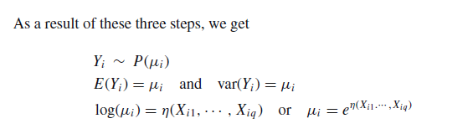
A generalized linear model has three components…
Zuur book (section 9.3)
Our data is Poisson distributed
The mean and variance are given by the
Poisson
The model value mean is a function of our
explanatory variables
The “link” function
In a Poisson, mean = n*p and p can’t be negative!
The exponential term ensures only positive model means!

Slide 9
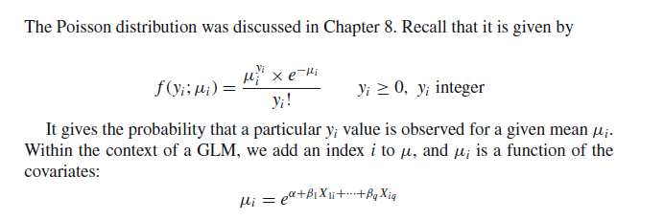
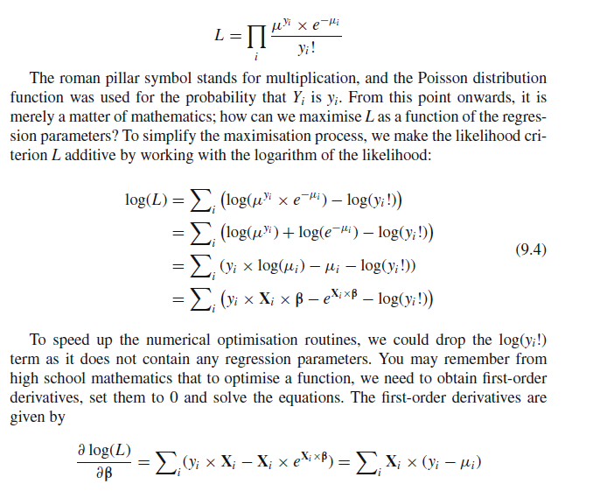
Put this all together and it will produce a likelihood function (Zuur book section 9.4)..
Our data are Poisson
distributed
The model mean is a function of our
explanatory variables
And we are ready to find the maximum likelihood

Slide 10

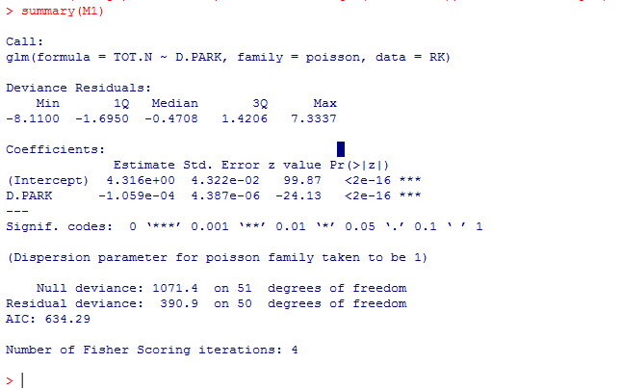
M1 <- glm(TOT.N ~ D.PARK, family = poisson, data = RK)
plot(RK$D.PARK, RK$TOT.N, xlab = "Distance to park",ylab = "Road kills",,main=paste( "Poisson AIC=", format(AIC(M1),digits=5)),ylim=c(-30,130))
modelMeans <- exp( coef(M1)[1] + coef(M1)[2]* xRange)
lines(xRange, modelMeans )
# variance equals the means
errbar(xRange, modelMeans, modelMeans + sqrt(modelMeans), modelMeans - sqrt(modelMeans),add=TRUE)
https://github.com/afodor/metagenomicsTools/blob/master/src/classExamples/poissonVsNegativeBinomial

Slide 11
Too many data points outside the variance
The assumption that variance = mean is not a good fit for this data
Does not go below zero
(which is good)

Slide 12
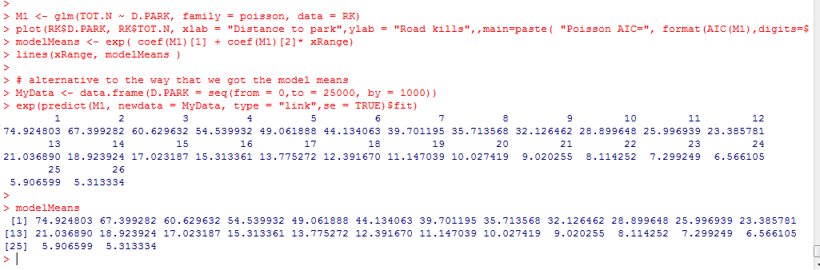
We can use “predict” to get the line for our model, but it is good to know that we can do
it ourselves…

Slide 13
One more PCA Example
Generalized linear models – Poisson distribution
Generalized linear models – Negative binomial distribution
Generalized linear models – logistic regression (binomial distribution)

Slide 14
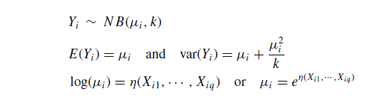
We can relax the assumption that the variance equals the mean with the negative
binomial distribution..
We add one parameter that adjusts the variance
Shotgun noise + additional variance
The “linkage” equation is the same as Poisson…

Slide 15
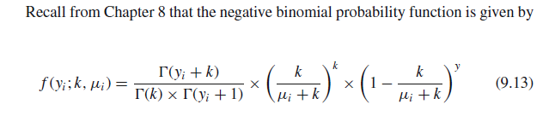
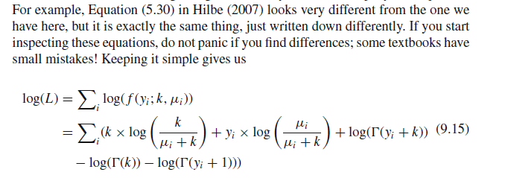

We put this all together (Zuur book Chapter 9) to get our likelihood function….
!
We have our likelihood function to maximize!
(Once we plug in that
)

Slide 16

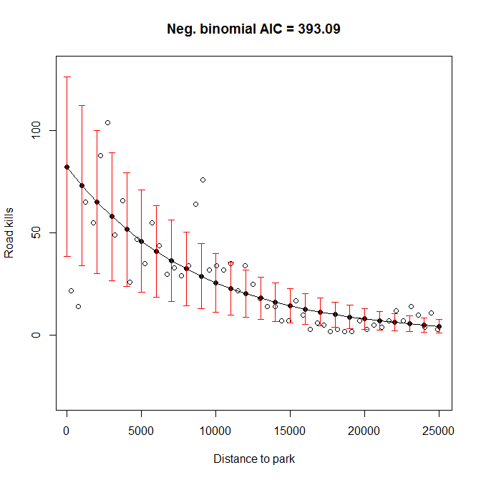
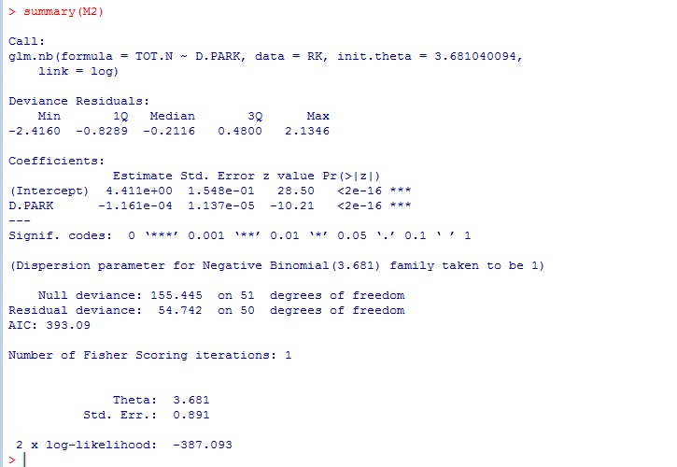
library("MASS")
M2 <- glm.nb(TOT.N ~ D.PARK, data = RK)
model2Means <- exp( coef(M2)[1] + coef(M2)[2]* xRange)
plot(RK$D.PARK, RK$TOT.N, xlab = "Distance to park",ylab = "Road kills",main=paste( "Neg. binomial AIC =", format(AIC(M2),digits=5)),ylim=c(-30,130))
lines(xRange, model2Means)
vars = model2Means + model2Means^2 / M2$theta
errbar(xRange, model2Means, model2Means + sqrt(vars), model2Means - sqrt(vars),add=TRUE, errbar.col="RED")

Slide 17
We capture large
variance at high
road kills
Our model doesn’t go below zero

Slide 18
Negative binomial seems like the best fit…
But the differences between the models are in some ways subtle..
They all capture the basic shape of the relationship..

Slide 19
One more PCA Example
Generalized linear models – Poisson distribution
Generalized linear models – Negative binomial distribution
Generalized linear models – logistic regression (binomial distribution)

Slide 20
What about binary variables.
voting democratic or republican
has cancer/does not have cancer

Slide 21
Here we simulate a classification problem (more on this later)
rm(list=ls())
numDataPoints <- 100
classBlue <- rnorm(10,mean=1);
classOrange <- rnorm(10, mean=0);
blueDataX1 <- vector();
orangeDataX1 <- vector();
for( i in 1:numDataPoints)
{
blueDataX1[i] <- rnorm(1, mean=classBlue[ sample(1:10,1) ], sd = 1/5)
orangeDataX1[i] <- rnorm(1, mean=classOrange[sample(1:10,1)],sd = 1/5)
}
colors <- c( rep("BLUE", numDataPoints), rep ("ORANGE", numDataPoints))
values <- c( rep(0, numDataPoints), rep (1, numDataPoints))
mergedDataX1 <- c( blueDataX1, orangeDataX1 );
plot(mergedDataX1, values,col=colors)
https://github.com/afodor/metagenomicsTools/blob/master/src/machineLearningExamples/logisticRegressionSims.txt

Slide 22
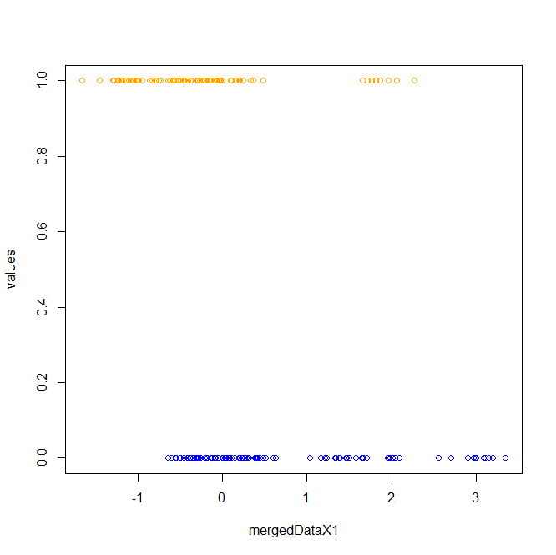
plot(mergedDataX1, values,col=colors)

Slide 23
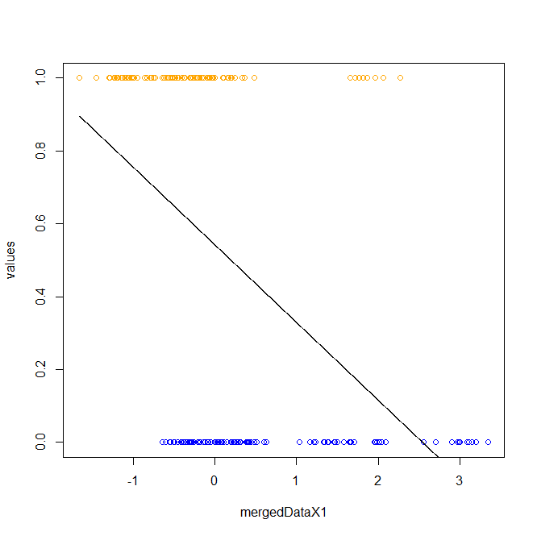
We can of course fit a linear model to these data
xSeq <- seq(min(mergedDataX1), max(mergedDataX1), 0.001)
myLm <- lm( values ~ mergedDataX1)
getProbLm <- function( x, B0, B1)
{
return ( B0 + B1 * x )
}
lines( xSeq, getProbLm(xSeq, coef(myLm)[1], coef(myLm)[2]),col="black")
We can think of the y-values as the p(blue|x value)
But our model can
Return values > 1 or <0, which doesn’t make sense for a probability

Slide 24
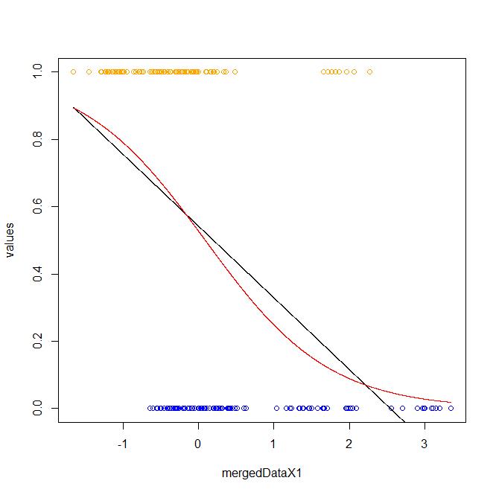
myLogReg <- glm( values ~ mergedDataX1 ,family = binomial)
summary(myLogReg)
xSeq <- seq(min(mergedDataX1), max(mergedDataX1), 0.001)
getProb <- function(x, B0, B1)
{
return (1 / (1 + exp(-(B0 + B1 * x ))))
}
lines( xSeq, getProb(xSeq, coef(myLogReg)[1], coef(myLogReg)[2]),col="red")
An alternative is a logistic regression
where the model can’t go >1 or <0

Slide 25
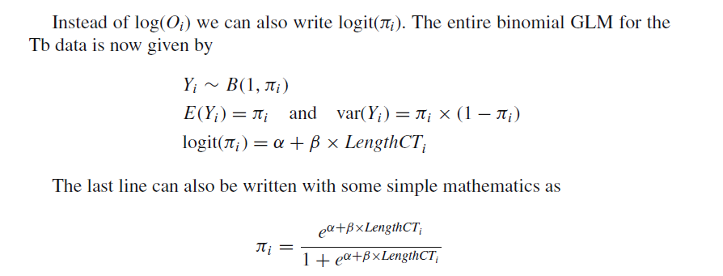
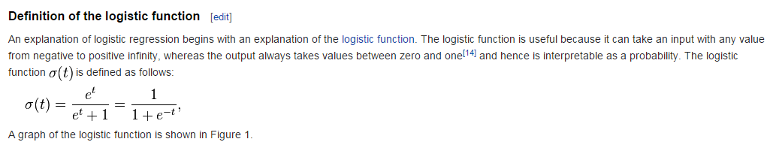
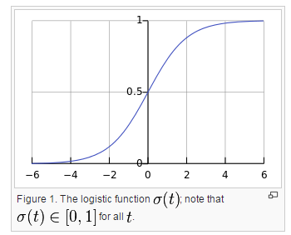
Here are the rules for a logistic regression…(Chapter 10 of the Zuur book..)
Binomial probability of 1 coin flip
Linker function
N * p * (1-p) with N = 1
Whatever intercept and
explanatory variables in your
design matrix
This constrains us to between 0 and 1
http://en.wikipedia.org/wiki/Logistic_regression

Slide 26
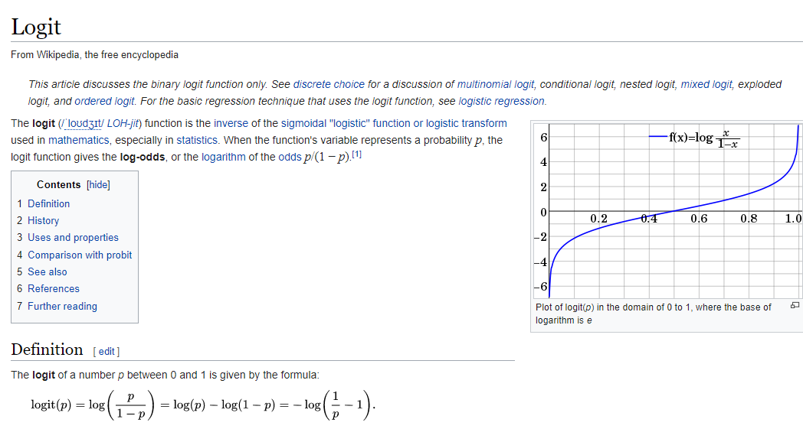

Slide 27

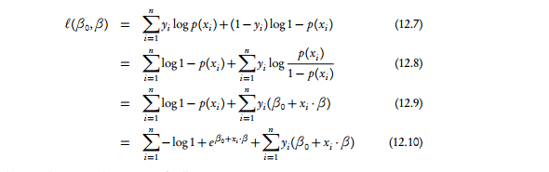
Put all this together into the likelihood…
Binomial distribution with n = 1
Yi is 1 or 0
This is π if a head (1- π) if a tail
Find the parameters to maximize this and we are good to go….
http://www.stat.cmu.edu/~cshalizi/uADA/12/lectures/ch12.pdf

Slide 28
The linear regression and logistic regression can vary in how closely they agree…
(Here we look at 3 different runs….)

Slide 29
Next:
Zero inflated Poisson and Negative Binomial

