Slide 1
Bayes law (with an updating cylon detector)
The famous dishonest casino

Slide 2

Consider a cylon detector…
Cylons are robots that look like organic people.
We can’t tell cylons from people by just looking at them.
Let’s say we know (somehow) that 1% of all people are cylons.
This is our prior distribution. Our belief before we look at any data in an experiment.
p(not a cylon) = 0.99%
P(cylon) = 0.01;
We define p(X) for two states. P(X)_{i=0} = 0.99 ; P(X)_{i=1} = 0.01
By convention for the rest of the semester, X are states that we are interested in but cannot observe.
By convention g_{x=0-i}(X) will be the probabilities of i such states such that Σg(x) = 1

Slide 3
We build a cylon detector.
We know (somehow) the cylon detector has the following properties
(later we will call these likelihood probabilities)
p(positive|cylon) = 0.9 p(negative|cylon)=0.1
p(positive|not a cylon) =0.05 p(negative|not a cylon)=0.95
We read p(positive|cylon) as the probability of a positive read given the person in the
detector is a cylon.
By convention, states that we can observe will be marked as Y.
The distribution P(Y|X) across multiple states of Y is a frequency distribution.
How frequently do we observe data given the underlying (hidden) state.
By convention f_{x=0-i}(X) will be the probabilities of i such states such that Σf(x) = 1
We have two frequency distributions here: one if the person is a cylon, one if they are not a cylon.

Slide 4
We want to calculate:
p(cylon|positive)
If our cylon detetor says someone is a cylon, how confident are we in that?
We define a joint probability
P(x,y) – the probability that someone is a cylon and gets a positive result…
p(x,y) = p(x | y ) * p(y)
but that’s the same as p(y,x) – the probability that someone gets a positive result
and is a cylon
p(y,x) = p(y|x) * p(x)
So… since p(x,y) = p(y,x)
p(x|y ) = p(y | x ) * p(x)
Bayes’ law
p(y)

Slide 5
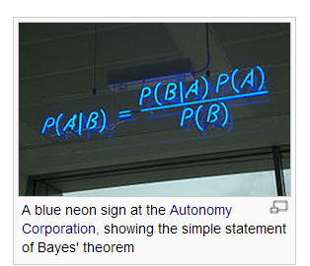
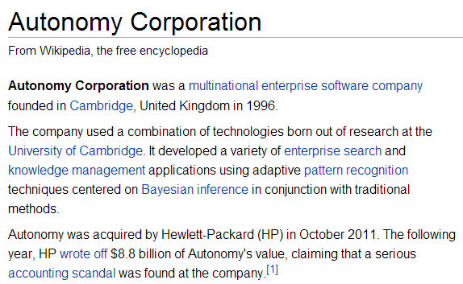
http://en.wikipedia.org/wiki/Bayes'_theorem
Bayesian accounting?

Slide 6
Bayes’ law
P(Person is a cylon | positive result) =
p(positive result | cylon) * p(cylon)
p(positive result)
We know p(positive result|cylon) and p(cylon)
To calculate p(positveResult), we can imagine the Bayesian Universe…

Slide 7
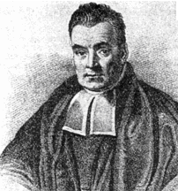
To calculate this,
we can imagine the Bayesian Universe
of possibilities.
(This is described nicely in the chapter
“Bayesian Inference for Discrete
Random Variables” in the Bolstad
“Introduction to Bayesian Statistics” book)
i = {0,1}
y₀
y₁
prior
Test positive
Test negative
Marginal probs
cylon
g(x₀)
g(x₀)
f(y₀|x₀)
g(x₀)
f(y₁|x₀)
g(x₀) = Σ g(x₀) *f(y_{i}|x₀)
x₀
i
j = {0,1}
not a
cylon
g(x₁)
g(x₁)
f(y₀|x₁)
g(x₁)
f(y₁|x₁)
g(x₁) = Σ g(x₁) *f(y_{i}|x₁)
i
x₁
Marginal probs
P(Y₀)=
P(Y₁)=
Σ g(x_{j}) *f(y₀|x_{j})
Σ g(x_{j}) *f(y₁|x_{j})
j
j
“Posterior probability is proportional to prior * likelihood”

Slide 8
To calculate this,
we can imagine the Bayesian Universe
of possibilities.
(This is described nicely in the chapter
“Bayesian Inference for Discrete
Random Variables” in the Bolstad
“Introduction to Bayesian Statistics”)
prior
Test positive
Test negative
Marginal probs
cylon
0.01
0.01 * 0.90
0.01 * 0.10
p(cylon) = 0.01 * 0.90 + 0.01 * 0.1 =
0.01
not a
cylon
0.99
0.99 * 0.05
0.99 * 0.95
p(not a cylon) =
0.99 * 0.05 +0.99 * 0.95
= 0.99
Marginal probs
P(testPositive)=
P(testNegative)=
= 0.01 * 0.90
+ 0.99 * 0.05
=0.0585
= 0.01 * 0.10
+ 0.99 * 0.95
= 0.9415

Slide 9
P(Person is a cylon | positive result) =
p(positive result | cylon) * p(cylon)
p(positive result)
(Even though the test is 90% accurate,
we are only ~15% sure that this is
not a false positive!)
= (0.9 ) * 0.01
= 15.38%
0.0585
prior
Test positive
Test negative
Marginal probs
cylon
0.01
0.01 * 0.90
0.01 * 0.10
p(cylon) = 0.01 * 0.90 + 0.01 * 0.1 =
0.01
not a
cylon
0.99
0.99 * 0.05
0.99 * 0.95
p(not a cylon) =
0.99 * 0.05 +0.99 * 0.95
= 0.99
Marginal probs
P(testPositive)=
P(testNegative)=
= 0.01 * 0.90
+ 0.99 * 0.05
=0.0585
= 0.01 * 0.10
+ 0.99 * 0.95
= 0.9415

Slide 10
In terms of the Bayes universe, the positive result reduces the Bayes universe to
one column.
The fraction of cylon (0.01 * 0.90) over all possibilities ( 0.01 *0.90 + 0.99 + 0.05 ) is only 15%
prior
Test positive
Test negative
Marginal probs
cylon
0.01
0.01 * 0.90
0.01 * 0.10
p(cylon) = 0.01 * 0.90 + 0.01 * 0.1 =
0.01
not a
cylon
0.99
0.99 * 0.05
0.99 * 0.95
p(not a cylon) =
0.99 * 0.05 +0.99 * 0.95
= 0.99
Marginal probs
P(testPositive)=
P(testNegative)=
= 0.01 * 0.90
+ 0.99 * 0.05
=0.0585
= 0.01 * 0.10
+ 0.99 * 0.95
= 0.9415

Slide 11
posterior distribution –
What we believe after we run
the detector
P(Person is a cylon | positive result) =
p(positive result | cylon) * p(cylon)
prior distribution –
What we believe before we run
the detector
p(positive result)
Likelihood–
What we will observe given the hidden state
Integral or normalizing constant.
The sum of likelihoods under the prior

Slide 12
If we had observed a negative….
P(Person is a cylon | negative result) =
p(negative result| cylon) * p(cylon)
0.01 * 0.1 / 0.9415 = 0.001062
=
p(negative result)
prior
Test positive
Test negative
Marginal probs
cylon
0.01
0.01 * 0.90
0.01 * 0.10
p(cylon) = 0.01 * 0.90 + 0.01 * 0.1 =
0.01
not a
cylon
0.99
0.99 * 0.05
0.99 * 0.95
p(not a cylon) =
0.99 * 0.05 +0.99 * 0.95
= 0.99
Marginal probs
P(testPositive)=
P(testNegative)=
= 0.01 * 0.90
+ 0.99 * 0.05
=0.0585
= 0.01 * 0.10
+ 0.99 * 0.95
= 0.9415

Slide 13
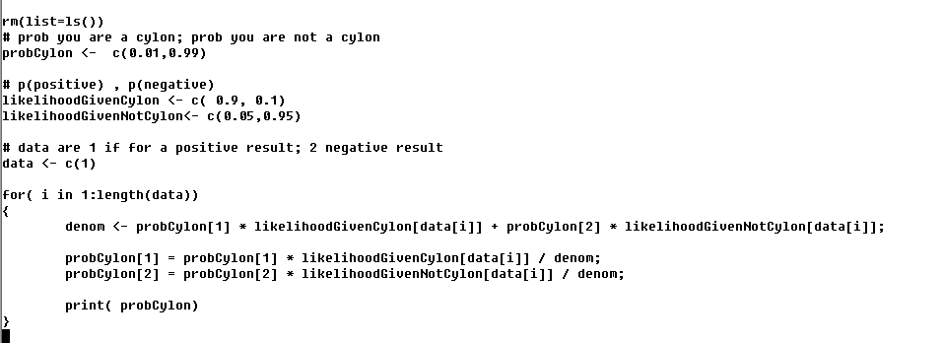
In R for a positive result
Our prior probability
A positive test
This yields our posterior probabilities for a positive result…
P(Person is a cylon | positive result)
P(Person is not a cylon | positive result)

Slide 14
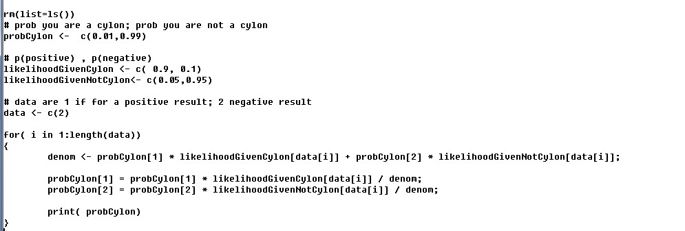

In R for a negative result
Our prior probability
Identical to previous code except
the test is now negative
This yields our posterior probabilities for a negative result…
P(Person is a cylon | negative result)
P(Person is not a cylon | negative result)

Slide 15
The great trick of Bayesian stats:
If the observations are independent the Bayesian update can be repeated.
We bring back our suspect for a second test that is also positive.
Now we want:
P(Person is a cylon | y_{p},y_{p})
where y_{p} and y_{p} are independent positive measurements.

Slide 16
We can use our old posterior from P(Person is a cylon | y_{p} ) as our new prior
P(Person is a cylon | y_{p},y_{p}) = p(y|person is a cylon) * p(person is a cylon) / p(testPositive)
= 0.9 * 0.154 / 0.1809 = 0.766
Our new prior is our old posterior
prior
Test positive
Test negative
cylon
0.154
0.154 * 0.90
0.154 * 0.10
p(cylon) = 0.154 * 0.90 + 0.154 * 0.1 =
0.154
not a
cylon
0.846
0.846 * 0.05
0.846 * 0.95
p(not a cylon) =
0.846 * 0.05 +0.846 * 0.95
= 0.846
P(testPositive)=
P(testNegative)=
= 0.154 * 0.90
+ 0.846 * 0.05
= 0.1809
= 0.154 * 0.10
+ 0.846 * 0.95
= 0.8191

Slide 17
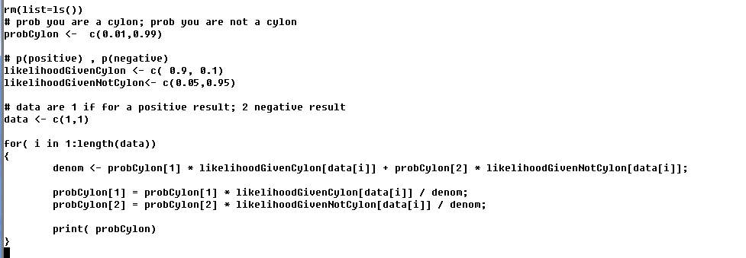

In R for two positive results
Our prior before we see any data…
We new see two data points
P(cylon)
P(not-cylon)
Our belief after 1st data point
Our belief after 2nd datapoint

Slide 18
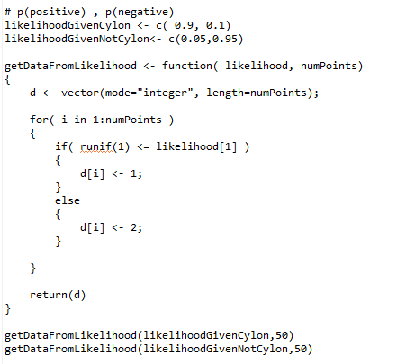
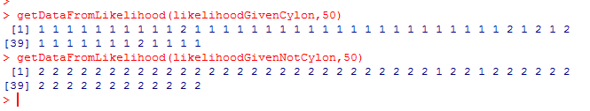
We can watch out beliefs change as new data comes in..
Let’s make a simulator that will generate test results from our two likelihood distributions
Our distribution of test results if
you are or aren’t a cylon
Simulated test results

Slide 19
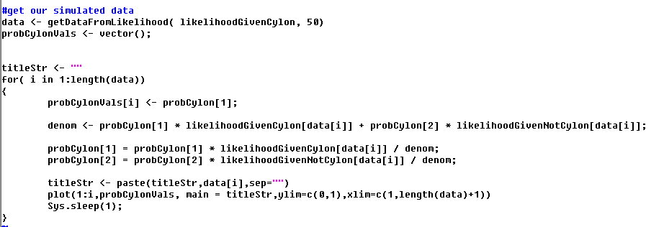
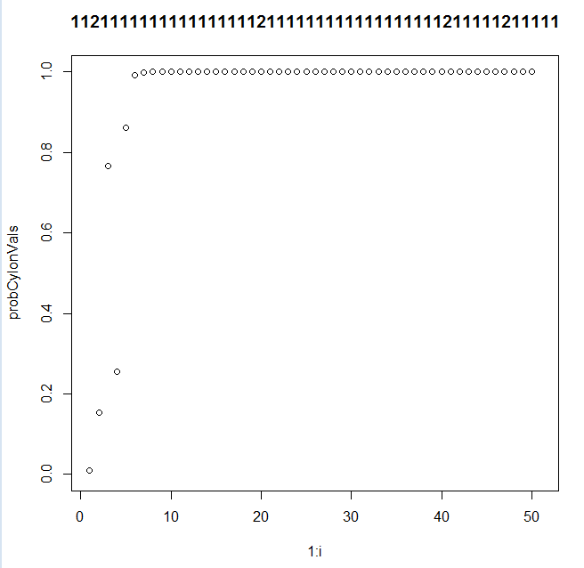
We can watch how much confidence we have that someone is a cylon given repeated
tests by repeatedly applying the update rule…
As we see more data, an occasional incorrect
result no longer has much influence on our beliefs…
https://github.com/afodor/afodor.github.io/blob/master/classes/stats2015/BayesDetector.txt

Slide 20
Bayes law (with an updating cylon detector)
The famous dishonest casino

Slide 21
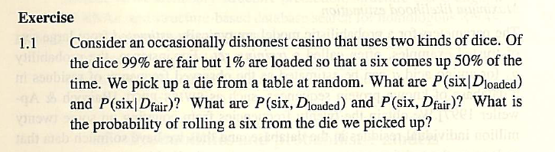
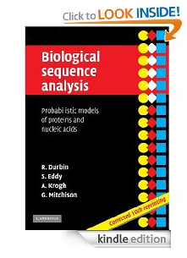
This is from Chapter 1 of the Durbin et al. book.

Slide 22
The famous “occasionally dishonest casino”.
Fair dice: 1,2,3,4,5,6 all come up (1/6) of the time
i.e. P(1) = 1/6, P(2) = 1/6, …. P(6) = 1/6
You have to roll a number between 1 and 6
Loaded Dice: 6 comes up 50% of the time.
i.e. P(1) = 1/10, P(2) = 1/10, P(3)=1/10, P(4)=1/10,p(5)=1/10,p(6)=1/2
You have to roll a number between 1 and 6

Slide 23
Probability that we roll a 1…6
P(1), P(2), P(3), P(4), P(5), P(6)
Let’s call that P(Y) – What we can observe
Probability that we pick up a die.
P(D_{fair}) = 0.99, P(D_{loaded})=0.01
Let’s call that P(X) – We don’t know which dice we’ve picked up.
The joint probability is P(X,Y) – that we pick up a some die
(fair or loaded) and roll some value (from 1 to 6) with it.
The probability of Y given X

Slide 24
There are 12 possibilities (2 dice * 6 values for each die)
P(1, D_{fair}) = (1/6) ( .99)
P(1, D_{loaded}) = (1/10) ( .01)
P(2, D_{fair}) = (1/6) ( .99)
P(2, D_{loaded}) = (1/10) ( .01)
P(3, D_{fair}) = (1/6) ( .99)
P(3, D_{loaded}) = (1/10) ( .01)
P(4, D_{fair}) = (1/6) ( .99)
P(4, D_{loaded}) = (1/10) ( .01)
P(5, D_{fair}) = (1/6) ( .99)
P(5, D_{loaded}) = (1/10) ( .01)
P(6, D_{fair}) = (1/6) ( .99)
P(6, D_{loaded}) = (5/10) ( .01)

Slide 25
In terms of the Bayesian Universe
Marginal
probs
prior
Y=1
Y=2
Y=3
Y=4
Y=5
Y=6
X=Fair die
0.99
0.99*
(1/6)
0.99*
(1/6)
0.99*
(1/6)
0.99*
(1/6)
0.99*
(1/6)
0.99*
(1/6)
p(fair)=0.99
X=Loaded die
0.01
0.01*
(1/10)
0.01*
(1/10)
0.01*
(1/10)
0.01*
(1/10)
0.01*
(1/10)
0.01*
(5/10)
p(loaded)=0.01
Marginal probs
P(1)=
0.166
P(2)=
0.166
P(3)=
0.166
P(4)=
0.166
P(5)=
0.166
P(6)=
0.17

Slide 26
Bayes’ theorem
(because it doesn’t matter whether we say
“I rolled a six with a die I picked up” or “I picked up a die and rolled a six”)
so..

Slide 27
So, to follow an example from the book
You pick up a die and roll 3 sixes.
What is the probability that the die is loaded?
P(D_{loaded}|3 sixes) =
P(3 sixes| D_{loaded}) * P(D_{loaded})
P(3 sixes)

Slide 28
So, to follow the example from the book
You pick up a die and roll 3 sixes.
What is the probability that the die is loaded?
P(D_{loaded}|3 sixes) =
P(3 sixes| D_{loaded}) * P(D_{loaded})
P(3 sixes)
P(D_{fair}|3 sixes) = P(3 sixes| D_{fair}) * P(D_{fair})
P(3 sixes)

Slide 29
So what does this have to do with bioinformatics…
Instead of dice rolls we have sequence…
Looking at a sequence, we want to find places where:
We transition from membrane to non-membrane sequence
We transition from intron to exon
We transition from “repeat element” to gene.
The sequences are like dice rolls. We ask, “which kind of
‘sequence die’ could produce the sequences that we observed”
Are we looking at an intron or an exon? The two kinds of
genomic structures “emit” different kinds of sequences.

Slide 30
Fair Die -> emits one distribution of probabilities
Loaded Die -> emits another distribution of probabilities
Membrane Region -> emits one distribution of aa’s
Non-Membrane Region -> emits another distribution of aa’s
Algorithms that help us discriminate Fair Die from Loaded Die
will also help us discriminate Membrane Regions from
Non-Membrane Regions
(or introns from exons, genes from non-genes,
RNAi genes from coding genes, etc. etc.)
A central “trick” of bioinformatics.

Slide 31
Where we are going with this…
If we want to know P(a sequence is transmembrane|sequence) for some observed protein sequence. “ATTGAYSSWWW….”
We need to know
P(sequence) = the probability of “rolling” that sequence using a “die” based on the background aa frequencies in all of SwissProt
P(transmembrane) = what fraction of all sequences are transmembrane
P(sequence|transmembrane)=the probability of “rolling” that sequence using a die based only on transmembrane sequences.
(i.e. using a “die” based on sequences in our training set)
(but more on that later….)

Slide 32
Next: Bayesian approach to inference with the binomial distribution…

