Slide 1
Menus
Overriding paintComponent() or paint()

Slide 2
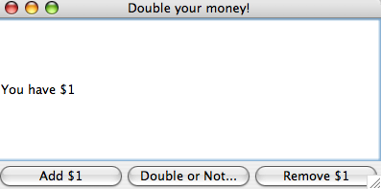
We’ll add some menus to our simple GUI example
A version of the “Double or Nothing” gui is here:
https://github.com/afodor/metagenomicsTools/blob/master/src/classExamples/gui/DoubleOrNothing.java

Slide 3
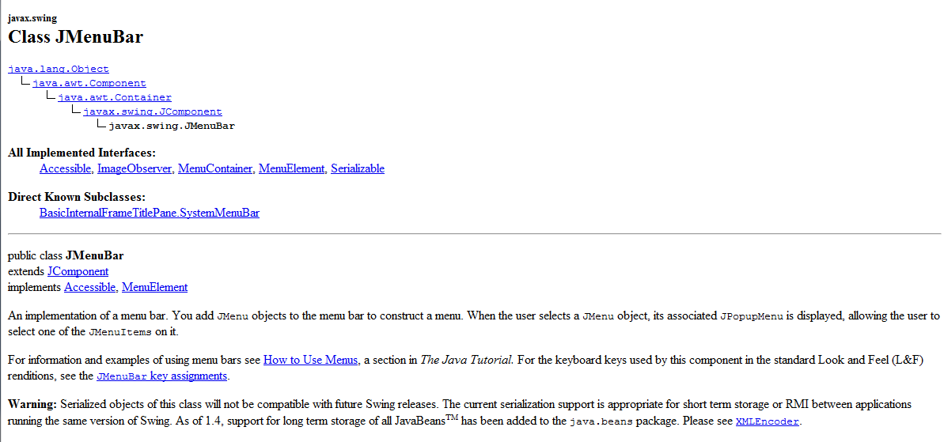
A JMenuBar is a Jcomponent is a Container is a Component
(is an Object)

Slide 4
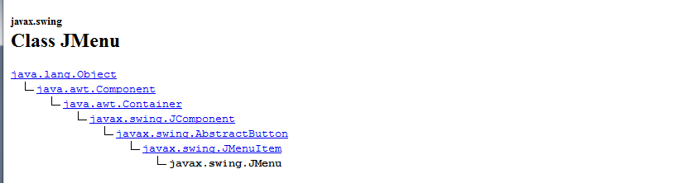
A JMenu (which we add to a JMenuBar) is a JMenuItem is
An AbstractButton is a JComponent is a Container is a Componenet
(is an Object)
JMenuItem is a super-class of JMenu.
Which means you can add menus to menus…

Slide 5
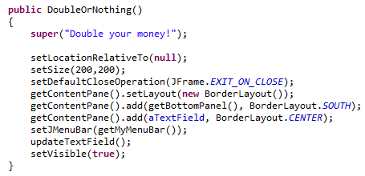
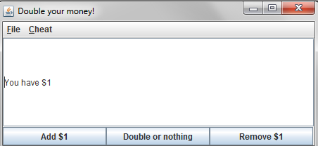
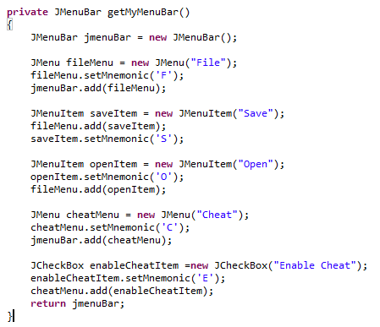
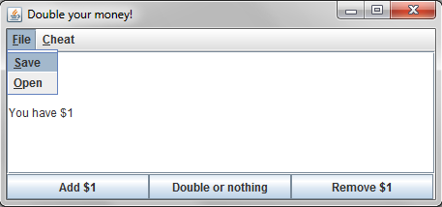
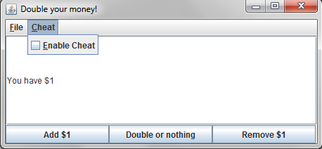
Adding menus is pretty straight-forward

Slide 6
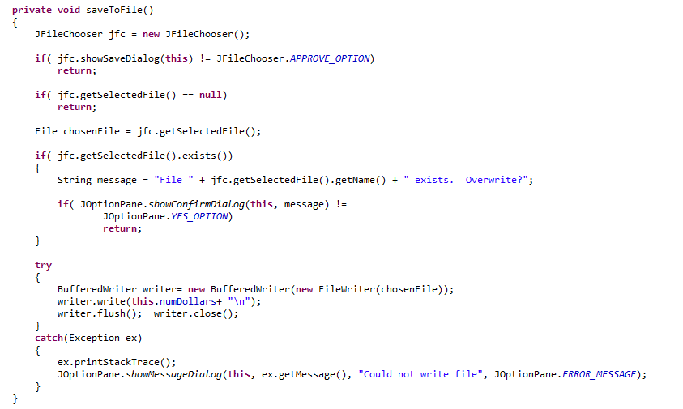
The menus are in the application, but they don’t do anything yet….
We have to add the functionality…
Here is the method to save the state of the application to the hard-disk
User hits cancel, we return
User decides not to
over-write an existing file

Slide 7
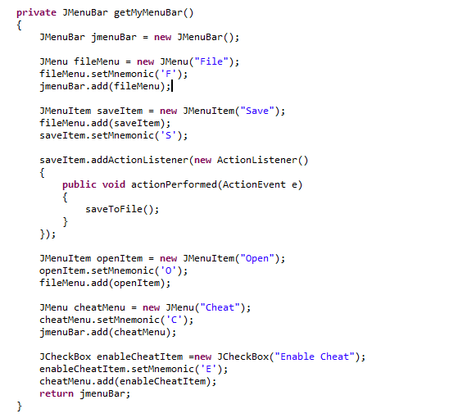
When the user clicks on the “Save” menuitem, we define an action
listener to invoke the “JFileChooser”

Slide 8
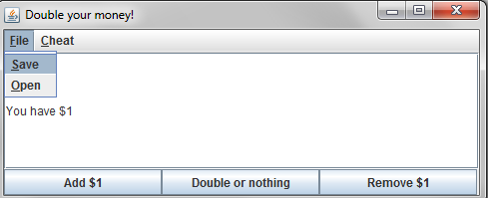
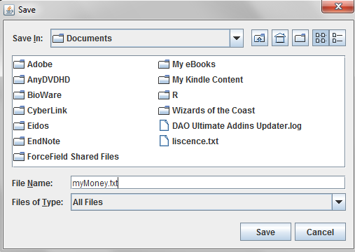
I choose
“File->Save”
The file-chooser comes up
If I hit cancel,
The FileDialog goes
away; no file is
saved
I have to type
a file name (I haven’t set any defaults….)
Will show all files
(I can change this behavior
by setting a FileFilter)

Slide 9
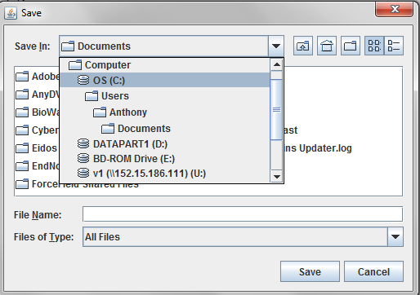
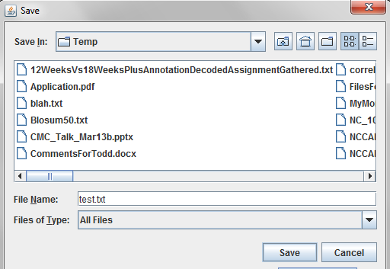
If all has gone well…
I navigate to C:\\temp
Hit save…

Slide 10
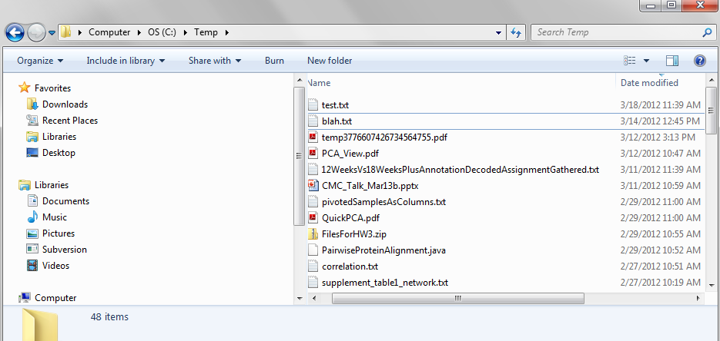
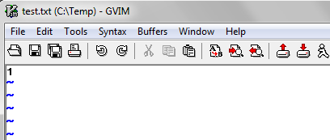
We have successfully saved the state of our program (such as it is)

Slide 11
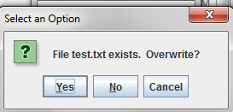
If the file exists, we let the user cancel….
(Here “no” and “cancel” do the same thing; probably not great UI design)
Probably should arrange it so that choosing “no” brings up another
FileChooser or just not show the cancel button..

Slide 12
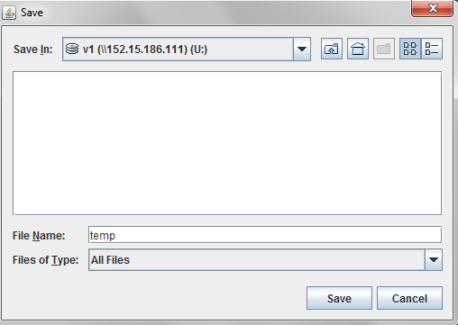
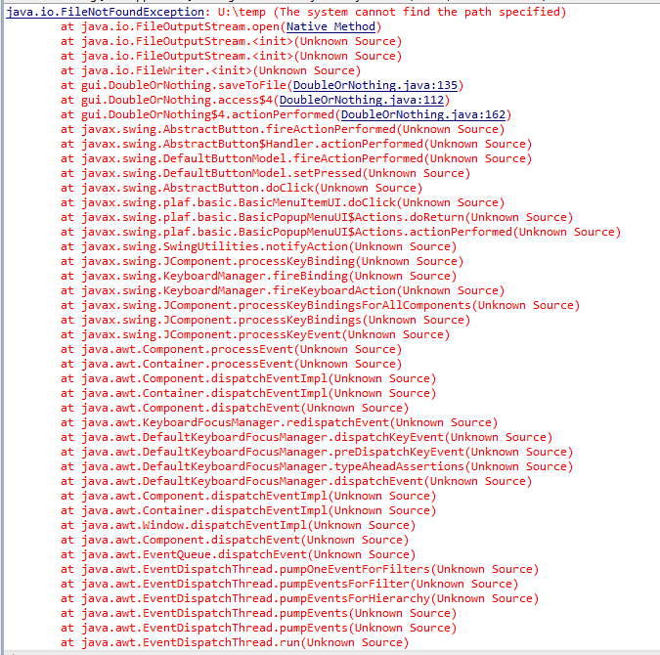
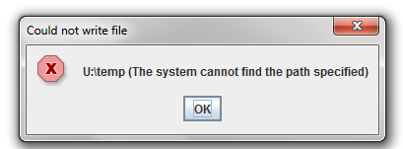
Finally if the write fails, we give the user (and the console) an error message and a graceful exit
Here we are writing to a network drive that is not visible to the Java VM

Slide 13
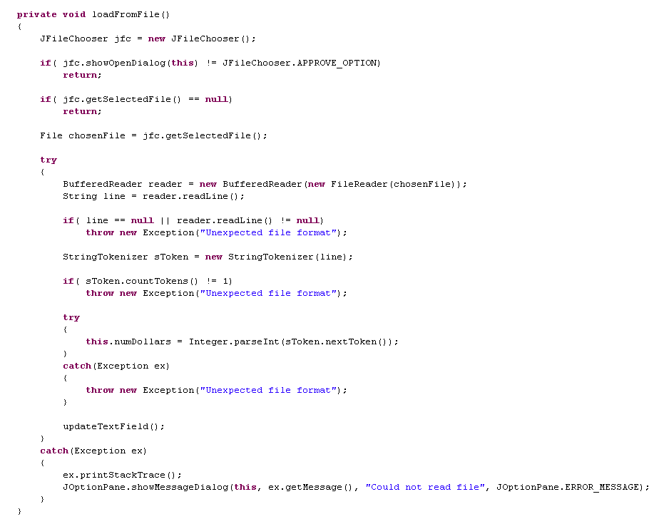
Corresponding code to re-load the state in… (probably could warn the user about erasing current state)

Slide 14
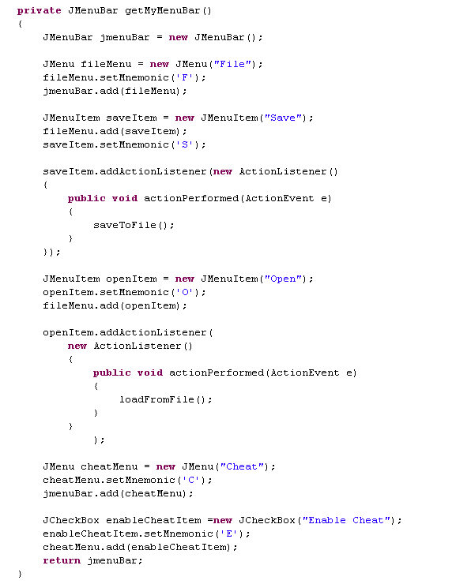
As before, we need to link our method to the correct menu item

Slide 15
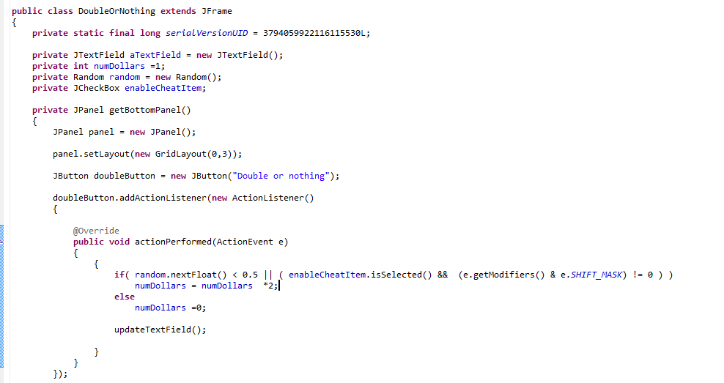
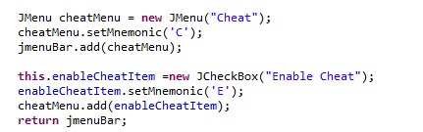
Getting the “cheat” box hooked in does not require an action lister
enableCheatItem has scope within our application
We check the state of the checkbox
We instantiate and add the
CheckBox to our menu

Slide 16
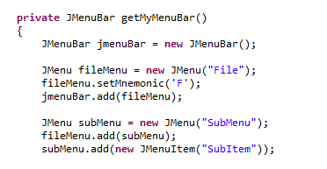
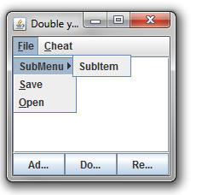
Because a JMenu is a JMenuItem, you can add menu to menus

Slide 17
Menus
Overriding paintComponent() or paint()

Slide 18
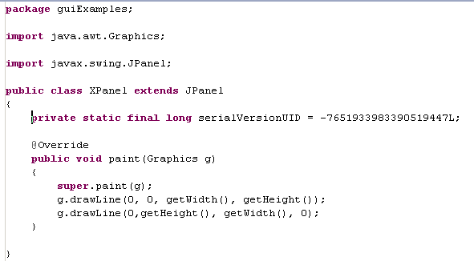
Each component knows how to Paint itself.
By overriding paint (), we can modify how that component paints itself
Here is a panel that draws an X.

Slide 19
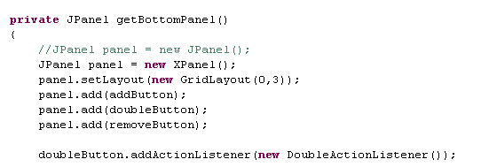
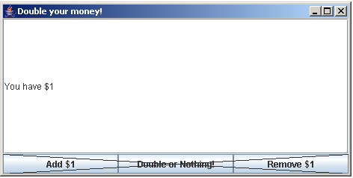
Replace our bottom Jpanel with an XPanel.
This works because an XPanel is a JPanel.
It has all the same code with the extra code drawing the X.

Slide 20
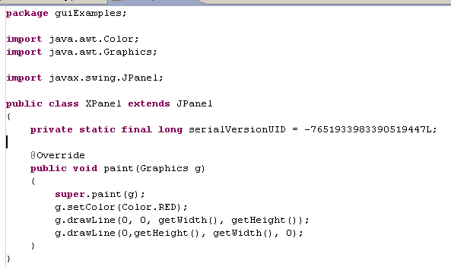
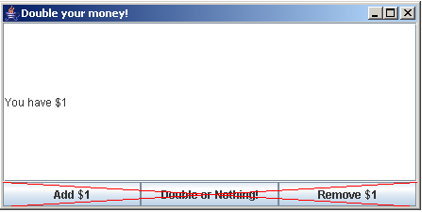
Lots of options on how to draw stuff
(covered in your basic Java book)

Slide 21
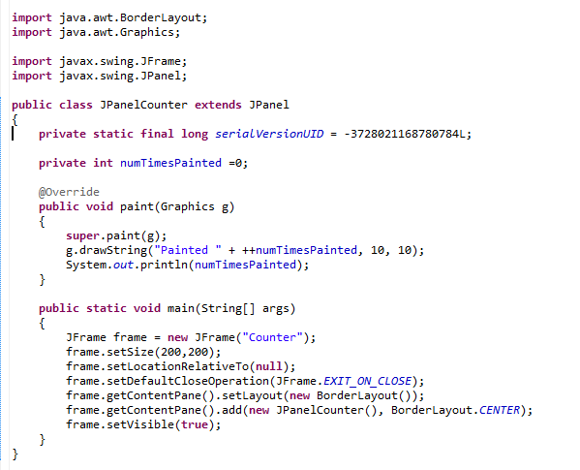
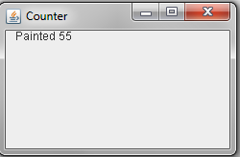
The paint () method gets called whenever the Frame gets damaged
(e.g. by another window passing over it).
Don’t worry about this

Slide 22
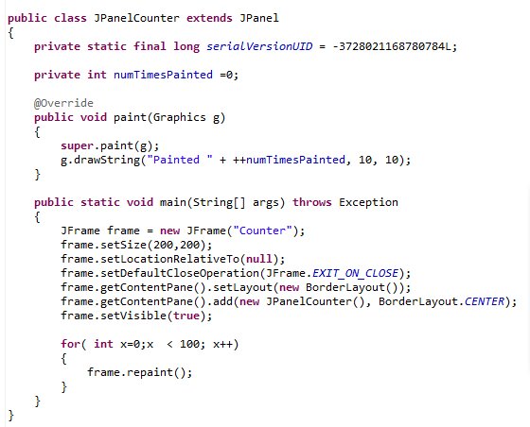
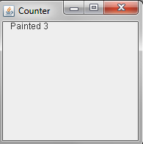
Don’t call paint(Graphics g) from your instantiating main method.
(You don’t have the graphics object to call)
Call repaint() which requests a repaint and then returns immediately.
Here repaint gets called 100 times, but paintComponent gets called three times

Slide 23
We are (finally) starting to think about threads
Main() thread
AWT thread()
Sends a request
to the AWT thread
repaint()
Calls paint(Graphics g)
(when it is not doing
anything else)
Returns
immediately

Slide 24
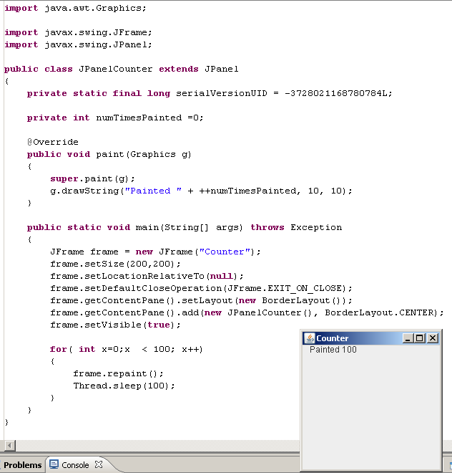
Here every repaint() request is granted (because the AWT thread
has time to grant each request and go back to waiting)

Slide 25
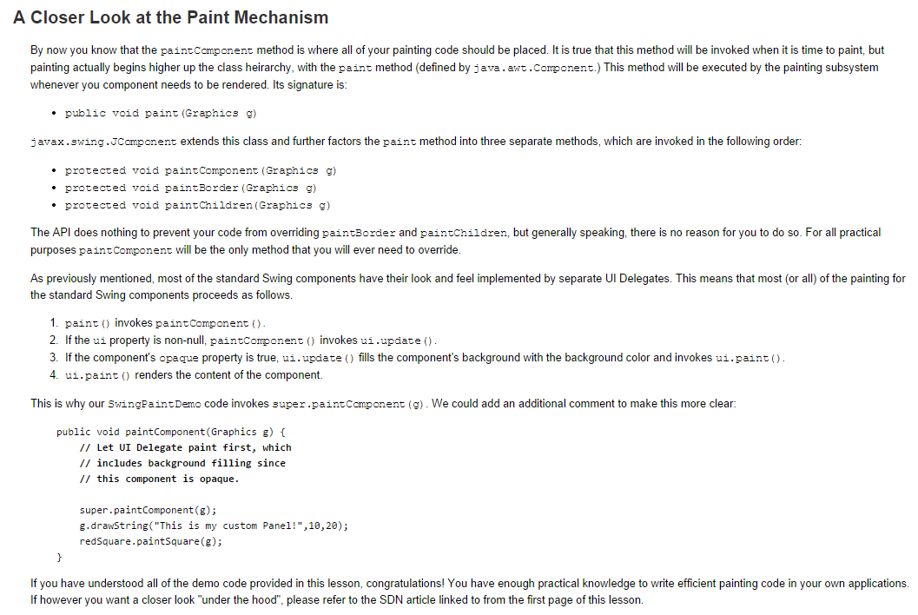
Alternatively, you can call paintComponent()..
http://docs.oracle.com/javase/tutorial/uiswing/painting/closer.html

Slide 26
Coming up next:
More on threads and theads in GUIs..

