Slide 1
Contrasting frequentist and Bayesian world-views
The multinomial distribution is the multi-dimensional extension of the binomial distribution
The Dirichlet distribution is the multi-dimensional extension of the beta distribution

Slide 2
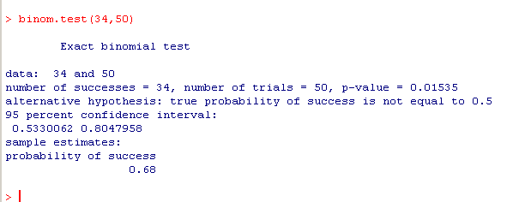
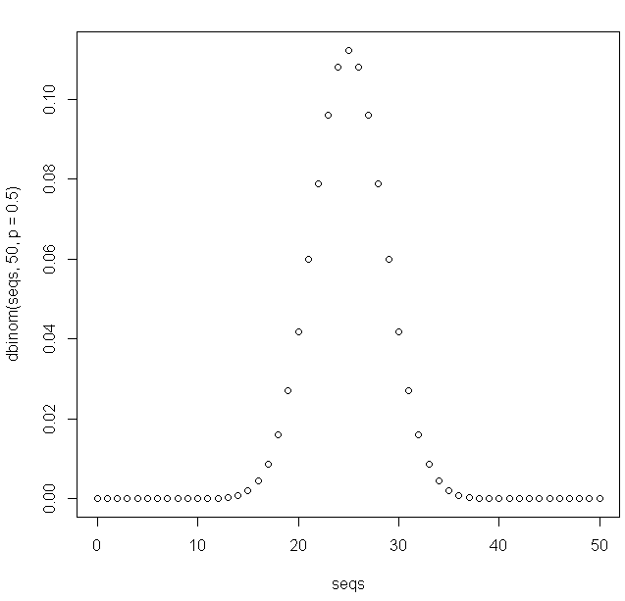
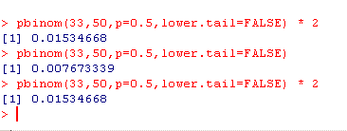
I have a coin and observe 34 heads out of 50 flips.
What is the probability that the coin is fair…
The “frequentist” (cannonical) hypothesis test
For our symmetrical PDF, twice the area
from 34 to 50

Slide 3
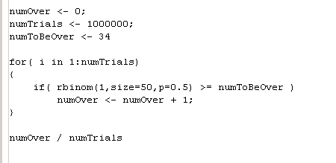

Philosophically, we think of p= 0.5 as a “fixed parameter”.
Given every possible experiment that we can do, how many times will we see
a result as or more extreme than the result we have…
In code…
Out of all the possible outcomes, what is the chance of the particular outcome that we saw?

Slide 4
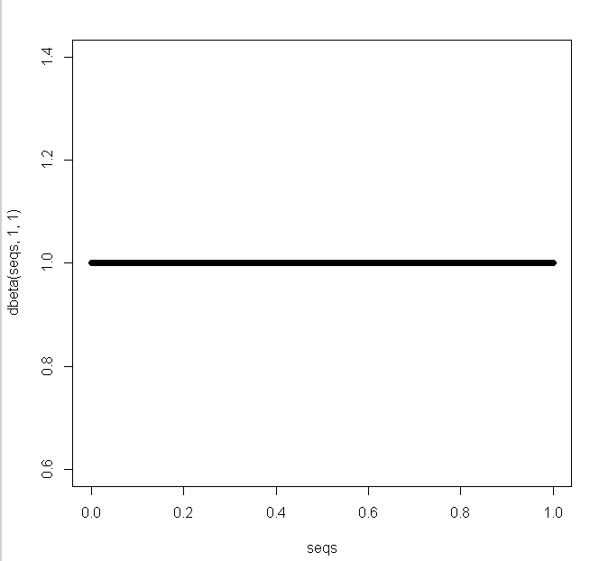
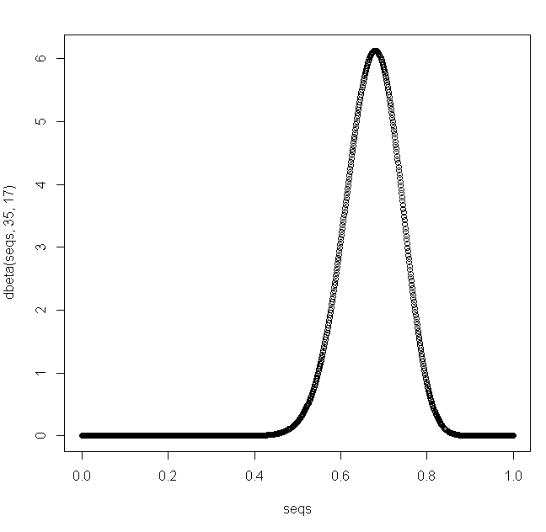

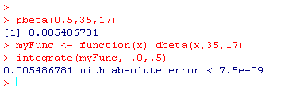
The Bayesian perspective turns this around….
We calculate the p(∏|data) which is given by the beta where alpha and beta
are the sum of our observations plus the initial settings of alpha and beta from the prior.
If we start with a uniform prior (alpha=1, beta=1)…
Then we see 34 successes (heads) and 16 failures (tails)
Now our beta distribution is alpha=35, beta=17
For a one sided-test, what area of
the probability curve is p <0.5?

Slide 5
Frequentist: Out of all the possible experiments you could have done, what fraction
had at least 34 heads? Around 0.007
Bayesian: Given that we observed 34 heads and 16 tails with a uniform
prior, how much of the area of p(∏|data) fell to the left of our assumption
of a fair coin? Around 0.005
Mathematically: These numbers are not that far apart.
Conceptually: It is a long argument in the literature.
My sense is that the math matters more than the concepts and
these two approaches are not in fact that far apart.
Put another way, there is so much noise in biology that there is
essentially no real difference between these calculations…
However, the Bayesian approach might reject the whole idea of a threshold
(e.g. p<0.05). They might say the posterior is our whole knowledge.
You will have to decide for yourself. I tend to lean towards the frequentist position..

Slide 6
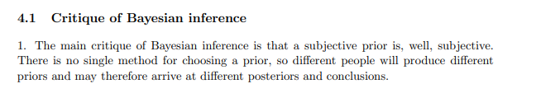
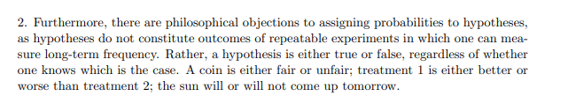
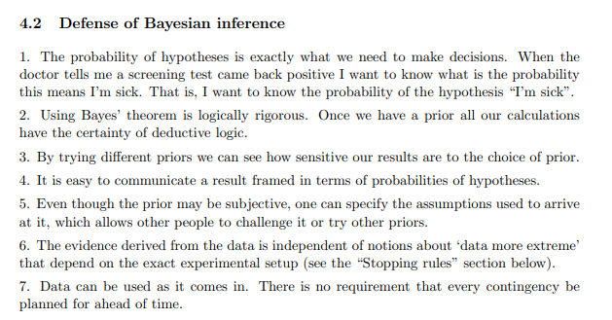
https://ocw.mit.edu/courses/mathematics/18-05-introduction-to-probability-and-statistics-spring-2014/readings/MIT18_05S14_Reading20.pdf

Slide 7
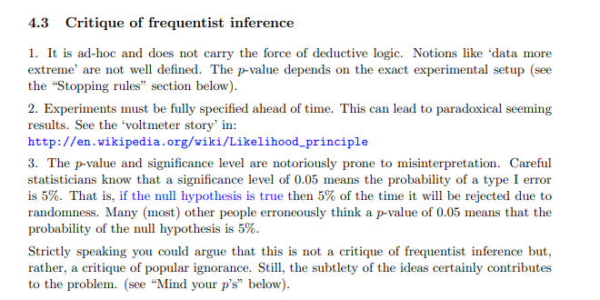
It is not valid to sample
until you achieve a
significant value
https://ocw.mit.edu/courses/mathematics/18-05-introduction-to-probability-and-statistics-spring-2014/readings/MIT18_05S14_Reading20.pdf

Slide 8
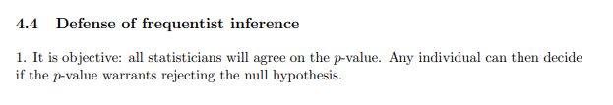
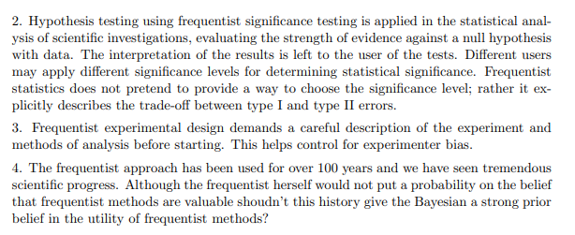
https://ocw.mit.edu/courses/mathematics/18-05-introduction-to-probability-and-statistics-spring-2014/readings/MIT18_05S14_Reading20.pdf

Slide 9
Contrasting frequentist and Bayesian world-views
The multinomial distribution is the multi-dimensional extension of the binomial distribution
The Dirichlet distribution is the multi-dimensional extension of the beta distribution

Slide 10
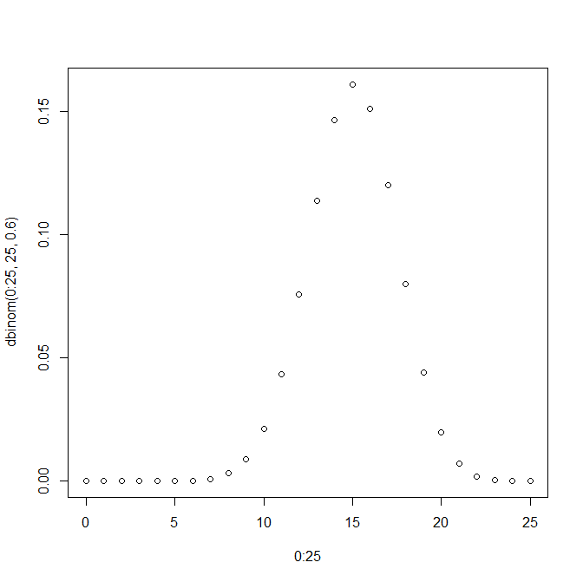
The binomial distribution tells us the probability of getting K heads in N flips of a coin…
For example…
plot( 0:25, dbinom(0:25, 25, .6))
N = 25 flips
K = 0:25 heads
p(head) = .6

Slide 11
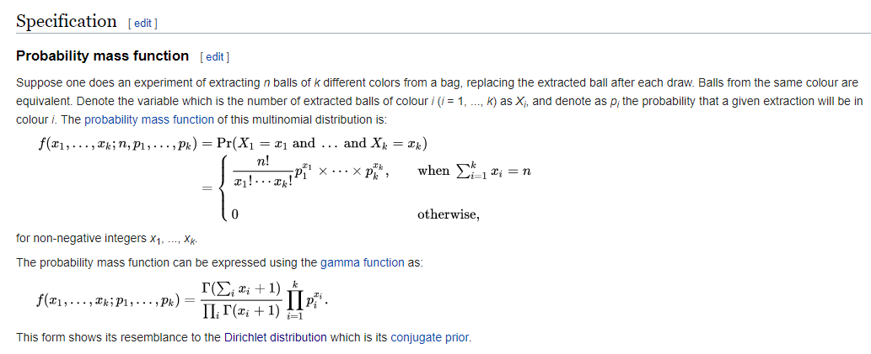
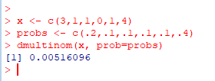
We can extend this naturally to dice
Consider a die with
P(1) = .2; p(2) = .1; p(3) = .1 ; p(4) = .1 ;p(5) = .1; p(6) = .4
What is the probability in 10 rolls of rolling:
https://en.wikipedia.org/wiki/Multinomial_distribution
This is given by the multinomial distribution
Rolls | # of times observed
1 | 3
2 | 1
3 | 1
4 | 0
5 | 1
6 | 4
(where the order does not matter)

Slide 12
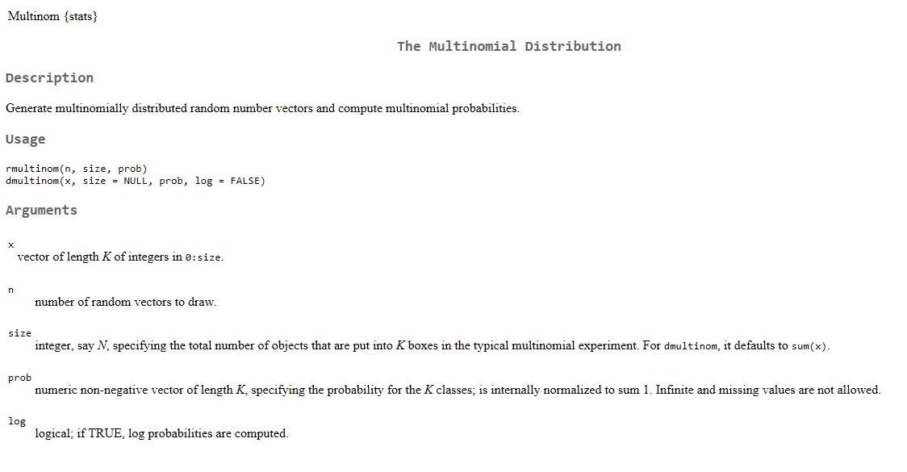

Slide 13
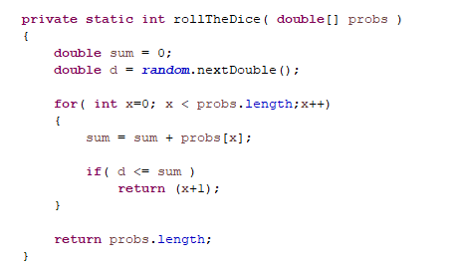
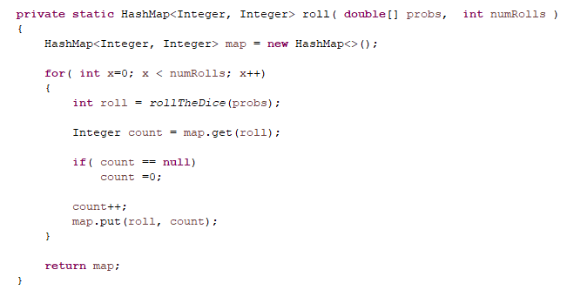
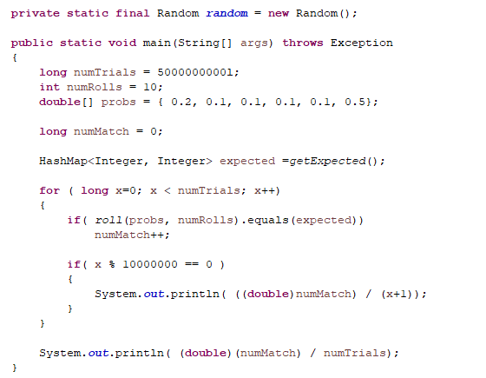
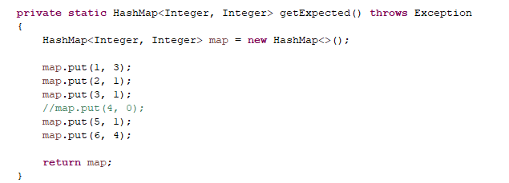

Sanity check #1: If we roll 10 die a large # of times, we will see the target distribution the expected number of times
https://github.com/afodor/metagenomicsTools/blob/master/src/classExamples/TestMultinomial.java

Slide 14
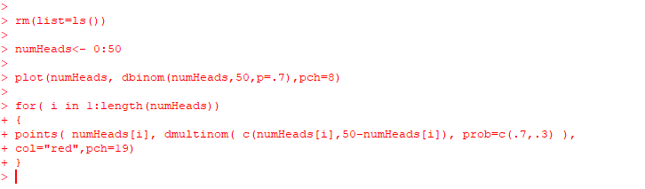
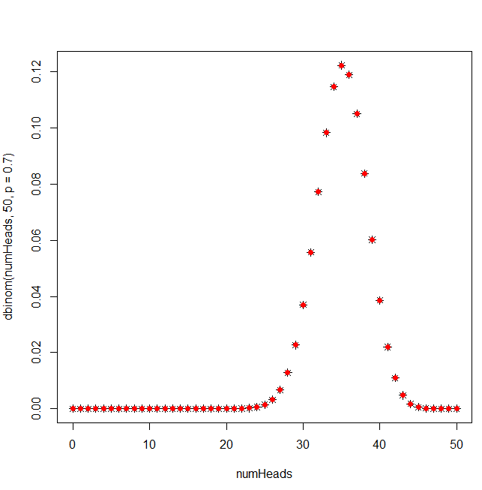
Sanity check #2: We can recover the binomial distribution as a special case of the multinomial distribution
(a two-sided die is equivalent to a coin…)

Slide 15
Contrasting frequentist and Bayesian world-views
The multinomial distribution is the multi-dimensional extension of the binomial distribution
The Dirichlet distribution is the multi-dimensional extension of the beta distribution

Slide 16
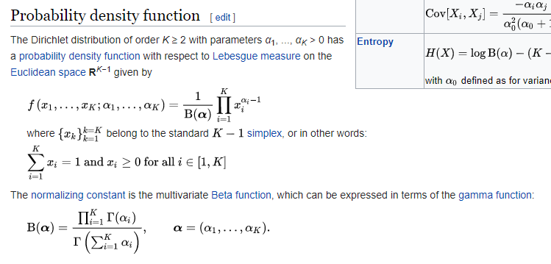
Just as we can extend the binomial distribution to the multinomial distribution,
we can extend the beta distribution to the Dirichlet distribution…
The Dirichlet distribution holds one constant for each side of the die
https://en.wikipedia.org/wiki/Dirichlet_distribution

Slide 17
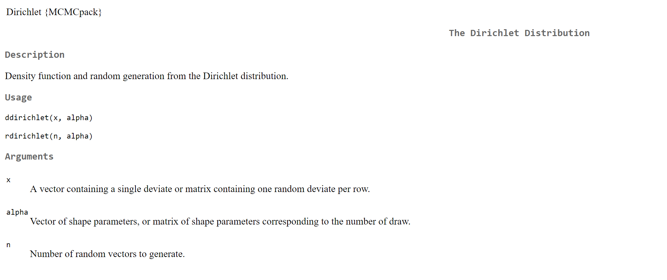

Slide 18
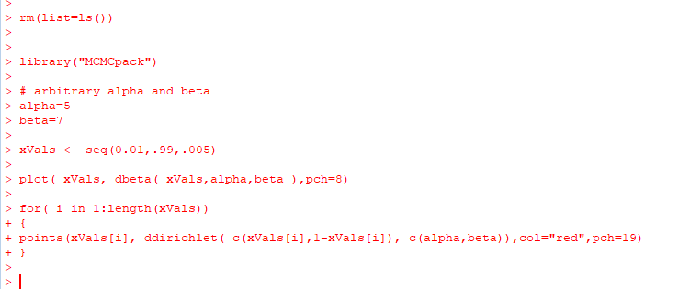
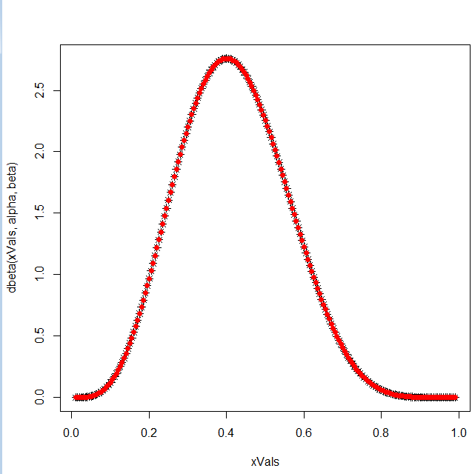
We can recover the beta distribution from the Dirichlet distribution

Slide 19
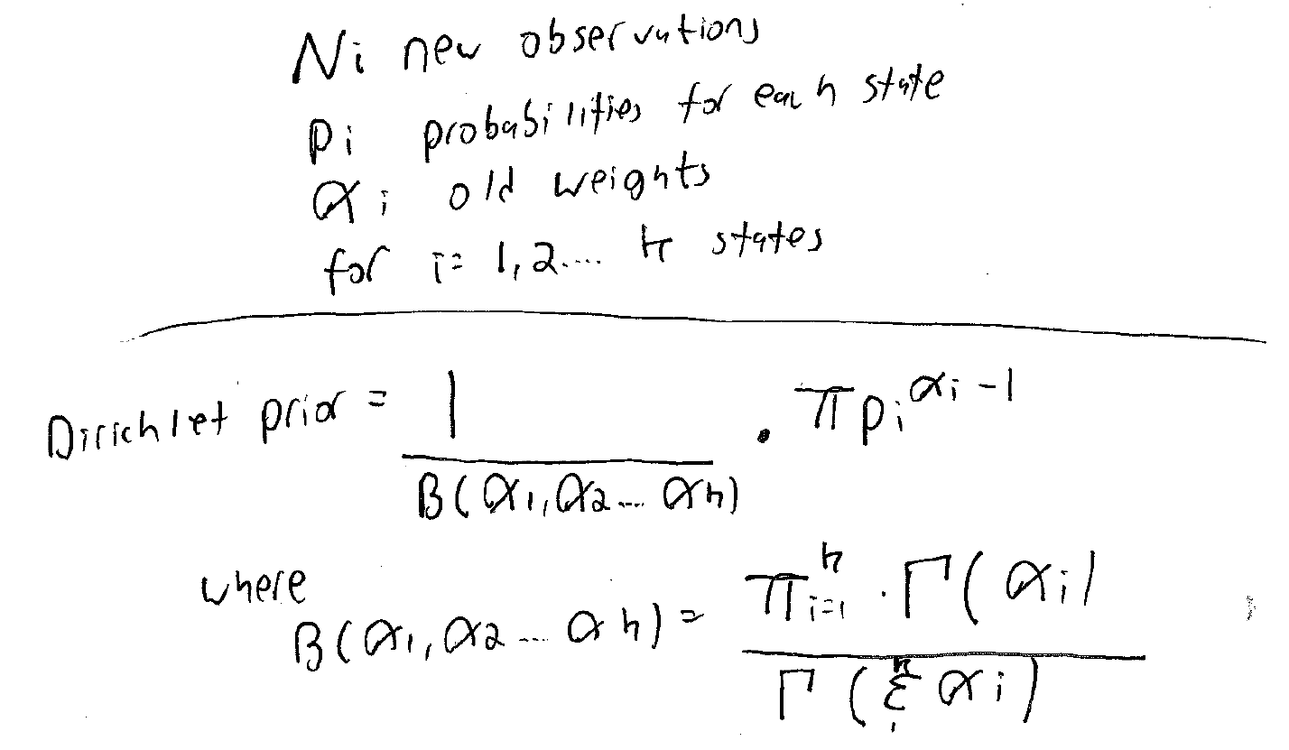
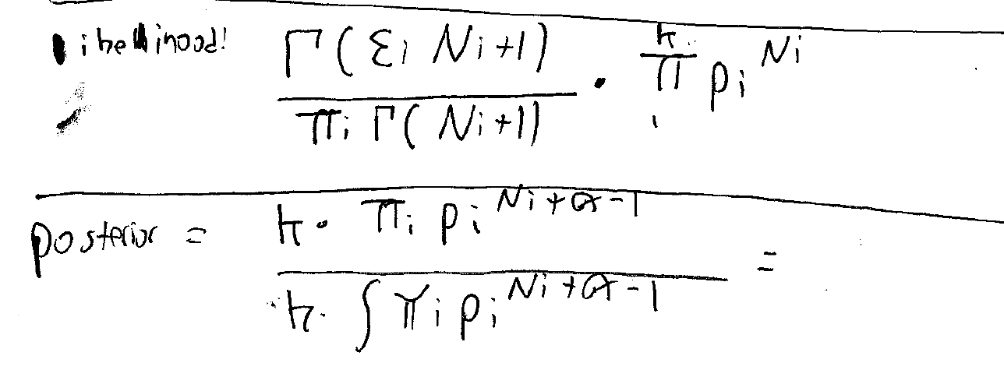
The Dirichlet is the conjugate prior of the multinomial.
The update rules for the Dirichlet work in the same way as for the beta (add 1 for each observation..)

Slide 20
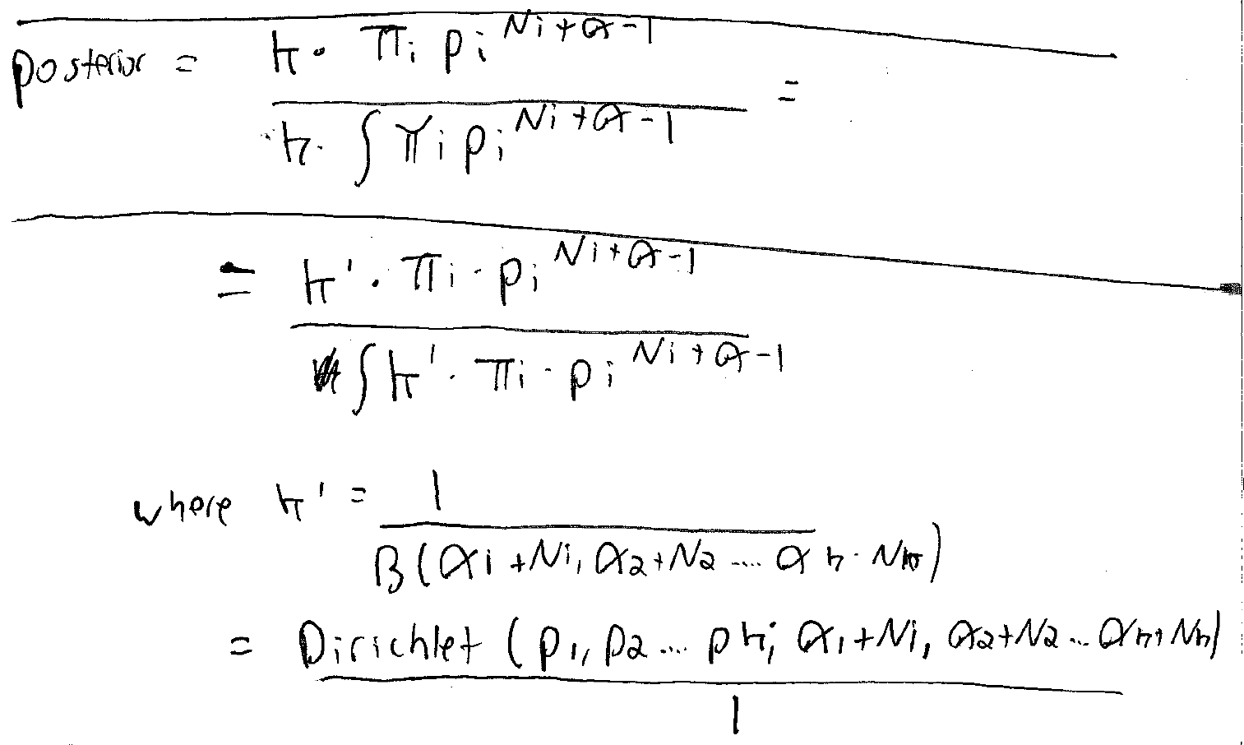
The Dirichlet is the conjugate prior of the multinomial.
The update rules for the Dirichlet work in the same way as for the beta (add 1 for each observation..)

Slide 21
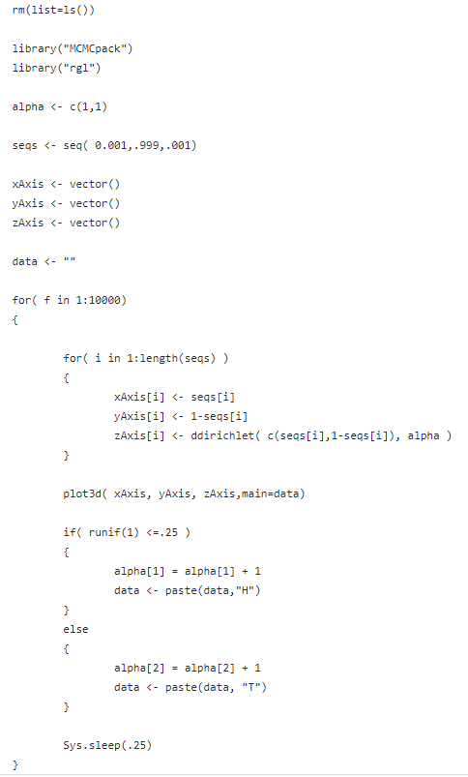
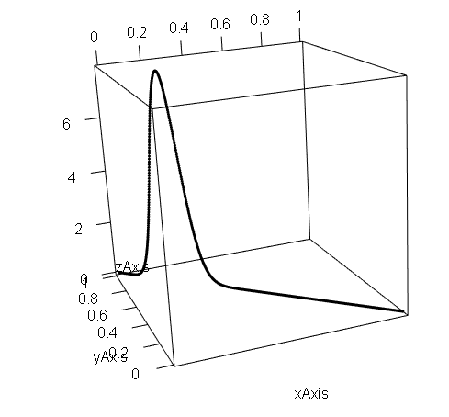
Because all the x values have to sum up to 1, the Dirichlet is described by a R^{(k-1)} subspace.
Our belief in the number of heads perfectly describes our belief in the
number of tails, so you capture the Dirichlet for a coin
in (2-1) = 1 dimension.
https://github.com/afodor/metagenomicsTools/blob/master/src/classExamples/dirichletUpdateCoinFlip.txt

Slide 22
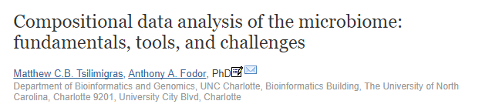
The Dirichlet describes compositional data. Data that sums to a constant.
Relative abundance.
In terms of genomics, RNA-seq (and microbiome) data are also compositional.
We will talk more about this later (but if you are interested you can read this…)

Slide 23
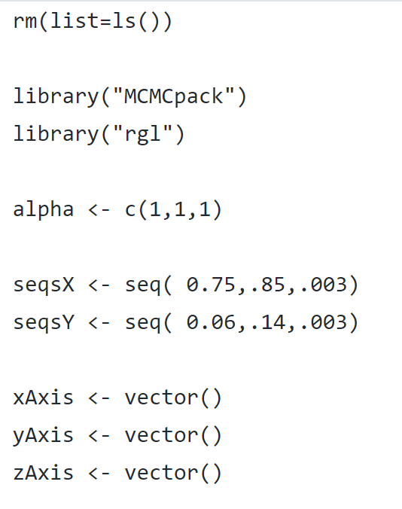
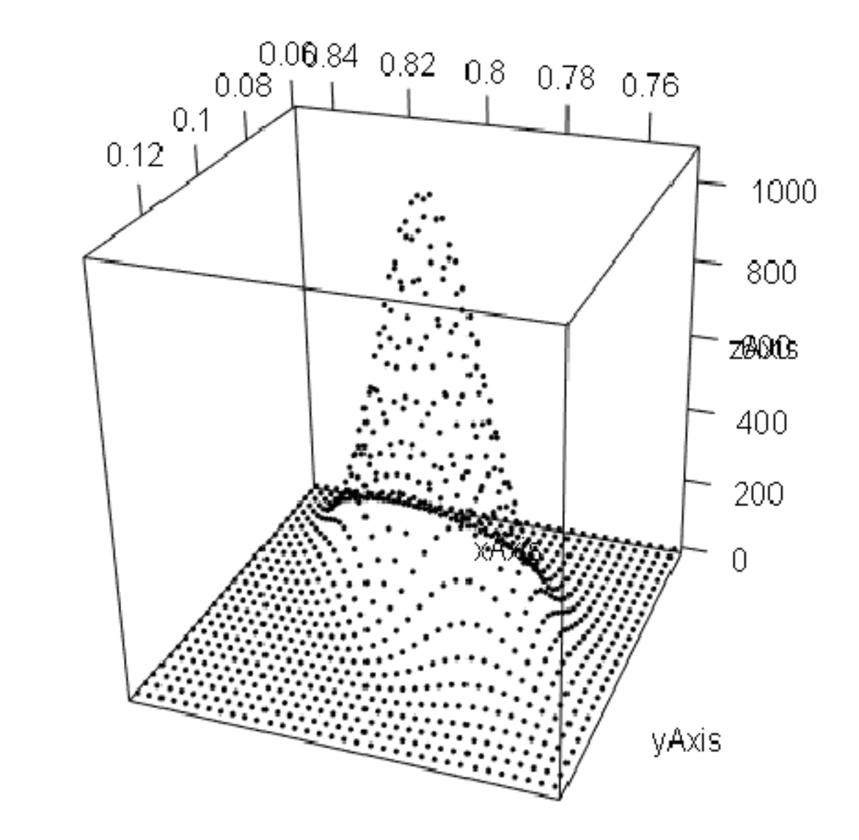
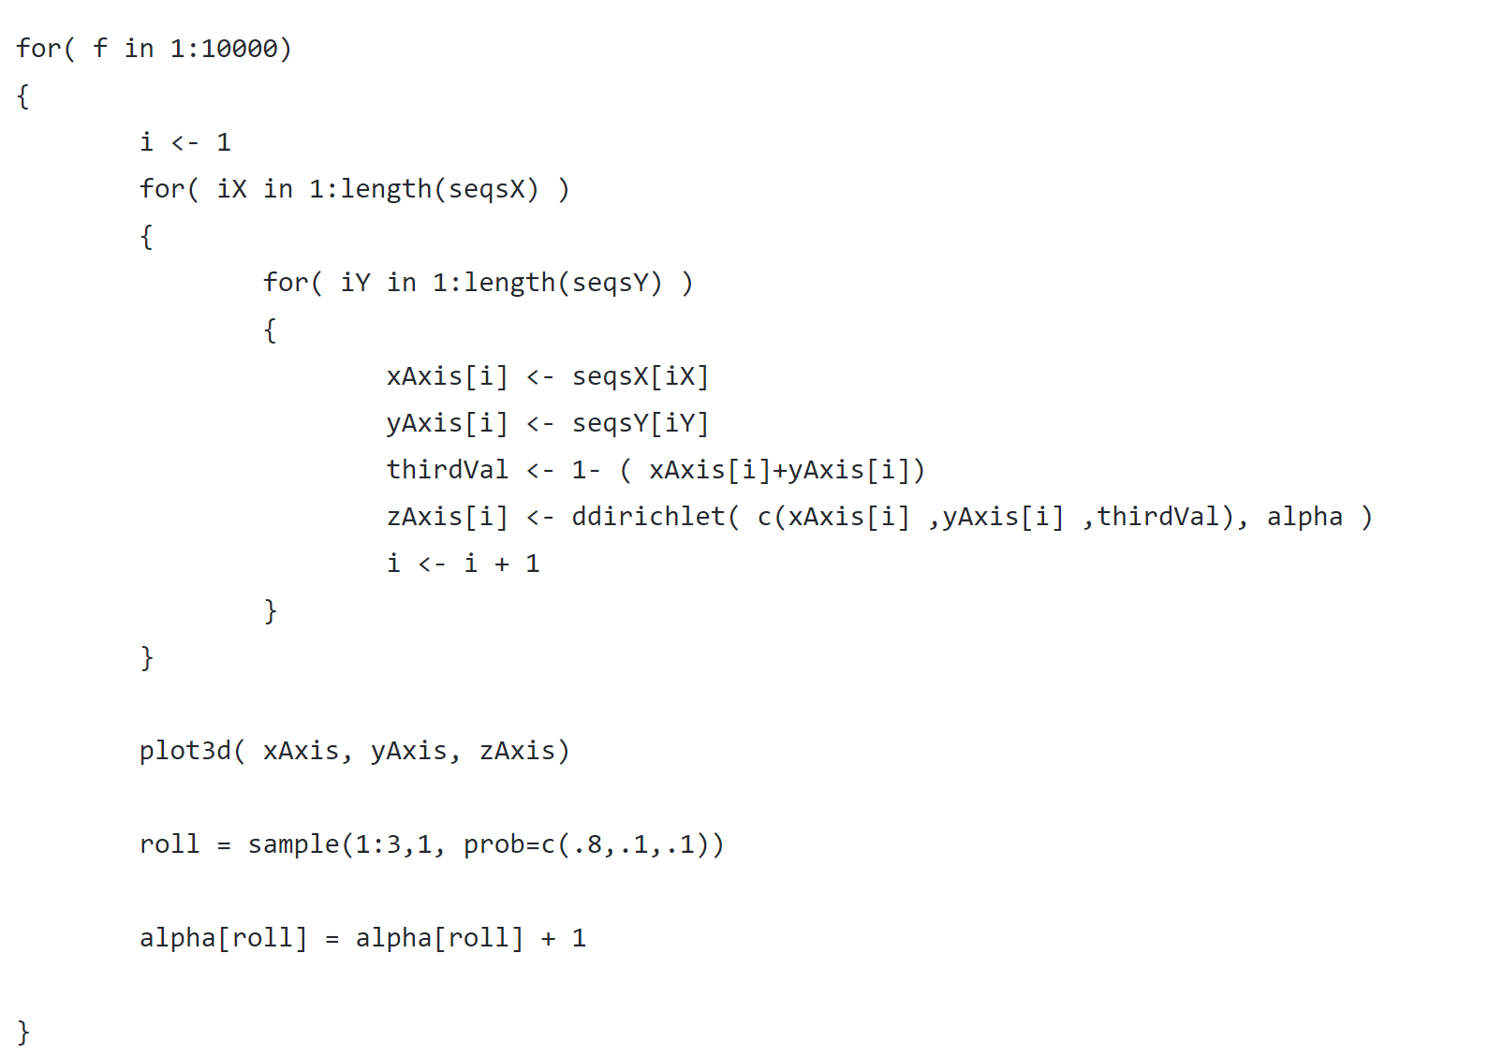
We can capture our beliefs about a 3 sided die in 2 dimensions (but that is the most # of sides we can graph!)
https://github.com/afodor/metagenomicsTools/blob/master/src/classExamples/dirichletUpdateThreeSidedDie.txt

Slide 24
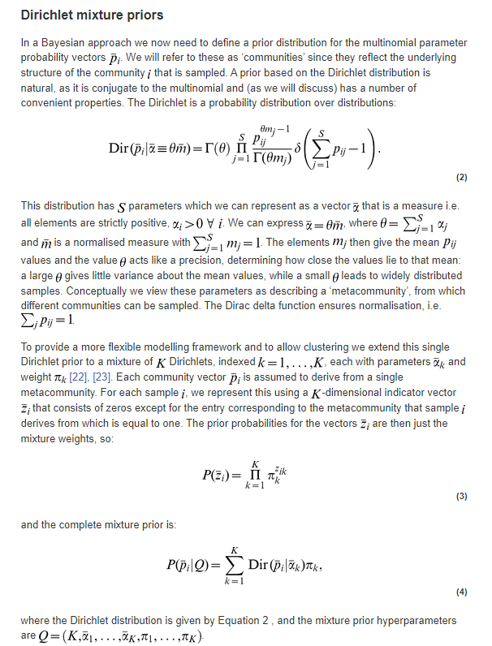
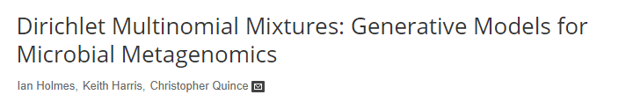
Because the Dirichlet is compositional, it can be used
to model a mixture of different communities identified by
sequencing data
Here the Dirichlet distribution is used to cluster a complex
community into K number of states, each represented
by their own Dirichlet

Slide 25
