Slide 1
Advanced Statistics for Genomics
BINF 6310/8310 – 6310L/8310L
Spring 2026
Anthony Fodor
afodor@charlotte.edu
When we go to in person:
Tuesday/Thursday 10:00-11:15; Bioinformatics 104 (class)
Thursday: 2:30-3:45 Bioinformatics 104 (lab/office hours)
Class web site:
https://fodorclasses.github.io/classes/stats2026/stats2026.html

Slide 2
Reading for next week:
“Vassar stats book”: http://vassarstats.net/textbook/
Chapter 1 “Principles of Measurement”
Chapter 2: “Distributions”
(or equivalent in your favorite canonical statistics text book).
(The above is presumably review).
In “The Art of R Programming” –
Chapter 1 – “Getting started” –
Chapter 2- “Vectors”
or equivalent chapters here:
https://diytranscriptomics.com/Reading/files/The%20Art%20of%20R%20Programming.pdf
If you are getting a non-electronic copy, get this book ordered!

Slide 3
Review of the syllabus
Empirical Distributions
Mean, median and variance
Lab exercise

Slide 4
Required textbook…

Slide 5
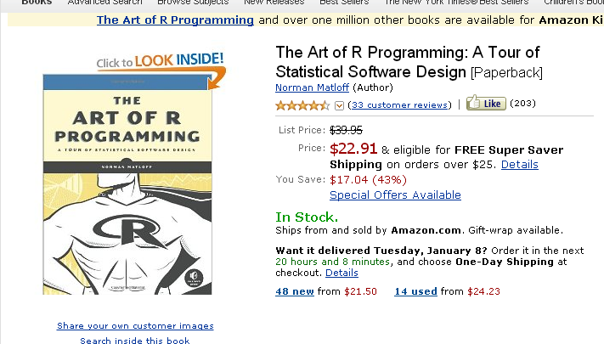
Required:
If you are getting a print copy, order it ASAP…
For most of the rest of you….
https://diytranscriptomics.com/Reading/files/The%20Art%20of%20R%20Programming.pdf

Slide 6


Required:
Zuur et al. Mixed Effect Models and Extensions in Ecology With R.
Download a free PDF: Springer Links link (should be able to login via UNCC)
https://link.springer.com/book/10.1007/978-0-387-87458-6

Slide 7
Recommended textbooks…

Slide 8
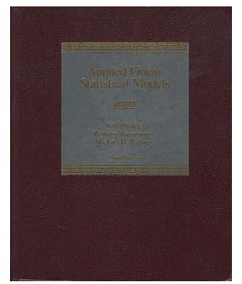
Recommended textbooks…
Applied Linear Statistical Models. John Neter, William Wasserman, Michael Kunter. Covers in great detail the “parametric” tests: linear regression and ANOVA. The theory behind these kinds of linear models really hasn’t changed very much in the last 50 years.
https://users.stat.ufl.edu/~winner/sta4211/ALSM_5Ed_Kutner.pdf

Slide 9

Recommended textbooks…
Either edition of this book is fine, but new or used is going to be around $40.
It really is an outstanding book (but dense!). It is worth the investment of time and money

Slide 10
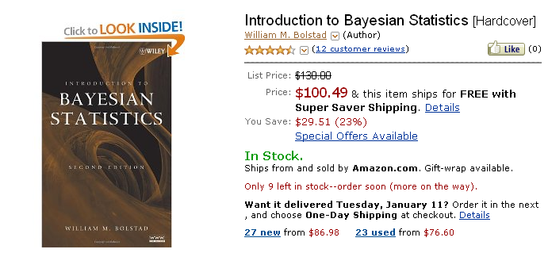
Optional depending on interest:
This is a great book, but is insanely over-priced!
We will touch on some of the stuff in here, but it won’t be a central focus.
If you think you will be implementing Bayesian stats in your pipelines, it might be worth having
https://onlinelibrary.wiley.com/doi/book/10.1002/9780470181188

Slide 11
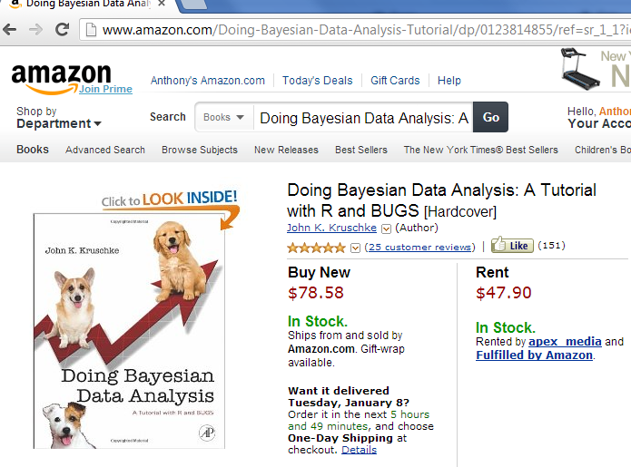
Doing Bayesian Data Analysis: A Tutorial with R and BUG. John K. Kruschke. More approachable, but also not quite as clear or concise as the Bolstad book. Very nice chapters on Monte Carlo approaches to Bayesian analysis, but a bit heavy on the Bayesian proselytizing for my taste. Also quite expensive. Overall, though, a very engaging text. If you get the Google electronic edition, make sure that your device(s) can show the scanned versions (which are DRM’ed ) as the equations in the default view are illegible.
Be sure to read sample
chapters on the device
of your choice to make
sure formatting is ok
before purchasing…
Optional depending on interest:
https://nyu-cdsc.github.io/learningr/assets/kruschke_bayesian_in_R.pdf

Slide 12

Optional depending on interest:
Recommended:
It’s about $30-$40 and will make your life easier, but is not strictly required.
More useful as a reference than as a tutorial…

Slide 13
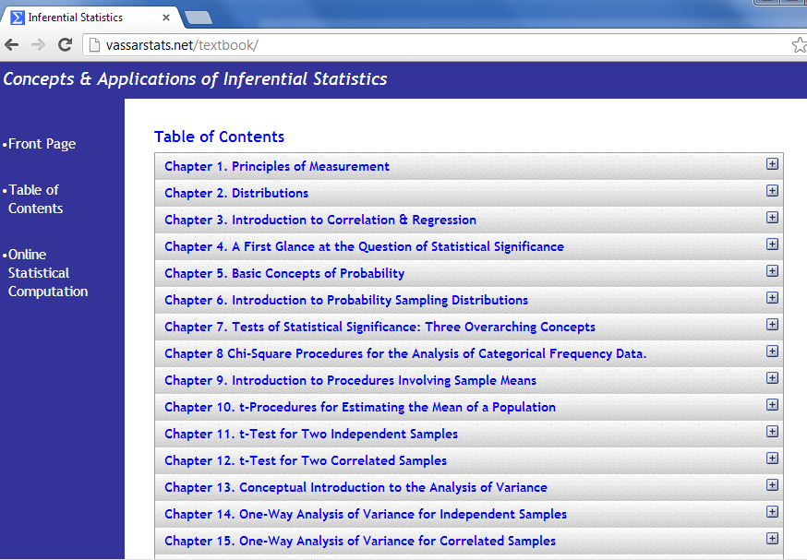
On-line resources:
Vassar stats book
http://vassarstats.net/textbook/
You will need at least one book that covers canonical statistics.
Start with this one (it is free) and then if it is not working for you, consider alternatives…

Slide 14
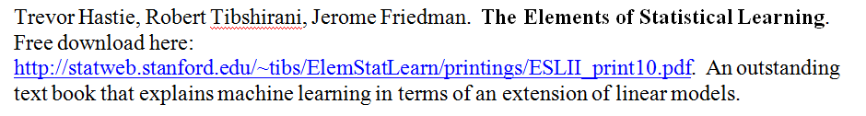
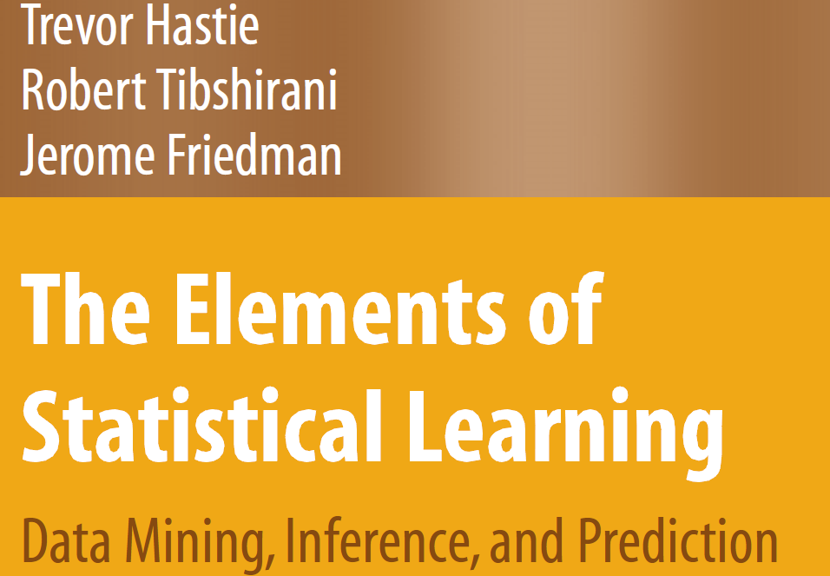
Legal download:
http://www-stat.stanford.edu/~tibs/ElemStatLearn/printings/ESLII_print10.pdf

Slide 15
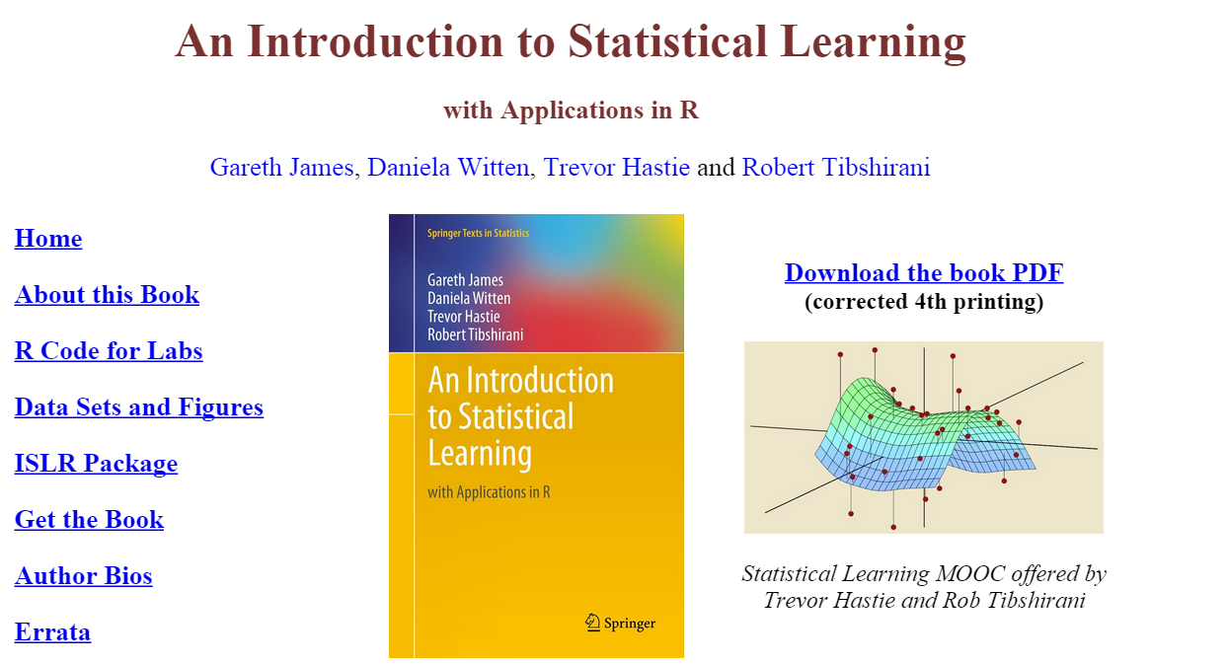
A less mathematical treatment of the same material….
http://www-bcf.usc.edu/~gareth/ISL/

Slide 16
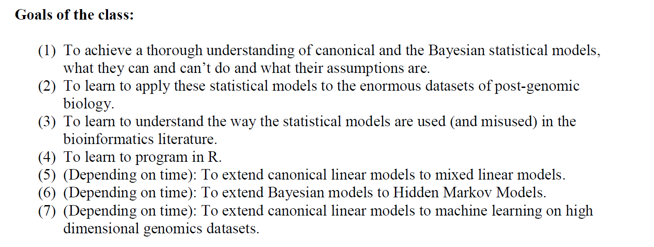

Slide 17
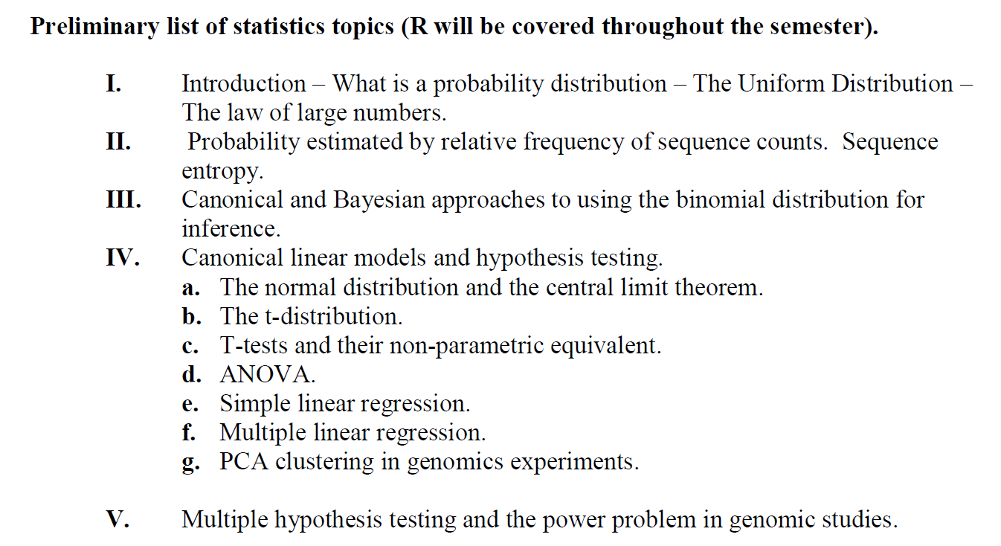

Slide 18
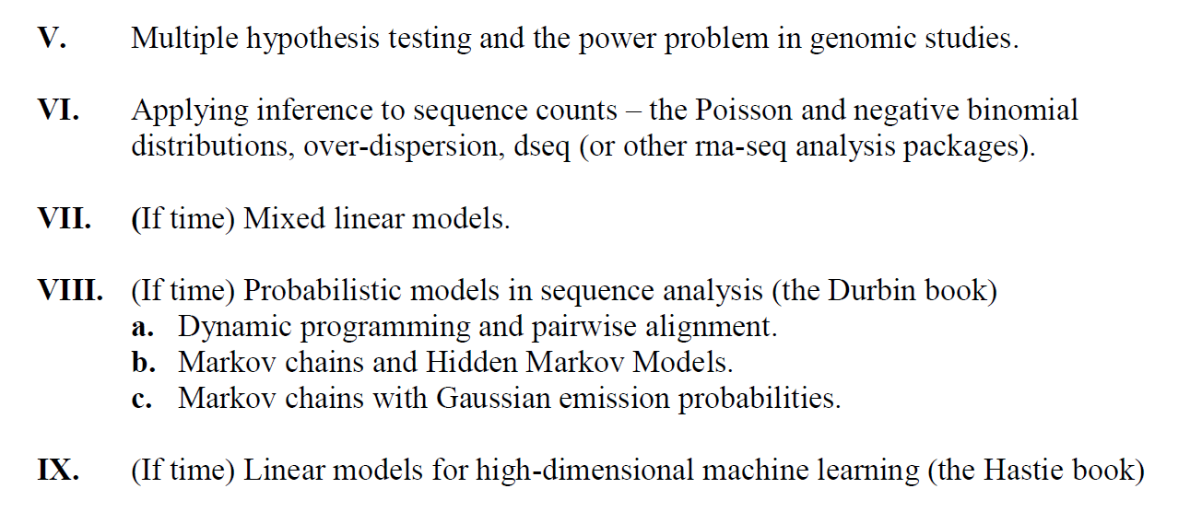

Slide 19
Review of the syllabus
Empirical Distributions
Mean, median and variance
Lab exercise

Slide 20
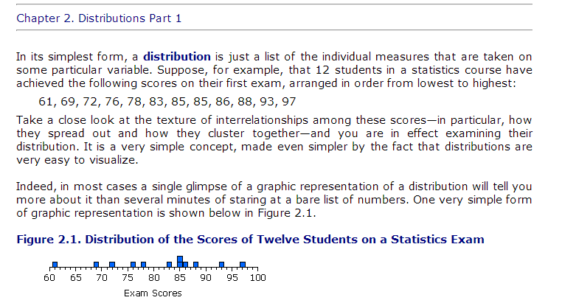
Empirical distributions – a set of data that has been observed (or is capable of being observed)
For example: 12 exam scores
http://vassarstats.net/textbook/

Slide 21
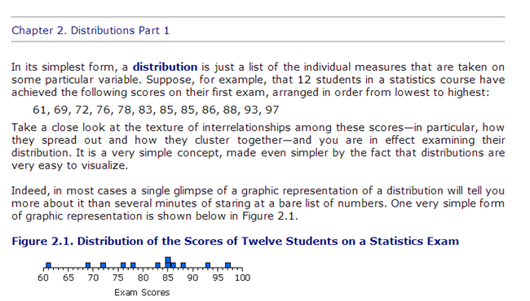
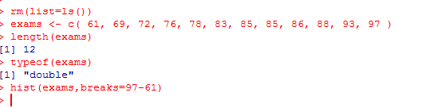
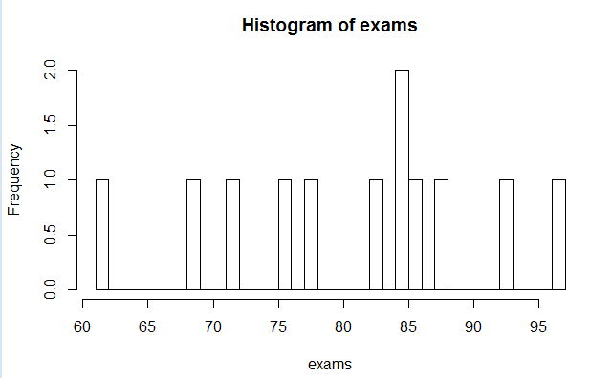
In R, we can create a vector that will hold our empirical distribution.
A vector in R is a one-dimensional ordered list of data.
All of the data in an R vector must be of the same type.

Slide 22
rm(list=ls()) - removes everything in the R workspace
exams <- c( 61, 69, 72, 76, 78, 83, 85, 85, 86, 88, 93, 97 )
Make a vector with the data and point to it with the reference “exams”
length(exams) – returns the length of our vector
typeof(exams) – returns the type of our vector (floating point numbers)
hist(exams,breaks=97-61) – Make a histogram with a separate bin for each possible grade

Slide 23
If we just do hist(exams), we get the default number of bins

Slide 24
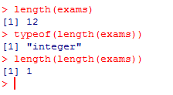
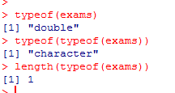
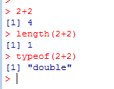
There are no single pieces of data in R. Everything is a vector
length returns a vector (of size=1) that holds the length of the input vector
typeof returns a vector (of size=1) that holds the string that describe the vector
“2+2” returns a vector of length 1…

Slide 25
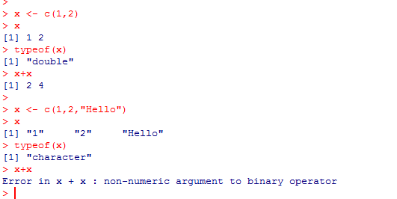
Everything in an R vector must be of the same data type.
R will find the common data type…
In the second case, the common data type is character.
The + operator is not defined for “character” so x + x fails in the second case…

Slide 26
Review of the syllabus
Empirical Distributions
Mean, median and variance

Slide 27
Let’s return to our empirical distribution:
For all distributions, we can define measures mean, median and variance:

Slide 28
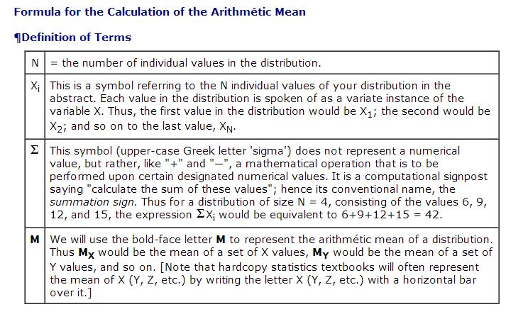
mean = sum(measurements) / # of measurements
mean is sensitive to outliers…
http://vassarstats.net/textbook/

Slide 29
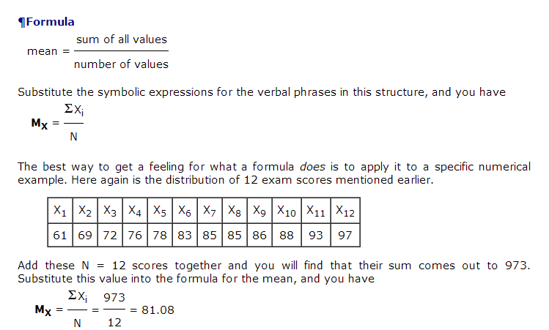
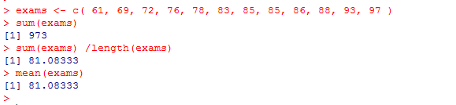
http://vassarstats.net/textbook/

Slide 30
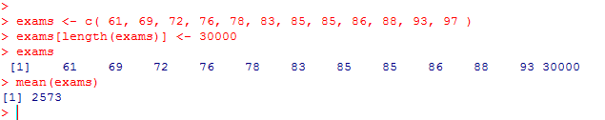
The mean calculation is sensitive to outliers…
Vectors are 1-indexed in R (unlike C/C++/Java data structures)
exams[length(exams)] <- 30000 changes the last data point.
We see the mean is changed.
We say that arithmetic mean is not robust to outliers.

Slide 31
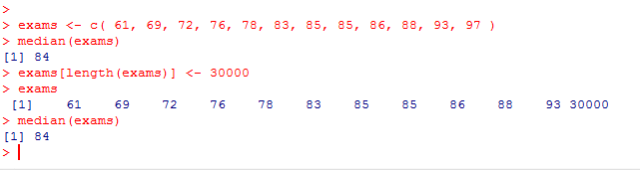
The median is just the middle value.
For an even set of numbers, it is the average of data above and below the middle
in the sorted list of data..
Notice the median does not change when the outlier is introduced.
We say that median is robust to outliers.

Slide 32
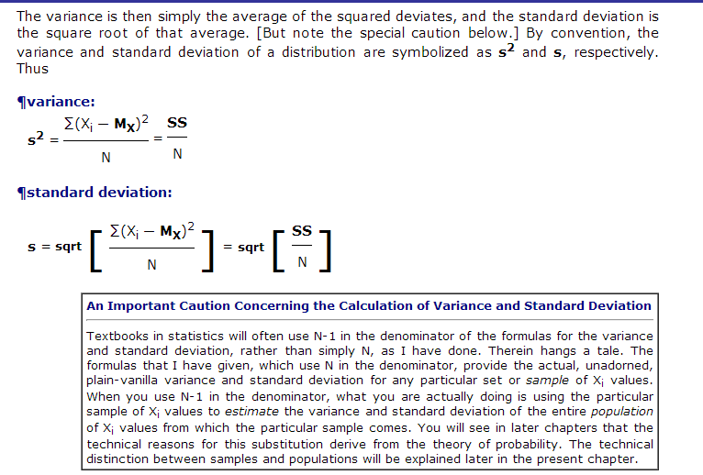
Variance (for “sample mean”)

Slide 33
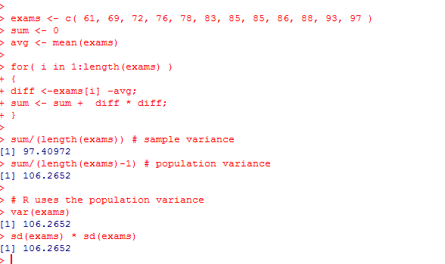
R uses the population variance (n-1 in denominator).
If you know the mean ahead of time, you can use the sample variance.
Otherwise (as is usually the case), you estimate the mean from your data,
lose 1 degree of freedom and use the population variance (with n-1 in the denominator)
Standard deviation is the sqrt(variance)

Slide 34
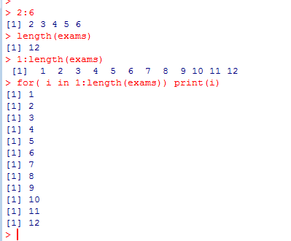
Notice I have a for loop here.
I index my vecor with [] (like arrays in Java).
: is sequence generator operator
(returns a vector)
1:length(vector) returns a vector with the
Integers 1 through 12.
The for loop iterates through these 12 vectors

Slide 35
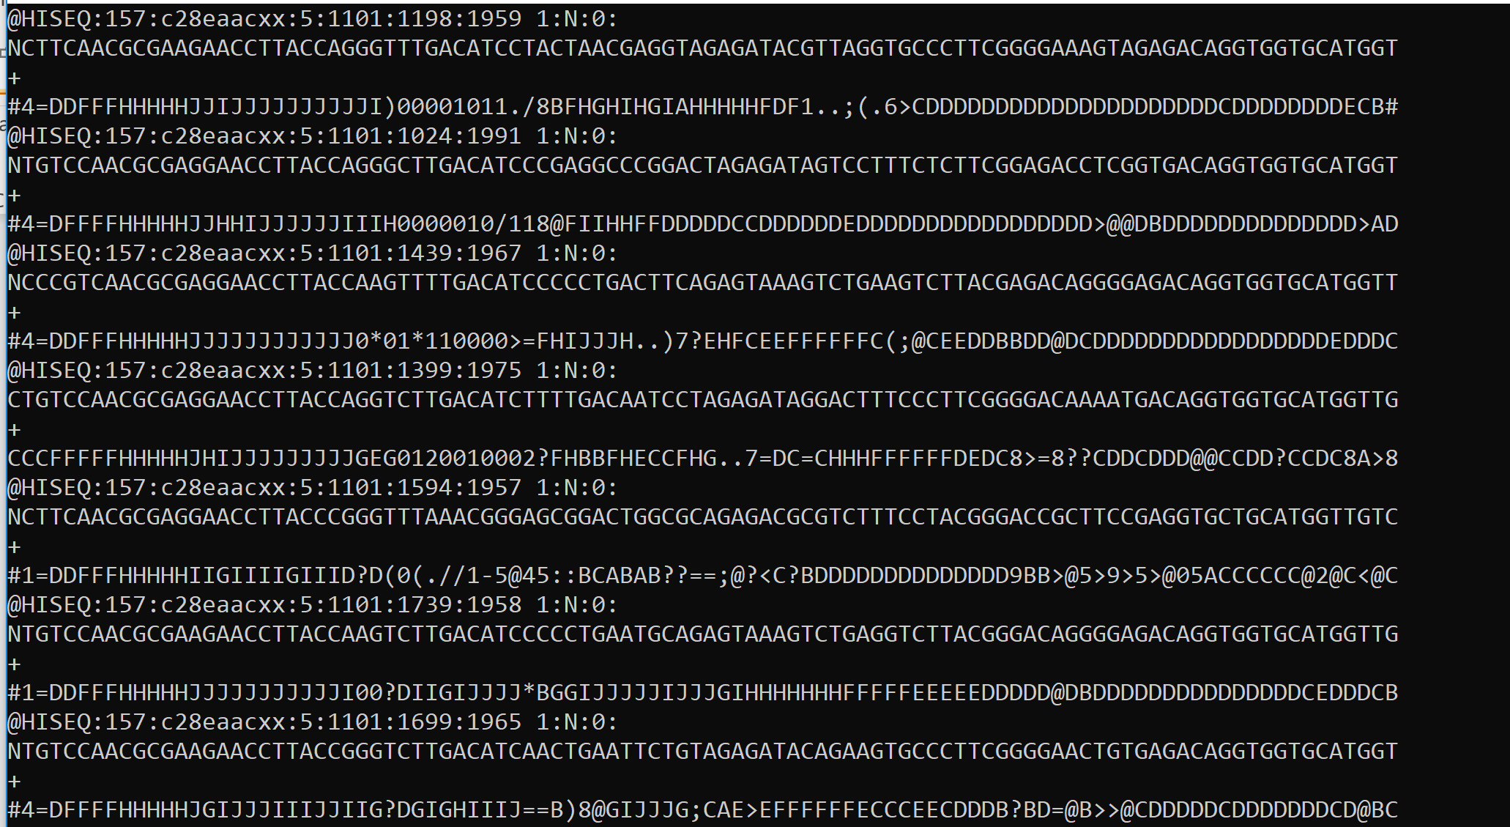
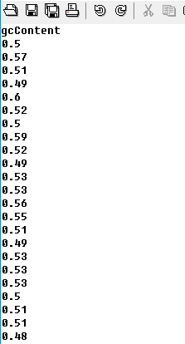
We can use R’s built-in graphs and summary statistics on empirical distributions
to quickly get a sense of a large number of observations..
Here I have a large number of sequences in a FASTQ file…
Using some parser (Java, Bioconductor, whatever),
I create a file with the GC
content of each sequence

Slide 36
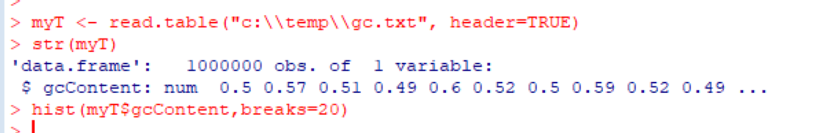
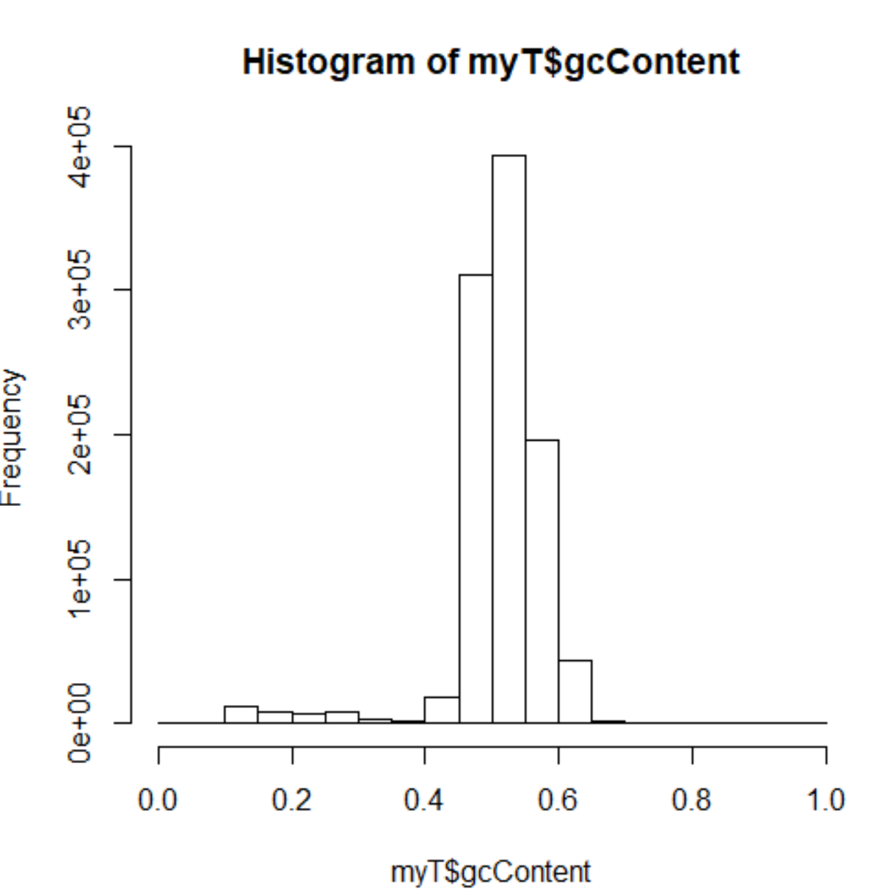
A very small number of lines of r-code allows me to inspect these data
read.table – reads a text file and produces a data frame
str – inspects (shows the structure of) an R object
hist – makes a histogram of the data
These are probably bad sequences

Slide 37
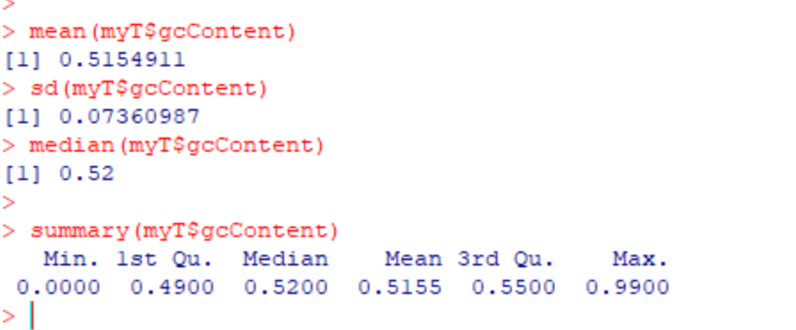
And of course we have our suite of summary statistics

Slide 38
R commands you should understand and practice from this lecture:
rm(list=ls())
ls()
length()
typeof()
hist()
mean()
median()
sd()
var()
str()
c()
The : operator
R concept you should understand at this point:
vector – one dimensional array with data all of the same type

Slide 39
“Hello World” Lab exercises
Use the mean and sd functions to calculate the mean and standard deviation
of the following numbers { 2.3, 4.3 ,1.2 , 3.4, 8.3, 12.2 }
(2) Use mean and sd in R to calculate the average and sd of { 4,5,6 …. 678,679,680 }
(the set of every positive integer between 4 and 680)
nothing to hand in yet…

Slide 40
Reading for next week:
“Vassar stats book”: http://vassarstats.net/textbook/
Chapter 1 “Principles of Measurement”
Chapter 2: “Distributions”
(or equivalent in your favorite canonical statistics text book).
(The above is presumably review).
In “The Art of R Programming” –
Chapter 1 – “Getting started” –
Chapter 2- “Vectors”
or equivalent chapters here: http://heather.cs.ucdavis.edu/~matloff/132/NSPpart.pdf
If you are getting a non-electronic copy, get this book ordered!

