Slide 1
Inheritance
Object
== vs .equals

Slide 2
Interfaces are one way we can work at a more abstract level in Java
Inheritance is another.
Instead of declaring Shape to be an interface we can make it an
abstract class and have our Shapes extend it..

Slide 3
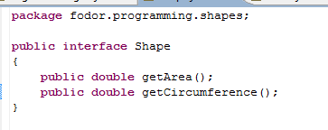
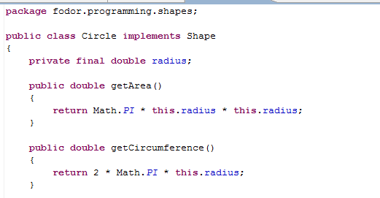
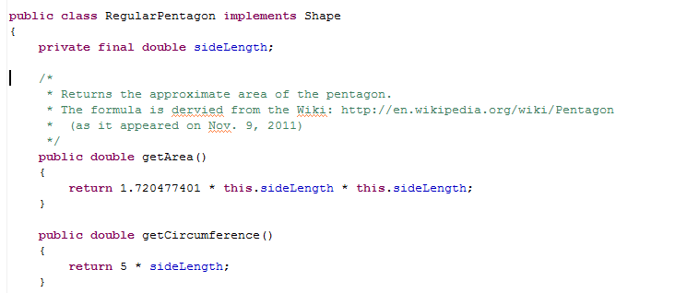
With an interface….
Circle implements Shape
RegularPentagaon
implements Shape

Slide 4
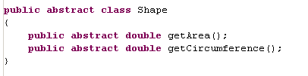
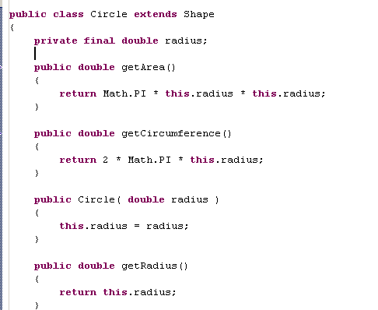
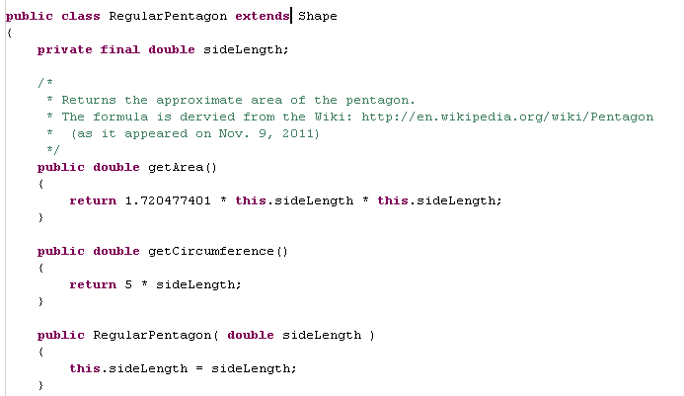
With abstract class….
Circle extends shape
RegularPentagon extends shape

Slide 5
Shape
abstract double getArea()
abstract double getCircumference()
*
isA
isA
Circle
RegularPentagon
hasA
overrides
hasA
overrides
radius
getArea()
sideLength
getArea()
getCircumference()
getCircumference()
Inheritance: Circle is a Shape.
Inheritance: Circle is a concrete sub-class of the Abstract class Shape.
Composition: Circle has a radius.
Circle overrides Shape’s abstract methods getArea() and getCircumference().
Circle can be instantiated. Shape cannot be instantiated.
*- getPerimeter() might have been a better name for this, although according to
Dictionary.com circumference and perimeter can be synonyms

Slide 6
Shape
abstract double getArea()
abstract double getCircumference()
isA
isA
Circle
RegularPentagon
hasA
overrides
hasA
overrides
radius
getArea()
sideLength
getArea()
getCircumference()
getCircumference()
Inheritance: RegularPentagon is a Shape.
Inheritance: RegularPentagon is a concrete sub-class of the Abstract class Shape.
Composition: RegularPentagon has a sideLength.
RegularPentagon overrides Shape’s abstract methods getArea() and getCircumference().
RegularPentagon can be instantiated. Shape cannot be instantiated.

Slide 7
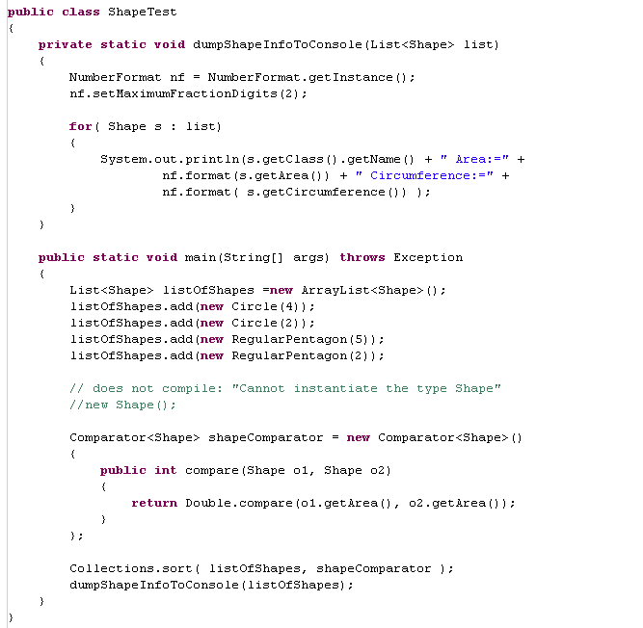

Our test code does not change at all whether Shape is an interface or an Abstract Class

Slide 8
A class can implement multiple interfaces.
A class can only extend one class
(i.e. no multiple inheritance in Java )

Slide 9
So why bother with inheritance when we already have interfaces?
In an interface, you can only list the function names.
In an abstract class, you can add non-abstract functions and they will be
inherited by the sub-classes.
Let’s say we want to impose a natural order on our Shape class so that
we can sort our Shapes by area without making a new Comparator.

Slide 10
Comparable<Shape>
int compareTo(Shape)
implements
Shape
abstract double getArea()
abstract double getCicumference()
int compareTo(Shape)
isA
isA
Circle
RegularPentagon
hasA
overrides
hasA
overrides
radius
getArea()
sideLength
getArea()
getCicumference()
getCicumference()
Circle and RegularPentagon will inherit compareTo()
(and hence will be Comparable)

Slide 11
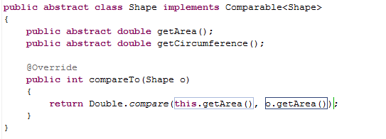
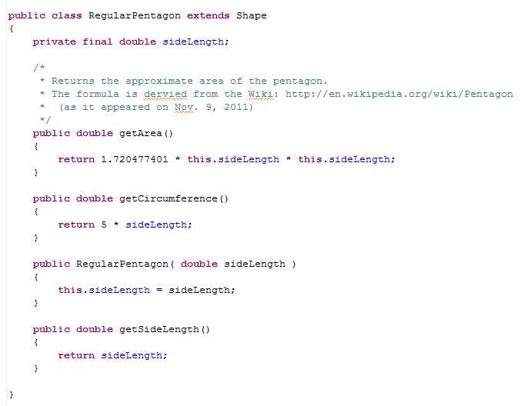
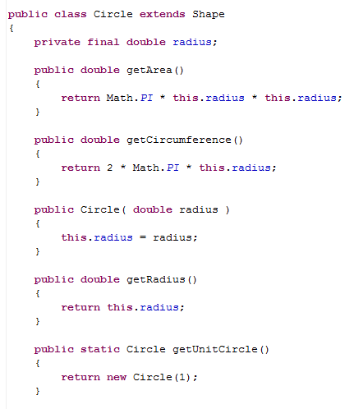
Circle and RegularPentagon extend Shape
Shape implements Comparable
Circle and RegularPentagon inherit the
Implementation of Comparable

Slide 12
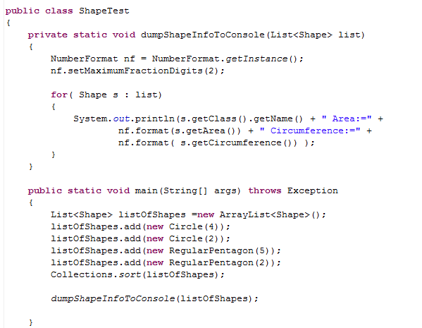

Having defined a natural order, we can now call Collections.sort(…)

Slide 13
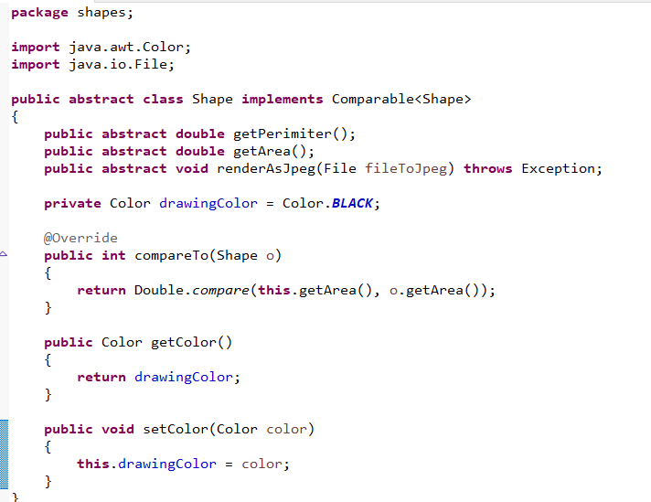
Likewise, we can allow shapes to “have a” color and have a default mutable color
https://github.com/afodor/renderingShapes/blob/main/src/shapes/Shape.java

Slide 14
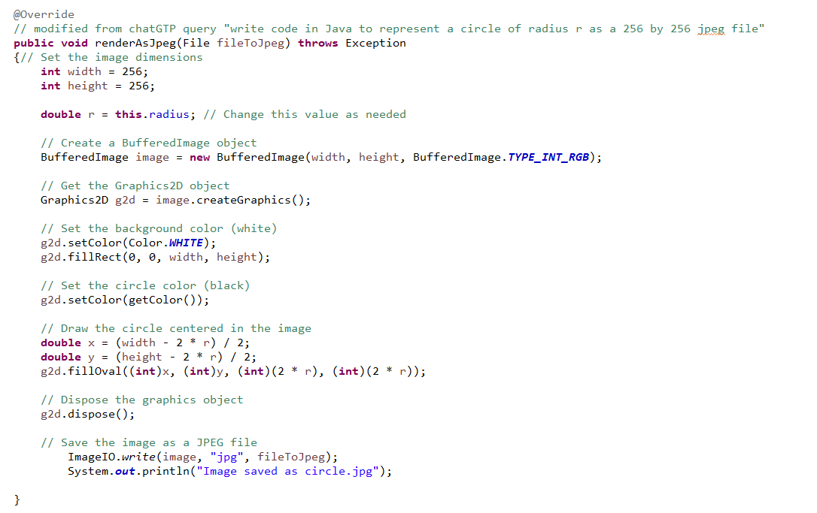
Render as JPEG in Circle now gets this circle’s color
https://github.com/afodor/renderingShapes/blob/main/src/shapes/Circle.java

Slide 15
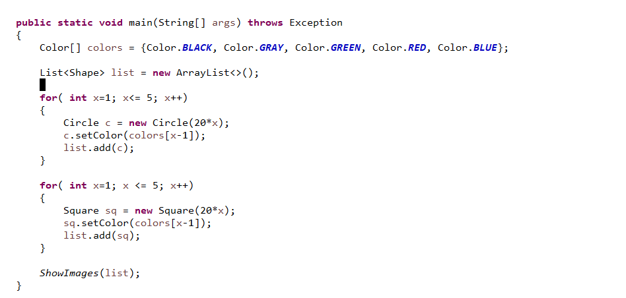
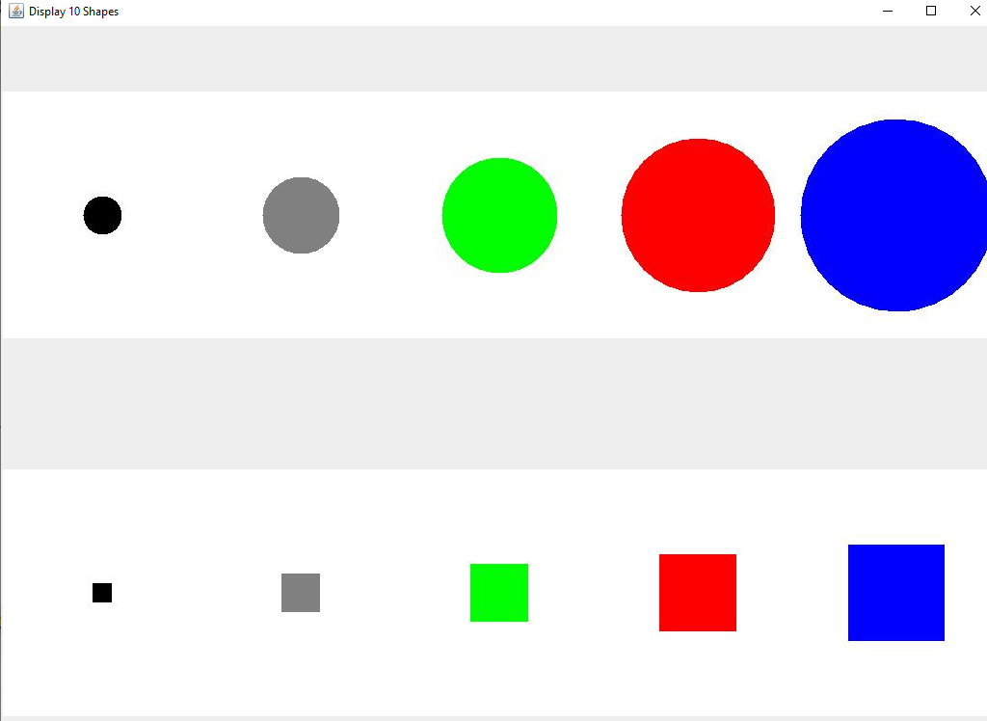
Each object now can manage its own color…
https://github.com/afodor/renderingShapes/blob/main/src/shapes/JPEG_Shape_Displayers.java

Slide 16
Comparable<Shape>
int compareTo(Shape)
implements
Shape
abstract double getArea()
hasA
Color
(with appropriate
getter and setter)
abstract double getCicumference()
int compareTo(Shape)
isA
isA
Circle
RegularPentagon
hasA
overrides
hasA
overrides
radius
getArea()
sideLength
getArea()
getCicumference()
getCicumference()
We say that after this modification, Shape now “has a” Color

Slide 17
Inheritance
Object
== vs .equals

Slide 18
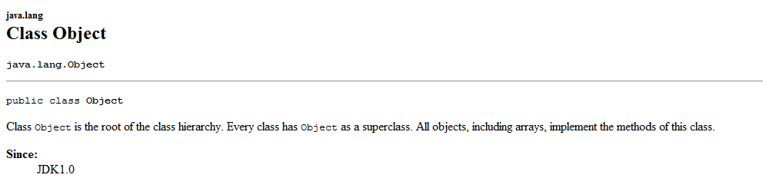
In Java (and C#) all objects automatically extend Object

Slide 19
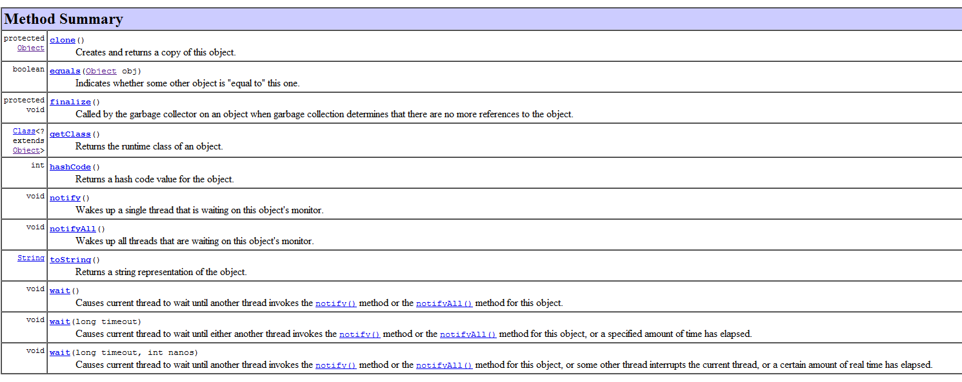
All objects have these methods…
wait() and notify() and notifyAll() are for threading (so we will get to them later)
clone() is very tricky to use (see Bloch Item #11: Override clone judiciously)
The 3 that we will think about now are: equals(…), hashCode(..) and toString(…)

Slide 20
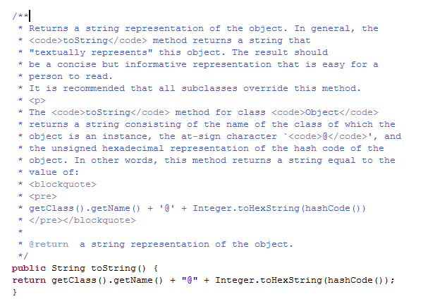
toString() is the easiest to understand…
In the Object superclass….

Slide 21
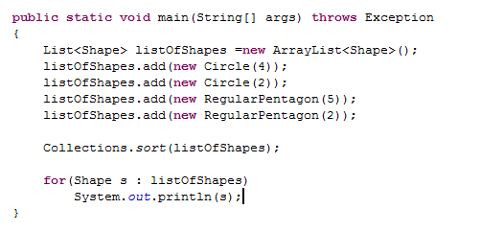

So toString() in our Shape class is not very informative by default
Shape is here autocast to a String (by calling s.toString() for each s in in listOfShapes)

Slide 22
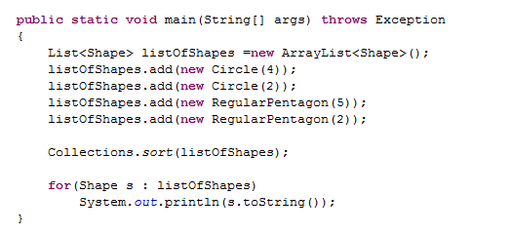
Explicitly calling toString() yields the same results…

Slide 23
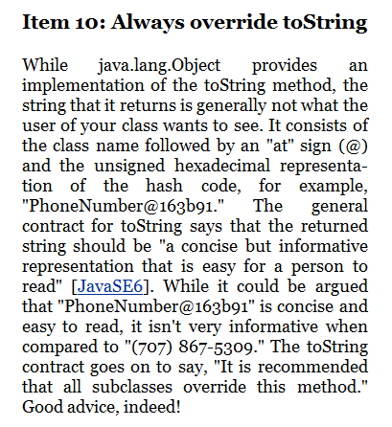
It is considered good form to override toString()
override is when the subclass defines the method with the same name
in the superclass.
The method gets executed from the subclass.

Slide 24
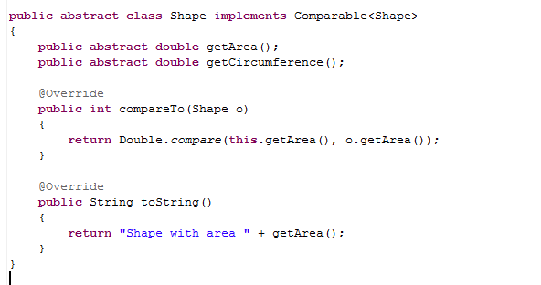
We can have Shape override toString()…
“@Override” is a note to the compiler that say, do not compile unless toString() is a method that is overriding a method in the superclass…

Slide 25
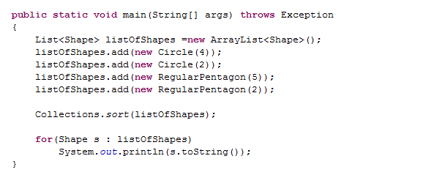

With toString() overriden in Shape…

Slide 26
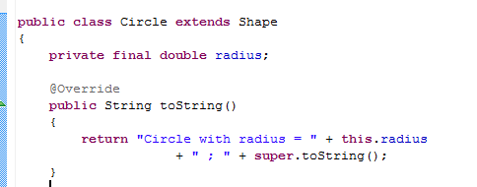

I can define toString() in Circle
Calls shape.toString()
RegularPentagon just calls Shape.toString()
(because there is no RegularPentagon.toString()
Circle calls Circle.toString()

Slide 27
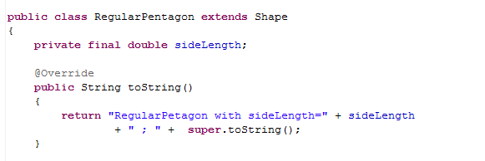

We add to toString() to RegularPetagon
Now we get a more consistent output…

Slide 28
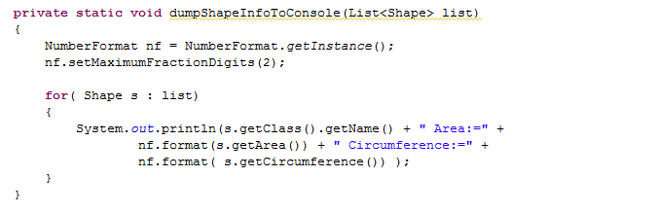
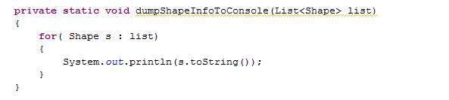
If we override toString() properly, we can simplify some our client code…
for example could become….
(but of course this assumes there is one way proper way to format object information)

Slide 29
Inheritance can reduce the amount of work you need to do by utilizing code reuse.
Consider Rectangle and Square…
Comparable<Shape>
int compareTo(Shape)
implements
Shape
abstract double getArea()
abstract double getCicumference()
int compareTo(Shape)
isA
isA
isA
Rectangle
Circle
RegularPentagon
isA
Square

Slide 30
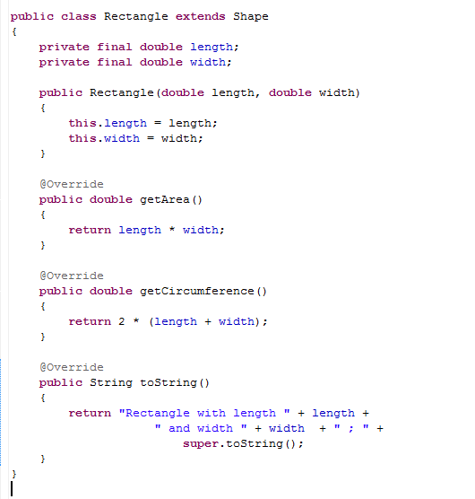
Here is a Rectangle

Slide 31
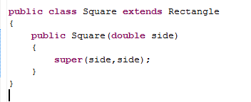
Here is a Rectangle
The Square can be gotten with almost no work
(although it might be “polite” to override toString() in Square too)

Slide 32
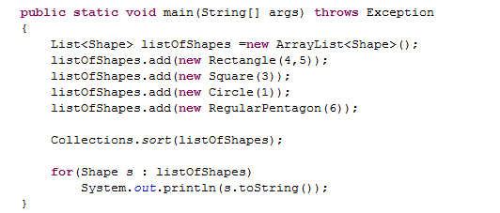

We can mix our new Rectangles and Squares with other Shapes…
Because we didn’t over-ride toString() in Square, toString() from Rectangle is used here…

Slide 33
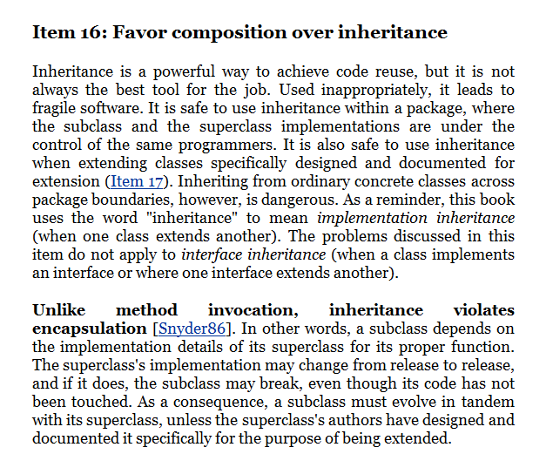
On the one hand, inheritance can make good use of code re-use.
On the other hand, it breaks encapsulation.
The way that Square works is dependent on the way Rectangle works.
Bloch has a lot to say about
this, that we will talk about
more later in the semester….

Slide 34
Inheritance
Object
== vs .equals

Slide 35
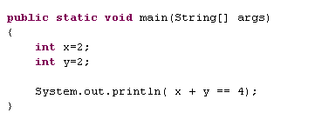
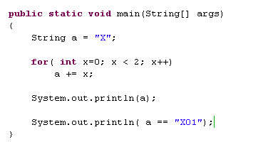

== works differently for basic types and objects..
For basics == compares the values of the variables
For objects, == checks if the objects have the same memory address
not the value of the objects..
(This is a common Java interview question…)

Slide 36
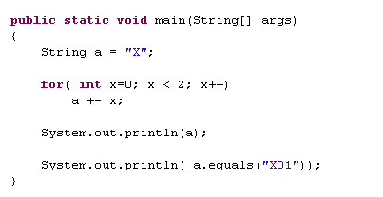

.equals() tests whether the value of two objects is the same…

Slide 37
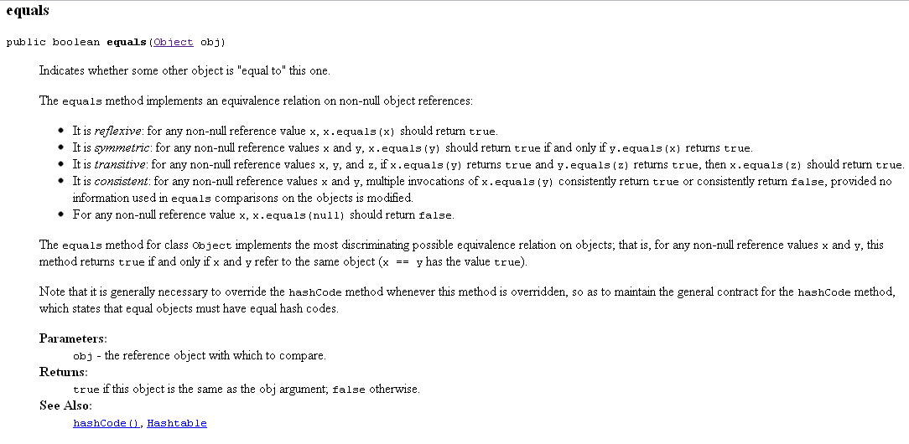
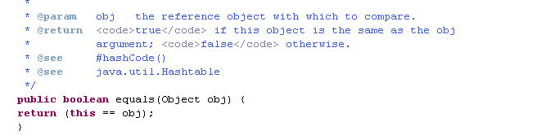
.equals is part of Object. By default it returns the same as the operator.
So if your don’t override .equals, then .equals and == will be the same.
In the Object source code

Slide 38
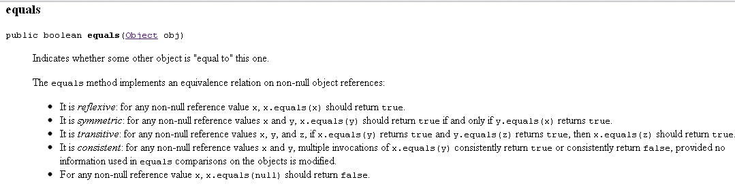
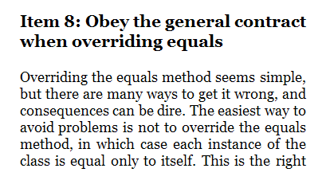
Bloch has a lot to say about these. We will come back to this when we have
talked more about HashSet and HashMap

Slide 39
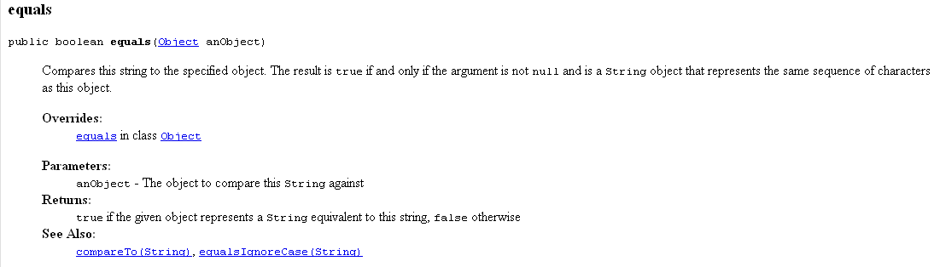
String overrides .equals (which is why string1 == string2 is not the same as
string1.equals(string2)

Slide 40
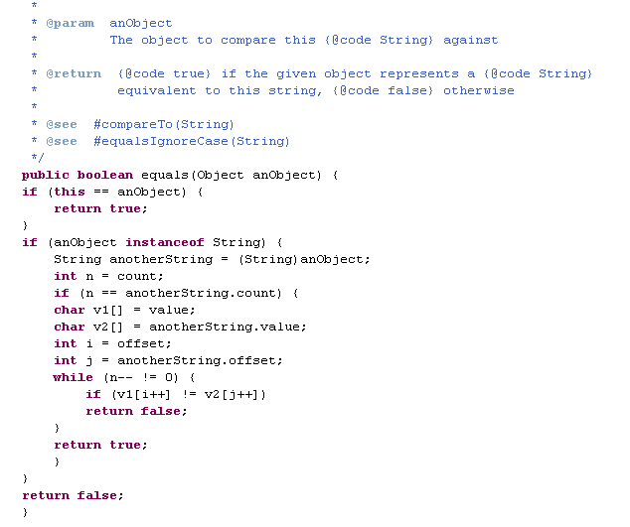
We can look at the source code for String.equals() to see how it works…
If the two objects are the same
object in memory, they are equal
If the other
Object is not a
String they are not
equal
If the two Strings have a
different length, they are not equal
If the two strings do not have a character in
common, they are not equal

Slide 41
Next time:
FastaSequence as a superclass of DNASequence and ProteinSequence
Still to come:
Boxing and unboxing primitives in Java
Exceptions
Constructor chaining
HashMaps and HashSets

