Slide 1
Lab #4 due 10/2 (two weeks); (midterm – on October 9th )
For Lab #4:
Make a static factory method that parses a Fasta file and returns a list
of FastaSequence objects
public static List<FastaSequence> readFastaFile(String filepath) throws Exception
{…}
Your FastaSequence class should have at least 3 methods:
// returns the header of this sequence without the “>”
public String getHeader()
{ … }
// returns the Dna sequence of this FastaSequence
public String getSequence()
{ …}
// returns the number of G’s and C’s divided by the length of this sequence
public float getGCRatio()
{ … }
(SEE NEXT SLIDE!!!!)

Slide 2
The following main() code should work on your FastaSequence class
(when, obviously, pointing to a real fasta file!)
public static void main(String[] args) throws Exception
{
List<FastaSequence> fastaList =
FastaSequence.readFastaFile("c:\\pointsToSome\\FastaFile.txt");
for( FastaSequence fs : fastaList)
{
System.out.println(fs.getHeader());
System.out.println(fs.getSequence());
System.out.println(fs.getGCRatio());
}
}
(SEE NEXT SLIDE!!!!)

Slide 3
Next, to your FastaSequence class add a static method
public static void writeUnique(File inFile, File outFile )
throws Exception
{ }
that writes each unique sequence to the output file with the # of times each sequence was
Seen in the input file as the header (sorted with the sequence seen the fewest times the first)
So if the input was
>Seq1
AC
>Seq2
AC
>Seq3
AA
>Seq4
AA
>Seq5
AC
>Seq6
AT
The output would be
>1
AT
>2
AA
>3
AC
Send you code (or links to your checked in code) to afodor@uncc.edu with subject Lab #4

Slide 4
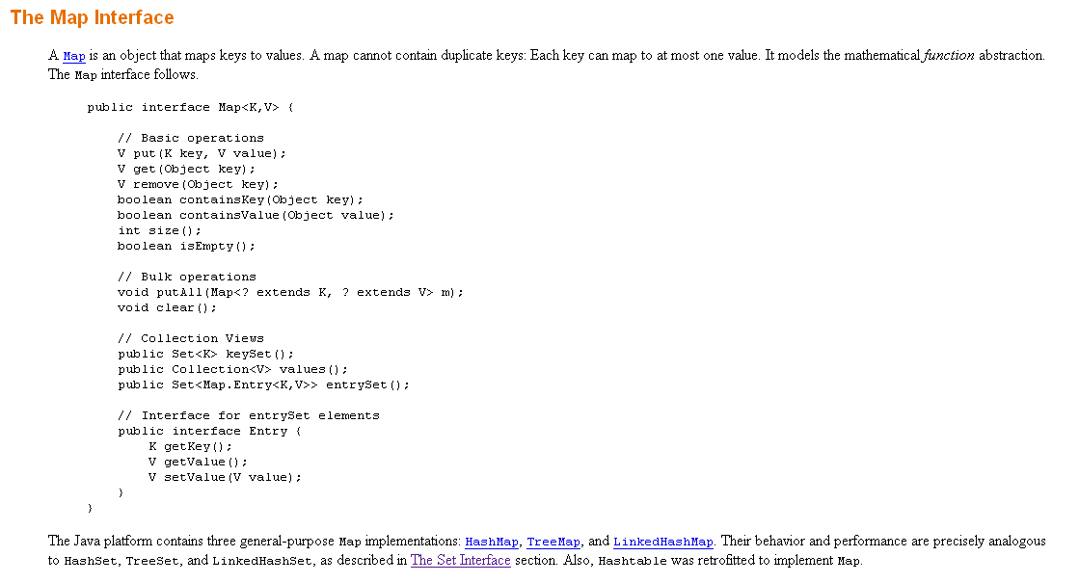
The HashMap class will be very useful for this assignment

Slide 5

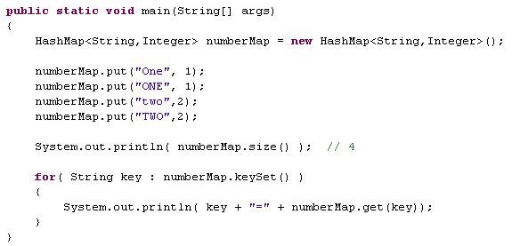
A map maps keys to values…

Slide 6
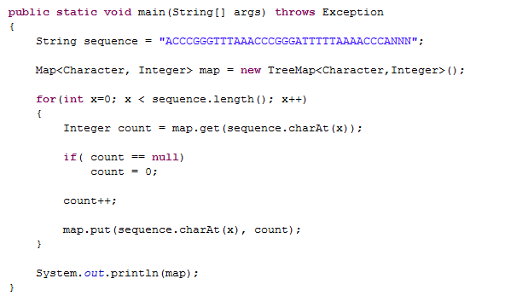

Maps are really great for counting things….
Our TreeMap keeps our keys ordered…
Maps only hold objects (not primitives)
So we have this awkward switch

Slide 7
For extra-credit:
Create a class that allows a user to parse an arbitrarily large Fasta file
one sequence at a time but does not hold the sequences in memory.
This class should have a function called something like
public FastaSequence getNextSequence()
that returns the next FastaSequence in the file or null if there are
no more sequences…

