Slide 1
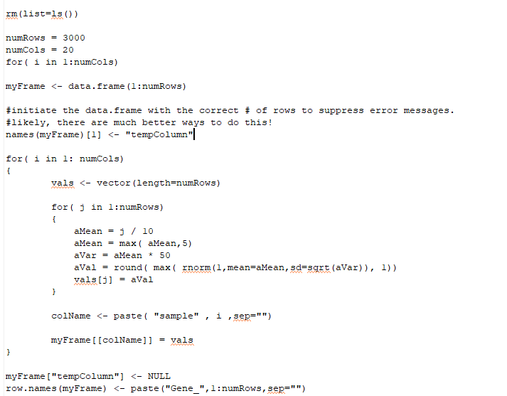
Consider code that generates a simulated dataset with 3,000 genes and 20 samples…
https://github.com/afodor/metagenomicsTools/blob/master/src/classExamples/modelsOnSimData.txt

Slide 2
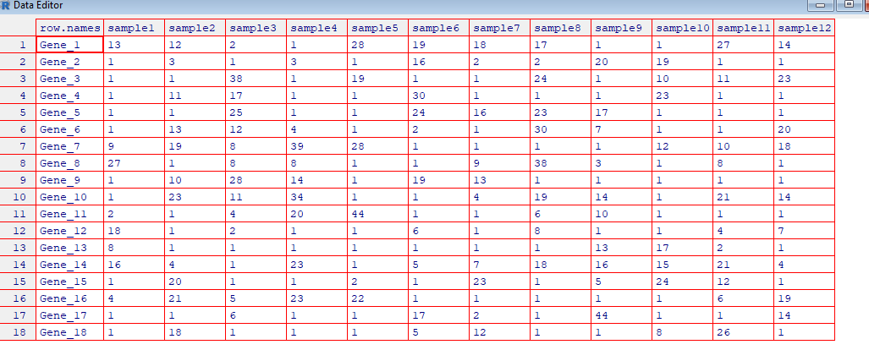
We end up with a simulated count table
20 samples
3,000 genes

Slide 3
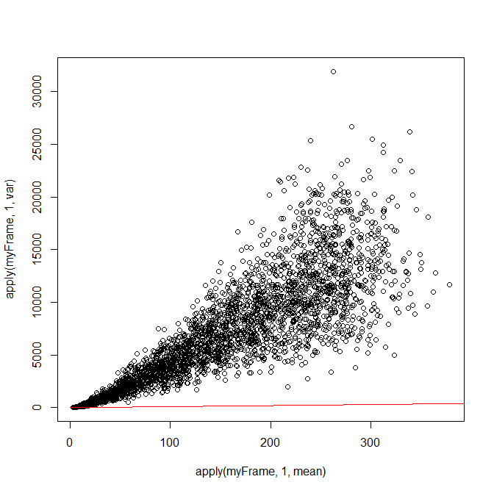
By design, the mean does not equal the variance
> plot( apply(myFrame,1,mean), apply(myFrame,1,var))
> lines( c(0:1000000), c(0:1000000), col="red")

Slide 4
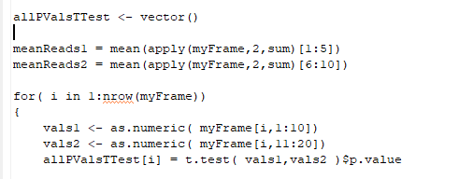
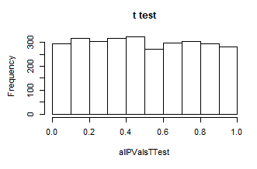
We say that the first 10 sample represent one condition (e.g. “cancer samples”) and
the last 10 columns represent another condition (e.g. “control samples”).
We can think of many statistical tests that will generate a frequentist p-value.
For example (coming up in the next few lectures), a t-test
hist(allPValsTTest, main="t test")
The t-test has an estimate for the variance and therefore produces an approximately uniform distribution
(for this case where the null hypothesis is always true)
https://github.com/afodor/metagenomicsTools/blob/master/src/classExamples/modelsOnSimData.txt

Slide 5
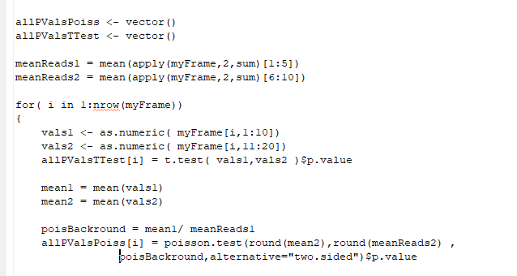
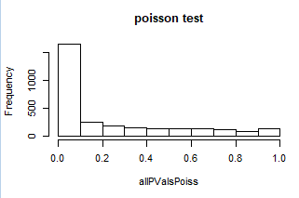
If we use a test on the Poisson distribution, the assumption that the mean equals the variance
causes the p-values to be too small…
https://github.com/afodor/metagenomicsTools/blob/master/src/classExamples/modelsOnSimData.txt

Slide 6
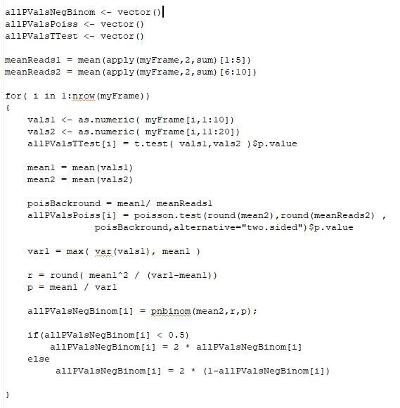
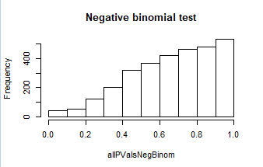
We can imagine a test based on the negative binomial distribution
(this is a drastic simplification of the DeSeq algorithm….)
hist(allPValsNegBinom,main="Negative binomial test")
Our approximate tests yields p-values that are
too conservative…

Slide 7
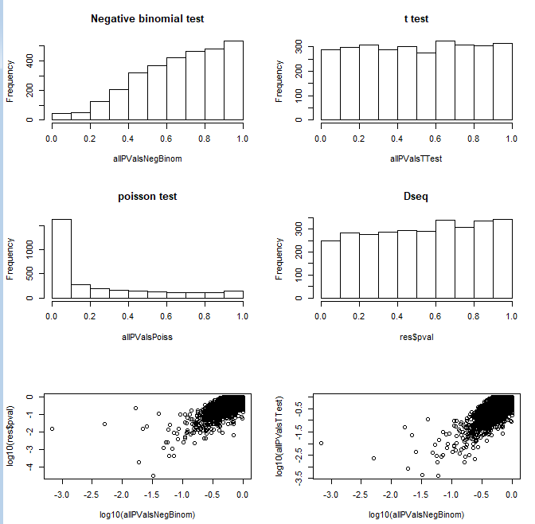
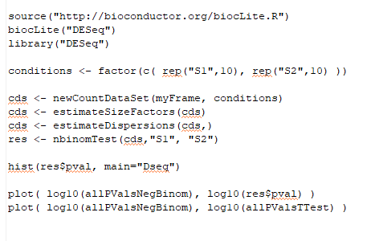
We can also run our data through DeSeq 1 (with the default “curve-fitting” for the variance)
This comes close to uniform (but not as close as
the t-test!)
But again, these different algorithms generally
agree on which genes are the most significant, but
disagree on how significant those genes are)

Slide 8
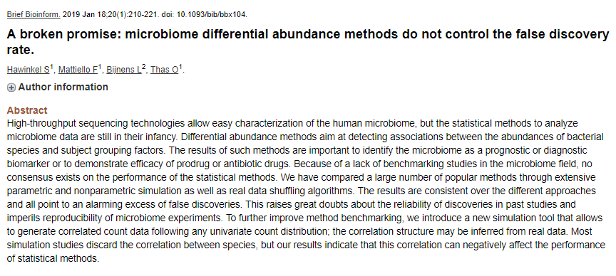
How to set threshold of significance in genomics is not a solved problem..

Slide 9
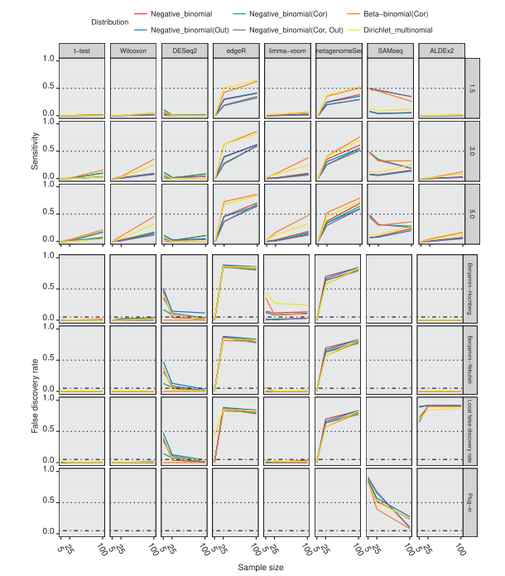
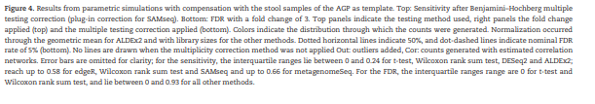
It is not difficult to find simulated datasets that “break”
the FDR thresholds produced by popular software
packages (such as DeSeq and FDR).
Often simpler models (such as the t-test and
Wilcoxon, that we will cover shortly) offer better
performance…

Slide 10
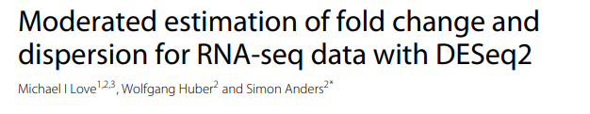
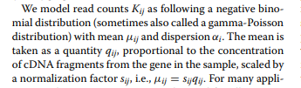

Methods are still being tweaked to find the appropriate balances between sensitivity and
reporting false positives…
DESeq2 continues to explore the correct ways to model variance
Introduces models of fold-change thresholds to help remove false positives
Replaces DESeq’s model of multiplying two negative binomial distributions together with a
more straight-forward generalized linear model
(We will cover generalized linear models later in the semester….)
But despite these tweaks, simpler models (like the t-test) remain viable…

