Slide 1
From the binomial to the normal
qqnorm
The Central Limit Theorem
Standard Normal Distribution
Preview: Chi-square and t-distributions

Slide 2
We’ve seen the Poisson distribution is an approximation to the binomial with large N
and small p.
Likewise, the normal distribution is an approximation to the binomial with a large N

Slide 3
Proving that the Gaussian distributions is the approximate limit of a binomial when N is large
is pretty involved…
http://mathforum.org/library/drmath/view/56600.html
You are not responsible for this proof!

Slide 4
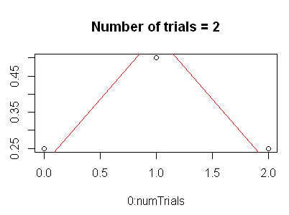
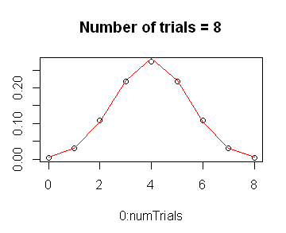
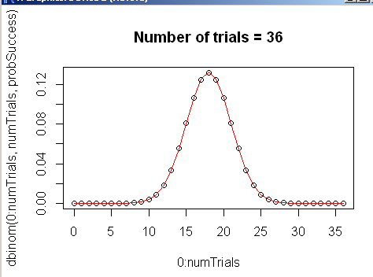
We can as usual demonstrate this effortlessly in R…
probSuccess = 0.5
for( numTrials in 2:500)
{
titleStr <- paste("Number of trials = ", numTrials,sep="")
plot( 0:numTrials, dbinom(0:numTrials, numTrials,probSuccess),main=titleStr)
lines( 0: numTrials, dnorm( 0:numTrials, mean=numTrials * probSuccess,
sd= sqrt(numTrials * probSuccess * (1-probSuccess))),col="RED");
Sys.sleep(1);
}
Note that N doesn’t have to get very large for the approximation to become quite good

Slide 5
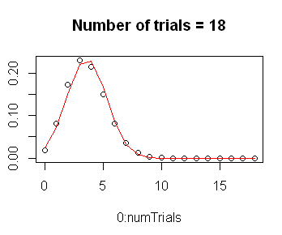
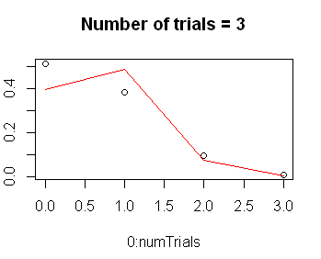
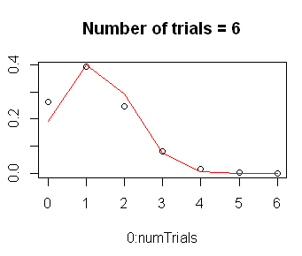
This works for p-values other than 0.5!
probSuccess = 0.2
for( numTrials in 2:500)
{
titleStr <- paste("Number of trials = ", numTrials,sep="")
plot( 0:numTrials, dbinom(0:numTrials, numTrials,probSuccess),main=titleStr)
lines( 0: numTrials, dnorm( 0:numTrials, mean=numTrials * probSuccess,
sd= sqrt(numTrials * probSuccess * (1-probSuccess))),col="RED");
Sys.sleep(1);
}

Slide 6
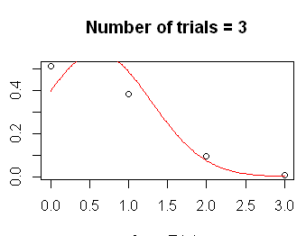
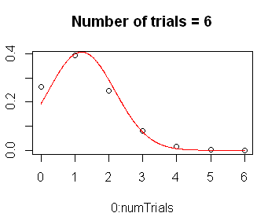
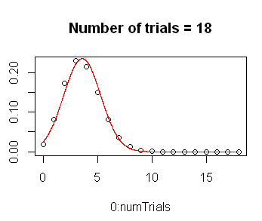
Of course, because the normal value is continuous, we can graph results intermediate
to the integer number of successes
probSuccess = 0.2
for( numTrials in 2:500)
{
titleStr <- paste("Number of trials = ", numTrials,sep="")
plot( 0:numTrials, dbinom(0:numTrials, numTrials,probSuccess),main=titleStr)
xVals <-seq( 0, numTrials,by=1/(numTrials*20))
lines( xVals, dnorm( xVals, mean=numTrials * probSuccess,
sd= sqrt(numTrials * probSuccess * (1-probSuccess))),col="RED");
Sys.sleep(1);
}
The continuous nature of the normal distribution makes it appropriate for non-count experiments
(such as microarrays)

Slide 7
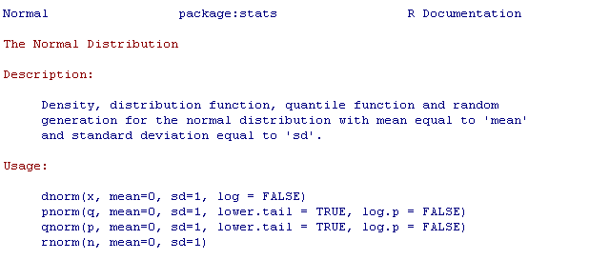
We have (as usual) dnorm, pnorm, qnorm, rnorm
dnorm – probability density function
pnorm - cumulative probability function
qnorm – inverse of pnorm
rnorm – generates random Gaussians

Slide 8
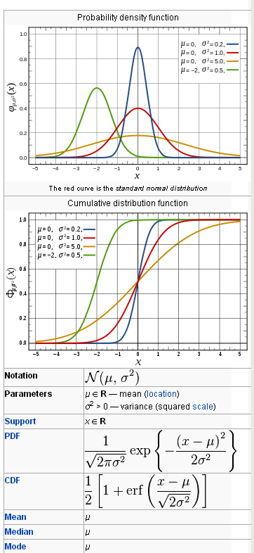

The PDF is defined in terms of the normal distribution’s mean and variance
http://en.wikipedia.org/wiki/Normal_distribution

Slide 9
Summary of inference models so far…
From the binomial to the normal
qqnorm
The Central Limit Theorem
Standard Normal Distribution
Preview: Chi-square and t-distributions

Slide 10


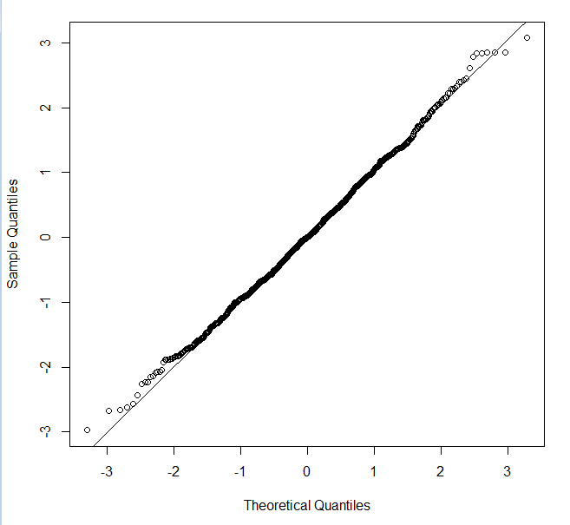
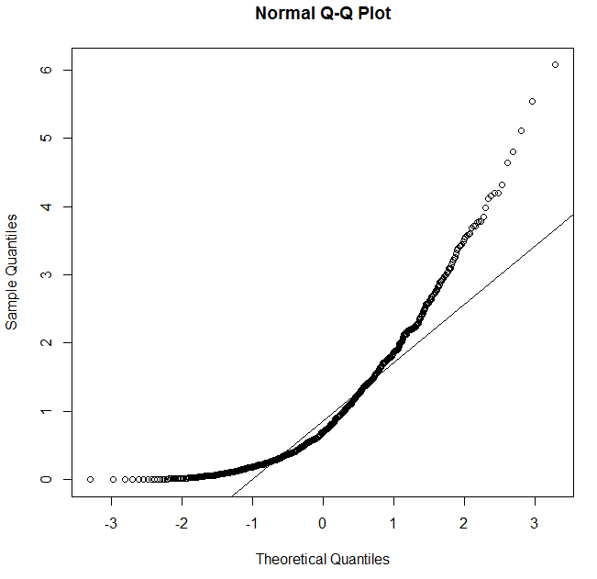
qqnorm and qqline can be used very quickly to visually tell if a distribution is normal

Slide 11
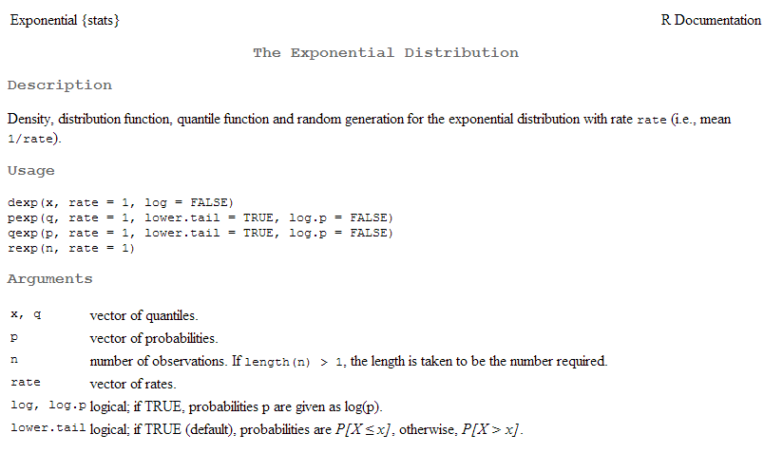
(A non-normal distribution….)

Slide 12
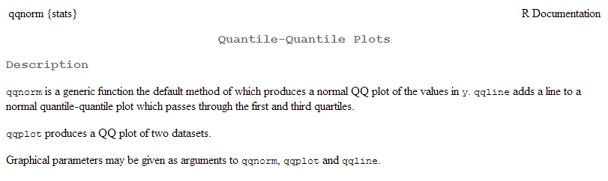

Slide 13
Summary of inference models so far…
From the binomial to the normal
qqnorm
The Central Limit Theorem
Standard Normal Distribution
Preview: Chi-square and t-distributions

Slide 14
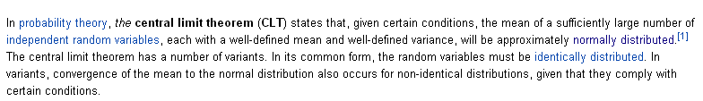
The central theorem gives us a surprising fact about the normal distribution!
http://en.wikipedia.org/wiki/Central_limit_theorem
The central limit theorem applies when you are taking the mean of a
distribution where each sample comes from a distribution with a constant mean and variance
and the samples are identically and independently distributed.

Slide 15
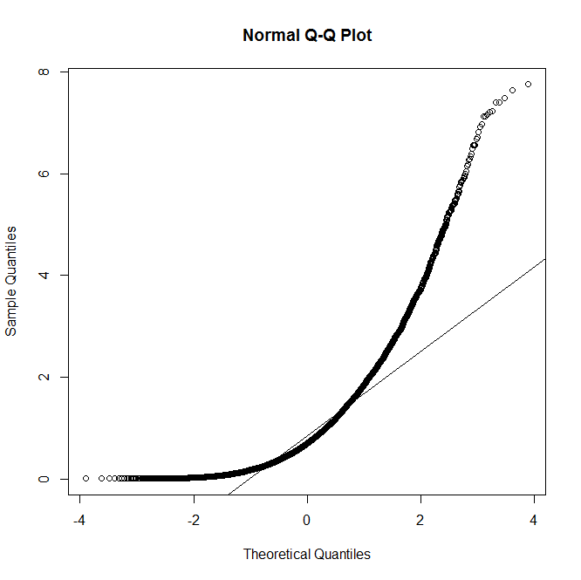
So here is an example of a random variable that is not normally distributed
someDist <- function() { x <- rexp(1)}
sampleSize <- 10000
results <- vector(length=sampleSize)
for( i in 1:sampleSize)
results[i] <- someDist()
myHist <- hist(results,breaks=50)
plot(myHist$breaks, myHist$density[1:length(myHist$breaks)])
lines( myHist$breaks, dnorm(myHist$breaks,mean=mean(results),sd=sd(results)),col="RED")
windows()
qqnorm(results) ; qqline(results)
We sample the exponential distribution (at n=1) and it absolutely not normal!

Slide 16
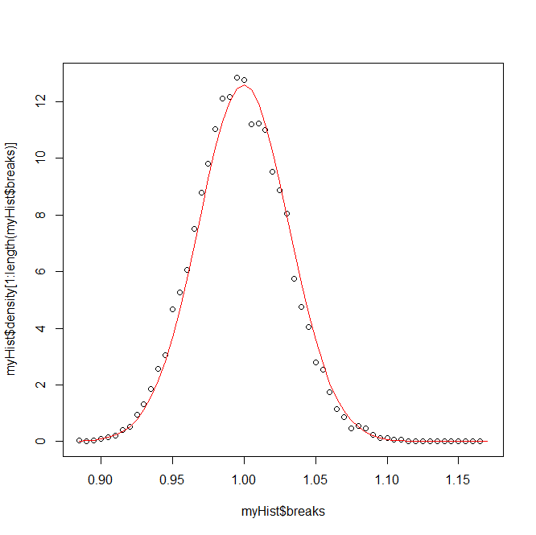
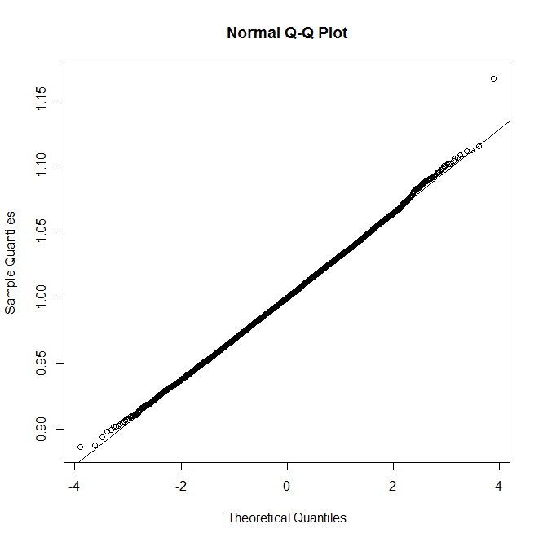
Now we take the average of the distribution (instead of a single read from the distribution)
Generate 1,000 numbers
someDist <- function() { x <- rexp(1000) }
sampleSize <- 10000
results <- vector(length=sampleSize)
for( i in 1:sampleSize)
results[i] <- mean( someDist())
myHist <- hist(results,breaks=50)
plot(myHist$breaks, myHist$density[1:length(myHist$breaks)])
lines( myHist$breaks, dnorm(myHist$breaks,mean=mean(results),sd=sd(results)),col="RED")
windows()
qqnorm(results) ; qqline(results)
Store the average of those 1,000 numbers
As advertised, the results are nearly perfectly normally distributed!

Slide 17
What the central theorem does say:
Taking the mean from an idd distribution will (eventually) lead to a normal
distribution
What the central theorem does not say:
Your particular dataset is normal
In biology, unfortunately, datasets are often not normally distributed.
Sample size may be insufficient for central limit theorem to kick in.
Sampling may not be from the same distribution across subjects.
(What actin does in patient X is different from patient Y)
We will still have to test for normality before applying parametric statistics!

Slide 18
Summary of inference models so far…
From the binomial to the normal
qqnorm
The Central Limit Theorem
Standard Normal Distribution
Preview: Chi-square and t-distributions

Slide 19

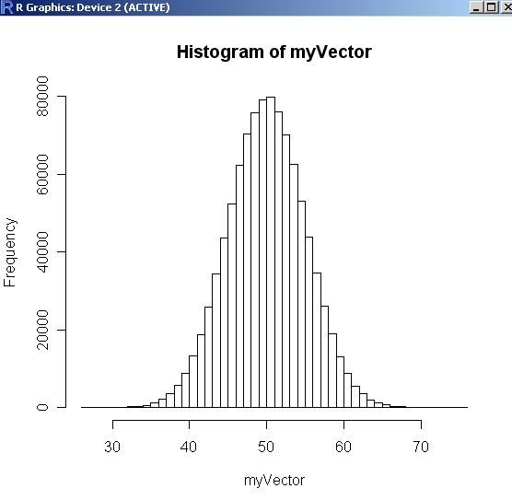
If you add a subtract a constant to a normally distributed
set of values, they are still normally distributed…
“Before”
Centered at 50

Slide 20

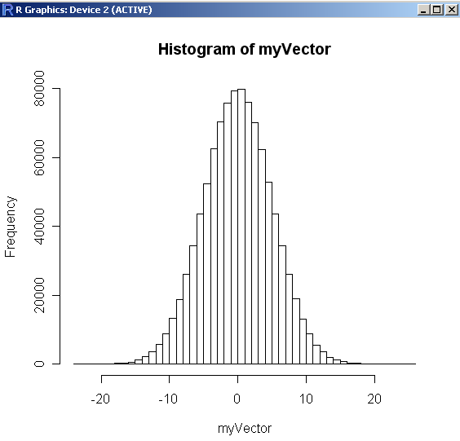
“After”
Now centered at 0

Slide 21
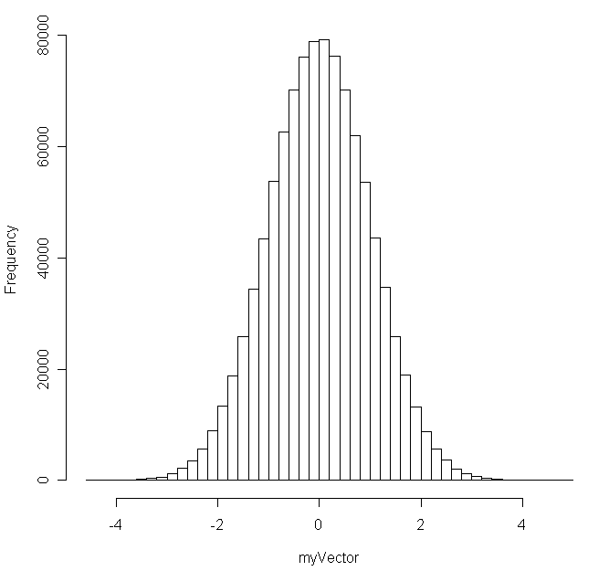
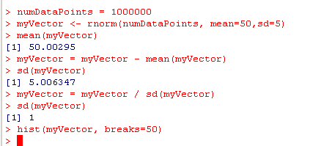
Likewise if you divide a normally distributed set of values
by a constant, it is still normally distributed…
All we’ve done is
re-scale the x-axis here

Slide 22
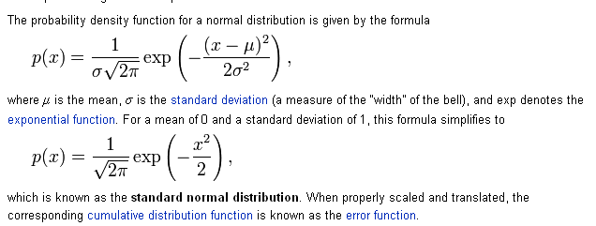
We define a standard normal distribution as a normal
distribution with mean=0 and SD = 1
Given any normal distribution, we can transform it to the
standard distribution via
Y is some random variable
u is the mean of that variable
s is the sd of that variable
Z = Y – u
s
http://en.wikipedia.org/wiki/Normal_distribution

Slide 23
False Discovery Rate
From the binomial to the normal
qqnorm
The Central Limit Theorem
Standard Normal Distribution
Preview: Chi-square and t-distributions

Slide 24
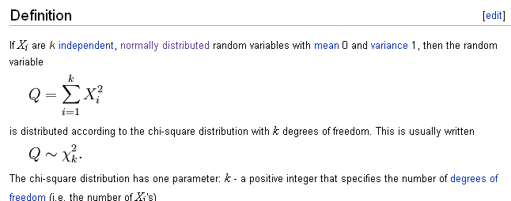
From the uniform normal distributions, we define the chi-square distribution
http://en.wikipedia.org/wiki/Chi-square_distribution

Slide 25
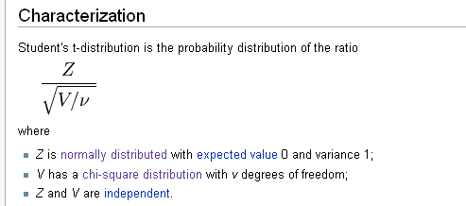
And we build on both to make the t-distribution…
With the z distribution, chi-square distribution and t-distribution,
we will have the z-test, chi-square test and t-test.
And we will talk about those next time…
Review t-test and chi-square test from your 1st semester stats book

Slide 26
Reading:
Canonical statistics text book through t-test and t-distribution

