Slide 1
It is straight-forward to extend ANOVA to multiple levels.
Consider a measurements (e.g. weight) for three genotypes
A/A A/a a/a
4.3
2.3
4.5
5.6
4.2
3.9
2.8
2.7
2.3
1.9
1.3
1.2
1.8
2.1
1.6
0.9
1.1
1.2
2.1
0.5
0.9
AA <- c(4.3,2.3,4.5,5.6,4.2,3.9,2.8)
Aa <- c(2.7,2.3,1.9,1.3,1.2,1.8,2.1)
aa <- c(1.6,0.9,1.1,1.2,2.1,0.5,0.9)
myData <- c(AA,Aa,aa)
genotypes <- c( rep("AA",length(AA)), rep("Aa",length(Aa)), rep("aa",length(aa)))
genotypes <- factor(genotypes)
myLm <- lm( myData ~ genotypes, x=TRUE)
anova(myLm)
myLm$x

Slide 2
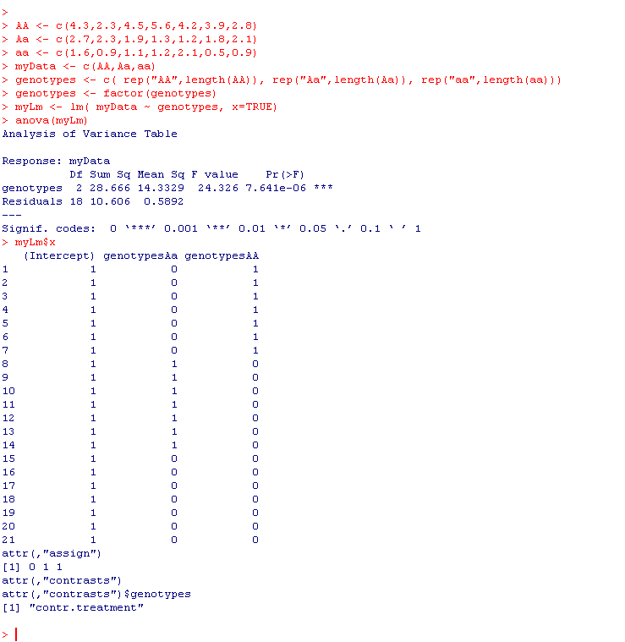


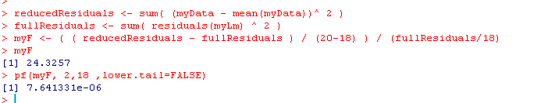
Full model:
weight = intercept + Aa + AA + E
(aa is background)
Residuals for full model is 10.6057
With 18 d.f. (n=21 – 3 parameters)
Reduced model:
weight = mean + E
20 D.F. (n=21 – 1 parameter)

Slide 3
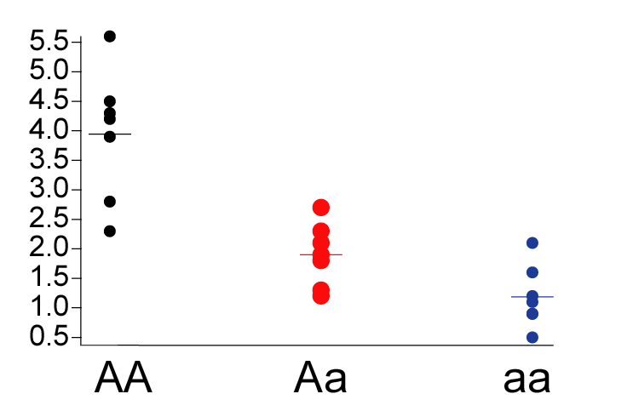
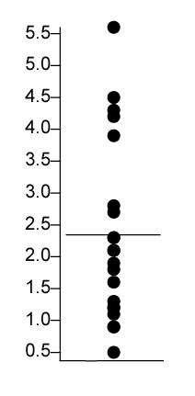
Full model: With three means
weight = intercept + Aa + AA + E
Reduced model: With one means
weight = B0 + e
ANOVA test: do we reduce the error by a
significant amount by adding the additional
parameters?

Slide 4
This p-value tests the null hypothesis
that µ_{AA} = µ_{Aa} = µ_{aa}
It doesn’t tell us which of these
individual means are different.
So it evaluates that genotype makes
a difference but doesn’t tell us if,
for example, µ_{AA} = µ_{aa}
These are “dummy
variables” –

Slide 5
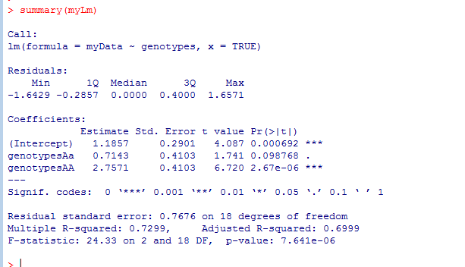
If we type summary, R will perform every comparison with respect to the chosen background
Here R chose “aa” as the background and compares everything to aa

Slide 6
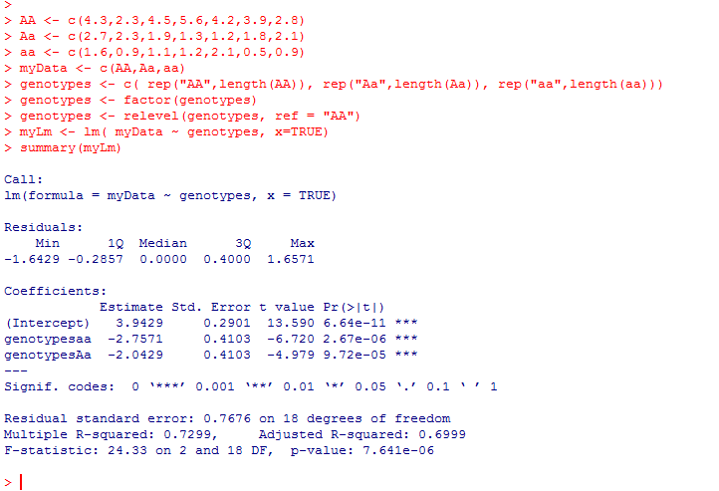
We can change which genotype is considered by using relevel
Here we use relevel to force all comparisons to AA

Slide 7
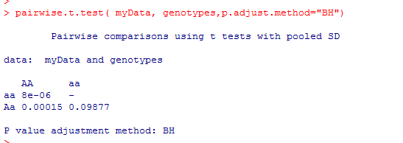
Alternatively, you can ask R to do every possible t-test…
(and correct for multiple comparisons!)

Slide 8
This problem could also be considered as a quantitative problem (a regression).
Define gene “dose” (does of the “a” allele):
AA = 0
Aa = 1
aa =2
Then this view of the data……
Becomes…

Slide 9
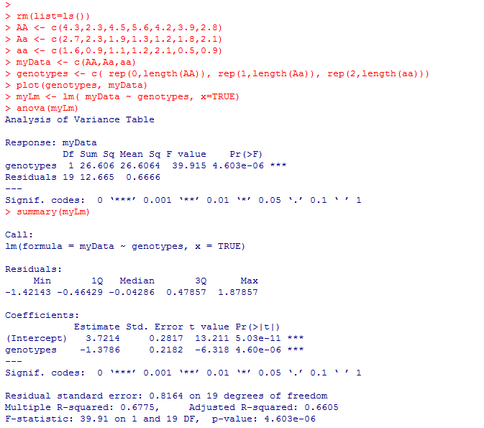
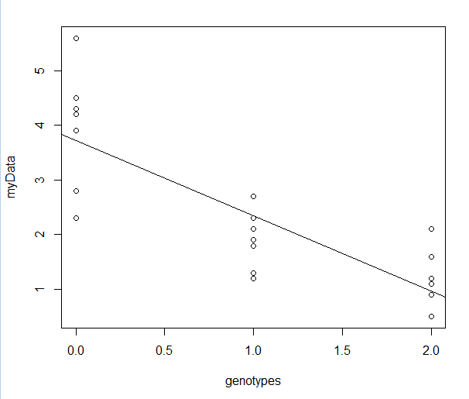

The linear regression view!

Slide 10
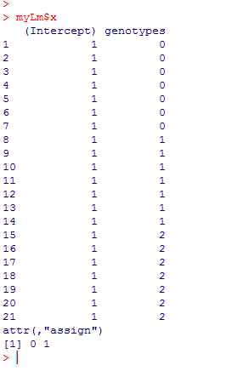

We’ve gained one degree of freedom as now our model has just
two parameters
Y = B0 + B1*genotype + error
However, the Matrix form of our equation has not changed:
We can still use the ANOVA to determine the significance of both parameters

