Slide 1
Threads.
Factorizing in parallel.
Threading is difficult
Parsing fasta sequences in parallel
Threads in GUIs.
Javascript is single-threaded

Slide 2
There are two ways you can spawn multiple threads in Java.
You can extend Thread or you can implement Runnable

Slide 3
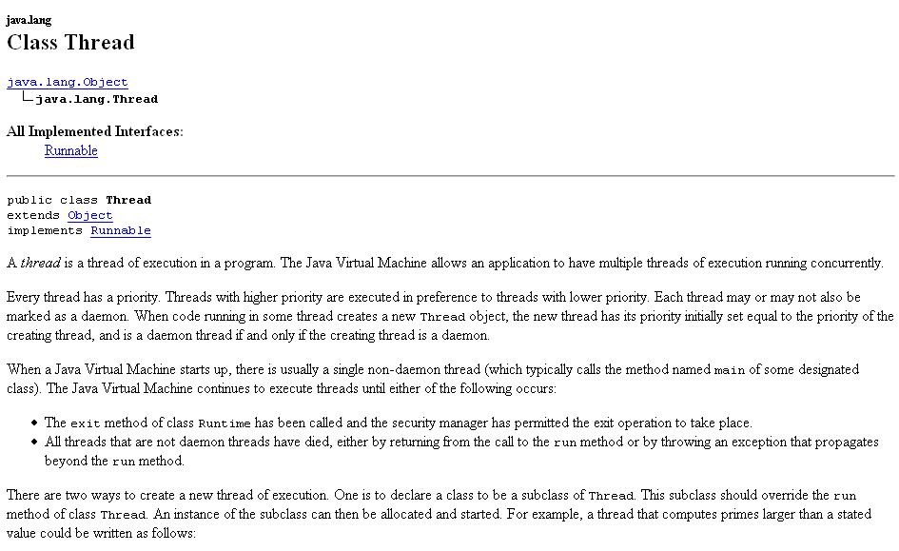

Slide 4
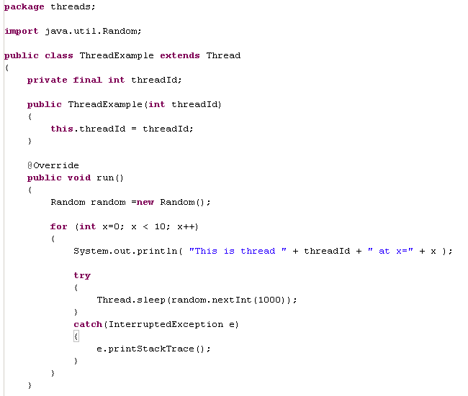
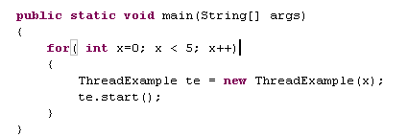
run(). What this thread will do…
This thread sleeps for
between 0 and 1000 msec
run() can’t throw an Exception

Slide 5
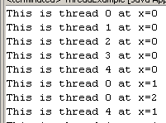
Thread 1
Thread 2
Thread 3
….
writing
sleeping
sleeping
Each thread “wakes up”, dumps
to the console and goes to sleep.

Slide 6
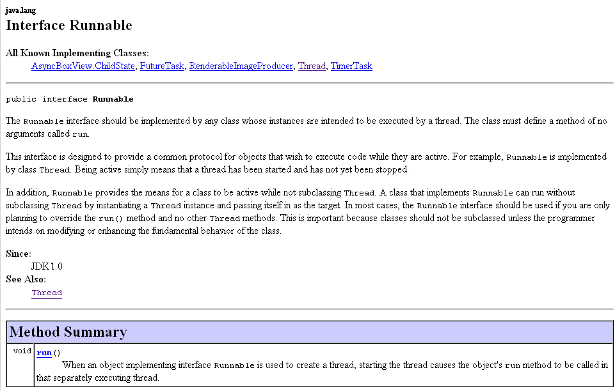
Another, more common way to instantiate a thread.
Implement the interface Runnable.
The runnable interface has a single method run()

Slide 7
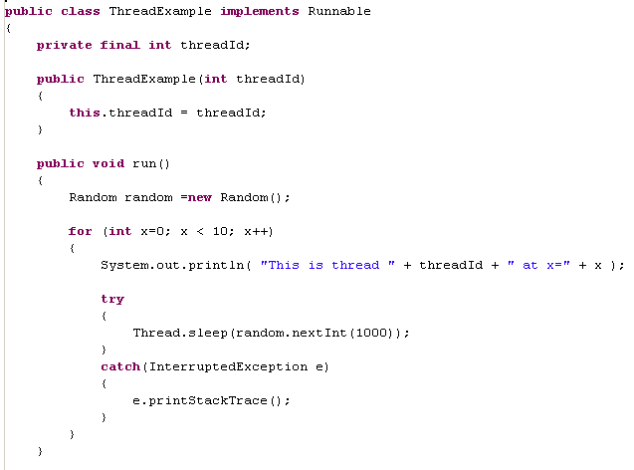
We now implement
Runnable instead of
extending Thread
This is exactly the same

Slide 8
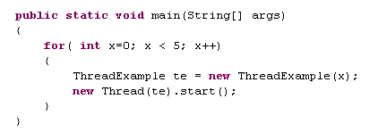
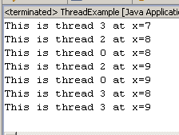
Here we say new Thread(Runnable).start()
Rather than te.start() as when ThreadExample
was a Thread
(since start() is in Thread but not Runnable)
But the application works the same way

Slide 9
Threads.
Factorizing in parallel.
Threading is difficult
Parsing fasta sequences in parallel
Threads in GUIs.
Javascript is single-threaded

Slide 10
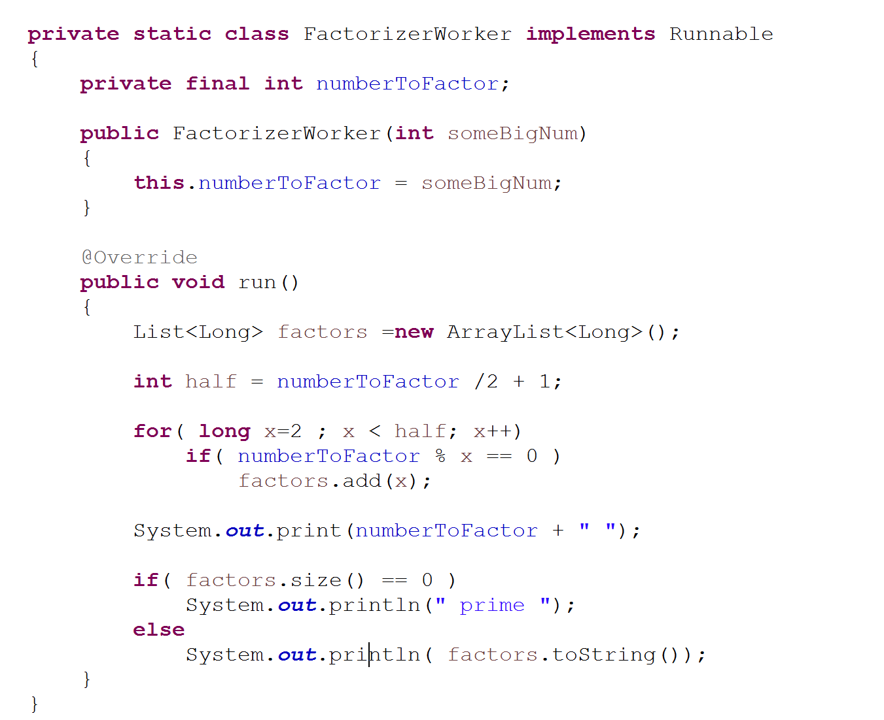
Consider a Worker class that finds factors
https://github.com/afodor/metagenomicsTools/blob/master/src/classExamples/ThreadExampleFactorizer.java

Slide 11
Implements Runnable
FactorizerWorker
numberToFactor

Slide 12
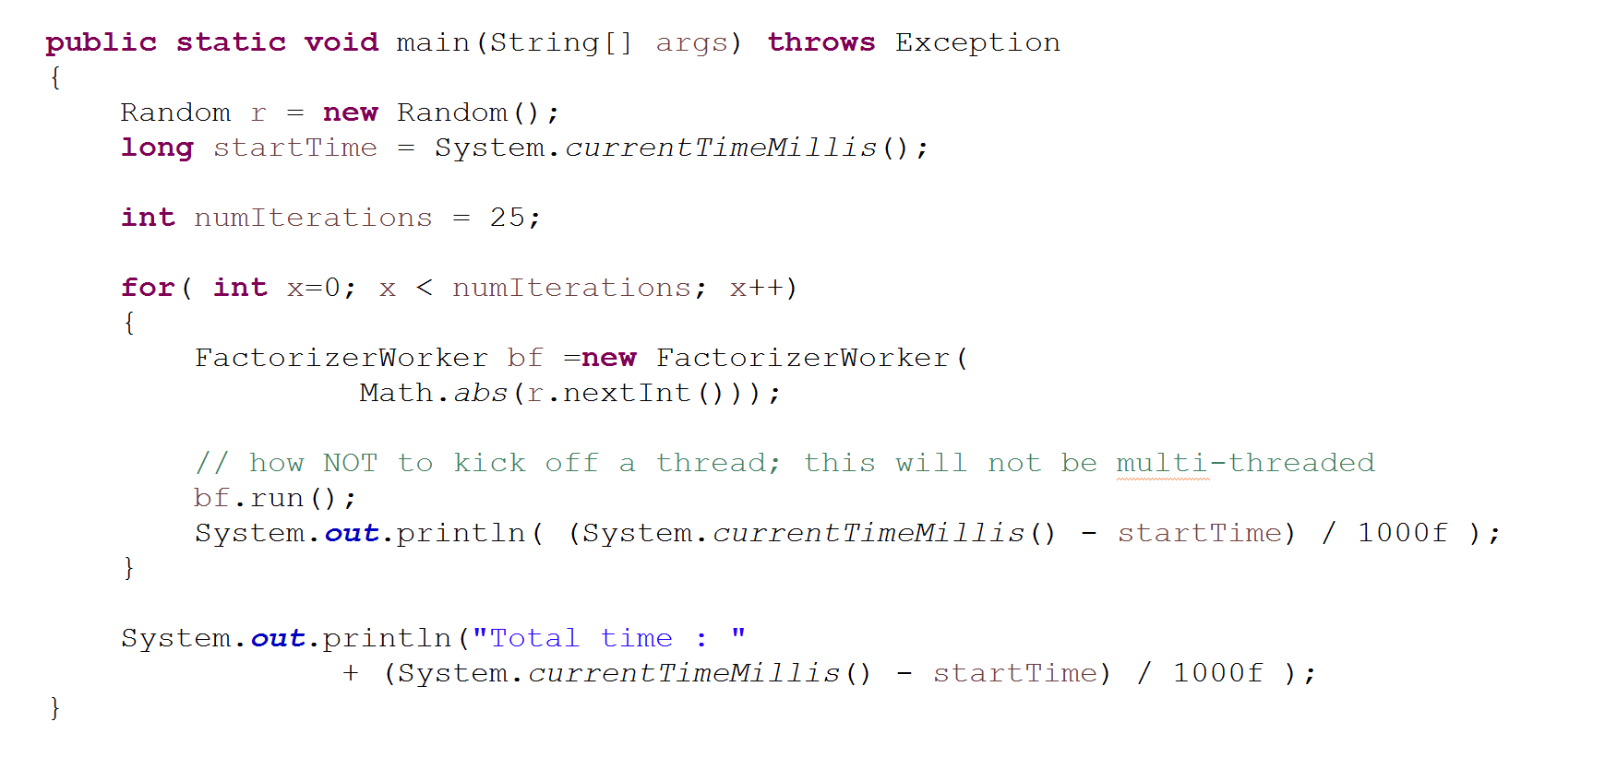
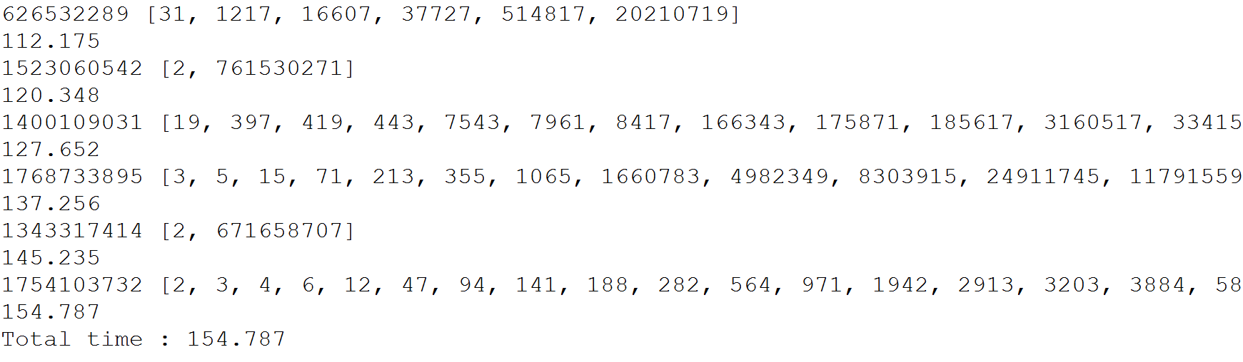
Code that runs one thread at a time
https://github.com/afodor/metagenomicsTools/blob/master/src/classExamples/ThreadExampleFactorizer.java

Slide 13
We can use the Semaphore class to make our code run in parallel
Implements Runnable
FactorizerWorker
numberToFactor
semaphore
Each Worker has their own number and a common ref to Semaphore
FactorizerWorker
FactorizerWorker
FactorizerWorker
numberToFactor
semaphore
numberToFactor
semaphore
numberToFactor
semaphore
A singleton Semiphore

Slide 14
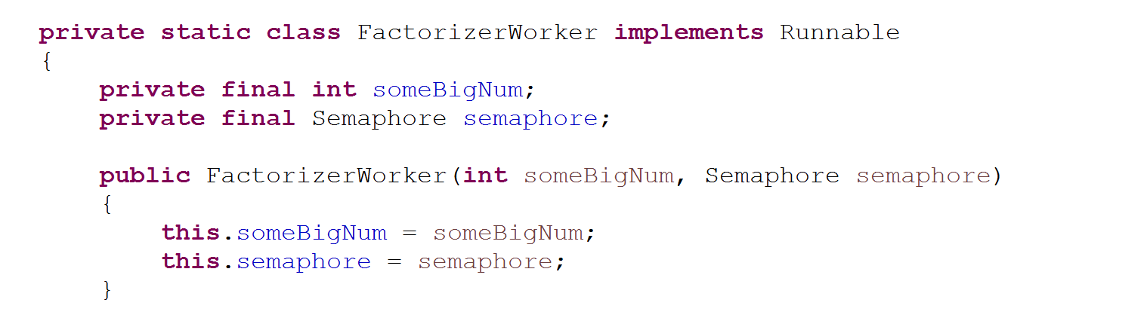
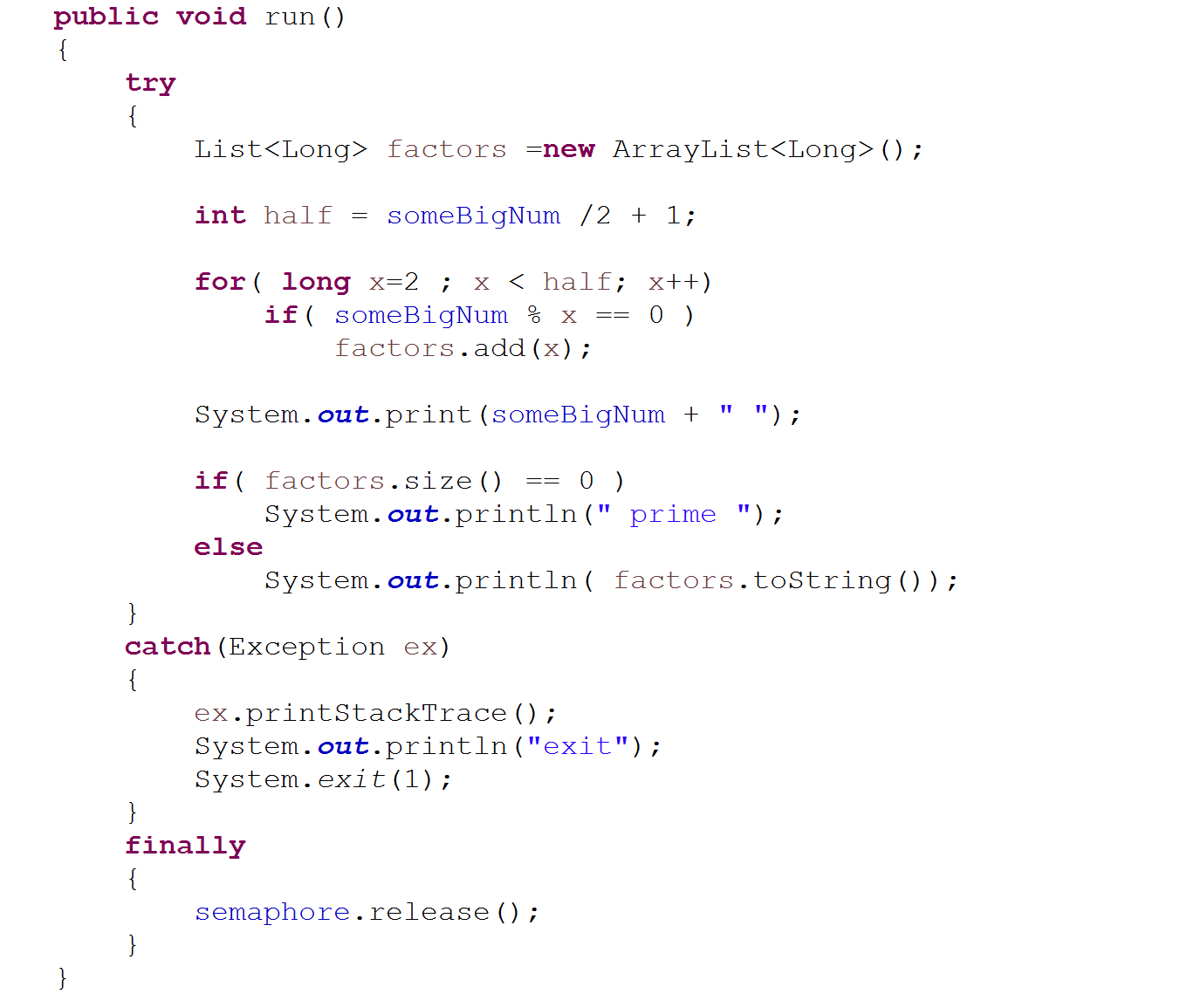
Immutable state of the Worker
constructor
Bring the entire VM (all threads)
down in case of error..
Always release the semaphore
https://github.com/afodor/metagenomicsTools/blob/master/src/classExamples/ThreadExampleFactorizerWithSemaphore.java

Slide 15
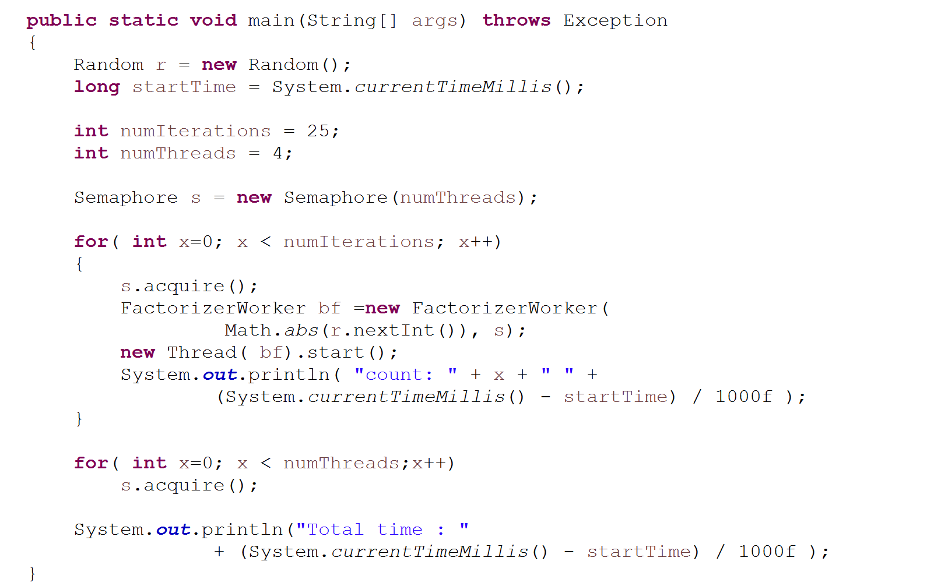
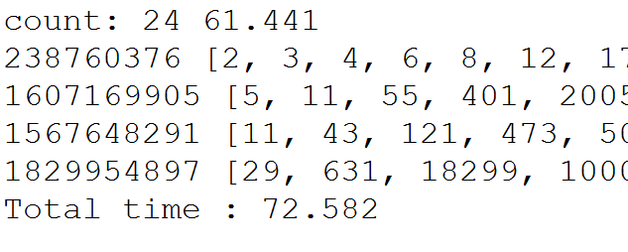
Our main method kicks off 4 threads (and waits for them to finish)
4 licenses
4 acquire a license
Acquire all the licenses
Definitely faster (but not 4 times faster!)
https://github.com/afodor/metagenomicsTools/blob/master/src/classExamples/ThreadExampleFactorizerWithSemaphore.java

Slide 16
Threads.
Factorizing in parallel.
Threading is difficult
Parsing fasta sequences in parallel
Threads in GUIs.
Javascript is single-threaded

Slide 17
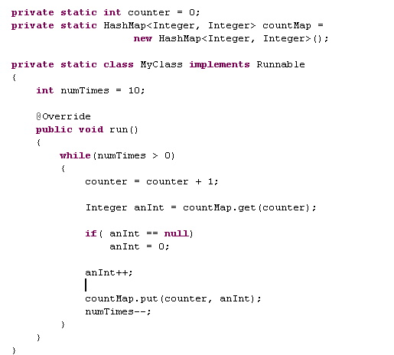
Multi-threading is tricky.
Let’s take an insanely broken example…
This is a map that is supposed to count the number of time an integer
is observed…
Counter shared among all
threads
HashMap shared
among all threads
Increment the shared counter
Have we seen this number
https://github.com/afodor/metagenomicsTools/blob/master/src/classExamples/ThreadExampleFactorizerWithSemaphore.java

Slide 18
Multi-threading is tricky.
Let’s take an insanely broken example…
This is thread safe (variable local to this thread)
Not thread safe
Not thread safe
Not thread safe
This is thread safe

Slide 19
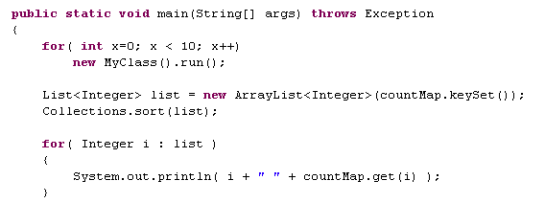

This runs the method 10 times in sequence.
No new thread is spawned
new MyClass()
Add 10 numbers to map
new MyClass()
Add 10 numbers to map
new MyClass()
Add 10 numbers to map
And all is well! We see each increment of counter one time

Slide 20
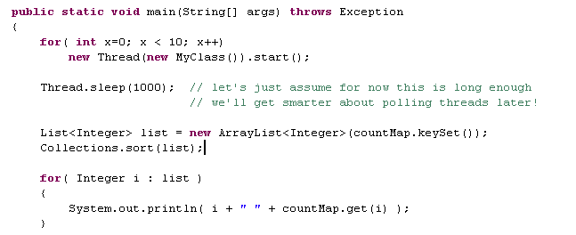

This runs the method 10 times in parallel.
New thread spawned!
The first 32 are skipped!
34 is skipped!
The integrity of the
HashMap is ruined!
(Two equal values in the
HashMap !)
Breaks in unpredictable ways

Slide 21
The threads all run at the same time
new MyClass()
Add 10 numbers to map
new MyClass()
Add 10 numbers to map
new MyClass()
Add 10 numbers to map
So, on occasion, the same number gets added as a key
to the hashmap ruining the integrity of the data structure.
We say HashMap is not a threadsafe data structure

Slide 22

Or, and this is the thing that kills you, it could run perfectly
(as it did the next time)
…

Slide 23

Or it could run closer to perfectly
Skipped 1
Skipped 5
HashMap integrity violation!

Slide 24
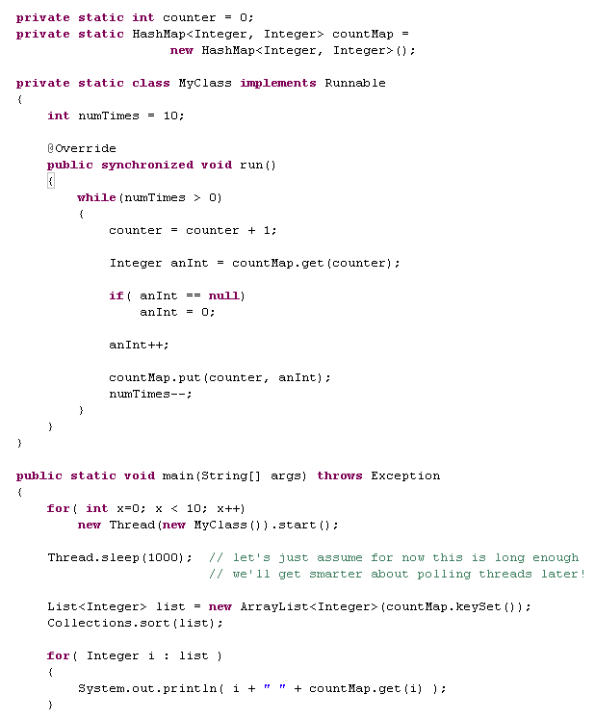

Java has a keyword “synchronized” which you might
think means “only one thread at a time”
Nope! Still broken.

Slide 25
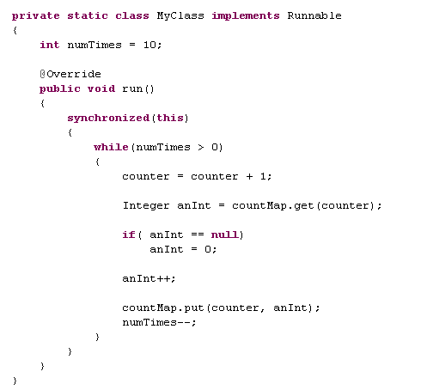
What went wrong?
synchronized means synchronized(this).
First you must obtain a lock on this object before the thread can proceed.
So the code on the previous slide is equivalent to…
Which you can see is no good.
We are instantiating multiple
instances of MyClass.
They are each locking on themselves!
So they can still run in parallel

Slide 26
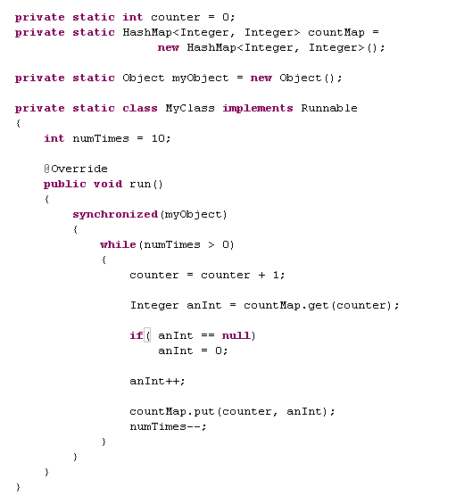
This is safe, but at the cost of only allowing one thread at a time!
May as well not use multi-threading!
All the instances of MyClass
share one “myObject”
Only one thread at a time!

Slide 27

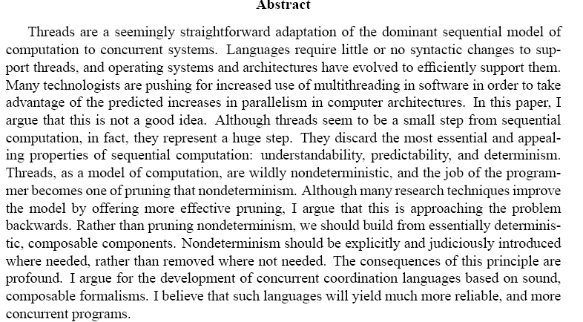
Threading is tough!
http://www.eecs.berkeley.edu/Pubs/TechRpts/2006/EECS-2006-1.pdf

Slide 28
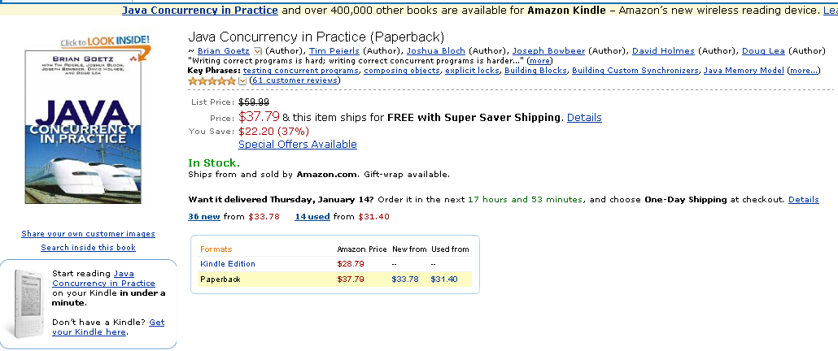
What are your options?
Don’t use threads. (But then no performance boost!)
or
(2) Favor immutable objects – they are inherently thread safe
(3) Minimize or eliminate information sharing between threads
If you are going to use threads a lot in Java, you need to read this book
very carefully:
We will be doing just that!

Slide 29
Threads.
Factorizing in parallel.
Threading is difficult
Parsing fasta sequences in parallel
Threads in GUIs.
Javascript is single-threaded

Slide 30
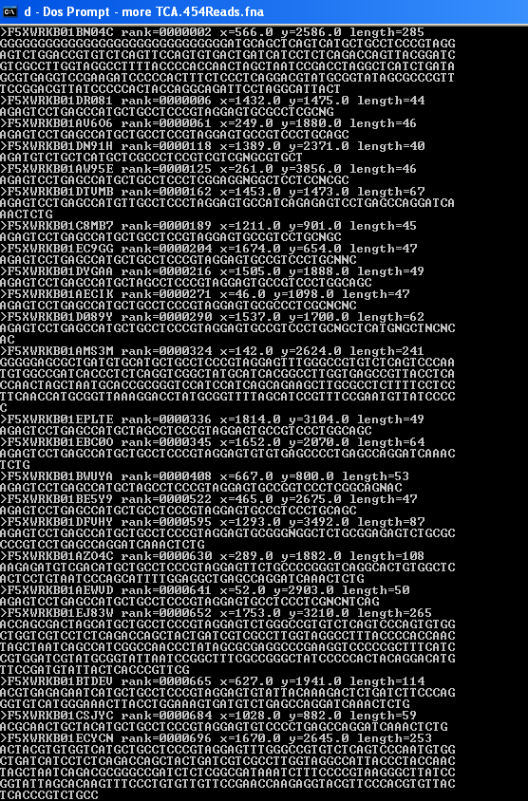
Let’s take an easy problem for our first multi-threading example
We have 445,426 sequences and we want to read them into memory
(filesize = 134 MB)

Slide 31
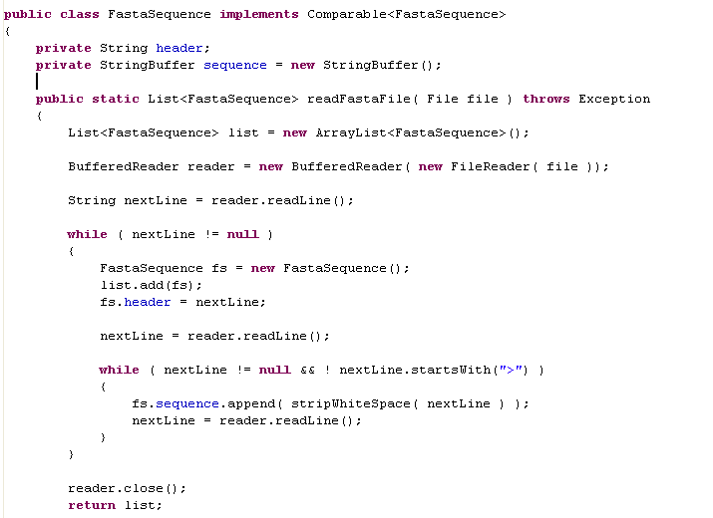
Not too hard to code up a single-core parser….
Takes about 6.5 seconds to parse 445,426 sequences

Slide 32
Can we do better on a multi-core machine?
Strategy: Instead of parsing a single sequence file, we will break up the
sequence file into multiple sequence files and have each thread
parse a sequence file in parallel.

Slide 33
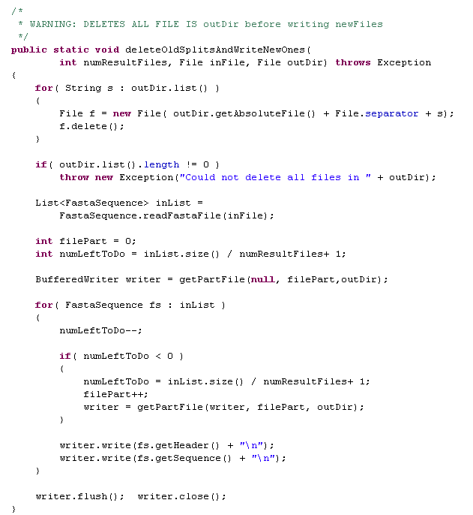
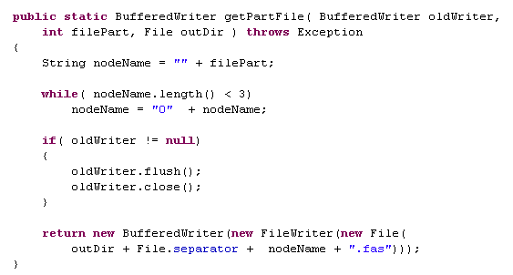
Here is the code to split up the file (keeping the sequences together)

Slide 34
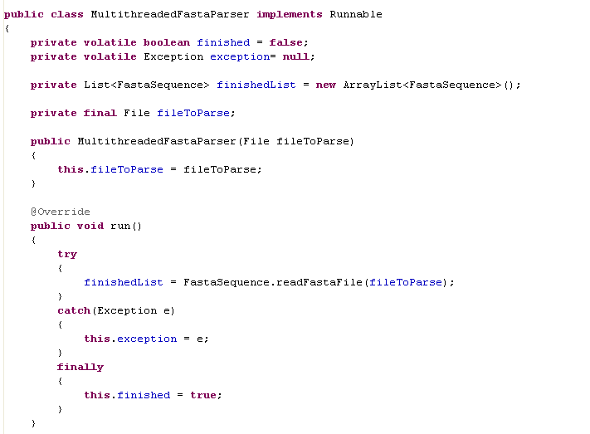
Not hard to make a runnable to parse the FastaFile
The volatile keyword is important. This ensures that when a new
value is written to those fields, all threads can see it.
Without the volatile keyword, this guarantee does not exist.

Slide 35
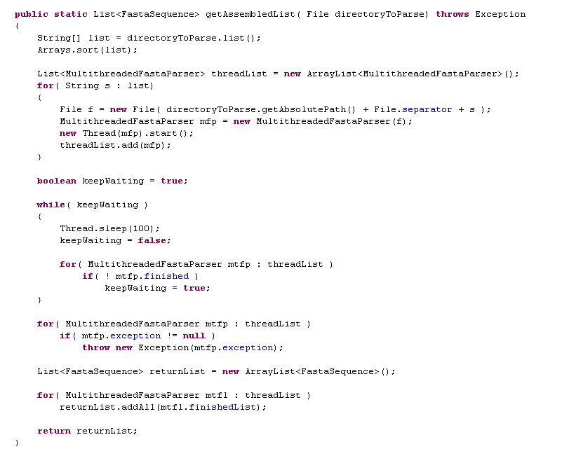
This kicks off the threads and gathers the results…

Slide 36
This kicks off the threads and gathers the results…
100 msec. Balance wasting CPU cycles vs.
unnecessarily sleeping when all threads
are done.
Wait until all threads
are done
(There are better ways to do this. We’ll
cover later in the semester)
If any of the threads fail,
everything fails
This is thread safe because we walk through one thread at a time

Slide 37
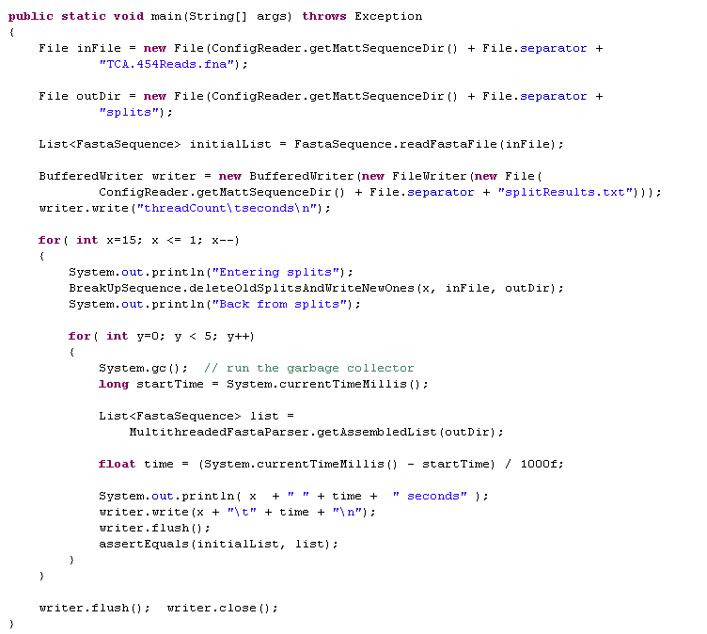
Let’s run some time trials…
Kick off between 1 and 15 threads
Run 5 time trials for each thread
One thread per file
in the split directory

Slide 38
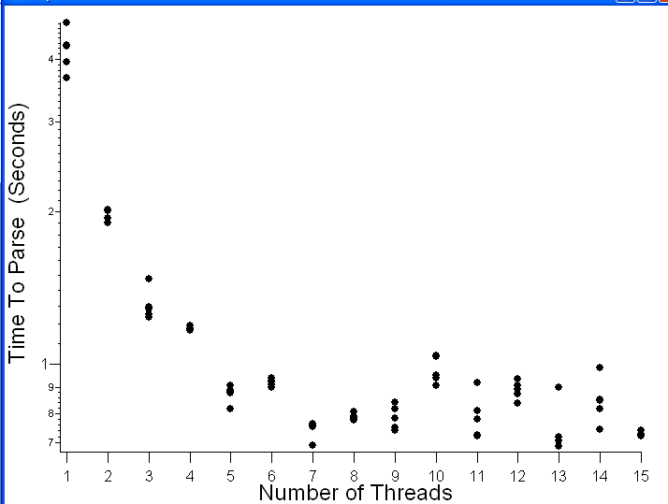
Results for an 8-core machine
Pretty dramatic speedup for not much programming effort.
Sweet spot seems to be 7 threads (run on an 8 core box…)
(around a 5.7X speedup with 7 threads….)

Slide 39
Some notes:
Parsing these sequences is embarrassingly parallel.
No synchronization between threads is needed.
(Which makes it an easy first problem)

Slide 40
Either master threads (as we will start to do later) or
as much as possible avoid them!

Slide 41
Threads.
Factorizing in parallel.
Threading is difficult
Parsing fasta sequences in parallel
Threads in GUIs.
Javascript is single-threaded

Slide 42
A place you can’t really avoid threads is GUIs
There is an “AWT” thread that is the thread that calls
the ActionListeners (and other Listeners).
It’s also responsible for updating the GUI…
If that thread hangs, the GUI freezes up…

Slide 43
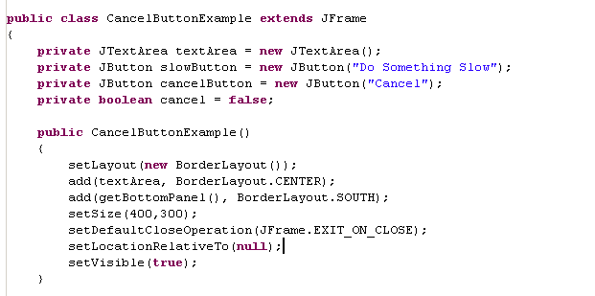
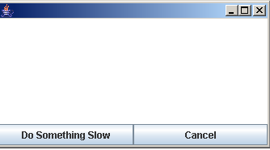
Cancel buttons require understanding thread.
Let’s build an app with a Cancel button
Our usual collection of
instance variables
Monitor if the cancel button is pressed
(actually should be volatile !)
textArea goes center
Our bottom Panel
holds the buttons

Slide 44
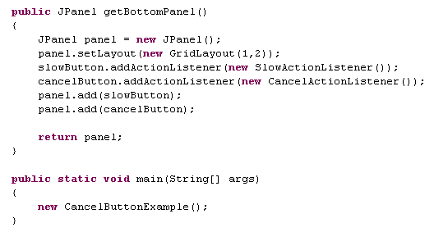
Our bottom panel provider…

Slide 45
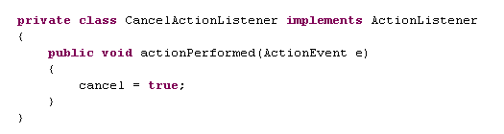
The listeners are clearly where the action is.
The CancelListener is the easy one…

Slide 46
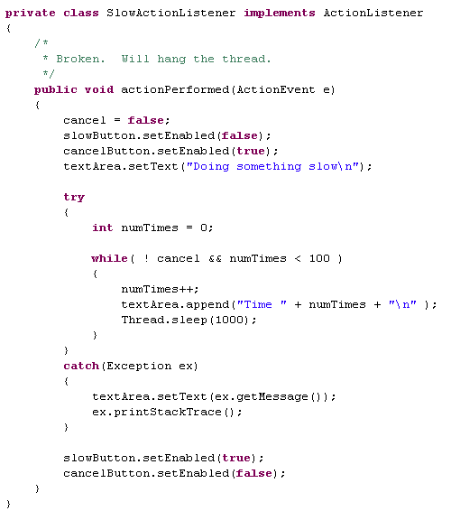
Here’s how NOT to do the SlowActionListener
The “AWT” thread blocks.
The application appears dead.

Slide 47
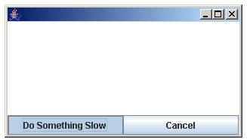
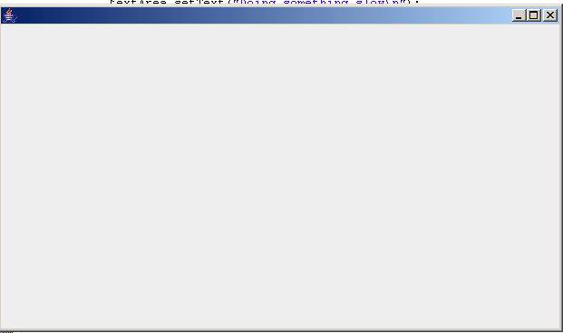
A “blocked” AWT thread means…
The “Do something slow” button doesn’t pop back up.
The text area doesn’t update
If the user switches away and switches back, the application
doesn’t redraw….
The user can’t cancel

Slide 48
The code we just saw….
AWT Thread
ActionListener()
Start the slow thing
AWT thread is blocked
Application appears dead
The slow stuff needs instead to happen on a different thread
AWT Thread
spawn
SlowActionRunnable
ActionListener()
This thread is
not blocked..
Does the slow thing

Slide 49
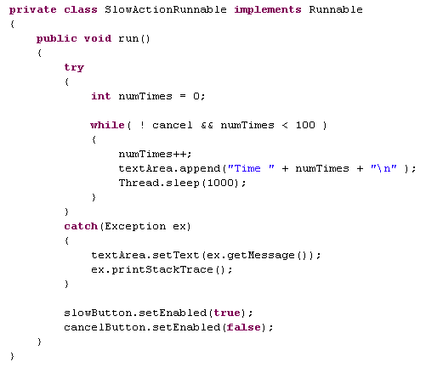
We make a Runnable that will be the newly spawned thread…
src.threads.CancelButtonExample

Slide 50
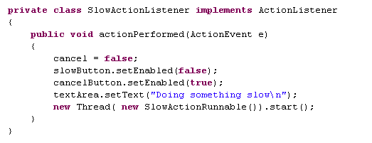
The slow stuff needs to happen on a different thread
AWT Thread
spawn
SlowActionRunnable
ActionListener()
This thread is
not blocked..
Does the slow thing
This is all fast
This is still slow, but is in its own thread.
So actionPerformed returns quickly
and SlowActionRunnable() runs in
a background thread…

Slide 51
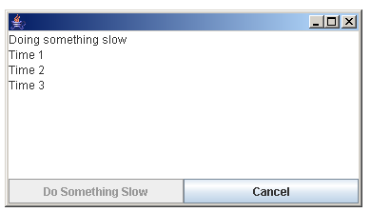
We now have a responsive interface and a working cancel button

Slide 52
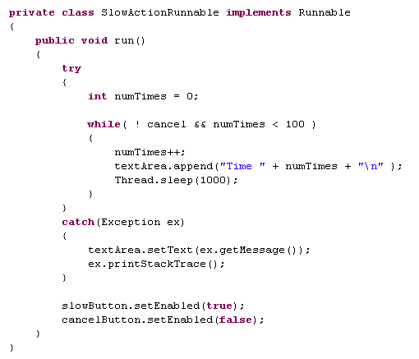
We are almost there. Our last remaining issues is that most
Swing methods are not thread-safe. That is, they should
only be called from the AWT thread.
We are making a number of calls to Swing methods from the non-AWT thread

Slide 53
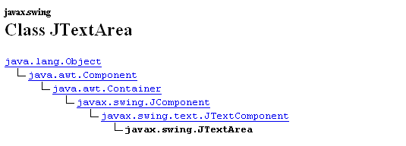
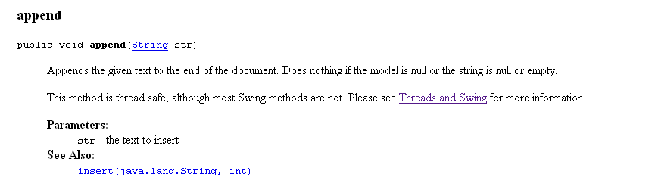
It turns out that sometimes this is ok….
We look in the JavaDocs….
so append (and it turns out setText()) can be called from any thread..

Slide 54
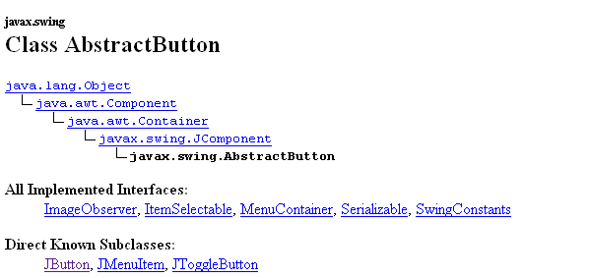
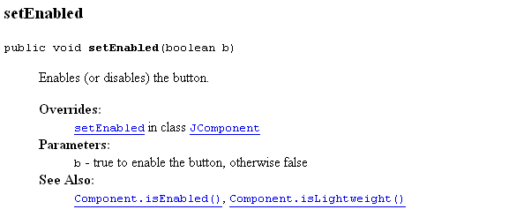
But setEnabled() is not marked as thread safe….

Slide 55
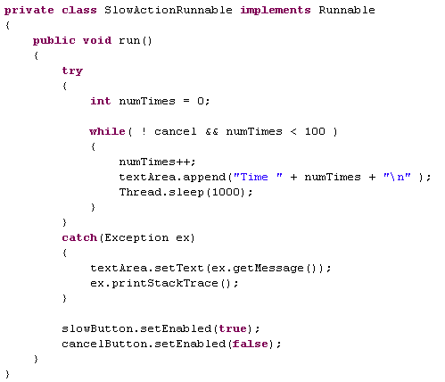
So if the AWT thread is doing something to the buttons when
these methods are called, the results are undefined
We need to place these lines of code on the AWT thread..

Slide 56
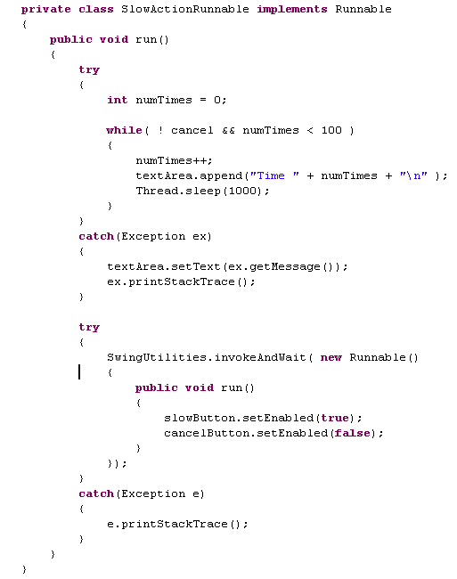
Place on AWT thread and block
the current thread until the
runnable has been executed

Slide 57
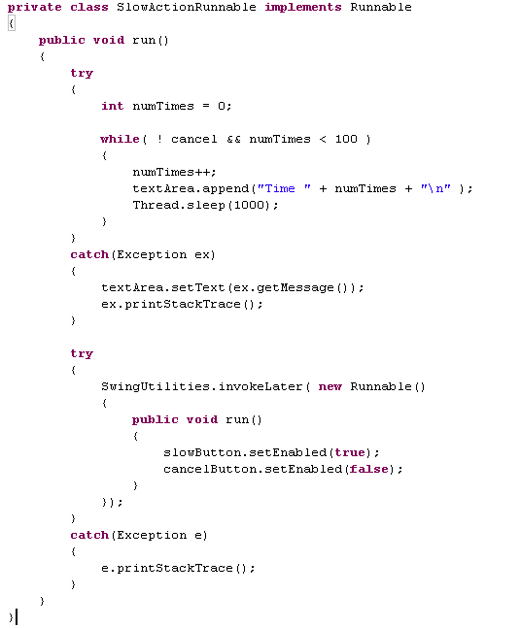
Place on AWT thread and this thread
Doesn’t block (e.g. invokeLater() )
returns immediately
Because we are at the end of the thread it doesn’t matter if we use
invokeLater or invokeAndWait

Slide 58
The slow stuff need to happen on a different thread
AWT Thread
spawn
SlowActionRunnable
ActionListener()
This thread is
not blocked..
Does the slow thing.
When finished
Send a Runnable
update GUI
You will see many applets and Java applications that block
when they are performing tasks…
This kind of multi-threading isn’t too bad, because you
are sending pretty simple messages to the GUIs…

Slide 59
Threads.
Factorizing in parallel.
Threading is difficult
Parsing fasta sequences in parallel
Threads in GUIs.
Javascript is single-threaded

Slide 60
We just saw that Java invokes your ActionListener’s on the AWT thread.
If you want to do something that might be slow, it is up to you to do your work on another thread
or the program will appear dead…
AWT Thread
ActionListener()
Start the slow thing
AWT thread is blocked
Application appears dead
The slow stuff needs instead to happen on a different thread
AWT Thread
spawn
SlowActionRunnable
ActionListener()
This thread is
not blocked..
Does the slow thing

Slide 61
Javascript by contrast is single threaded.
Everything else the brower does (rendering, managing requests from the server, etc.) is multi-threaded.
But our code is expressed as call-back functions and happens in a single thread.
In Javascript, you can’t spawn another thread.
But you could send a message to the server and tell javascript to call your function when the server is done
Javascript thread
Server
Ask server to do
Something slow.
Define a callback function()
javascript does a bunch of other things
Does the slow thing
Callback function() gets called when
the server is done
javascript does a bunch of other things

Slide 62
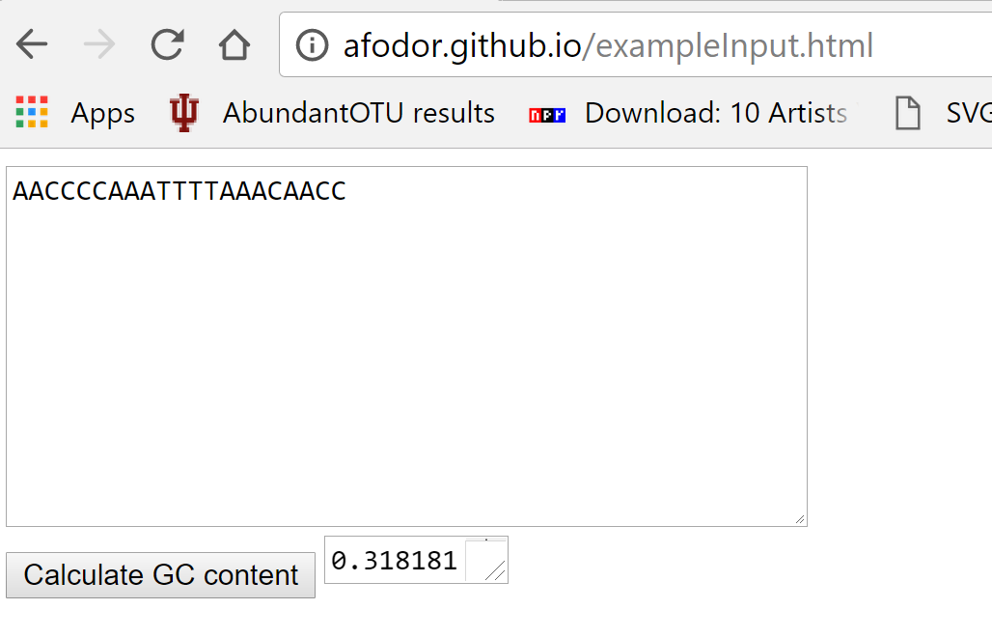
It is very easy to make simple web calculators/web apps in javascript
http://afodor.github.io/exampleInput.html

Slide 63


The callback method attached to the button is similar to a Java action listener
https://github.com/afodor/afodor.github.io/blob/master/exampleInput.html

Slide 64
Callbacks into the javascript thread work very similarly to callbacks to the AWT thread in Java
Javascript thread
User
Clicks on button
javascript does a bunch of things
Callback function() gets called when
javascript gets around to it
javascript does a bunch of other things
If you do something slow on the javascript thread you will crash the browser.
(Which is an unfriendly thing to your user)

Slide 65
This is a weird declaration if you are used to Java.
This makes a function called setAnswer()
but that function is not bound to any class.
Instead functions themselves are objects
In javascript there are only objects, not classes.
You can copy an object, but javascript is weakly typed so a class can’t really have any meaning..

Slide 66
If we have time at the end of the semester, we’ll return to javascript…

