Slide 1
Lab 2:
As before, send code or links to access your repository to afodor@uncc.edu
Your code and/or links are due on ( 9/18)
(2 week lab)
If you finish early, you can spend some time thinking about what you want to do
for your independent project.
Lecture on Friday 9/6 will be on Zoom. (zoom link will be sent by e-mail)
Don’t use ChatGPT for the lab
(but extra credit at the end asks you to compare your answer to ChatGPT)

Slide 2
This week, we are going to make a quiz to drill amino acids
The quiz works like this:
-It is 30 seconds long.
-The quiz ends after 30 seconds or when there is a single incorrect answer.
-The program displays the full name of an amino acid (like “alanine” )
and asks the user to type in the one character code (like a)
-The quiz ignores case in the answer.
-The program displays the amino acids in random order, can repeat amino
acids and can show more than 20 if the user gets that many correct.
-The total score is the number of correct answers…
Notes:
You can input a string from the use by using code like:
String aString = System.console().readLine().toUpperCase();
You can get the first character by using code like:
String aChar = "" + aString.charAt(0);
However, the readline() only works when Java is run from the command line
(not Eclipse).
You can edit in Eclipse but use the command line to run the program…

Slide 3
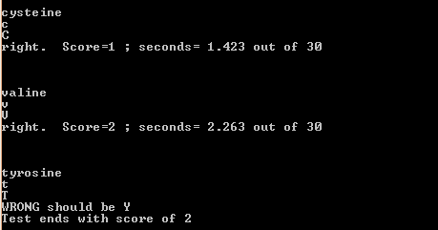
Sample output… (you don’t have to match the output exactly, but the overall information should be the same in your program)
(We can have an informal contest to see who can get the most answers right in 30 seconds).
(Since we haven’t done threading yet, you can check the time after each user input to see
If 30 seconds are up; when we get to multi-threading we will learn how to set a
Background clock that will stop when time is up)

Slide 4
Useful arrays to copy and paste:
public static String[] SHORT_NAMES =
{ "A","R", "N", "D", "C", "Q", "E",
"G", "H", "I", "L", "K", "M", "F",
"P", "S", "T", "W", "Y", "V" };
public static String[] FULL_NAMES =
{
"alanine","arginine", "asparagine",
"aspartic acid", "cysteine",
"glutamine", "glutamic acid",
"glycine" ,"histidine","isoleucine",
"leucine", "lysine", "methionine",
"phenylalanine", "proline",
"serine","threonine","tryptophan",
"tyrosine", "valine"};

Slide 5
Improvements/modifications (for extra credit)
Make the # of seconds a parameter that can be passed in on the command line.
Alternatively, allow an option that will ask a certain number of questions before terminating.
Or allow the user to quit by typing “quit”.
Have the program not terminate on wrong answers but give a report at the end
summarizing which amino acids were gotten right and wrong how many times.
When I used ChatGPT, it got partway there but didn’t perfectly meet the specifications.
Compare your solution to a ChatGPT solution. What data structures did ChatGPT use
to solve the problem? Does its code meet all the requirements of the specifications?

