Slide 1
Last time:
mean and variance of an empirical distribution
Initial commands in R
Everything in R is a vector ;
elements of a vector all share a common data type

Slide 2
Reading for the next week:
Vassar stats book: Chapter 5 – Chapter 6
(basic concepts of probability through binomial distribution)
(or equivalent in your favorite canonical stats book)
Art of R programming:
Chapter 2 ( Vectors), Chapter 4 (Lists)
(or equivalent chapters here: http://heather.cs.ucdavis.edu/~matloff/132/NSPpart.pdf)

Slide 3
Lists in R
R is not a high-performance language
The Uniform distribution
Mean and SD on discrete theoretical distributions
The law of large numbers

Slide 4
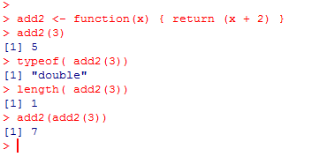
We can make our own functions in R…
Here we return a vector of type double and length 1

Slide 5
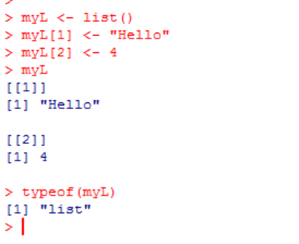
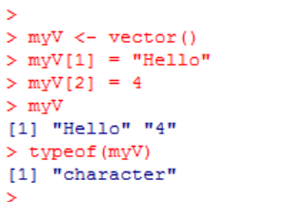
Lists are alternative to vectors that hold multiple datatypes;
A list is a vector of vectors
[1]
[2]
vector
“Hello”
4
list
vector
vector
Since all the types must be the same,
the vector is a character vector
(casting “4” to character)
“Hello”
character
4
double
The list can tolerate different data types

Slide 6
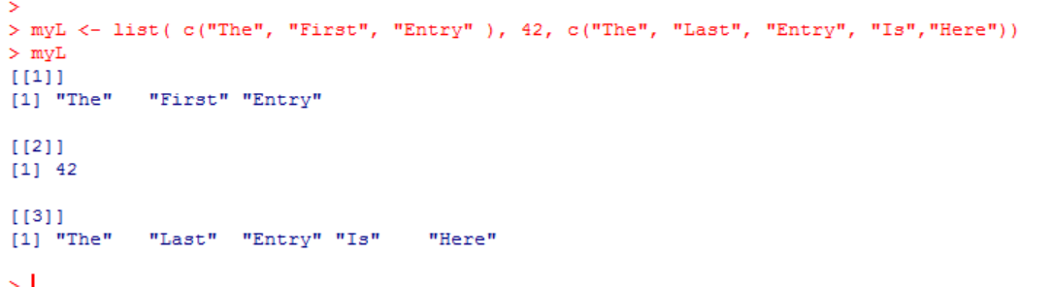
Lists can be arbitrarily complex…
list
vector
vector
vector
“The”
“first” “entry”
42
“The”
“last” “entry”
“Is”
“Here”

Slide 7
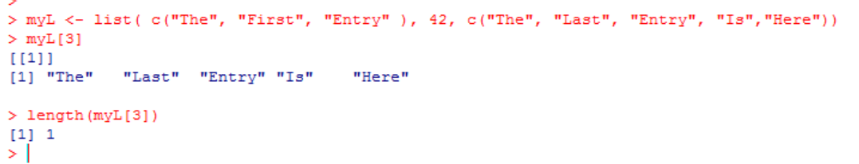

The [] operator on lists returns a slice of a list (a sub-list of the indices)
myL[3]
Returns a new
list with this vector
(so length ==1)
list
vector
vector
vector
“The”
“first” “entry”
42
“The”
“last” “entry”
“Is”
“Here”

Slide 8
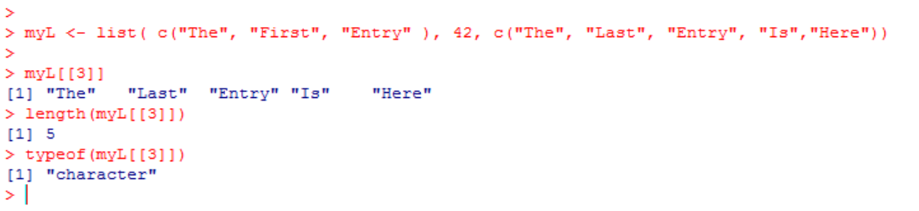
The [[]] operator, by contrast, returns the vector that is in the list!
list
vector
vector
vector
“The”
“first” “entry”
42
“The”
“last” “entry”
“Is”
“Here”
myL[[3]] returns the vector in the third element of the list

Slide 9
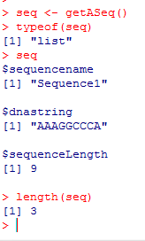
We can use lists to simulate c’s structs or Java’s objects…
Here we have a function that returns a List describing a DNA sequence
getASeq <- function()
{
aSeq <- list()
aSeq$sequencename <- "Sequence1";
aSeq$dnastring <- "AAAGGCCCA";
aSeq$sequenceLength <- nchar(aSeq$dnastring)
return (aSeq)
}
seq is a list with 3 elements:
1: sequenceName (== “Sequence1”)
2: dnastring (== “AAAGGCCCA”)
3: sequenceLength (== 9)
This is pretty different from data structures in Java and will take some getting used to!

Slide 10
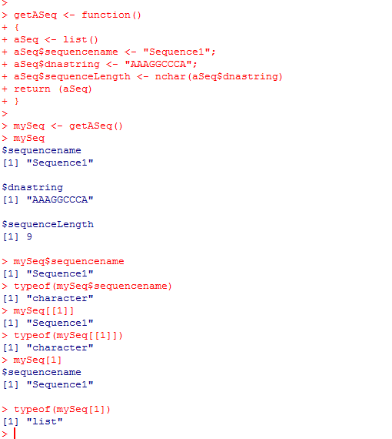
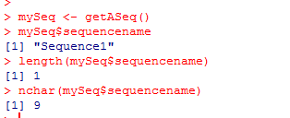
The elements in a list can be referred to either by their name or by their [[]] index
Element 1 in our list – a character vector of length 1
[1]
mySeq
list
sequenceName
dnaString
sequenceLength

Slide 11
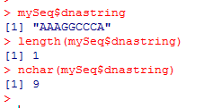
The elements in a list can be referred to either by their name or by their [[]] index
Element 2 in our list – a character vector of length 1
[1]
mySeq
list
sequenceName
dnaString
sequenceLength

Slide 12
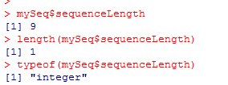
The elements in a list can be referred to either by their name or by their [[]] index
Element 3 in our list – a integer vector of length 1
[1]
mySeq
list
sequenceName
dnaString
sequenceLength

Slide 13
The elements in a list can be referred to either by their name or by their [[]] index
[1]
mySeq
list
sequenceName
dnaString
sequenceLength
This is equivalent to mySeq$sequencename
[[]] and [] are very different operators!

Slide 14
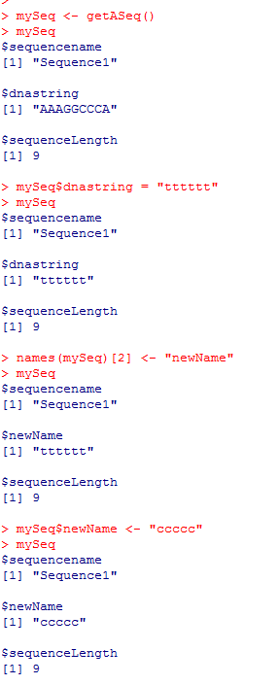
We can read and write the names associated with our list dynamically…
getASeq <- function()
{
aSeq <- list()
aSeq$sequencename <- "Sequence1";
aSeq$dnastring <- "AAAGGCCCA";
aSeq$sequenceLength <- nchar(aSeq$dnastring)
return (aSeq)
}
Give this 2nd element of this list a new name
[1]
mySeq
list
sequenceName
dnaString
sequenceLength

Slide 15
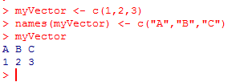
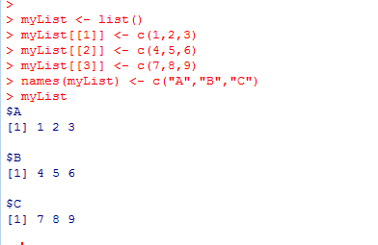
Name tricks work for vectors as well ….
(which makes sense because a List is just a vector of vectors !)
(note the [[ ]] operator )

Slide 16
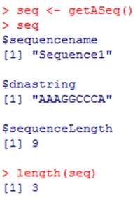
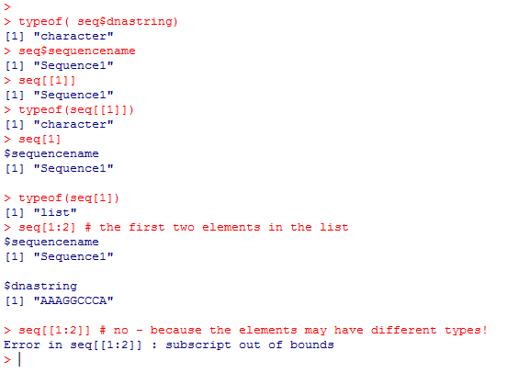
Beware the [] vs. [[]] differences !!!
getASeq <- function()
{
aSeq <- list()
aSeq$sequencename <- "Sequence1";
aSeq$dnastring <- "AAAGGCCCA";
aSeq$sequenceLength <- nchar(aSeq$dnastring)
return (aSeq)
}
Return as type “character”
Return as type “character”
Return as a sub list of type “list”
The [] operator returns a sub-list
The [[]] operator returns
the requested item cast to type

Slide 17
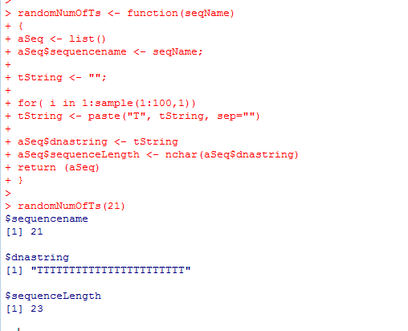
Here is a very inefficient function that returns a sequence with a number of T’s between 1 and 100
randomNumOfTs <- function(seqName)
{
  aSeq <- list()
  aSeq$sequencename <- seqName;
  tString <- "";
  for( i in 1:sample(1:100,1))
  tString <- paste("T", tString, sep="")
  aSeq$dnastring <- tString
  aSeq$sequenceLength <- nchar(aSeq$dnastring)
  return (aSeq)
}

Slide 18
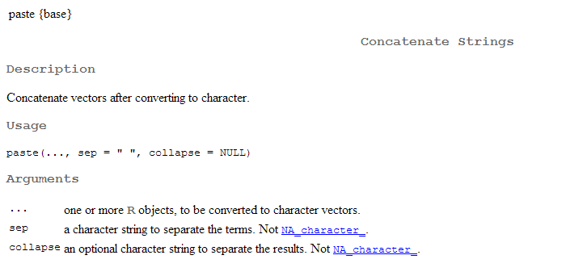
?paste

Slide 19
Here we can get a collection of sequences of random length
getRandomCollection <- function(numToGet)
{
returnList <- list();
if(numToGet >= 1 )
{
for( i in 1:numToGet)
{
returnList[[i]] <- randomNumOfTs( paste("Seq", i,sep=""));
}
}
return (returnList);
}
Access each element in the underlying list..
R requires the [[]] operator to assign
[1]
[2]
[3]
[numToGet]
list
list
list
list
…….
list
sequenceName
dnaString
sequenceLength
sequenceName
dnaString
sequenceLength
sequenceName
dnaString
sequenceLength
sequenceName
dnaString
sequenceLength
(a rough equivalent to List<DnaSequence> in a language like Java…)

Slide 20
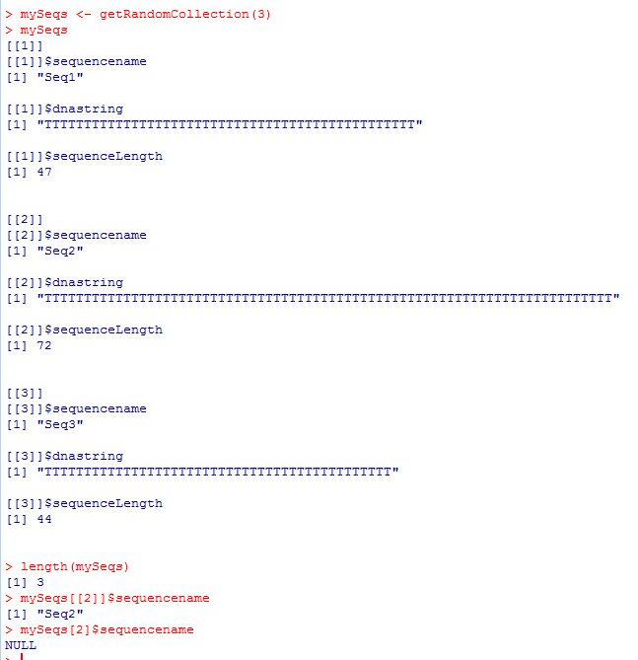
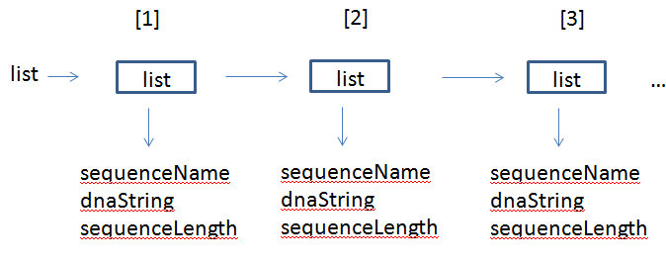
Using the [[]] operator gets the list our function put in
Using the [] operator gets a new list containing the list we put in
(that new list does not have a type $sequenceName at the top level )

Slide 21

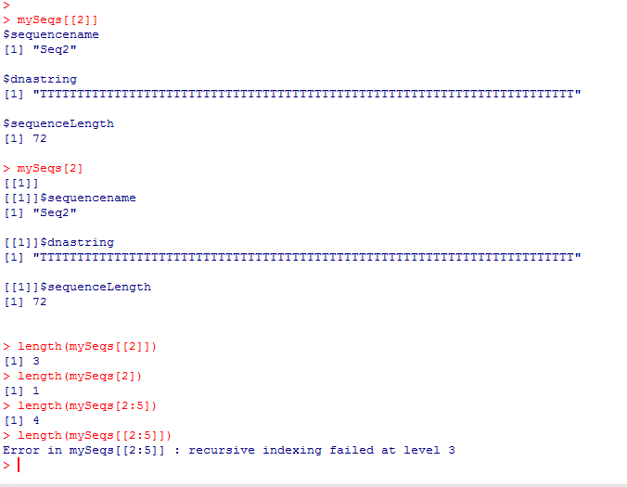
Again: [] vs. [[]] is confusing….
The list we put in (length=3)
A new list containing the list we put in (length=1)
The list we put in (length=3)
A list containing the list we put in (length=1)
Ok. A new list containing sequences 2-5
R can’t interpret this
A not helpful error message!

Slide 22
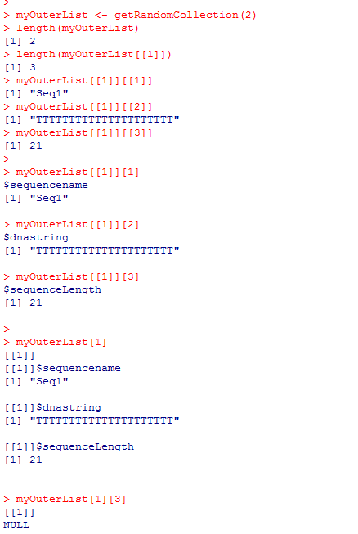
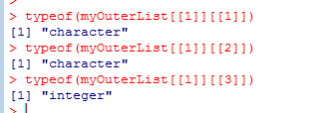
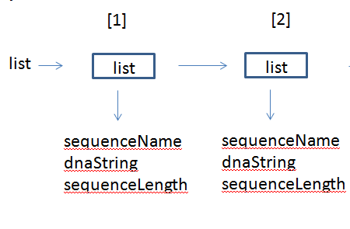
Again: [] vs. [[]] is confusing….
Our two sequence “objects”
The first sequence
The three elements of the first sequence as vectors…

Slide 23
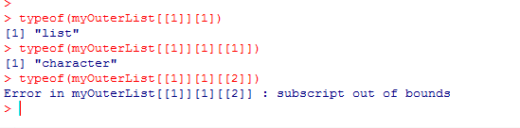
The three elements of the first sequence as lists
each containing a single vector

Slide 24
The first sequence as a new list of length 1
containing the original list that has the three vectors!

Slide 25
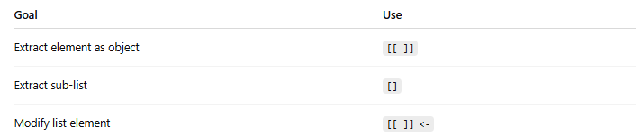
Conclusion: You can fight you way through this,
but you may wish to avoid complex data structures in R
In general:

Slide 26
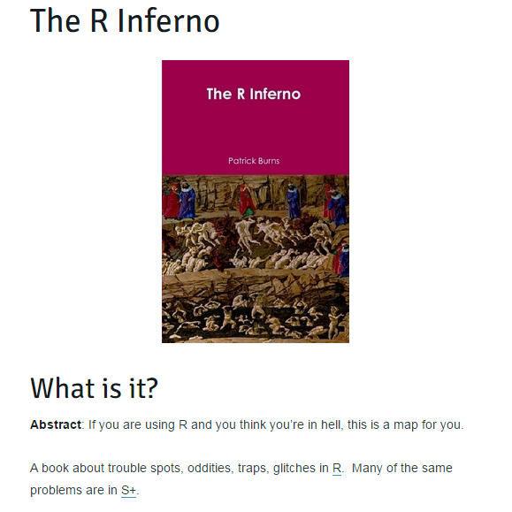
These examples do not reflect good design decisions in R!
http://www.burns-stat.com/documents/books/the-r-inferno/
(we won’t be covering this book this semester, but it is certainly worth a look…)

Slide 27
Lists in R
R is not a high-performance language
Theoretical distributions
The Uniform distribution
Mean and SD on discrete theoretical distributions
The law of large numbers

Slide 28
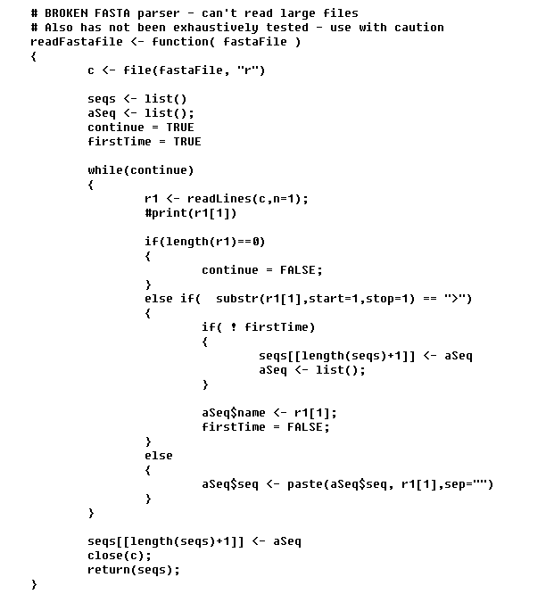
A (slow) Fasta parser…
Open up an input stream for reading
Read one line
Read the first character
Add our new sequence
to the end of the list
Append each line of the sequence
Any ideas why this would be unusably slow?

Slide 29
By default, every R function makes a copy of the input data structures.
This line:
seqs[[length(seqs)+1]] <- aSeq
makes a copy of the entire list and then adds one to the end…
Equivalent to Java’s “CopyOnWriteArrayList”
You can try and work around this, pre-allocate the list, etc, etc.
But a better solution is to write the parser is some other language and
import into R as a native method…

Slide 30
Lists in R
R is not a high-performance language
Theoretical distributions
The Uniform distribution
Mean and SD on discrete theoretical distributions
The law of large numbers

Slide 31
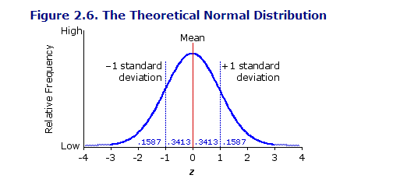
A theoretical distribution is a mathematical description of what we expect to see in
a series of observations…
The most famous distribution is the normal distribution;
Likely familiar from your previous stats. Class
We will get there soon…
http://vassarstats.net/textbook/

Slide 32
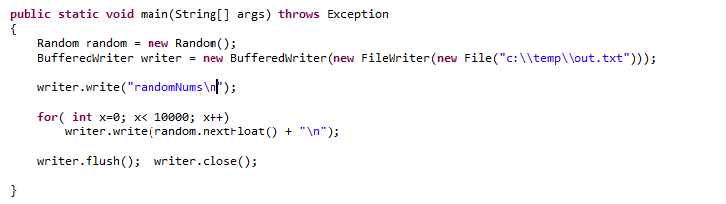
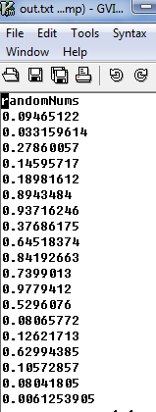
But we will start with the Uniform distribution.
The Uniform distribution is what is sampled when you call on Java’s Random number generator
When we call random.nextFloat() we are sampling the Uniform distribution from an interval of 0 and 1

Slide 33
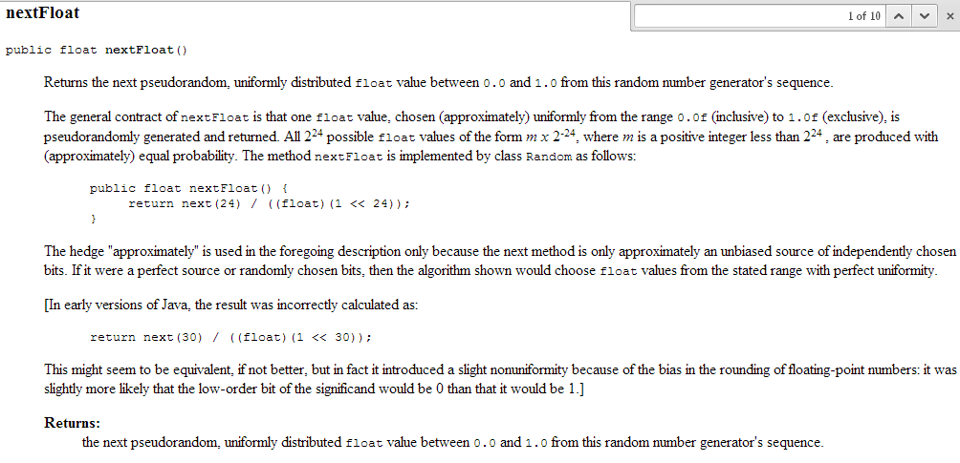
When we call random.nextFloat() we are sampling the Uniform distribution from an interval of 0 and 1

Slide 34
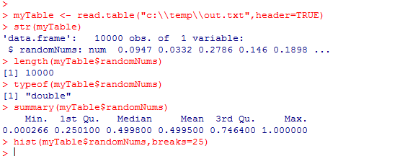
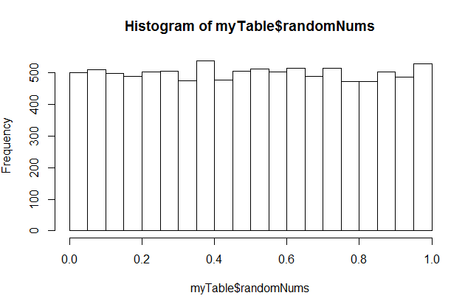
We can use R to investigate the results of calling nextFloat()
myTable – reads our file and returns
a DataFrame.
A DataFrame in R is a set of vectors
(like a spreadsheet).
In this case, we only have one vector
of type double.
str() asks R for the structure of an Object
The uniform distribution means that any value between
0 and 1 is equally likely

Slide 35
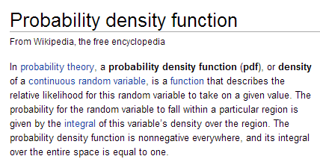
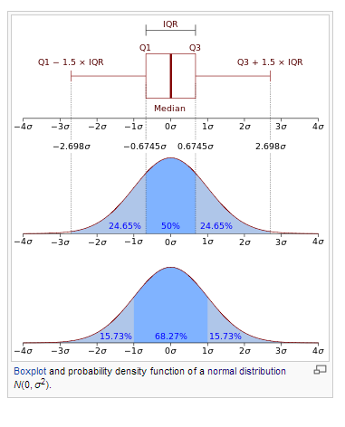
We can define a probability density function (pdf) for the uniform distribution.
Chapter 3 of “Doing Bayesian analysis” by Kruschke has a nice description of pdf’s
A PDF is a “sponge” with an area set to 1;
The shape of the the “sponge” tells you
the probability of seeing different values

Slide 36
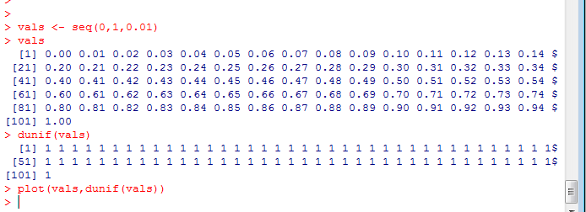
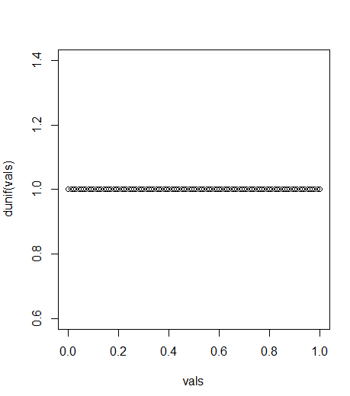
The Uniform distribution has a very boring probability density function..
Again, we sample uniformly between 0 and 1

Slide 37
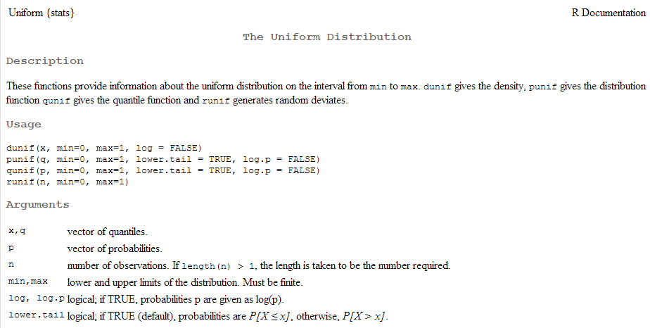
Here we made use of dunif(…)
Given a vector x, return the probability density of that vector from the Uniform distribution.
(dunif is vector in/vector out)

Slide 38
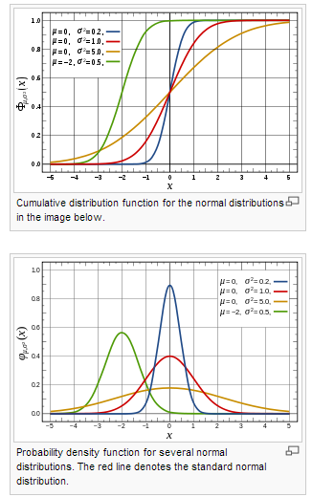
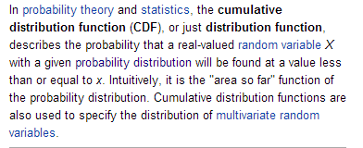
We can also define a cumulative distribution function.
http://en.wikipedia.org/wiki/Cumulative_distribution_function

Slide 39
This is given by punif..

Slide 40
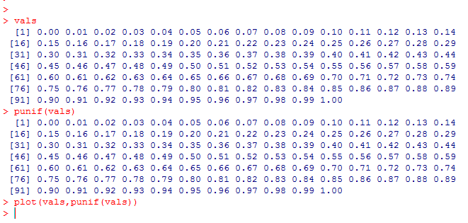
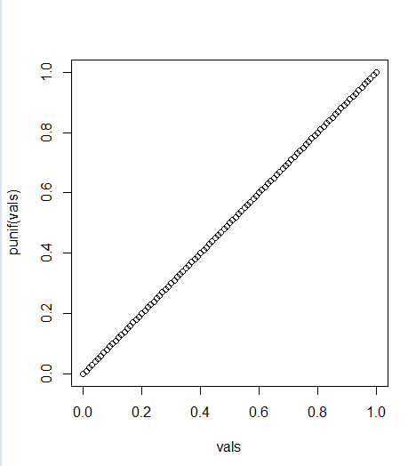
punif gives the cumulative uniform distribution
20% of the time, I expect to see 0.2 or less
50% of the time, I expect to see 0.5 or less.
70% of the time, I expect to see 0.7 or less..

Slide 41
Finally, we don’t need to go to Java to sample the Uniform distribution
hist(runif(10000),breaks=20)

Slide 42
Here are 100,00 dice rolls (using a dice with an infinite number of sides between 1 and 6!)

Slide 43
The “d” and “r” prefixes will be used for all the distributions we will study this semester!
So we will see dbinom, dnorm, dchisq, etc. etc.
and rbinom, rnorm, rchisq, etc. etc.

Slide 44
If we want discrete dice rolls, we can use sample
hist( sample( 1:6,100000,replace=TRUE))

Slide 45
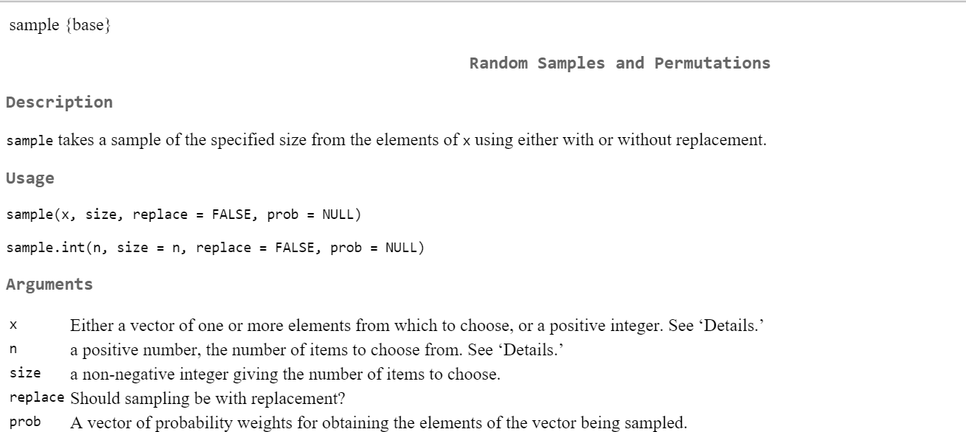

Slide 46
Uniform distributions are pretty boring but…
A statistical test repeated many times in cases in which null
hypotheses are always true will yield a uniform distribution
of p-values between 0 and 1.
UNLESS the assumptions of the test are not valid.
This will make more sense as the semester progresses!

Slide 47
So what does this have to do with bioinformatics.
Consider a microarray with 25,000 genes
(or an rna-seq experiment with 25,000 genes).
Let’s say you are comparing cancer cells to non-cancer cells
(with n=3 in each condition).
This is like performing 25,000 experiments at once.
For each gene, we form a null hypothesis of no change.
If we know there really is no change (for example, the same DNA
is applied to all of the microarrays), then all of these null
hypotheses are true. If we apply a statistical test (say the t-test)
25,000 times the resulting distribution should be uniform…

Slide 48
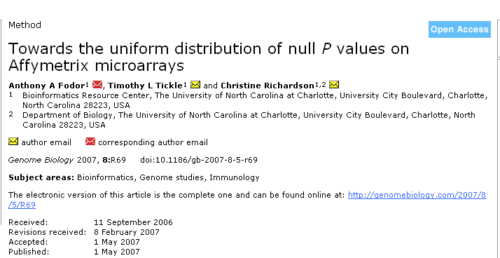
This is one of the papers that came out of an independent
Project from the first time I taught this course (Tim Tickle was
one of 4 students)

Slide 49
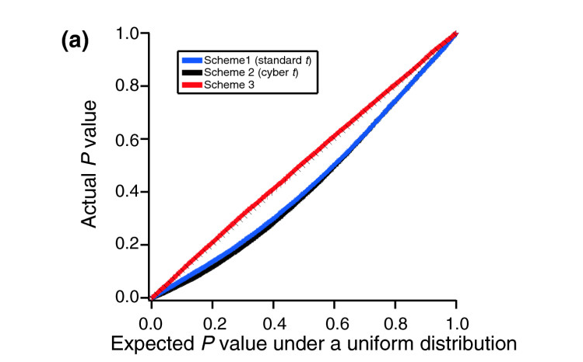
here is the same graph of actual vs. expected p-values
This is a way of measuring how good the assumptions of
our statistical tests are in case where we know there should be
no differences between samples..

Slide 50
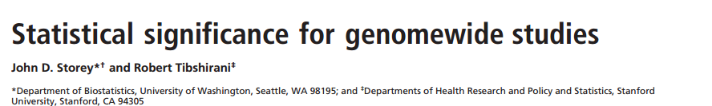
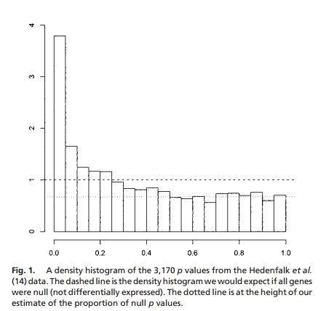
Comparison to the uniform-distribution can be used to perform inference.
If there was no difference between case and control, p-values should be uniform.
If they are smaller than uniform, the experiment showed differences…
Basis for Storey q-values
(more on false discovery rate later
The dashed lines is the uniform distribution

Slide 51
For Bayesian statistics, the uniform distribution is often an appropriate prior
when you have no expectations about what you expect in the data…
(More on this later)

Slide 52
Lists in R
R is not a high-performance language
The Uniform distribution
Mean and SD on discrete theoretical distributions
The law of large numbers

Slide 53
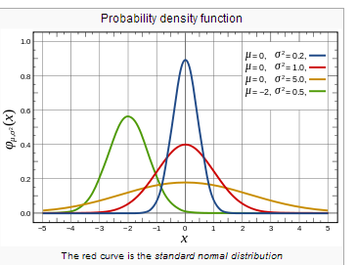
We are used to thinking about mean and standard deviation as the parameters on the normal distribution
However mean and variance can be defined on any discrete or continuous probability distribution

Slide 54
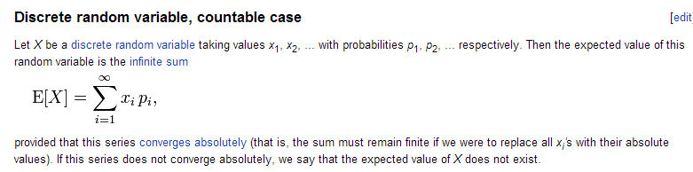
Consider a fair die with
p(1) = 1/6
p(2) = 1/6
p(3) = 1/6
p(4) = 1/6
p(5) = 1/6
p(6) = 1/6
P(7 or greater) =0
This is a discrete probability distribution.
The prob(1..6) = 1
The mean, or expected value is defined as
1/6 * 1 + 1/6 *2 + 1/6 * 3 + 1/6*4 + 1/6 *5 + 1/6 * 6 = 3.5
http://en.wikipedia.org/wiki/Expected_value

Slide 55

Expected value (mean) for a fair die:
1/6 * 1 + 1/6 *2 + 1/6 * 3 + 1/6*4 + 1/6 *5 + 1/6 * 6 = 3.5
We can confirm the correctness of this calculation with simulated data in R:
We pre-allocate to avoid concatenation
The mean is within error of the expected value

Slide 56


We can likewise define variance for any distribution..
For our fair die:
(1/6) ( 1 – 3.5)^2 + (1/6) ( 2 – 3.5)^2 +
(1/6) ( 3 – 3.5)^2 +
(1/6) ( 4 – 3.5)^2 +
(1/6) ( 5 – 3.5)^2 +
(1/6) ( 6 – 3.5)^2 =2.916
http://en.wikipedia.org/wiki/Variance

Slide 57



We can ask: How many rolls of the dice do we need to reliably see the expected
mean and variance?
The more rolls we have,
the closer we get to the
expected values for mean
and values

Slide 58

An example of the law of large numbers
If you gamble for enough time, you will lose money…

Slide 59
What is a random number?
Classical computers are deterministic.
“random” numbers are not really random.
You start with a seed and manipulate the bits of that seed to generate
a number that looks random..

Slide 60

From ChatGPT:

Slide 61


Java’s next() moves to the next seed and produces the next random number

Slide 62

To “flip a coin” on a quantum computer, you prepare a “qbit” in a
super-position of heads and tails, then measure the qbit and the universe
will flip the coin for you…
These will not cycle
or repeat (except repetitions
by chance)
They are not
replicable
(you can’t get the same
series starting with a seed
because there is no seed)
In classical computing, randomness comes from deterministic algorithms and seeds.
In quantum mechanics, measurement outcomes are fundamentally probabilistic.
Individual results are unpredictable, but the probability distribution is perfectly reproducible.

Slide 63
Concepts for this lecture:
R concepts…
Lists are “recursive vectors” ;
allows collections of different data types
(read the List chapter in your textbook!)
Difference between the [] and [[]] operators for Lists
Lists of lists…
Statistical concepts…
Probability density functions (pdfs)
Mean and standard deviation of distributions.
The uniform distribution: dunif, punif in R..
The law of large numbers.
Random vs. psuedo-random numbers

Slide 64
Reading for this week:
Vassar stats book: Chapter 5 – Chapter 6
(basic concepts of probability through binomial)
(or equivalent in your favorite canonical stats book)
Art of R programming:
Chapter 2 ( Vectors), Chapter 4 (Lists)
(or equivalent chapters here: http://heather.cs.ucdavis.edu/~matloff/132/NSPpart.pdf)

