Slide 1
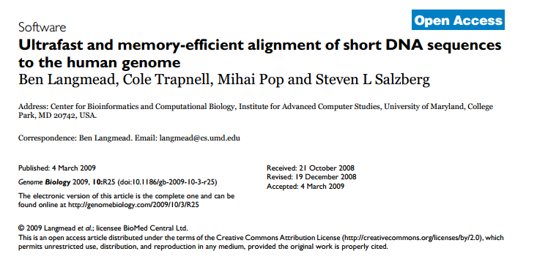
An “ultrafast” and “memory efficient” alternative to BLAST
https://genomebiology.biomedcentral.com/articles/10.1186/gb-2009-10-3-r25
(> 21,000 citations)

Slide 2
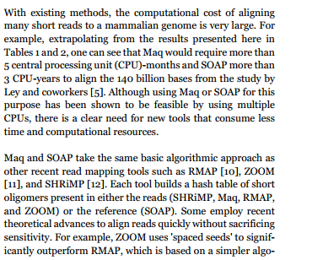
Existing methods are not scalable to new sequencing technologies…
We know how to do this in Java..

Slide 3
Schematic of a hash-based method…
Big sequence to index:
AACCGAGTATTAAA…………………….AACTTTTAA
Make a HashTable<String,Integer>
The key is the hash (at a given word length)
The value is the position in the String.
Advantages:
Constant time no matter the size of the database.
Searches are in time proportional to the size of the query.
Disadvantages:
Memory intensive.
Worst-case: memory needed is N * K where N is the length
of the database and K is the word-length
If the word-length is too big, your searches will be insensitive.
You have to specify the word-length ahead of time.
If you want to repeat searches at different word-lengths, you
need to rebuild the database (which is slow).

Slide 4
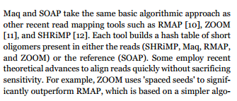
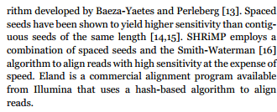
One solution: use a small word-length and keep track of the
“neighborhood” of the seeds.
Break your query into small seeds and find the “neighborhood” where
multiple seeds hit and then (possibly) use Smith-Waterman to try and
extend the neighborhood…
This is a pretty reasonable approach (and more or less what BLAST does)

Slide 5
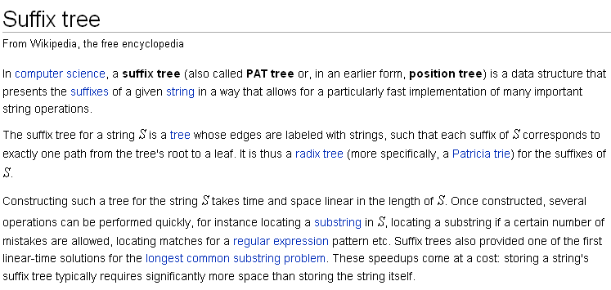
Another alternative: use suffix trees…
http://en.wikipedia.org/wiki/Suffix_tree

Slide 6
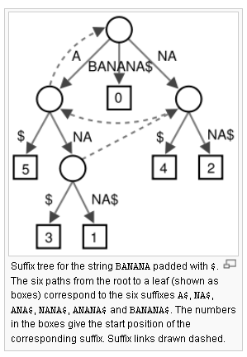
Example of searching a suffix tree with a query sequence
B A N A N A $
0 1 2 3 4 5 6
“Find all instances of ANA”
Start at the root, and read until you have exhausted
the query string…
Read all the #s that occur below the node you stopped.
Those are the exact substrings.
http://en.wikipedia.org/wiki/Suffix_tree

Slide 7
A
B A N A N A $
0 1 2 3 4 5 6
“Find all instances of ANA”
Start at the root, and read until you have exhausted
the query string…
Read all the #s that occur below the node you stopped.
Those are the exact substrings.
A is at 1,3,5
http://en.wikipedia.org/wiki/Suffix_tree

Slide 8
B A N A N A $
0 1 2 3 4 5 6
ANA
“Find all instances of ANA”
Start at the root, and read until you have exhausted
the query string…
read all the #s that occur below the node you stopped.
Those are the exact substrings.
AN is at 1,3
http://en.wikipedia.org/wiki/Suffix_tree

Slide 9
B A N A N A $
0 1 2 3 4 5 6
ANA
“Find all instances of ANA”
Start at the root, and read until you have exhausted
the query string…
ANA is at 1,3
This is in linear time to the query. (We used 3 operations).
Pretty cool….
Building suffix trees will be one of (many) topics we won’t cover this semester…

Slide 10
Advantages of suffix trees:
There are algorithms that are linear in time of the database to construct a suffix tree.
Suffix trees are linear in memory to the size of the database.
Exact-match queries are linear in time to the length of the query.
You can search a string (k-mer) of any length without having to rebuild the suffix tree.
Disadvantage of suffix trees:
Even though they grow linearly in space, they can take more space to store than
the space needed to store the database string.
That is a potential problem for genomics where the size of the database
(e.g. the human genome) can be giga-bases…
One solution: just use high-memory boxes…

Slide 11
This paper describes another solution.
Use data compression to compress the database so that
the memory needed to hold the database can actually be smaller than
the string that represents the database!

Slide 12
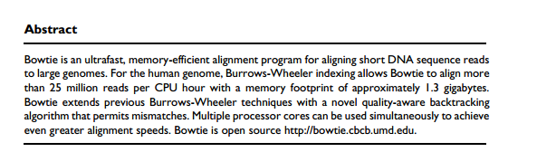
Holds the entire human genome (>2 billion basepairs) in 1.3 GB!!!
Pretty nice trick!
How does this work?

Slide 13
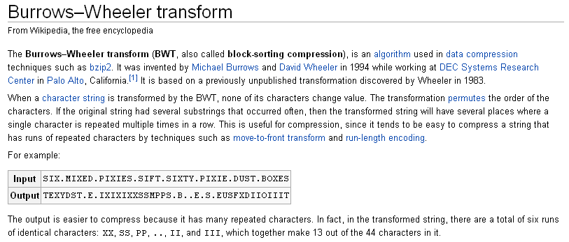
The trick is the Burrows-Wheeler transform (BOWTIE: get it?)

Slide 14
Here is (an inefficient version) of the BWT algorithm.
(1) Take the string you want to make a database or compress:
Our first example: “AACT”
A A C T
0 1 2 3
(2) Add a $ to the end ($ is a character that is not in the string and by definition sorts to the top)
A A C T $
0 1 2 3 4
(3) Start at every position, write every string (wrapping around from to the beginning
when you get to the end). We end up with 5 strings:
AACT$
ACT$A
CT$AA
T$AAC
$AACT
(4) Sort the resulting list.
(5) The BWT transform is the last column of the sorted table:
T$AAC
$AACT
AACT$
ACT$A
CT$AA
T$AAC

Slide 15
Take out pen and paper:
Produce the BW transform for “CGAA$”
(set the transformed string aside)

Slide 16
The BWT transform has at least 3 remarkable properties:
(1) It yields a string that can be easily compressed
(if there is certain kinds of repetition in the input)
(2) It can be easily “unpermuted” in linear space and time
(3) A BWT transform can act like a suffix tree to support searches in
time proportional to the query…

Slide 17
(1) BWT yields a string that can be easily compressed (if there is certain kinds of repetition in the input)
Consider the sequence CGCGCGCGCGTCGCGCGCGCG$
The BWT transform is: GGGGGT$GGGGCCCCCCCCCCG
Here is the BWT matrix.
$CGCGCGCGCGTCGCGCGCGCG
CG$CGCGCGCGCGTCGCGCGCG
CGCG$CGCGCGCGCGTCGCGCG
CGCGCG$CGCGCGCGCGTCGCG
CGCGCGCG$CGCGCGCGCGTCG
CGCGCGCGCG$CGCGCGCGCGT
CGCGCGCGCGTCGCGCGCGCG$
CGCGCGCGTCGCGCGCGCG$CG
CGCGCGTCGCGCGCGCG$CGCG
CGCGTCGCGCGCGCG$CGCGCG
CGTCGCGCGCGCG$CGCGCGCG
G$CGCGCGCGCGTCGCGCGCGC
GCG$CGCGCGCGCGTCGCGCGC
GCGCG$CGCGCGCGCGTCGCGC
GCGCGCG$CGCGCGCGCGTCGC
GCGCGCGCG$CGCGCGCGCGTC
GCGCGCGCGTCGCGCGCGCG$C
GCGCGCGTCGCGCGCGCG$CGC
GCGCGTCGCGCGCGCG$CGCGC
GCGTCGCGCGCGCG$CGCGCGC
GTCGCGCGCGCG$CGCGCGCGC
TCGCGCGCGCG$CGCGCGCGCG
All the C’s and G’s sort together on the left,
and because of the repeat in the CG island, this
causes (most) of the Cs and Gs to cluster together on the right…
We can represent:
GGGGGT$GGGGCCCCCCCCCCG
As
5GT$4G10CG
We’ve gone from 22 bytes to 10 bytes.
>2X compression (and obviously we could do better
by being more careful with our bits in the reduced
alphabet of DNA spaces)

Slide 18
(2) A BW transform can be unpermuted
The key to this is to see that the ith position of a character on the right is the
ith character on the left
Input string: AACT$
$AACT
AACT$
ACT$A
CT$AA
T$AAC
corresponds
to this A
This first A
Input string: AACT$
$AACT
AACT$
ACT$A
CT$AA
T$AAC
corresponds
to this A
This second A

Slide 19
the ith position of a character on the right is the ith character on the left
Consider: AFAHACD$
$AFAHACD
ACD$AFAH
AFAHACD$
AHACD$AF
CD$AFAHA
D$AFAHAC
FAHACD$A
HACD$AFA
These 3 A’s sort together
So the sort order of the A’s on the right
must be the same as the A’s on the left
The relative order of the 3 lines that correspond to the A’s moving to the end has to be
the same as the lines that start with the 3 A’s (because the 3’s A’s are equal, so the sort
order of the lines that start with A is determined by the sub-strings after the A’s
once the A’s have been added to the end of the sequence).

Slide 20
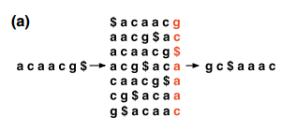
So let’s say we have acaacg$
The BW transform is: gc$aaac

Slide 21
How do we “unpermute” gc$aaac
Sort to yield $aaaccg
Line up the two columns:
$ g
a c
a $
a a
c a
c a
g c
We now have the first and last column of the BWT.

Slide 22
How do we “unpermute” gc$aaac
Line up the two columns:
$ g
a c
a $
a a
c a
c a
g c
We now have the first and last column of the BWT.
The $ is the end of the string….
The character before the $ is a g
So we have: g$

Slide 23
How do we “unpermute” gc$aaac
Sort to yield $aaaccg
Line up the two columns:
$ g
a c
a $
a a
c a
c a
g c
We now have the first and last column of the BWT.
There is only one g, so we know these 2 g’s are the same
So we have: g$

Slide 24
How do we “unpermute” gc$aaac
Sort to yield $aaaccg
Line up the two columns:
$ g
a c
a $
a a
c a
c a
g c
We now have the first and last column of the BWT.
The character before this g is a c
So we have: cg$

Slide 25
How do we “unpermute” gc$aaac
Sort to yield $aaaccg
Line up the two columns:
$ g
a c
a $
a a
c a
c a
g c
We now have the first and last column of the BWT.
This is the 2nd c on the right, so it corresponds to the 2nd c on the left
So we have: cg$

Slide 26
How do we “unpermute” gc$aaac
Sort to yield $aaaccg
Line up the two columns:
$ g
a c
a $
a a
c a
c a
g c
We now have the first and last column of the BWT.
This is the 2nd c on the right, so it corresponds to the 2nd c on the left.
The character before that c is an a
So we have: acg$

Slide 27
How do we “unpermute” gc$aaac
Sort to yield $aaaccg
Line up the two columns:
$ g
a c
a $
a a
c a
c a
g c
So we have: acg$

Slide 28
How do we “unpermute” gc$aaac
Sort to yield $aaaccg
Line up the two columns:
$ g
a c
a $
a a
c a
c a
g c
So we have: aacg$

Slide 29
How do we “unpermute” gc$aaac
Sort to yield $aaaccg
Line up the two columns:
$ g
a c
a $
a a
c a
c a
g c
So we have: aacg$

Slide 30
How do we “unpermute” gc$aaac
Sort to yield $aaaccg
Line up the two columns:
$ g
a c
a $
a a
c a
c a
g c
So we have: caacg$

Slide 31
How do we “unpermute” gc$aaac
Sort to yield $aaaccg
Line up the two columns:
$ g
a c
a $
a a
c a
c a
g c
So we have: caacg$

Slide 32
How do we “unpermute” gc$aaac
Sort to yield $aaaccg
Line up the two columns:
$ g
a c
a $
a a
c a
c a
g c
So we have: acaacg$

Slide 33
How do we “unpermute” gc$aaac
Sort to yield $aaaccg
Line up the two columns:
$ g
a c
a $
a a
c a
c a
g c
And we are at the end…
So we have: acaacg$
We have un-transformed the string with a sort + a linear walk

Slide 34
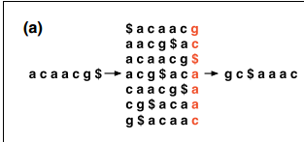
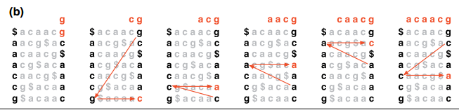
So in time (n) and space (2*n) linear to the transformed string, I can untransform it!
(alternatively: time n*log(n) and space (n) )
From the paper…

Slide 35
With pen and paper:
Take your BW transformed string that you have for “CGAA$”
Unpermute your BW transformed string to recover the original sequence

Slide 36
A BWT transform can act like a suffix tree to support searches in time proportional to the query…
We’ll need to keep track of the original index when we sort…
acaacg$
0123456
We start with
unsorted: sorted:
0 acaacg$
1 caacg$a
2 aacg$ac
3 acg$aca
4 cg$acaa
5 g$acaac
6 $acaacg
6 $acaacg
2 aacg$ac
0 acaacg$
3 acg$aca
1 caacg$a
4 cg$acaa
5 g$acaac
We store: { 6,2,0,3,1,4,5} and {g,c,$,a,a,c}
Which can be stored compressed

Slide 37
Given:
{ 6,2,0,3,1,4,5} and
{g,c,$,a,a,c}
where was aac in the original string:
acaacg$
0123456
Sort to yield $aaaccg
Line up the two columns:
$ g
a c
a $
a a
c a
c a
g c

Slide 38
Given:
{ 6,2,0,3,1,4,5} and
{g,c,$,a,a,c}
where was aac in the original string:
acaacg$
0123456
Sort to yield $aaaccg
Line up the two columns:
6 $ g
2 a c
0 a $
3 a a
1 c a
4 c a
5 g c
Start with c. Find c in sorted list (which we can do quickly). c is at 1,4

Slide 39
Given:
{ 6,2,0,3,1,4,5} and
{g,c,$,a,a,c}
where was aac in the original string:
acaacg$
0123456
Sort to yield $aaaccg
Line up the two columns:
6 $ g
2 a c
0 a $
3 a a
1 c a
4 c a
5 g c
Now do ac. Check the prefix of both of our c rows. There is an a in both of them.
So ac is at (0,3)… (since we started at 1,4 and have moved one in both substrings)

Slide 40
Given:
{ 6,2,0,3,1,4,5} and
{g,c,$,a,a,c}
where was aac in the original string:
acaacg$
0123456
Sort to yield $aaaccg
Line up the two columns:
6 $ g
2 a c
0 a $
3 a a
1 c a
4 c a
5 g c
Now do aac.
We find the matching a’s.

Slide 41
Given:
{ 6,2,0,3,1,4,5} and
{g,c,$,a,a,c}
where was aac in the original string:
acaacg$
0123456
Sort to yield $aaaccg
Line up the two columns:
6 $ g
2 a c
0 a $
3 a a
1 c a
4 c a
5 g c
Now do aac.
We find the matching a’s. This tells us what characters come before the ac.
There is a before one of the ac rows.
For the string we are growing, we started at 4 and have added 2, so the position is 2.
There is no match for the other string, so we eliminate it from our results…

Slide 42
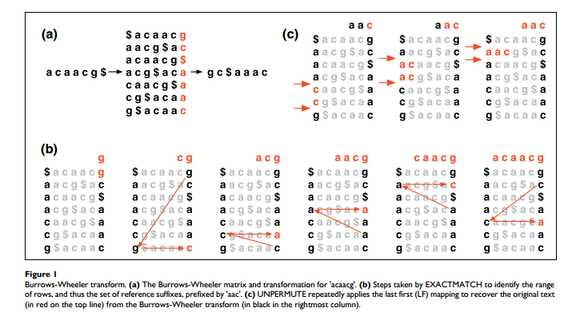
From the paper…
Note (b) and (c) are reversed in the legend!

Slide 43
Our search algorithm can work just as well on a representation like
5GT$4G10CG
as a representation like
GGGGGT$GGGGCCCCCCCCCCG
So we can keep the characters in compressed form saving memory but still
count when, for example, the 2nd a on the right matches the 2nd a on the left.
So all I need to keep is the compressed form of the left and right columns and the index ( e.g. { 6,2,0,3,1,4,5} ).
Linear in memory, but more efficient in memory than a suffix tree.
Queries still happen in time linear to the query sequence.
Very nice algorithm to index large genomes efficiently in RAM.

