Slide 1
The hypergeometric distribution/ Fisher exact test
Using the hypergeometric distribution to ask if there is a lane effect for RNA-seq
The Poisson distribution
The Poisson distribution and rnaSeq

Slide 2
The binomial distribution samples with replacement.
Flipping a coin does not change the probability of the next flip.
There are so many pairs of residues in the protein that we
(correctly or incorrectly) treat them as independent..
The background death rate of the disease is not affected by our study.

Slide 3
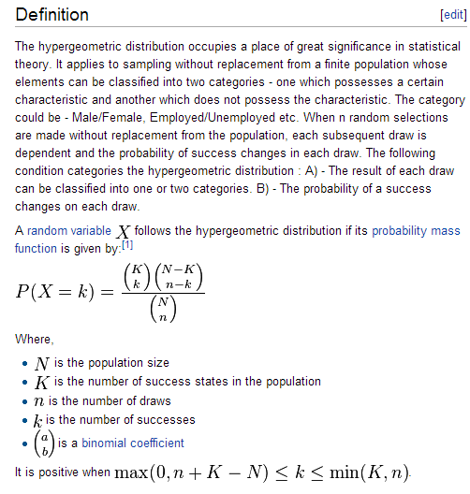
The hypergeometric distribution samples without replacement.
I have a deck of 60 cards and 20 of them are marked.
I draw 7. What is the probability that I will draw X marked cards.
Not exactly dbinom(p=20/60) because if I draw a marked card, the number of remaining marked cards changes.
From the Wiki:

Slide 4

This is not hard to understand or implement.
I have 60 cards. 20 are marked. I draw 7. What are the odds I have 3 marked?
N=60
K = 20
n = 7
k = 3
How many ways can I draw 3 marked cards * how many ways can I draw 4 unmarked cards
How many ways can I draw any 7 cards

Slide 5
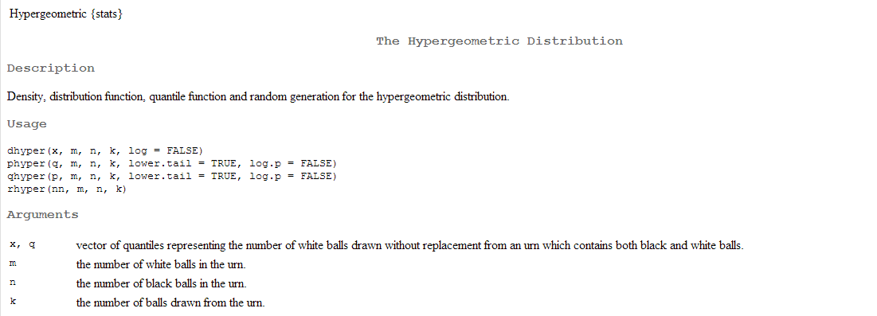
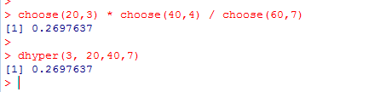
And of course, we have dhyper, phyper, qhyper and rhyper…

Slide 6
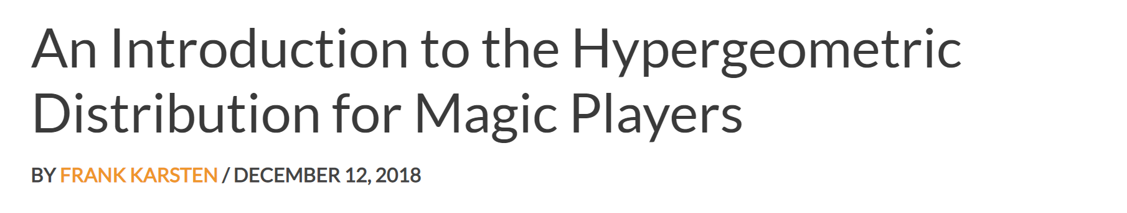

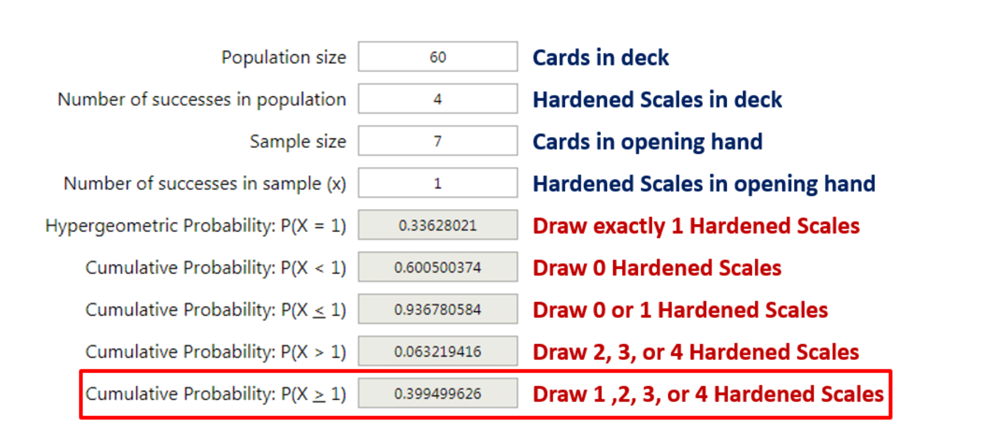
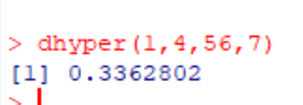
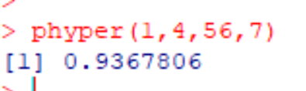
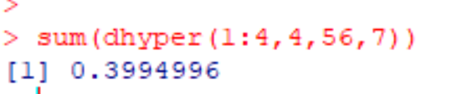
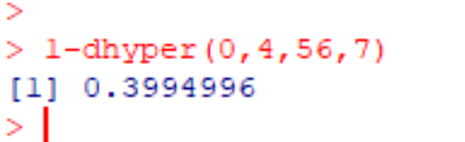
To be a good Magic or Poker player, you have to know this distribution…

Slide 7

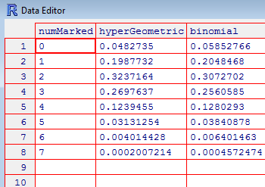
We see that the hypergeometric and binomial distributions in this case have close to
(but not exactly the same) PDFs..

Slide 8
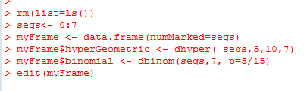
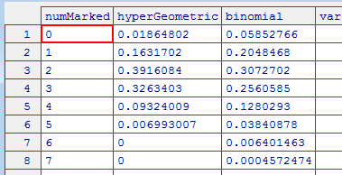
The differences between the hypergeometric and the binomial matter more when
the sample size is smaller (of course)
Here we have 5 marked cards in a deck of 15 for which we draw 7

Slide 9


If you use the hypergeometric distribution for inference, this is called the
Fisher test…
We have a clinical trial…
 | On Drug | Not on Drug
Lived | 13 | 3
Died | 2 | 16
For a one-sided test what are the odds that by chance you could have split
the people who lived with at least 13 on the drug living?
The people who live are “marked”. We drew 13 “marked” people in 15 draws.
There are a total of 16 “marked” people out of 34 people…
dhyper(13,16,18,15)
# drawn
Number marked
and drawn
# not marked
Total # marked

Slide 10
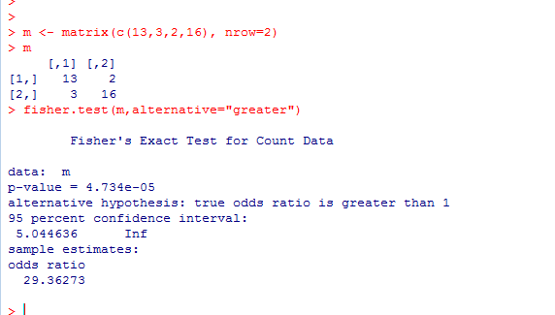
 | On Drug | Not on Drug
Lived | 13 | 3
Died | 2 | 16
Alternatively, you can use Fisher.test but you have to input the matrix…

Slide 11
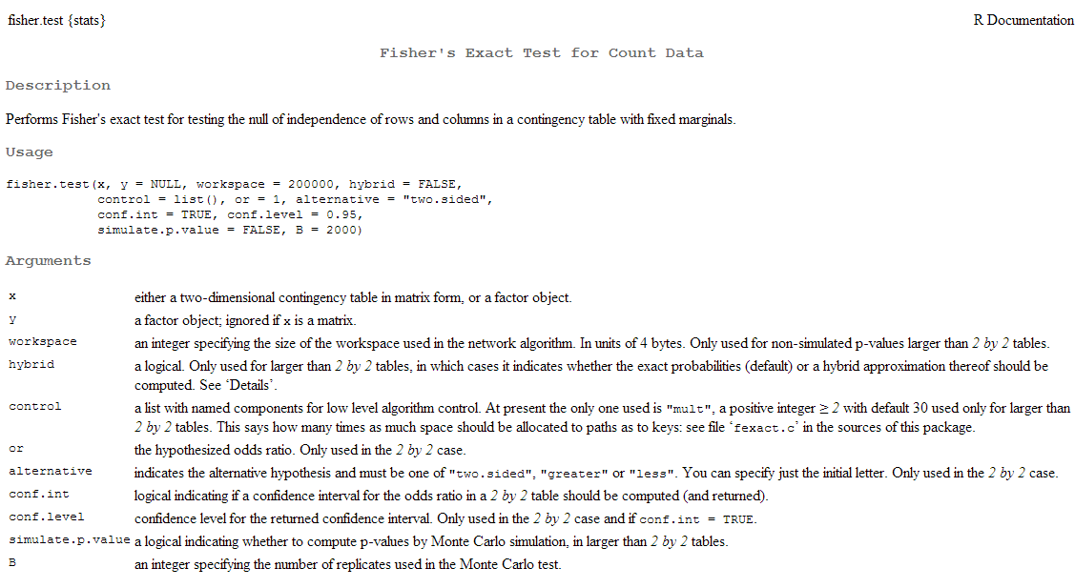
This documentation is tough going…

Slide 12
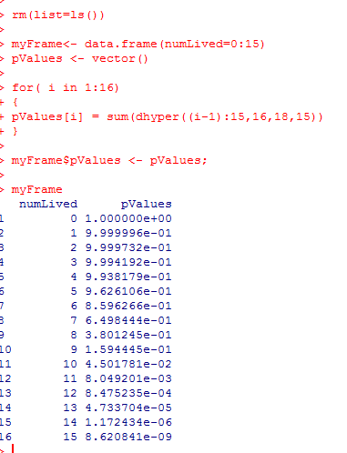
Surprisingly, the Fisher exact test can be conservative.
Because of it’s discrete nature, the only “available” p-values may not line up to 0.05.
You want to test at 0.05, but the test can’t report that.
In this case, it can only report 0.045 so if your “real” p-value is >0.045 but <0.05, the
test will report 0.16.

Slide 13
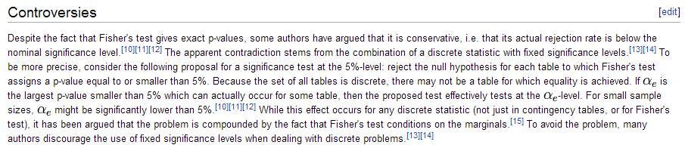
From the Wiki:
You are unlikely to get into trouble with reviewers for using the Fisher exact test, however..

Slide 14
The hypergeometric distribution/ Fisher exact test
Using the hypergeometric distribution to ask if there is a lane effect for RNA-seq
The Poisson distribution
The Poisson distribution and rnaSeq

Slide 15
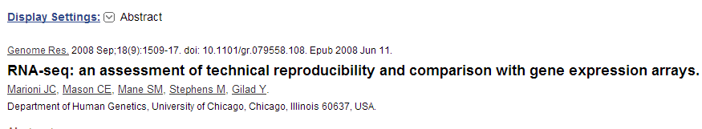
An example of the hypermetric distribution from the genomics literature:

Slide 16
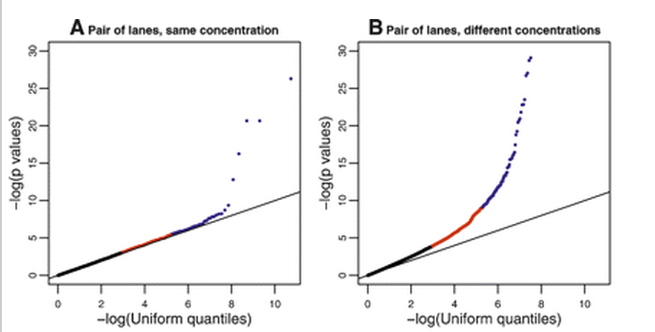
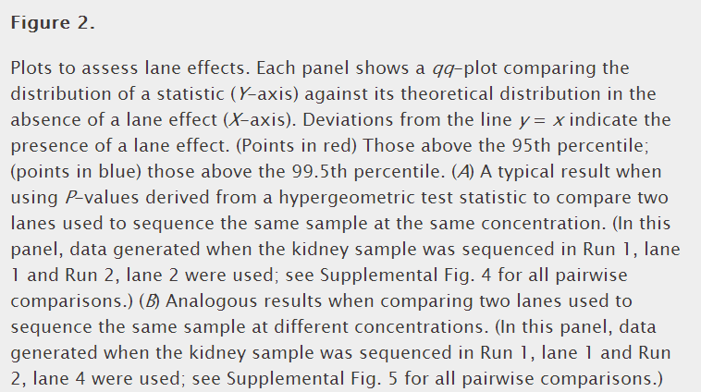
An example of the hypergeometric distribution from the genomics literature:
Is there a lane effect
In RNA-seq experiments?

Slide 17
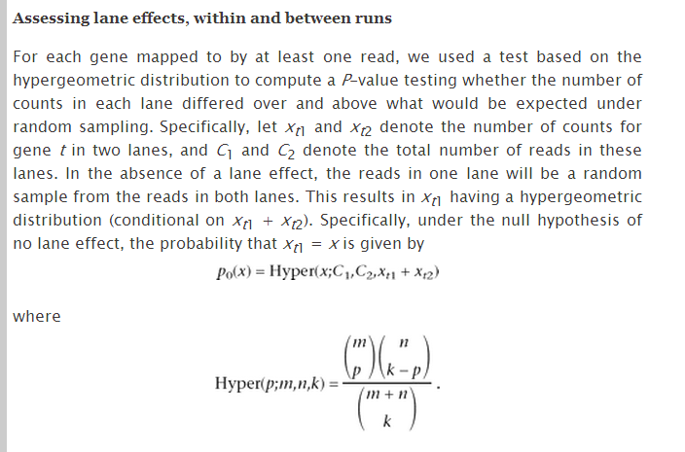
dhyper(x1,x1+x2,C1+C2-(x1+x2),C1)
To put this into R:
# drawn in lane 1
x1= number of marked reads in lane 1
C1 – number of reads in lane 1
x2= number of marked reads in lane 2
C2 – number reads in lane 2
Number marked
and drawn in
lane #1
# not marked
Total # marked

Slide 18
We can put it in matrix form and then use Fisher.test
x1= number of marked reads in lane 1
C1 – number of reads in lane 1
x2= number of marked reads in lane 2
C2 – number reads in lane 2
 | Lane 1 | Lane 2
From the gene | x1 | x2
Not from the gene | C1-x1 | C2-x2
m <- matrix( c(x1,x2,numReadsLane1-x1,numReadsLane2-x2 ), nrow=2)
pValue <- fisher.test(m)$p.value;

Slide 19
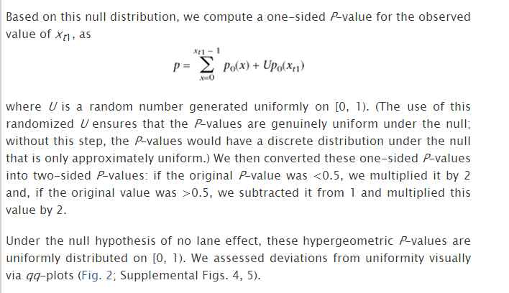
We look in the methods section of the paper for more details……
Add some small # to make up for
the discontinuous nature
Not clear what justifies this #

Slide 20

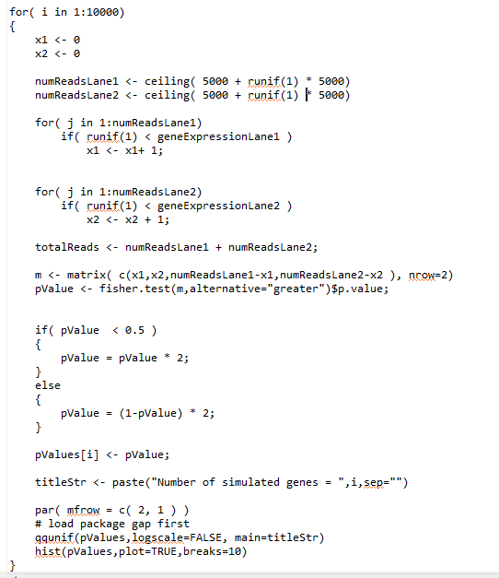
We can run this as a simulation (in this code ignoring the correction for discontinuity)
“ceiling” just rounds up
to an integer
https://github.com/afodor/metagenomicsTools/blob/master/src/classExamples/simDist/hyper.txt

Slide 21
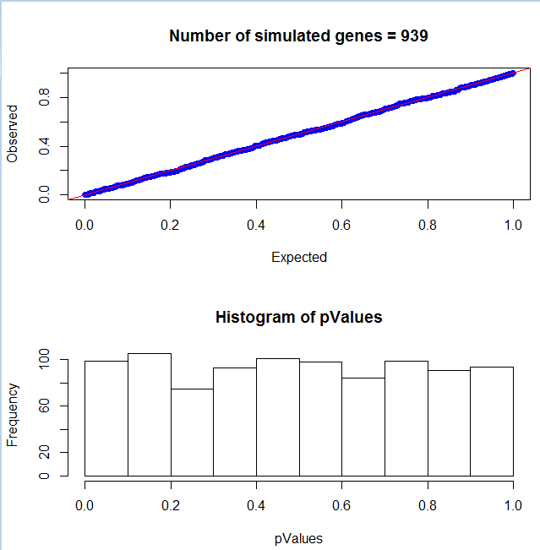
This is (of course) uniformly distributed…

Slide 22
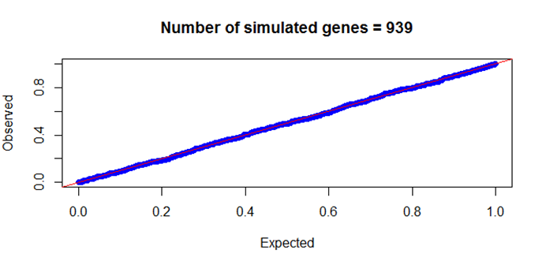
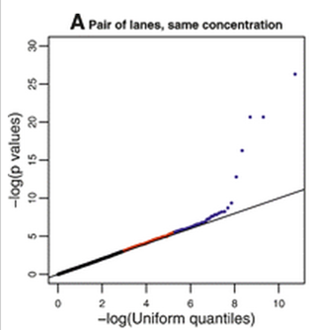
It is interesting to compare our simulation to the real lane data
Clearly the real data does have some artifacts
that effect the distribution of a few genes…

Slide 23
The hypergeometric distribution/ Fisher exact test
Using the hypergeometric distribution to ask if there is a lane effect for RNA-seq
The Poisson distribution
The Poisson distribution and rnaSeq

Slide 24
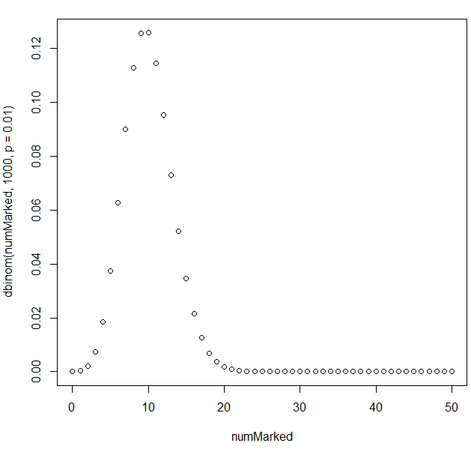

Consider a rare event:
I have a (very large) collection of cards. 1% of them are marked.
I draw 1,000 of the cards.
How many times can I expect to see the cards?
We can show this with dbinom
The expected value = n * p = 1,000 * 0.01 =10

Slide 25
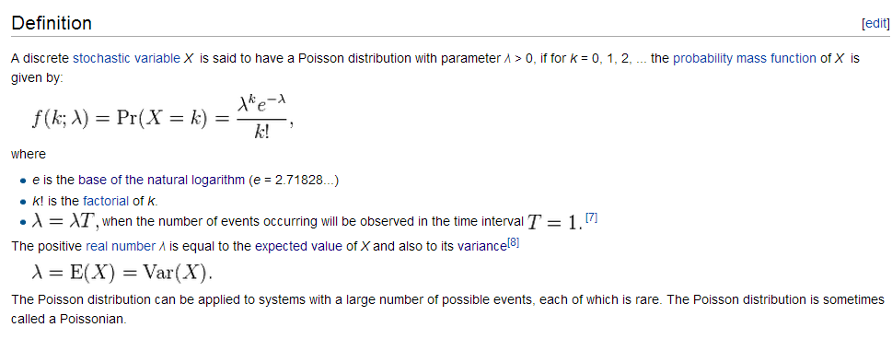
The Poisson distribution is an alternative way of modeling rare events
Here lambda is the expected value ( n * p ) that would occur in n trials.
lambda can also be thought of as the frequency of an event occurring over some set interval of time…
K is the number of successes…
http://en.wikipedia.org/wiki/Poisson_distribution

Slide 26
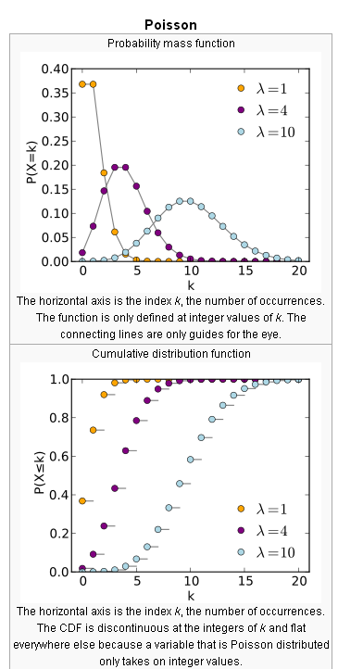
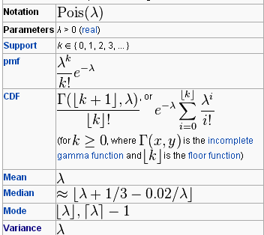
http://en.wikipedia.org/wiki/Poisson_distribution

Slide 27
For the binomial:
mean = np
variance = n * p * (1-p)
For the Poisson, p is small. (1-p) approaches 1 so…
mean = np
variance = n * p = mean
The variance and the mean for the Poisson distribution are equal!

Slide 28

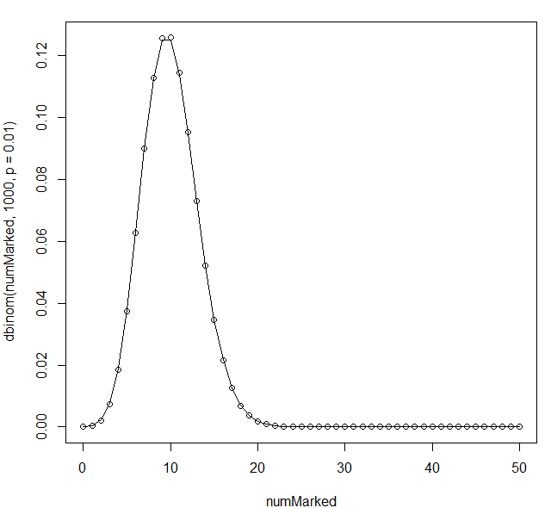
We see that the Poisson distribution nicely approximates the binomial distribution
for a large sample size…
Derivation of the Poisson from the binomial for the limiting case of an infinite # of samples:
https://probabilityandstats.wordpress.com/2011/08/18/poisson-as-a-limiting-case-of-binomial-distribution/

Slide 29
Just as we can use the binomial test for inference, we can use the Poisson test for inference…
Consider an RNA seq experiment (modeled the same way as marked cards):
I have a (small) RNA-seq dataset with 100,000 reads
I have a gene that is expressed 0.1% of the time.
Expected number of reads = p * N = 100,000 * 0.001 = 100
What are the odds that I would see X sequences from this gene?
This is the same problem as for the cards…

Slide 30

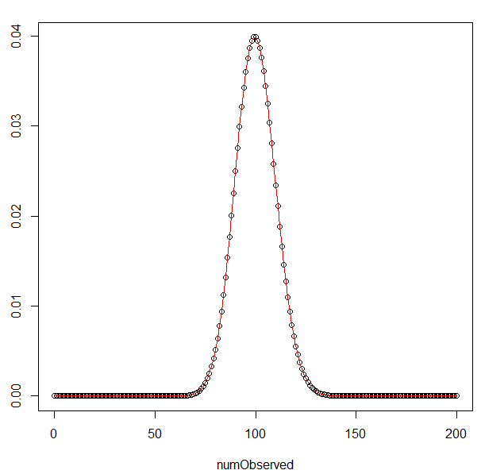
What are the odds that I would see X sequences from this gene?
This is the same problem as for the cards…
We can do inference in exactly the same
way as the binomial test…
What are the odds that I would see
130 reads if the “true” expression of the
gene was 0.001?

Slide 31
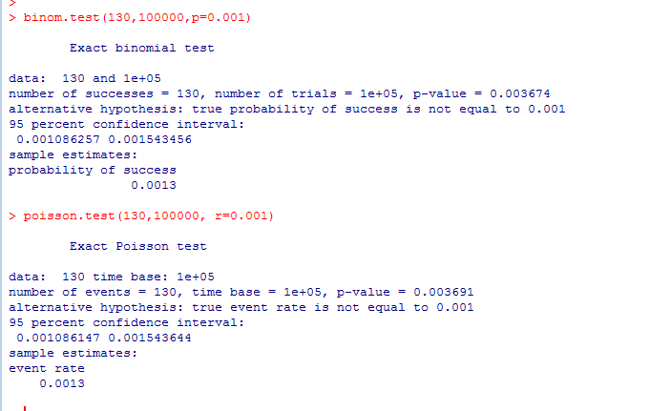
What are the odds that I would see 130 reads if the “true” expression of the gene was 0.001?
The Poisson and binomial tests will give (nearly) identical results in the limiting case of an
infinitely large sample size and small p.

Slide 32
The hypergeometric distribution/ Fisher exact test
Using the hypergeometric distribution to ask if there is a lane effect for RNA-seq
The Poisson distribution
The Poisson distribution and rnaSeq

Slide 33
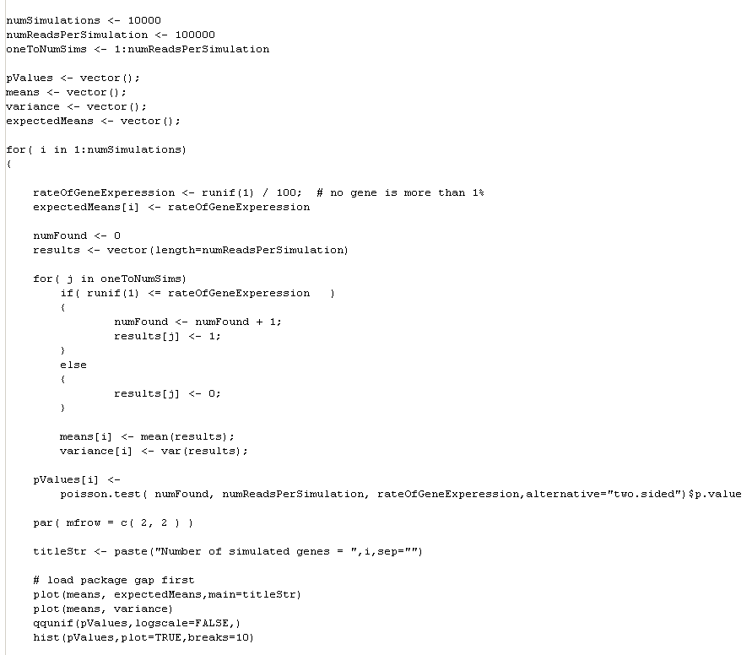
We can use the Poisson distribution to simulate an rna-seq experiment.
We call a success ( a read that belongs to the gene) “1” and a failure “0”.
Then mean = n * p = # of expected successes..
https://github.com/afodor/metagenomicsTools/blob/master/src/classExamples/simDist/Poisson.txt

Slide 34
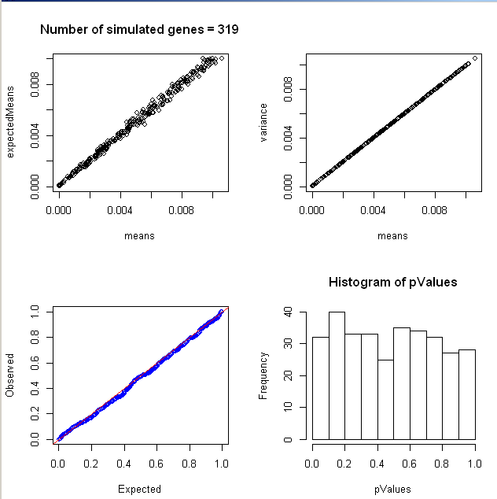
The mean does equal the variance
Our analytical
calculation of
the mean is
correct
The p-values
Generated by
the Poisson test
are uniform for a true null

Slide 35

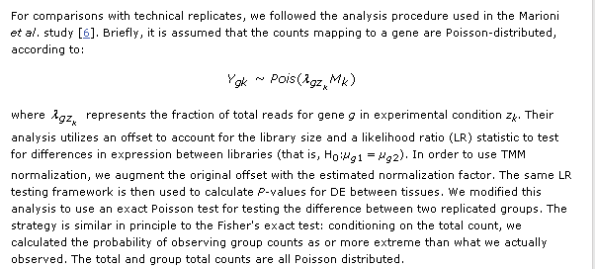
We see this exact Poisson test in use (for example) here…
This is just like the
Fisher test with no
replacement.
(Won’t matter at the
large sample size of the
# of reads in a typical
rna-seq experiment)
Set a p the background frequency observed in one lane.
What are the odds that you will see as many reads in the other lane if the real value was p?

Slide 36
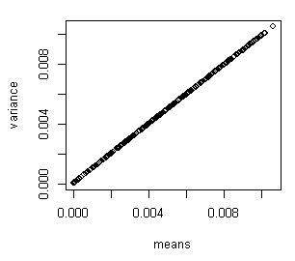
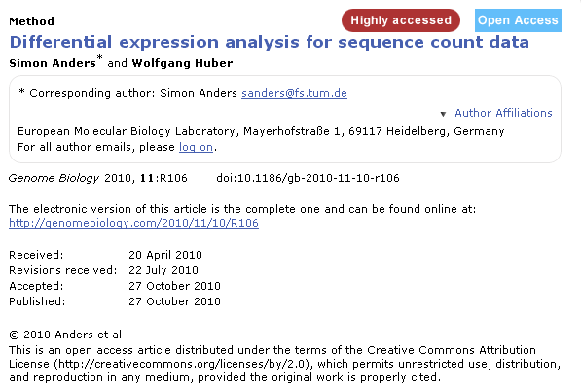
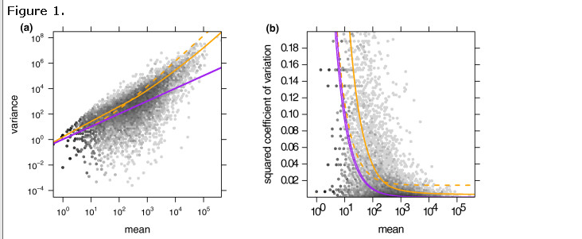
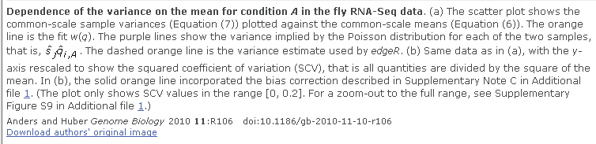
However, when we compare our simulated data to real data…
The mean-variance
relationship predicted
by the Poisson does
not hold!
Lack of independence

Slide 37
Next time:
The negative binomial distribution.

