Slide 1

We start with the simplest possible classification task.
We define 4 taxa that are dominated by A, C, G, or T
The length of each sequence
The number of sequences in each file
Rather than have a single sequence dataset, we will generate new sequences each time we train the model.
(This is more realistic than it might seem as we often have an avalanche of sequence data to train from).
This will help us avoid over-fitting (but is an unusual approach in machine learning).
https://github.com/afodor/LearningExamples/blob/main/src/simpleTaxonomicClassifier/RandomTaxa.java

Slide 2
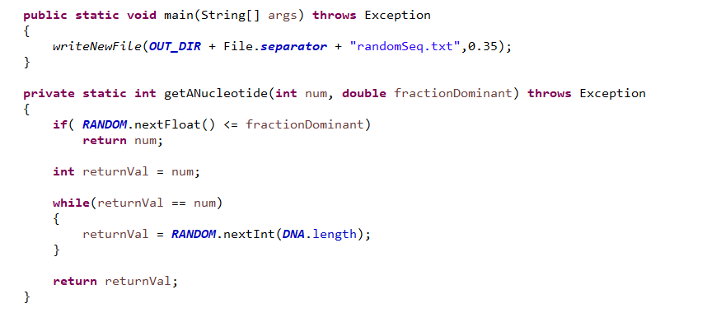
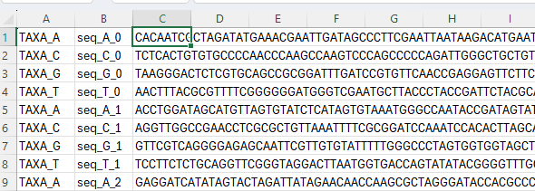
We code A==0, C==1, G==2, T==3
You have a fractionDominant chance of returning
the dominant nucleotide
Otherwise, you have an equal chance of
returning the other 3 nucleotides
We end up with an easily parsed3 column file.
The TaxaID is the first column;
The sequence is the third column
https://github.com/afodor/LearningExamples/blob/main/src/simpleTaxonomicClassifier/RandomTaxa.java

Slide 3
We will start by training an extremely simple ANN to classify our sequences

