Slide 1
Is a one-way ANOVA or linear regression more appropriate?
We can use the ANOVA algebra to compare a 3 vs. 2 parameter model
Consider a measurements (e.g. weight) for three genotypes
A/A A/a a/a
4.3
2.3
4.5
5.6
4.2
3.9
2.8
2.7
2.3
1.9
1.3
1.2
1.8
2.1
1.6
0.9
1.1
1.2
2.1
0.5
0.9
AA <- c(4.3,2.3,4.5,5.6,4.2,3.9,2.8)
Aa <- c(2.7,2.3,1.9,1.3,1.2,1.8,2.1)
aa <- c(1.6,0.9,1.1,1.2,2.1,0.5,0.9)
myData <- c(AA,Aa,aa)
genotypes <- c( rep("AA",length(AA)), rep("Aa",length(Aa)), rep("aa",length(aa)))
genotypes <- factor(genotypes)
myLm <- lm( myData ~ genotypes, x=TRUE)
anova(myLm)
myLm$x

Slide 2
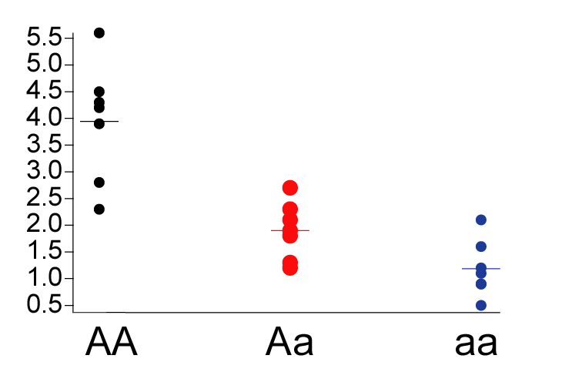
This problem could also be considered as a quantitative problem (a regression).
Define gene “dose” (does of the “a” allele):
AA = 0
Aa = 1
aa =2
Then this view of the data……
Becomes…

Slide 3
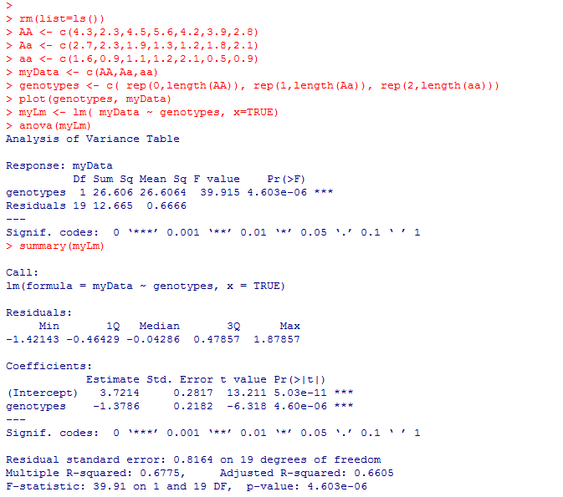
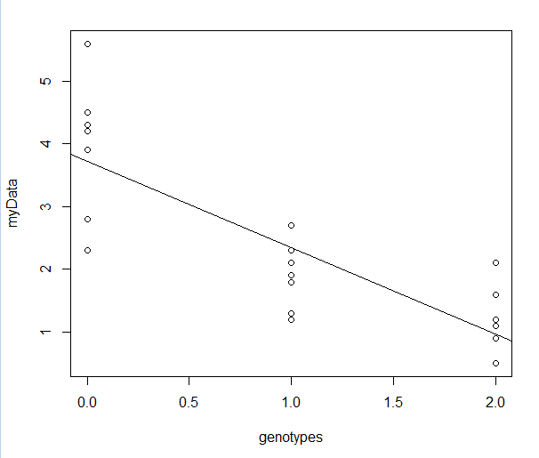

The linear regression view!

Slide 4
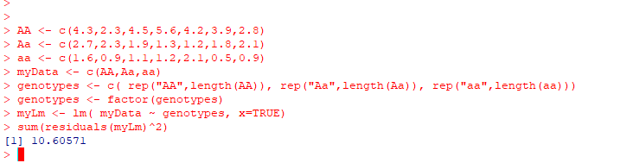
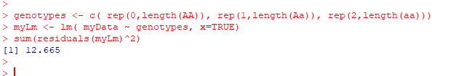
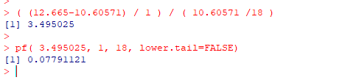
Residuals of the 3 parameter model : 10.6 with 18 d.f.
Residuals of the 2 parameter model : 12.665 with 19 d.f.
(reduced error – full error)/ (reduced DF – full DF)
(Full error)/ (full DF)
The 3rd parameter only makes
for a marginally better model

Slide 5
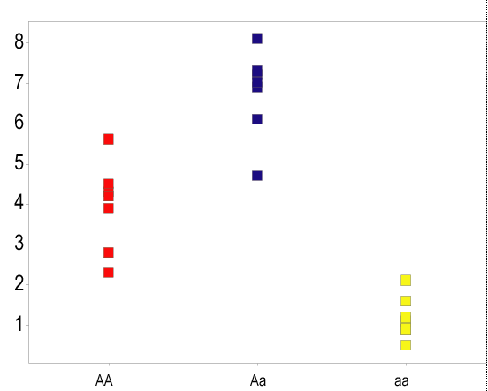
Let’s consider a case where the 2-parameter model is clearly bad
AA <- c(4.3,2.3,4.5,5.6,4.2,3.9,2.8)
Aa <- c(7.2,6.1,4.7,8.1,7.3,6.9,7.0)
aa <- c(1.6,0.9,1.1,1.2,2.1,0.5,0.9)
myData <- c(AA,Aa,aa)
genotypes <- c( rep("AA",length(AA)), rep("Aa",length(Aa)), rep("aa",length(aa)))

Slide 6
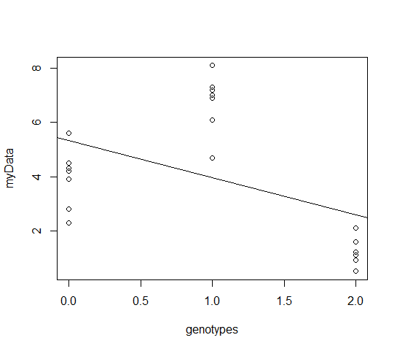
A two-parameter regression model is clearly not as good a fit
genotypes <- c( rep(0,length(AA)), rep(1,length(Aa)), rep(2,length(aa)))
plot(genotypes, myData )
abline(lm(myData~genotypes))

Slide 7
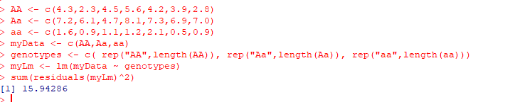

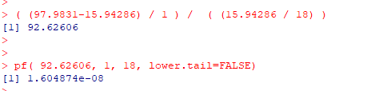
Residuals of the 3 parameter model : 15.94 with 18 d.f.
Residuals of the 2 parameter model : 97.9831 with 19 d.f.
(reduced error – full error)/ (reduced DF – full DF)
(Full error)/ (full DF)
Here the 3rd parameter makes
for a better model
We reject the null hypothesis there is no difference between the models

