Slide 1
Scoping in Javascript
Closures are central to javascript and allow for encapsulation
Javascript is single-threaded

Slide 2
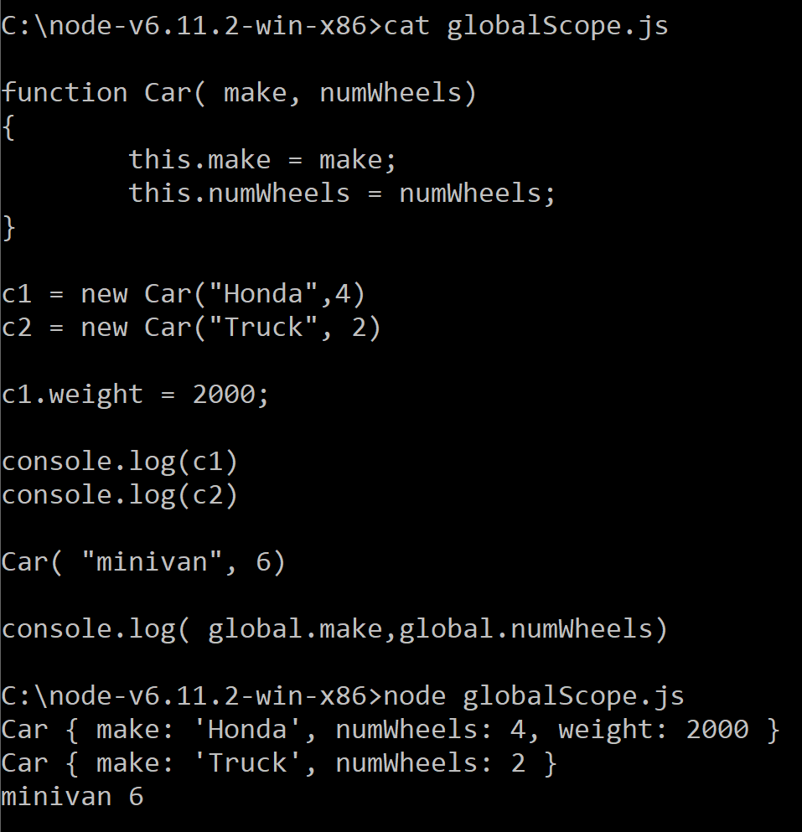
By default, javacript has two scopes: “local” and “global”
Block level scope is created by the “let” keyboard (in recent versions of javascript)
We’ve seen global scope has different names in different environments (global in node; window in the browser…)

Slide 3
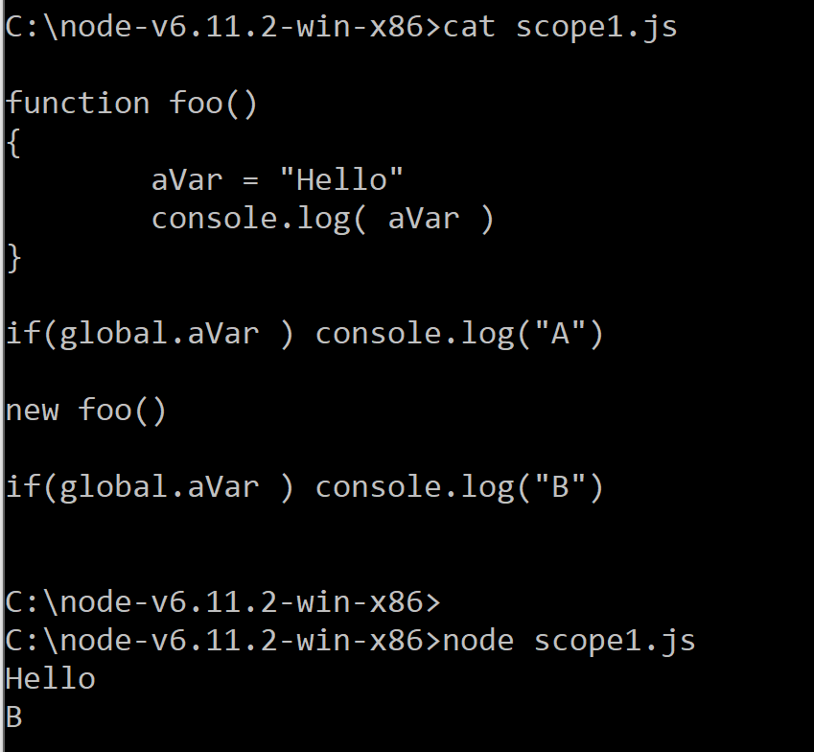
By default, without the use of “var” or “let” or “this.” variables scope to global scope
We declare a variable without “var” so
Java helpfully set this to global scope
Foo has never been invoked, so global.aVar is
not defined
After foo executes, global.aVar is now defined

Slide 4
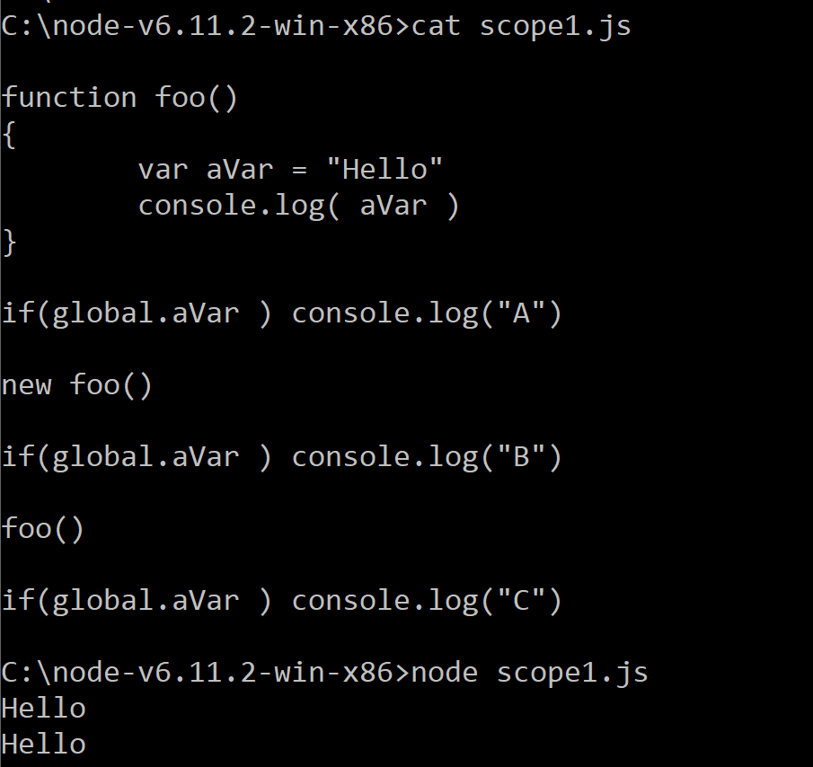
With “var”, variables will be attached to the local scope….
Here aVar is not accessible outside of foo()

Slide 5
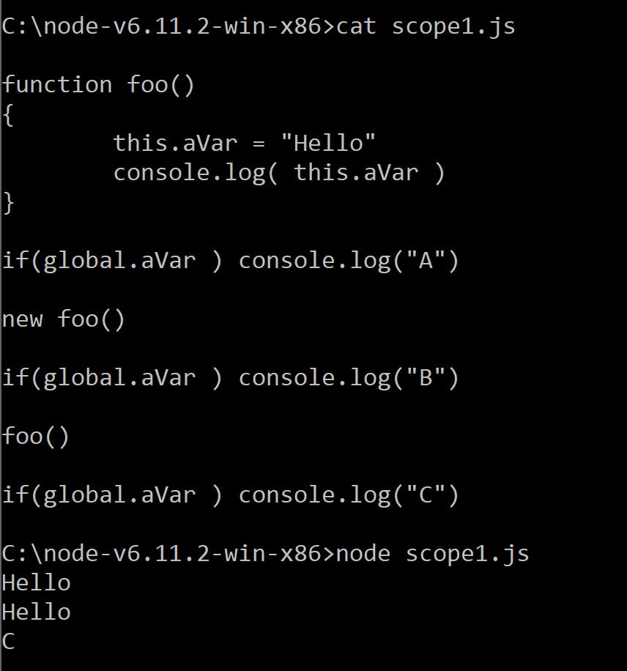
If I use, “this” instead of var, I am binding the variable to whatever the current context is.
But that context might be the global context
Without the “new” the context will be the global object
With “var” (or with default), there will be one “aVar” associated with the function.
With “this”, every “new” will create a new copy of aVar

Slide 6
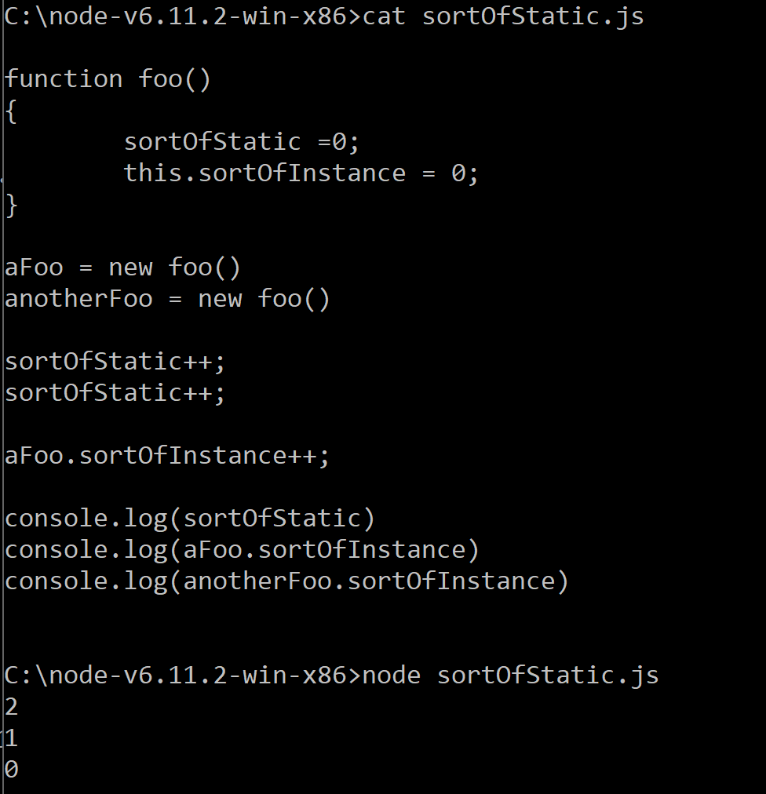
Variables declared without “var” are sort of like “public static” variables in Java
Variables defined with this are sort of like instance variables in Java

Slide 7
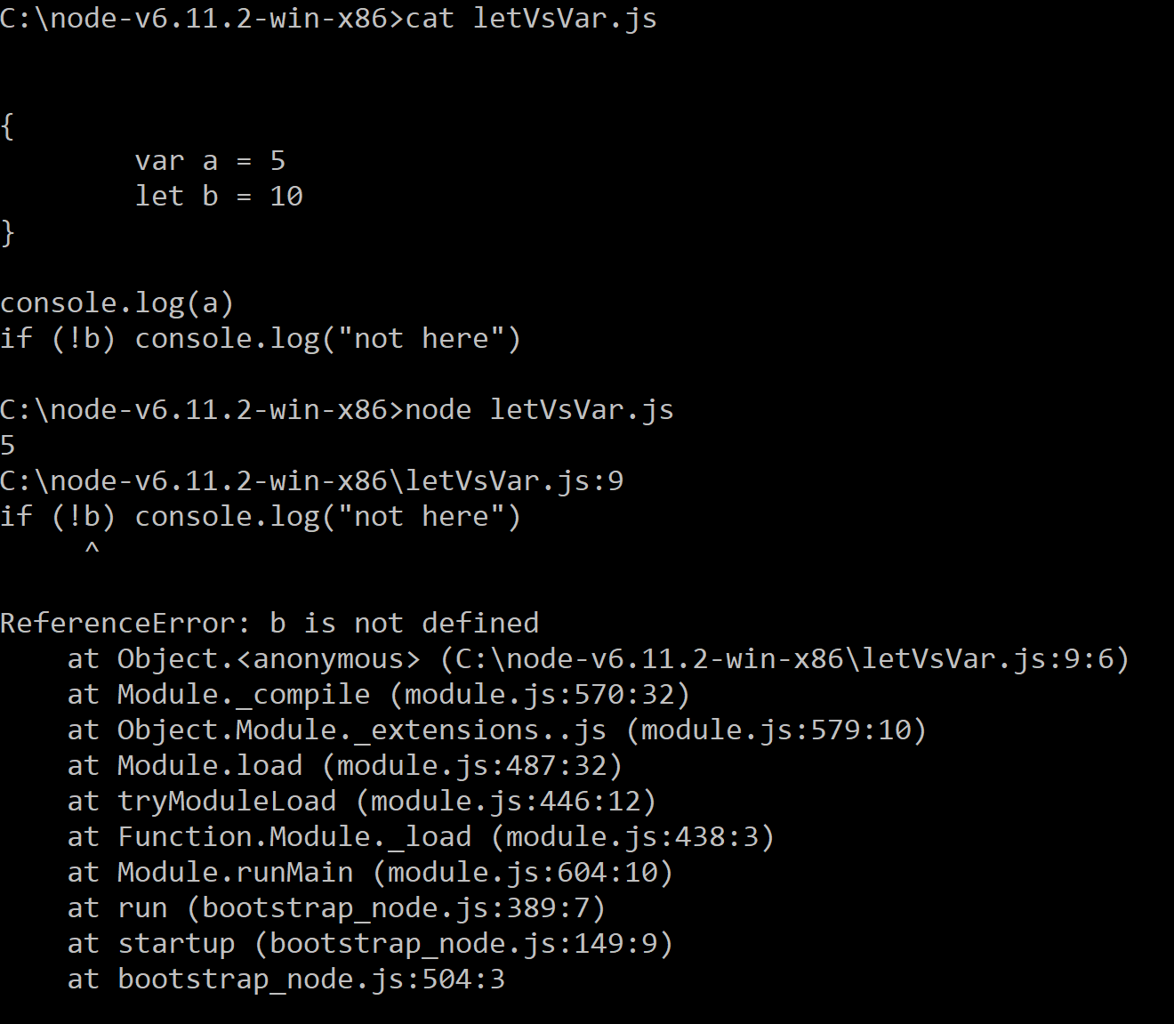
By default, “var” blocks to the function (local or global) not the block (this is different than Java)
“let” assigns to block scope (more like Java…)
Here a is in the global scope
b is not visible outside of the
block (more like Java)

Slide 8
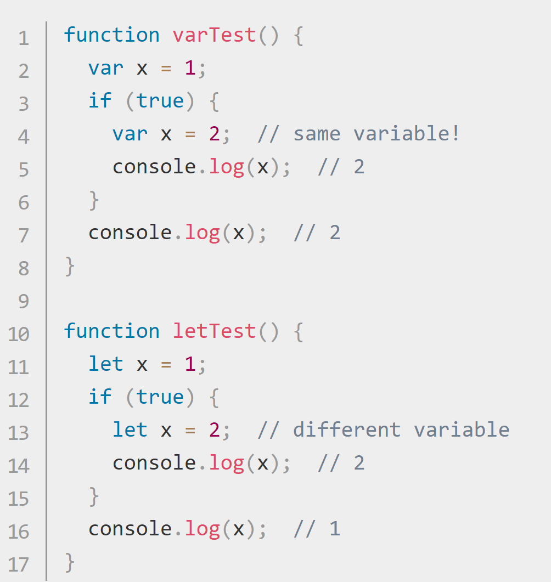
By default, “var” blocks to the function (local or global) not the block (this is different than Java)
“let” assigns to block scope (more like Java…)
This will be important for closures….
(and the way closures interact with for loops)
This is very counter-intuitive for a Java programmer
x in the inner scope is a different variable than
x in the outer scope.
https://developer.mozilla.org/en-US/docs/Web/JavaScript/Reference/Statements/let

Slide 9
Scoping in Javascript
Closures are central to javascript and allow for encapsulation
Javascript is single-threaded

Slide 10
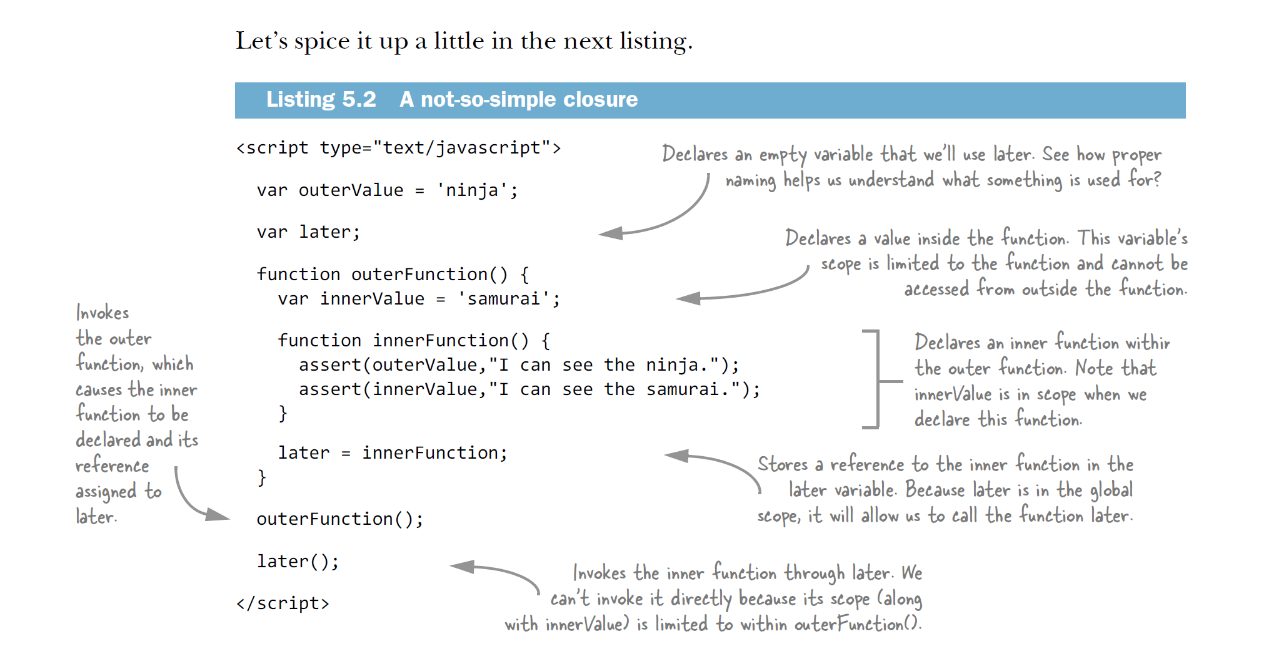
Closures allow for an inner function to see an outer function’s scope after the outer function has exited…
Secrets of the Javascript Ninja’s…

Slide 11
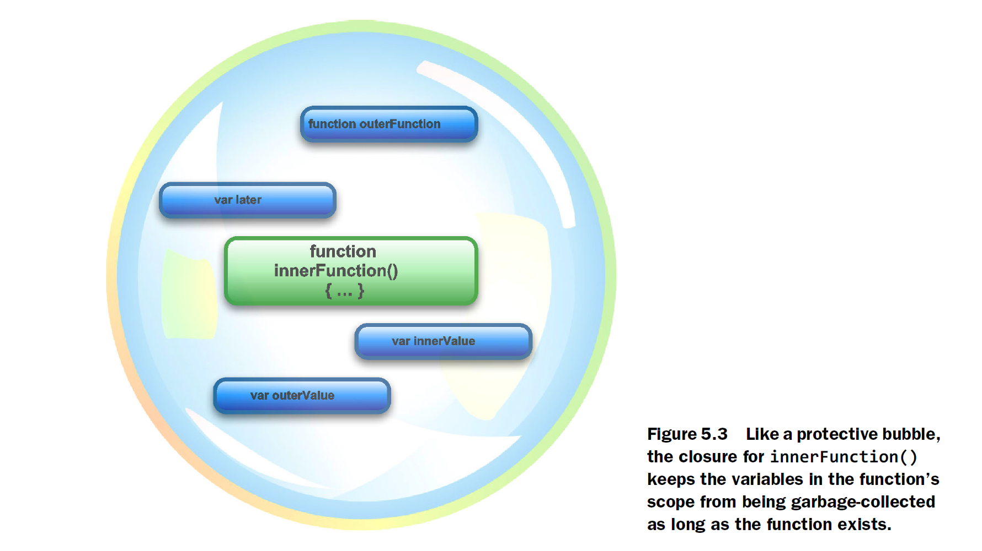
Secrets of the Javascript Ninja’s…

Slide 12
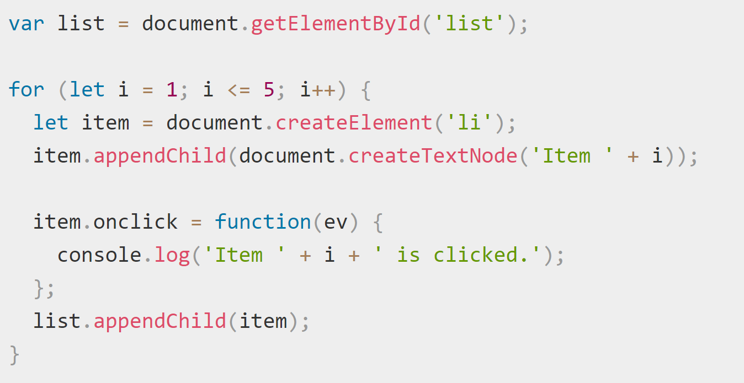
If you want to attach a function to each item it a list with closures, the easiest way is with “let”
https://developer.mozilla.org/en-US/docs/Web/JavaScript/Reference/Statements/let

Slide 13
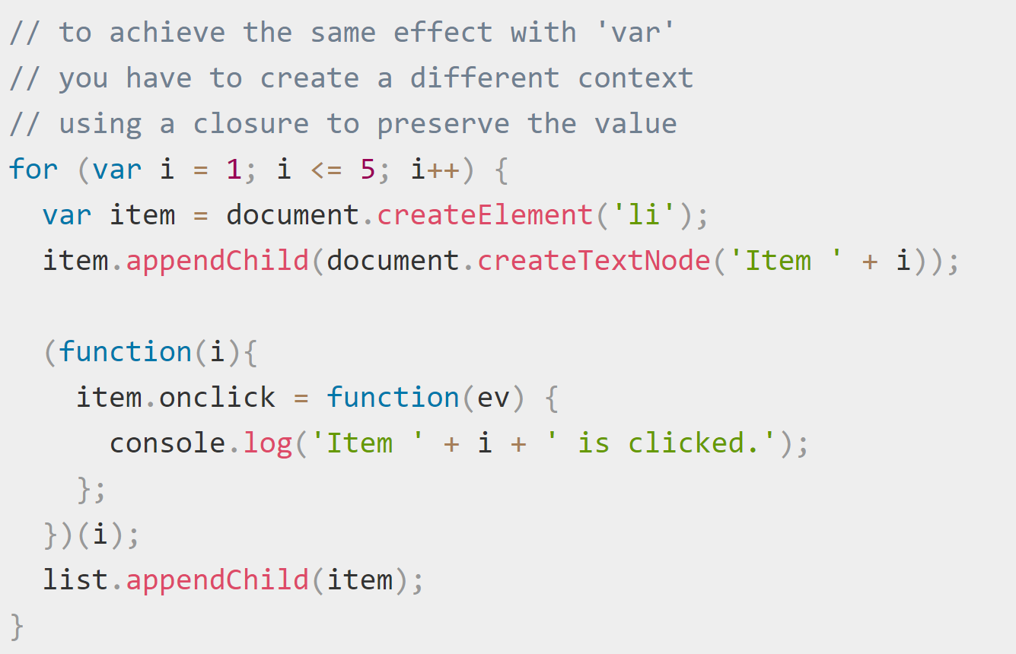
Using var you kind of have to tie yourself in knots to find an appropriate scope via the closure
https://developer.mozilla.org/en-US/docs/Web/JavaScript/Reference/Statements/let

Slide 14
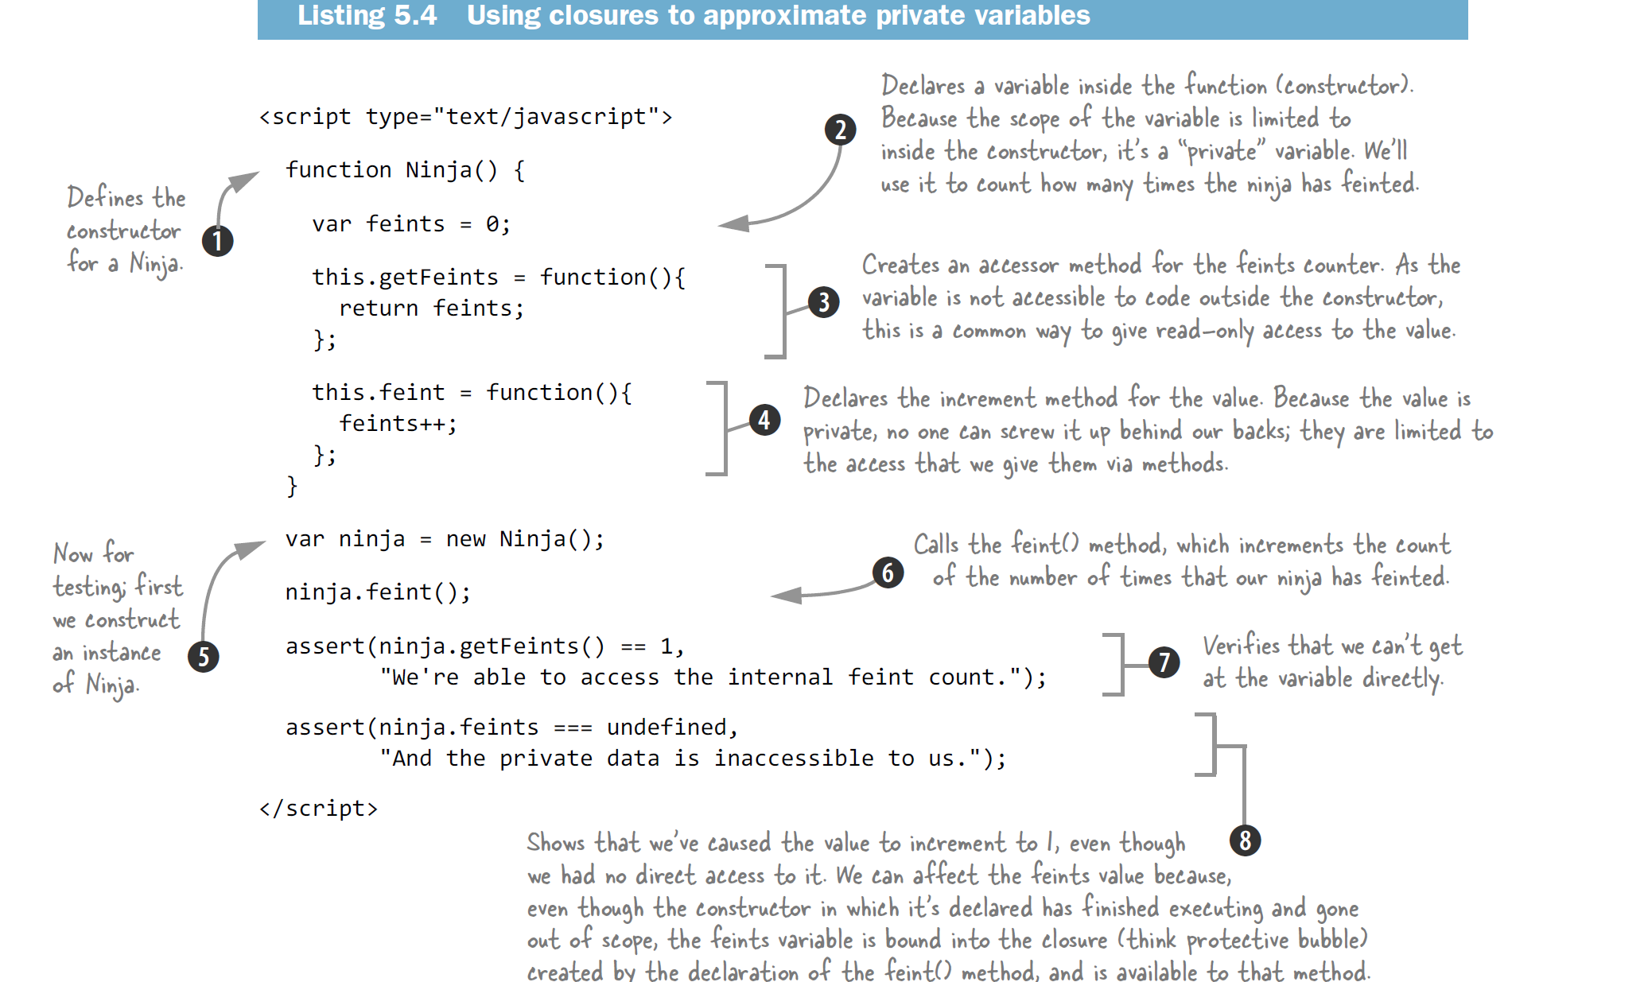
Closures can be used to make functions have the equivalent of private instance variables….
Secrets of the Javascript ninjas

Slide 15
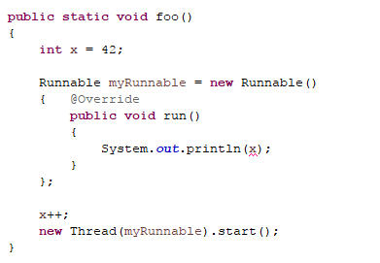
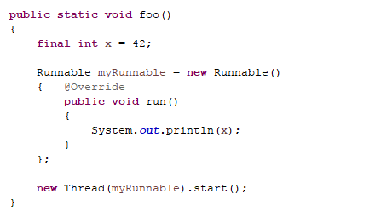
Note that we (sort of) had closures in Java (but the inner functions could only access final data…)
Here the inner class has access to x, but Java requires that x be final or “effectively final”
This compiles fine…

Slide 16
Scoping in Javascript
Closures are central to javascript and allow for encapsulation
Javascript is single-threaded

Slide 17
Javascript does not allow multiple threads to share access to mutable data.
There is no equivalent to new Thread().start().
There are no Semaphores or other methods for co-ordinating multiple threads.
“Everything is multi-threaded except your code”
However, javascript can still manage multiple events via the use of closures and callback functions…

Slide 18
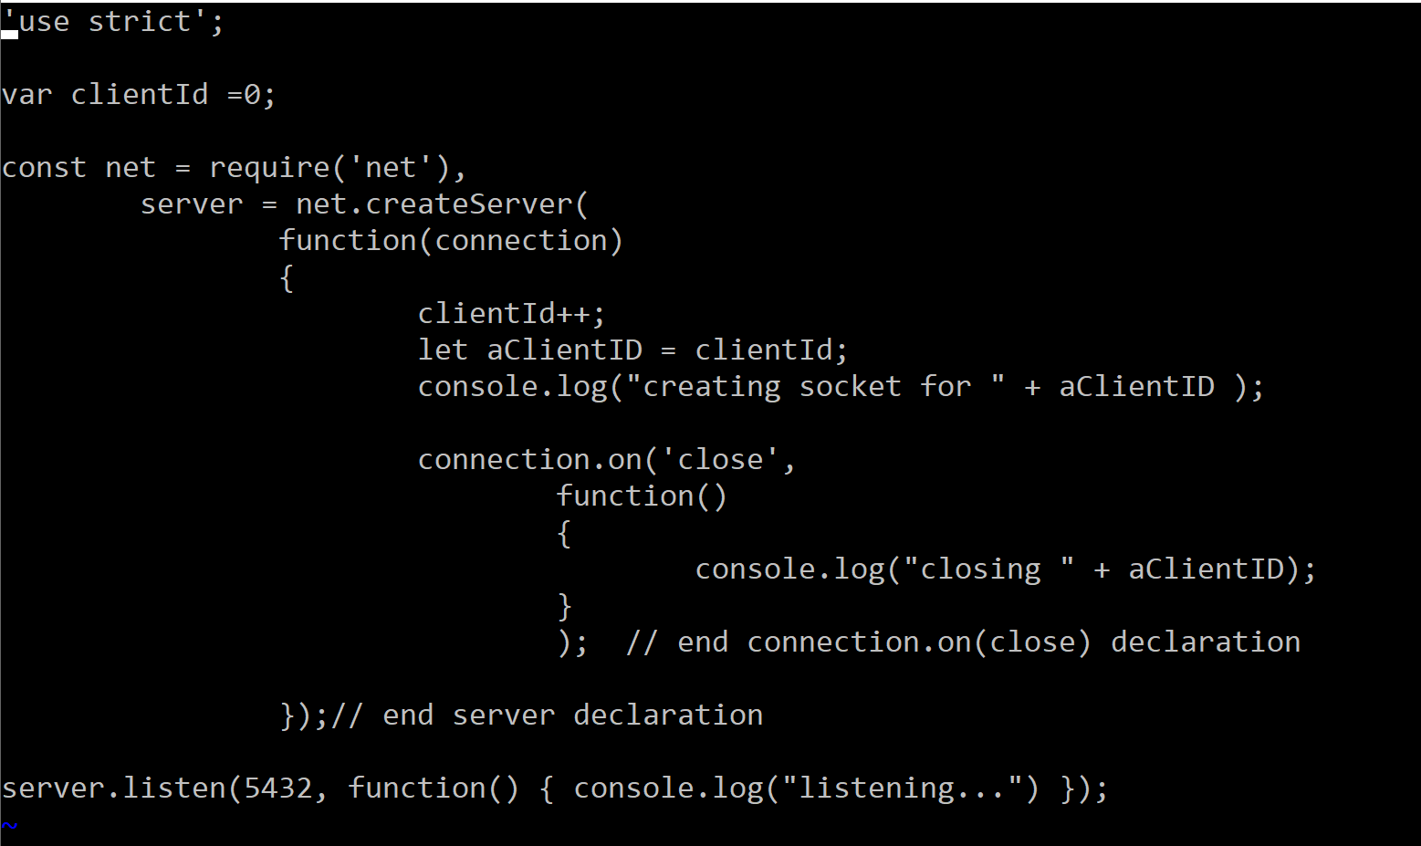
Here is a skeleton server that allows each client to have an associated state (via closures)
Capture local
variables via closures

Slide 19
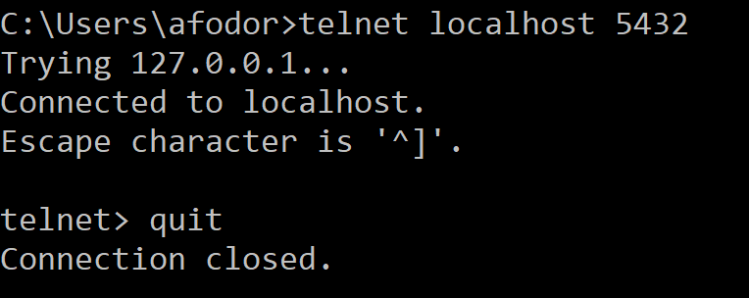
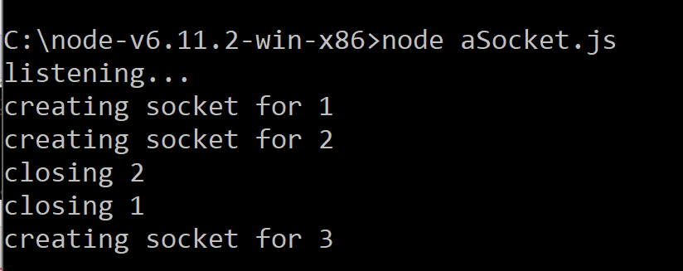
Via the closure, each client can have its own state…

Slide 20
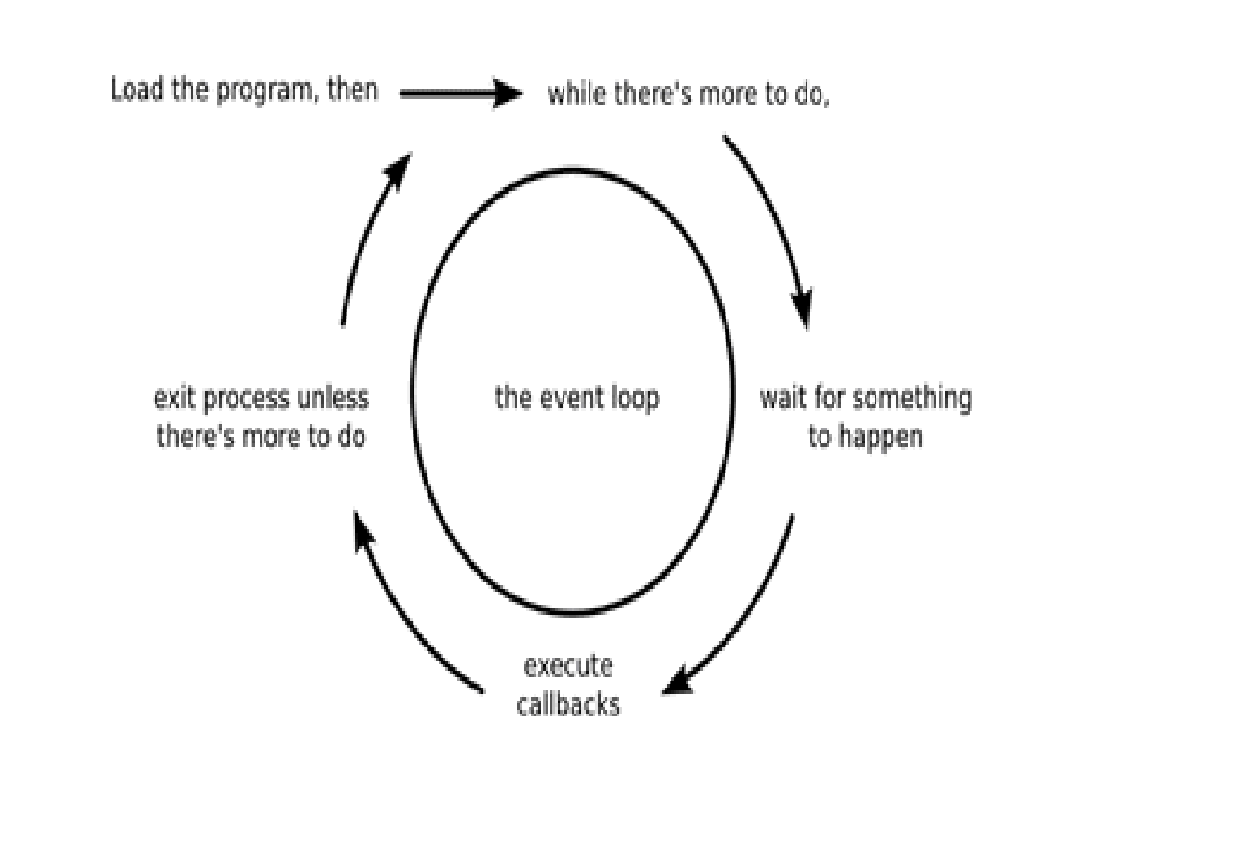
The javascript event loop runs single-threaded and waits for something to happen via a callback function…
Node.js: the right way

Slide 21
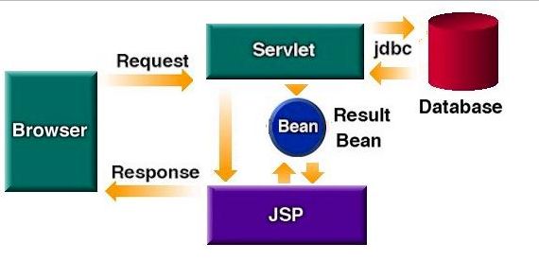
Compare this to the java/servlet web cycle where each request to a servlet can
(potentially) start a new thread…
http://www.kirkdorffer.com/jspspecs/images/scenario2.jpg

Slide 22
Javascript server
Synchronous startup-
Load libraries and other startup tasks that
might be slow
Asynchronous serving-
Slow things must be relegated to a server
or background process or otherwise off the
event loop
Java server
Single threaded startup-
Load libraries and other startup tasks that
might be slow
Multi-threaded serving-
Each request can be handled in its own thread
Any individual thread can block
(as long as there are still some threads to handle the
new requests)
Allow for shared access to mutable data structures.
When the slow things gets done, call back
To the asynchronous event loop.
None of your code in the event loop should block

Slide 23
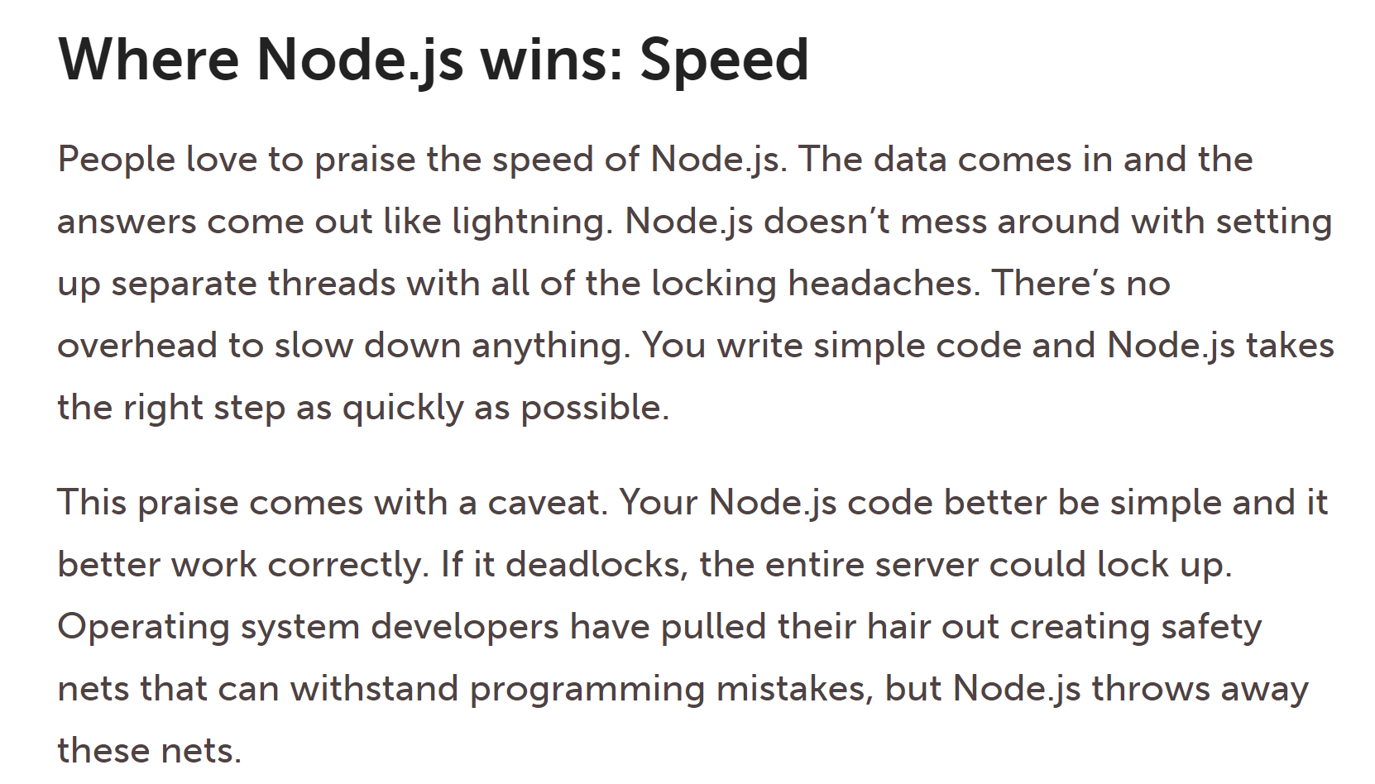
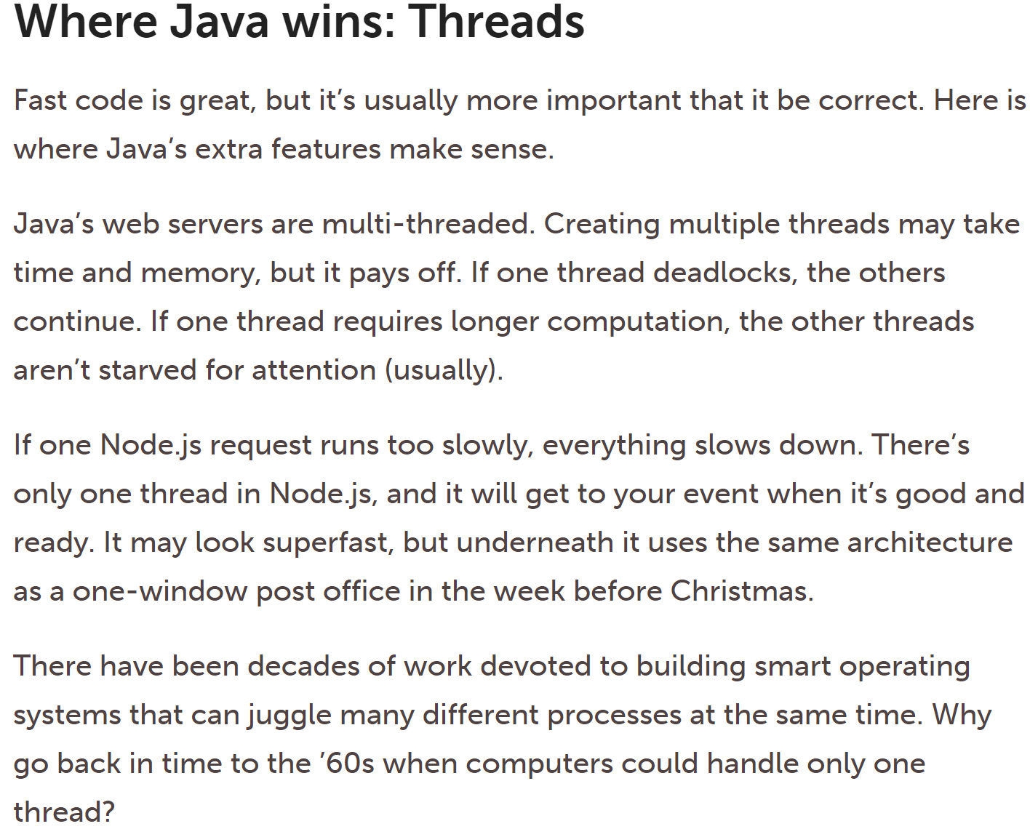
With lack of overhead, node.js can actually be faster…
https://www.infoworld.com/article/2883328/node-js/java-vs-nodejs-an-epic-battle-for-developer-mindshare.html

Slide 24
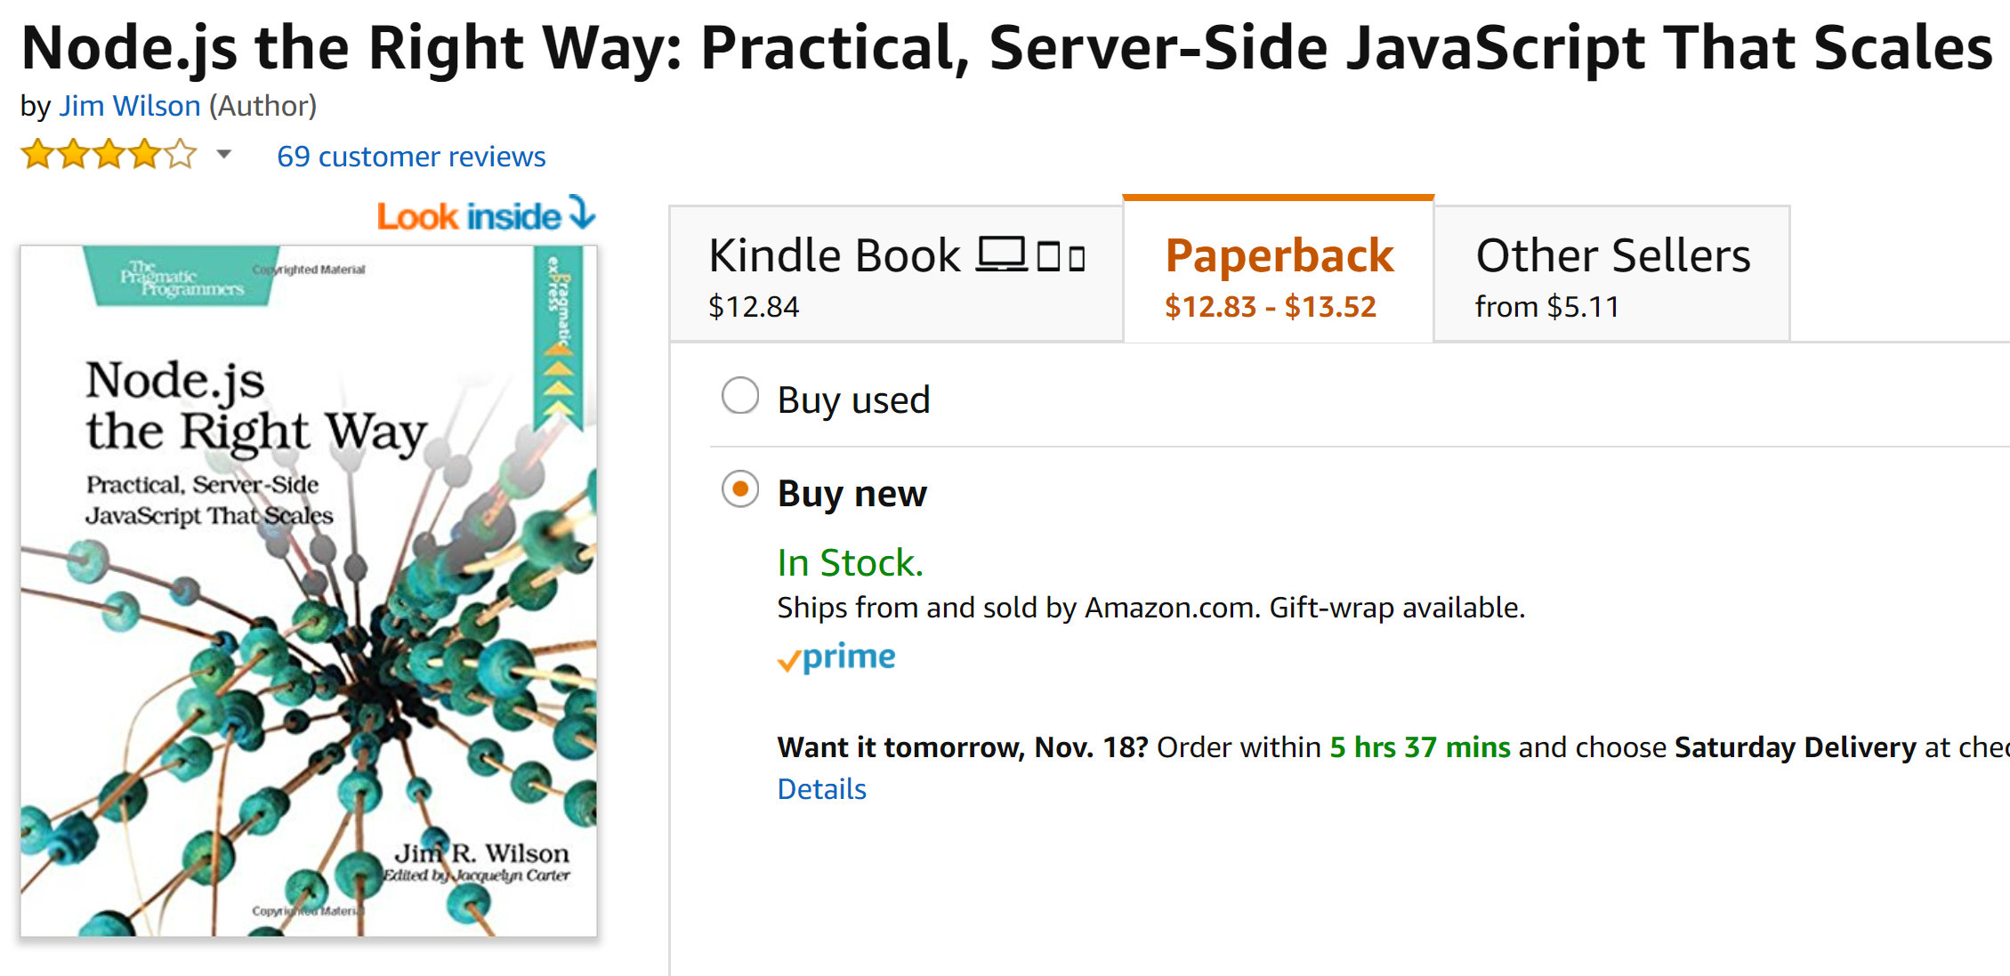

Slide 25


