Slide 1
AbstractSequence, ProteinSequence and DNASequence
HashSet
equals() and hashCode()
Iterators
HashSet, LinkedHashSet, TreeSet

Slide 2
A more bioinformatics driven example of code reuse through inheritance
AbstractSequence
double getRatioValid()
abstract Set<Character> getAlphabet()
is a
is a
ProteinSequence
DnaSequence
double getRatioHydrophobic()
double getGCRatio()

Slide 3
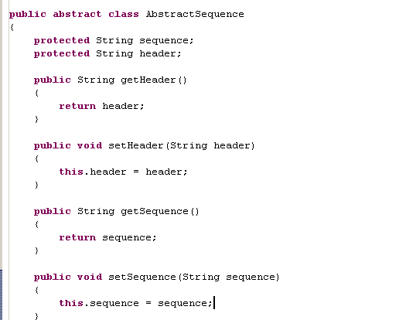
The sequence and the header are common to both DNA and Protein,
so they live in the abstract super-class

Slide 4
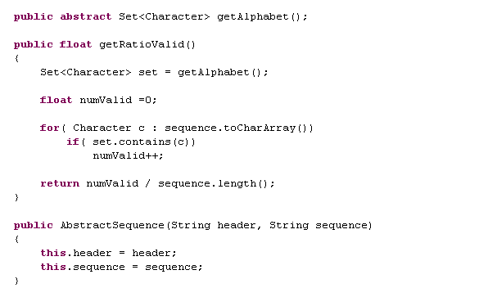
AbstractSequence (continued)….
DNASequence and
ProteinSequence will
provide an alphabet of valid characters
This calculation will be the same for protein and
DNA sequences, so lives in the Abstract class
The constructor will set the
sequence and the header

Slide 5
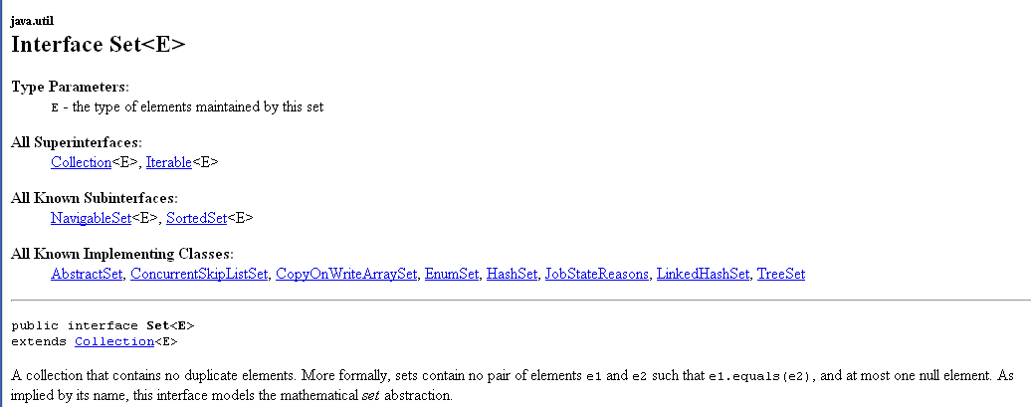
A set holds no duplicate elements (not necessarily in any order).
A list can have duplicate elements (and is always ordered)

Slide 6
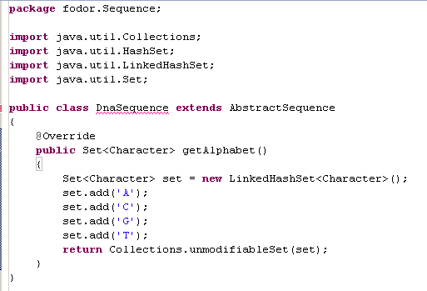
Here we start to build our implementation of DnaSequence
This is a set which does maintain an order (the same order as elements were added; much more on this later!)
A little bit of extra safety;
We don’t let anyone modify our set once
we publish the reference to it.
This still doesn’t compile…
We are trying to call the default constructor on AbstractSequence()
(but there isn’t one)

Slide 7
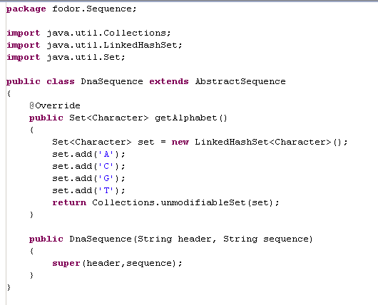
This fixes the problem
We have the new keyword “super” that calls the constructor of the superclass
This is the entire DnaSequence class.
getRatioValid() is defined at the abstract superclass level and is inherited from AbstractSequence

Slide 8
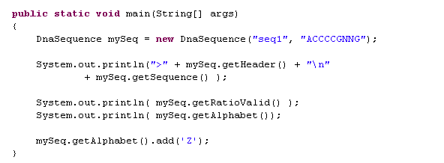
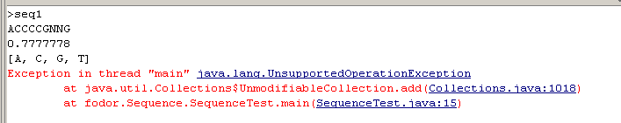
We can instantiate our DnaSequence
DnaSequence constructor chains
To AbstactSequence constructor
Methods defined in AbstractSequence
Abstract method in AbstractSequence;
Implemented in DnaSequence.
(toString() is defined by the HashSet implementation)
No; we can’t modify the alphabet
(because we returned Collections.unmodifiableSet())

Slide 9
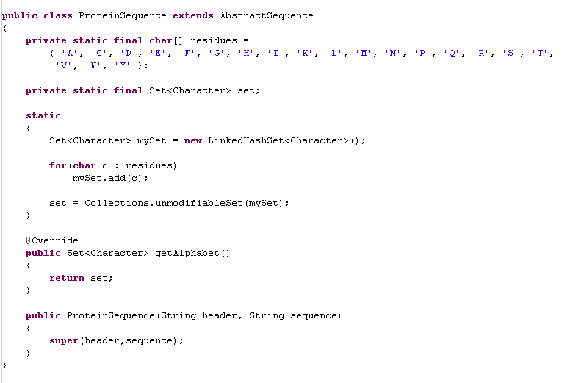
Here is one possible implementation of ProteinSequence
We extend AbstractSequence
Just to save on typing
“set.add(‘Amino Acid’)”
20 times
Our static initializer to set up
our cached alphabet
We cache the alphabet
(so we don’t have to make
a new one each time getAlphabet() is called)
We chain to the superclass constructor as before

Slide 10
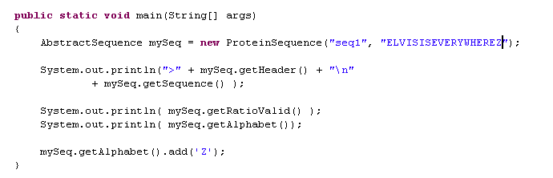
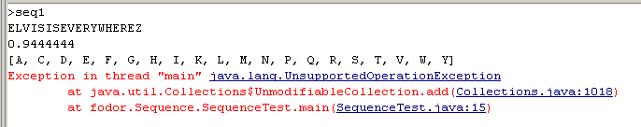
And here is an instantiation of ProteinSequence

Slide 11
AbstractSequence, ProteinSequence and DNASequence
HashSet
equals() and hashCode()
Iterators
HashSet, LinkedHashSet, TreeSet

Slide 12
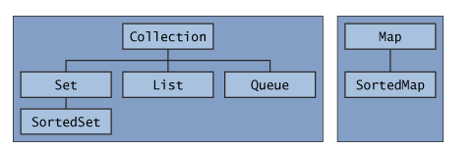
Lists and Sets are part of the Collections API
(written in part by Josh Bloch and introduced in Java 1.4)
http://java.sun.com/docs/books/tutorial/collections/interfaces/index.html
The Collections API

Slide 13
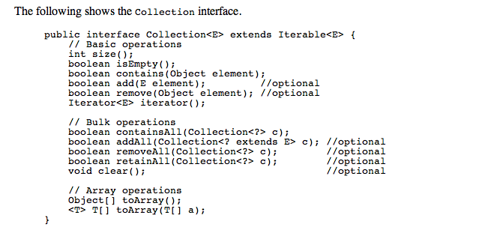
http://java.sun.com/docs/books/tutorial/collections/interfaces/index.html

Slide 14
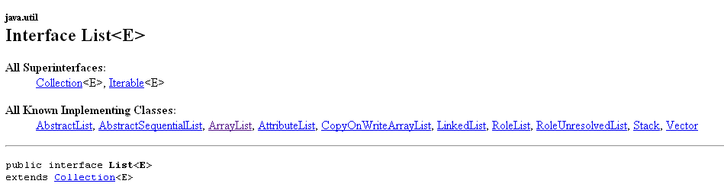
The interface List implements Collection
(meaning all of the function names in the interface List are also in the interface Collection)

Slide 15
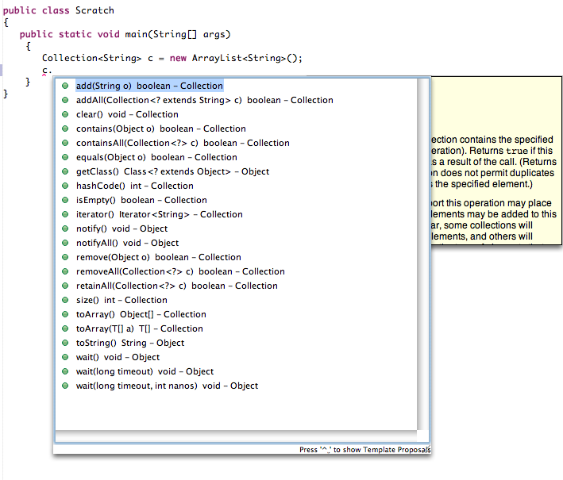
So, we can refer to an ArrayList as a List or as a Collection.
But there is no get(x) or set(x, Element) if we refer to the ArrayList as a Collection
(because those concepts do not belong to all Collections)

Slide 16
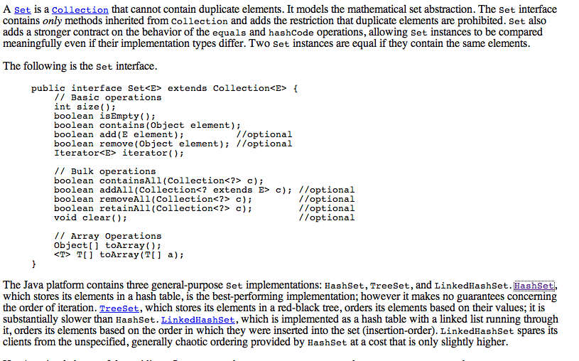
A Set is another type of Collection that cannot contain duplicate elements and is
not necessarily ordered
http://java.sun.com/docs/books/tutorial/collections/interfaces/set.html

Slide 17

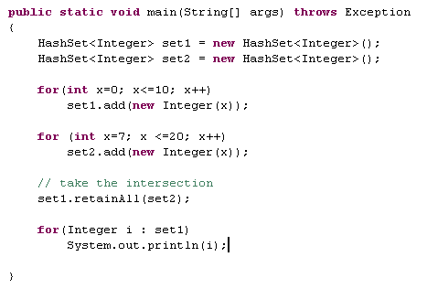
Sets are extraordinarily useful.
You can do some nice things with small amounts of code…
Note the order is not maintained
(more on this later…)

Slide 18
AbstractSequence, ProteinSequence and DNASequence
HashSet
equals() and hashCode()
Iterators
HashSet, LinkedHashSet, TreeSet

Slide 19
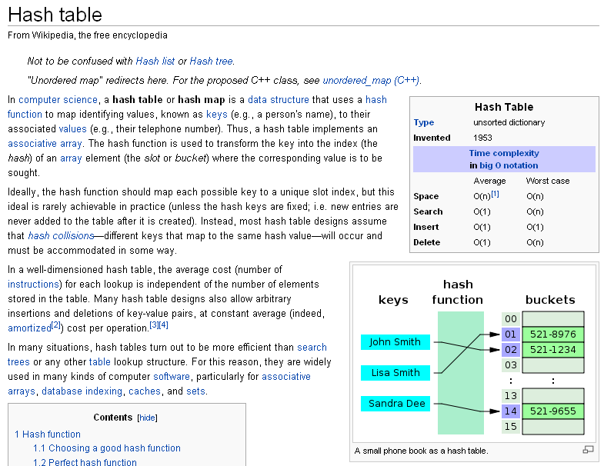
Hash Sets map each element in the Collection to a bucket…
http://en.wikipedia.org/wiki/Hash_table

Slide 20
Consider a HashSet of Strings (made up example)
bucket
0
“A1” “D3” “G4” “L4”
I call .contains(“T3”) on my set.
My hash function works on “T3”
and determines it is in bucket 2.
My hash function works in constant time.
I then have to search bucket 2 for
“T3”. My load balancing algorithm
in the Set should keep only a few
Strings in each bucket, so this
search is quick (linear over just a few
elements).
1
“N3” “C2” “T4” “S3”
2
“T3” “Z1” “S7” “NY”
…..
100
“B21” “L” “S22” “DD”
Because the number of buckets increases with N, but the number of Strings in each
bucket stays about the same, my contains() function scales in constant time
with the size of the database.
Very useful for the large datasets of Bioinformatics!

Slide 21
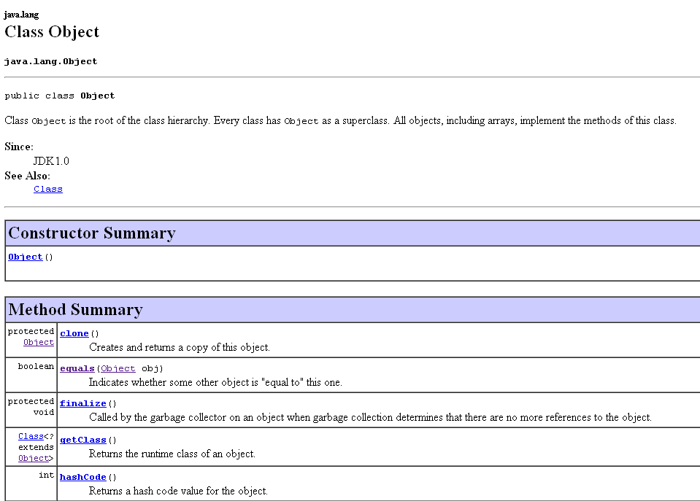
hashCode() is one of the methods in Object.
So every Java object is guaranteed to be able to produce a hashCode()

Slide 22
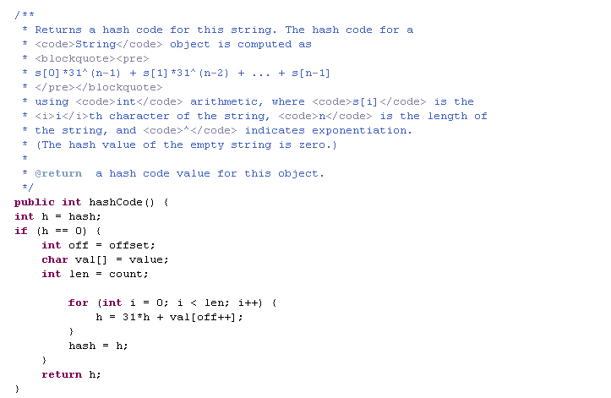
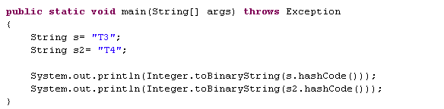

hashCode() for String is some function that is designed to produce a
reproducible pattern of 0 and 1s spread throughout 32 bits for a given String

Slide 23
An example of two Inserts into a HashSet
“T2”
The Objects to be hashed
“T3”
Hash Function (toHash() in String)
Generates some mix of 0’s and 1’s evenly spread
out amount 32 bits
T2 101001011111
T3 101001100000
If we have 8 buckets,
we can take the last 3 bits as the bucket address.
T2 belongs in “bucket 7”
T3 belongs in “bucket 0”
“T
“T2”
“T3”
bucket
0
1
2
3
4
5
6
7
String’s toHash() is linear in time of the length of the String (not the size of the Set).
Insertion time is independent of the size of the collection…

Slide 24
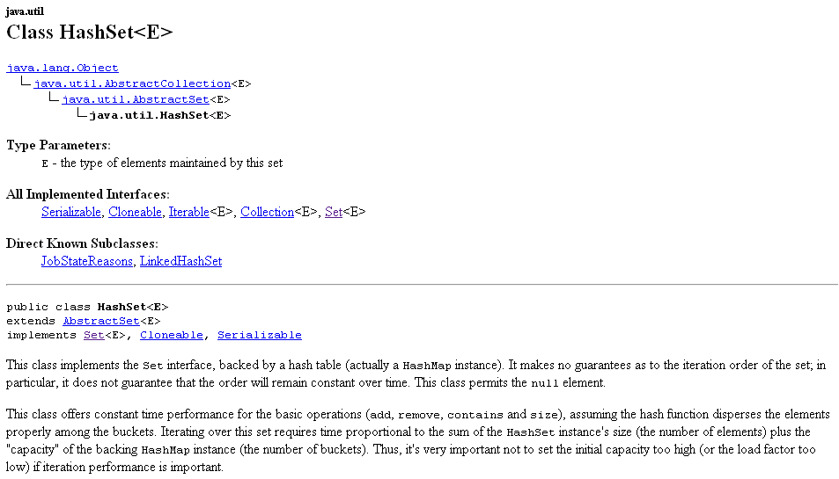
For Java’s built in classes (like String), there is a “good enough” hash function.
For our classes, we have to provide a hash function.
We do this by overriding Objects hashCode() method in our object…

Slide 25
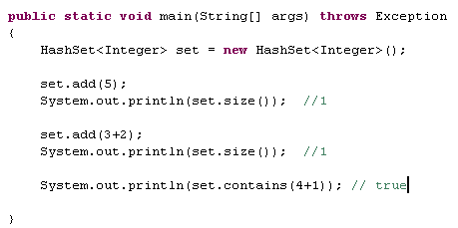
No two elements in a HashSet can be equal

Slide 26

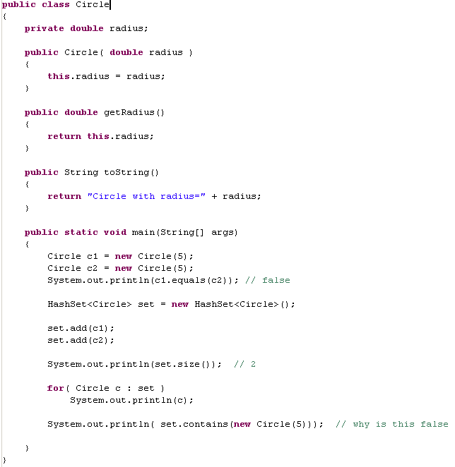
But we have to tell Java what we mean by equal()
Because we have not over-ridden .equals()
for circle, the default .equals returns c1==c2
which is false because they are different objects
in different locations in memory
Java doesn’t see our
two Circles as equal

Slide 27
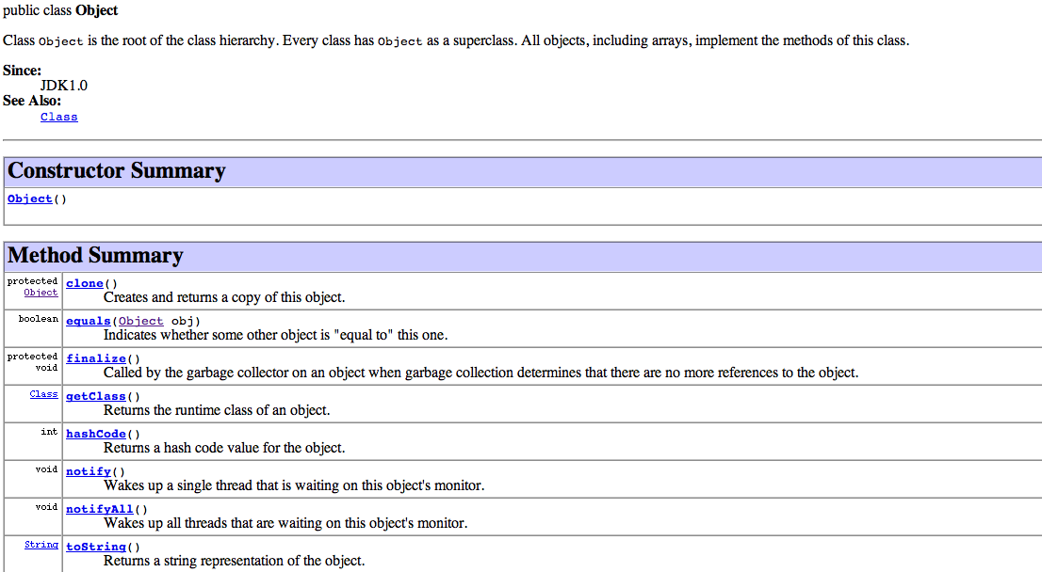
Just like toString(), we need to override equals()
To tell Java what we mean by two objects being equal

Slide 28

The default behavior (from object) is to check to see
if the objects are identical (that is have the same
physical address in memory)
That’s not what we want for Circle

Slide 29
Bloch Item# 8: Obey the general contract when overriding
Equals.
Reflexive: x.equals(x) must be true
Symmetric: x.equals(y) must be the same as y.equals(x)
Transitive: x.equals(y) and y.equals(z) then x.equals(z)
Consistent: equals should only chage if the state of
the objects changes. Should never change for immutable
objects.
x.equals(null) should return false for all non-null x.

Slide 30
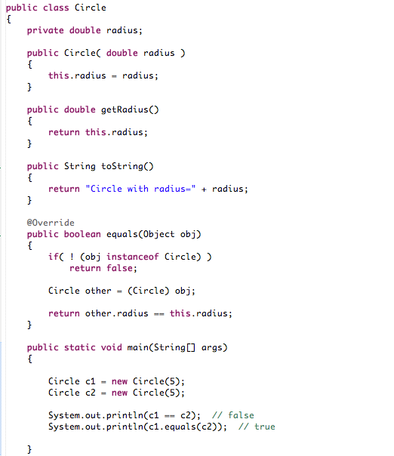
How Bloch says to do it…

Slide 31
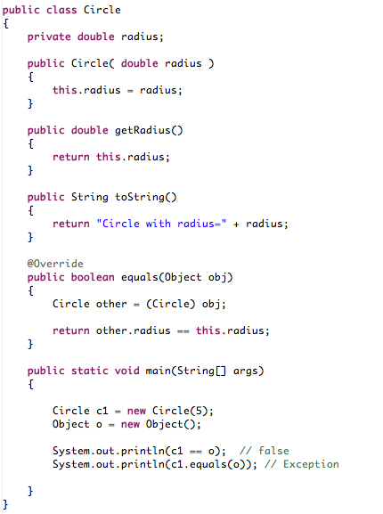

How I usually do it…
May throw a ClassCastException or NullPointerException
Again, I never want to fail silently…

Slide 32

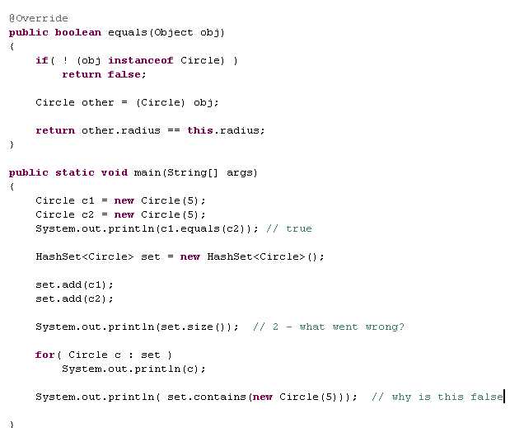
We override .equals so that two Circles with the same radius are equal
But HashSet still treats two Circles with the same radius as distinct.
What went wrong?
Here we can use == since this is a primitive
Item #9: Always override hashCode when you override equals

Slide 33
HashSets work with “buckets”
When you call set.contains(new Circle(5))
Circle
Our two Circles use Object’s hashCode().
They may not have the same hashCode() and
hence end up in different buckets!
HashCode for Circle
An Index for an Array of Buckets
Does that bucket contain a Circle .equal() to
new Circle(5) ??
We are looking in the wrong bucket!

Slide 34
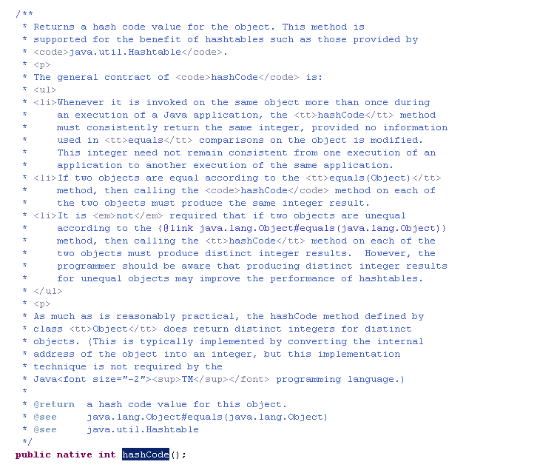
Object’s hashCode() returns an integer representation of that object’s position in memory

Slide 35
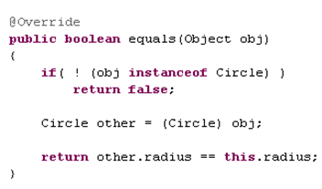
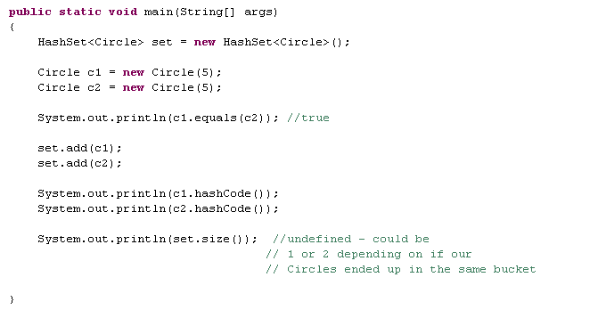

We didn’t override .hashCode() so we get undefined behavior in our HashSet

Slide 36
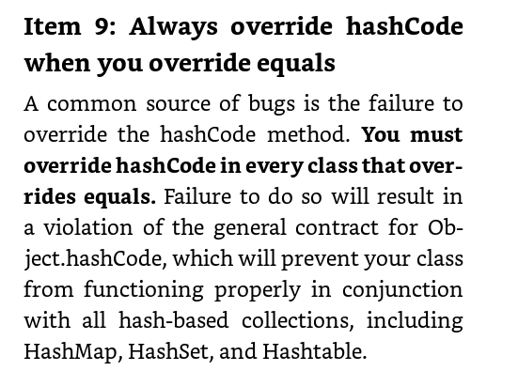
Bloch Item #9:

Slide 37
The hashCode() contract:
When invoked on the same object, it must return
the same hash, unless the state of the object
used for equals() has changed. Does not have
to remain the same for different executions.
If two objects are equal, then calling the hashCode
method on each of the two objects must produce
the same hash.
Two objects that are not equal may return the same
hash, but this may degrade performance.

Slide 38

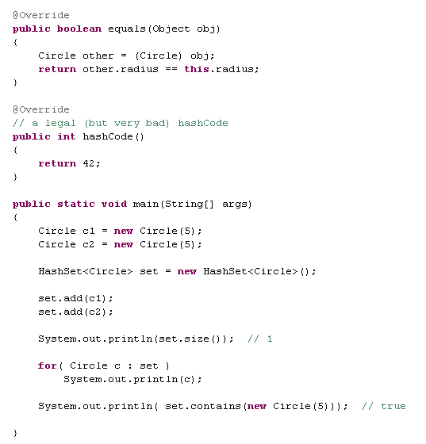
You can obey the contract by returning a constant,
but this will severely degrade performance

Slide 39
HashSets work with “buckets”
When you call set.contains(new Circle(5))
Circle
HashCode for Circle (42)
An Index for an Array of Buckets
(will always be same
bucket)
Does that bucket contain a Circle equal to
new Circle(5) (we will find the circle in our one bucket!)
This works, but the performance for contains will degrade from constant time
(which it should be for a HashSet) to linear time (as if this were a List).
We’ll have to iterate through every object in our one bucket

Slide 40
With a bad (but legal) hash function (like “return 42”) we will achieve the Worst Case complexity
(but our program will still be correct)
http://en.wikipedia.org/wiki/Hash_table

Slide 41
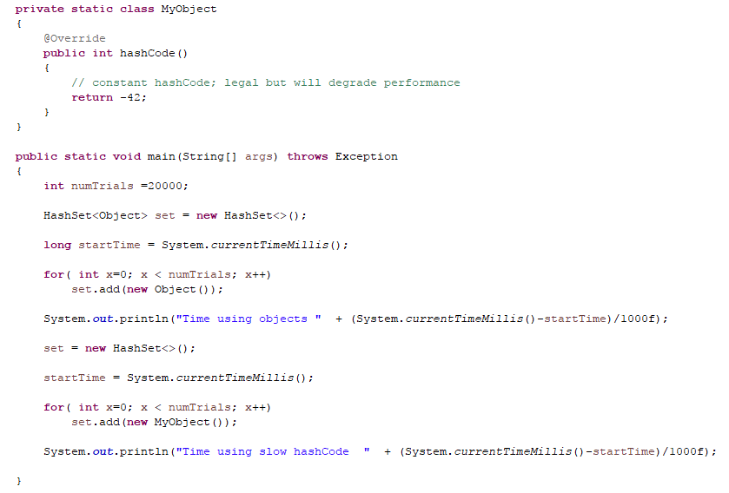

An “legal” but slow hashCode() severely degrades performance
https://github.com/afodor/metagenomicsTools/blob/master/src/classExamples/HashSetPerformance.java

Slide 42
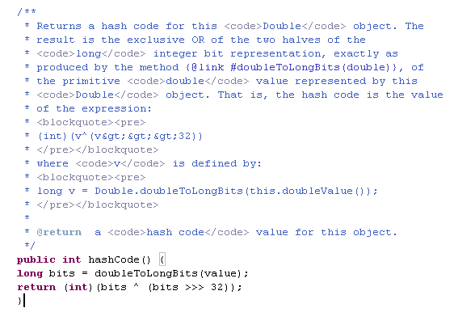
For our Circle, we can make a better hashCode() by looking in the Double class
in Java for the hashCode() for a Double…
One easy solution is just to copy this into our code…

Slide 43
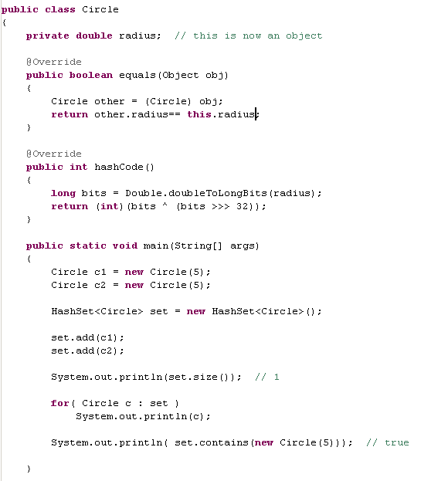
Bloch (Item #9) notes that Java’s hashes are not very good
(meaning the 1s are not very evenly distributed throughout the integer).
On the other hand, good enough!

Slide 44

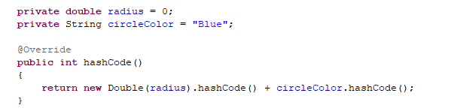
You can usually figure out how to use Java’s hashes for most of your objects.
If you can represent the data in your object as a String call, string.hashCode().
If a primitive type, copy the hashCode() from the corresponding class
(e.g. Double’s hashCode() for a double)
If the state of your object depends on multiple fields you can add
the hashCode of each field
Alternatively, Bloch Item #9 gives a formula that is easy to use…

Slide 45

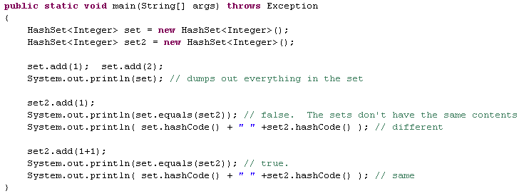
equals(), hashCode() and toString() are all overriden
in HashSet()

Slide 46
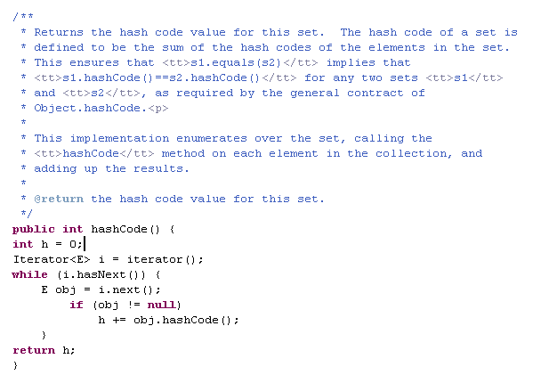
The hashCode() of a set is simply the sum
of all the hashCode() of everything in the set
And, of course, the hashCode of an Integer is
just the value of that integer

Slide 47
AbstractSequence, ProteinSequence and DNASequence
HashSet
equals() and hashCode()
Iterators
HashSet, LinkedHashSet, TreeSet

Slide 48
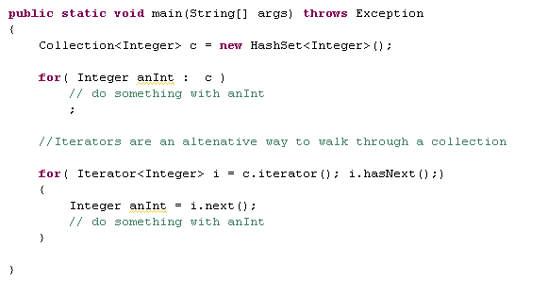
Iterators are an alternative way to walk through a collection….

Slide 49
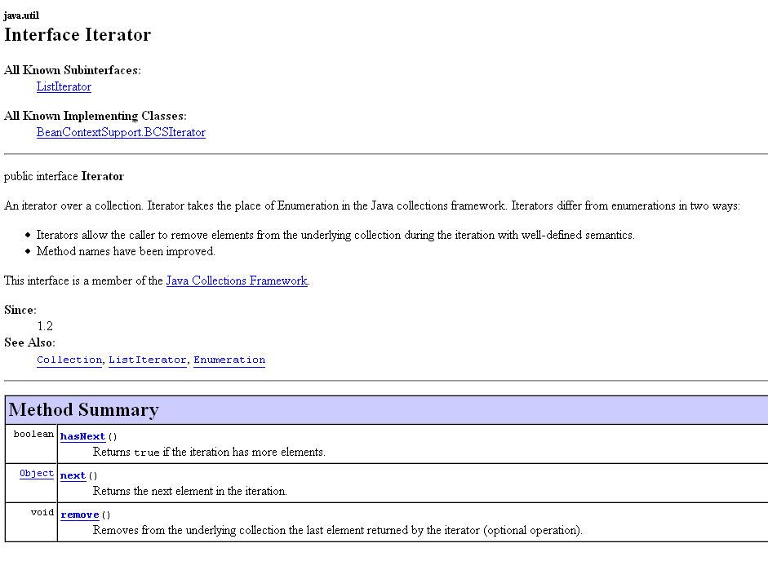

Slide 50

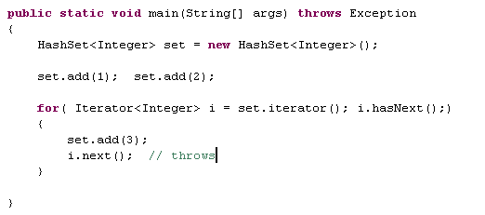
You cannot change the contents of your collection
while iterating through it except by using
Iterator.remove()

Slide 51
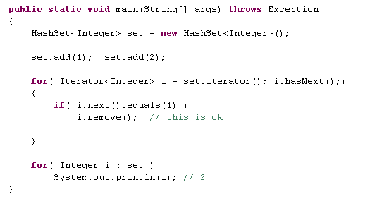
You cannot change the contents of your collection
while iterating through it except by using
Iterator.remove()
I usually prefer the for ( : ) syntax, which was new in Java 1.5.
But the .remove() method in Iterator can be handy.

Slide 52
AbstractSequence, ProteinSequence and DNASequence
HashSet
equals() and hashCode()
Iterators
HashSet, LinkedHashSet, TreeSet

Slide 53
Object
Collection
(interface)
Set
(interface)
HashSet
(fast, no order)
TreeSet (slow,
Orders elements by
Natural order or
Comparator)
LinkedHashSet
(a little slower,
retains order in which
elements are added)
When in doubt use HashSet because it is the fastest!!

Slide 54
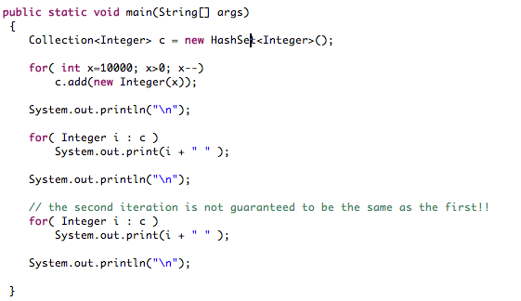

Hash set has no order, but is constant time for
add, remove, contains and size!
Interface
Implementation
Iteration order may or may not be the same both times

Slide 55
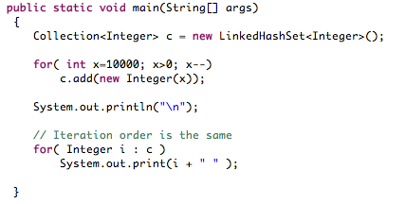
LinkedHashSet maintains the order that elements are added
Performance is usually just a little slower than HashSet

Slide 56
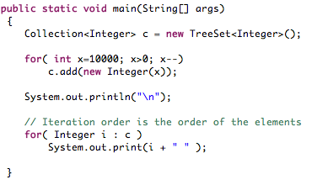
TreeSet maintains the order of the elements.
Much slower than HashSet. O(n) time for add, remove, contains.
Can be faster than sorting a List ( which is n*log(n)).
(You can pass a Comparator to the TreeSet constructor
instead of using the “natural order”)

Slide 57
Still to come...
HashMaps…
Boxing and unboxing primitives in Java
Exceptions
Constructor chaining

