Slide 1
Some simple neural networks in Java

Slide 2
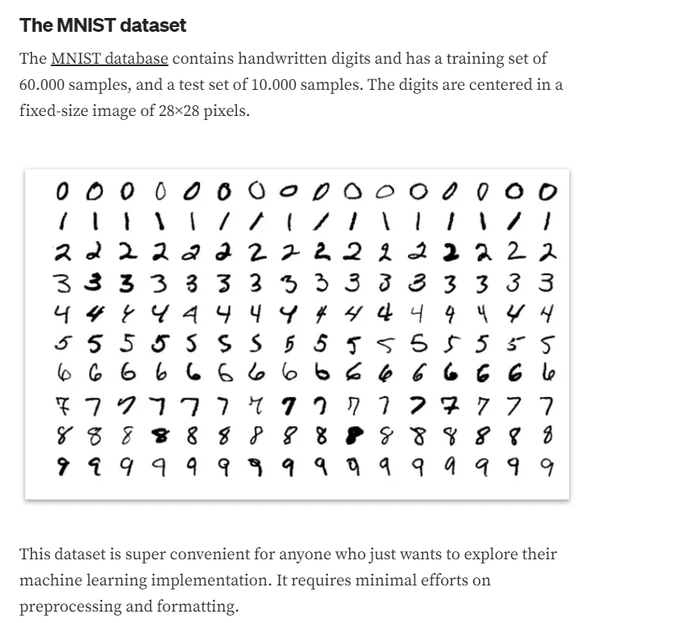
The MNIST dataset is a collection of 60,000 training images and 10,000 test images of digits.
Widely used machine learning dataset.
Each image is 28*28 pixels; greyscaled single byte images.
https://towardsdatascience.com/part-5-training-the-network-to-read-handwritten-digits-c2288f1a2de3

Slide 3
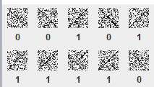
To start, we are going to make an even simpler “hello world” dataset…
We will have two categories:
We asked chatGPT to whip up some Java code to make this for us…

Slide 4
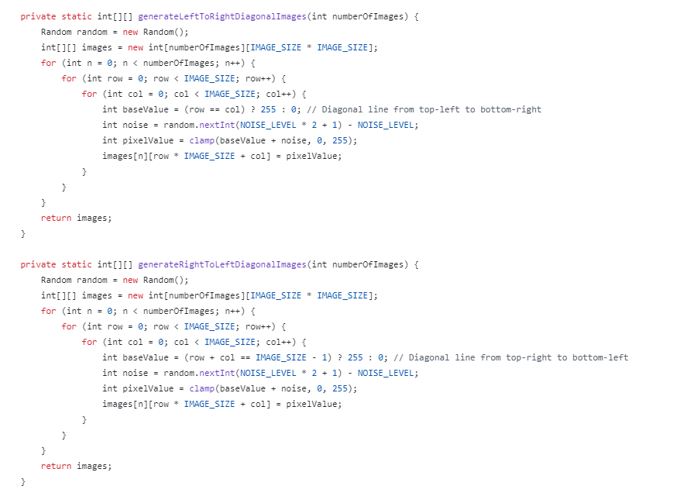
We asked chatGPT to whip up some Java code to make this for us…
https://github.com/afodor/mnistMaven/blob/main/src/main/java/simpleSampleData/SyntheticMNISTGenerator.java

Slide 5
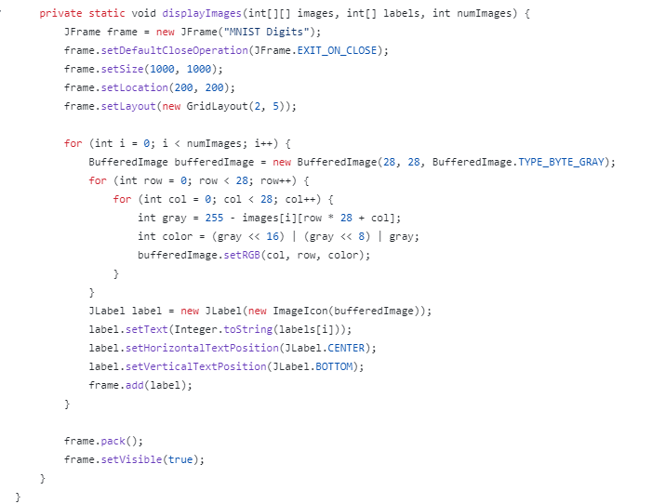
And we asked ChatGPT to make code to show the first 10 generated figures…
https://github.com/afodor/mnistMaven/blob/main/src/main/java/simpleSampleData/MNISTReader.java

Slide 6
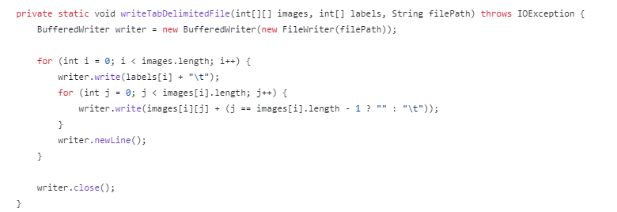
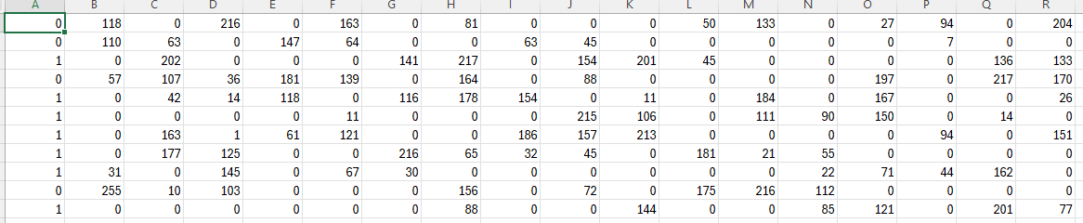
And we asked chatGPT to write the dataset to a tab-delimited text file
Class label
Pixels (28*28 total columns)
https://github.com/afodor/mnistMaven/blob/main/src/main/java/simpleSampleData/MNISTToTabDelimited.java

Slide 7
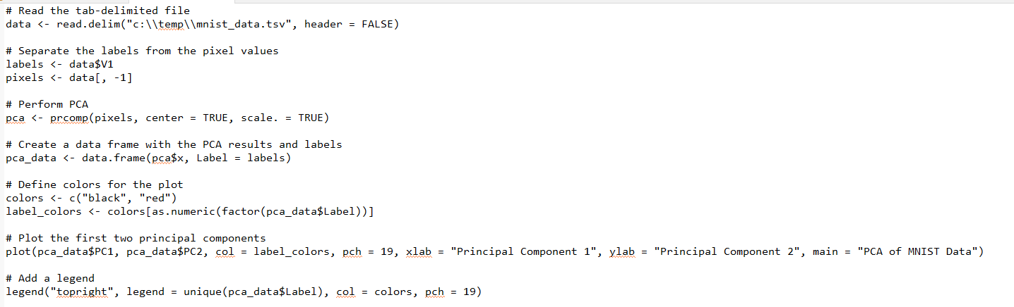
We can visualize the dataset with PCA to begin to build visual intuitions about the data
(this is modified ChatGPT code…)
https://github.com/afodor/mnistMaven/blob/main/src/main/java/simpleSampleData/PCA_on_MNIST.txt

Slide 8
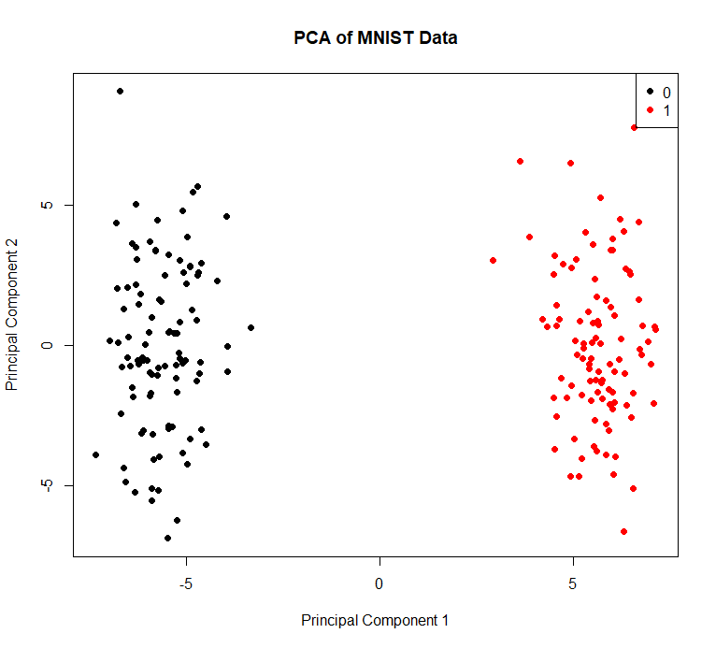
We can visualize the dataset with PCA to begin to build visual intuitions about the data
This tells us that this is an easy classification problem.
We could build a highly accurate classifier by
just using the first PCA component.
Nonetheless, this is a useful “hello world” dataset
To build our first neural network…

Slide 9
We ask ChatGPT to whip up a simple neural network for us to classify our simple sequences.
Input layer
(28*28 neurons)
Hidden layer
(64 neurons)
Output layer
(2 neurons)
(also called
Embedded layer)
This is a dense neural network.
Each node in the preceding layer is connected to each node in the preceding layer with a “weight” parameter

Slide 10
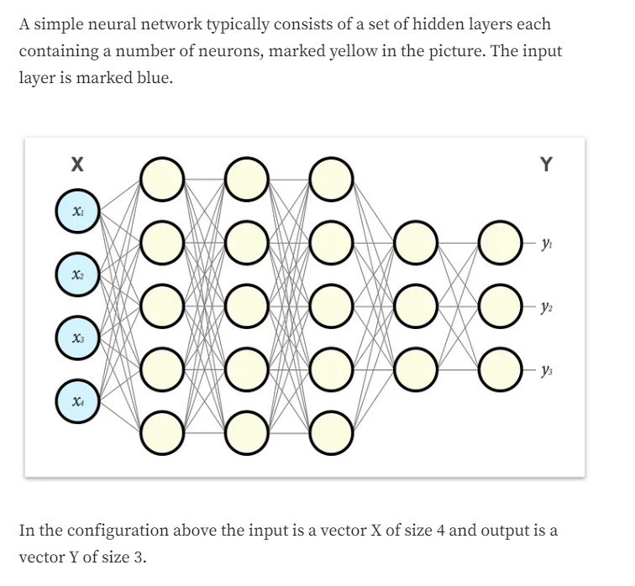
My favorite explanation of this so far is here…
https://towardsdatascience.com/part-1-a-neural-network-from-scratch-foundation-e2d119df0f40
I used the ideas in these web pages (but not the code)

Slide 11
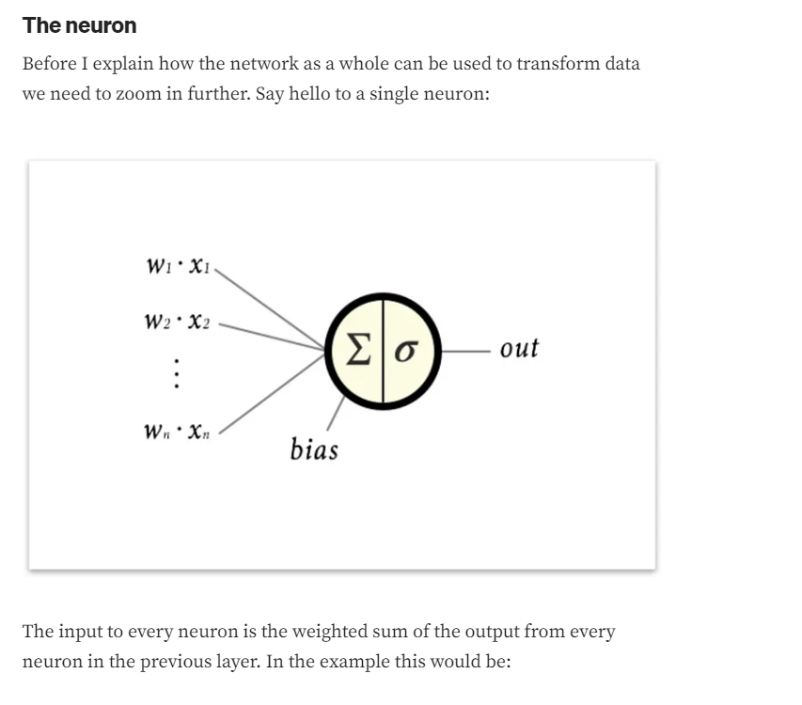
https://towardsdatascience.com/part-1-a-neural-network-from-scratch-foundation-e2d119df0f40

Slide 12
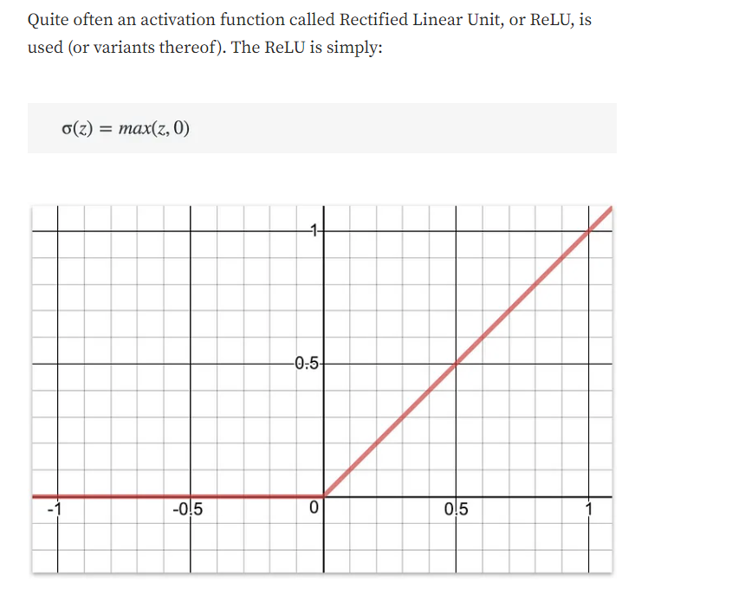
We have to choose an activation function that puts the value in each node of the network
https://towardsdatascience.com/part-1-a-neural-network-from-scratch-foundation-e2d119df0f40

Slide 13
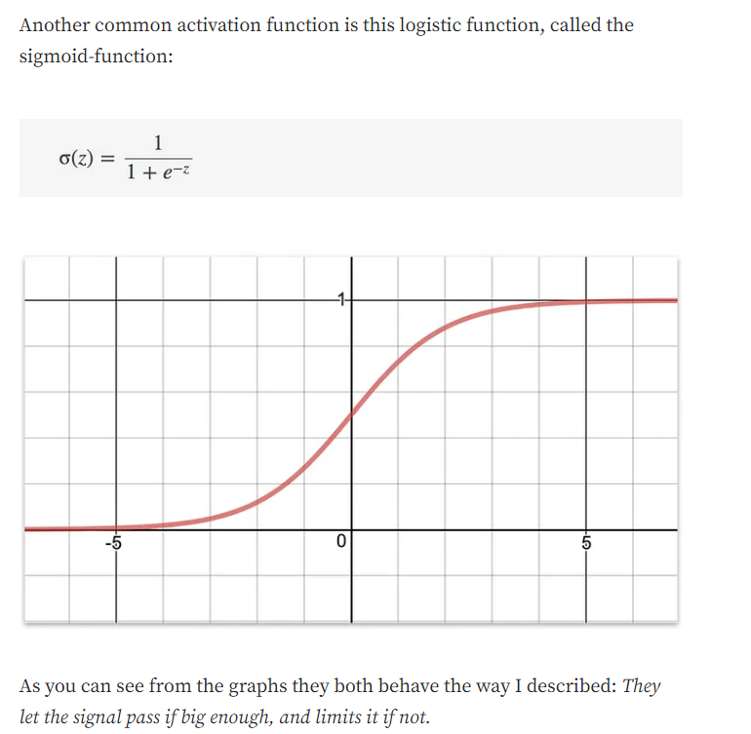
https://towardsdatascience.com/part-1-a-neural-network-from-scratch-foundation-e2d119df0f40

Slide 14
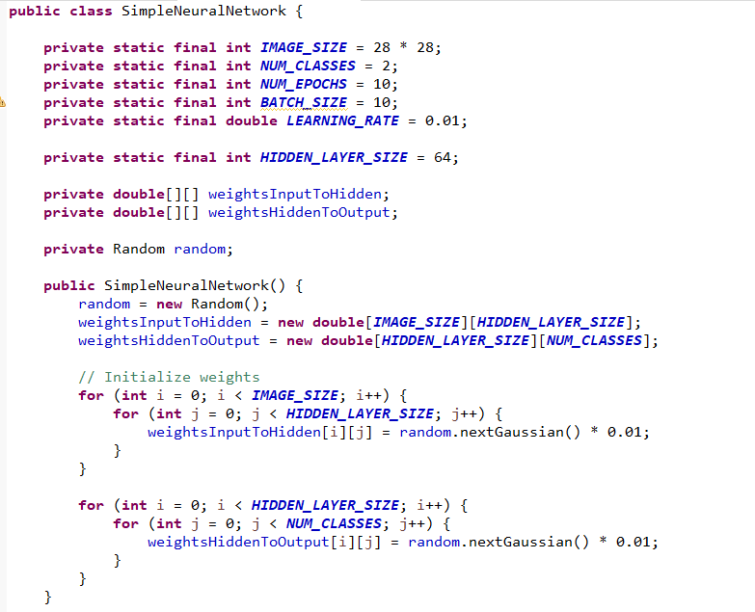
With this background, we can read ChatGPT’s code…
Two classes in our hello world dataset
(won’t use batches yet!)
Input layer
(28*28 neurons)
Hidden layer
(64 neurons)
Output layer
(2 neurons)
We have 28*28*64 parameters connecting the
Input layer to the hidden layer
We have 64*2 parameters connecting the hidden
Layer to the output file.
Our simple code does not have a bias term
(more on this later)
https://github.com/afodor/mnistMaven/blob/main/src/main/java/simpleSampleData/SimpleNeuralNetwork.java

Slide 15
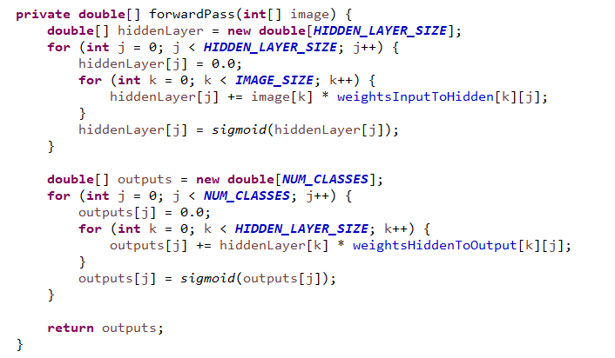
Here we do a forward pass on a single image (containing 28*28 pixels).
Input layer
(28*28 neurons)
Hidden layer
(64 neurons)
Output layer
(2 neurons)
https://github.com/afodor/mnistMaven/blob/main/src/main/java/simpleSampleData/SimpleNeuralNetwork.java

Slide 16
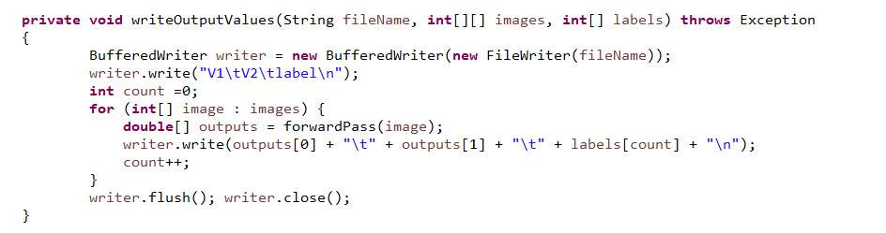
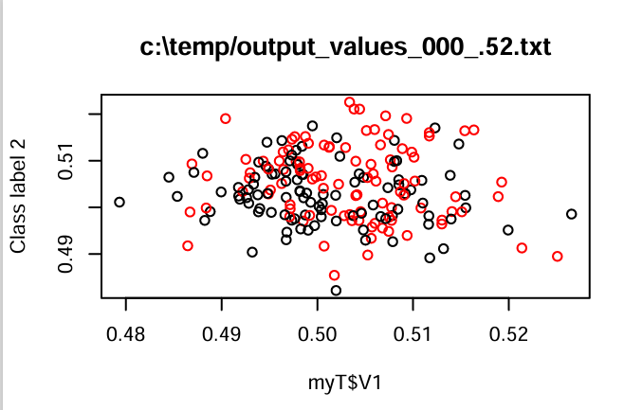
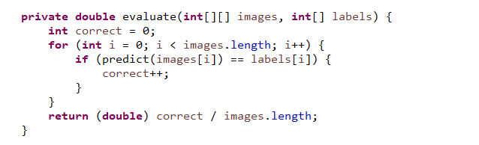
We can make an output file to visualize the last state (two values) for each image in our dataset
We haven’t done any training on the data yet, so there is not yet separation between our two classes..
The accuracy is 52% (because we
are basically just guessing at random)
R code: https://github.com/afodor/mnistMaven/blob/main/src/main/java/simpleSampleData/plotResults.txt

Slide 17
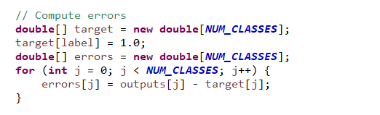
Now we are going to train the model with back propagation.
We have to define a cost function (also called loss function).
target[] has two values ; 1.0 is in the correct slot
The error is the difference between the expected value (0 or 1) and the actual
value for both classes.
Normally you would square this or take the absolute value, but since there
are only two classes (and because this is such an easy problem), what we have here is fine.
https://github.com/afodor/mnistMaven/blob/main/src/main/java/simpleSampleData/SimpleNeuralNetwork.java

Slide 18
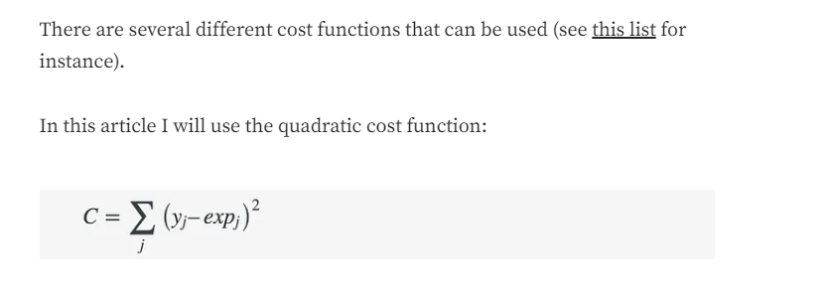
A more robust loss function is described here…
https://towardsdatascience.com/part-2-gradient-descent-and-backpropagation-bf90932c066a

Slide 19
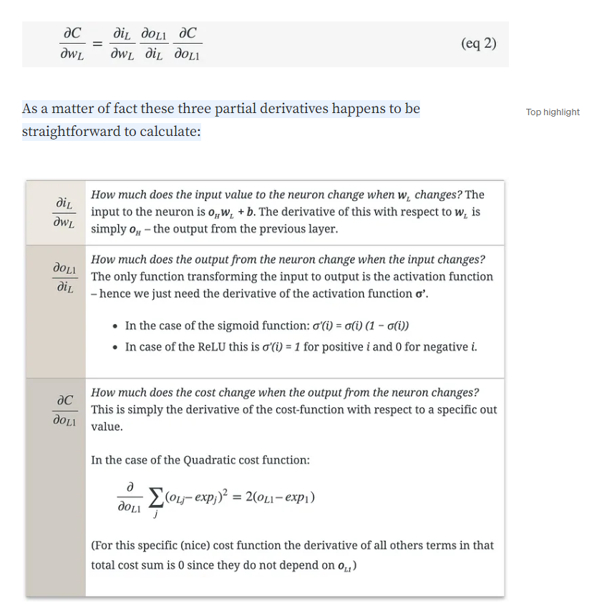
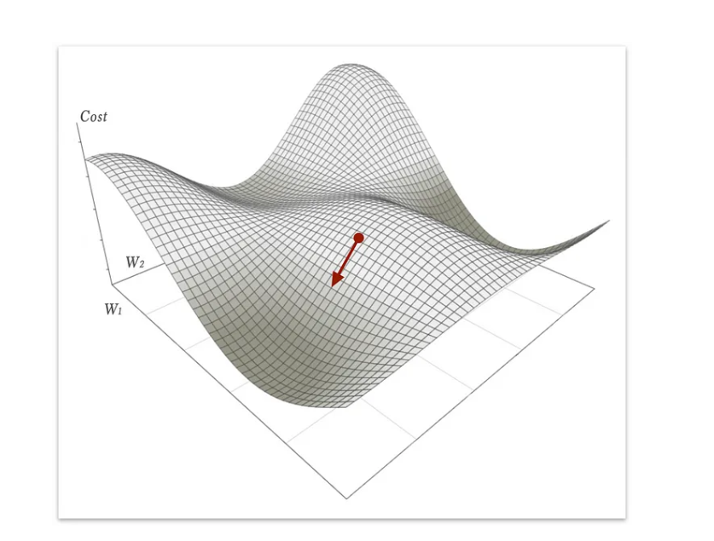
Once we have the loss function, we want to find the parameters that minimize its value…
We do this by taking partial derivatives…
Using dynamic programming, you go from the back of the model to the front…
https://towardsdatascience.com/part-2-gradient-descent-and-backpropagation-bf90932c066a

Slide 20
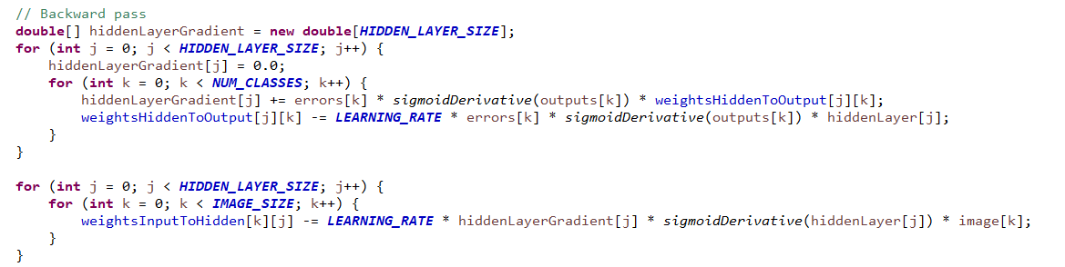
You can see our simple code working its way backwards…
I have NOT gone through this math in detail
https://github.com/afodor/mnistMaven/blob/main/src/main/java/simpleSampleData/SimpleNeuralNetwork.java

Slide 21
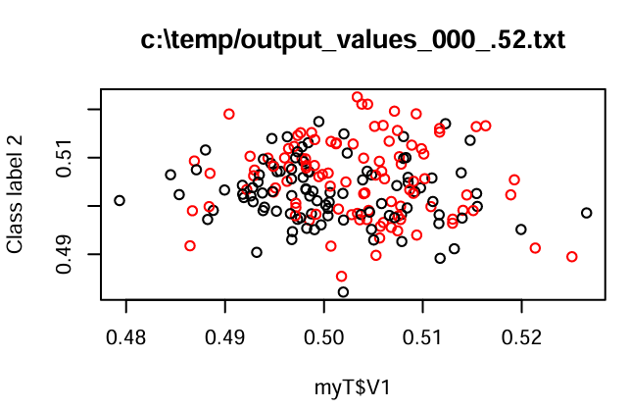
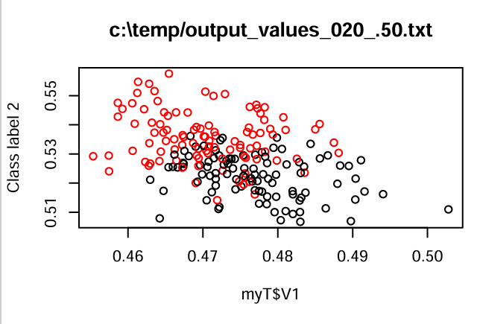
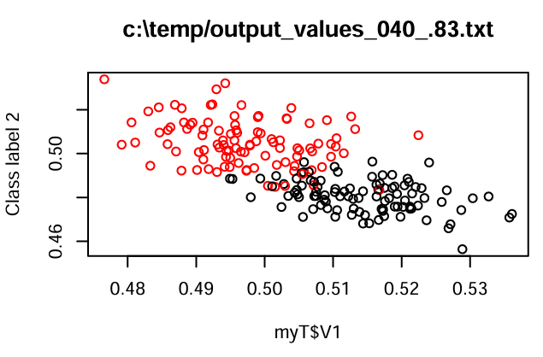
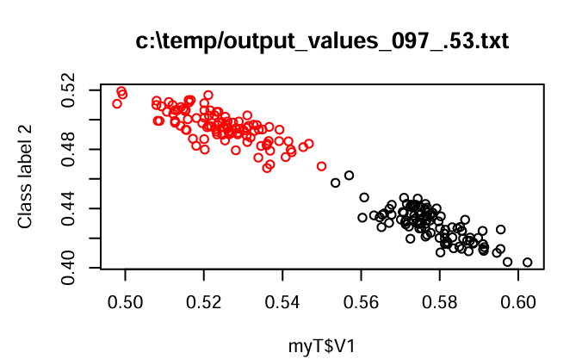
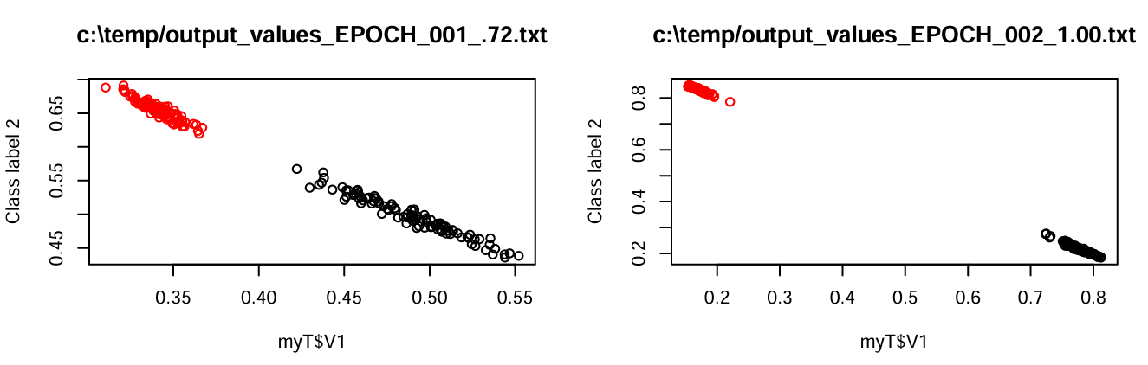
We can watch the learning as we process more images and the accuracy improves…
0 images; 52% accuracy
20 images; 50% accuracy
40 images; 83% accuracy
97 images; 53% accuracy
Using 0.5 as our threshold of accuracy is clearly not ideal, but by the 2nd epoch this doesn’t matter.
Our less than perfectly defined model requires some additional training to compensate for its flaws

Slide 22
We can now move to the full MINST digit dataset
https://towardsdatascience.com/part-5-training-the-network-to-read-handwritten-digits-c2288f1a2de3

Slide 23
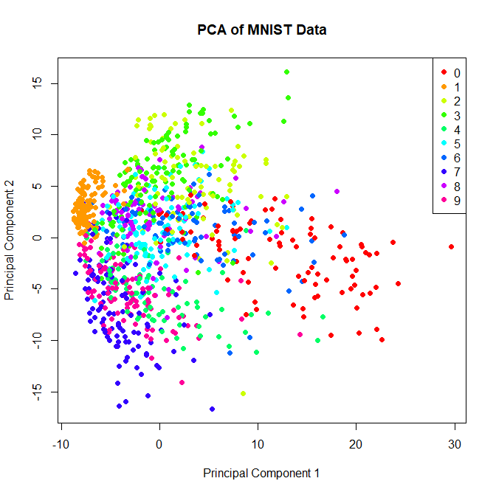
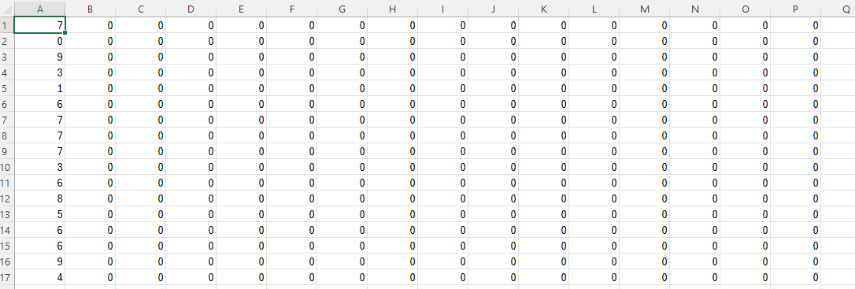
We can again represent this as a tab delimited file and perform PCA
Class label
Pixels (28*28 total columns)
We see this is a much more challenging dataset
(although maybe telling 1 from other digits is not that hard)
https://github.com/afodor/mnistMaven/blob/main/src/main/java/mnist/MNISTToTabDelimited.java
https://github.com/afodor/mnistMaven/blob/main/src/main/java/mnist/PCA_on_MNIST.txt

Slide 24
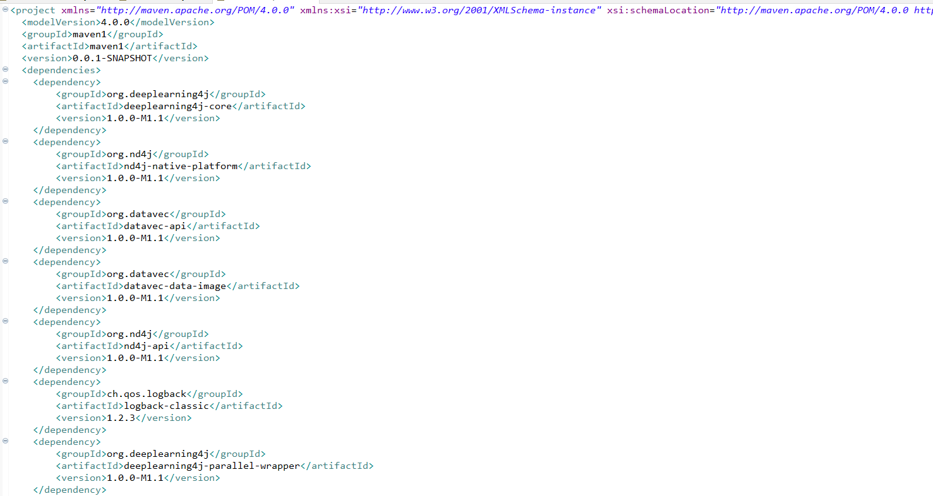
For this “real” dataset, ChatGPT used the deep learning for Java library.
ChatGPT provided a pom.xml file that we could drop into a Maven project in Eclipse.
Eclipse then downloaded all the dependencies…
https://github.com/afodor/mnistMaven/blob/main/pom.xml

Slide 25
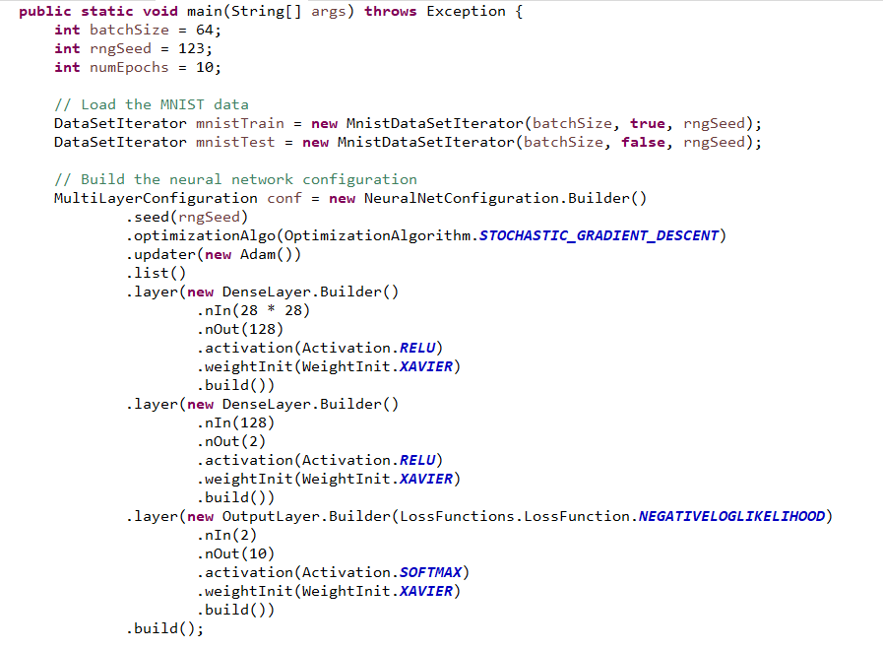
Here is the model declaration…
Input layer
(28*28 neurons)
Hidden layer
(64 neurons)
Hidden layer
(2 neurons)
Output layer
(10 categories; softmax)
https://github.com/afodor/mnistMaven/blob/main/src/main/java/mnist/MNISTClassifier.java

Slide 26
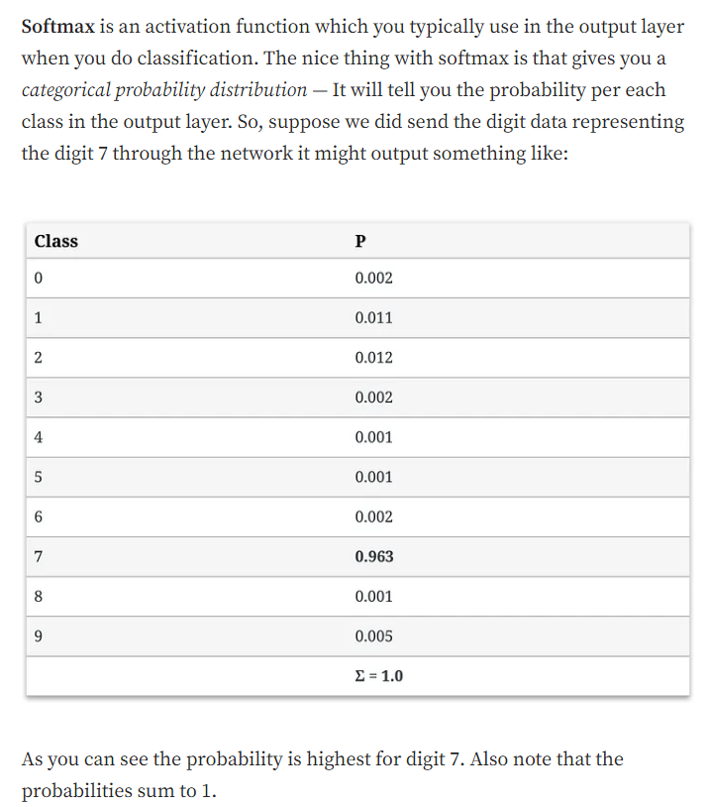
Input layer
(28*28 neurons)
Hidden layer
(64 neurons)
Hidden layer
(2 neurons)
Output layer
(10 categories; softmax)
The last (Softmax) layer is constrained so all sum of all the neurons is 1 (like a Dirichlet distribution)
https://towardsdatascience.com/part-5-training-the-network-to-read-handwritten-digits-c2288f1a2de3

Slide 27
Input layer
(28*28 neurons)
Hidden layer
(64 neurons)
Hidden layer
(2 neurons)
Output layer
(10 categories; softmax)
Our layer here is
just so that we can
visualize the model as it is
learned.

Slide 28
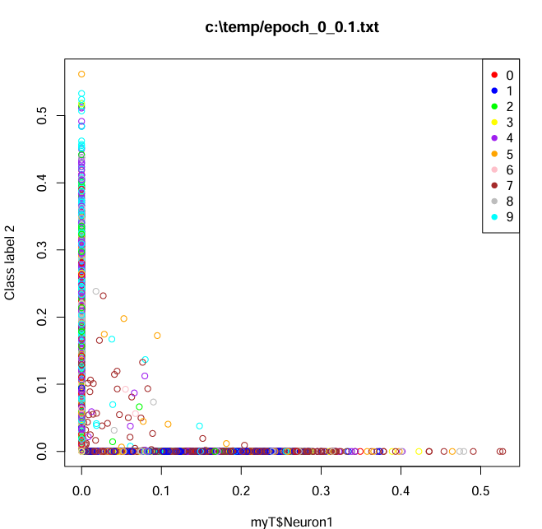
Before we do any learning, the accuracy is 10% and feed forwarding the images doesn’t give us any
structure..
https://github.com/afodor/mnistMaven/blob/main/src/main/java/mnist/plotResults.txt

Slide 29
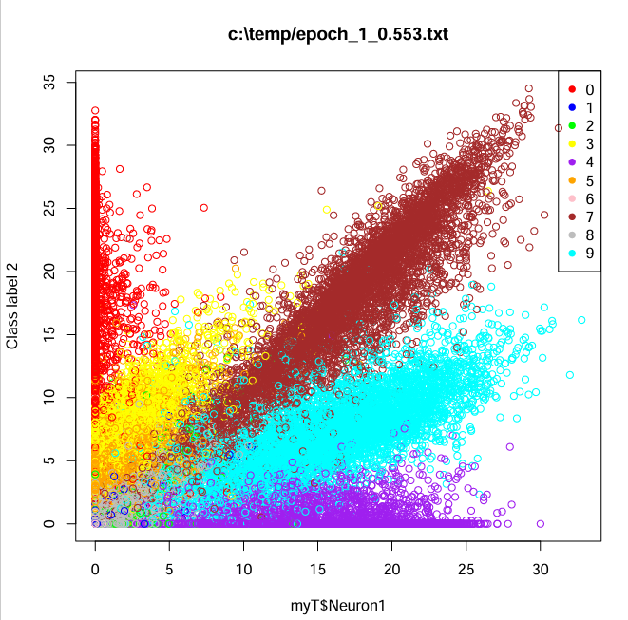
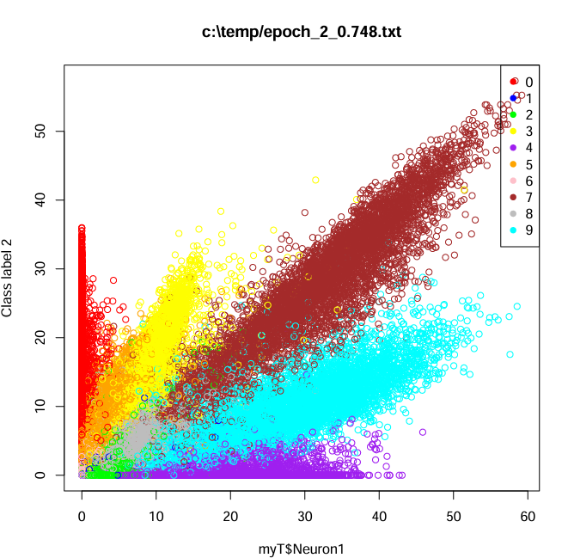
After 1 epoch with 53% accuracy
After 2 epochs with 75% accuarcy

Slide 30
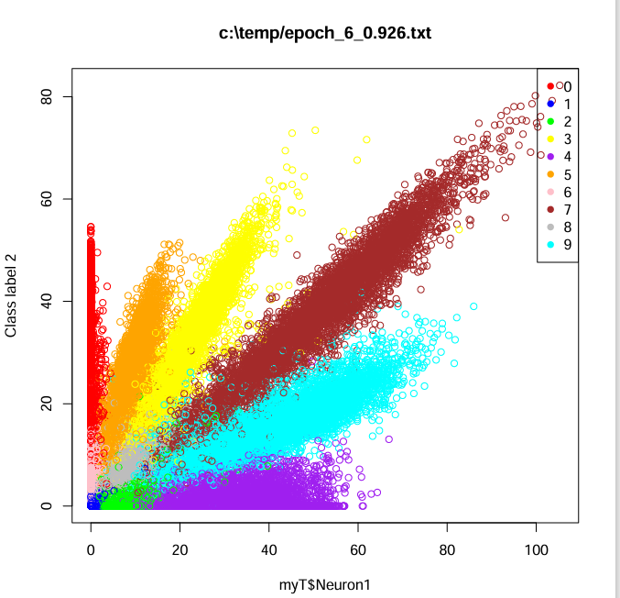
After 6 epochs with 93% accuracy

Slide 31
Towards a simple generative model…

Slide 32
Previously, we had a neural network for classification.
Input layer
(28*28 neurons)
Hidden layer
(64 neurons)
Hidden layer
(2 neurons)
Output layer
(10 categories; softmax)
In this section, we will start to work towards models that generate data.

Slide 33
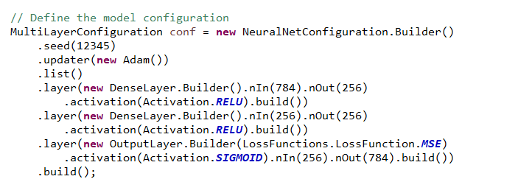
This is a simple encoder-decoder model
Input layer
(28*28 neurons)
Hidden layer
(256 neurons)
Hidden layer
(256 neurons)
decode
Output layer
(28*28)
We compress (encode) the input data into 256 neurons and then (decode) back to pixel space
https://github.com/afodor/mnistMaven/blob/main/src/main/java/mnist/unsupervisedAutoEncoder/MnistAutoencoder.java

Slide 34
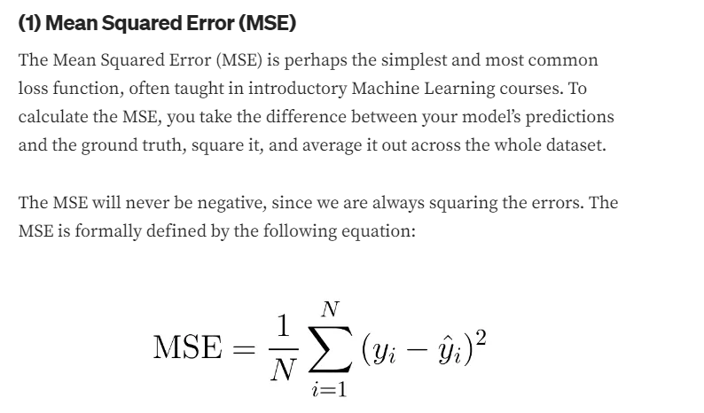
Our loss function is a simple mean squared error across all the pixels
Input layer
(28*28 neurons)
Hidden layer
(256 neurons)
Hidden layer
(256 neurons)
decode
Output layer
(28*28)

Slide 35
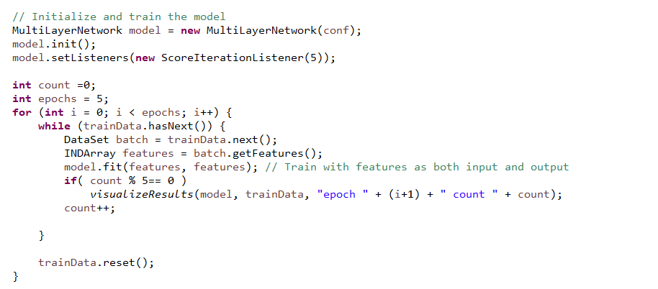
Here we train the model
Input layer
(28*28 neurons)
Hidden layer
(256 neurons)
Hidden layer
(256 neurons)
decode
Output layer
(28*28)
https://github.com/afodor/mnistMaven/blob/main/src/main/java/mnist/unsupervisedAutoEncoder/MnistAutoencoder.java

Slide 36
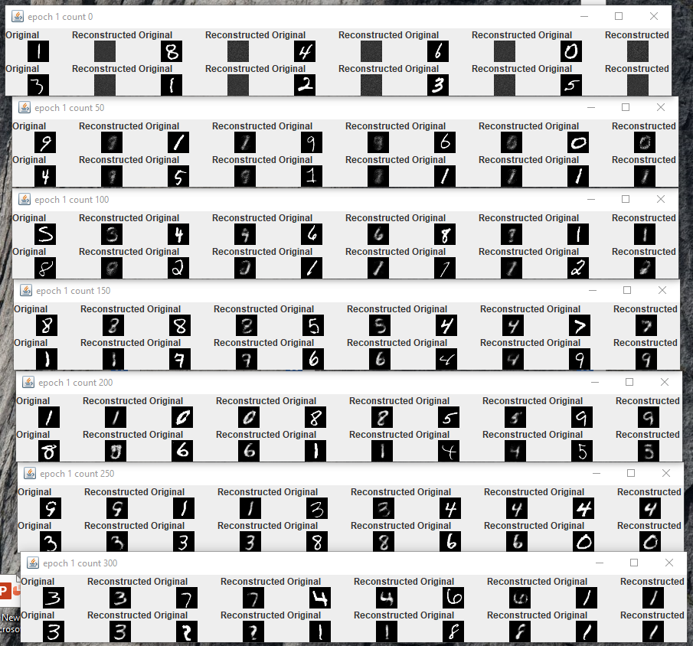
We can watch our model
learn more about the features of the
input space

Slide 37
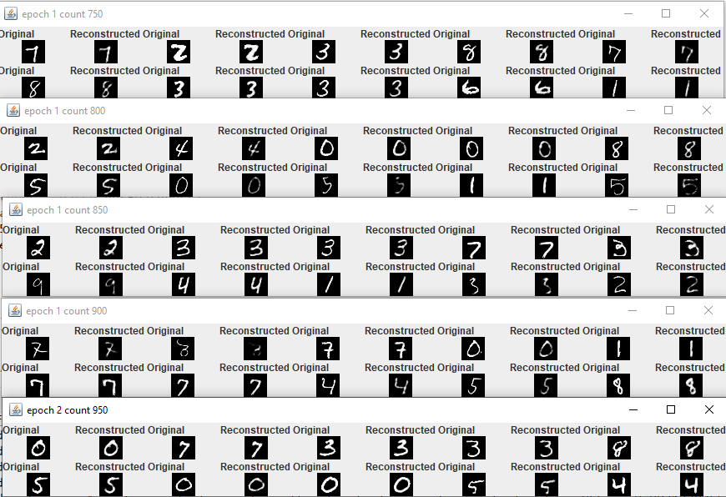

Slide 38
Input layer
(28*28 neurons)
Hidden layer
(256 neurons)
Hidden layer
(256 neurons)
decode
Output layer
(28*28)
By sampling from this last hidden layer, we can start to
build models that can generate new data..

