Slide 1
Chapter 3 review:
Java Concurrency in Practice

Slide 2
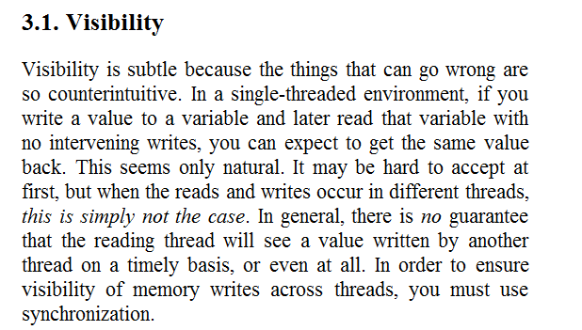

Slide 3
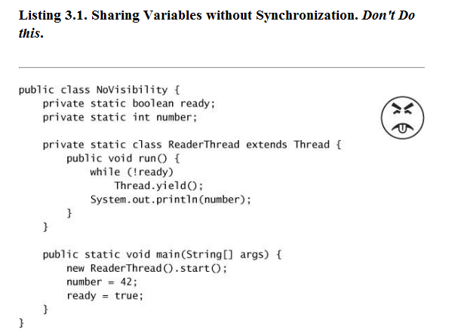
There is no guarantee that one thread will ever see the non-volatile data written
by another thread!
The output of the program is not determined.
It could print 42 or 0 or never terminate…

Slide 4
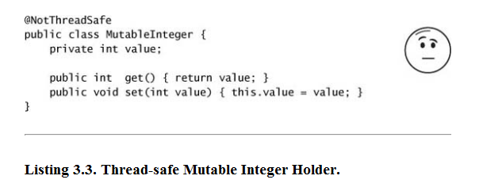
No guarantee that a value written by one thread will ever be seen by another thread.
If threads can live with “stale” date this may be ok.
Or it may break if that is not acceptable for the logic of your program

Slide 5
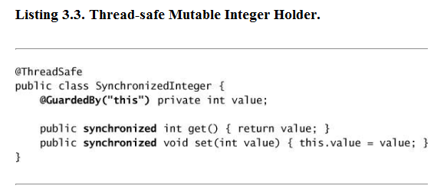
One solution…

Slide 6
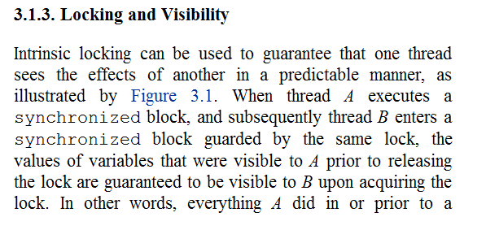
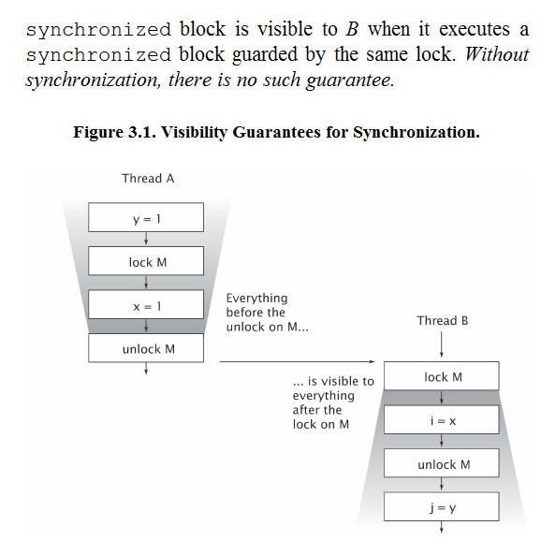
“synchronized” essentially makes all
variables visible to the thread that
acquires the lock act as if they were
declared volatile

Slide 7
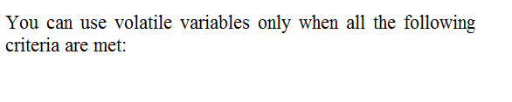
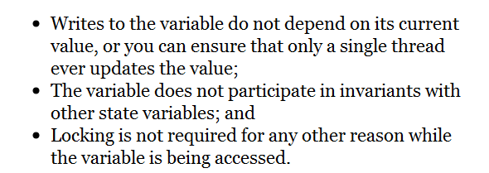
volatile is a weaker version of synchronized.
synchronized implies volatile but not the other way around!

Slide 8
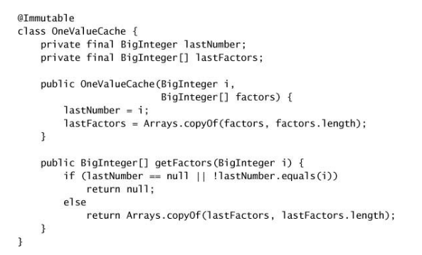
A nice use of volatile to address the “two things must switch at once” problem.
First define a nice, final immutable class…

Slide 9
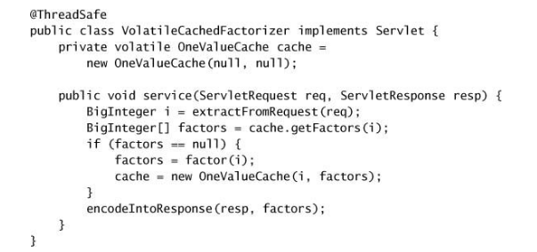
Then make a volatile reference to that holder
This is thread safe without explicit synchronization…

Slide 10
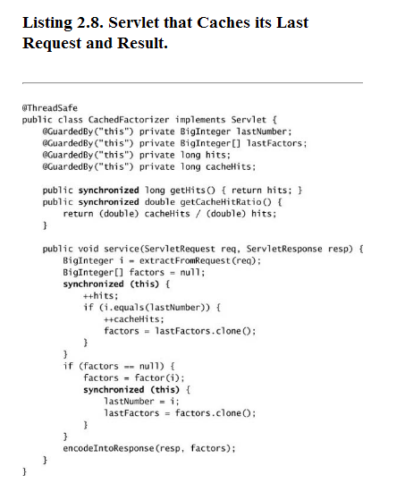
May be both faster and easier to
understand than the solution
that uses explicit synchronization…

Slide 11
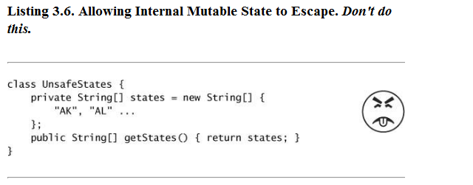
Publishing and escape.
Can an object or variable be referenced outside of its current scope?
If so, it has been published…
A public reference to private objects publishes those objects…

Slide 12
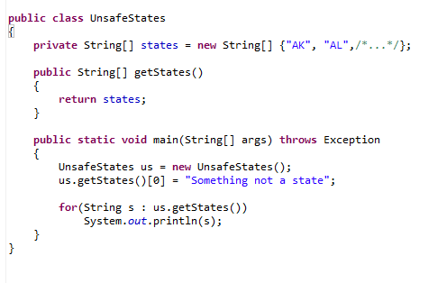
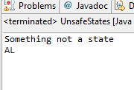
Sharing data in this way allows for possible corruption violating encapsulation

Slide 13
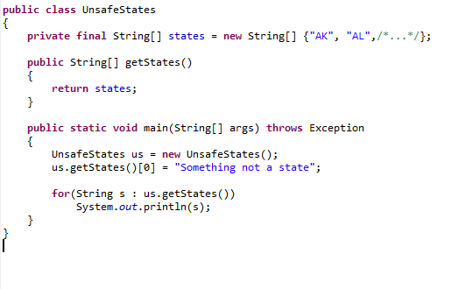
Making the String[] final didn’t help. Why not?

Slide 14
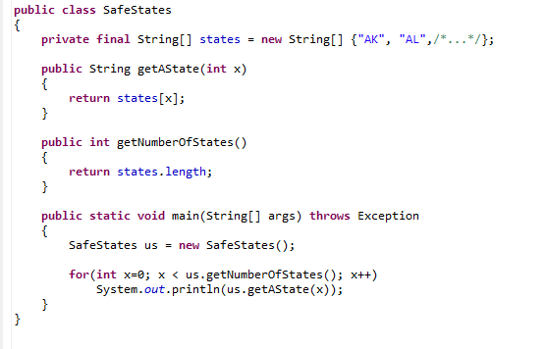

One option; don’t publish the array; just allow access to it..
No way for client code to modify states without a compile error

Slide 15
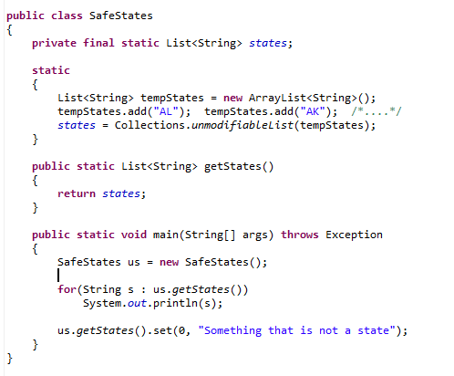
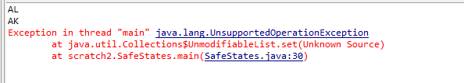
Another option: switch to a List.
And to static (since there is no reason to have more than one copy of the 50 states)
(Only problem with this is that changing the list give a run-time and not compile-time error
on modification)

Slide 16
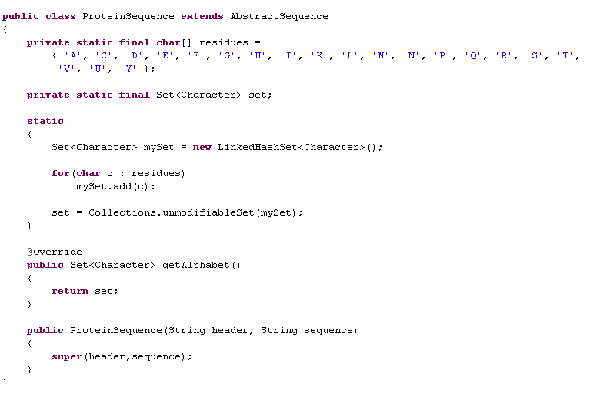
We saw this earlier…
No reason the user should need to change the 20 residues that make up a protein
We extend AbstractSequence
Just to save on typing
“set.add(‘Amino Acid’)”
20 times
Our static initializer to set up
our cached alphabet
We cache the alphabet
(so we don’t have to make
a new one each time getAlphabet() is called)
We chain to the superclass constructor as before

Slide 17
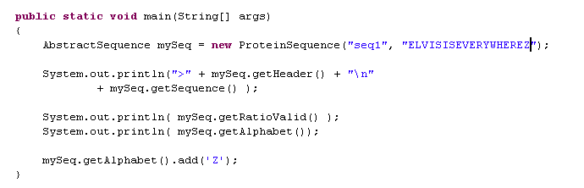
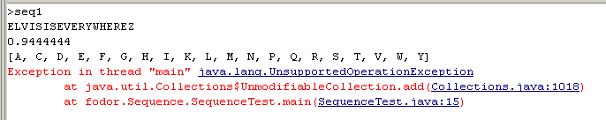
And here is an instantiation of ProteinSequence

Slide 18
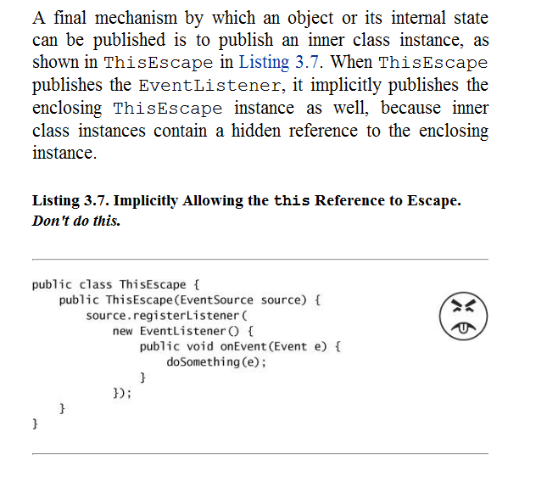
Anyone understand what is wrong with this example?

Slide 19
What they are worried about
Thread A
GUI
A button (EventSource source)
User hits the button
doSomething()…
(a method gets invoked on the object
By the GUI thread before the constructor has finished).
Results are undefined
This is published to the GUI
registerlistener()
Constructor
Constructor hasn’t finished
doSomething()

Slide 20
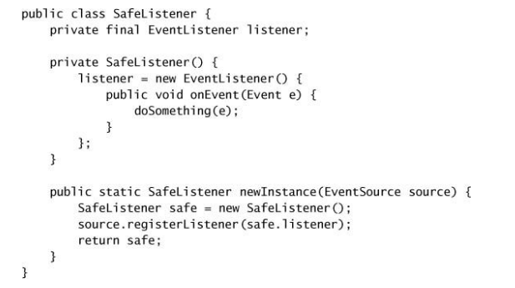
One alternative. The factory pattern to only publish the properly constructed object…

Slide 21
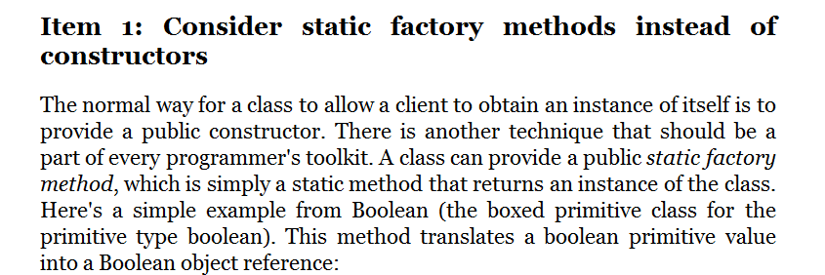
Bloch likes factory methods… This is another place where it can be good to use them..

Slide 22
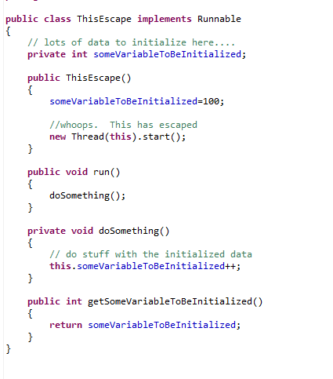
Don’t start threads from Constructors
Thread A
Thread B
Constructor
Calls doSomething()
before the
constructor has
finished.
Results are
Undefined!
Starts new thread
doSomething()

Slide 23
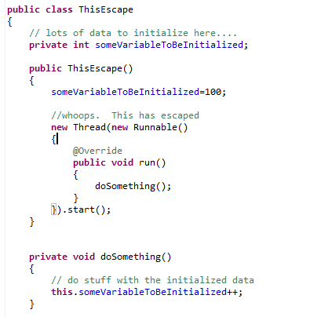
This can escape due to inner classes having a reference to the surrounding class
Still a reference to the ThisEscape object
being constructed…

Slide 24
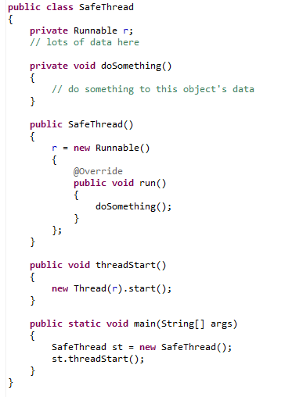
Here is one way to start a thread. Note that this does not guarantee only a
single thread at a time will run through the object’s data..

Slide 25
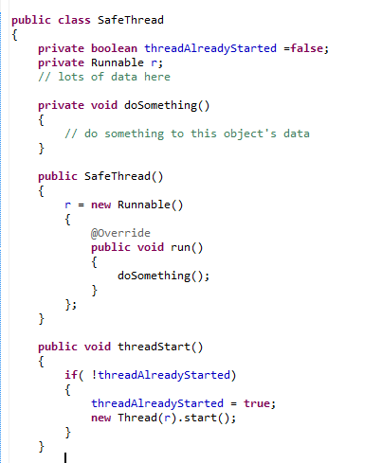
Here is an attempt to make it so that multiple calls to threadStart() start only a single thread. Does this code make that guarantee?

Slide 26
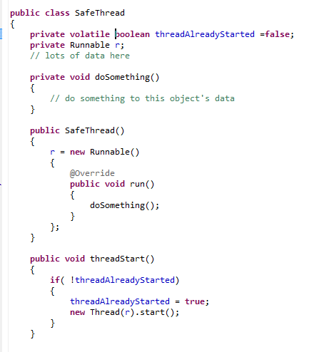
How about this? Any better?

Slide 27
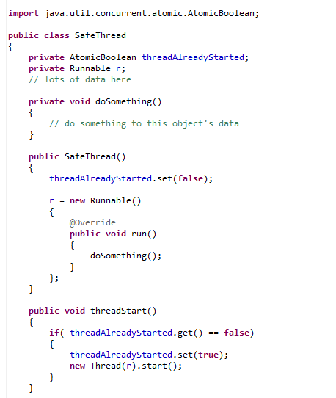
How about this? Any better?

Slide 28
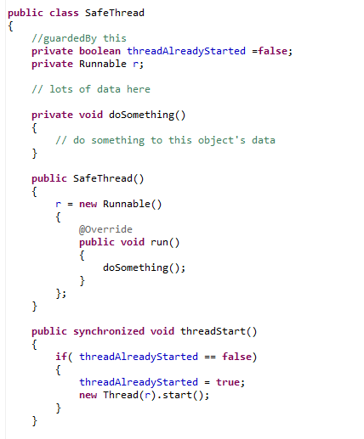
How about this?

Slide 29
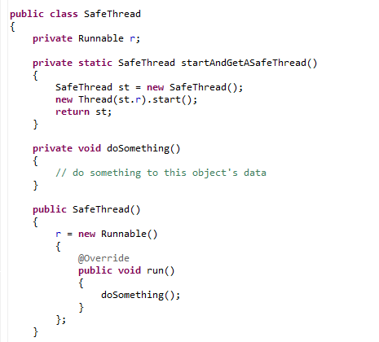
Alternatively, use the factory method…

Slide 30
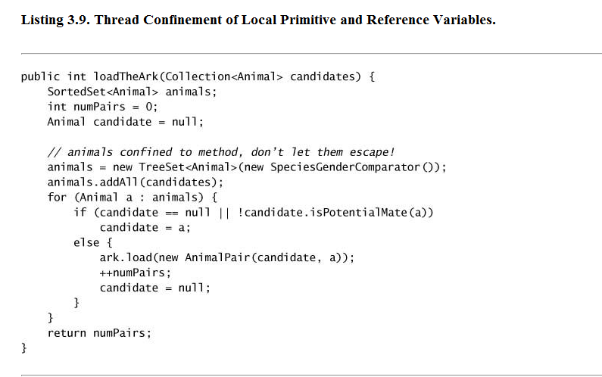
Stack confinement… As long as variables stay in local scope, thread safety is not an issue
(This method should probably be called something like countTheAnimals() )
(this does assume that candidates is not changing while we are working on it!)

Slide 31
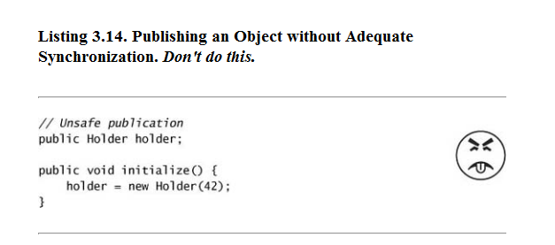
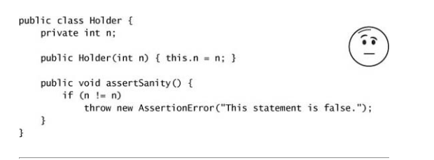
What they are worried about. Threads A and B both have reference to holder
A
B
Reads n on a
Partially constructed object (gets 0)
Initialize()
Reads n on object that is constructed
(gets 42)
n= n fails!!!

Slide 32
Immutable objects are always thread safe.
This is one reason Bloch suggests to “Favor Immutable Objects”
(other reasons include reducing complexity of code…)

Slide 33
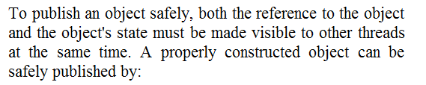
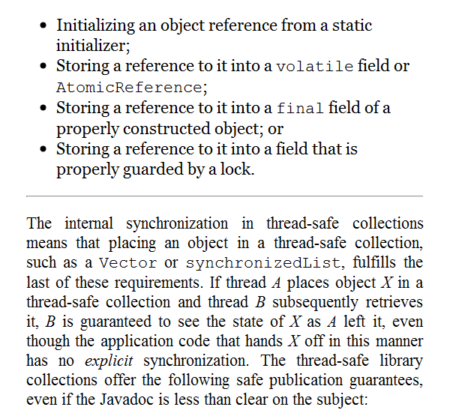

Slide 34

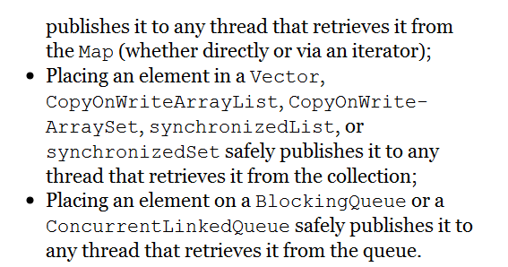
Since almost everything we do in bioinformatics is via the collections, we are usually safe

Slide 35
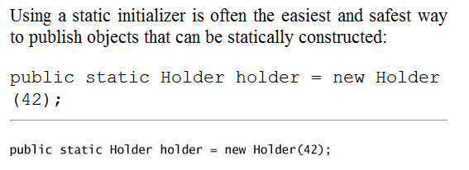
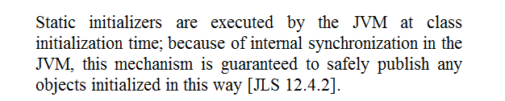
Initialized this way or with the
static
{ }
constructor

Slide 36
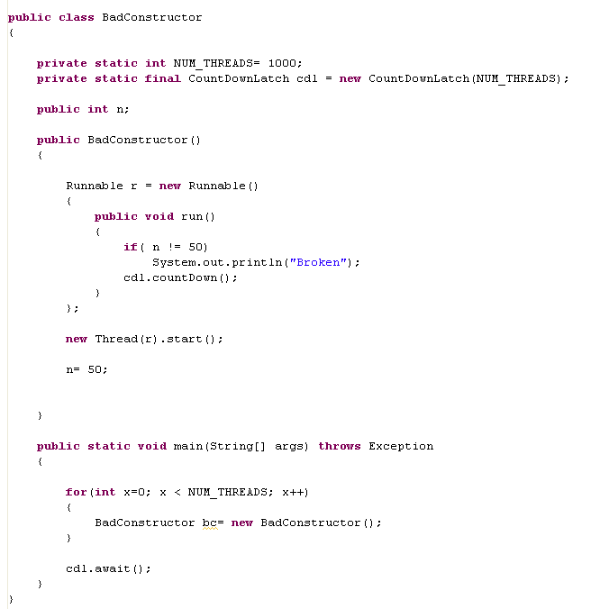
This never failed for me (Broken was never printed), but you can see that it is
very fragile. There is no guarantee that the thread will see the correctly constructed object

Slide 37
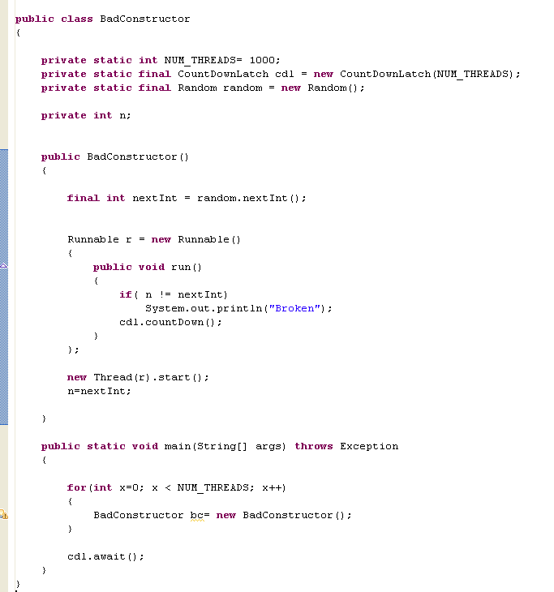
In trying to break it, I tried this. (Which also didn’t break).
But it got me wondering, is Random.nextInt() thread safe?

Slide 38
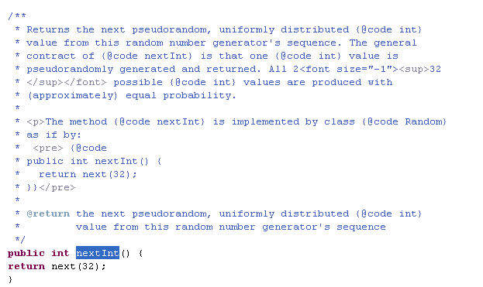
But it got me wondering, is Random.nextInt() thread safe?
Can multiple threads invoking nextInt() at the same time get the same “random” number?
There is, of course, no documentation.

Slide 39
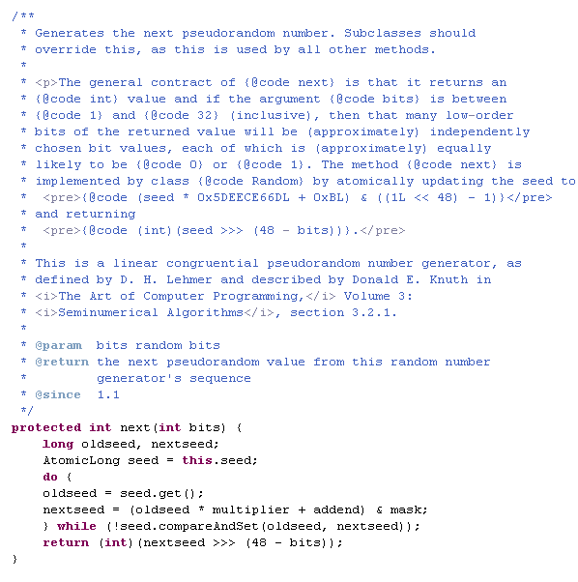
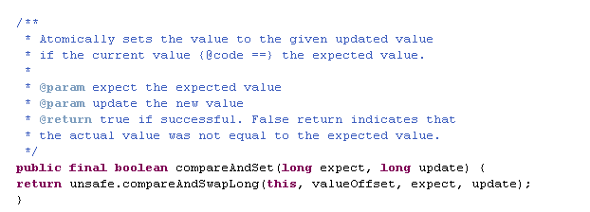
They do document that it is
atomic
If another thread has interfered,
generate the next number.
Pretty sweet…
Thread safe with minimal synchronization.
It would have been nice to more
explicitly document the thread safety!

Slide 40
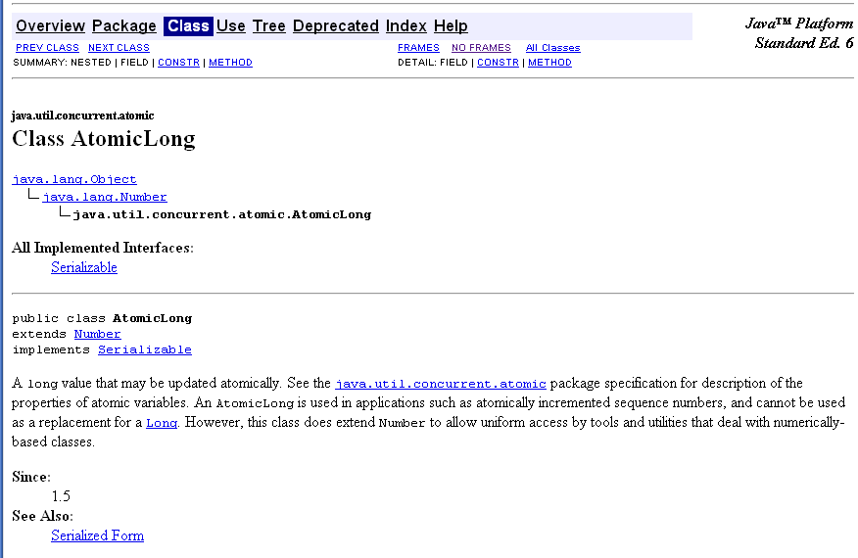
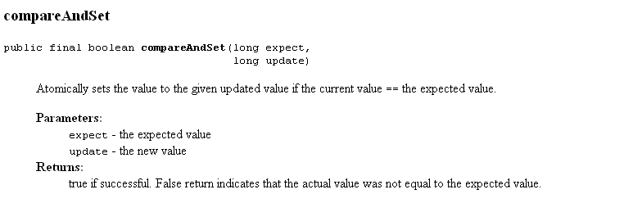

Slide 41
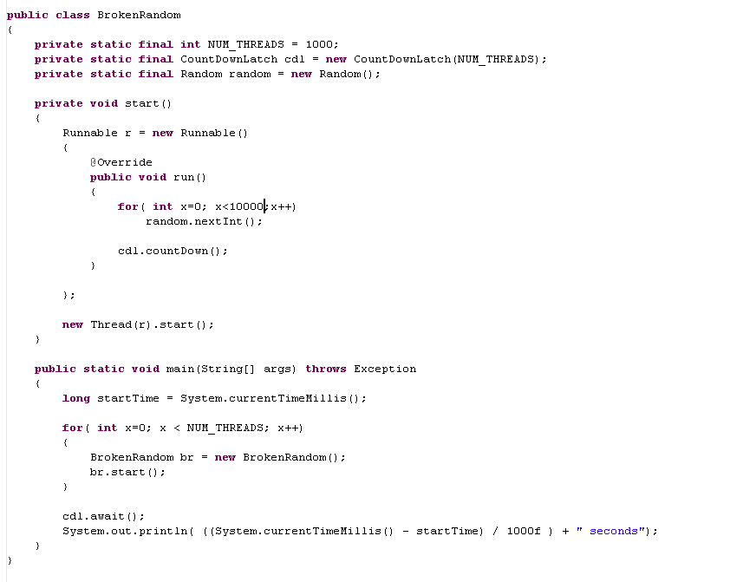
There is some (minimal) resource contention here but not too bad..
When the threads interfere with each other, they spin…
This runs in ~2 seconds

Slide 42
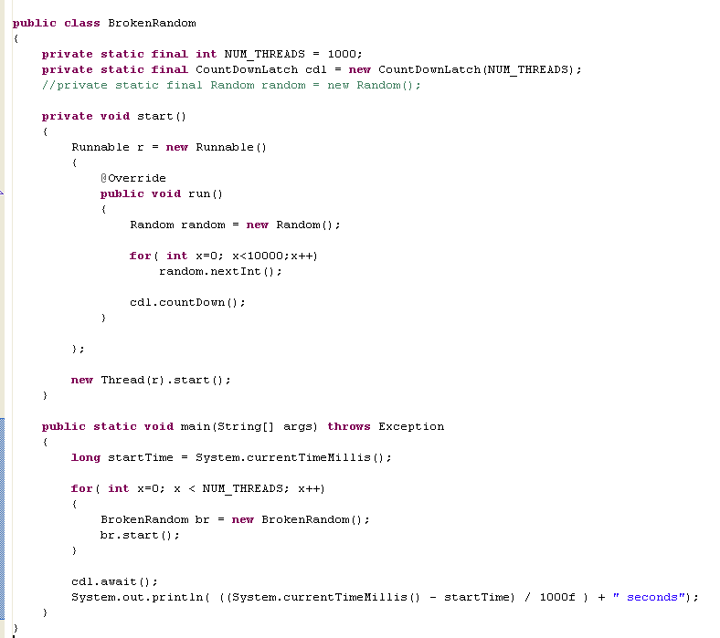
Give each thread its own random is about 0.5 seconds
(but is actually a bad idea because many of those randoms will have the same seed!)

Slide 43
Coming up: Java Concurrency in Practice Chapters 4-5:
The monitor pattern
Thread safe HashMap

