Slide 1

Topic: Methods for Monitoring Microbes in Built Environments
`
Anthony Fodor
Professor
Department of Bioinformatics and Genomics
UNC Charlotte
http://fodorclasses.github.io/gc/gc.pdf
Gordon Research Conference of the Built Environment
June 2025

Slide 2
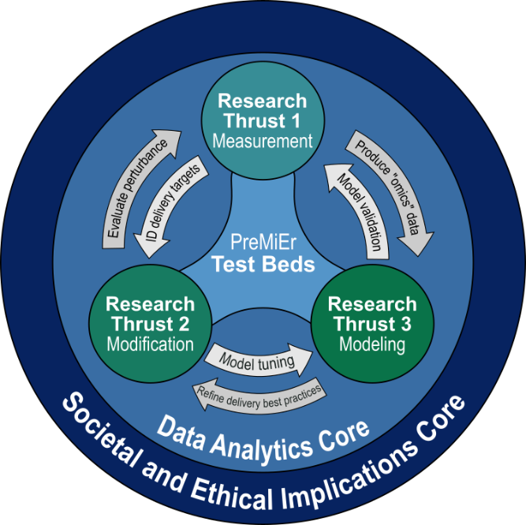

Figure CR-1. Relationship of PreMiEr's research thrusts and cores.
https://premier-microbiome.org/

Slide 3
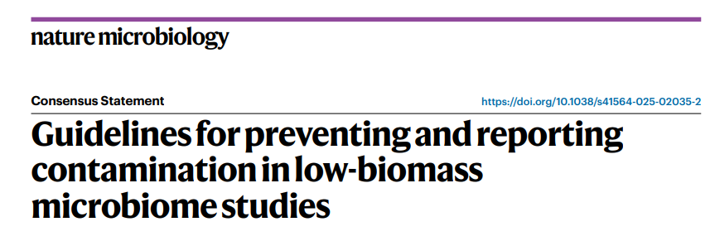
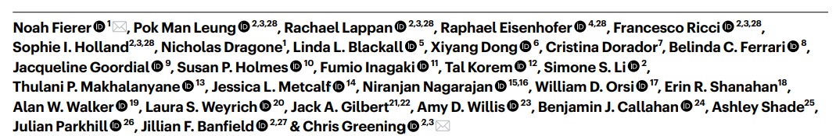
There are important resources, attempts to create standards that everyone should study

Slide 4
Your control strategy should be tied to the purpose of your study
Design to avoid the possibility of cross-contamination
There is no “magic” algorithm that will make the contamination problem go away.
Negative controls are an experimental category in your study and should be powered as such
Reproducibility across studies can build confidence in the rigor of your results
Contamination is not your only problem

Slide 5
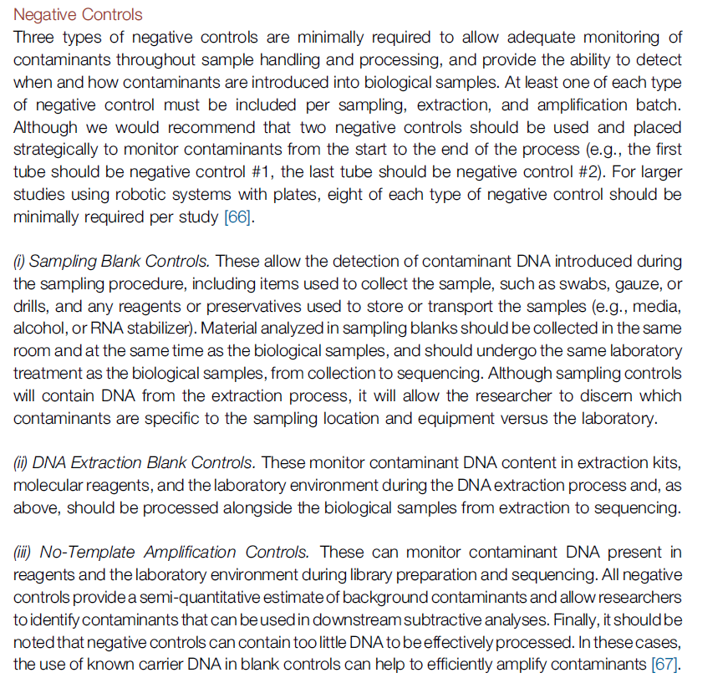
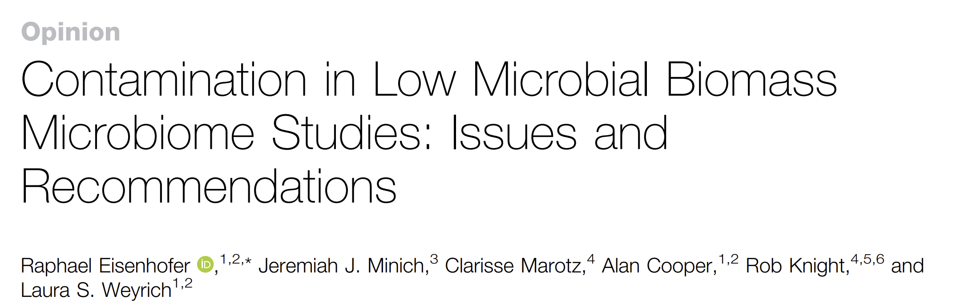
Not all controls are created equal.
Controls at the beginning of an experiment
have more power for contaminant detection.
Controls at each step have more power in
resolving the source of a contaminant.

Slide 6
Your control strategy should be tied to the purpose of your study
Design to avoid the possibility of cross-contamination
There is no “magic” algorithm that will make the contamination problem go away.
Negative controls are an experimental category in your study and should be powered as such
Reproducibility across studies can build confidence in the rigor of your results
Contamination is not your only problem

Slide 7
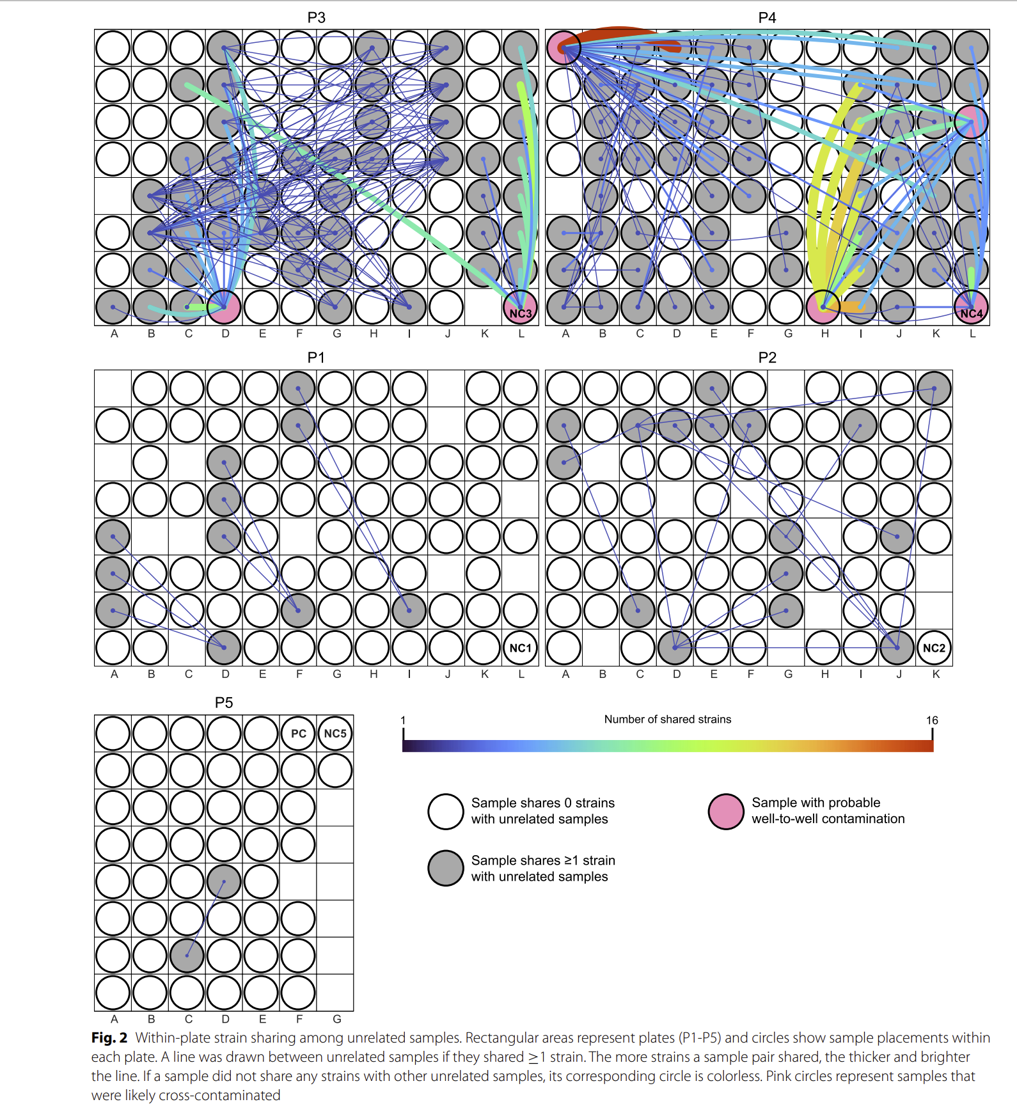
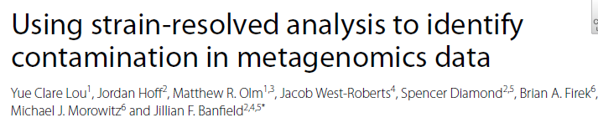
By request: Cross well contamination is a sometimes under-appreciated
source of artifact in low biomass samples
Cross-contamination is widespread,
especially if 96 well plate automation is used.
Mixing high-abundance and low-abundance
samples on the same plate is a recipe for
potential disaster…
Make sure case and control samples are
not run on separate plates as plate effects
may be mistaken for true category effects

Slide 8
Your control strategy should be tied to the purpose of your study
Design to avoid the possibility of cross-contamination
There is no “magic” algorithm that will make the contamination problem go away.
Negative controls are an experimental category in your study and should be powered as such
Reproducibility across studies can build confidence in the rigor of your results
Contamination is not your only problem

Slide 9



Slide 10
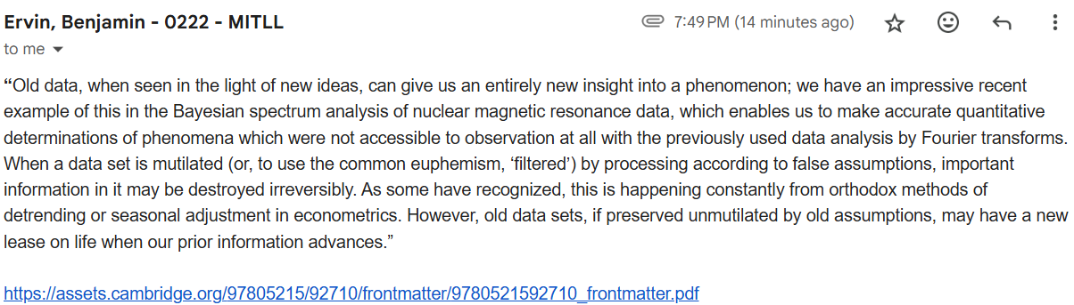
It is crucial to deposit both filtered and un-filtered data into public databases
Including the original data will allow for re-analysis as methods improve
Probability theory The logic of Science – E.T. Jaynes - 2002

Slide 11
Your control strategy should be tied to the purpose of your study
Design to avoid the possibility of cross-contamination
There is no “magic” algorithm that will make the contamination problem go away.
Negative controls are an experimental category in your study and should be powered as such
Reproducibility across studies can build confidence in the rigor of your results
Contamination is not your only problem

Slide 12
Your control strategy should be tied to the purpose of your study
Design to avoid the possibility of cross-contamination
There is no “magic” algorithm that will make the contamination problem go away.
Negative controls are an experimental category in your study and should be powered as such
Reproducibility across studies can build confidence in the rigor of your results
Contamination is not your only problem

Slide 13
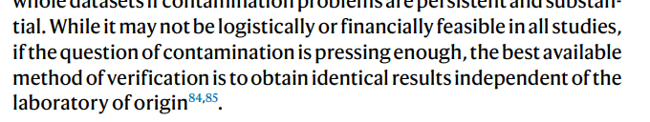

Slide 14

An integrated analysis suggest strong reproducibility in the existing literature
when examining different habitats (hand-level vs. floor) of the built environment
Abeoseh Flemister

Slide 15
An integrated analysis suggest strong reproducibility in the existing literature
when examining different habitats (hand-level vs. floor) of the built environment
4 publicly available 16S datasets that have
hand-associated vs. floor-associated samples
Abeoseh Flemister

Slide 16
An integrated analysis suggest strong reproducibility in the existing literature
when examining different habitats (hand-level vs. floor) of the built environment
4 publicly available 16S datasets that have
hand-associated vs. floor-associated samples
Leave one study out –
train a random forest model on the other 3
Abeoseh Flemister

Slide 17
An integrated analysis suggest strong reproducibility in the existing literature
when examining different habitats (hand-level vs. floor) of the built environment
4 publicly available 16S datasets that have
hand-associated vs. floor-associated samples
Leave one study out –
train a random forest model on the other 3
Capture the predictions on the left out 4th study with an ROC curve.
Abeoseh Flemister

Slide 18
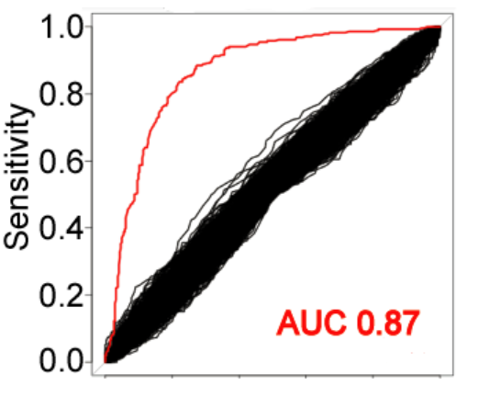
An integrated analysis suggest strong reproducibility in the existing literature
when examining different habitats (hand-level vs. floor) of the built environment
4 publicly available 16S datasets that have
hand-associated vs. floor-associated samples
Leave one study out –
train a random forest model on the other 3
Capture the predictions on the left out 4th study with an ROC curve.
Abeoseh Flemister
Red line – “real data”
Black lines – model trained on data with labels scrambled

Slide 19
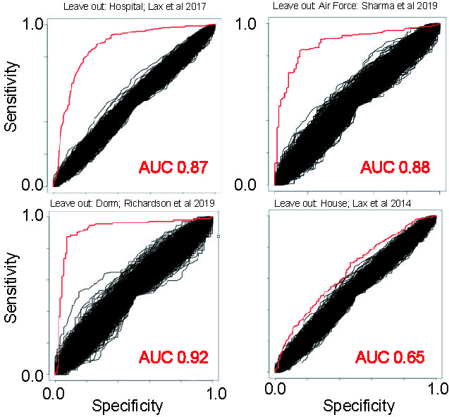
An integrated analysis suggest strong reproducibility in the existing literature
when examining different habitats (hand-level vs. floor) of the built environment
Abeoseh Flemister

Slide 20
Your control strategy should be tied to the purpose of your study
Design to avoid the possibility of cross-contamination
There is no “magic” algorithm that will make the contamination problem go away.
Negative controls are an experimental category in your study and should be powered as such
Reproducibility across studies can build confidence in the rigor of your results
Contamination is not your only problem

Slide 21
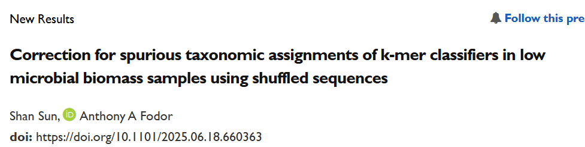


Shan Sun
https://www.biorxiv.org/content/10.1101/2025.06.18.660363v1

Slide 22
Choose six publicly available cancer datasets (low biomass samples)
Shan Sun
https://www.biorxiv.org/content/10.1101/2025.06.18.660363v1

Slide 23
Choose six publicly available cancer datasets (low biomass samples)
Run through the classifier Kraken
Shan Sun
https://www.biorxiv.org/content/10.1101/2025.06.18.660363v1

Slide 24
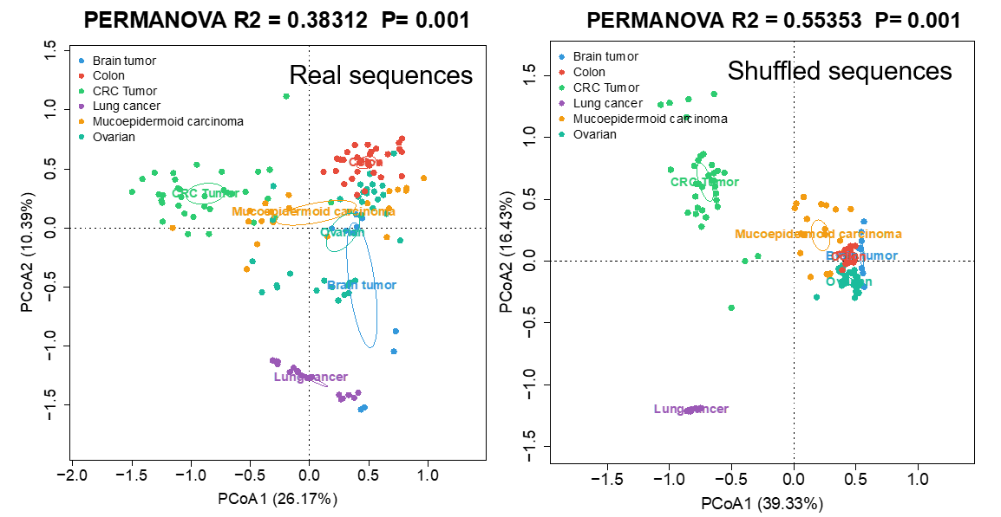
Non-shuffled sequences produce distinct microbial “signatures” in cancer samples
Shan Sun

Slide 25
Choose six publicly available cancer datasets (low biomass samples)
Run through the classifier Kraken
Shuffle the sequences.
Run the shuffled sequences through Kraken
Shan Sun
https://www.biorxiv.org/content/10.1101/2025.06.18.660363v1

Slide 26
Both shuffled and non-shuffled sequences produce distinct microbial “signatures” in cancer samples
Shan Sun

Slide 27
Conclusions:
Avoid optimism
Design to avoid cross-contamination
Negative controls that are as close as possible in space and time to your original
samples can be prioritized. Don’t skimp on negative controls.
Share original, un-filtered data
Have a prior that everything in your samples is an artifact and
use rigorous statistical inference to convince yourself that your results are real

Slide 28














Acknowledgements
UNC-Chapel Hill
Janelle Arthur
Ian Carroll
Annie Green Howard
Marcus Muhlbauer
Penny Gordon-Larsen
Jonathan Hansen
Temitope Keku
UNC-Charlotte
Roshonda Barner
Matthew Brown
Farnaz Fouladi
Ra’ad Gharaibeh
Cynthia Gibas
Jon McCafferty
Shan Sun
Michael Sioda
Kathryn Winglee
Matthew Brown
UF- Gainesville
Christian Jobin
USC Vanderbilt University
Tanya L Alderete Martha J. Shrubsole
Michael Goran
Emily Noble
Scott Kanoski
Kathryn Winglee
Annie Green Howard
Penny Gordon-Larsen
Raad Gharaibeh
Jon McCafferty
Marcus Muhlbauer
Janelle Arthur
Christian Jobin

Slide 29



Slide 31
Source | Is clearly contaminant | Can be addressed with database searches | Can be solved with long-read requirements | Can be addressed algorithmically | Implications for inference
Non-biological contaminant (e.g. kit contaminant) | Yes. Using a different kit will produce different results. | Probably (especially if a kit has been used in many previous experiments) | Possibly | Possibly (contaminants should be about equally present in all samples irrespective of metadata) | When comparing samples of similar biomass, spurious results are unlikely to be produced.
Biological contaminant (e.g. skin contaminant) | Unclear. If you send a researcher into the built environment, the environment changes. But is that contaminant? Like electrons, measuring the built environment will change the built environment | Possibly (but each person has a distinct skin microbiome!) | No | Possibly (contaminants should be equally present in all samples, but depends on when in the process samples were exposed to human microbiome) | When comparing samples of similar biomass, spurious results are unlikely to be produced.
Cross-samples contaminant | Yes. | No (since each experiment is likely to have unique taxa) | No | Possibly but only if all batch information (including well location) is recorded | Minimal if all blocks (including well) are randomized

Slide 32
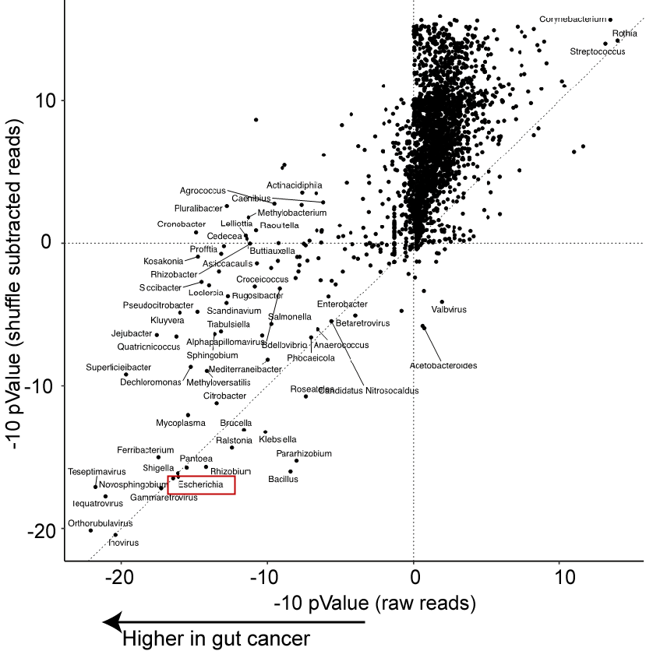
Subtraction of shuffled sequences from observed sequences yields biologically plausible inference
Shan Sun

