Slide 1
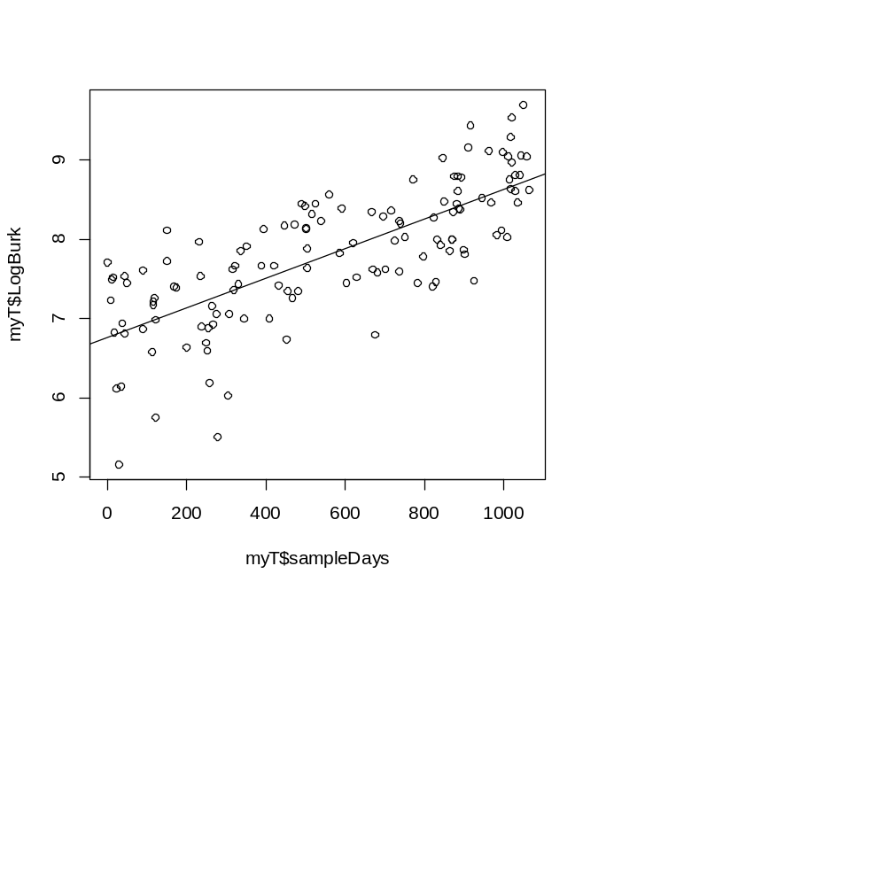
An alternative description of fitting models is maximum likelihood
Consider our two parameter model for LogBurk vs. time from the last lecture…
myT <- read.table("qPCRWithSampleDays.txt", sep="\t", header=TRUE)
myLm <- lm( myT$LogBurk ~ myT$sampleDays)
plot( myT$sampleDays , myT$LogBurk)
abline( myLm)
res <- residuals(myLm)

Slide 2
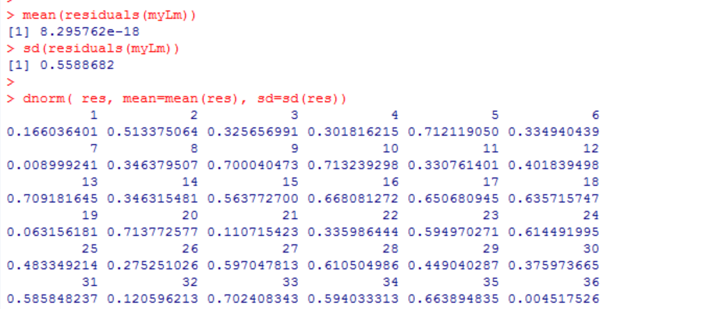
Some datapoints are right on the model line and others are further away…

Slide 3
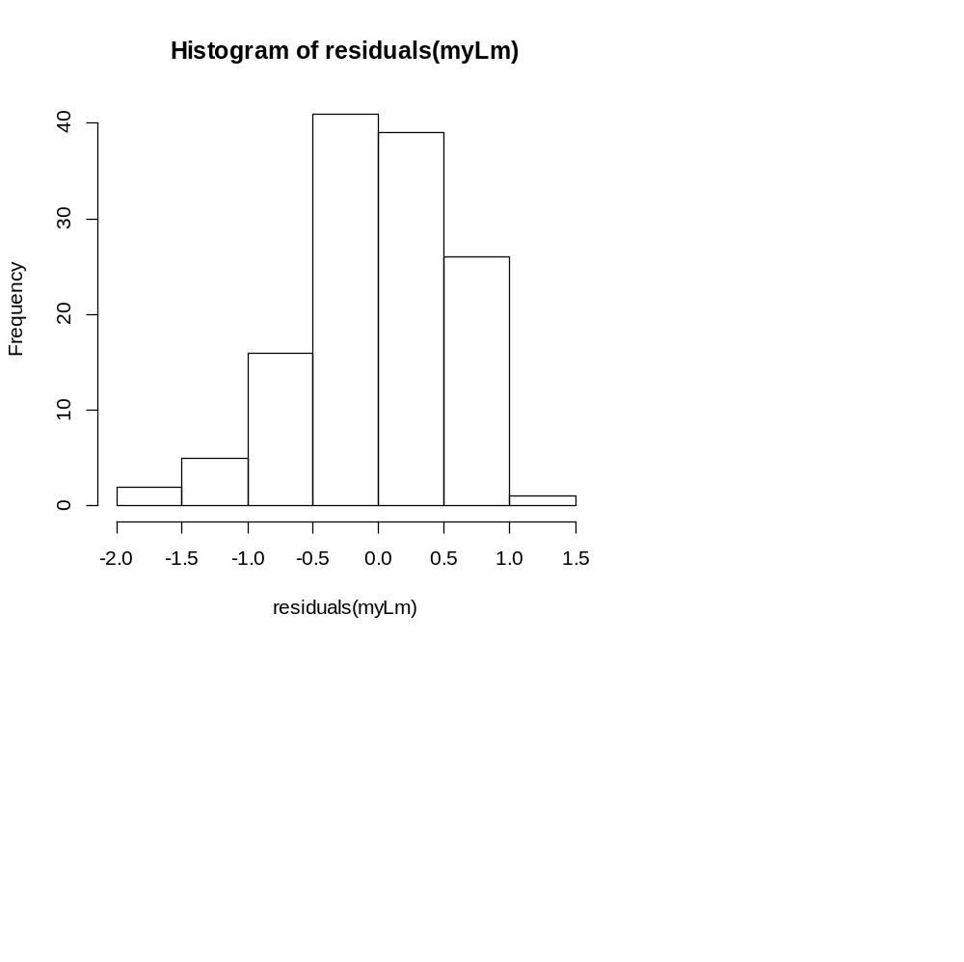

The residuals is the distance between the model (y-hat) and the datapoints (Y_{i})
hist(residuals(myLm))
We define the likelihood as the product of the probabilities of all the residues relative to this
distribution…
sum(log( dnorm( res, mean=mean(res), sd=sd(res))))

Slide 4
Consider a dataset with 4 datapoints…
If the probability from dnorm of the 4 points is
0.3, 0.01, 0.03, 0.1
then the likelihood of the model is
0.3 * 0.01 * 0.03 * 0.1 = 9e-06
Since the probabilities quickly get too small to hold
with standard doubles, we instead take the sum of the logs
log(0.3) + log(0.01) + log(0.03) + log( 0.1 ) = -11.61829
Since log(a*b) = log(a) + log(b)
More likely models will be closer to zero;
less likely models will have log sums that are more negative

Slide 5
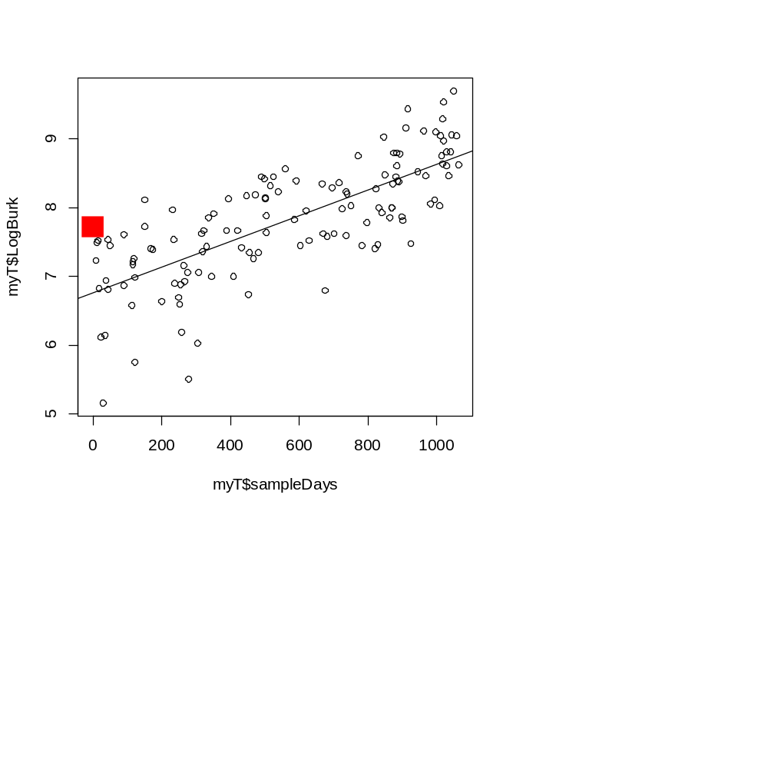
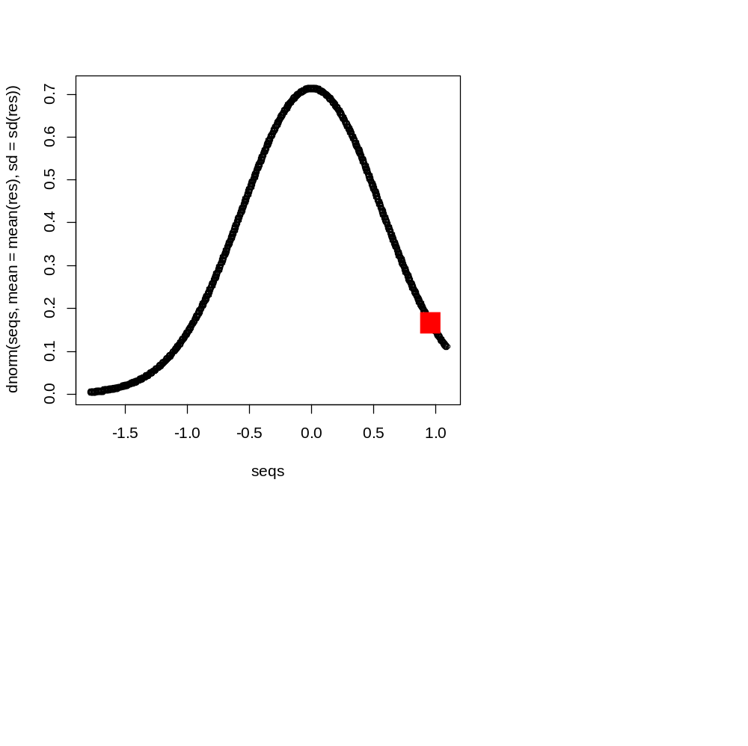
res = residuals(myLm)
seqs <- seq(min(res), max(res), (max(res)-min(res))/1000)
plot(seqs, dnorm(seqs,mean=mean(res), sd = sd(res)))
points( res[1], dnorm( res[1], mean=mean(res), sd=sd(res)), col="red",pch=15, cex=3)
myT <- read.table("qPCRWithSampleDays.txt", sep="\t", header=TRUE)
myLm <- lm( myT$LogBurk ~ myT$sampleDays)
plot( myT$sampleDays , myT$LogBurk)
points( myT$sampleDays[1], myT$LogBurk[1], col="red", pch=15, cex=3)
abline( myLm)

Slide 6
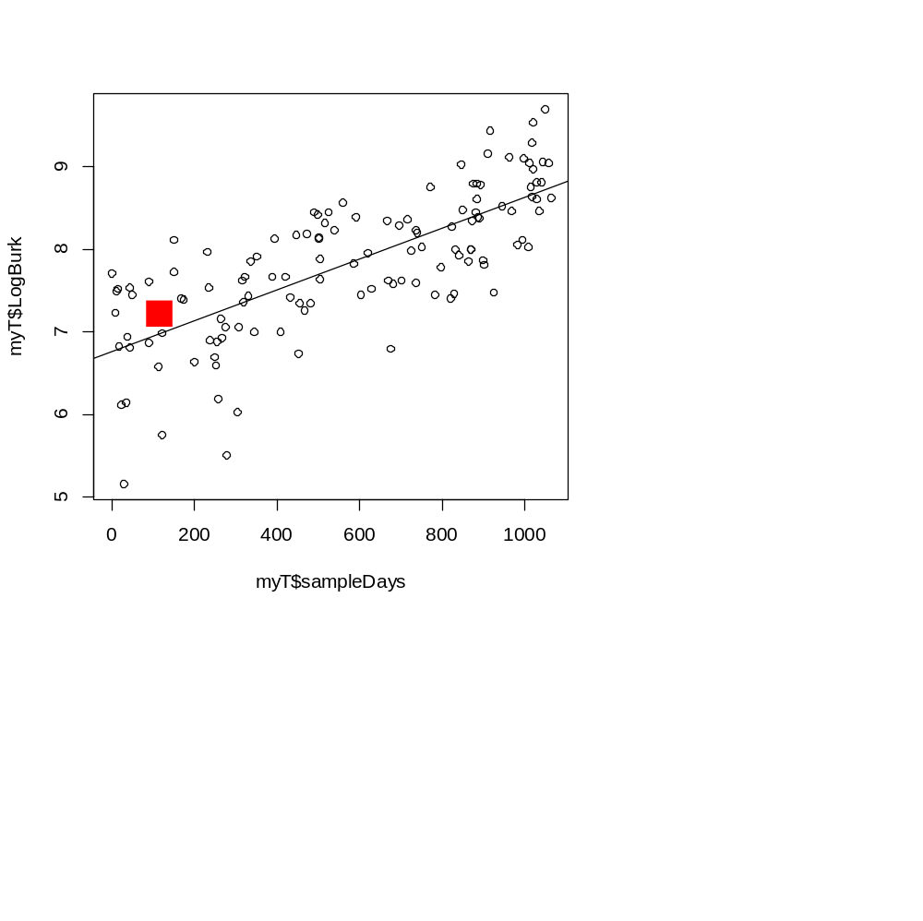
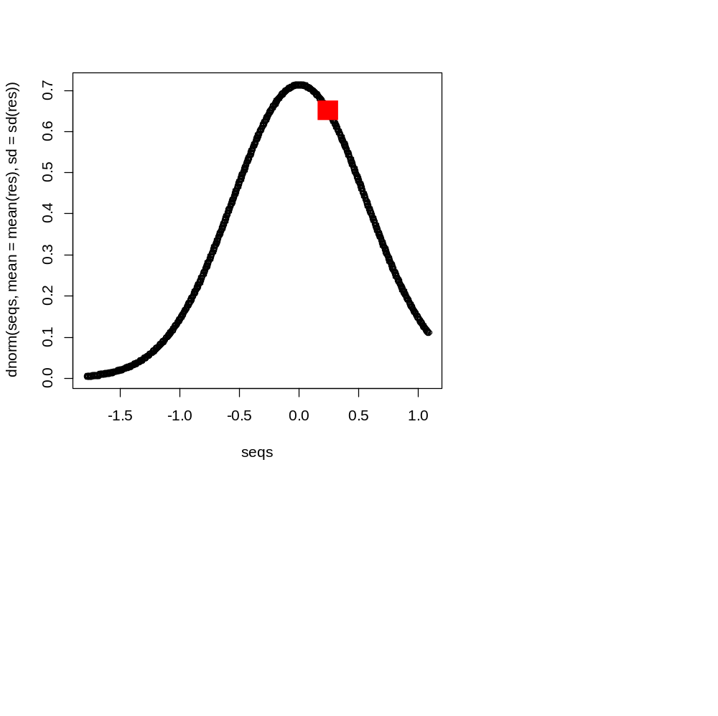
myT <- read.table("qPCRWithSampleDays.txt", sep="\t", header=TRUE)
myLm <- lm( myT$LogBurk ~ myT$sampleDays)
plot( myT$sampleDays , myT$LogBurk)
points( myT$sampleDays[17], myT$LogBurk[17], col="red", pch=15, cex=3)
abline( myLm)
myT <- read.table("qPCRWithSampleDays.txt", sep="\t", header=TRUE)
myLm <- lm( myT$LogBurk ~ myT$sampleDays)
plot( myT$sampleDays , myT$LogBurk)
points( myT$sampleDays[17], myT$LogBurk[17], col="red", pch=15, cex=3)
abline( myLm)
We can fit models by finding parameters that maximize the likelihood
(more on that later…)

Slide 7
How do you decide which models are “best” –
As you increase the # of parameters, the error will go to zero.
But that is just over-fitting the data!

Slide 8

The question of when a model is over-fit is not merely academic!
http://www.wsj.com/articles/how-computers-trawl-a-sea-of-data-for-stock-picks-1427941801

Slide 9
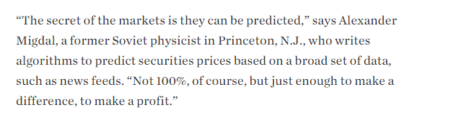
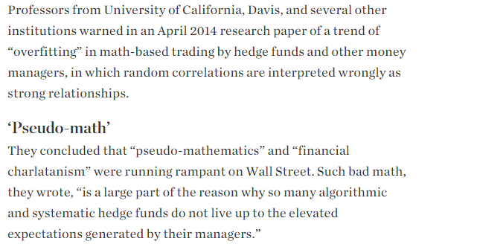
or

Slide 10
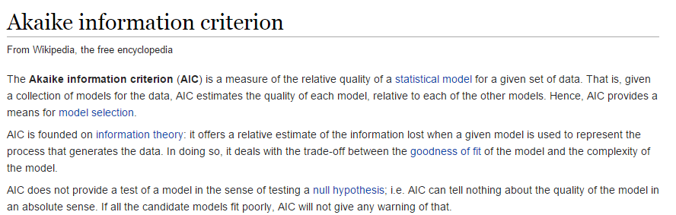
How do we choose between different models?
No perfect answer (of course) but a popular method is the AIC
http://en.wikipedia.org/wiki/Akaike_information_criterion

Slide 11
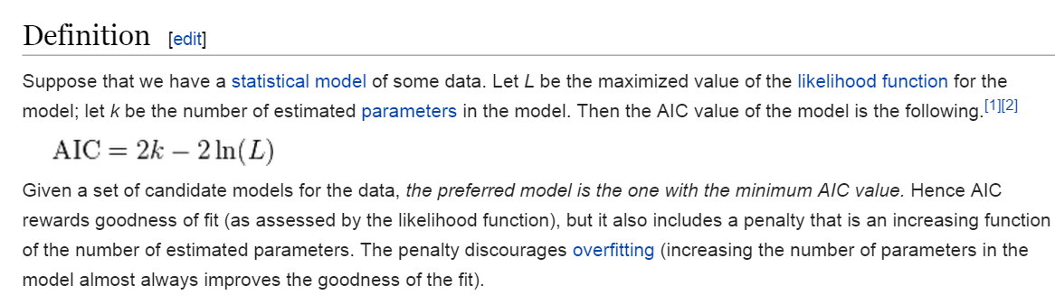
The AIC has a very simple way of balancing model complexity and fit
http://en.wikipedia.org/wiki/Akaike_information_criterion

Slide 12
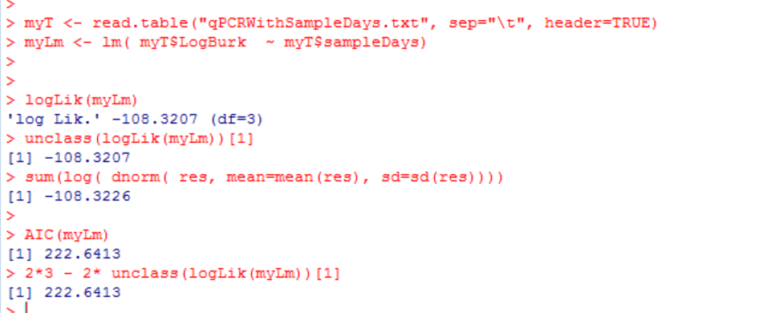
Easy to calculate…
Three parameters: slope, intercept and variance of the residuals…

Slide 13
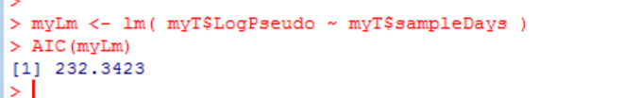
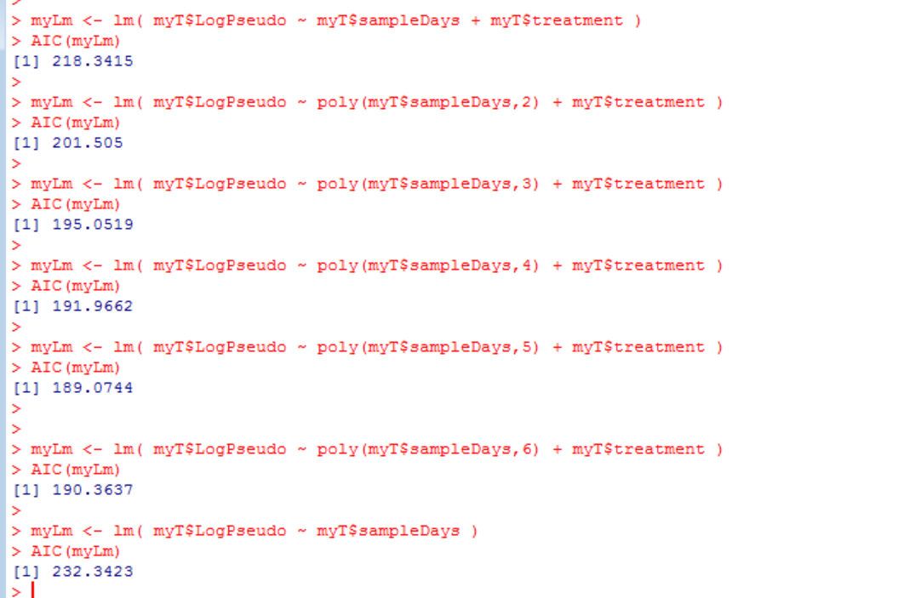
The AIC criteria seems to like the 6 parameter model…

Slide 14
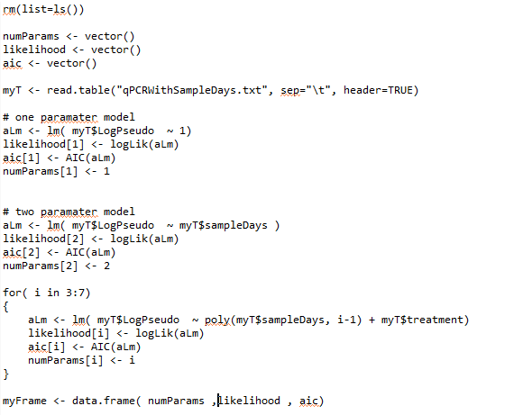
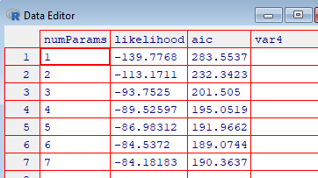
AIC balances out the number of paramaters vs. increase in likelihood
https://github.com/afodor/metagenomicsTools/blob/master/src/classExamples/likelihoodTable.txt

Slide 15

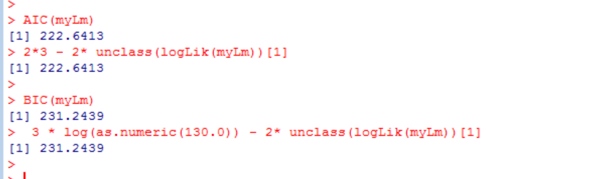
A closely related alternative to this is the Bayesian information criterion
Add a term for
the sample size

Slide 16
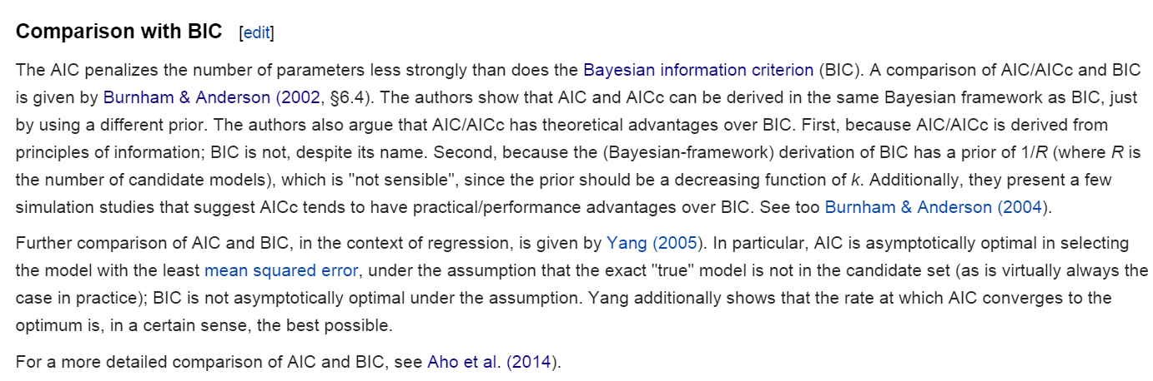
In practice AIC and BIC tend to pretty similar…
We won’t be covering this literature this semester…
http://en.wikipedia.org/wiki/Akaike_information_criterion

