Slide 1
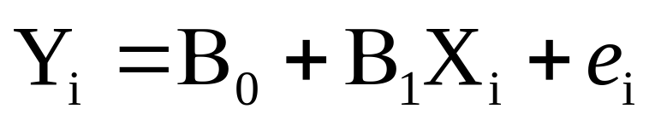
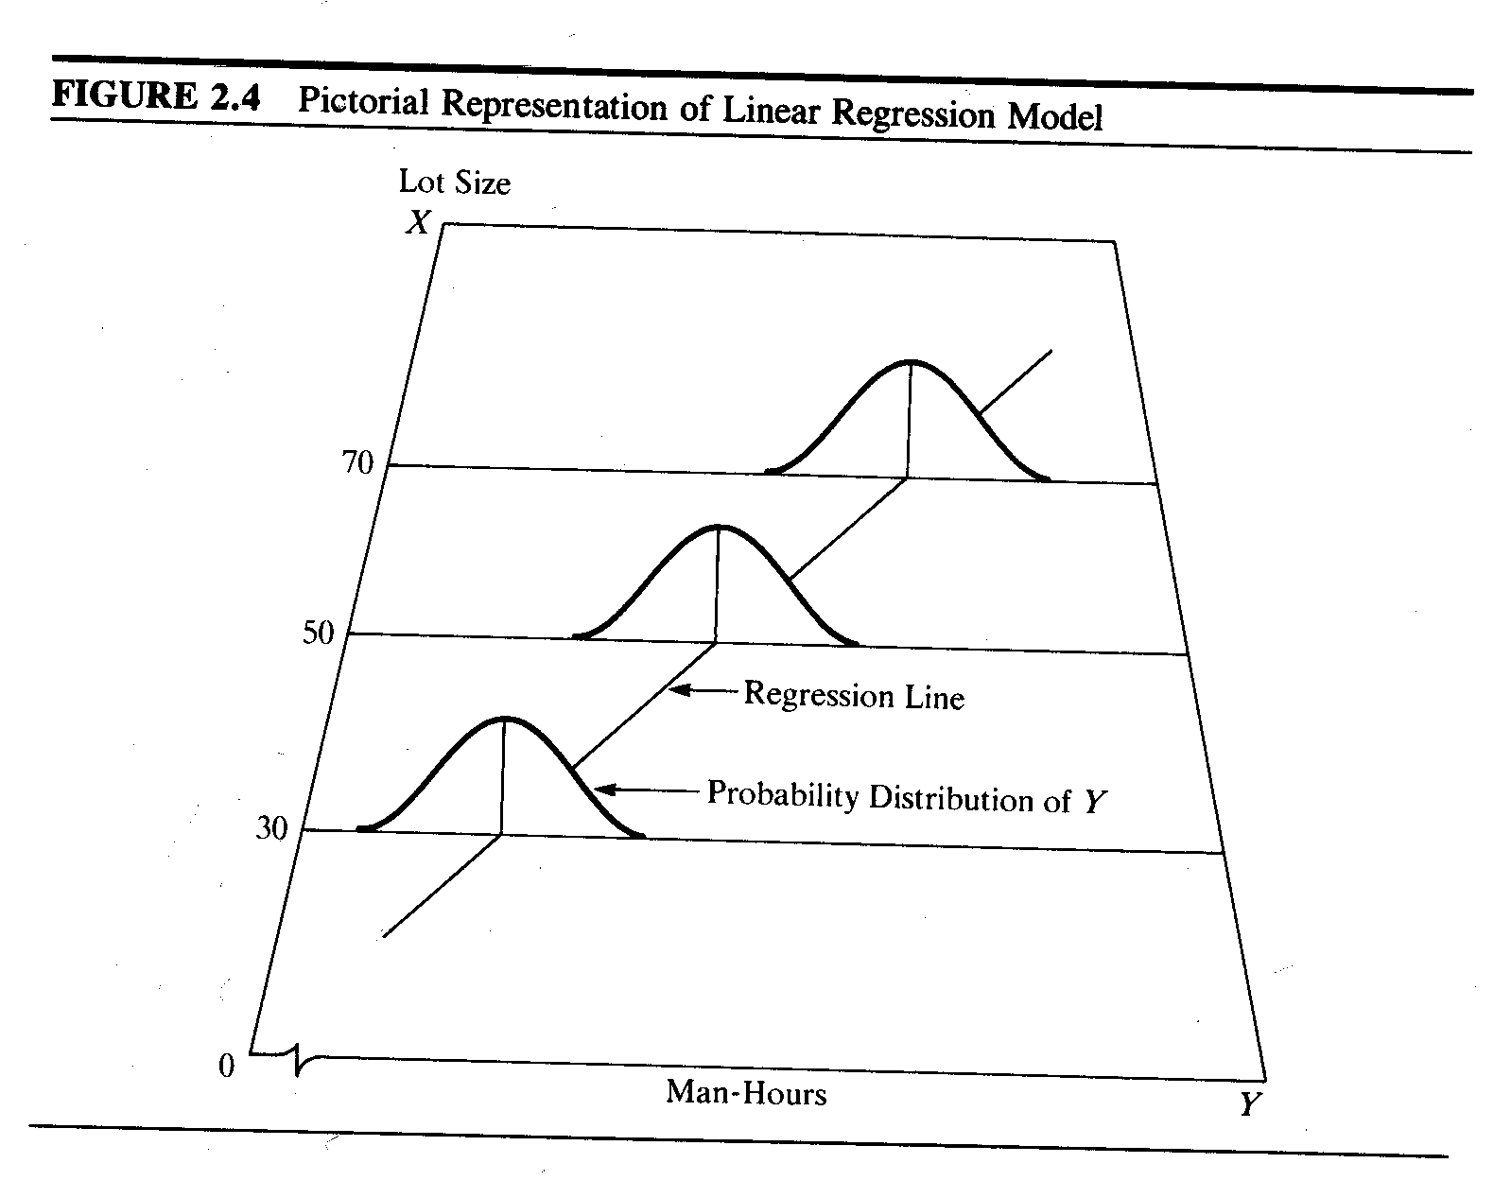
Linearity
Independence
Normality
Equal Variance
Neter et al - Applied Linear Statistical Models

Slide 2
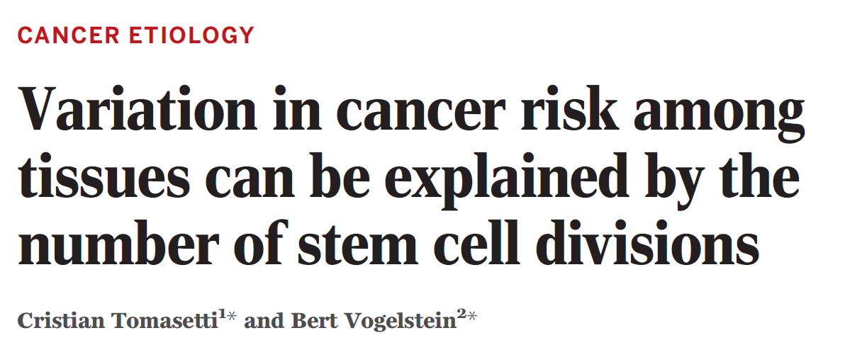


Slide 3
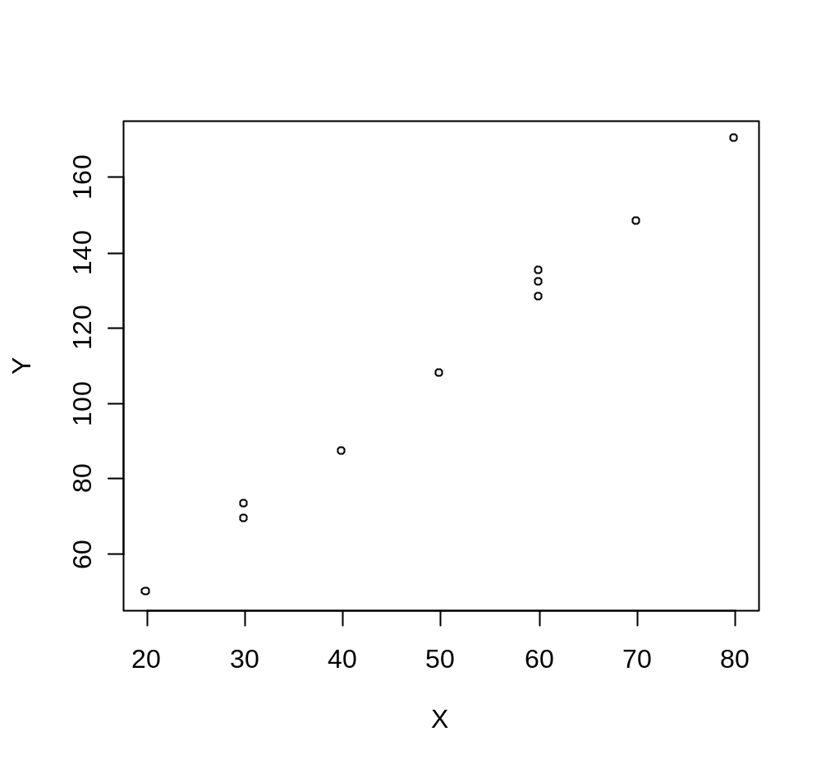
This is the example from the 3rd edition of “Applied Linear Statistical Models” (3rd edition)
X <- c(30,20,60,80,40,50,60,30,70,60)
Y <- c(73,50,128,170,87,108,135,69,148,132)
plot(X,Y)

Slide 4
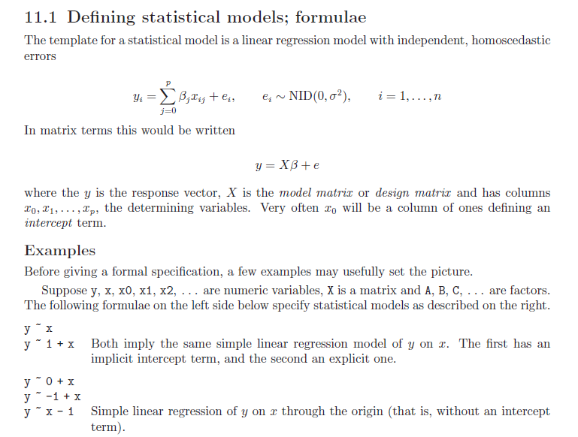
R has an extremely simple syntax for linear regression
> X <- c(30,20,60,80,40,50,60,30,70,60)
> Y <- c(73,50,128,170,87,108,135,69,148,132)
> myLinearModel = lm( Y ~ X )
The kinds of models are summarized on p. 50-1 in
“An introduction to R”

Slide 5
> X <- c(30,20,60,80,40,50,60,30,70,60)
> Y <- c(73,50,128,170,87,108,135,69,148,132)
> myLinearModel = lm( Y ~ X )
Hiding in that Y ~ X is an intercept and an error term
The full model is:
Y_{i} and X_{i} are the i th observation
B₀ and B₁ are parameters
ε_{i} is the error-term or i th residual
We seek parameters B₀ and B₁ that minimize the sum-squares of the error terms.

Slide 6
It is useful to think of linear models in terms of column vectors
Y₁
1
X₁
e₁
Y₂
1
X₂
e₂
Y₃
=
X₃
e₃
B₀
1
+
B₁
+
….
….
….
….
Y_{n}
1
X_{n}
e_{n}

Slide 7




X <- c(30,20,60,80,40,50,60,30,70,60)
Y <- c(73,50,128,170,87,108,135,69,148,132)
Y = B₀ + B₁X + e
+
+
=
B₀
B₁

Slide 8
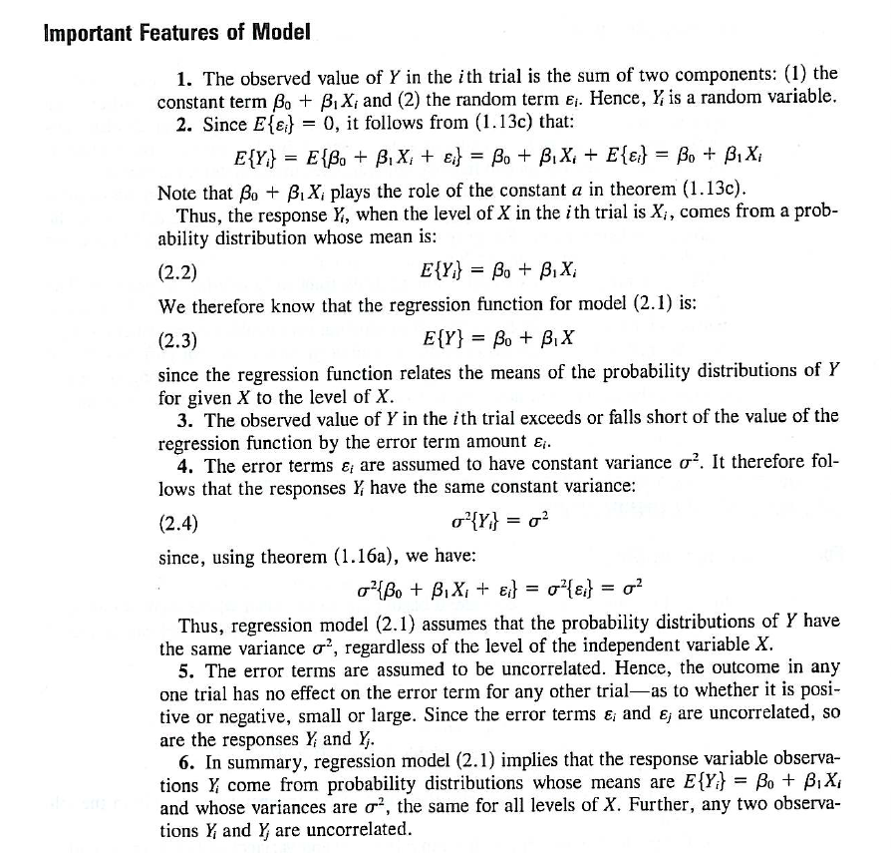
Neter et al - Applied Linear Statistical Models
Linearity
Independence
Normality
Equal Variance
σ² is the variance of the error terms

Slide 9
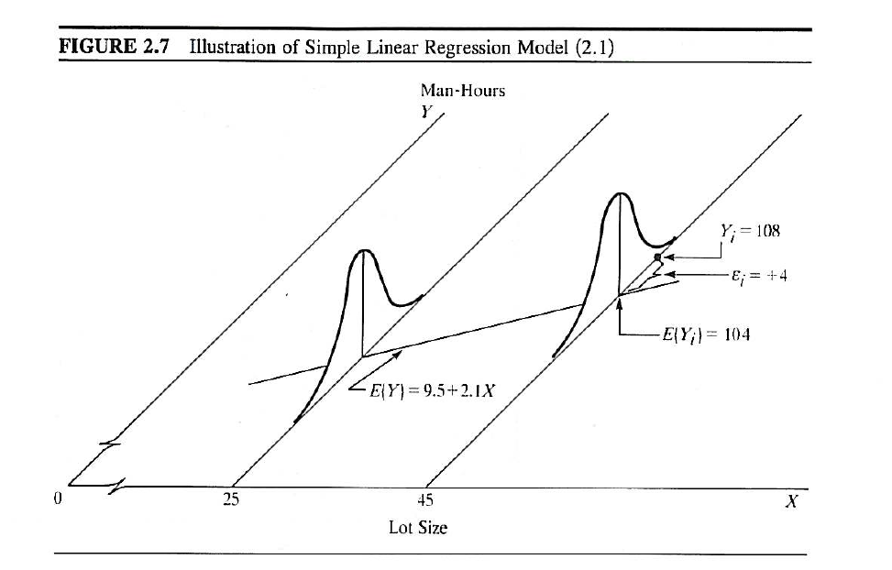
The actual value
The error
The expected value
under the model
Assumption: The error terms are normally distributed with a constant variance ( σ² )
independent of the x-value
Neter et al - Applied Linear Statistical Models

Slide 10
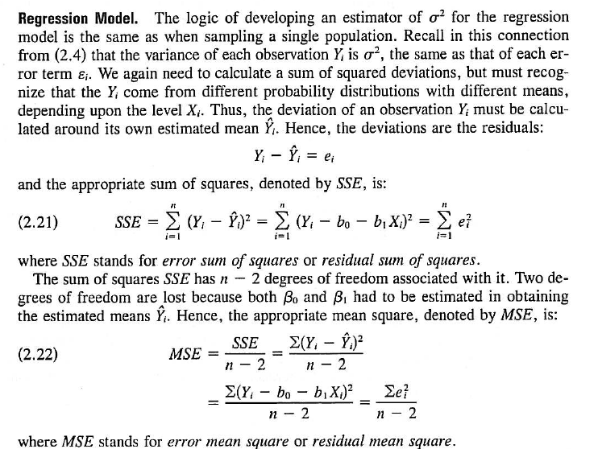
We define two terms: MSE and SSE
We seek parameters for B0 and B1 that will minimize these terms
Neter et al - Applied Linear Statistical Models

Slide 11
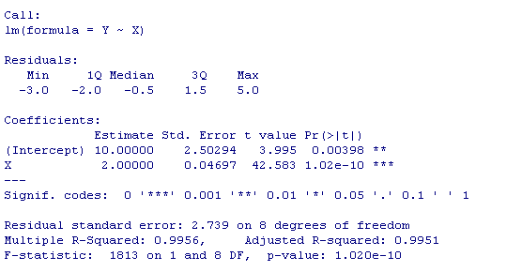
R makes it easy to find these parameters
> X <- c(30,20,60,80,40,50,60,30,70,60)
> Y <- c(73,50,128,170,87,108,135,69,148,132)
> myLinearModel = lm( Y ~ X )
summary(myLinearModel)
Slope
You can also easily find these parameters with minimal programming…

Slide 12
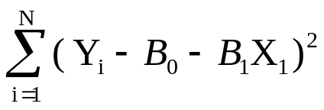
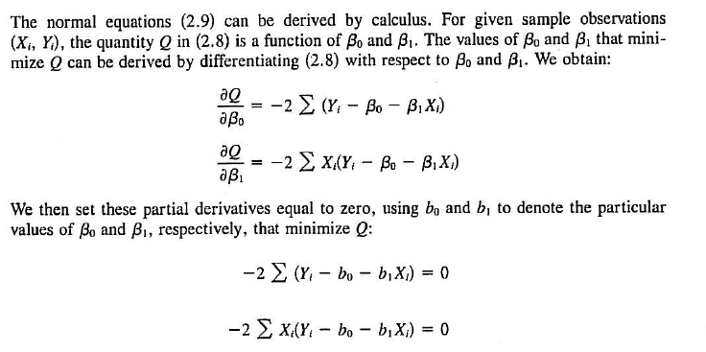
We seek values for B0 and B1 that will minimize the squared errors..
Q =
We want to minimize Q
Neter et al - Applied Linear Statistical Models

Slide 13
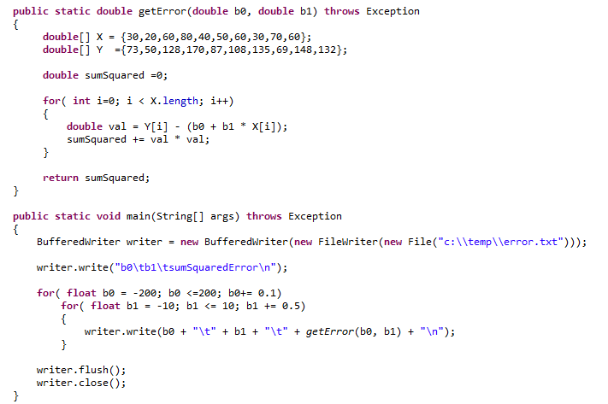
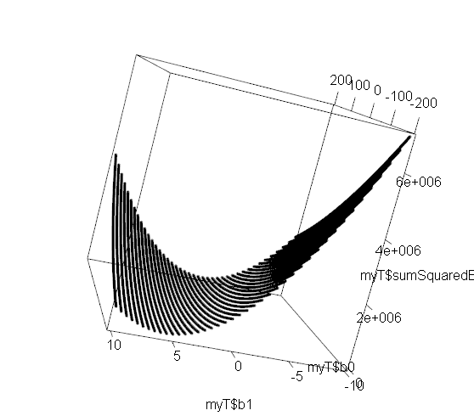
Graphically, we want to find the minimum of the sumSquaredError function

Slide 14

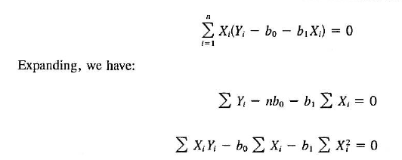
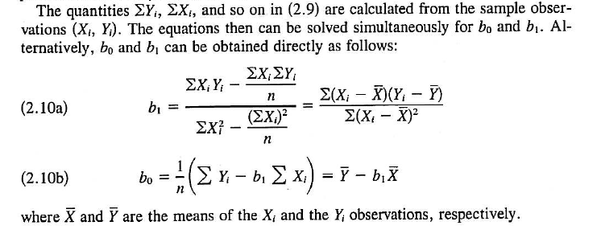
We take derivatives and set them to zero to solve for these parameters
Trivial to implement
In Python or Java
Neter et al - Applied Linear Statistical Models

Slide 15
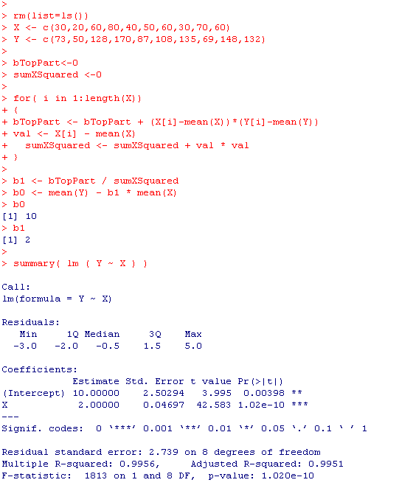
We can find these
coefficients with a trivial amount of code…

Slide 16
We can test the hypothesis that the slope = 0
H₀: The slope is zero
H₁: The slope is non-zero

Slide 17
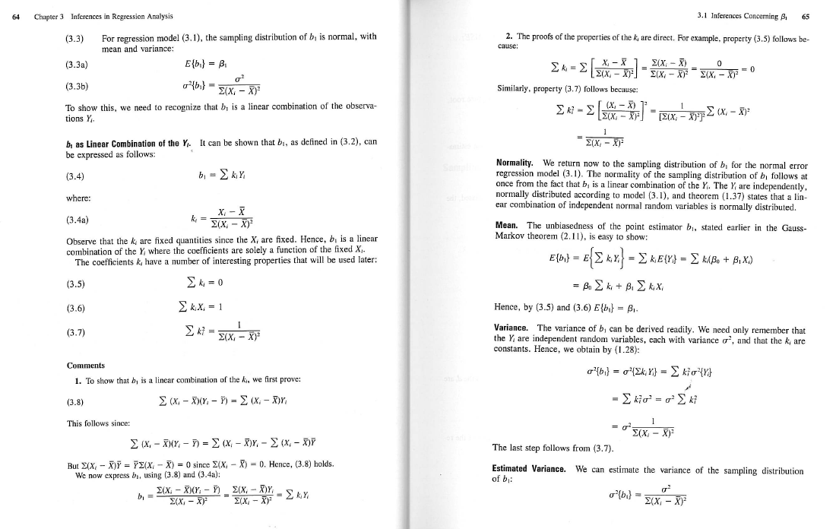
This proof tells us how we can use the t-distribution to perform inference on our parameter
You are not responsible for the proof, but note the use of the assumptions….
Neter et al - Applied Linear Statistical Models

Slide 18
Linearity
Independence
Normality
Equal Variance
Neter et al - Applied Linear Statistical Models

Slide 19
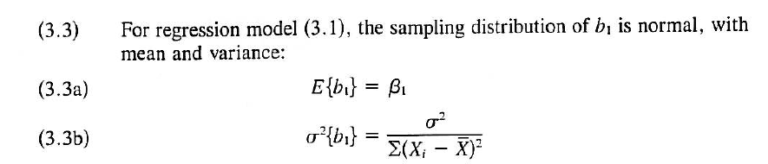
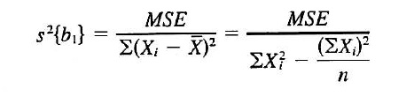

test that the slope is
some value
(usually zero…)
So a test that with a null hypothesis that the true slope (B1) = 0 is
b1 (estimated slope ) / s{b₁}

Slide 20
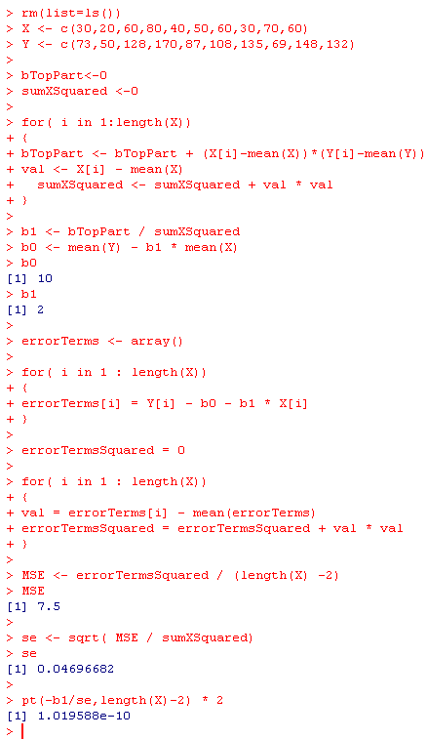

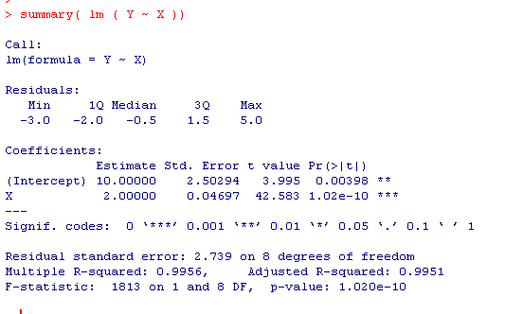
A trivial amount of code to do inference on
linear regression…

Slide 21
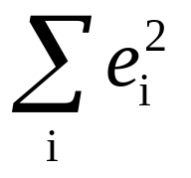
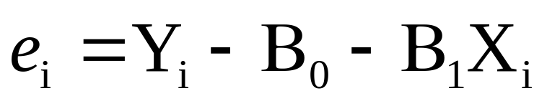
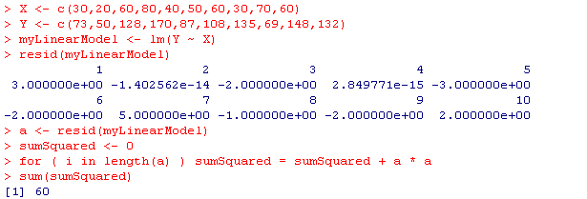
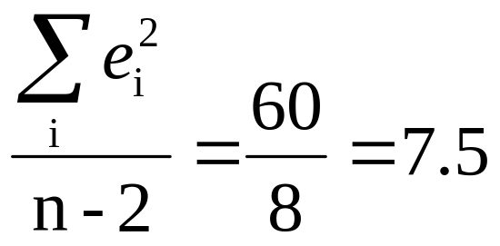
R can also just hand you the residuals
MSE =

Slide 22
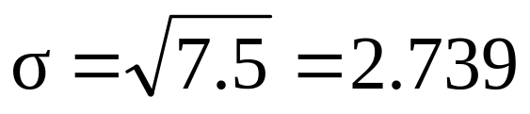
SQRT(MSE)
A measure of how much is NOT explained by the model

Slide 23
A test that is useful much less often…
H₀: The intercept is zero
H₁: The intercept is non-zero

Slide 24
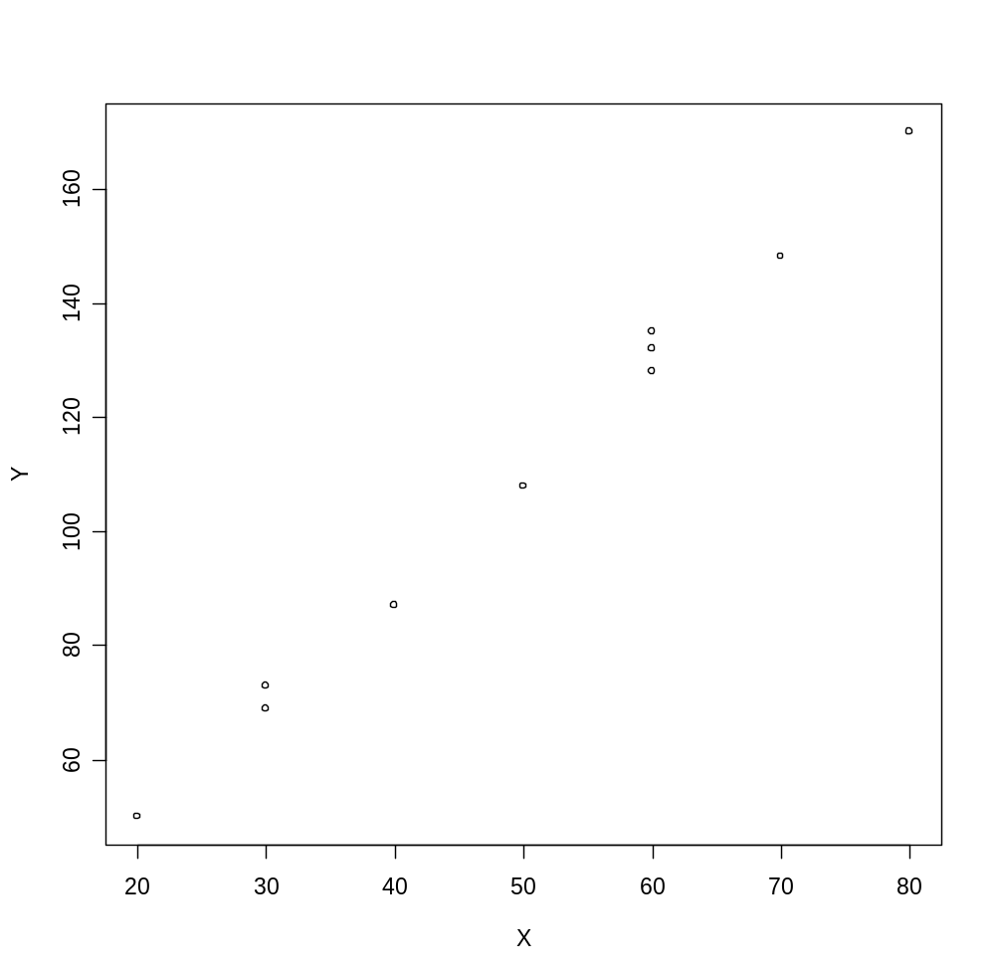
Most straightforward thing to do is just look at the data
plot(X,Y)

Slide 26
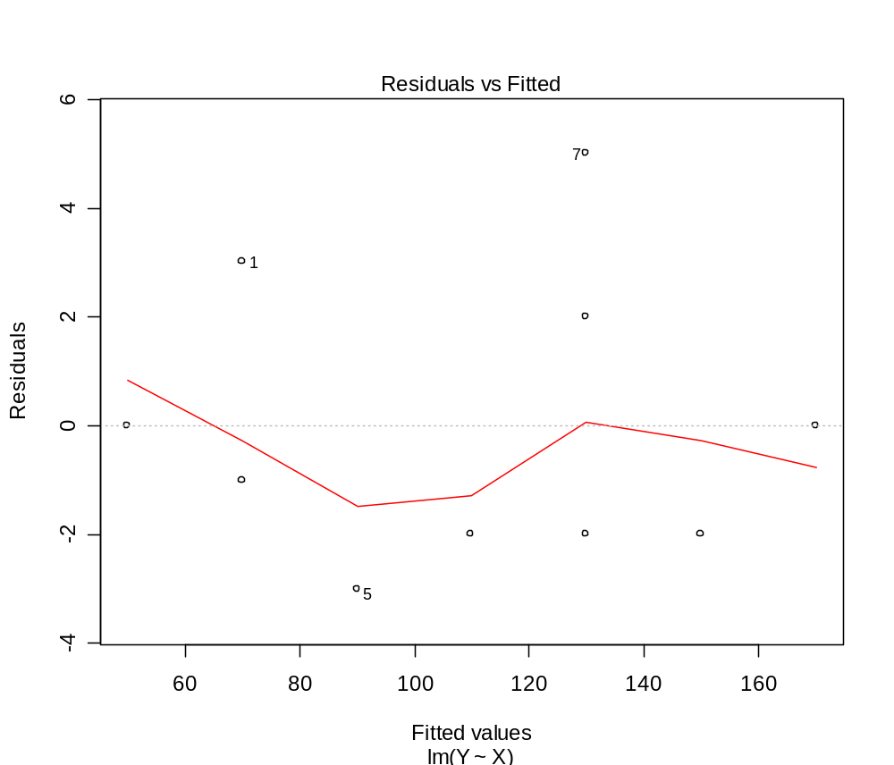
Some built in graphs to help see how well you meet
the assumptions
> myLm <- lm(Y ~ X)
> plot(myLm)

Slide 27
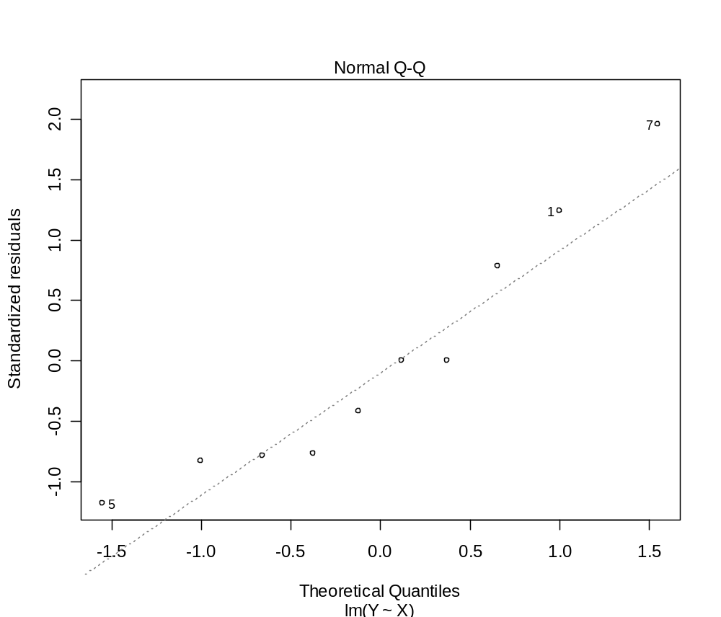
Some built in graphs to help see how well you meet
the assumptions
> myLm <- lm(Y ~ X)
> plot(myLm)
qqnorm(residuals(myLm))
or
Deviations from line = non-normality

Slide 28
Next time:
Continuing linear models with the F-test and the ANOVA approach
to regression (chapter 3 in the 3rd edition of the Neter text book)

