Slide 1
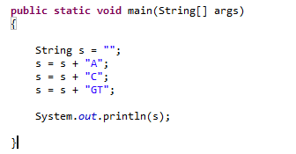
Lab 1 – Random DNA sequences…
The “+” operator is defined to produce String concatenation…
This yields “ACGT”
(For performance reasons, this is sometimes not a good idea, but more on that later!)

Slide 2
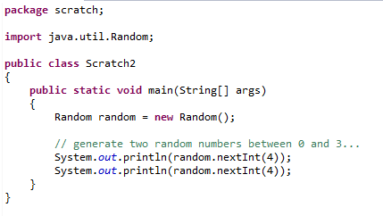
We can use Java’s random number generator to randomly sample
the numbers { 0,1,2,3} from the uniform distribution…
Tell Java we will use the Random class

Slide 3
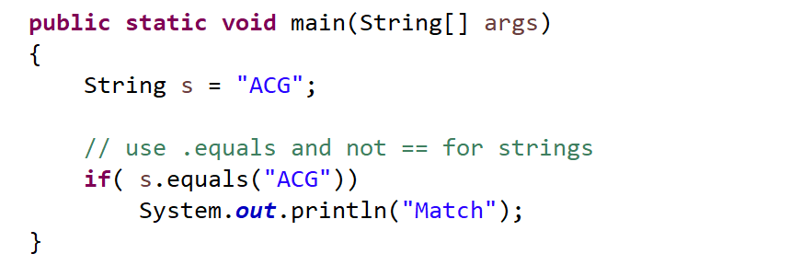
Use .equals (and not ==) to check for the contents of a String
(more on this later….)

Slide 4
Lab Exercise for Friday (due Wed Sep. 4):
(1) Write code to print to the console 1,000 randomly generated
DNA 3 mers (e.g. “ACA”, “TCG” )
where the frequency of A,C,G and T is 25% and is uniformly sampled.
Have your code track how often it prints out the 3 mer (“AAA”)
How often would you expect to see this 3mer by chance? Is Java’s number
close to the number that you would expect?
Send you code to afodor@uncc.edu before next week’s lab session.
Make sure the phrase “Lab 1” is in the subject line
(As a better alternative, check your code into a BitBucket or GitHub repositiory and work
with me to make sure that I have access – see slides at the end of this lab)
(Send afodor@uncc.edu an e-mail when the code is checked in and ready to grade)
(For extra-credit exercise see next slide)

Slide 5
Extra credit
Modify your code so that the frequency of A,C,G and T is
p(A) = 0.12
p(C) = 0.38
p(G) = 0.39
p(T) = 0.11
What is the expected frequency now of “AAA”? Does Java produce “AAA”
at close to the expected frequency?
Hint the code:
Random random = new Random();
float f = random.nextFloat();
produces a random number uniformly between 0 and 1.
(2) For those with a stats background and a lot of time on your hands…
Rerun the above simulation for 10,000 sequences 10,000 times.
Use the chi-square test to show that the p-values for the null hypothesis
that the actual distribution does not match the expected distribution are
uniformly distributed.
Hint: This might help
http://www.vvlasov.com/2013/06/how-to-calculate-pvalue-from-chisquare.html

Slide 6
Next: Optional exercise to publish your code to the internet

Slide 7
Set up a GitHub account…
https://github.com/join
For a free GitHub account, the code you commit is publically available.
If you are not comfortable with this, use an anonymous user id/e-mail
(or delete your repository at the end of the lab!).
Or pay for a private GitHub account (useful if you are working for/with people
on private projects)

Slide 8
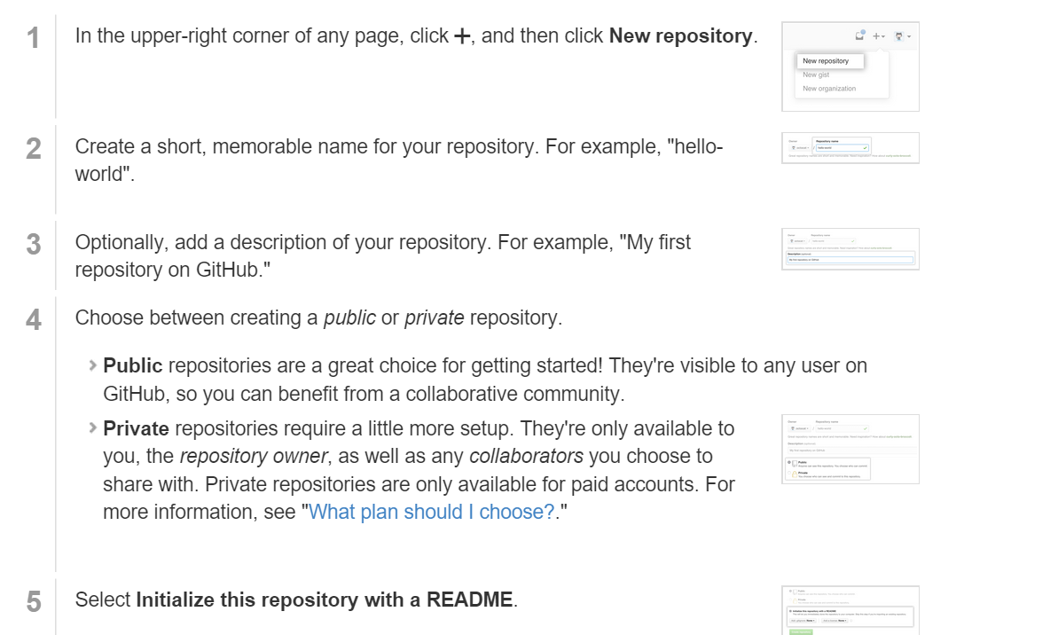
Create a github repository
(This assumes you have a “HelloWorld.java” class in some project in Eclipse

Slide 9
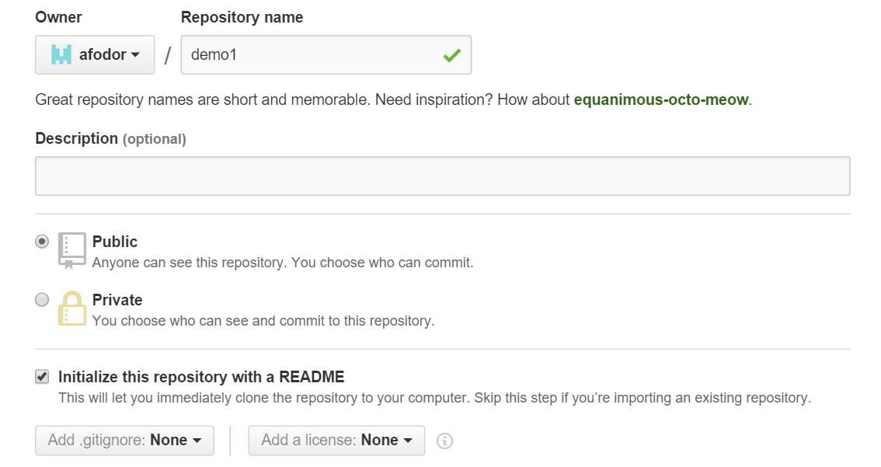
Give your repository a catchy name

Slide 10
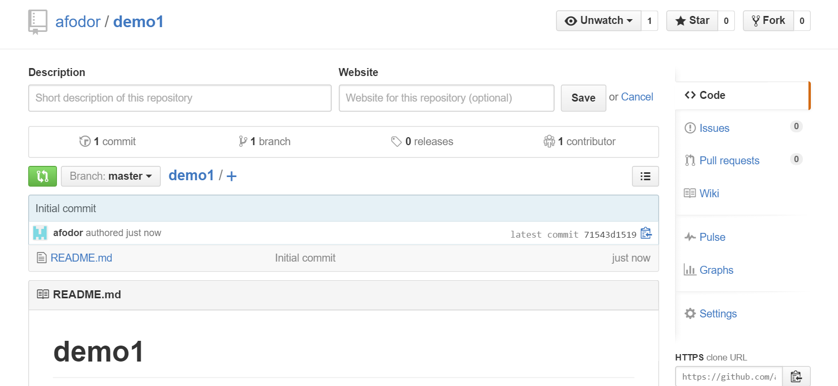
After you create your repository, it will have its own web page at GitHub

Slide 11
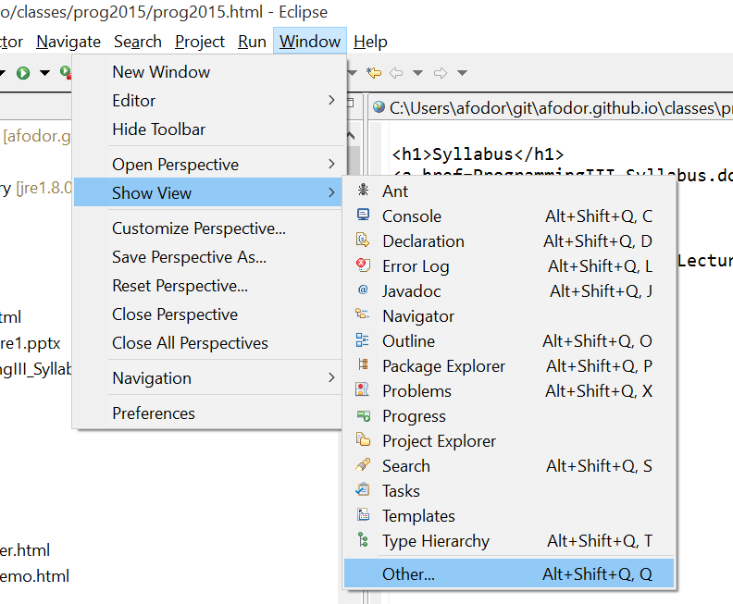
From Eclipse, “checkout” your repository….
Do “Show View”->”Other…”

Slide 12
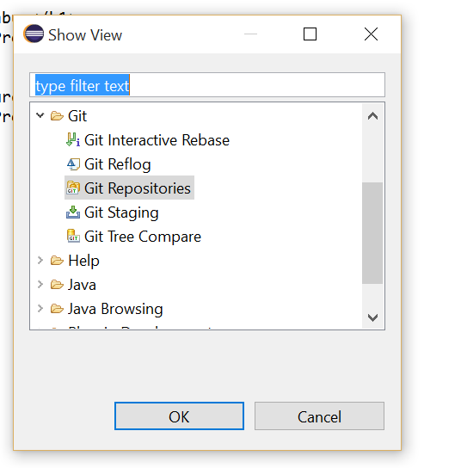
Choose “Git repositories”

Slide 13
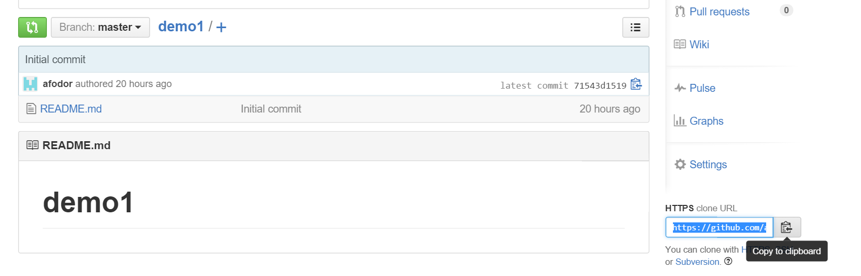
From the “github.com” web site for your project, choose “cloneURL…”

Slide 14
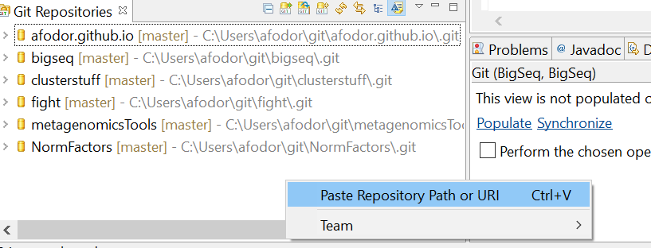
Back in Eclipse, find your “Git Repositories” window…
Right-click and choose “Paste Repository Path or URI”

Slide 15
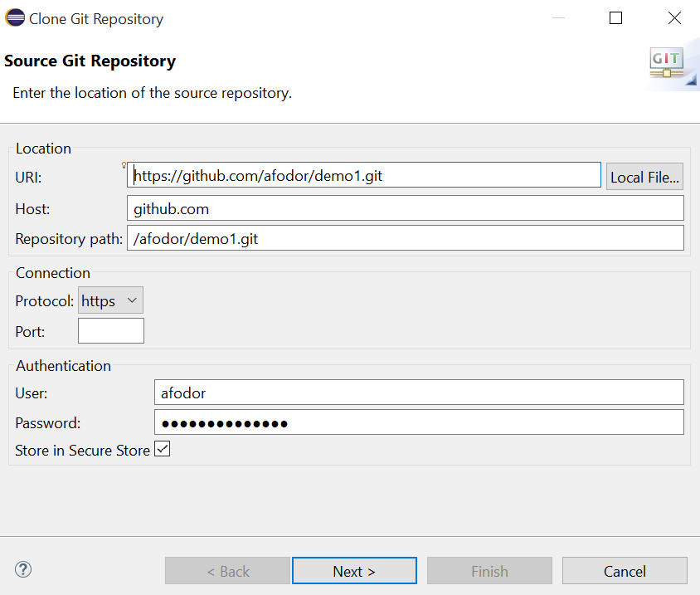
Click through the dialog screens…

Slide 16
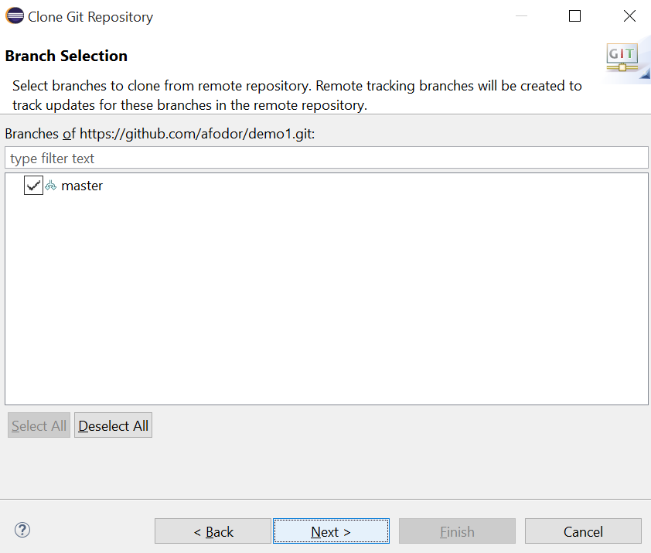
Click through the dialog screens…

Slide 17
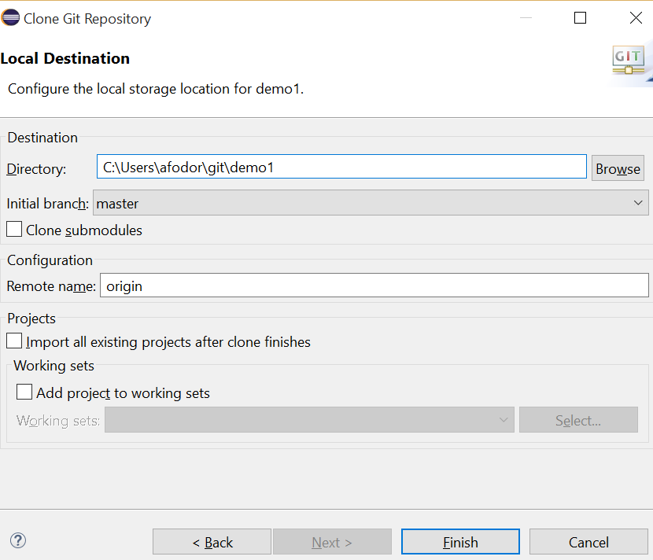
Click through the dialog screens…
remember this…

Slide 18
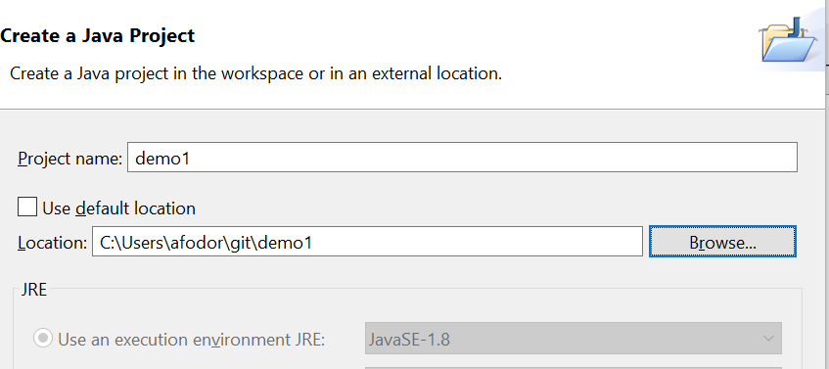
Now find the “Package Explorer” window…
Right-click and choose new -> “Java Project”
Give your new project the same name as the GIT project
Navigate to where you put your GIT project
uncheck
Click “finish”

Slide 19
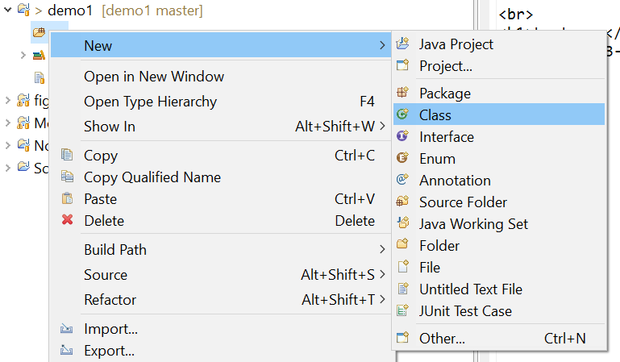
In the “src” directory in your new project, make a “HelloWorld.java” class as before
(or copy it from the file system or from another Eclipse project)

Slide 20
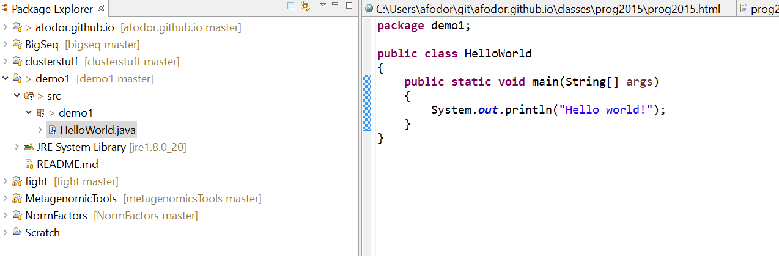

Slide 21
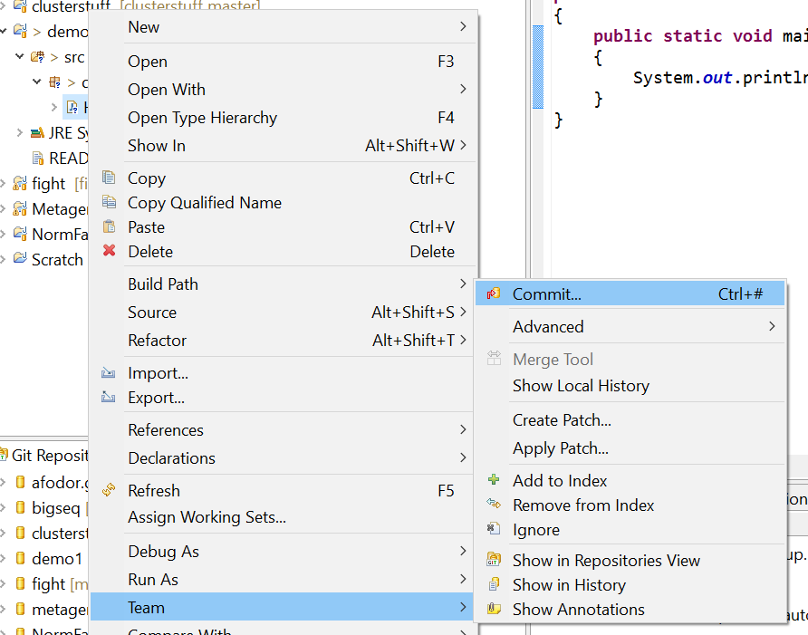
Now we will publish it to the web… In the “Package Explorer” frame, right-click and
Choose “Team→Commit”

Slide 22
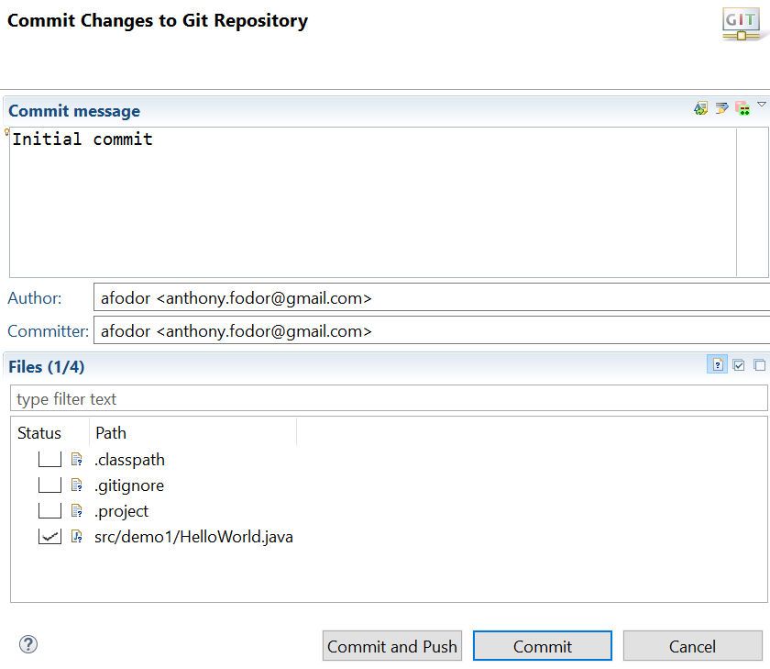
You have to type something here…
Choose (only) your class
Hit commit and push
(to push your code to GitHub)

Slide 23
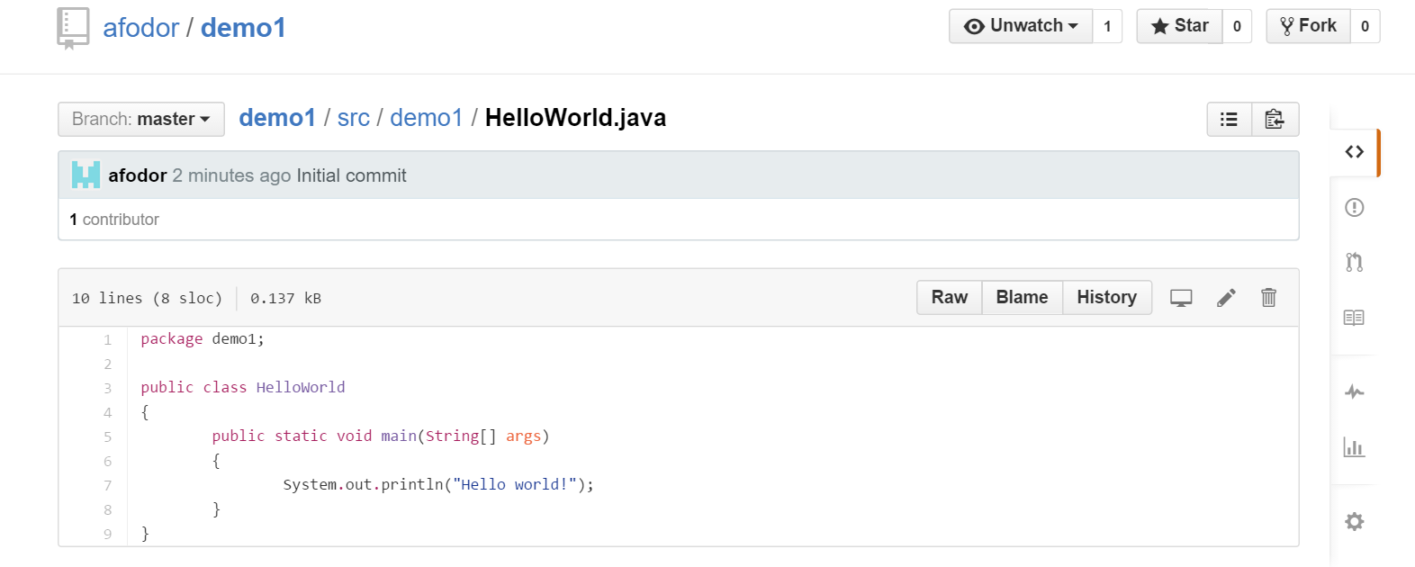
With any luck, your code is on the web.
You can invite people into your project to collaborate..
https://github.com/afodor/demo1/blob/master/src/demo1/HelloWorld.java

Slide 24
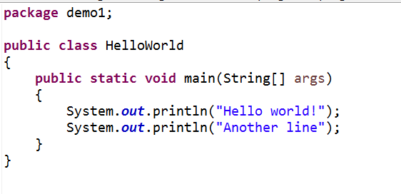
Go back to Eclipse and change your code…

Slide 25
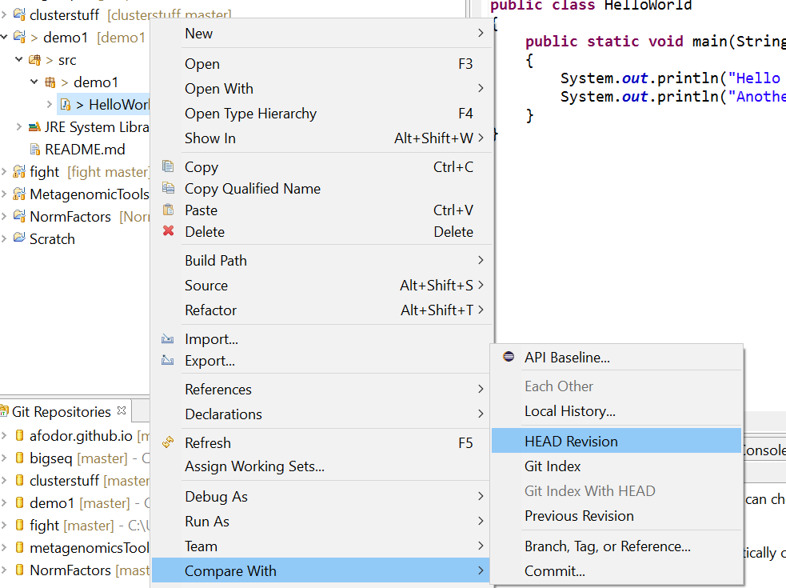
We can compare our current code to what is at GitHub
Right-click in the Project Explorer -> Compare With -> Head Revision

Slide 26
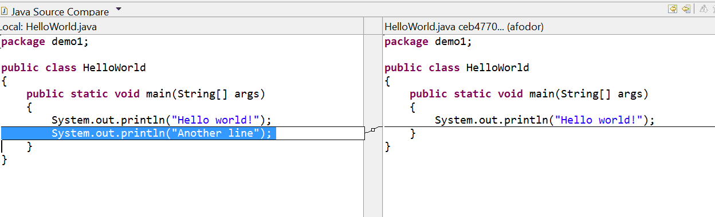
This is an invaluable tool.
Iterative development one small change at a time!
You can also replace the code with any previous version
Right click -> “Replace With…”
If you want to keep these changes, right-click -> team -> commit and they will be published

Slide 27
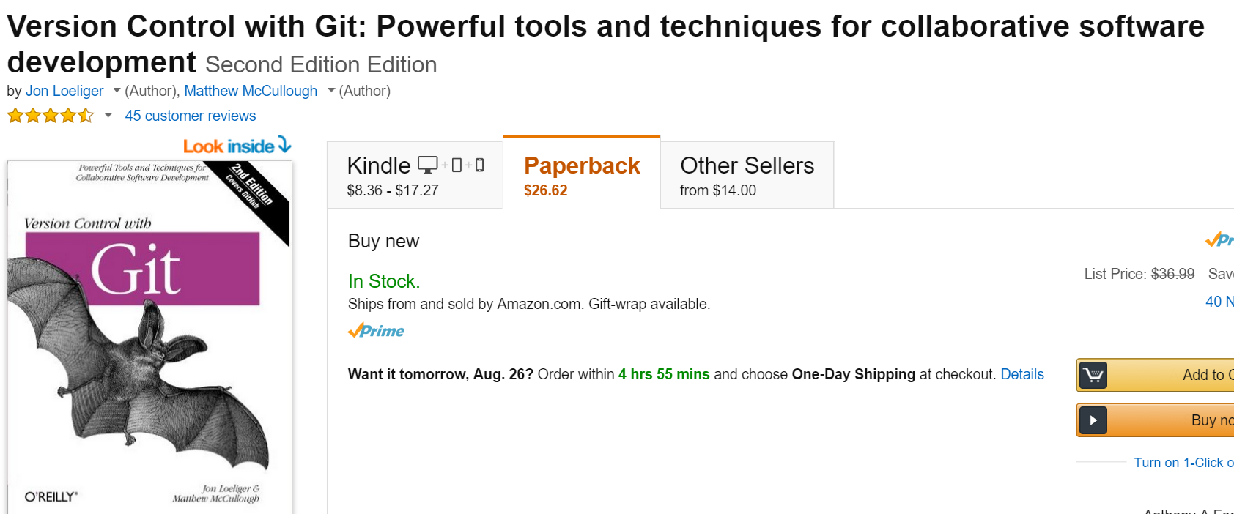
Git is a bit complex.
This is a useful reference (not sure if there is a free version).
Mastering GIT is a useful skill, but will not be a focus of the class.
I am happy to answer any GIT questions I can in lab (my knowledge of GIT is incomplete).
It takes a while to get the hang of GIT, but it very useful once you figure out the basics..

Slide 28
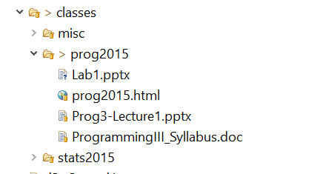
By the way, the class web site is published on Git/GitHub
I just add stuff to the directory and commit it.
Automatically backed up, shared across multiple machines,
Free to publish web site.
Pretty great…

