Slide 1
Schedule:
No in-person class on Friday Sep 2
Optional on-line “help session” for the homework:
Friday, Sep. 2; 1:30-2:30
Zoom link will be sent by e-mail
(if you don’t get it by class time and want it, e-mail me….)
No class – Sep. 6th (Labor day)
E-mail if you are stuck on the homework.
Homework is due Wed. Sep 8th

Slide 2
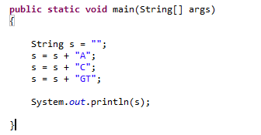
Lab 1 – Random DNA sequences…
The “+” operator is defined to produce String concatenation…
This yields “ACGT”
(For performance reasons, this is sometimes not a good idea, but more on that later!)

Slide 3
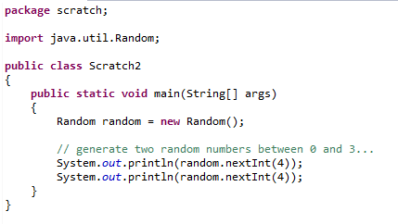
We can use Java’s random number generator to randomly sample
the numbers { 0,1,2,3} from the uniform distribution…
Tell Java we will use the Random class

Slide 4
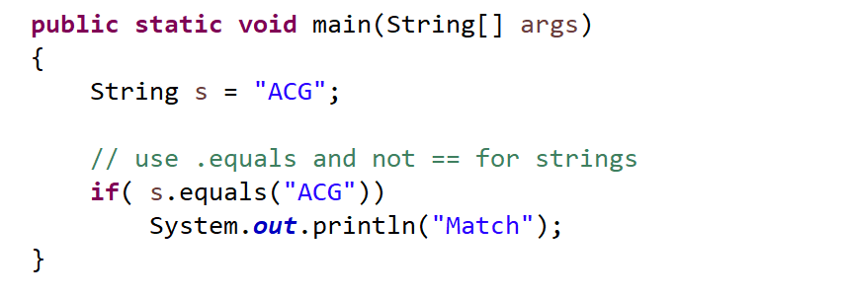
Use .equals (and not ==) to check for the contents of a String
(more on this later….)

Slide 5
Lab Exercise for Friday (due Wed Sep. 23):
(1) Write code to print to the console 1,000 randomly generated
DNA 3 mers (e.g. “ACA”, “TCG” )
where the frequency of A,C,G and T is 25% and is uniformly sampled.
Have your code track how often it prints out the 3 mer (“AAA”)
How often would you expect to see this 3mer by chance? Is Java’s number
close to the number that you would expect?
(3) Modify your code so that the frequency of A,C,G and T is
p(A) = 0.12
p(C) = 0.38
p(G) = 0.39
p(T) = 0.11
What is the expected frequency now of “AAA”? Does Java produce “AAA”
at close to the expected frequency?
Hint the code:
Random random = new Random();
float f = random.nextFloat();
produces a random number uniformly between 0 and 1.
(see next slide….)

Slide 6
Extra credit
For those with a stats background and/or a lot of time on your hands…
Rerun the above simulation for 10,000 sequences 10,000 times.
Use the chi-square test to show that the p-values for the null hypothesis
that the actual distribution does not match the expected distribution are
uniformly distributed.
Hint: This might help
http://www.vvlasov.com/2013/06/how-to-calculate-pvalue-from-chisquare.html
Due Sep 8:
Check your code into a GitHub repository
send afodor@uncc.edu an e-mail with the link when the code
is checked in and ready to grade.
Alternatively, just send your code to afodor@uncc.edu (but GitHub is preferred)

