Slide 1
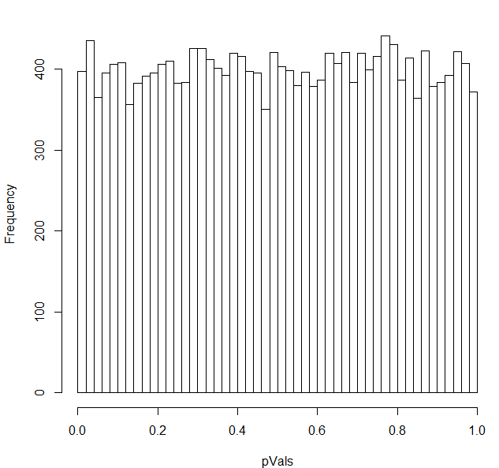

You have 20,000 genes in an rna-seq experiment.
You have two conditions (A) and (B).
You run them through DeSeq (or any other stats package).
If the null hypothesis is always true (no difference between A and B),
the p-values will be uniformly distributed…
We can model this pretty simply:

Slide 2
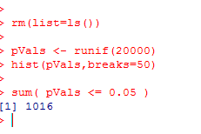
If we use a simple threshold of significance of 0.05, we would
expect about 1,000 genes to be called significant even if the null
hypothesis were always true..
There are 1,016 genes that have p-values <0.05
in this case where the p-values are uniform

Slide 3
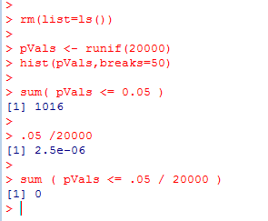

One alternative:
Use as a p-value threshold Bonferroni correction.
The desired threshold / number of tests.
In this case 0.05 / 20000 = 2.5e-06
None of our p-vals reach this threshold..
At this threshold, there is a 5% chance of any false positives

Slide 4
Bonferroni correction is sometimes considered too conservative for genomics experiments.
At small sample sizes, you might have few genes with p-values smaller than the
Bonferroni thresholds.
A less conservative alternative, false discovery rate.
At a 5% false discovery rate, we expect 5% of our hits to be false positives.
This is less conservative than Bonferroni correction, where there is a 5% chance
that any of our hits are false positives.

Slide 5
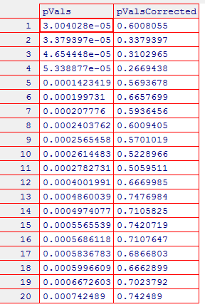
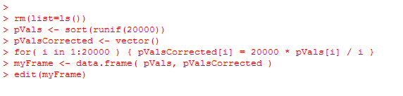
One straight-forward approach to finding genes at a given false-discovery rate
Benjamini and Hochberg FDR
1. Rank all the p-values (smallest first). The rank of each value = K
2. Calculate N * p / k
where N = the # of hypotheses that you are testing
p = the “raw” (uncorrected) p-value.
3. Start at the top of the list. Go down to N * p / k > threshold
(e.g. 0.10 for 10% FDR).
N * p = # of expected false positives at a given p-value
k = # of genes actually observed at that p-value

Slide 6
Note that for the first hit (smallest p-value),
Bonferroni correction is the same as BH FDR.
(Since if k=1,
N * p / K = N * p
which is the same as multiplying the p-value by the number of hypotheses to
do the correction)

Slide 7
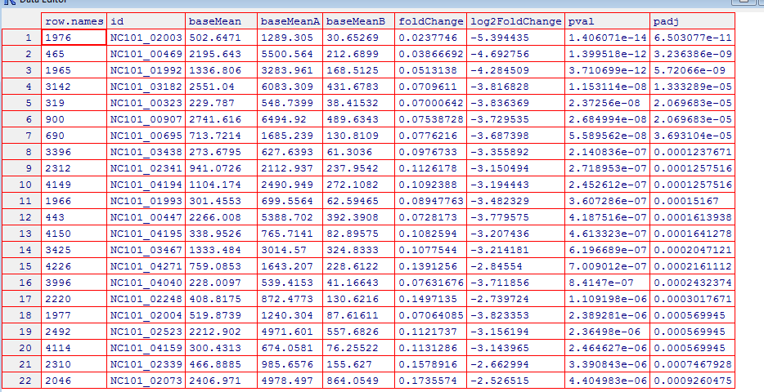
So in DeSeq…
FDR adjusted
p-values..
Raw p-values

Slide 8
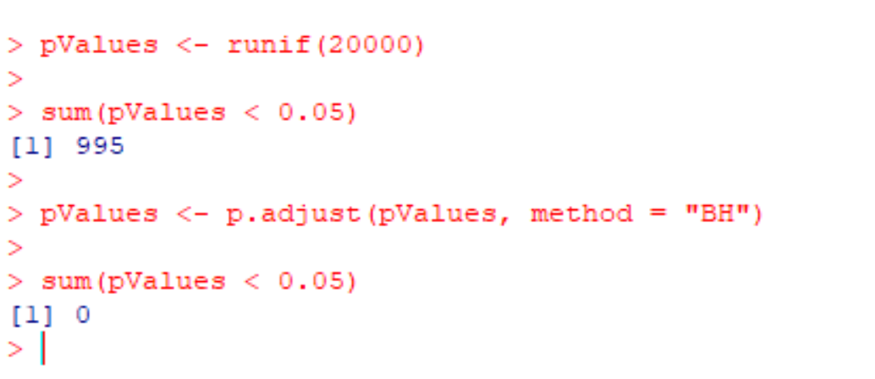
In R, you can use p.adjust to perform multiple hypothesis testing

