Slide 1
Calendar:
4/29/2021 last lecture
5/4/2021 Optional lab during class time at 1:00 pm
(or e-mail me for an appointment)
Final project write-up and all homeworks due May 14th
(no extensions as grades are due)
If you get me final projects earlier, I might be able to provide a grade
and give you the option to re-submit (depending on when you get me
your draft)
Optional: (Extra credit homeworks).
For anyone who wants to work through these assignments, I will grade
them if you get to me. Do not due these if you have homeworks due or
if you need time on your final projects
Lab #11 and Lab #12 from last year’s course
https://fodorclasses.github.io/classes/stats2020/stats2020.html
(obviously, ignore the due dates. Extra credit labs are due 5/14 )

Slide 2
Zero inflated models
Kendall’s tau

Slide 3
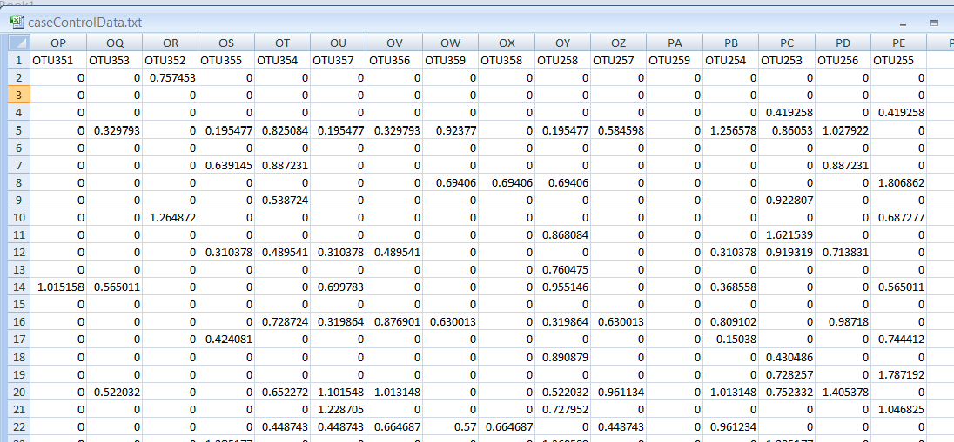
We often see lots of zeros in our sequence datasheets…
The source of all these zeros is not entirely clear…
Sequencing error, mis-classified taxa, lack of sequencing depth in some samples,
Biological diversity (we all have a few unique bugs that are not shared across many people).
http://afodor.github.io/classes/stats2015/caseControlData.txt

Slide 4
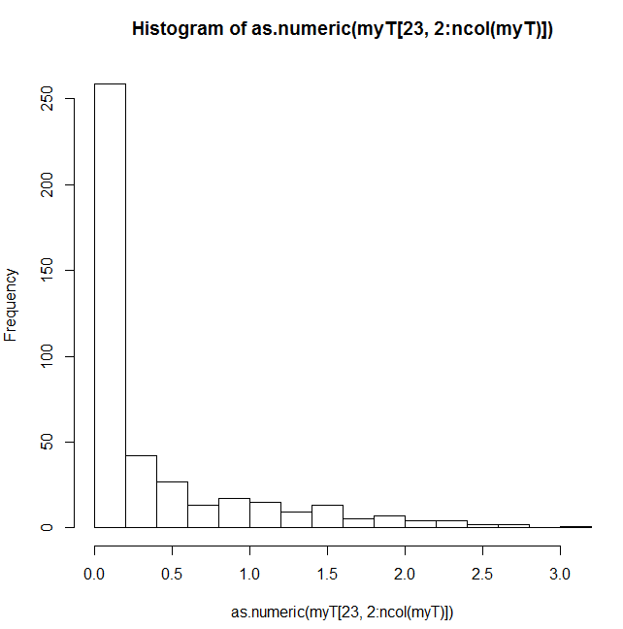
The zeros play havoc with assumptions such as normality
Today we will look at mixture models that explicitly model the over-abundance of zeros.
We follow chapter 11 in the Zuur book…

Slide 5
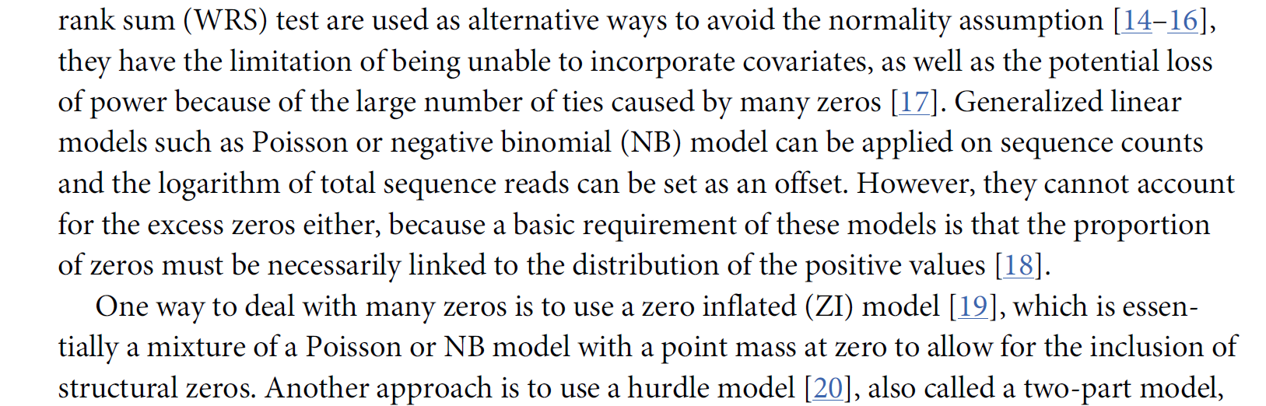
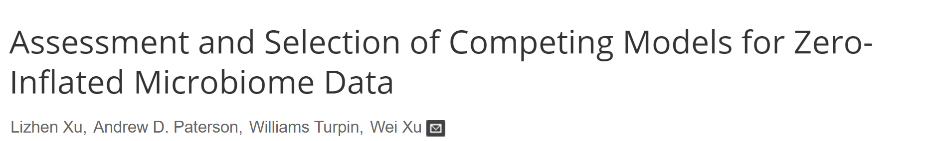
Poisson and negative binomial models have an explicit expectation of some zeros,
but the # of zeros is linked to the overall parameters of the model

Slide 6


Zero-inflated models use Mixture models to explicitly model the over-abundance of zeros
This will be binomial distributed with π = probability of a false or “rounded” zero
This will be either Poisson or Negative Binomial distributed of the true or “essential” zeors
We will start with the Poisson distribution…
Prob of zero under binomial distribution
Poisson probability of a zero
Poisson probability of non-zero

Slide 7



As in all generalized linear models, we have 3 parts in the specification for a
Poisson zero inflated model
Model assumptions:
Zeros are distributed by binomial + Poisson
non-zeros distributed by Poisson
Mean and variance
(stated without proof)
(link equations)
The two link equations can share parameters
or not!
Our link equations ensure that π (which belongs to the binomial) can
only range from 0 to 1 (where the binomial is defined)
And that μ (which belongs to the Poisson) can only range >= 0
(where the Poisson is defined)
From these, we can write a (complicated) likelihood function to maximize..

Slide 8
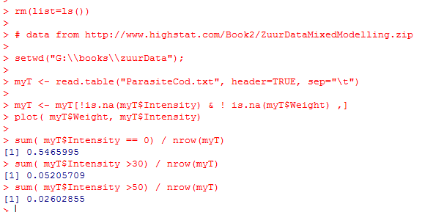
Let’s consider an example dataset…
Many zeros in this dataset (~54%) of all data
Your eye is drawn to the high intensity points,
But only ~2.6% of all data > 50

Slide 9
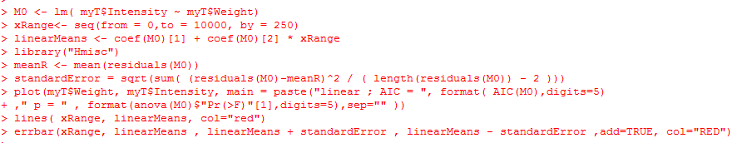
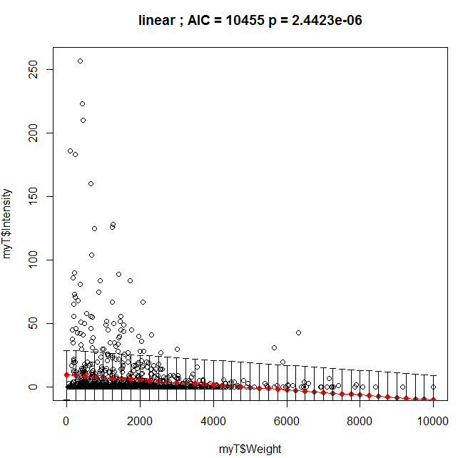
We will fit a series of models to the data… We start with a simple linear model..
Constant variance
Is problematic
Our model goes below
Zero…
https://github.com/afodor/metagenomicsTools/blob/master/src/classExamples/zeroInflatedExample.txt

Slide 10
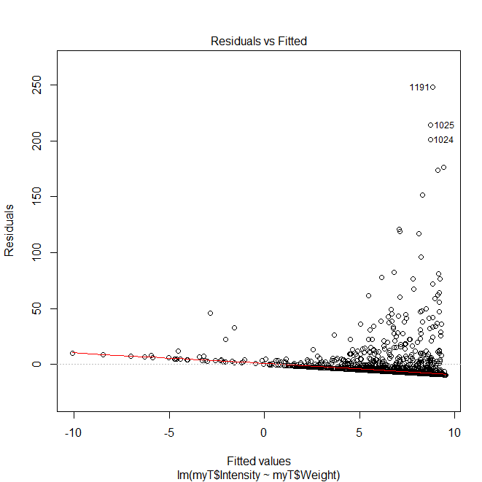
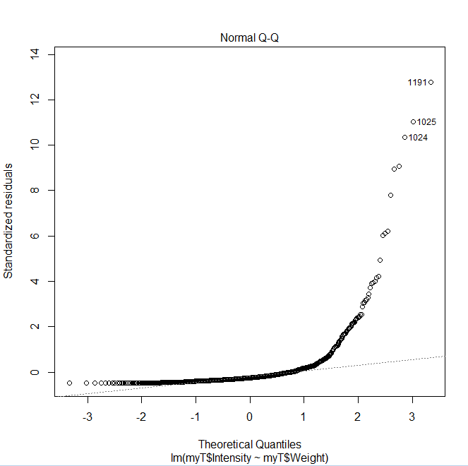
The residuals are a mess…
plot(M0)

Slide 11
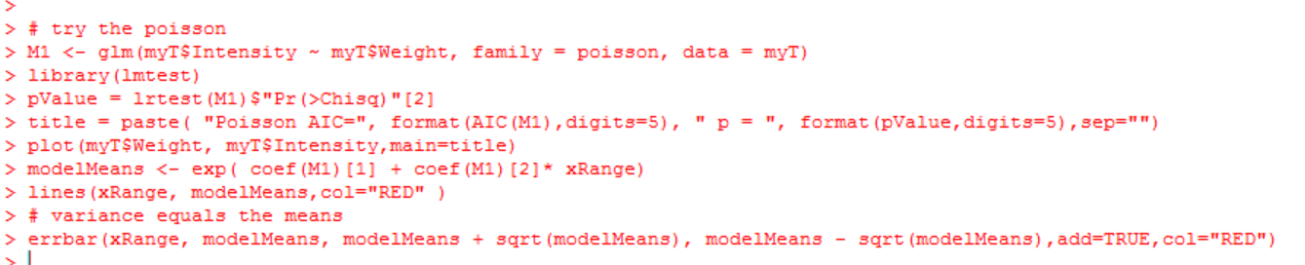
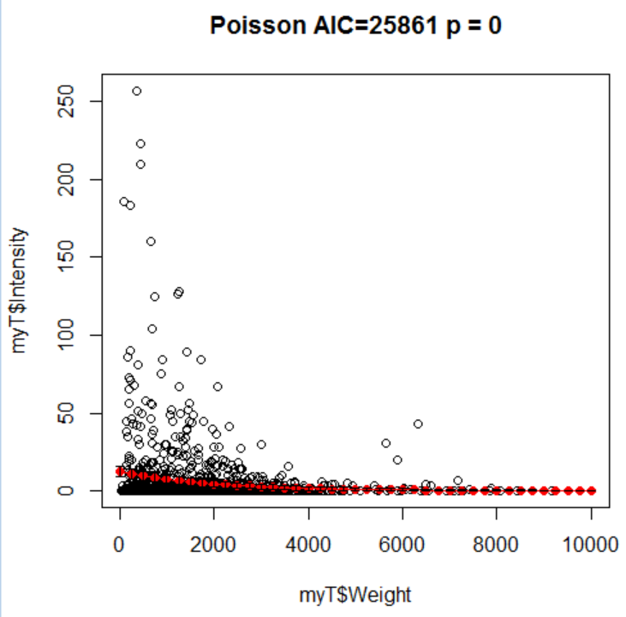
Next, we consider a Poisson model..
Fit is considerably worse than linear;
Assumption that mean==variance
seems a poor one..
Model doesn’t go below zero

Slide 12
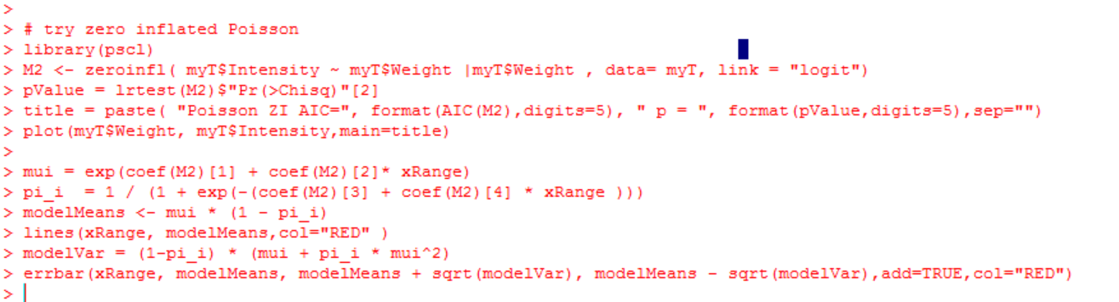
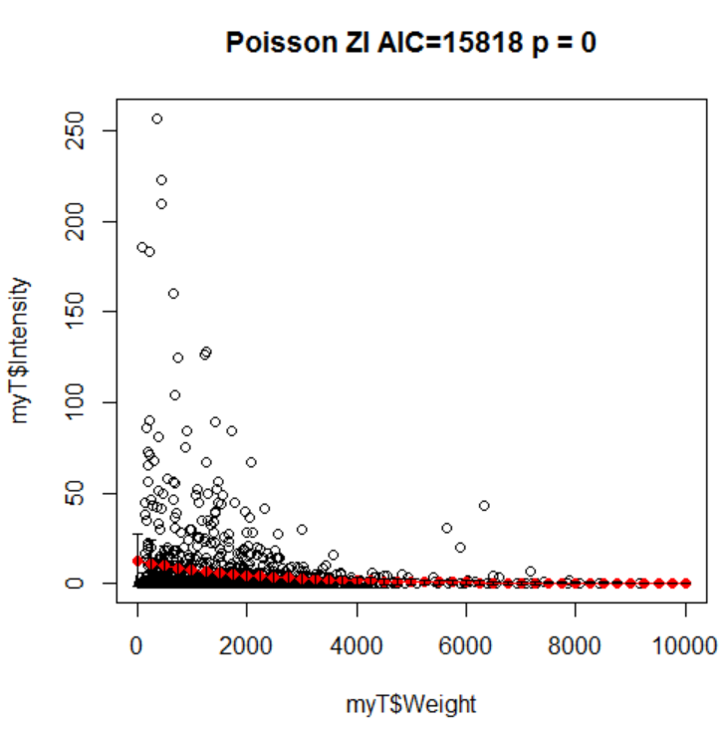
Next the zero-inflated Poisson

Slide 13
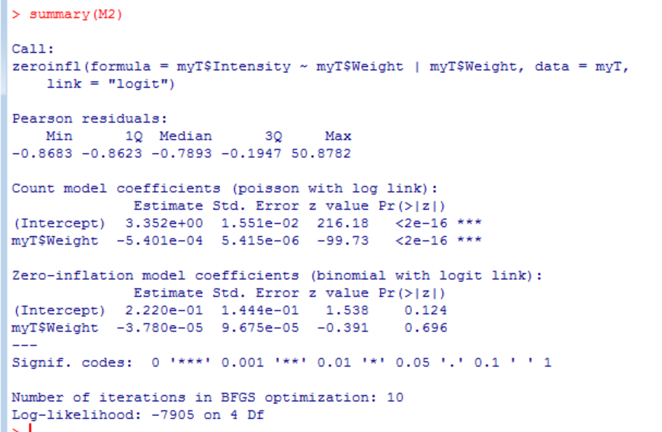

Slide 14
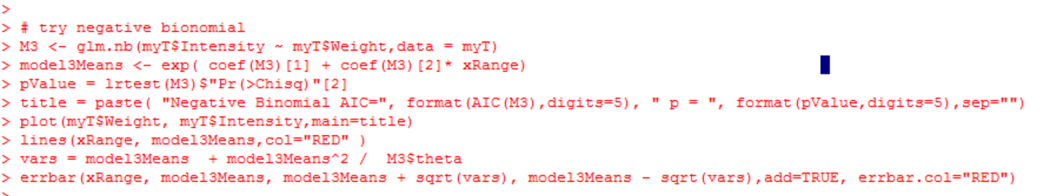
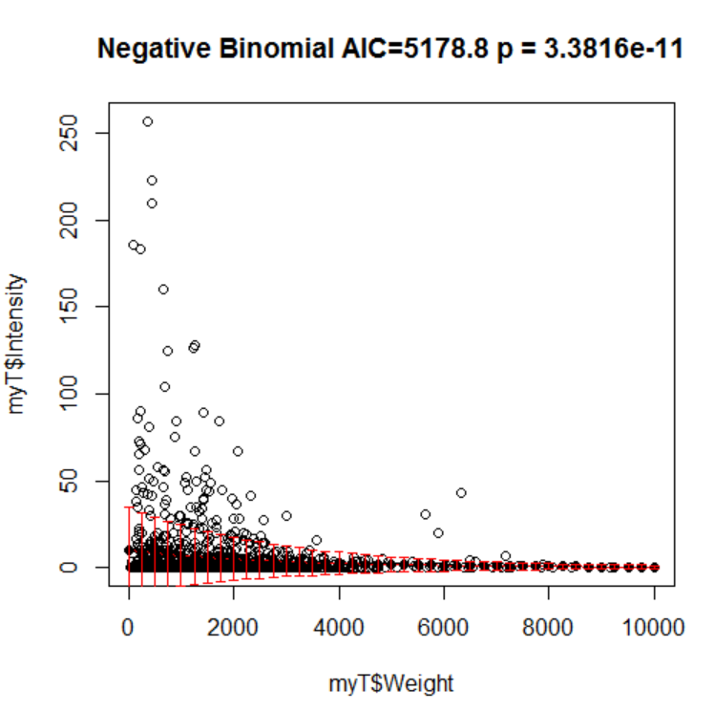
The negative binomial…

Slide 15
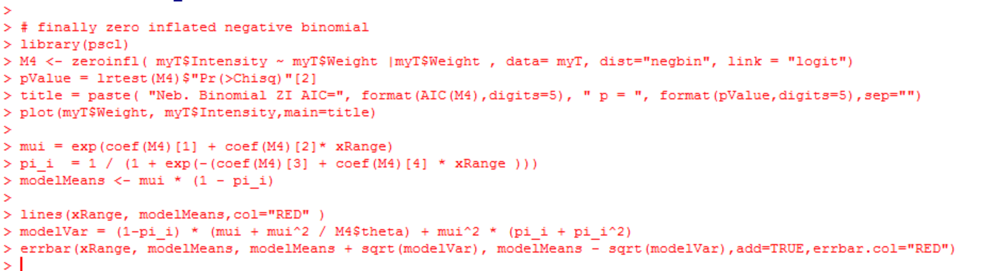
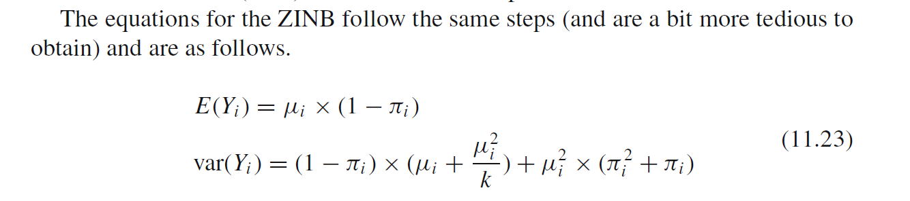
Finally, the zero inflated negative binomial…
From the Zuur book…

Slide 16
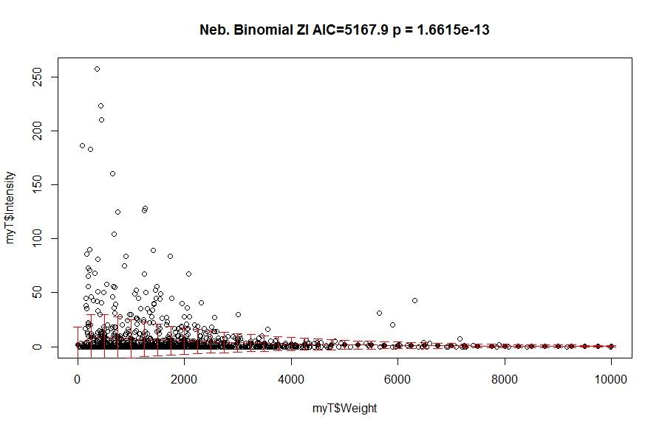

Slide 17
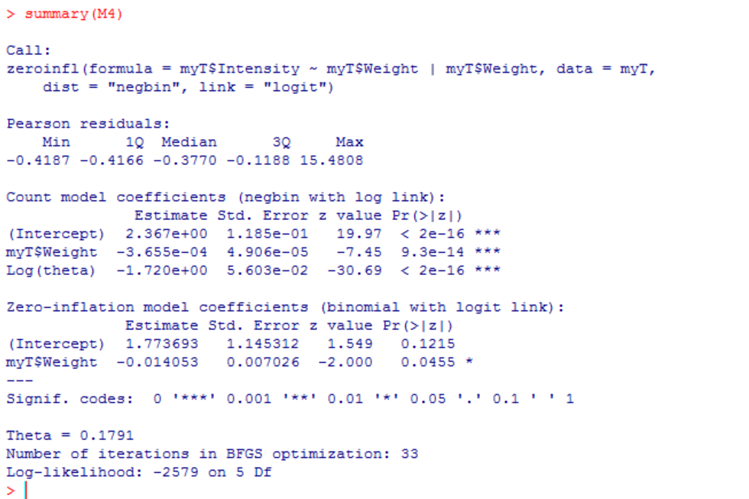

Slide 18
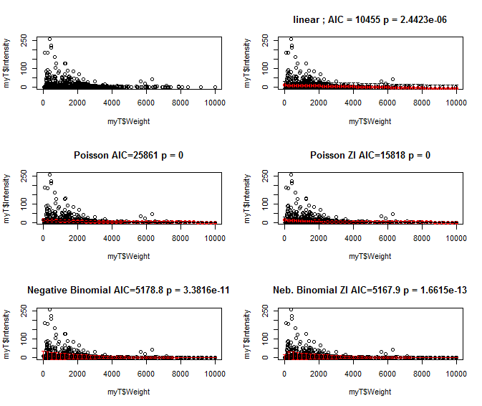
A summary view of all our models…

Slide 19
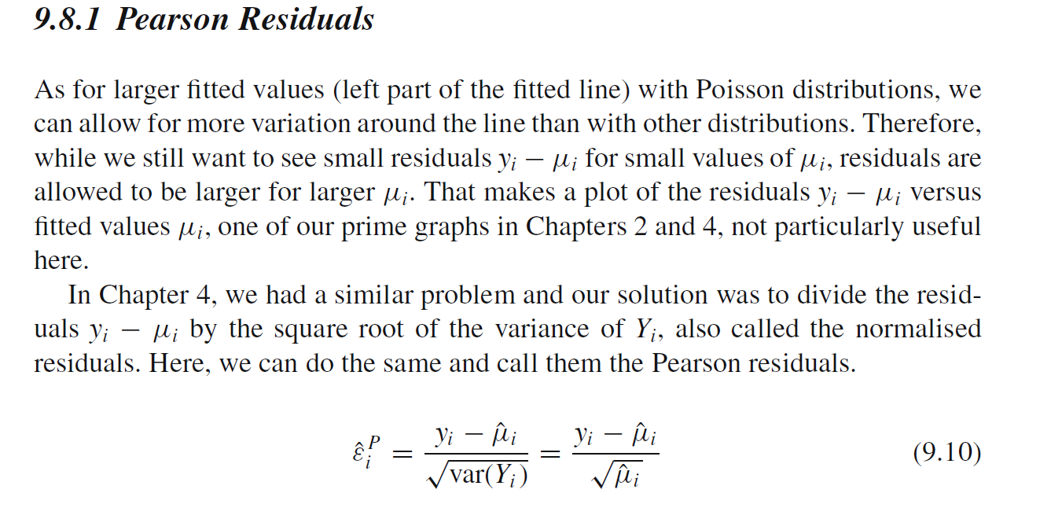
From the Zuur book; we can look at Pearson residuals vs. model or covariates

Slide 20
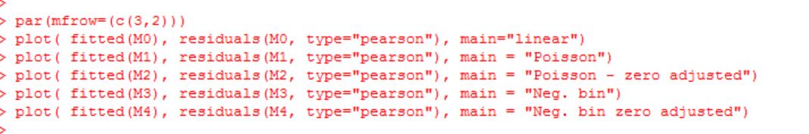
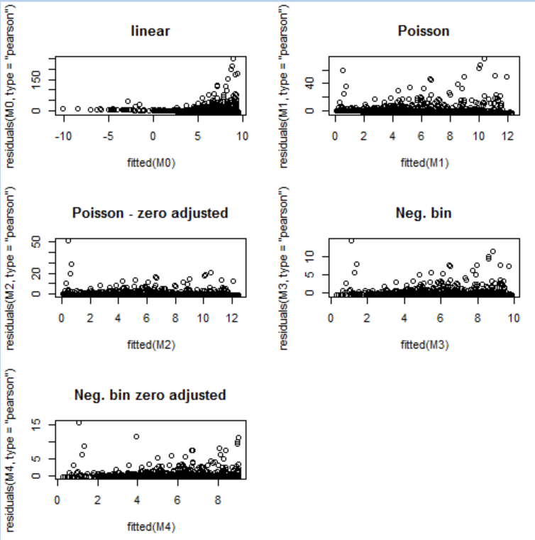
None of these models are free from patterns in their residuals..

Slide 21
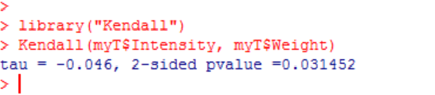
A non-parametric alternative with a (just barely) significant p-value

Slide 22
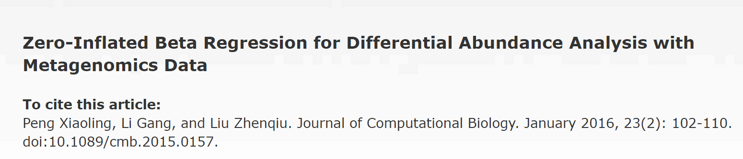
Zero inflated models are an area of very active research in genomics…

Slide 23

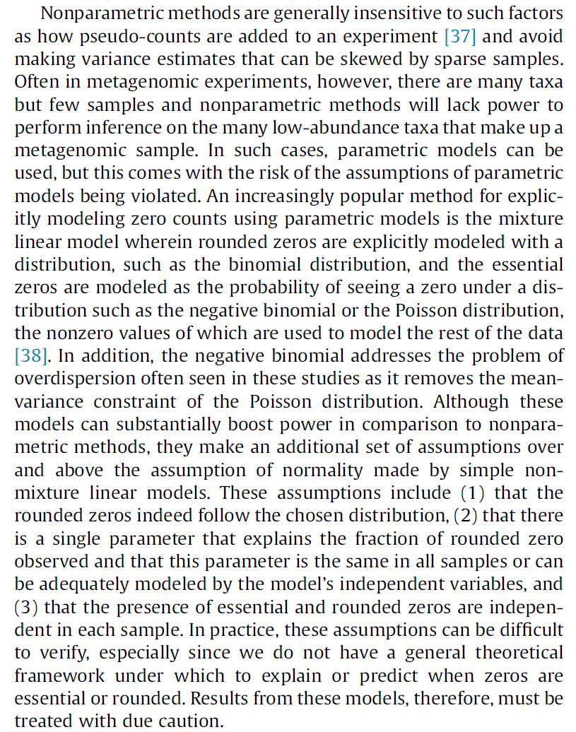
I tend to view these models with some suspicion…

Slide 24
Zero inflated models
Kendall’s tau

Slide 25
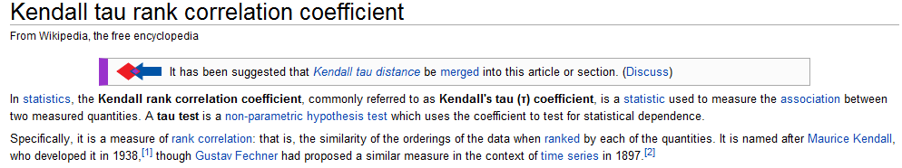
Kendall Rank Correlation – A non-parametric alternative to linear regression
http://en.wikipedia.org/wiki/Kendall_tau_rank_correlation_coefficient

Slide 26
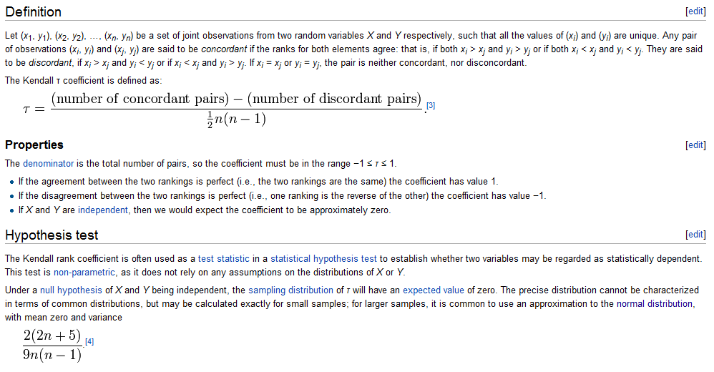
http://en.wikipedia.org/wiki/Kendall_tau_rank_correlation_coefficient

Slide 27
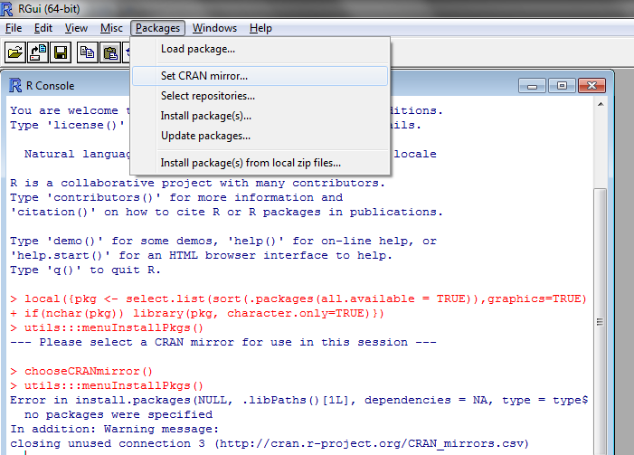
This test is not part of the main distribution in R…

Slide 28
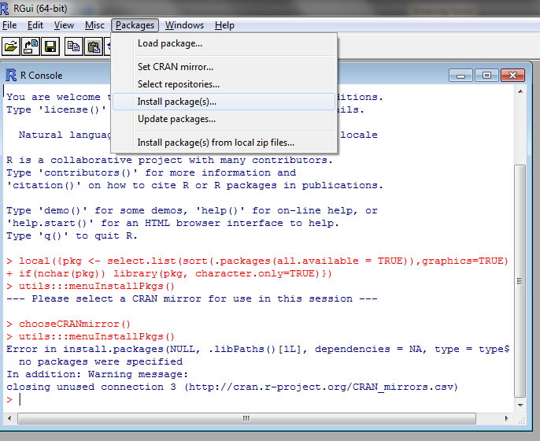

Slide 29
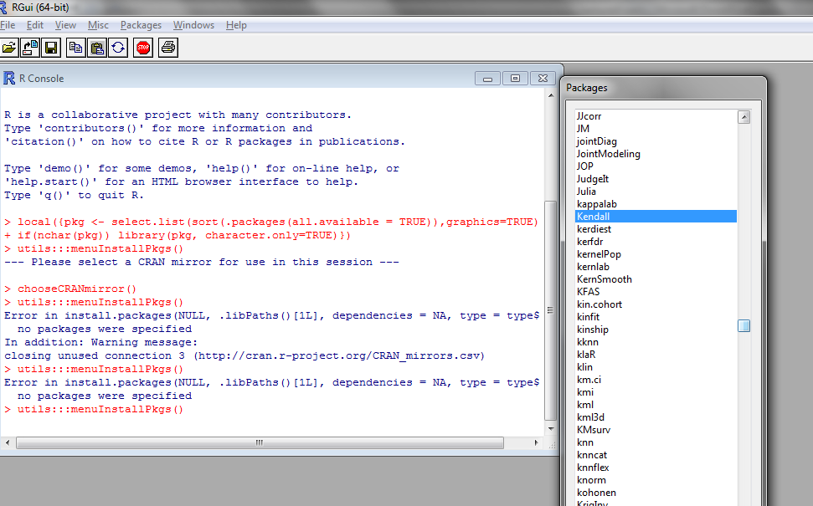
Choose Kendall and click “OK”.

Slide 30
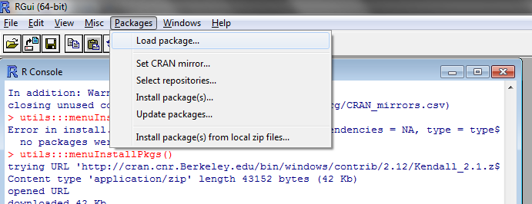
Every time you start R, you have to load the package

Slide 31
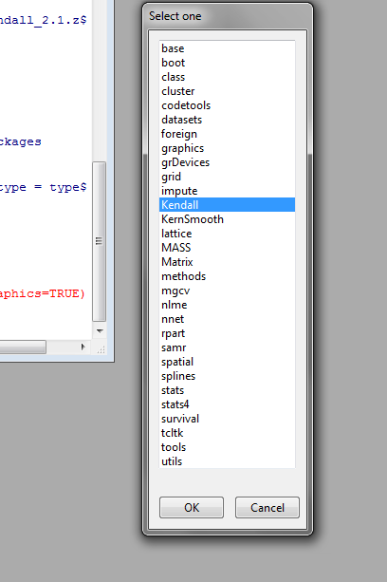

Slide 32
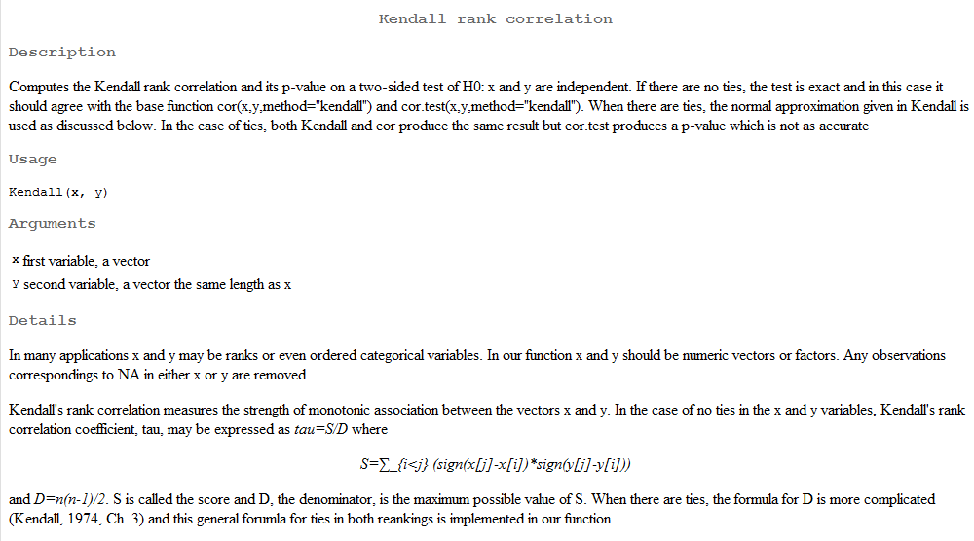
When everything is installed, “?Kendall” will yield this help file….

Slide 33
