Slide 1
Average Power for the frequentist binomial test for a disease diagnostic
Average Power for a Bayesian disease diagnostic method

Slide 2

We build a cylon detector.
We know (somehow) the cylon detector has the following properties
p(positive|cylon) = 0.9 p(negative|cylon)=0.1
p(positive|not a cylon) =0.05 p(negative|not a cylon)=0.95
We can think about this in a frequentist way to ask how many times
(on average) would we need to run the test to reject a null hypothesis that a person is not a cylon.
This is called a power estimate. What sample size will we need to achieve a given threshold of significance some percentage of the time
(by convention, this is often 80%)

Slide 3
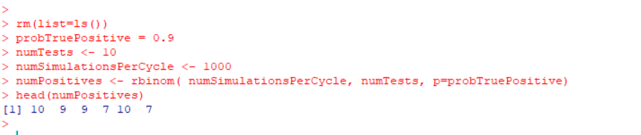
One way to make a power calculation is to simulate data under the alternative hypothesis
and then test the data under the null hypothesis.
If someone has a disease (or is a cylon), they are 90% likely to have a true positive test.
Let’s say we are going to give each person the test 10 times and we want to simulate a 1,000
people taking the tests
We end up with a vector of how many positive results we get out of 10 (with the average around 9).
These are data generated under the alternative hypothesis (that the person is sick).

Slide 4

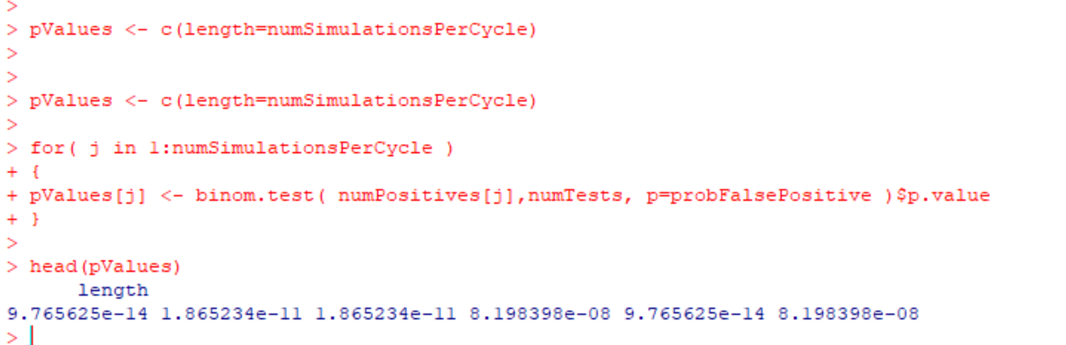
For our power estimate, we test under the alternative hypothesis (that the person is healthy).
We ask what is the probability that we would get as many or more positive results if the
person is healthy?
The probability that a person who is healthy would have 10 false positive results

Slide 5
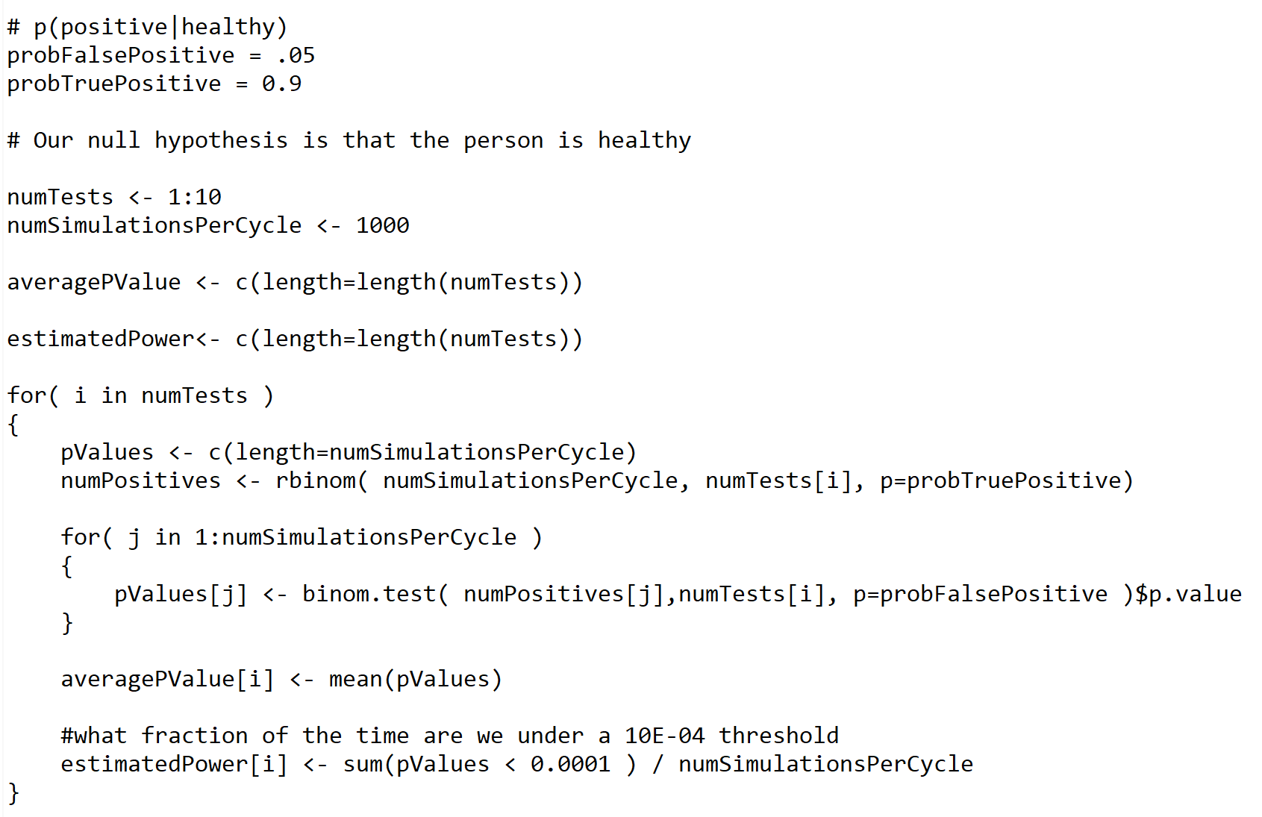
Putting this all together….
Generate data under
the alternative hypothesis
Test under the null hypothesis
https://github.com/afodor/metagenomicsTools/blob/master/src/classExamples/frequentistBinomialPower.txt

Slide 6
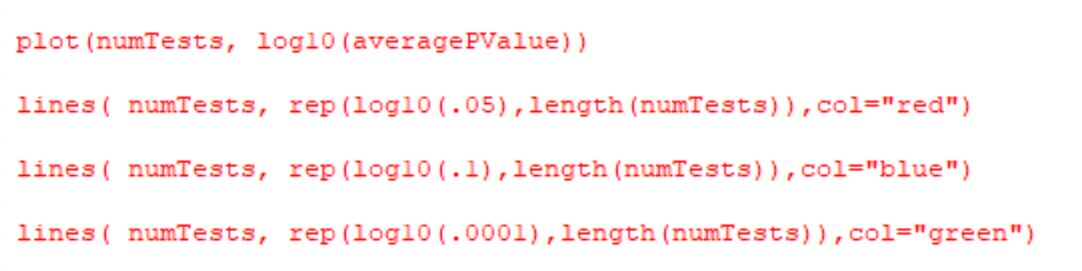
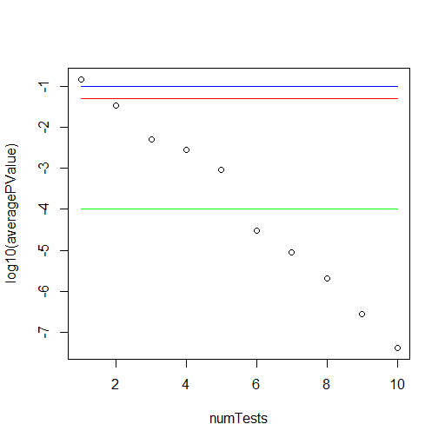
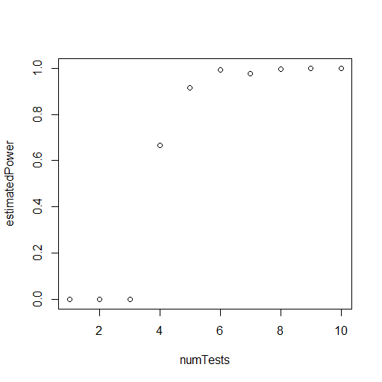
We need ~5 tests to reject the null hypothesis of a person being healthy at a p < 0.0001 threshold
plot( numTests, estimatedPower)
We say: We are powered at 80% at a p < 0.0001 threshold at ~6 repeats of the test

Slide 7
Average Power for the frequentist binomial test for a disease diagnostic
Average Power for a Bayesian disease diagnostic method

Slide 8
We can also power Bayesian inference…
We can say, how many tests do we need to run to be 80% likely to have
a posterior probability over some threshold that a person has the disease.

Slide 9
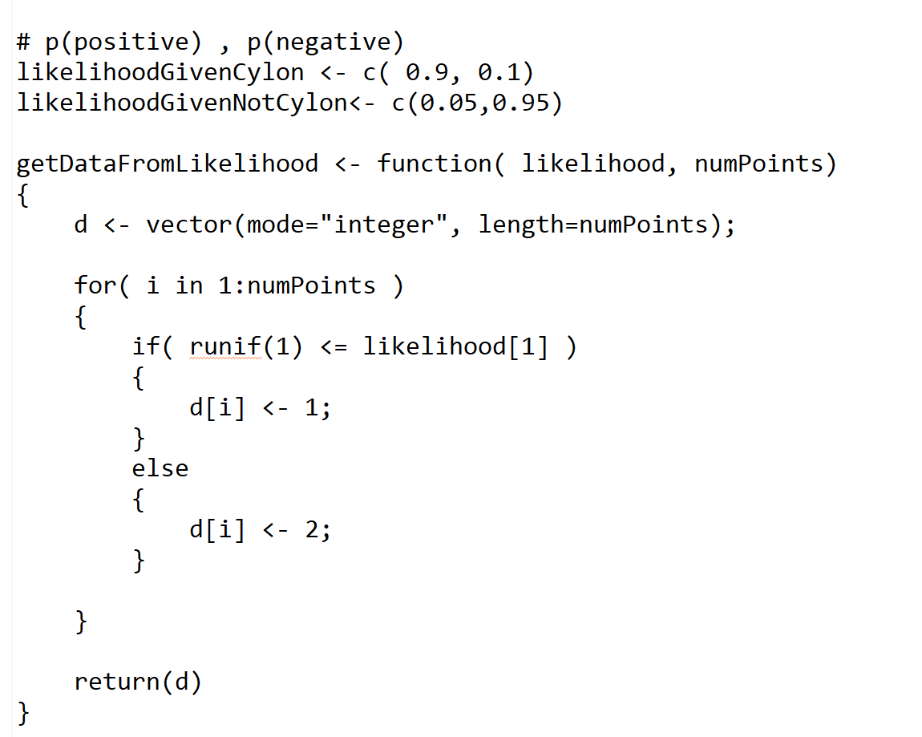
We set up our Bayesian diagnostic test as before…
https://github.com/afodor/metagenomicsTools/blob/master/src/classExamples/BayesianBinomialPower

Slide 10
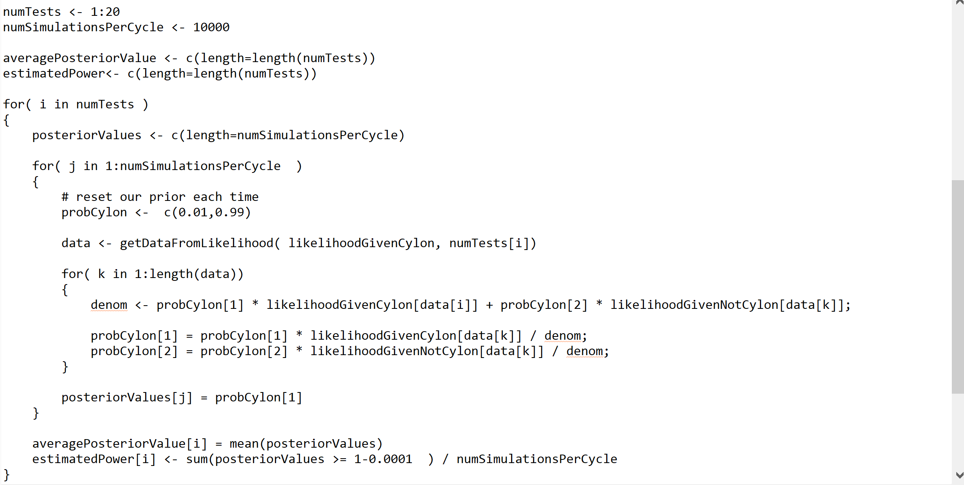
We generate data under the likelihood the person has the disease
We capture our posterior probability after our last Bayesian update for each trial
What fraction of the time is our ending posterior probability > 0.9999

Slide 11
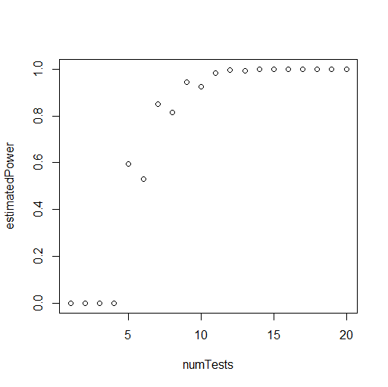
plot( numTests, estimatedPower)
We say “We are powered at 80% to be greater than 99.99% confident in a person with the disease
being detected as having the disease with a sample size of 7-8”

Slide 12
Comparing the Bayesian and frequentist analyses
Frequentist:
We are powered at 80% at a p < 0.0001 threshold at ~5 repeats of the test
to reject the null hypothesis that we would not have seen more extreme test results if the person was
healthy
Bayesian:
We are powered at 80% to be greater than 99.99% confident that a person with the disease
will be detected as having the disease with a sample size of 7-8
You can see that (in this case) the Bayesian inference is less awkward, easier to understand
and more useful.
(This is why Bayesian stats is usually covered in a first stats class for disease diagnostics).
Note the sample sizes are pretty close between frequentist and Bayesian.
The math is not that far apart. The interpretation of the math is pretty different (and important).

