Slide 1
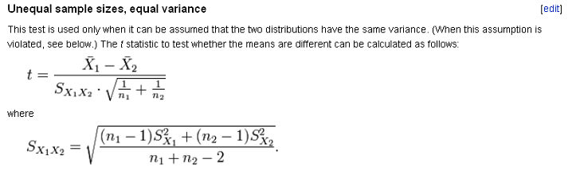
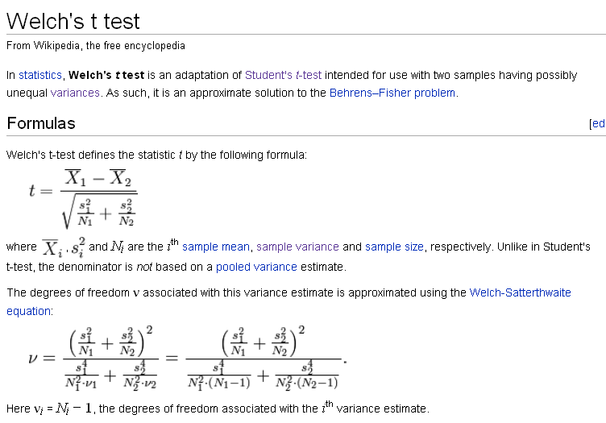
Two forms of the t-test
This is a weighted average
Here the
“biggest” variance
wins

Slide 2
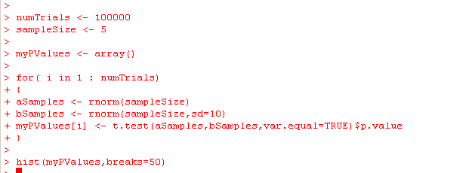
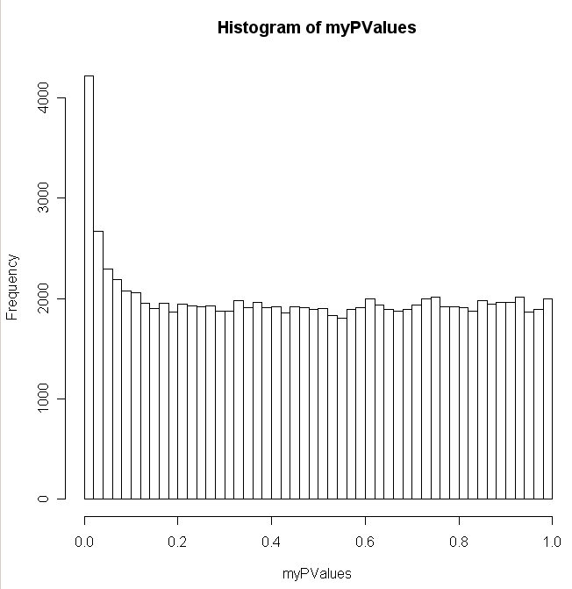
The t-test breaks if you mess with the assumption of equal variance

Slide 3
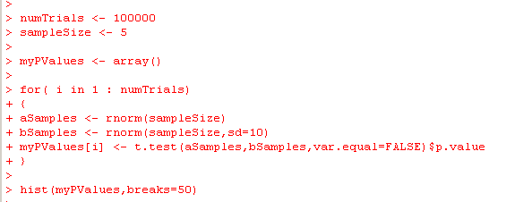
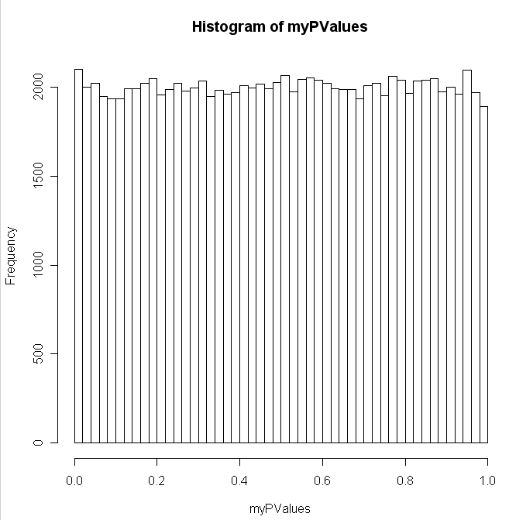
Of course, you can fix this easily in R

Slide 4
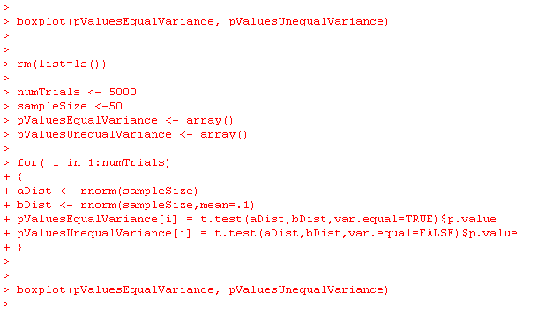
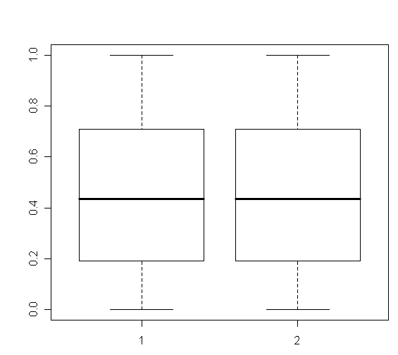
Should we always just use the t-test with the assumption of
unequal variance?
The answer seems to be “yes”.
There is no sensitivity penalty for
dropping the assumption of equal variances…

Slide 5
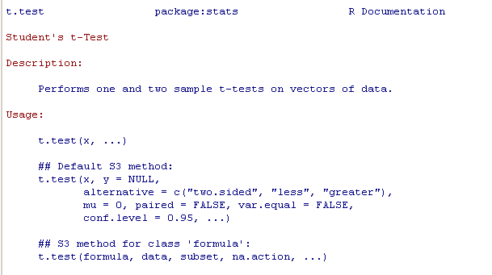
This is probably why R sets var.equal=false as the default.
There is no reason not to use it…

Slide 6
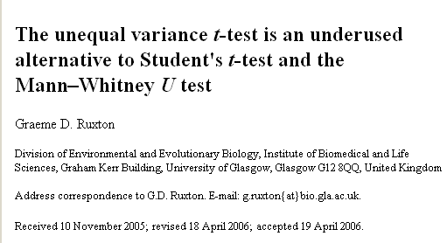
Because the math is easier to understand (or maybe just because
people don’t know any better, the assumption of equal variance is
often left in…)

Slide 7
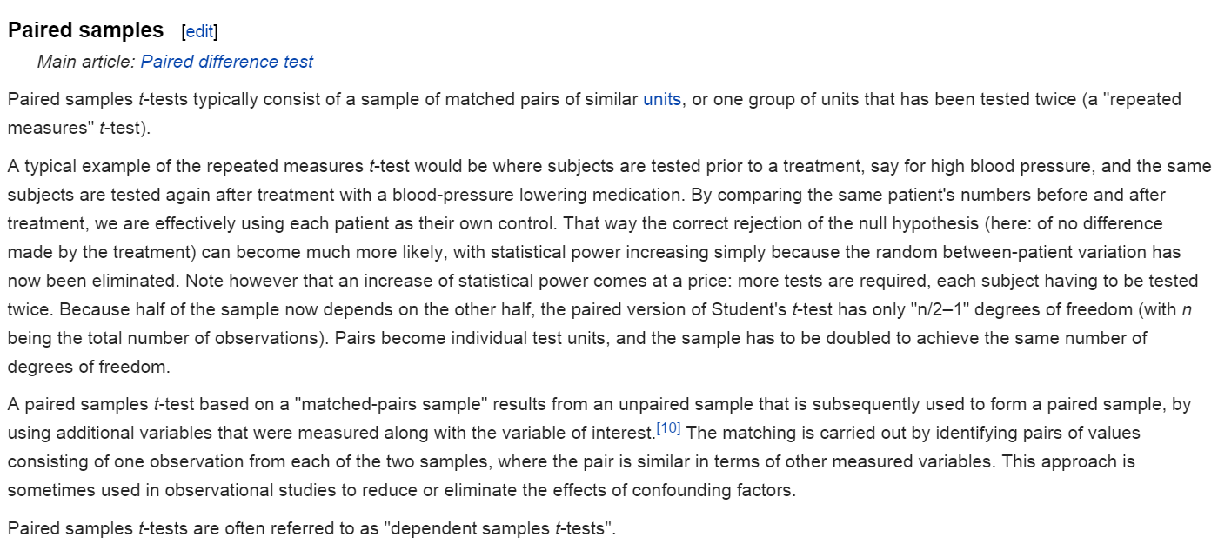
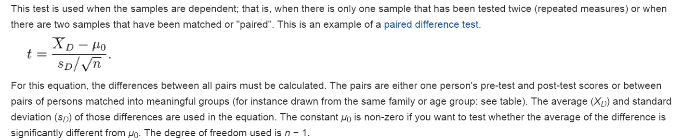
You can tell R whether the t-test is paired or un-paired
uo is almost always zero
Uo is usually zero
http://en.wikipedia.org/wiki/Student%27s_t-test#Dependent_t-test_for_paired_samples

Slide 8
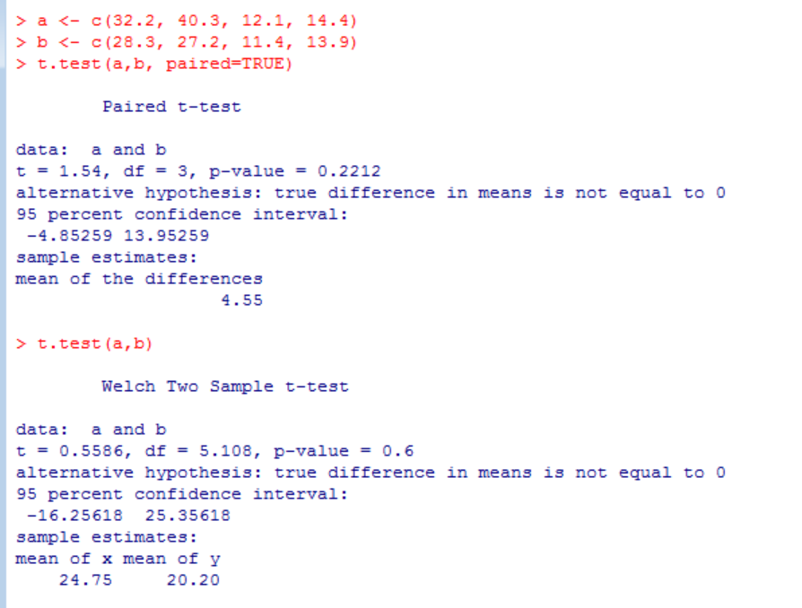
Using the paired t-test can lead to increased power
Mouse ID | Weight before treatment | Weight after treatment
1 | 32.2 | 28.3
2 | 40.3 | 27.2
3 | 12.1 | 11.4
4 | 14.4 | 13.9

Slide 9
T-test with equal variance and unequal variance
Paired t-test
The t-test in Java
Does a dataset meet the parametric assumptions?
Non-parametric equivalents to the t-test.
The algebra of linear regressions

Slide 10
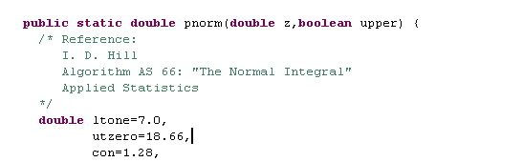
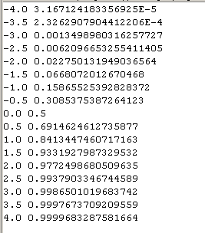
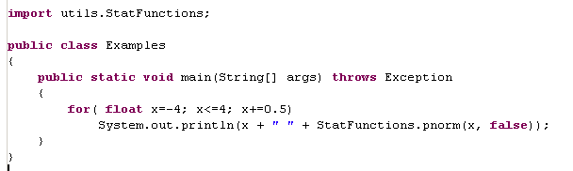
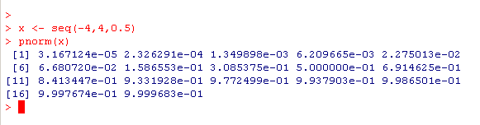
pnorm for the standard normal distribution
https://github.com/afodor/metagenomicsTools/blob/master/src/utils/StatFunctions.java

Slide 11
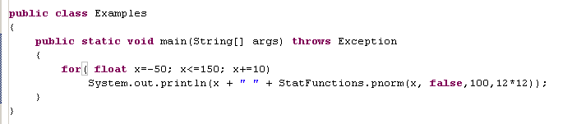
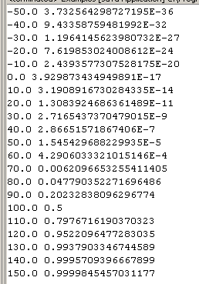
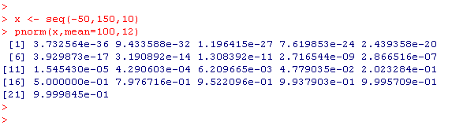
Alternatively, you can specify mu and sigma…

Slide 12

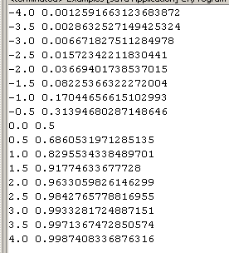
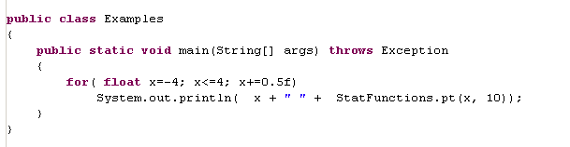
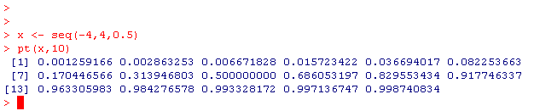
pt is there too….

Slide 13
Once you have pt all you have to do is calculate this….

Slide 14
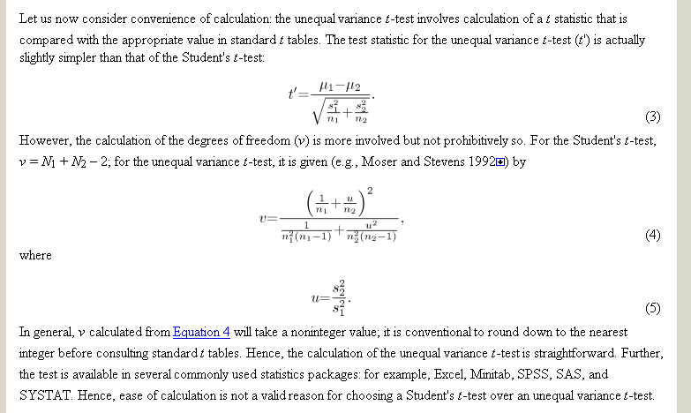
or this…
http://beheco.oxfordjournals.org/content/17/4/688.full
which are both trivial…
(likely this is all easy to do in Python as well…)
T-test implementation:
https://github.com/afodor/metagenomicsTools/blob/master/src/utils/TTest.java

