Slide 1
Classification by linear models
Classification by nearest neighbor
Variance vs. bias trade-offs
The curse of dimensionality

Slide 2
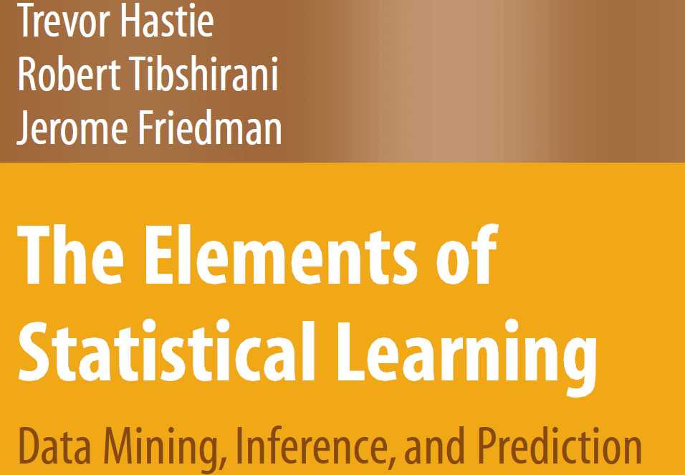
Legal download:
http://www-stat.stanford.edu/~tibs/ElemStatLearn/printings/ESLII_print10.pdf

Slide 3
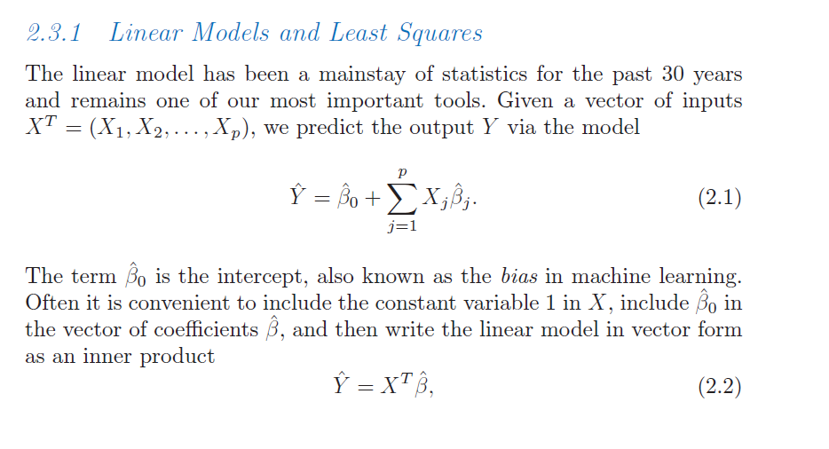
We have our (familiar) linear algebra notation for linear models..
Hastie et al: The elements of Statistical Learning
http://www-stat.stanford.edu/~tibs/ElemStatLearn/download.html

Slide 4
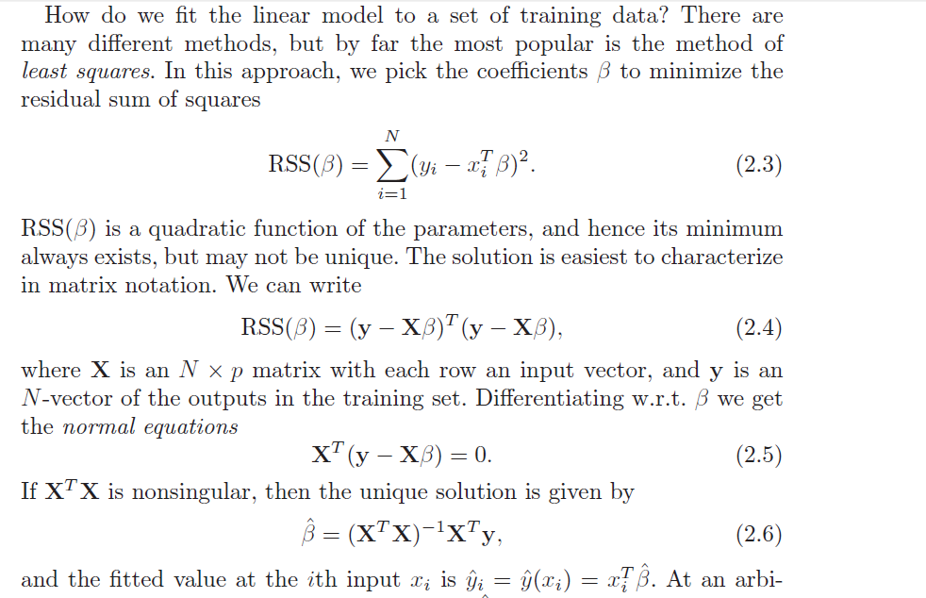

Slide 5
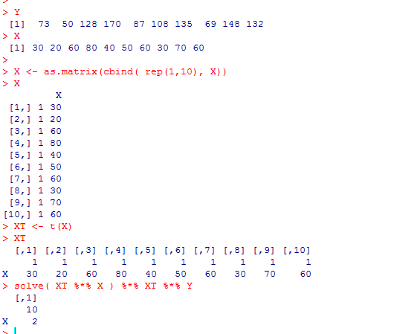
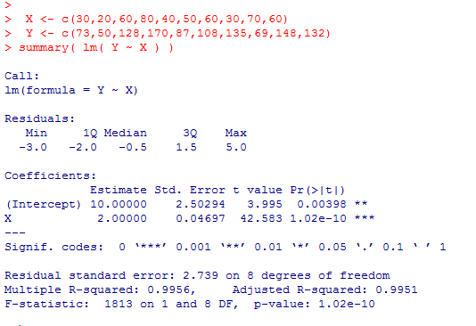

So we can find least square parameters easily with a few line of matrix manipulation
Previously, we were primarily concerned with inference
What is the probability that the true values of the parameters are 0?
Dependent on assumptions: normality, equal variance, linearity, etc.
Now we are more concerned with classification.
Given a new set of X values, how well can we predict y?

Slide 6
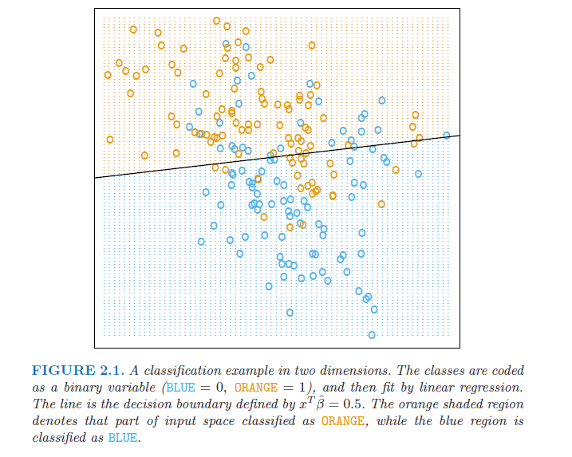
A two-dimensional classification problem…

Slide 7
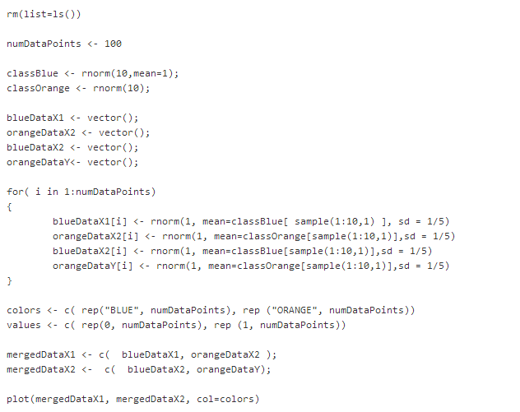
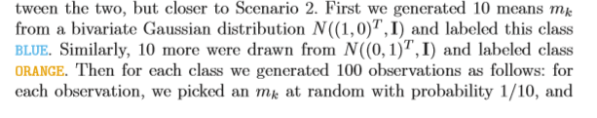
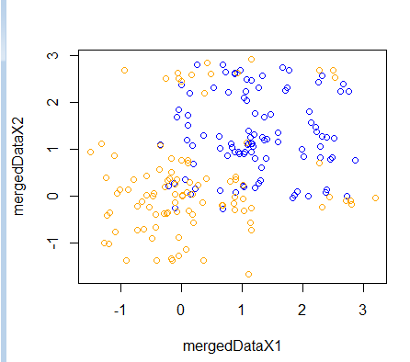
Here is code that generates a similar training set
https://github.com/afodor/metagenomicsTools/blob/master/src/machineLearningExamples/linearExampleInR.txt

Slide 8
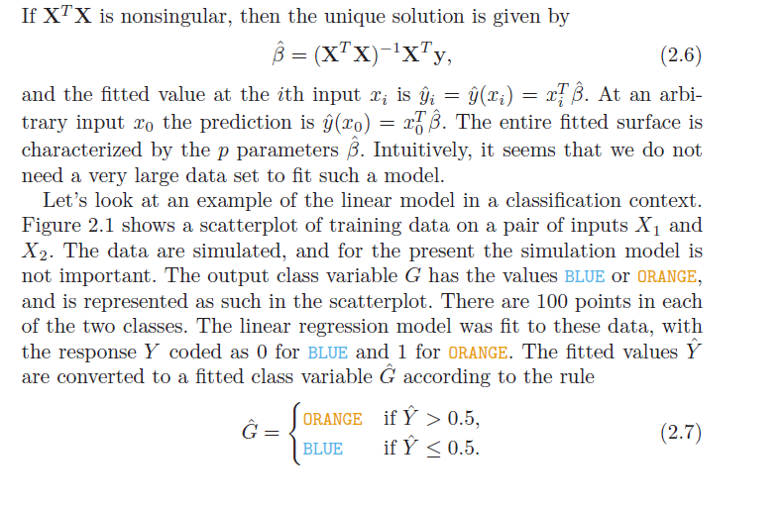
Y = B0 + B1 * X1 + B2 *X2
We want the line where Y = 0.5
0.5 = B0 + B1 * X1 + B2 * X2
X2 = ( 0.5- B0 - B1 * X1 ) / B2

Slide 9
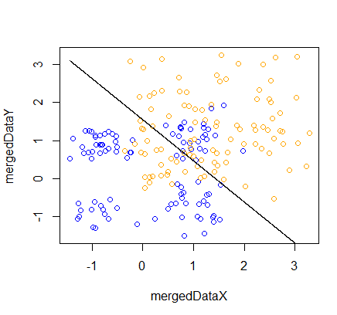
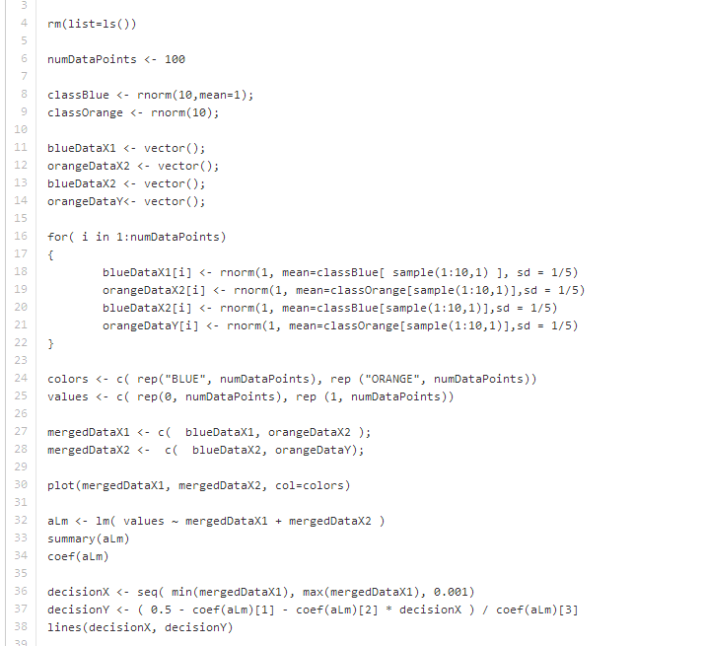
This is very easy to implement in R…
Make a linear model as usual
Solve for 0.5
https://github.com/afodor/metagenomicsTools/blob/master/src/machineLearningExamples/linearExampleInR.txt

Slide 10
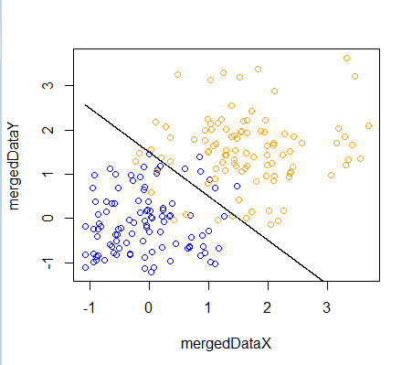
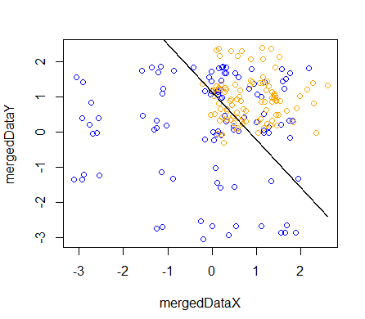
Successive runs on our simulated data set show the linear model sometimes doing
better than others…

Slide 11
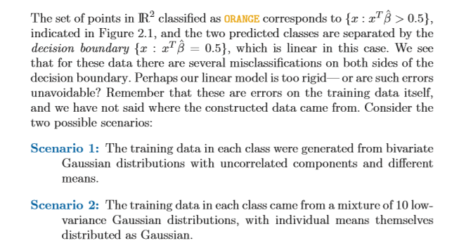

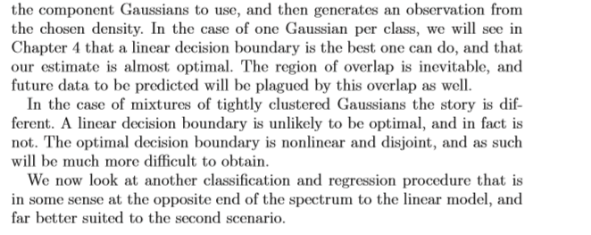
Can we do better than linear models?

Slide 12
Classification by linear models
Classification by nearest neighbor
Variance vs. bias trade-offs
The curse of dimensionality

Slide 13
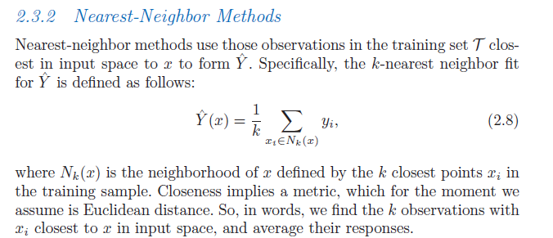

Slide 14
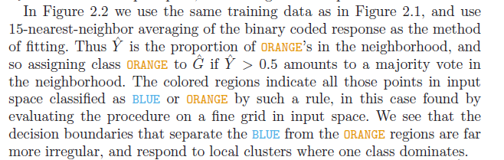
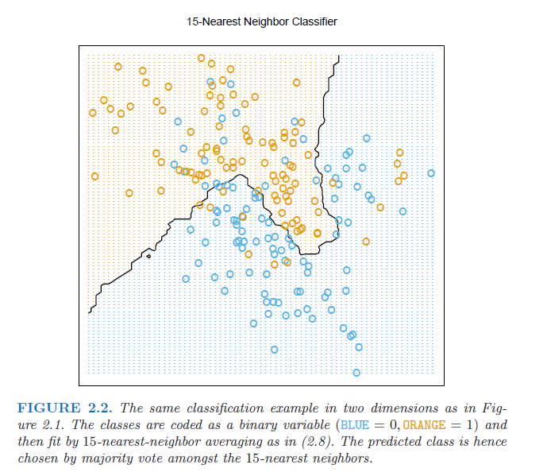
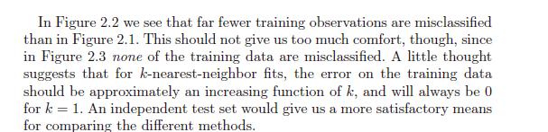

Slide 15
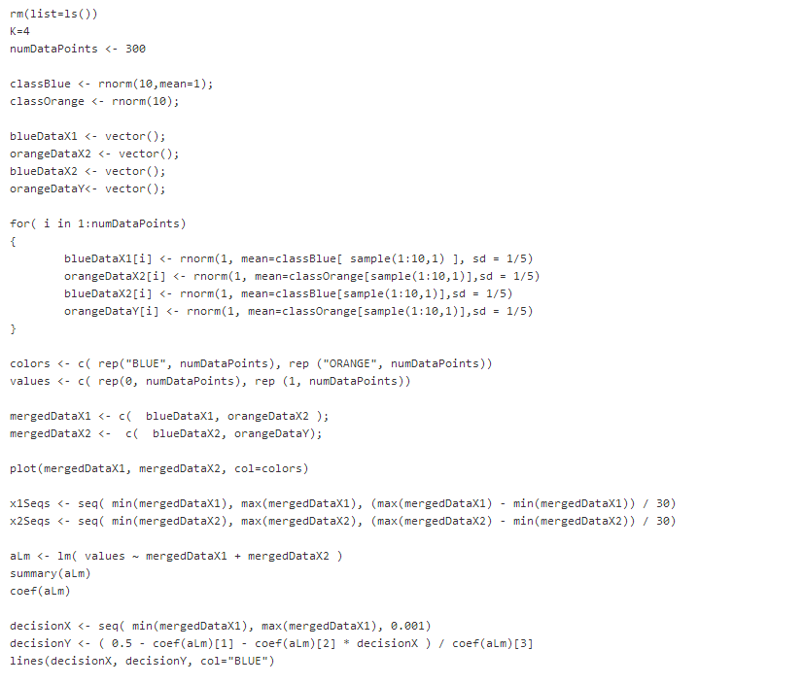
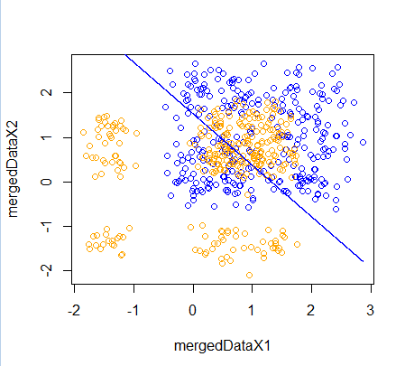
This is a (little) trickier to code up.. We start as before (with the linear fit)..
https://github.com/afodor/metagenomicsTools/blob/master/src/machineLearningExamples/nearestNeighborInR

Slide 16
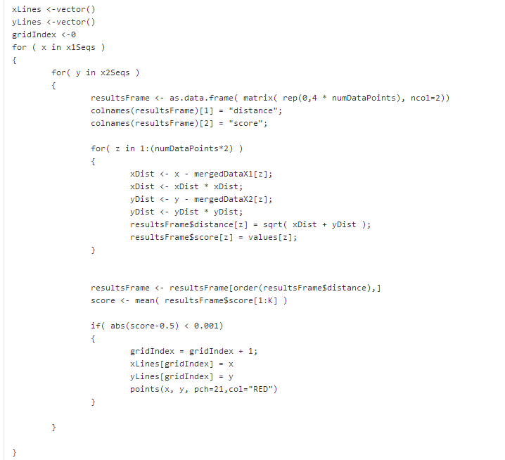
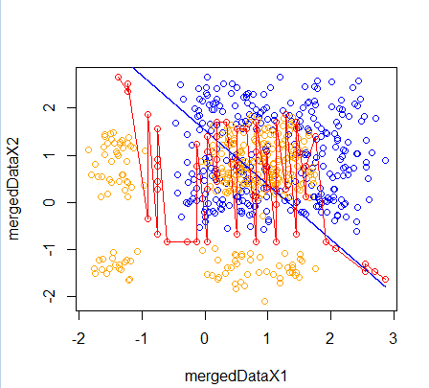
Next we add the least square fit..
Region of over-fitting
https://github.com/afodor/metagenomicsTools/blob/master/src/machineLearningExamples/nearestNeighborInR

Slide 17
Next we add the least square fit..
Evaluate every point in the grid
Find the distance to all points in the grid
Score the nearest neighbors
Note that k has to be even for this to work!
https://github.com/afodor/metagenomicsTools/blob/master/src/machineLearningExamples/nearestNeighborInR

Slide 18
Another case where K= 4 beats the linear model…

Slide 19
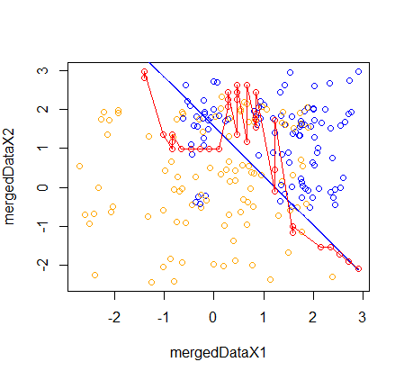
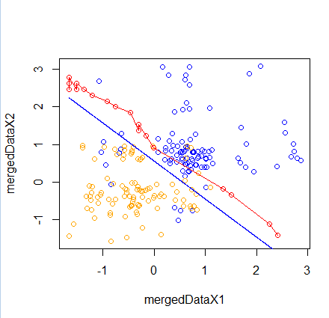
Hear are k=16 examples..

Slide 20
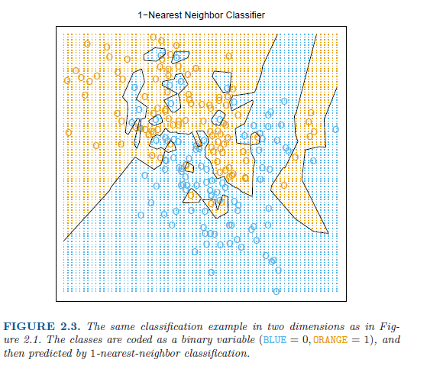
With k=1, over-fitting becomes more and more likely..

Slide 21
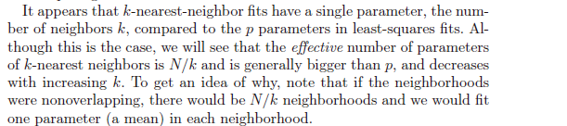
We can more easily over-fit with k-means because there are more effective parameters
How do we choose k? We can’t minimize the sum-squared errors..

Slide 22
Classification by linear models
Classification by nearest neighbor
Variance vs. bias trade-offs
The curse of dimensionality

Slide 23
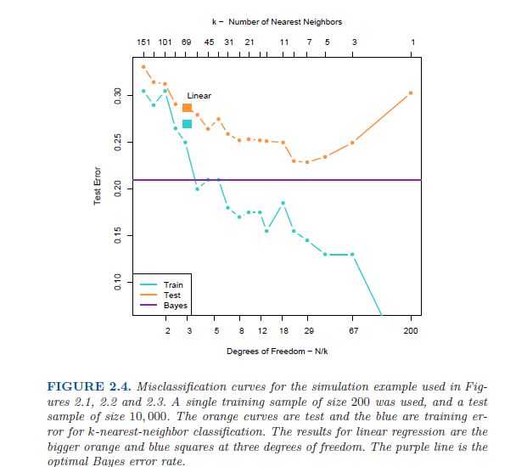
Model is
Under-trained;
High error in
Both training set
And the test set
Model is over-trained;
Low error in the training set
High error in the test set
The theoretically best
model that could be
obtained (if you knew
the “true” distributions)

Slide 24
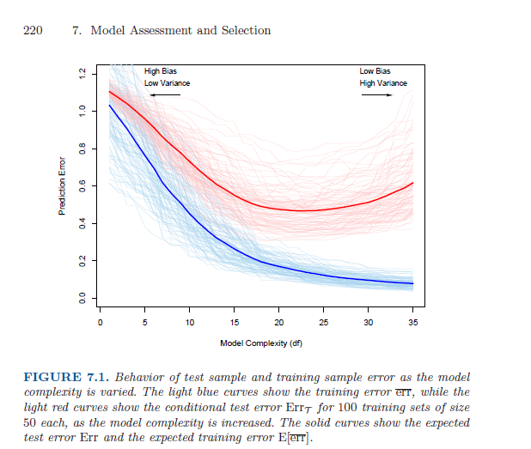
This idea of tuning model complexity to avoid over-fitting and under-fitting
is central to the book (and shows up again in Chapter 7)

Slide 25
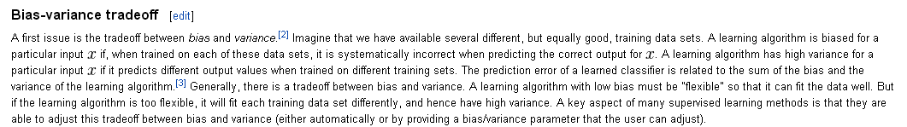
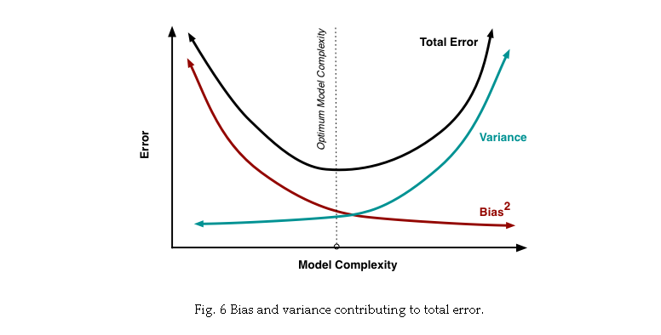
http://scott.fortmann-roe.com/docs/BiasVariance.html

Slide 26
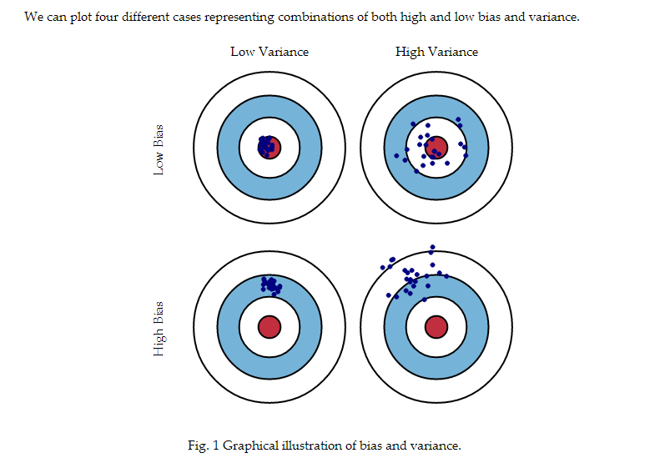
http://scott.fortmann-roe.com/docs/BiasVariance.html

Slide 27
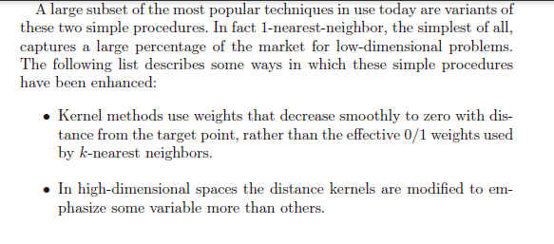
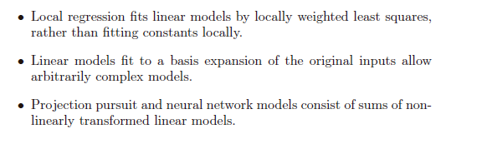

Slide 28
Classification by linear models
Classification by nearest neighbor
Variance vs. bias trade-offs
The curse of dimensionality

Slide 29
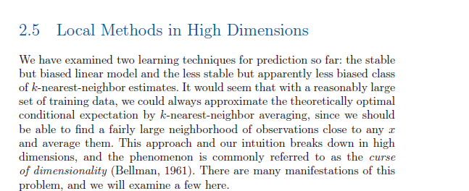
Lots of math towards the end of chapter 2 that we won’t cover…
But this is sort of interesting..

Slide 30
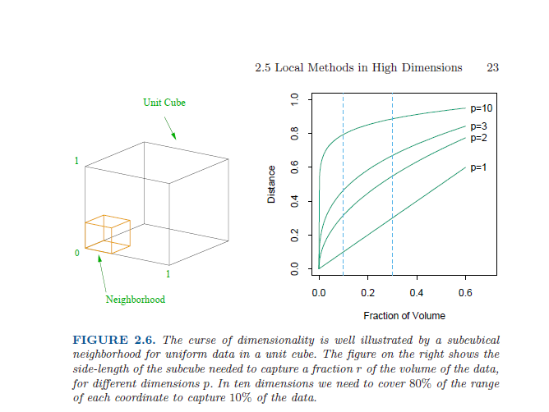
If we have a line, covering 10% of the line take 10% of the total pixels of the line
For a square: I want to cover 10% of all the data. How much of each side (d) do I need?
d ^ 2 = 0.10 ; d = 0.10 ^ (1/2) = 0.31
For a cube: I want to cover 10% of the data: How much of each side (d) do I need?
d ^ 3 = 0.10 ; d = 0.10 ^ (1/3) = 0.46
For 10 dimensions: d ^ 10 = 0.10 ; d = 0.10 ^ (1/10) = 0.794

Slide 31
So for K-means, the “local” space in high dimensions is not local at all!
You’ll need data on the full range of inputs (which you almost certainly will not have)
So we can’t use simple linear models or simple k-nearest neighbors in
high-dimensional space!

