Slide 1

The really interesting thing about linear models, is no matter how complicated they get, the solution remains the same..
We can make models arbitrarily complex and the statistics will work
(whether they still have any meaningful biology is another question!

Slide 2

This dataset is described in this paper
http://jcm.asm.org/content/53/1/237.short

Slide 3
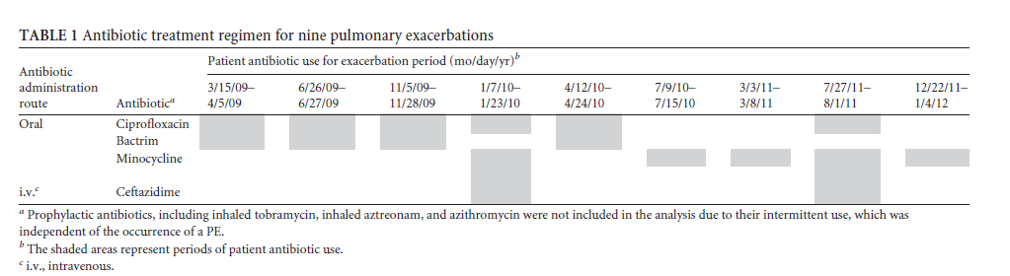
The data are from a single Cystic Fibrosis patient exposed to an antibiotic regime…

Slide 4

As an example of this, we will analyze a qPCR data set..
You can grab the data here:
http://afodor.github.io/classes/stats2015/qPCRWithSampleDays.txt

Slide 5
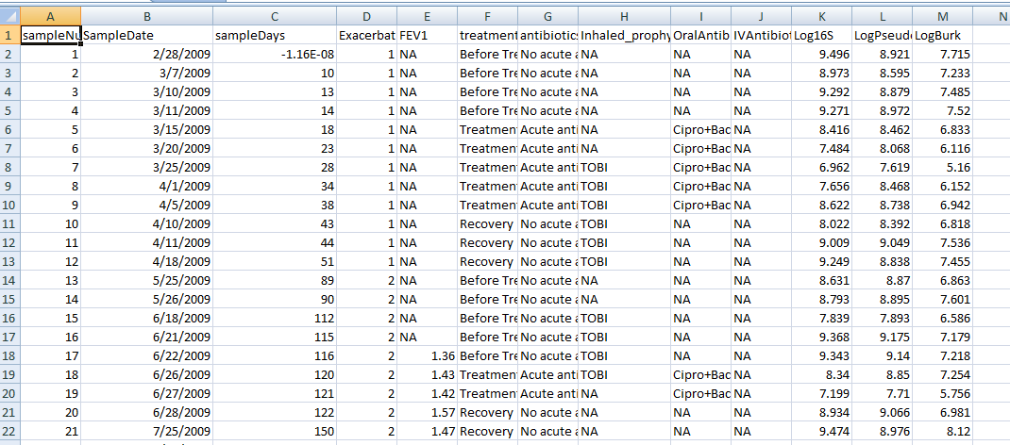
http://afodor.github.io/classes/stats2015/qPCRWithSampleDays.txt

Slide 6
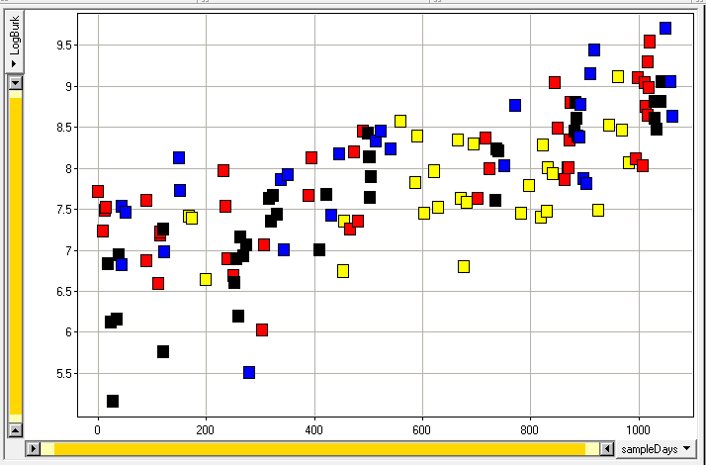

How does the 16S signal change with time (the x-axis) and with
antibiotic treatment (the colors)
We will build and evaluate a series of linear models…

Slide 7
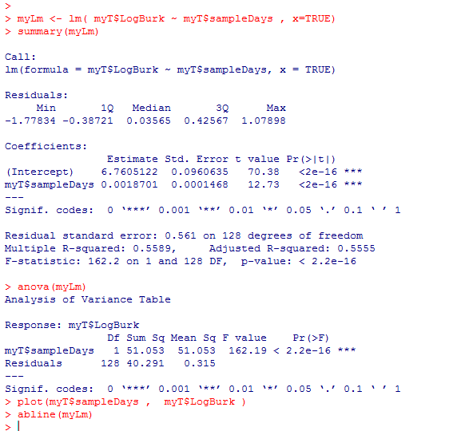
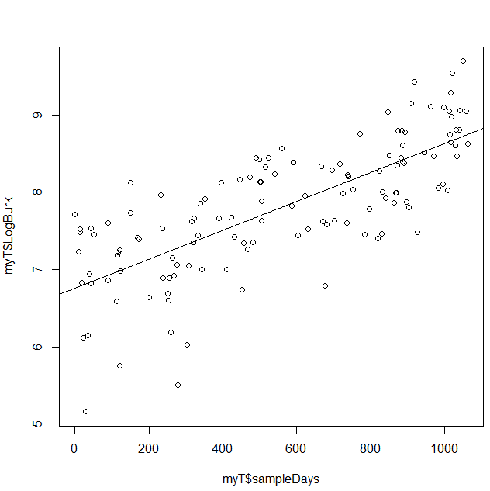
First we look only at time (ignoring antibiotic treatment)
logBurk = B0 + B1 * times + error
Time explains more than half the variance and we reject the zero slope hypothesis easily

Slide 8
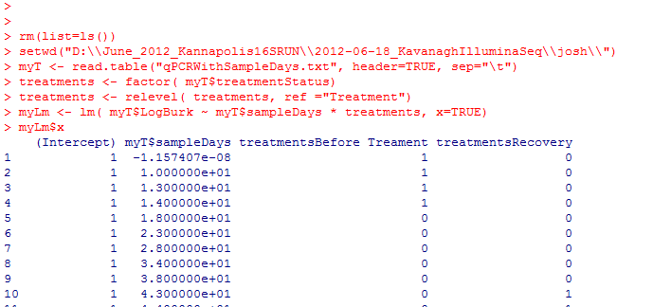
We start with the full model (including interaction terms!)
This is a small amount of typing in R but produces a highly complex model.
logBurk = B0 + B1 * sampleDays + B2 * “BeforeTreatment” + B3 * “Recovery” + B4 * “stable”
+ B5 * “BeforeTreatment*sampleDays” + B6 * “Recovery*sampleDays”
+ B7 * “stable*sampleDays”

Slide 9
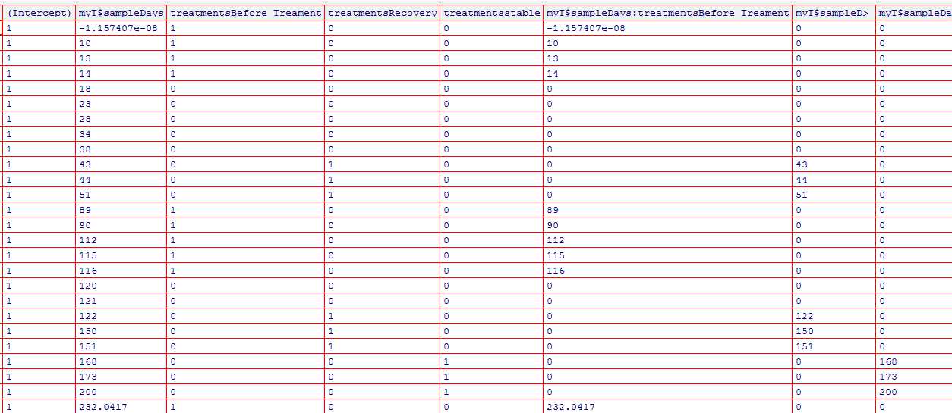
At the matrix level…
myLm <- lm ( myT$LogBurk ~ myT$sampleDays * treatments, x=TRUE)
edit(myLm$x)
B0
Intercept
B1
Time
B2
B3
B4
B5
B6
B7
beforeTreatment
Recovery
Stable
beforeTreatment
*study days
Recovery
*study days
stable
*study days
“Dummy variables” controlling intercept values
“Dummy variables” controlling slope values

Slide 10
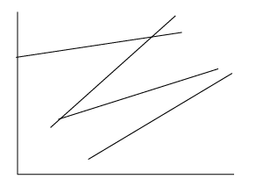
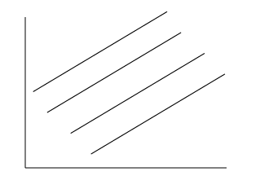
Do we need all of these parameters?
logBurk = B0 + B1 * sampleDays + B2 * “BeforeTreatment” + B3 * “Recovery” + B4 * “stable”
+ B5 * “BeforeTreatment*sampleDays” + B6 * “Recovery*sampleDays”
+ B7 * “stable*sampleDays”
Can we get rid of the interaction terms?
Full model (allows slopes to vary with antibiotic treatments)
Reduced model (one slope for all data)

Slide 11
Our first model comparison:
The full model:
myT$LogBurk ~ myT$sampleDays * treatments
The reduced model:
myT$LogBurk ~ myT$sampleDays + treatments
In the reduced model, B5-B7 are set to zero.
That is, there is no interaction between treatment and time.
That is, all the data can be fit with a single slope.

Slide 12

At the matrix level… the full model
myLm <- lm ( myT$LogBurk ~ myT$sampleDays * treatments, x=TRUE)
edit(myLm$x)
B0
Intercept
B1
Time
B2
B3
B4
B5
B6
B7
beforeTreatment
Recovery
Stable
beforeTreatment
*study days
Recovery
*study days
Stable
*study days
“Dummy variables” controlling intercept values
“Dummy variables” controlling slope values
Error is 33.8603 on 122 degrees of freedom
(n=130 – 8 parameters)

Slide 13
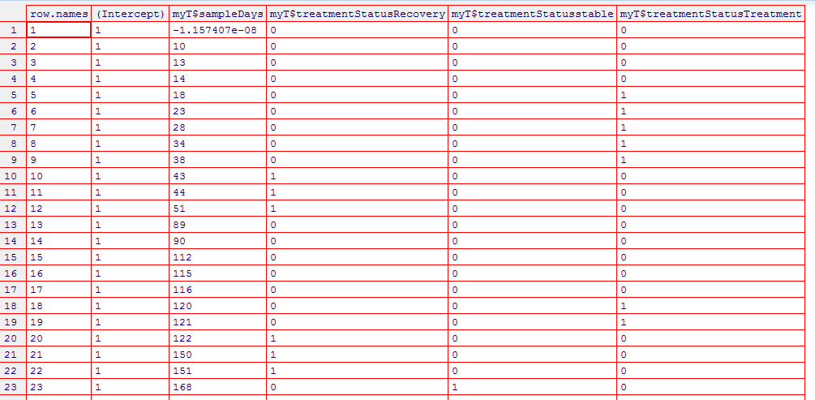

The reduced model:
B0
Intercept
B1
Time
B2
B3
B4
beforeTreatment
Recovery
Stable
Error is 35.97212 with 125 d.f. (n=130 -5 parameters)

Slide 14
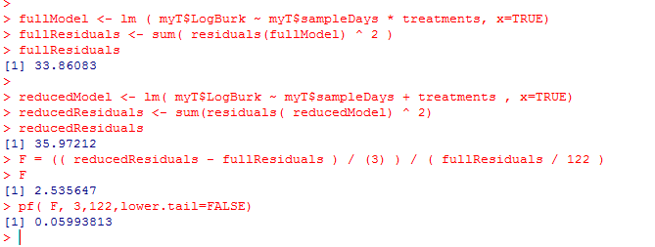
Full model:
Error is 33.8603 on 122 degrees of freedom
(n=130 – 8 parameters)
Reduced Model:
Error is 35.97212 with 125 d.f. (n=130 -5 parameters)
F = ( (35.97212 - 33.8603 ) / ( 125-122 ) ) / (33.8603/122) = 2.536324

Slide 15
At a p=0.05 threshold, the extra parameters for slope don’t reduce a significant amount of variance…
This is consistent with
“eyeballing” the data.
The 4 colors don’t seem
to have dramatically
different slopes…

Slide 16
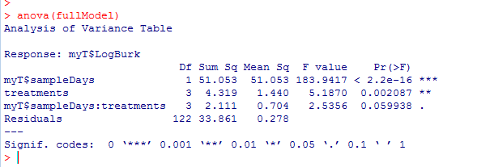
R can do a lot of this work for us (with much less typing!)
Equivalently…
Zeroing out the interaction terms leads to a non-significant difference.
(Zeroing out the other terms does make a difference!)

Slide 17
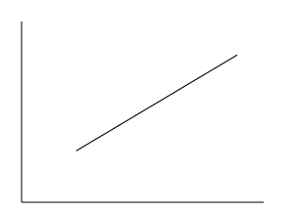
We seek the simplest model that can explain our data.
So our new “full model” drops the interaction terms.
Our new “full model”:
logBurk = B0 + B1 * sampleDays + B2 * “BeforeTreatment” + B3 * “Recovery” + B4 * “stable”
A five parameter model. There is only one slope (B1).
The intercept can be modulated by treatment.
We compare this to a “reduced model”
logBurk = B0 + B1 * sampleDays
Does treatment make a difference?
Full model (one slope; four intercepts)
Reduced model (one slope; one intercept)

Slide 18
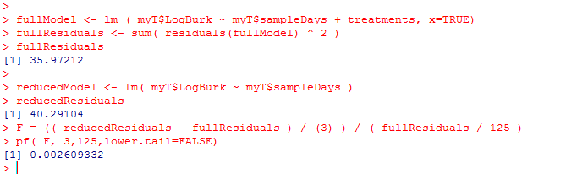

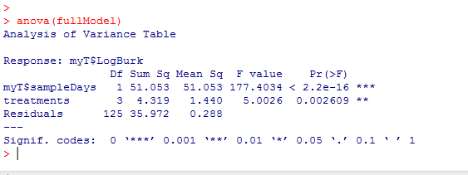
The intercepts do make a significant difference in the amount of variance explained!
Or (with less typing)
So the treatment makes a difference! So we don’t accept the reduced model

Slide 19

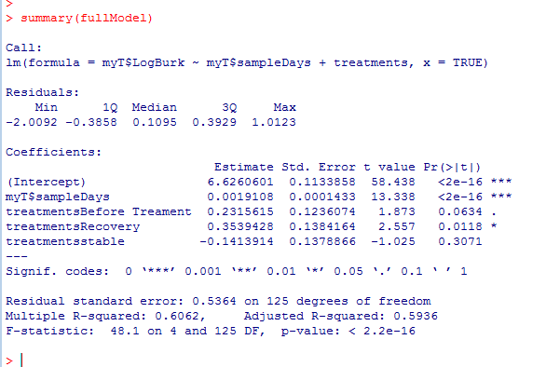
But which treatments are different?
Treatment is our baseline.
The intercept for “treatment” is 6.62; this is different than 0
The slope is not 0
Recovery is significantly
higher than treatment;
the bug grows back when
the antibiotic is stopped.

Slide 20
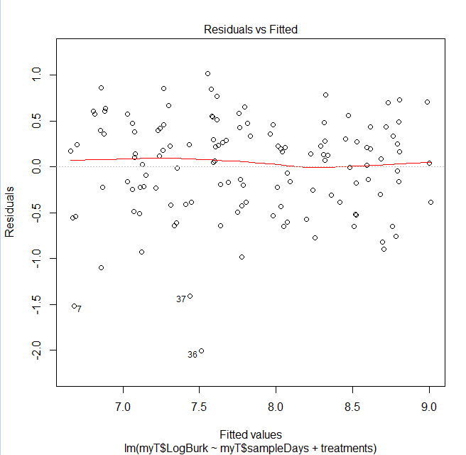
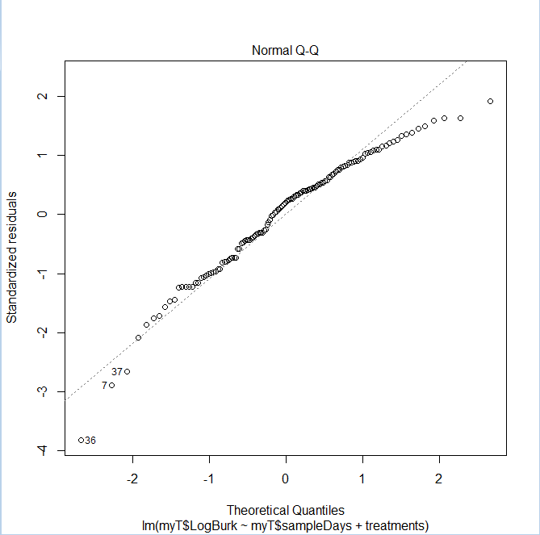
How well do we fit the assumption of normality?
plot(fullModel)
There is minimal systematic bias in the residuals…

Slide 21
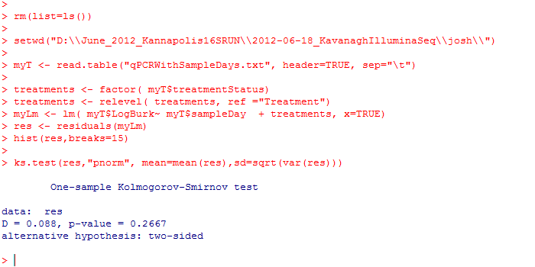
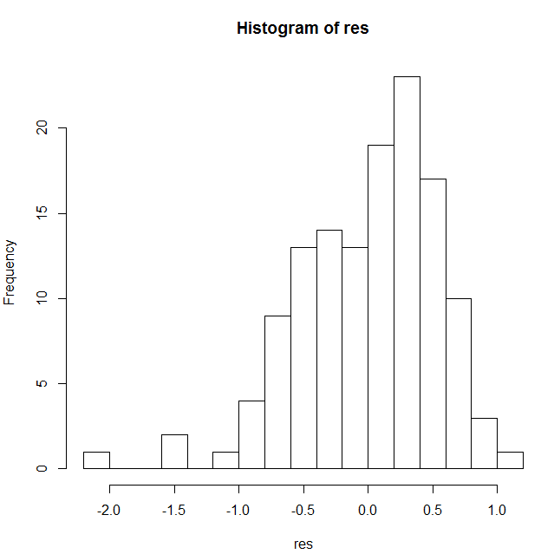
With the ks.test, we fail to reject a hypothesis that the residuals are not normally distributed
The assumption of normality seems reasonable in this case…

Slide 22
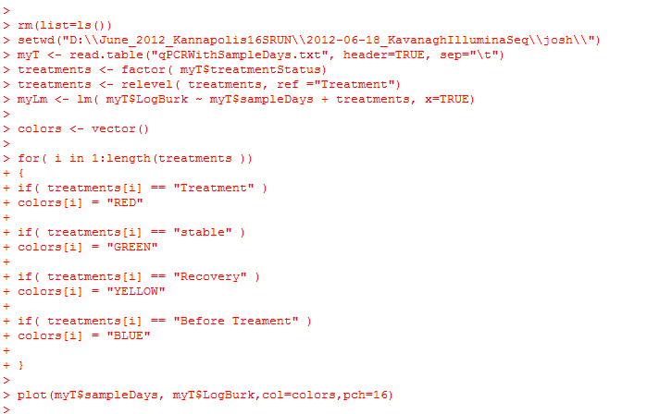
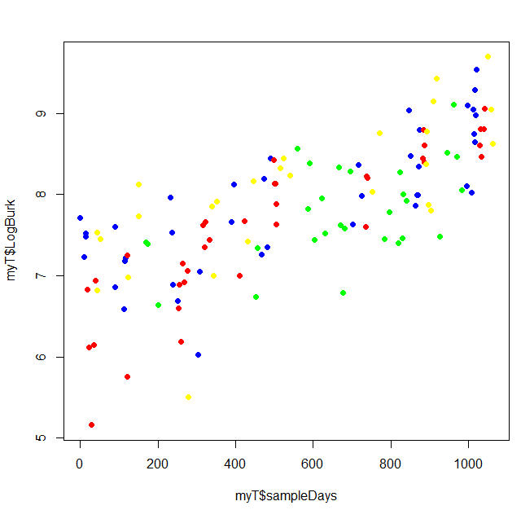
Making a graph of our model.. We start with just the data…

Slide 23
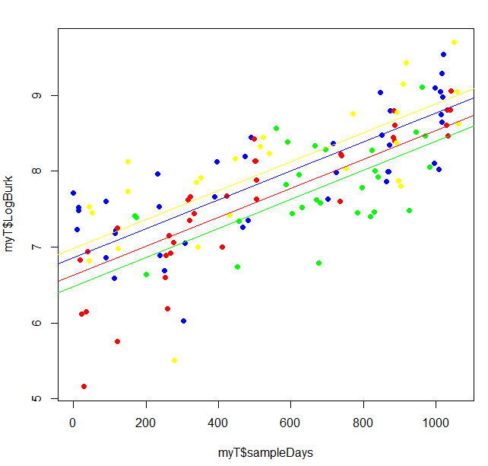
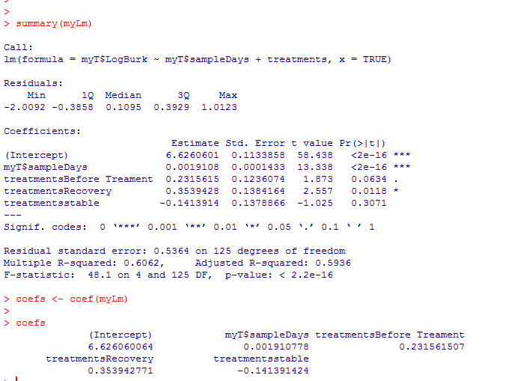
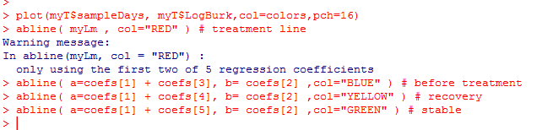
Adding in the model to our graph

