Slide 1
HashMaps
A database implemented with List vs. a Map Collection
Exceptions
Boxing and unboxing

Slide 2
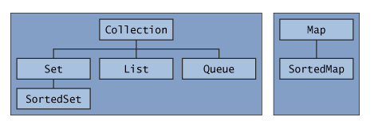
Lists and Sets are part of the Collections API
(written in part by Josh Bloch and introduced in Java 1.4)
http://java.sun.com/docs/books/tutorial/collections/interfaces/index.html
The Collections API

Slide 3
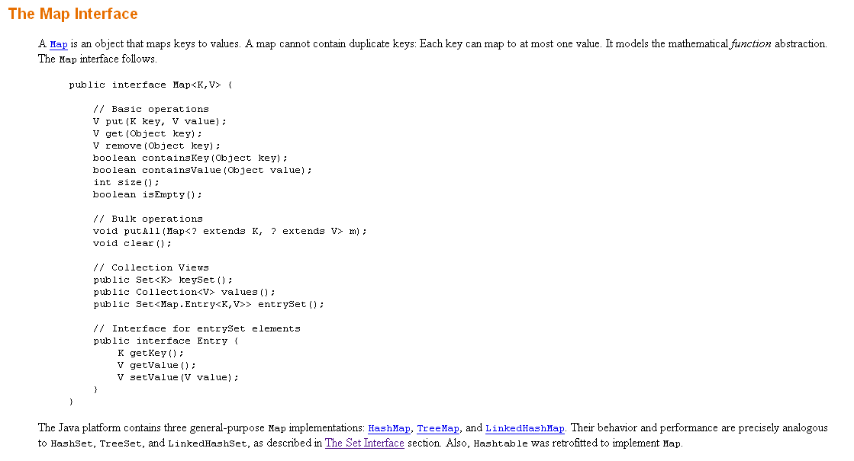

Slide 4
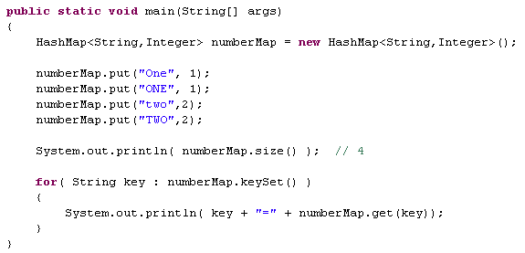

A map maps keys to values…

Slide 5
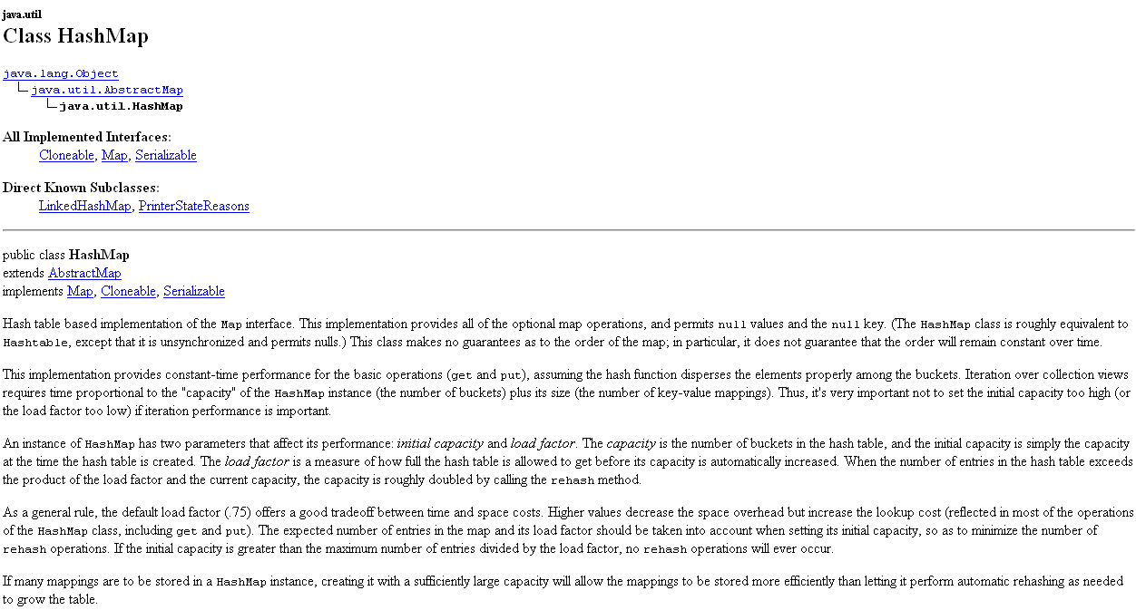
Constant time performance for get and put.
You can set the initial capacity (# of buckets) and load factor
(how full the hash table gets before its capacity is increased)

Slide 6
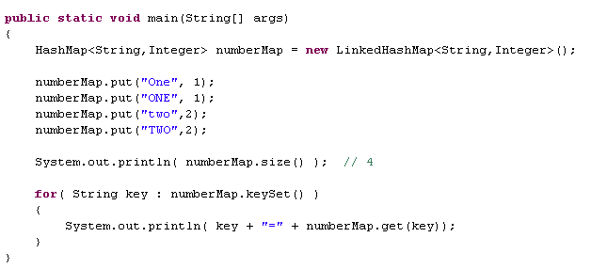

You can probably guess what LinkedHashMap does….
keys are in the same order they were added…

Slide 7
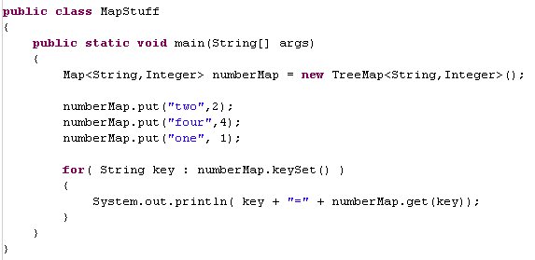

You can probably guess what TreeMap does….
Keys are iterated according to the “natural order” or comparator

Slide 8
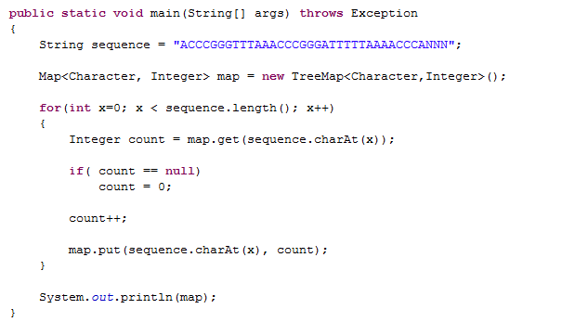

Maps are really great for counting things….
Our TreeMap keeps our keys ordered…
Maps only hold objects (not primitives)
So we have this awkward switch

Slide 9
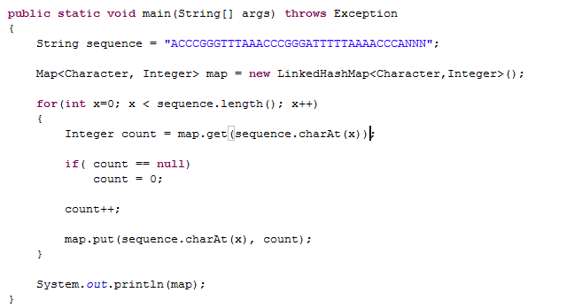
If we switch to a LinkedHashMap, the order of iteration
reflects the initial order that we saw in populating the map

Slide 10
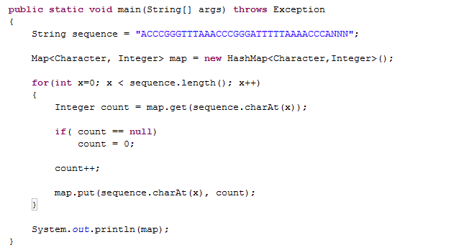

With just an ordinary HashMap, the iteration order is undefined…

Slide 11
HashMaps
A database implemented with List vs. a Map Collection
Exceptions
HashMaps
A database implemented with List vs. a Map Collection
Exceptions
Boxing and unboxing

Slide 12
The constant time performance makes maps a central
data structure in bioinformatics
Consider a large database of patients:
Patient
String patientID
String firstName
String lastName
float weight
float height

Slide 13
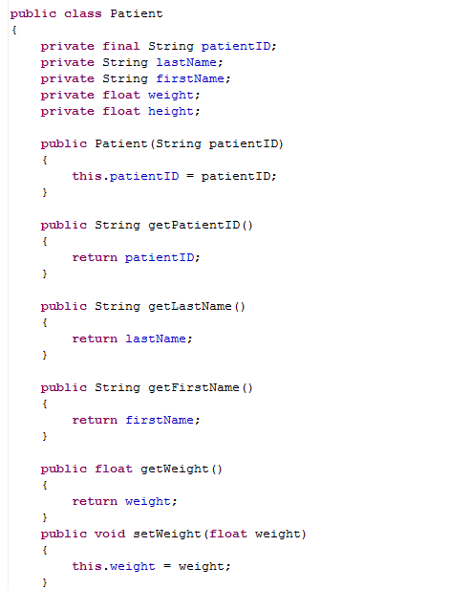
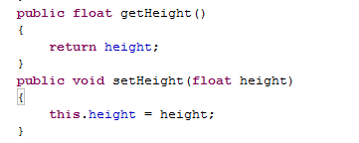
Patient
String patientID
String firstName
String lastName
float weight
float height

Slide 14
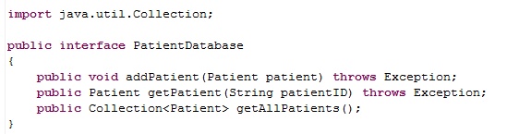
We want to make a database program that allows us to add or remove
Patients from a database
Patient
PatientDatabase
String patientID
String firstName
String lastName
float weight
float height
void addPatient( Patient patient)
Patient getPatient( String patientID)
Collection<Patient> getAllPatients()
(for now we will pretend the program will run forever and we won’t
worry about making persistent data that would survive the termination of
the JVM; that will come with SQL later)

Slide 15
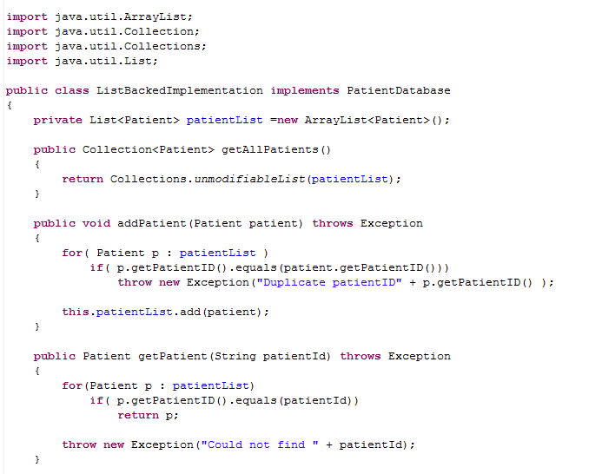
Here is an implementation backed by a List
This works but addPatient() and getPatient() scale linearly with the size of the database.
We have to crawl through every Patient in the database…

Slide 16
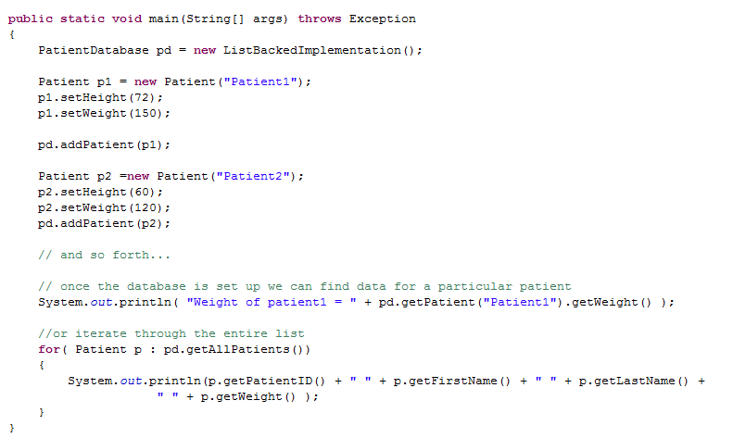
Here is a client interacting with the ListBackedImplementation()
interface
implementation

Slide 17
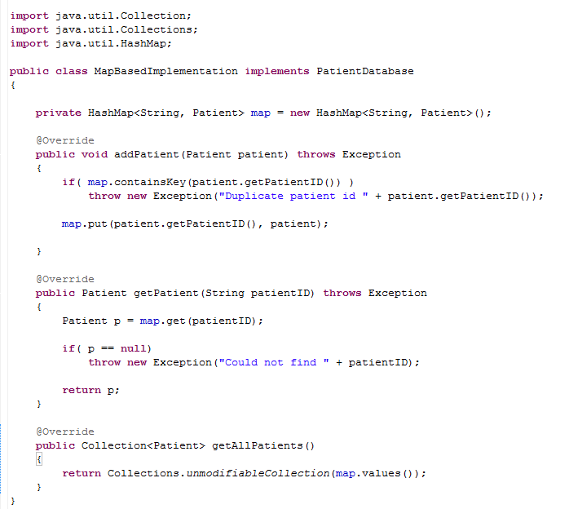
As a faster alternative, we can make a Map based implementation
getPatient() and addPatient() now scale in constant time with the # of patients
This is a bit less efficient in terms of memory, however (since we are holding
the patientID in both the keys and the values)

Slide 18
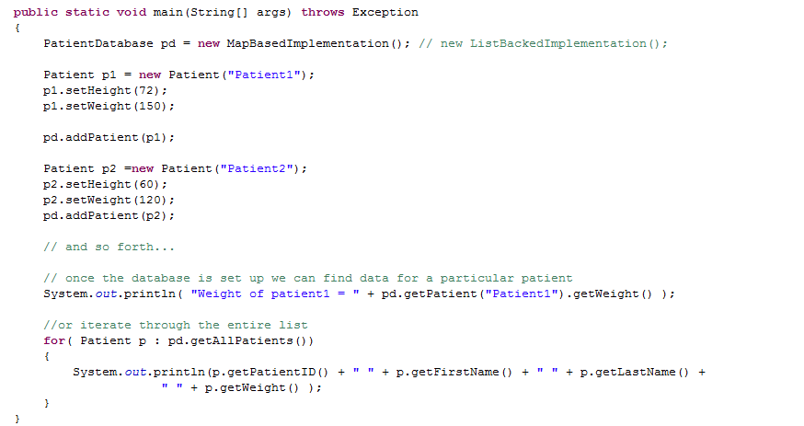
Because PatientDabase is an interface, we can switch to this new
implementation in one line of code…

Slide 19
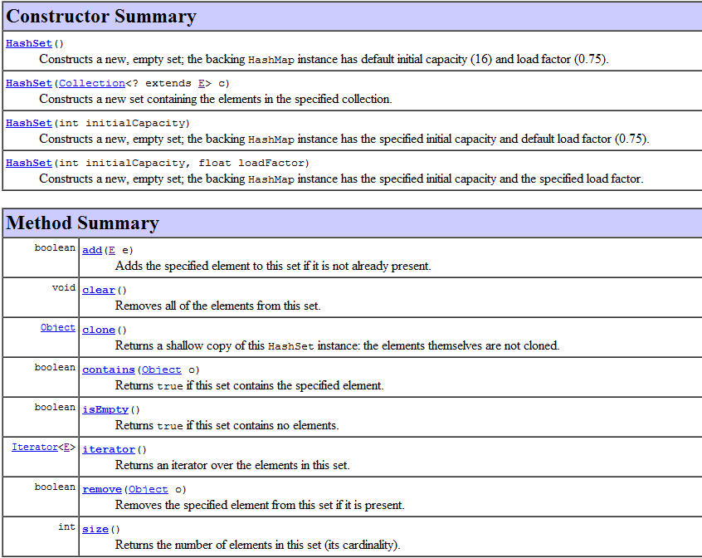
Notice that HashSet does not have a get() method.
Sets are useful for quickly finding duplicates
Maps are useful for making lookup tables

Slide 20
HashMaps
A database implemented with List vs. a Map Collection
Exceptions
Boxing and unboxing

Slide 21
Throwable
Error
Exception
RuntimeException
“unchecked”
Errors usually indicate something has gone seriously wrong

Slide 22
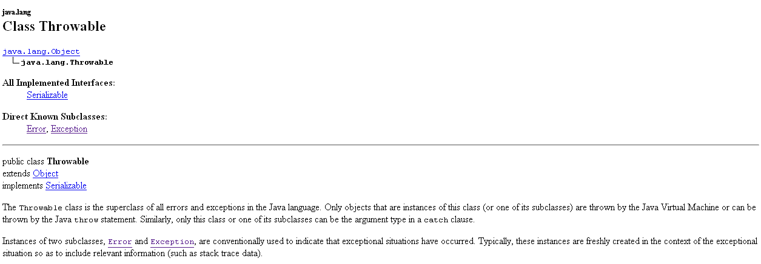

Slide 23
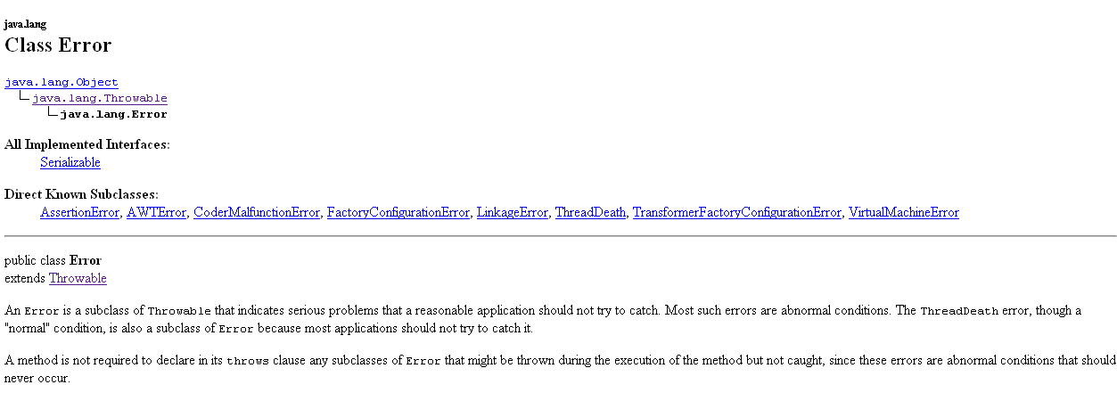

Slide 24
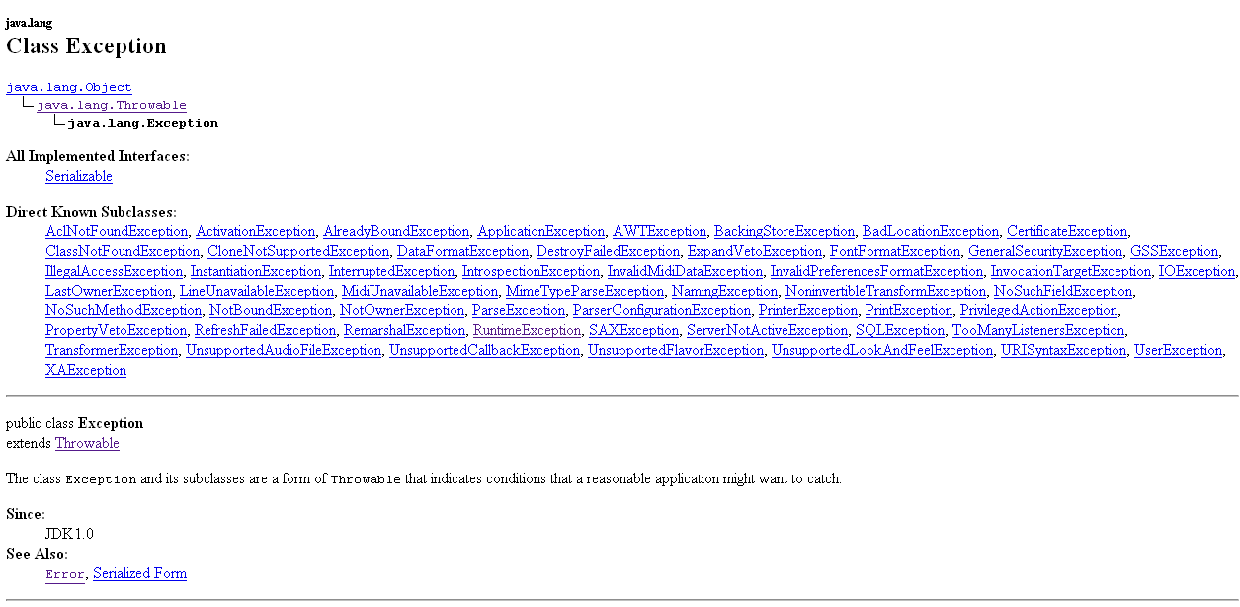

Slide 25
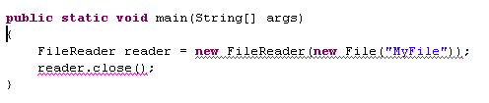

We’ve seen that the compiler is asking us to deal with Exceptions…

Slide 26

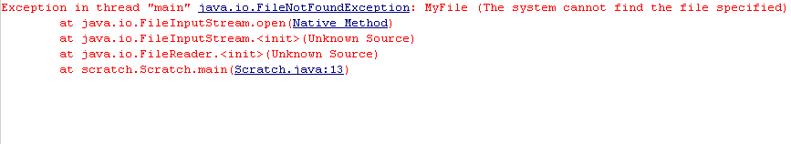
One way to handle this is the “throws” declaration
If we try to run this, and the file is not found we get…
You can click on this and Eclipse will take you to the
correct line of code…

Slide 27
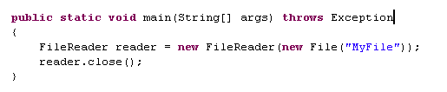

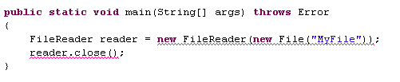

or
or
but not
Exceptions are not Errrors!

Slide 28
Throwable
Error
Exception
RuntimeException
“unchecked”

Slide 29
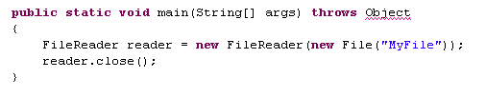

Only Throwables may be thrown
Objects are not Throwable

Slide 30
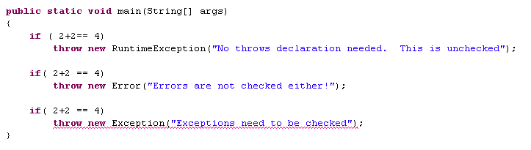
Java discriminates between checked and unchecked Exceptions
Throwable
Error
Exception
RuntimeException
“unchecked”
C# does not make this distinction. There is no “throws” in C#.
I think C# is right! I make every method throws Exception!
This is not standard. But makes sense for bioinformatics.
Bad for the Space Shuttle!

Slide 31
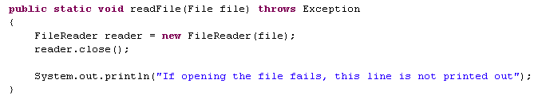
If you throw an Exception, the rest of the method is not executed
An alternative to throws is Try…Catch…Finally logic

Slide 32
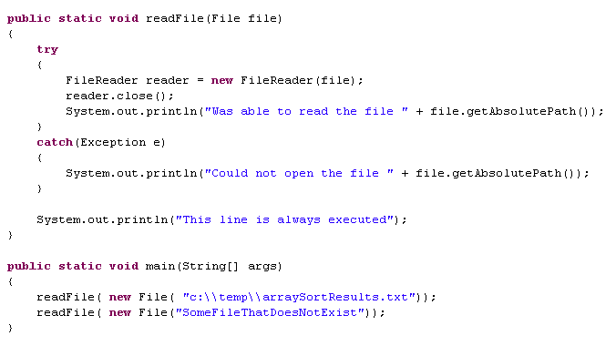

An alternative to throws is Try…Catch…Finally logic
No throws
No throws

Slide 33
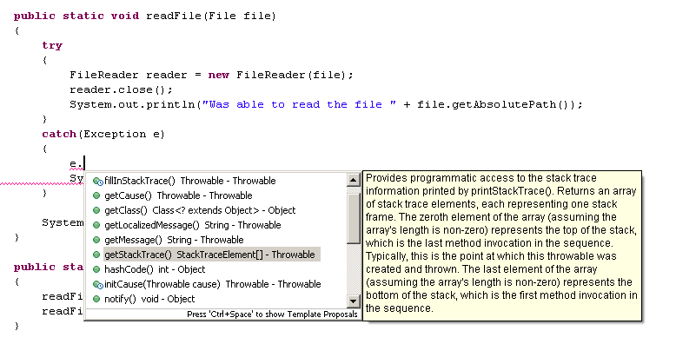
Exception is just an Object.
You can call methods and manipulate it.

Slide 34
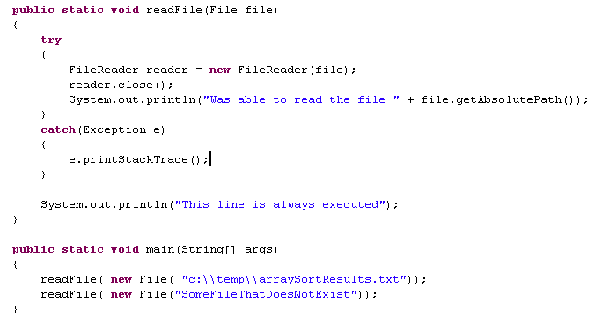
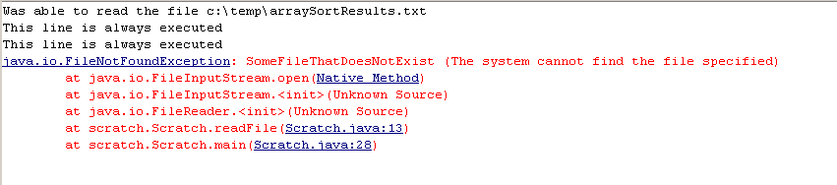
Eclipse’s console messes up the order here!

Slide 35
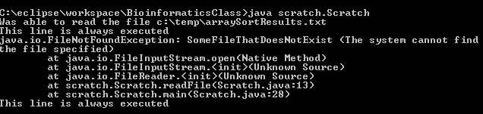
Command line java gives the correct order!

Slide 36
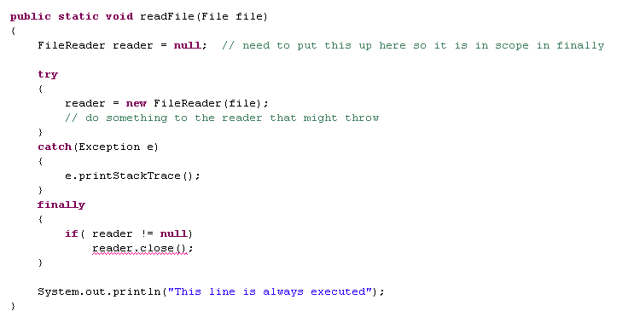

Finally guarantees that execution of a block of code will happen
Aarrgh. The close itself throws!

Slide 37
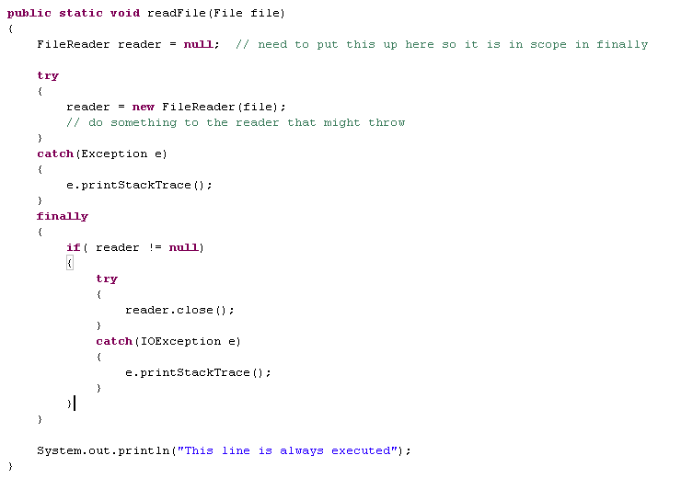
This is awkward but very safe

Slide 38
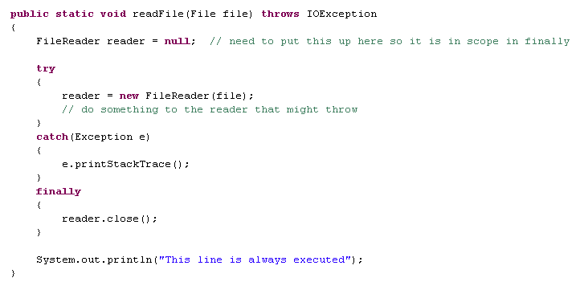
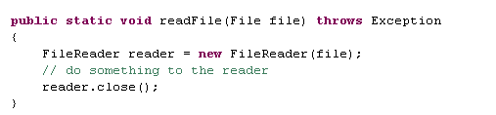
Another option…
What I usually do…
Code is simpler, but also dangerous because the reader may not close
Again, good for bioinformatics, bad for Space Shuttle…

Slide 39
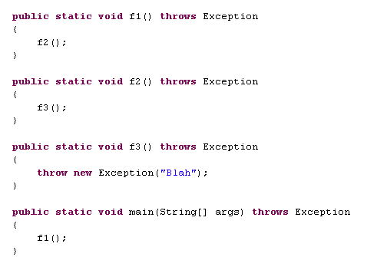

When you are trying to debug a program, the stack trace is your
best friend in the whole world…
These are all clickable
in Eclipse

Slide 40
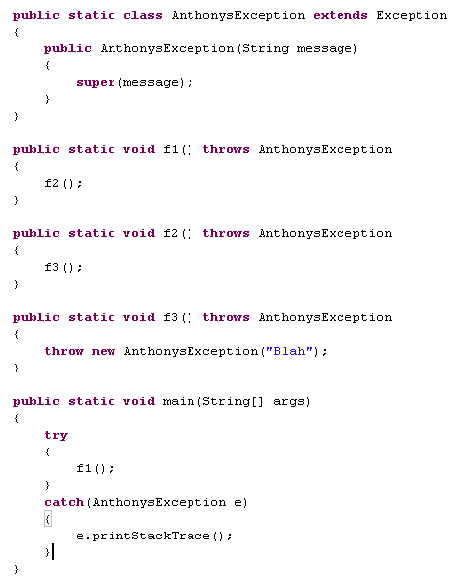

I can easily make my own Exceptions

Slide 41
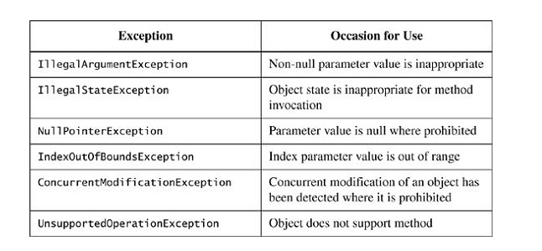
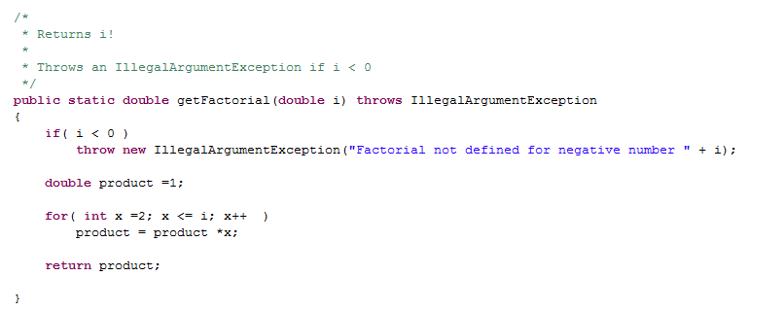
But it is usually better (clearer) to re-use Java’s built-in Exceptions
Bloch Item #60: Favor the Use of Standard Exceptions

Slide 42
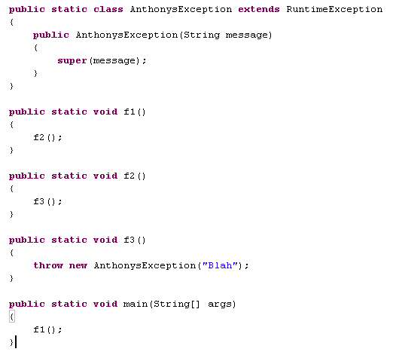
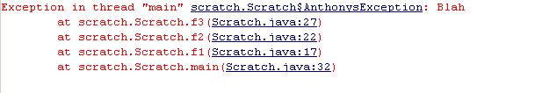
If I extend RuntimeException, I don’t need a throws or catch.
All Exceptions in C# act this way, but this is discouraged in Java
No throws

Slide 43
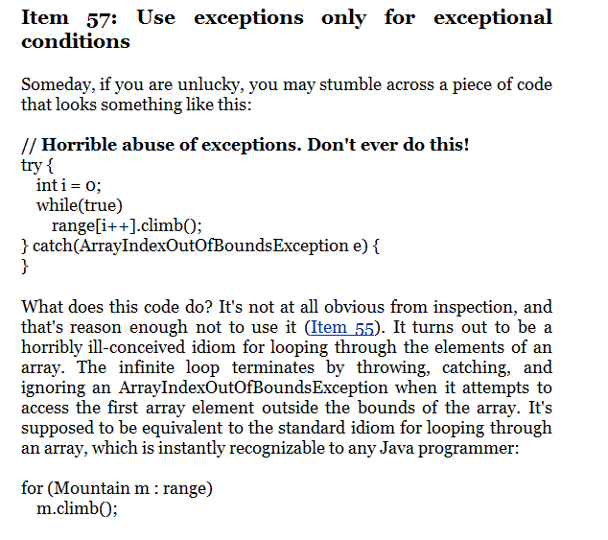
Try..catch can be expensive to set up and should not be abused..
Bloch: Item #57.
One problem is that if
something else goes
wrong in your while loop,
you will never be able
to find it….

Slide 44
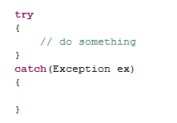
Bloch Item #65 – Don’t ignore Exceptions
Usually not something you want to do in Bioinformatics programming.
Are your results now in error?
You have turned off all error checking…
Results can be disastrous; our results are incorrect but we don’t know.
MUCH better to throw the exception than just to bury it…

Slide 45
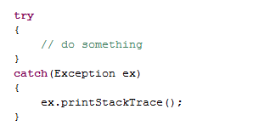
Bloch Item #65 – Don’t ignore Exceptions
35.86005831
A little better; at least an error message is printed out….
But if this on a server at 3:00 in the morning no one will see it!
One reason I prefer just to throw all of the Exceptions…
If the Exception halts execution it can’t be ignored…

Slide 46
HashMaps
A database implemented with List vs. a Map Collection
Exceptions
Boxing and unboxing

Slide 47
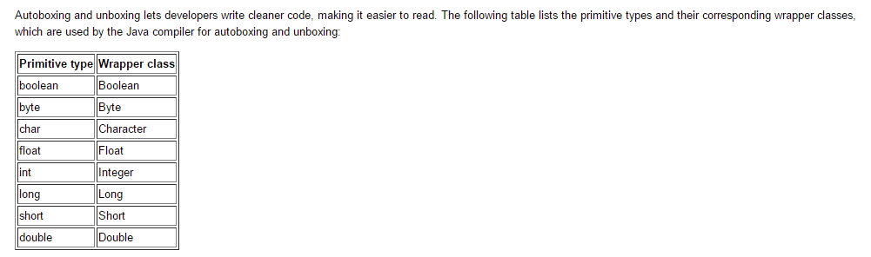
The basic types in Java all have “wrapper” classes
int
Integer
basic type
Wrapper class
https://docs.oracle.com/javase/tutorial/java/data/autoboxing.html

Slide 48
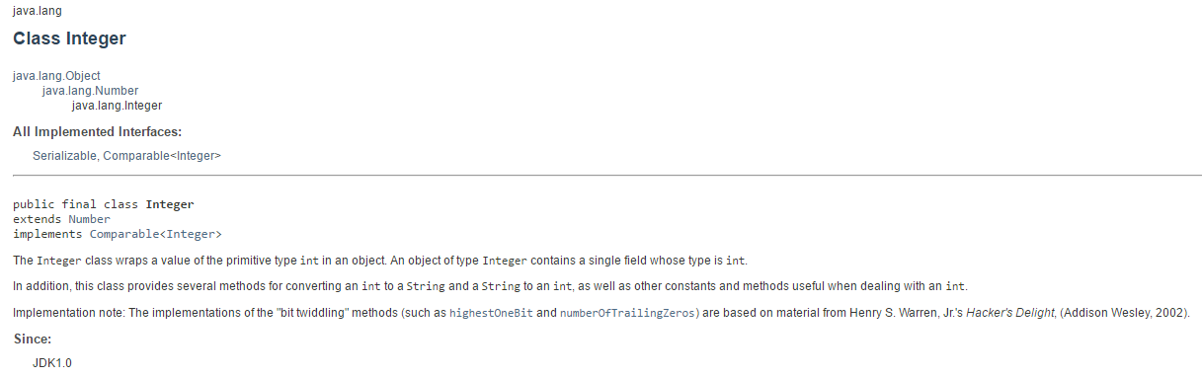

Slide 49
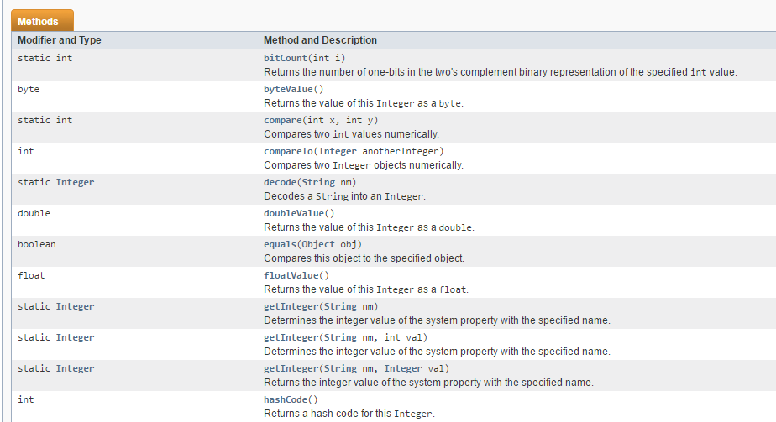
The methods are generally quite easy to understand…

Slide 50
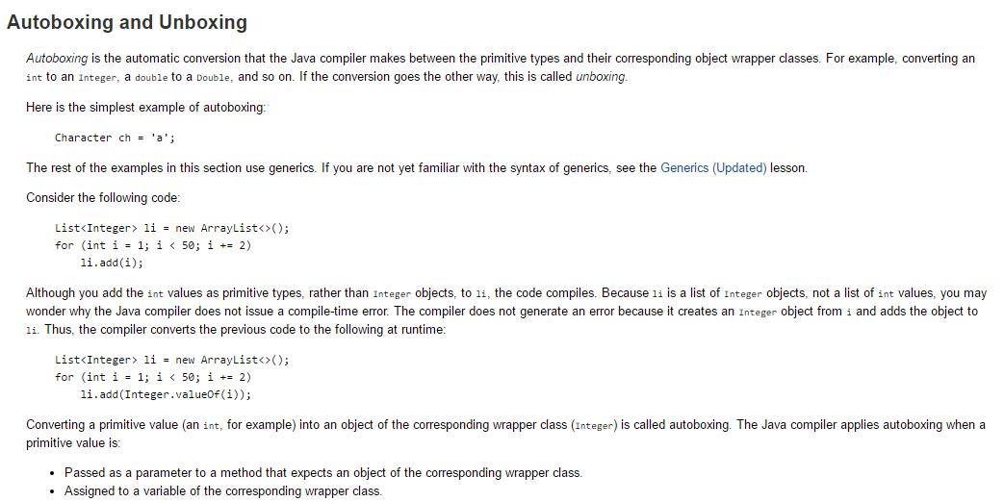
Java’s collection API requires the Wrapper classes and not
the basic types…
Java will convert back and forth automatically.
This is called “autoboxing” and “unboxing”
https://docs.oracle.com/javase/tutorial/java/data/autoboxing.html

Slide 51
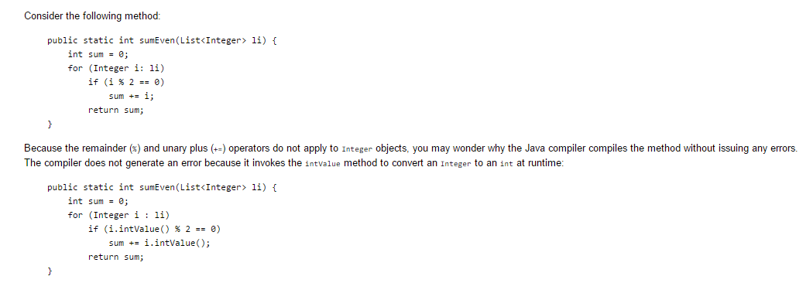
This is so intuitive that you don’t really need to think about it most of the time…
https://docs.oracle.com/javase/tutorial/java/data/autoboxing.html

Slide 52
Machine learning
GUIs

