Slide 1
Interfaces
List, ArrayList and LinkedList
Sorting, Comparable and Comparator
Extending our Shape interface so shapes can render themselves

Slide 2
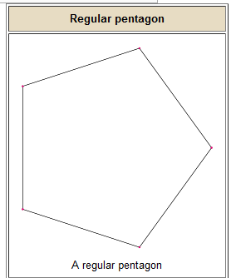
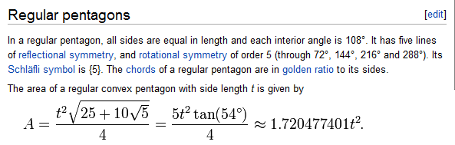
An interface is a collection of function names…
Consider a new Shape: Regular Pentagon
http://en.wikipedia.org/wiki/Pentagon

Slide 3
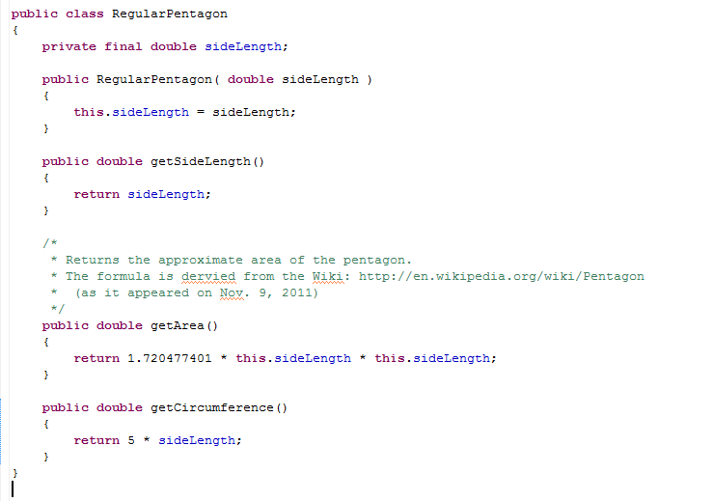

Slide 4
Circle and RegularPentagon have some methods in common (and some that are different)
g
g
Circle
RegularPentagon
getRadius()
getArea()
getCircumference()
getSideLength()
getArea()
getCircumference()
Java has a number of ways that we can indicate classes with common functionality.
One of these is an interface….

Slide 5
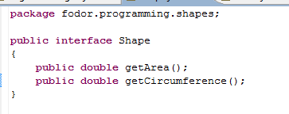
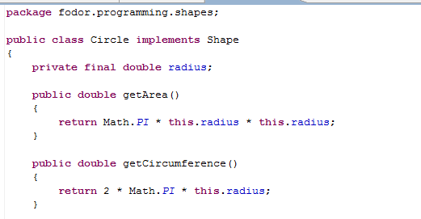
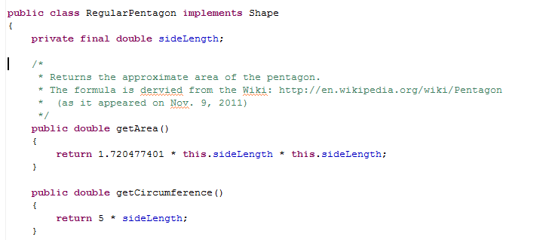
Circle implements Shape
RegularPengaon
implements Shape

Slide 6
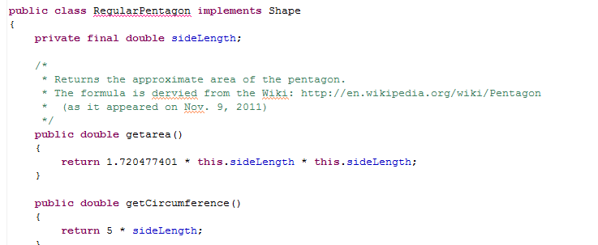

The presence of getArea() and getCircumference() are enforced by the compiler.
The functions must be named exactly the same as in the interface (so getarea() here doesn’t compile)

Slide 7
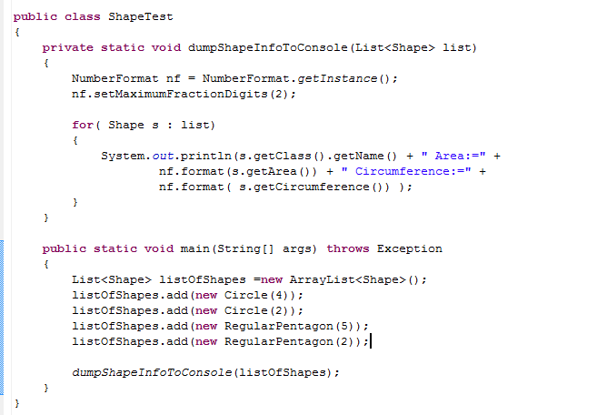

The presence of the interface allow us to work at a more abstract level.
We can manipulate objects with Shape references.
This method works at the
Shape level.
It will work on new Shapes
defined in the future…
I can mix different Shapes
within my list

Slide 8
Interfaces
List, ArrayList and LinkedList
Sorting, Comparable and Comparator

Slide 9
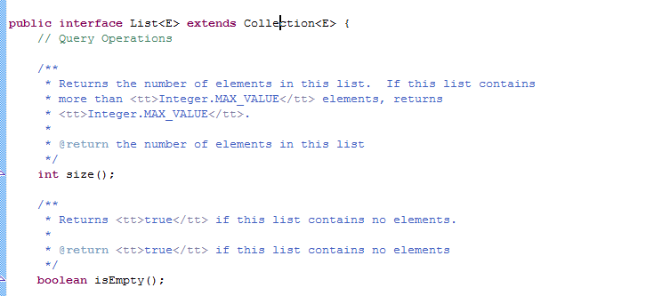
We can now understand the relationship between
the interface List and the implementation ArrayList
We will talk about the “extends” later
The List interface is a collection of function names that an implementing list
must define in order to be compiled as a List..

Slide 10
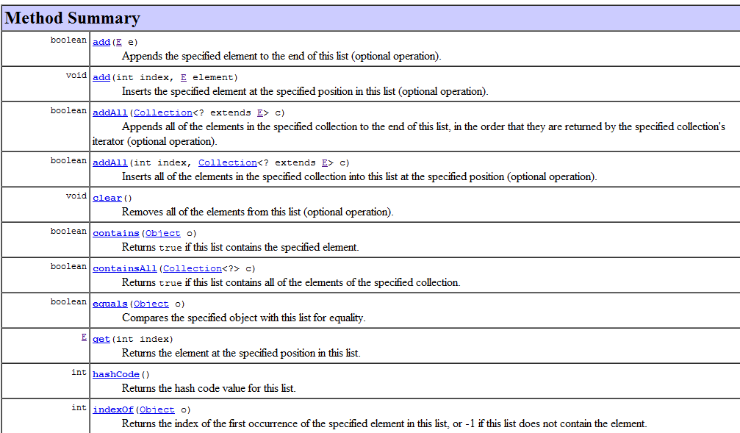
If you want to make your own implementation of List, you need to provide all
of these functions…
and so forth…
(Actually some of these methods you can inherit from Object, but more on that later)

Slide 11


Because an interface is just a collection of function names it can’t be instantiated.
It is abstract.

Slide 12
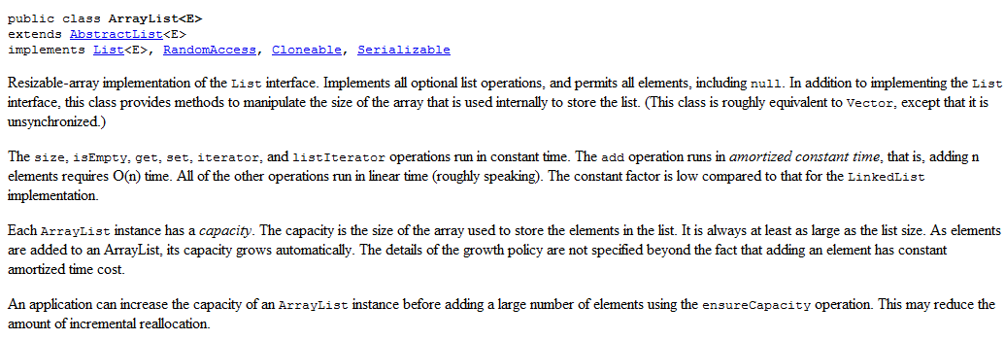
Java provides many different kinds of lists.
ArrayList is used most frequently.
It stores the list in an array (and copies the array into a bigger array on the
fly when the data in the array gets too big).
size, isEmpty, get, set all run in constant time
(because you can manipulate an element of an array directly).
a[x] = 4.24 will execute in the same amount of time no matter how big
the float array “a” is or what x is…

Slide 13
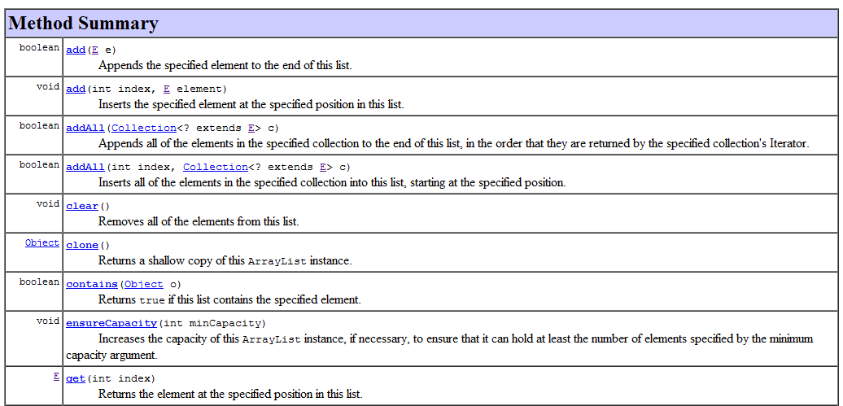
ensureCapacity() is not part of the List interface (because not all lists will
have a capacity)
For an ArrayList, ensureCapacity says make the underlying array at least this big
(even if I don’t have any elements added to the list)

Slide 14
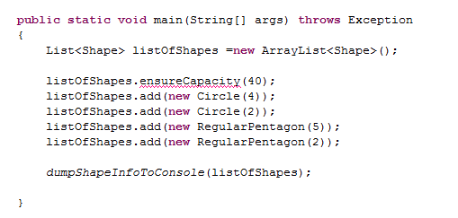

Because ensureCapacity is part of ArrayList (but not List) it cannot be invoked from
a List<> reference…

Slide 15
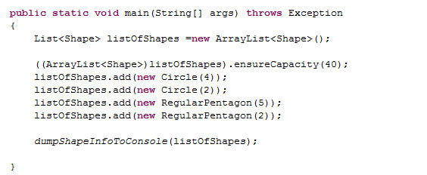
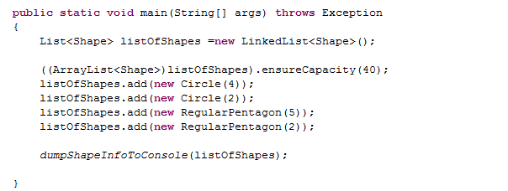
This works (but defeats the attempt to deal with the List at a more abstract level)
If I change to a different kind of List, the cast will throw a runtime Exception
So cast with care… Probably better just to leave it as a List<Shape> and let the list manage its
own capacity (optimize last!). It will probably be fast enough.

Slide 16
A LinkedList is also a List but holds the data in a very different way…
Each element holds a reference to the next element..
E
Element
E
Element
E
Element
End
next
next
next
Start

Slide 17
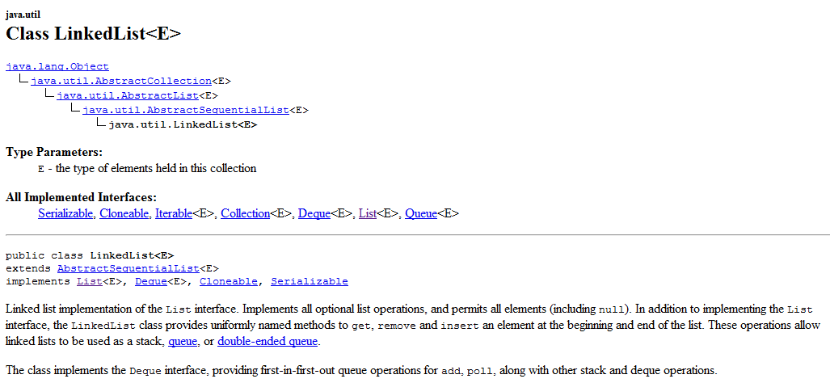
get() takes linear time here. (Not constant time like an ArrayList)
But, adding an element to the beginning of the list can be done in constant time.
For an array list, the entire list has to be copied to a new array (linear time) if you
add and element at the beginning
99% of the time, you want to use the ArrayList
(I don’t think I’ve ever used a LinkedList for production code)

Slide 18
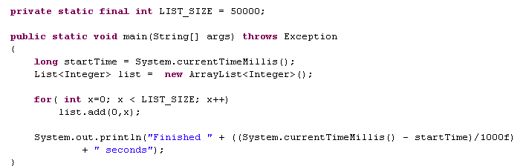

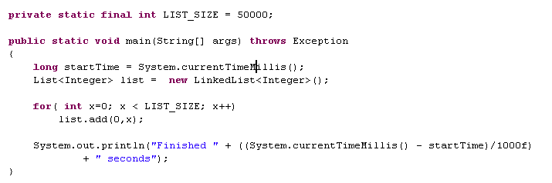

Adding elements to the beginning of an ArrayList is slow..
(Linear time with the size of the list)
Adding elements to the beginning of a LinkedList is fast (constant time)..

Slide 19
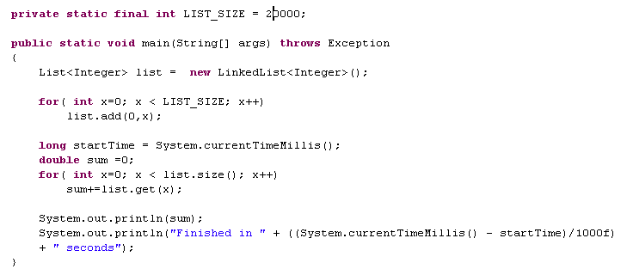


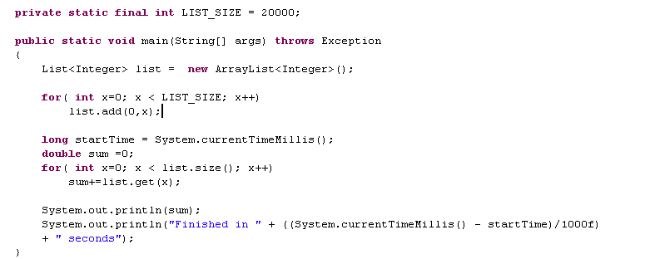
get() in a LinkedList is slow…
get() in an ArrayList is fast…

Slide 20
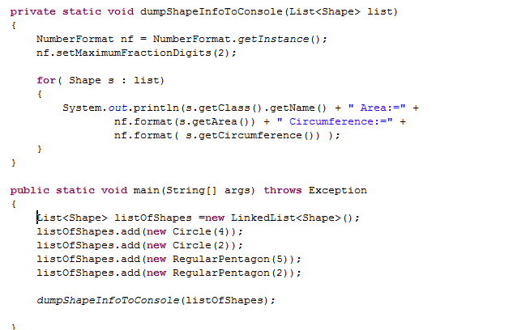
By using a reference at the Interface level (List) and not the implementation, you
can switch back and forth with a single line of code…
or
All of code works with either the ArrayList or the LinkedList because they are both Lists

Slide 21
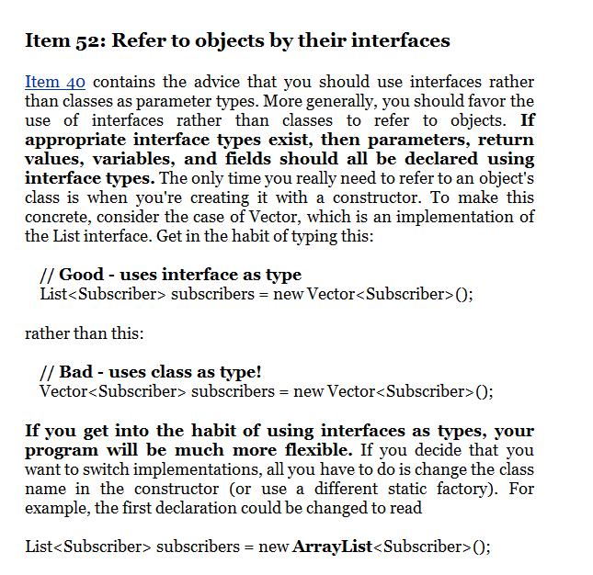

Slide 22
Interfaces
List, ArrayList and LinkedList
Sorting, Comparable and Comparator
Extending our Shape interface so shapes can render themselves

Slide 23
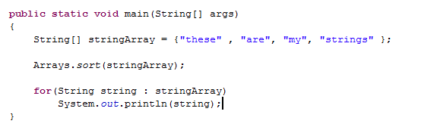

We’ve seen sorting in arrays…

Slide 24
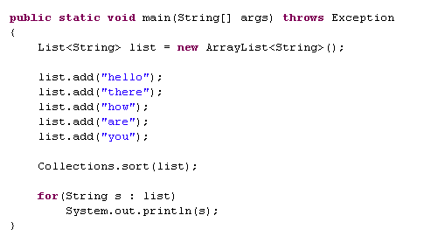

You can of course also sort a List…

Slide 25
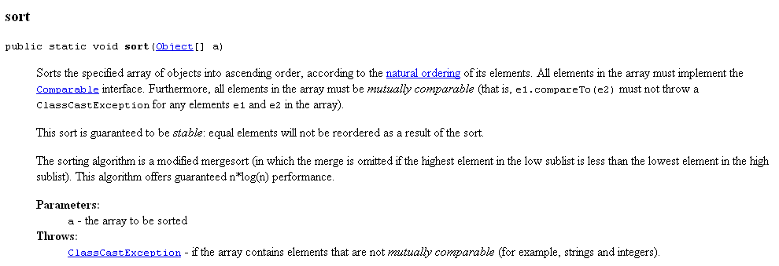
If we look at the Javadocs for Arrays.sort()
All of the elements of the array must implement Comparable.

Slide 26
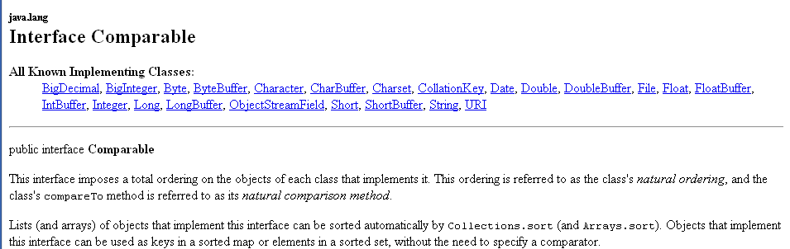
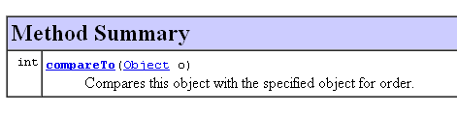
An interface that you will come to know well…

Slide 27
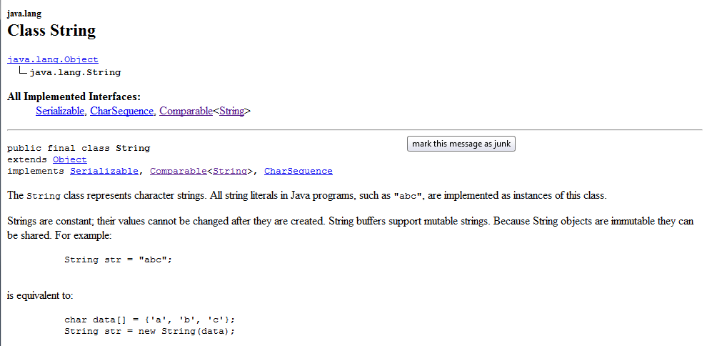
Arrays.sort() and Collections.sort() can sort Strings because they can sort any classes that implement Comparable and String implement Comparable.

Slide 28
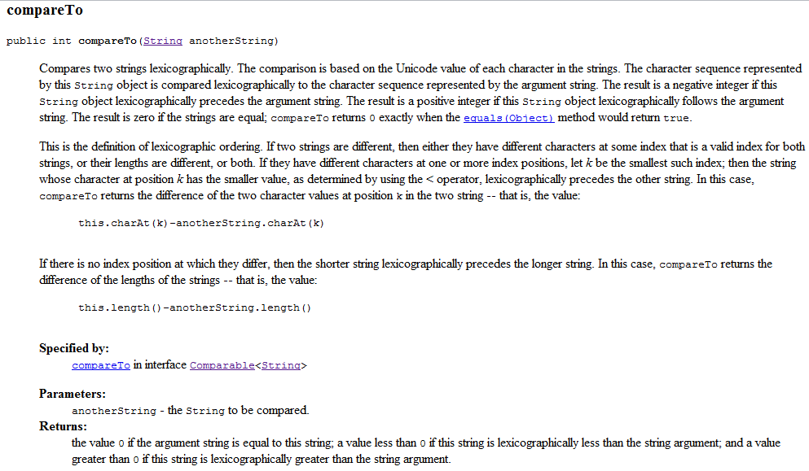
The javadoc (String.compareTo) will tell us what it means to sort Strings according to
their “natural order”

Slide 29
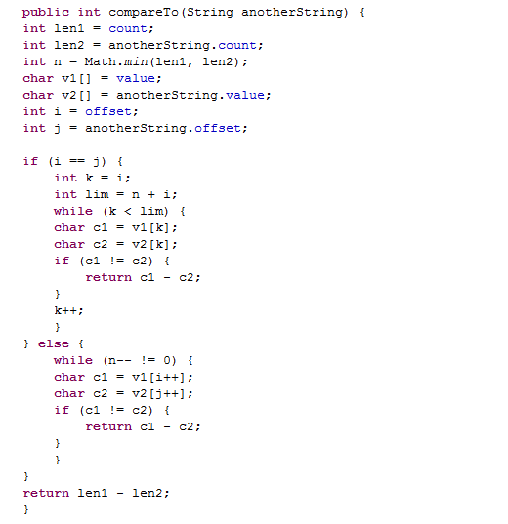
Or we can look at the source code (String.compareTo)

Slide 30
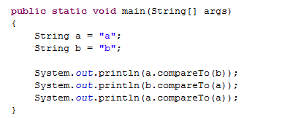

Certainly the comparison works the way we expect it to….

Slide 31
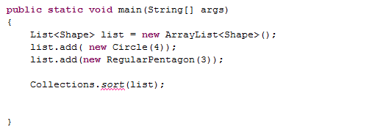
Because we have not defined what it means to sort a Shape
(i.e. we have not define compareTo() for Shape)
(i.e. Shape does not implement Comparable )
We cannot sort a list of Shapes without additional work…
Maybe not the clearest error message here!

Slide 32
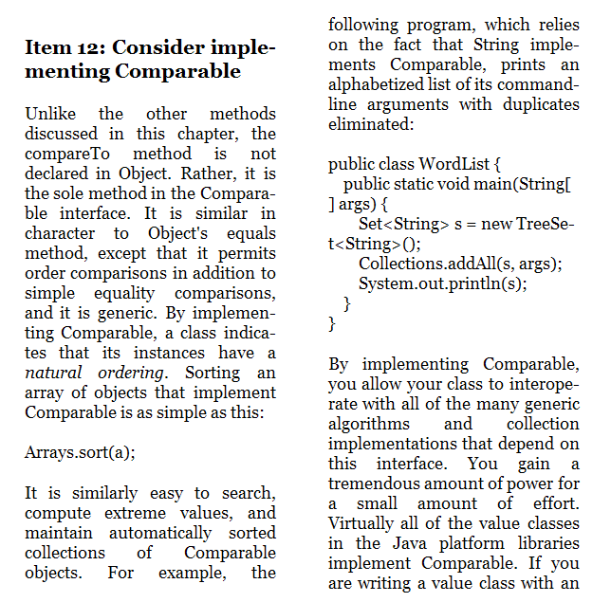
We could make Shape implement Comparable
(but it turns out we are not ready to do that yet….)
Bloch item #12 has stuff
we need to know before
we implement Comparable.
But we need to understand
inheritance, so we will
come back to this later..

Slide 33
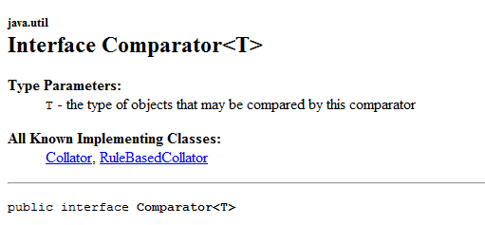

We can, however, make our own Comparator function
(that doesn’t require the Shapes to implement Comparable)

Slide 34

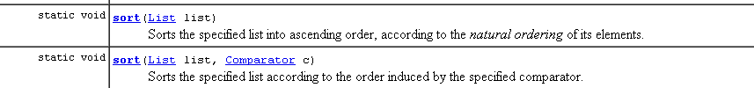
The “natural ordering” is specified by each object implementing Comparable
The ordering is specified by a Comparator that we make…

Slide 35
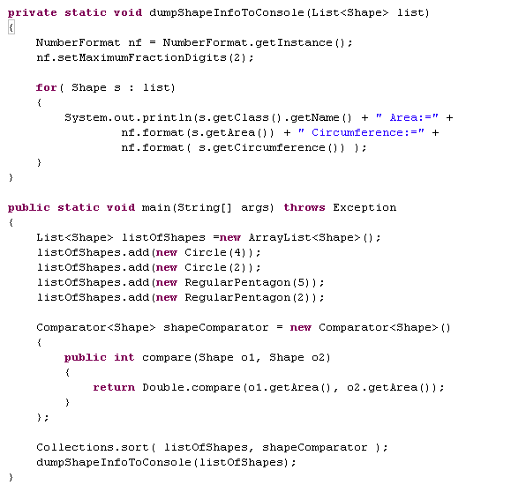

Tricky syntax.
An inner class.
We instantiate and define
shapeComparator at the
same time!

Slide 36
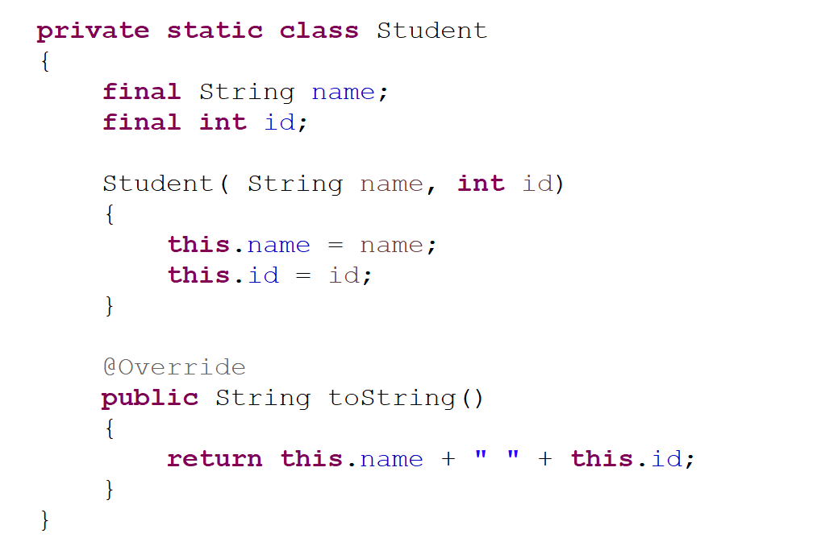
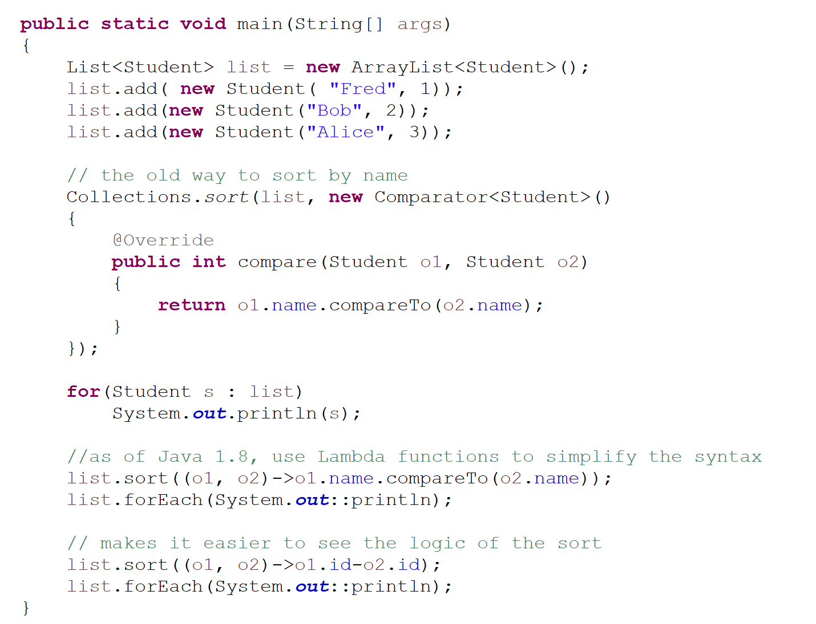
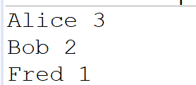
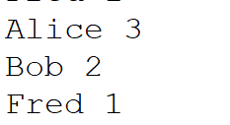
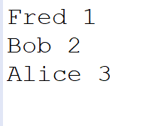
Starting with Java 1.8, lambda expressions allow for a more concise syntax
https://github.com/afodor/metagenomicsTools/blob/master/src/classExamples/SimpleLambdaSort.java

Slide 37
More on lambda functions (and closures) if/when we get to javascript later..

Slide 38
Interfaces
List, ArrayList and LinkedList
Sorting, Comparable and Comparator
Extending our Shape interface so shapes can render themselves

Slide 39
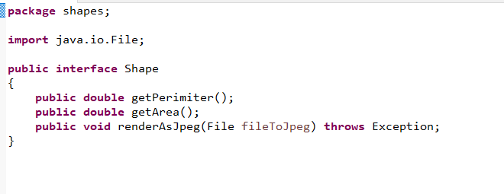
Extending our Shape interface so shapes can render themselves
We add a method to our Shape interface requiring each shape to represent itself as a jpeg
https://github.com/afodor/renderingShapes/blob/main/src/shapes/Shape.java

Slide 40
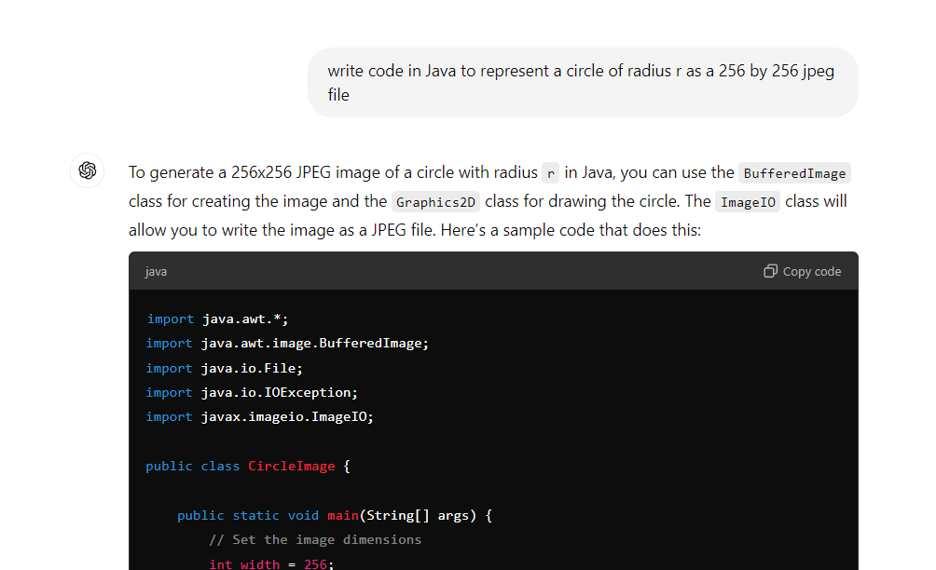
We can ask ChatGPT to write the first draft of the rendering code for us…

Slide 41
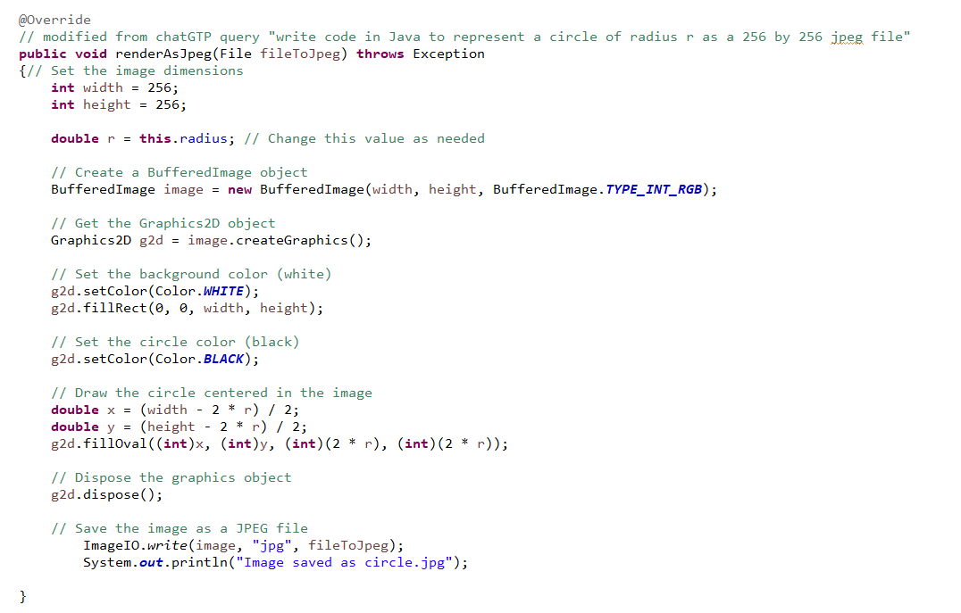
With some manual editing, we can integrate this code into our Circle class
Linking chatGPT’s code to “this” circle
https://github.com/afodor/renderingShapes/blob/main/src/shapes/Circle.java

Slide 42


This seems to be working pretty well…

Slide 43
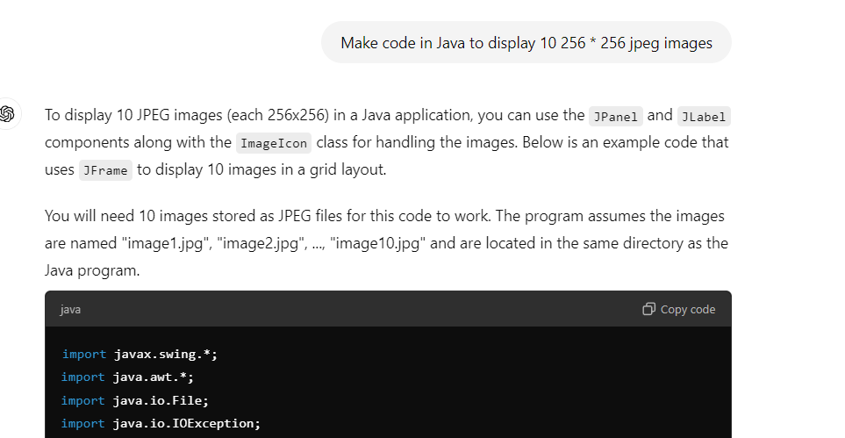
We can ask ChatGPT to make us a JPEG viewer so we can look at multiple images…

Slide 44
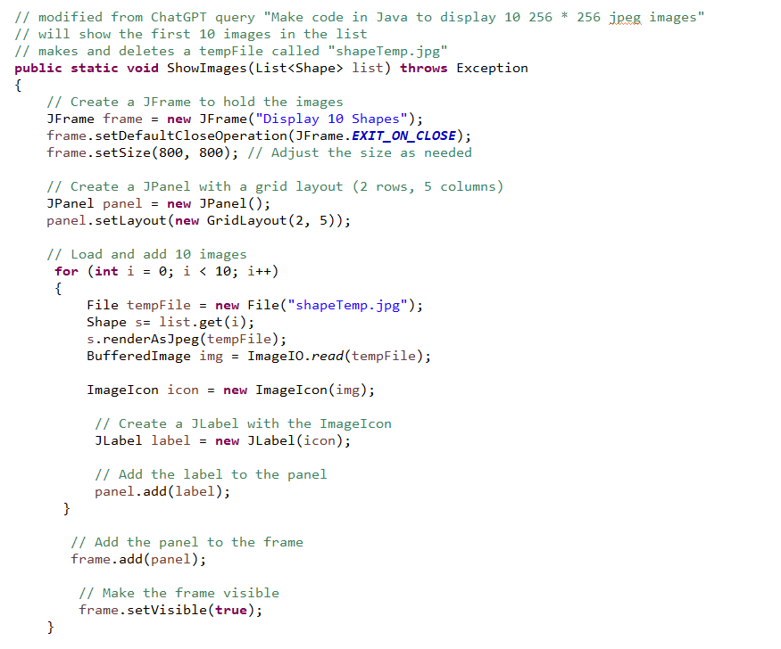
With a little work, we can adopt this to work on a List of Shapes
Our method takes a List<Shape>
Invoke our render method at the interface level
https://github.com/afodor/renderingShapes/blob/main/src/shapes/JPEG_Shape_Displayers.java

Slide 45
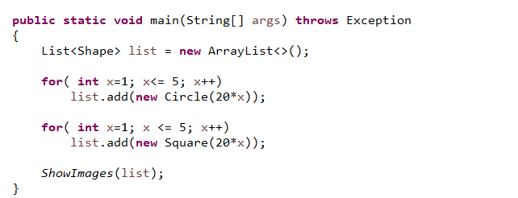
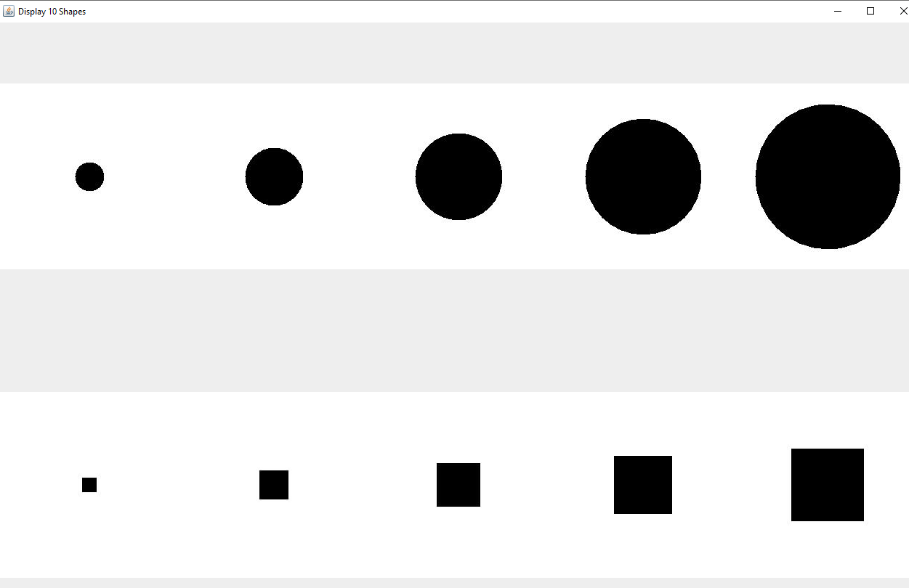
And we have a nice little application with very little coding effort…

Slide 46
Still to come:
Inheritance
== and .equals()
Overloading and Overriding
source control
Boxing and unboxing primitives in Java
Exceptions
Constructor chaining
HashMaps and HashSets

