Slide 1
Lab #5
In Java, make a GUI version of your amino acid quiz (Lab #2).
Your GUI should have:
a place for users to type in the answer
a place that shows how many right/wrong and the time left
“start quiz” and “cancel” buttons
The time left should count down (in real-time) from 30 sec
The quiz should end when the time left is 0 seconds.
The quiz should not terminate on a wrong answer
(unlike assignment #2) but keep track of # right and wrong
Lab is due Nov. 6
Send you code (or links to your checked in code) to afodor@uncc.edu with subject Lab #5
(see next slide for hint)

Slide 2
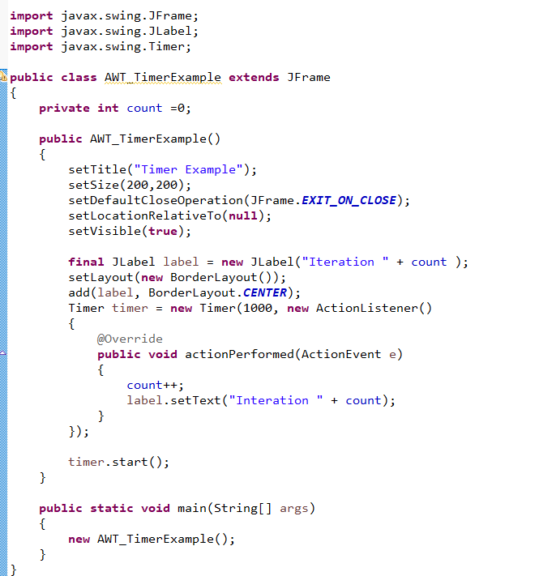
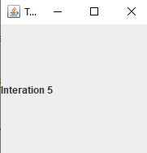
This code will help you with the timer
Be sure to use the javax.swing.Timer (more on why later)
https://github.com/afodor/metagenomicsTools/blob/master/src/classExamples/AWT_TimerExample.java

