Slide 1
In our last lecture, we had a neural network for classification.
Input layer
(28*28 neurons)
Hidden layer
(64 neurons)
Hidden layer
(2 neurons)
Output layer
(10 categories; softmax)
In this lecture, we will start to work towards models that generate data.
Input layer
(28*28 neurons)
Hidden layer
(64 neurons)
Hidden layer
(2 neurons)
Output layer
(10 categories; softmax)

Slide 2
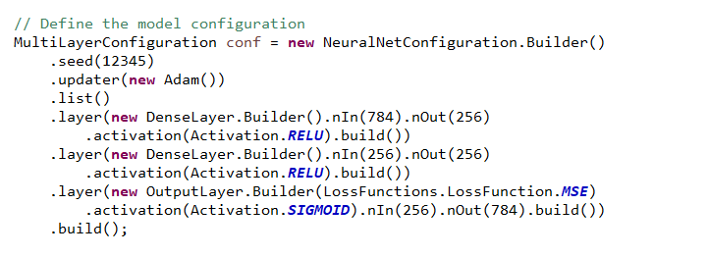
This is a simple encoder-decoder model
Input layer
(28*28 neurons)
Hidden layer
(256 neurons)
Hidden layer
(256 neurons)
decode
Output layer
(28*28)
We compress (encode) the input data into 256 neurons and then (decode) back to pixel space
https://github.com/afodor/mnistMaven/blob/main/src/main/java/mnist/unsupervisedAutoEncoder/MnistAutoencoder.java

Slide 3
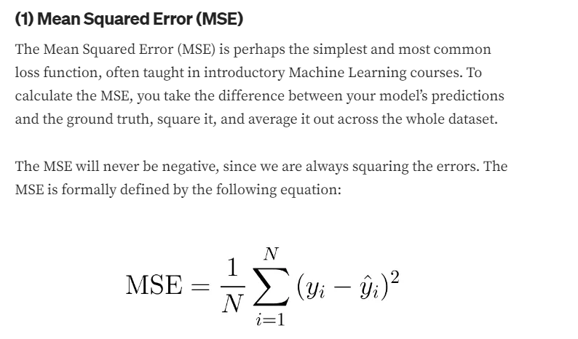
Our loss function is a simple mean squared error across all the pixels
Input layer
(28*28 neurons)
Hidden layer
(256 neurons)
Hidden layer
(256 neurons)
decode
Output layer
(28*28)

Slide 4
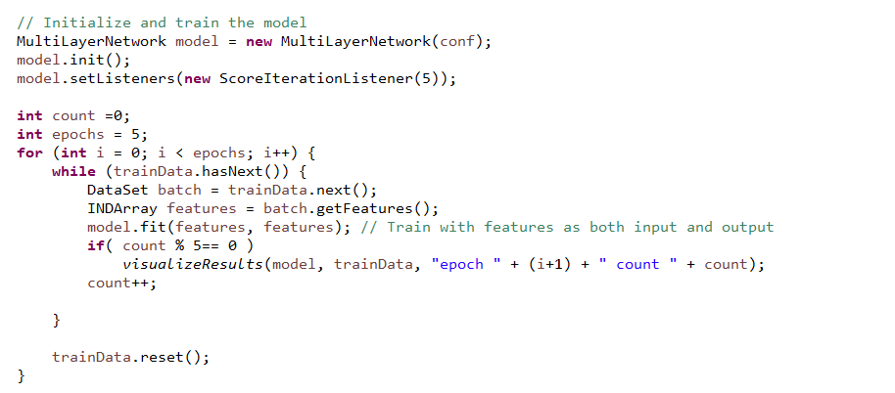
Here we train without labels
Input layer
(28*28 neurons)
Hidden layer
(256 neurons)
Hidden layer
(256 neurons)
decode
Output layer
(28*28)
https://github.com/afodor/mnistMaven/blob/main/src/main/java/mnist/unsupervisedAutoEncoder/MnistAutoencoder.java

Slide 5
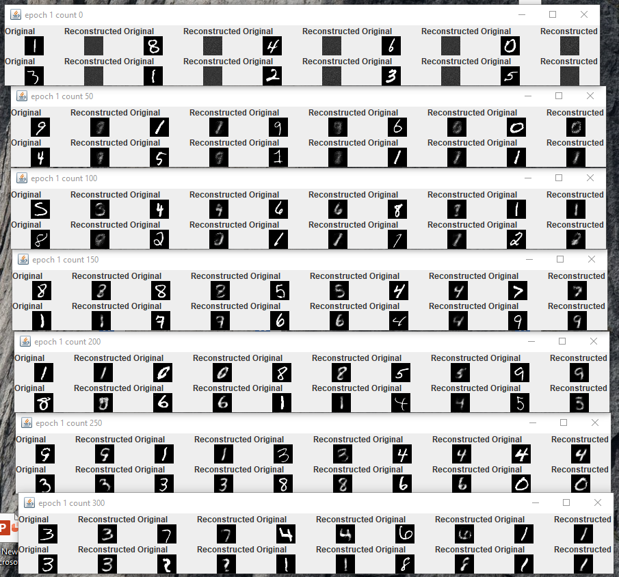
We can watch our model
learn more about the features of the
input sppce

Slide 6
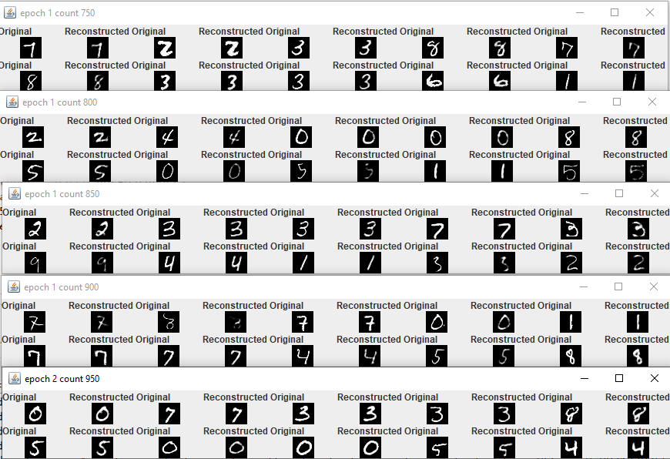

Slide 7
Input layer
(28*28 neurons)
Hidden layer
(256 neurons)
Hidden layer
(256 neurons)
decode
Output layer
(28*28)
By sampling from this last hidden layer, we can start to
build models that can generate new data..

