Slide 1
Lab #6: GUI to do something slow in background threads (for example, find prime numbers)
(due Nov. 30th; wed after thanksgiving). Send your code to afodor@uncc.edu and hmaanaki@uncc.edu
with the subject line lab #6
Make a GUI with the following properties (also see slide #4 )
(1) It does a slow calculation (for example finding prime numbers up to some large number) in a
single-background thread.
(2) It reports on the results (for example how many primes have been found)
every few seconds or so.
(3) It has a cancel button that can cancel the operation.
(4) At the end of the calculation, or if the user hits cancel, the
results are shown (and the amount of time it took to do the calculation).
(5) Finally, extend your program so that it uses multiple background threads.
Report the speed up (if any) over a single-background thread. Allow the user
to control from the GUI how many background threads are spawned

Slide 2
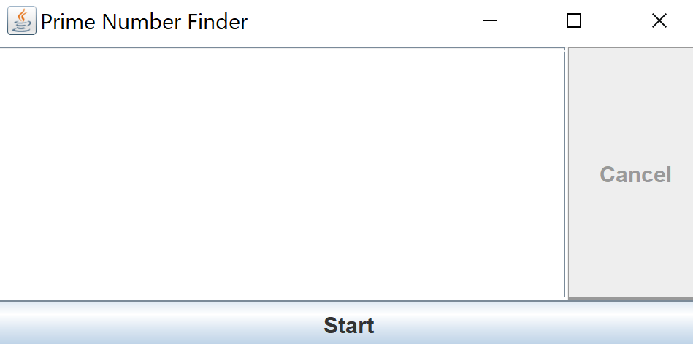
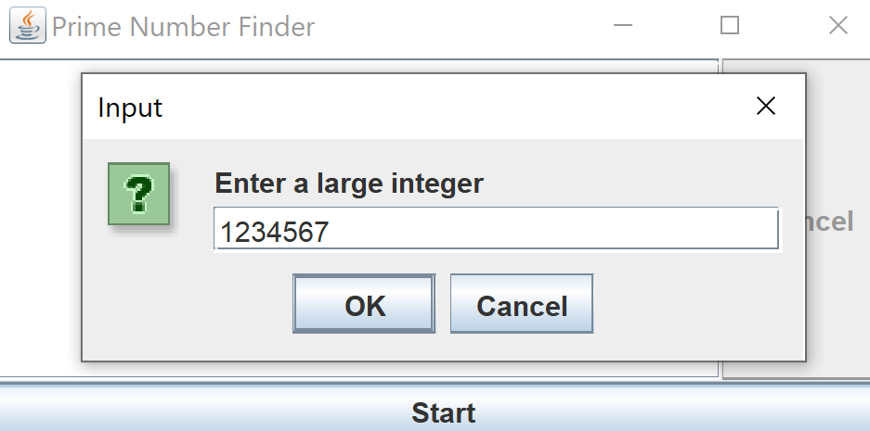
Here is an example (you can – and should - design your GUI to look different and probably better)
User hits start and is asked to input a number
User enters the number;
Program will find all the primes between
1 and this #

Slide 3
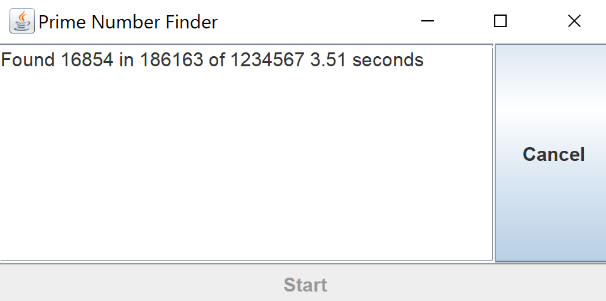
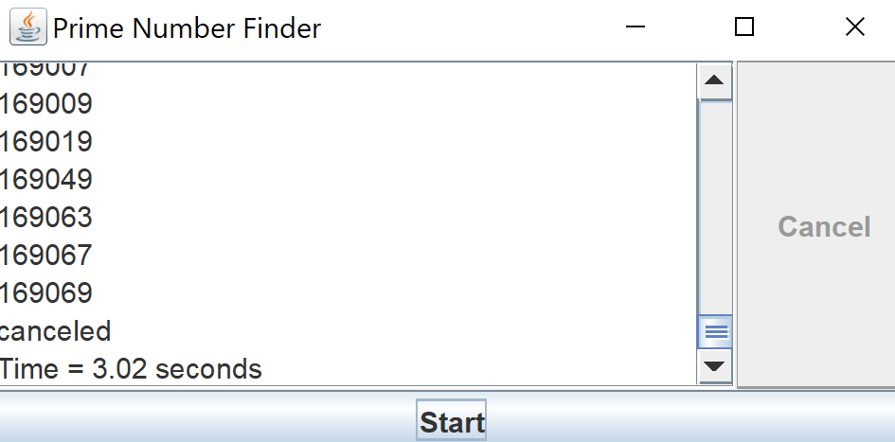
While the program is running, the user is updated on the status
At the end of the calculation (or if the user hits cancel),
the results are shown and the time is shown.
(This is a JScrollPane wrapping a JTextArea)

Slide 4
You should consider MVC architecture
https://en.wikipedia.org/wiki/Model%E2%80%93view%E2%80%93controller
Make your “workers” independent of the GUI
(you should be able to interact with them from the command line or from non-GUI code)
Then “wrap” the GUI around the developed (and tested workers).
This will allow you to develop in distinct modules which will reduce complexity and make testing easier…

