Slide 1
static methods and variables
String, StringBuffer and string concatenation performance
BufferedReader, FileReader and File
How much slower is Java than C/Optimize last
From Arrays to Lists

Slide 2
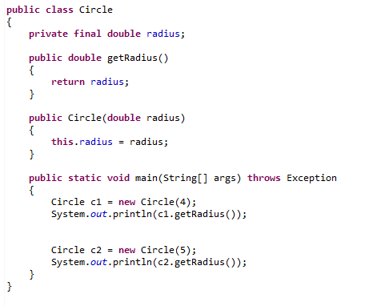

Objects in Java each have their own separate copy of data
circle1
circle2
radius=4
radius=5
By contrast a static variable is associated with the class not with objects of a class…

Slide 3
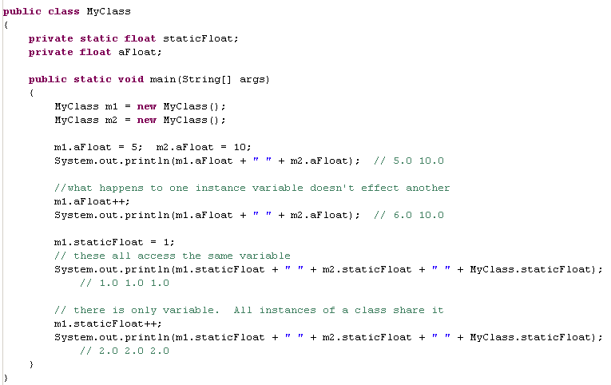
Static and instance variables
instance variables are associated with objects – instances of a class
static variables are associated with the class itself -

Slide 4
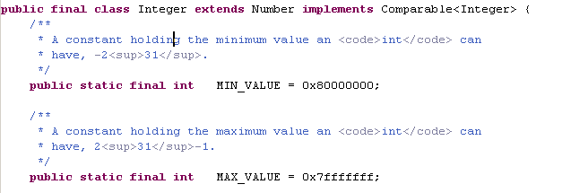
Static variables can be used to grant easy access
to frequently used variables

Slide 5

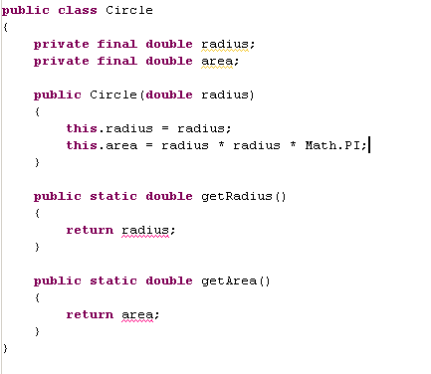
Static methods cannot access instance variables

Slide 6
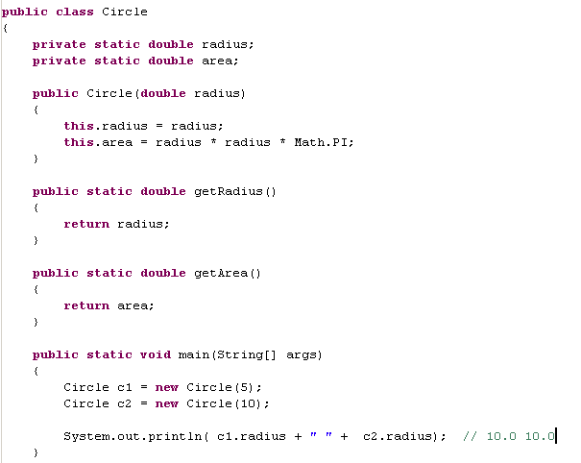
You would never want to do something like this!
The radius “leaks” from one Circle to the next

Slide 7
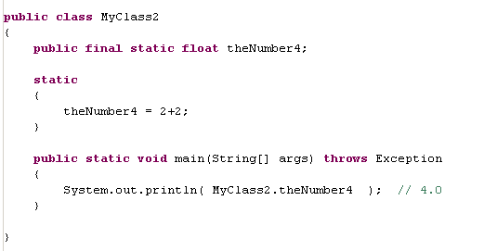
Static constructors initialize static variables…
static constructor
No object was instantiated here.
You cannot pass parameters to static constructors.

Slide 8
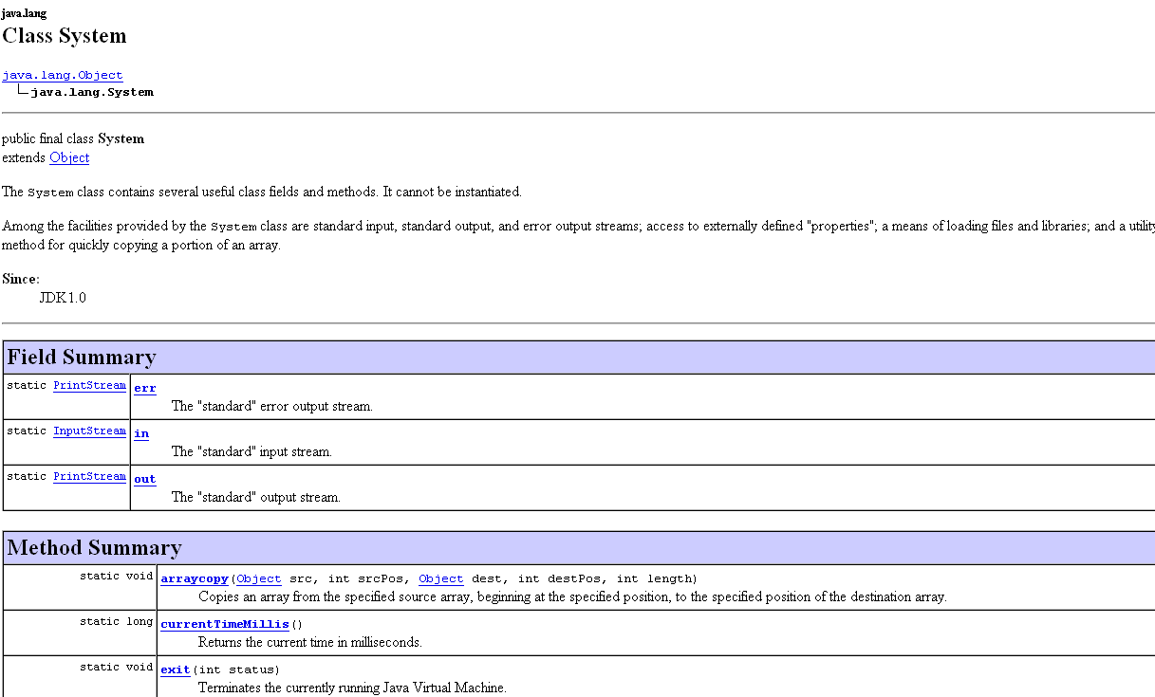
System consists of static methods and variables.
It makes sense. There is one OS. There is one output stream.

Slide 9
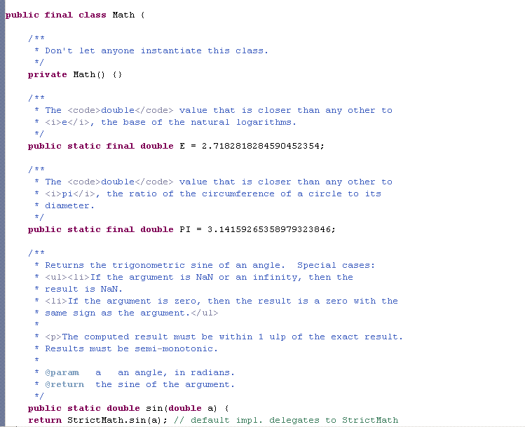
java.lang.Math is a collection of static values and methods
(F2 in eclipse with the cursor on any field will take you to a definition of that field)

Slide 10
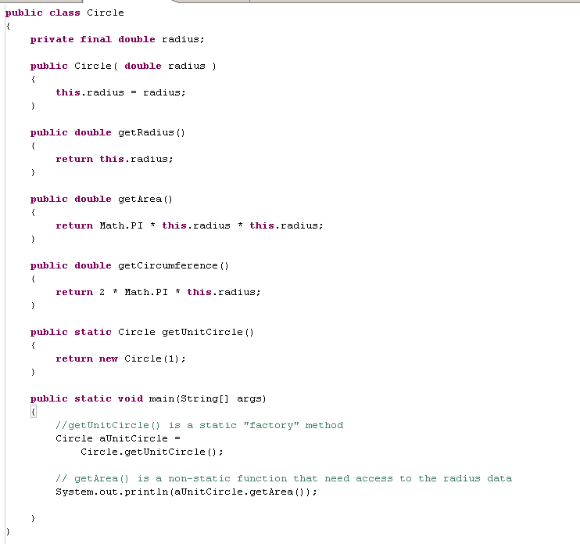
A static method is often invoked by the class name
Make a new circle with radius == 1

Slide 11
A static method is often invoked by the class name
This is an example of the “static factory” pattern.
A static method instantiates and produces an object

Slide 12
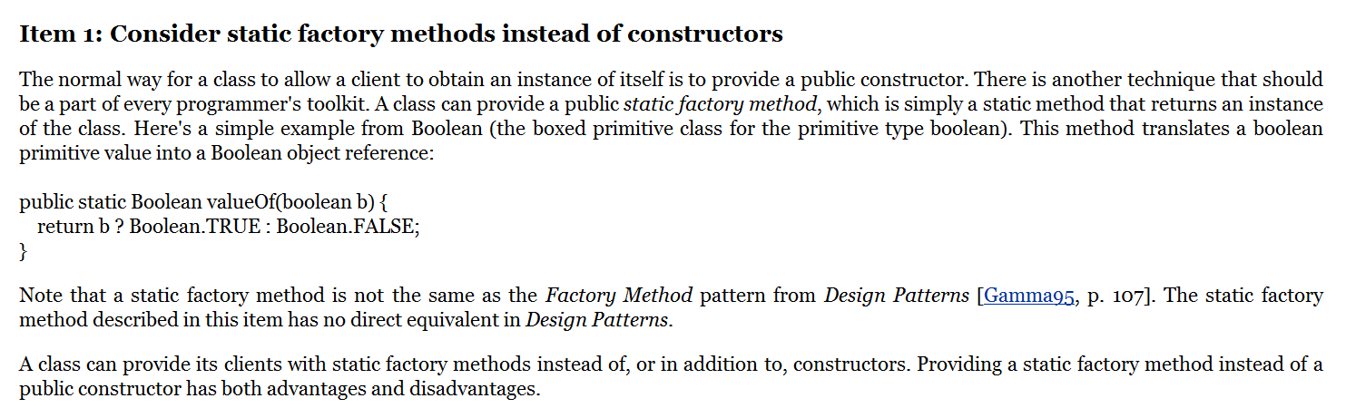
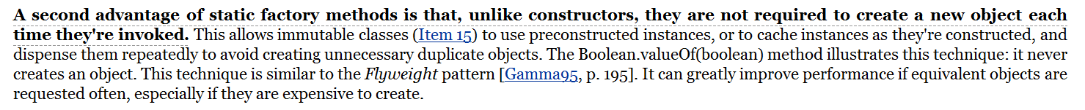
This is item #1 in Effective Java

Slide 13
static methods and variables
String, StringBuffer and string concatenation performance
BufferedReader, FileReader and File
How much slower is Java than C/Optimize last
From Arrays to Lists

Slide 14
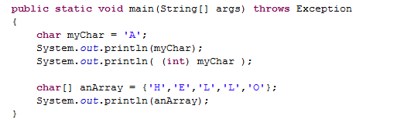

We can represent Strings in the C way as Character arrays…

Slide 15
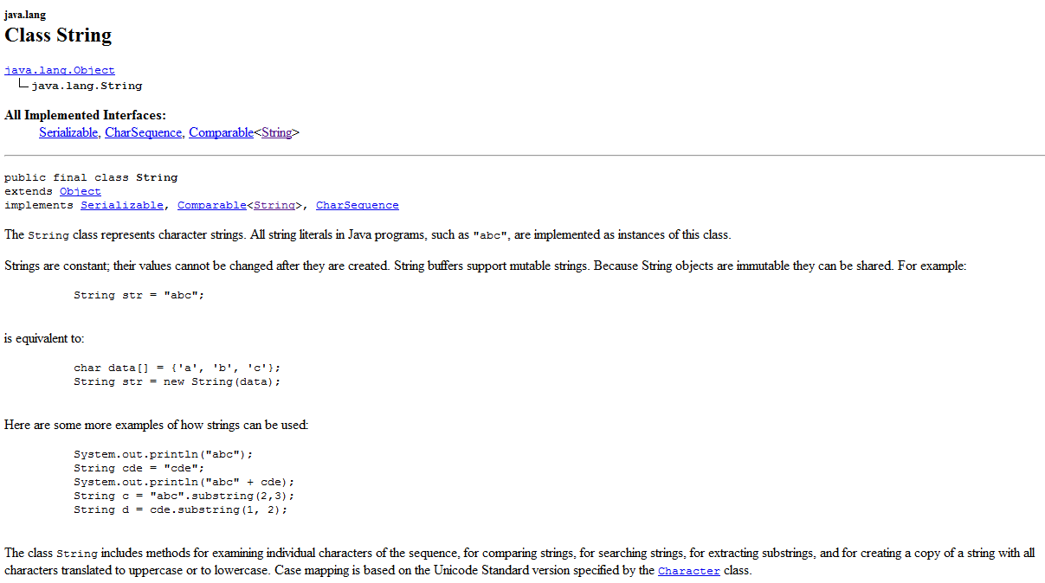
But much better is Java’s built in String class
If you peruse the Java Doc’s for String, you will see many useful functions…

Slide 16
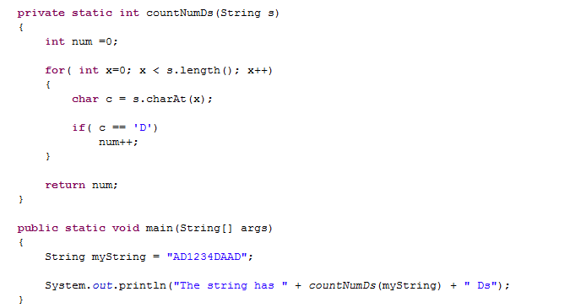

It is easy to iterate through the characters in a String

Slide 17
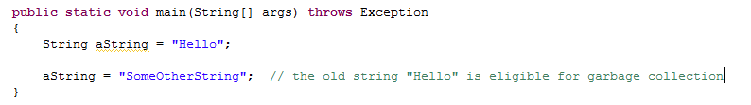
Java strings are immutable…
Once you have a reference to a String, the reference can change, but the
String object cannot be changed

Slide 18
Java strings are immutable…
Once you have a reference to a String, the reference can change, but the
String object cannot be changed
Hello
aString
“aString” is a reference to memory that holds “Hello”

Slide 19
Java strings are immutable…
Once you have a reference to a String, the reference can change, but the
String object cannot be changed
Hello
SomeOtherString
aString
“aString” is a reference to memory that holds “SomeOtherString”

Slide 20
Java strings are immutable…
Once you have a reference to a String, the reference can change, but the
String object cannot be changed
Hello
SomeOtherString
aString
“aString” is a reference to memory that holds “SomeOtherString”
“Hello” gets is no longer referenced and is marked for garbage collection

Slide 21
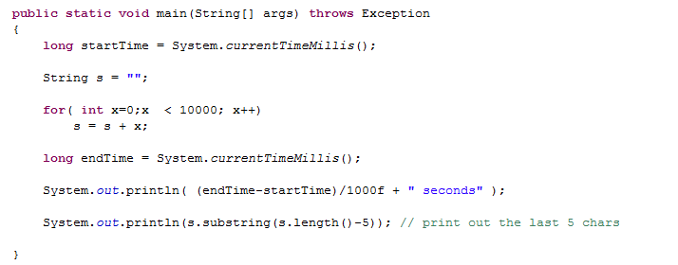

The immutability of strings has profound consequences for performance
In this case, each time we append a number to our string, a new
String is created in memory (and the old ones get marked for garbage collection).

Slide 22
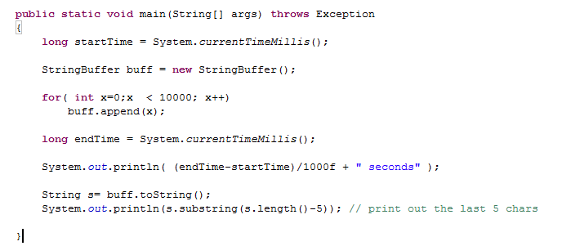

An alternative is here 20 times faster….
We use StringBuffer instead of String..
StringBuffer is a mutable version of String

Slide 23
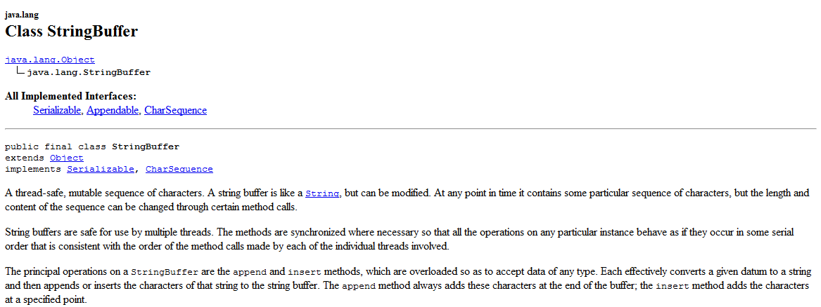
The JavaDocs for StringBuffer tells us that StringBuffer is a mutable string

Slide 24
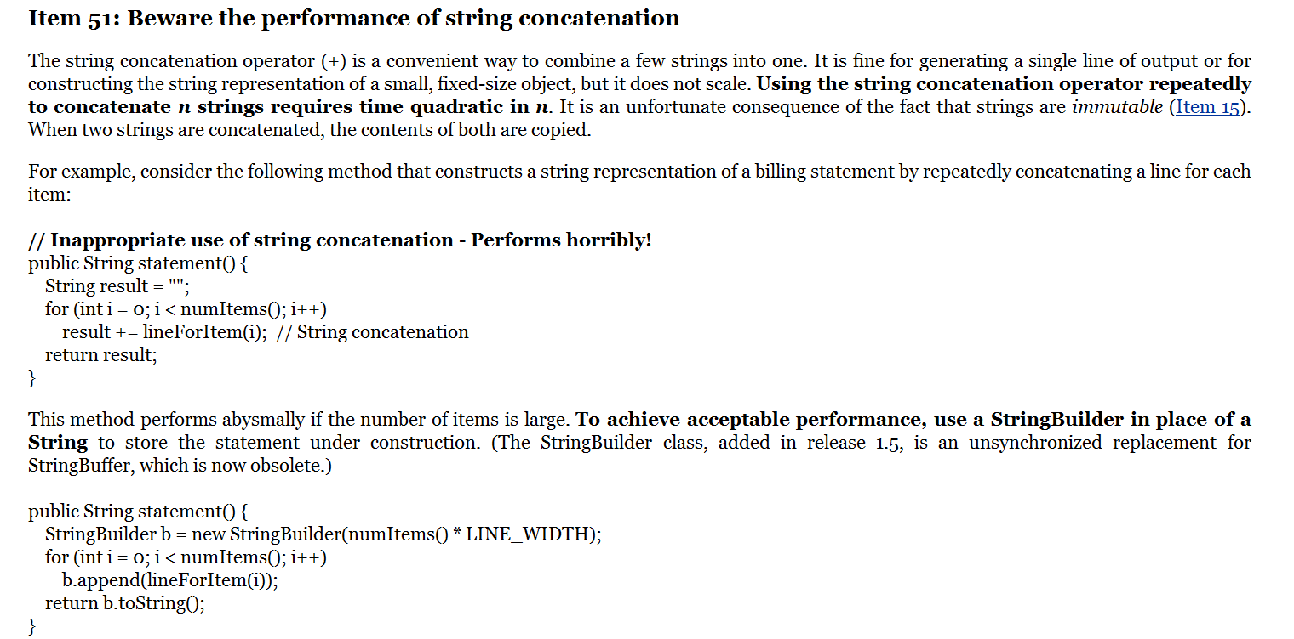
Notice Bloch prefers StringBuilder (as of Java 1.5) to StringBuffer
Performance of concatenation is a huge problem in languages like R where
there are many immutable data structures

Slide 25
static methods and variables
String, StringBuffer and string concatenation performance
BufferedReader, FileReader and File
How much slower is Java than C/Optimize last
From Arrays to Lists

Slide 26
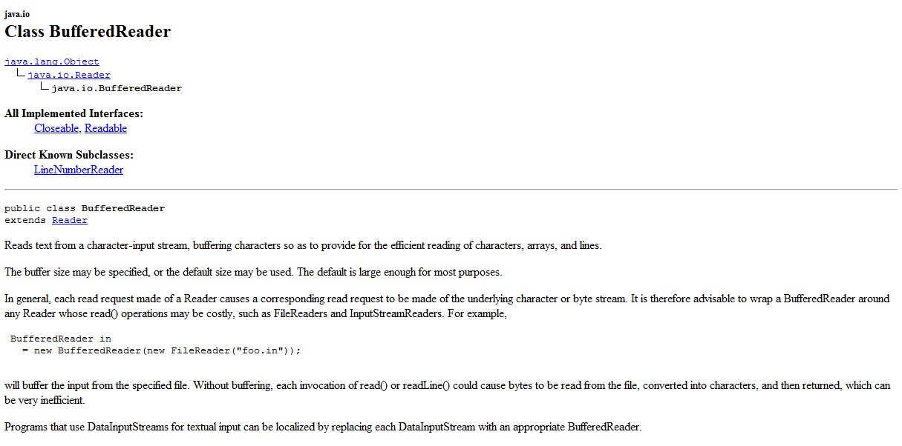
An upcoming lab will be the dreaded FastaSequence parser…
We need to manipulate text files..
Java provides many reader and writer classes to help us…

Slide 27
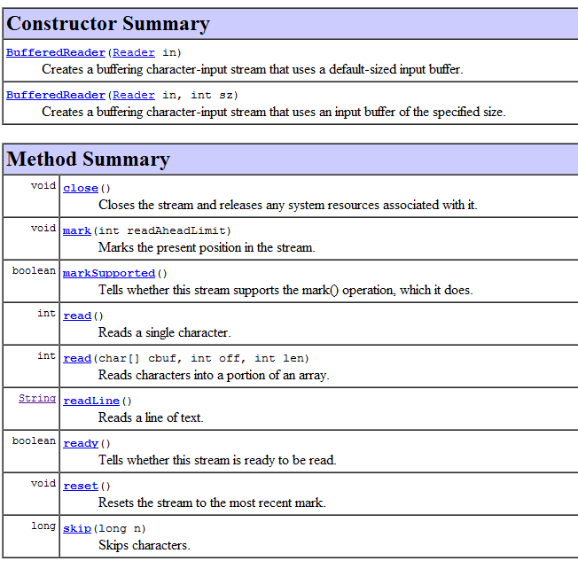
The methods for BufferedReader…
BufferedReader is constructed from a FileReader which is constructed from a File

Slide 28
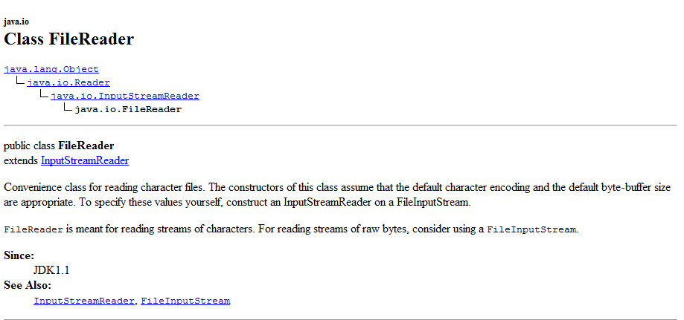

Slide 29
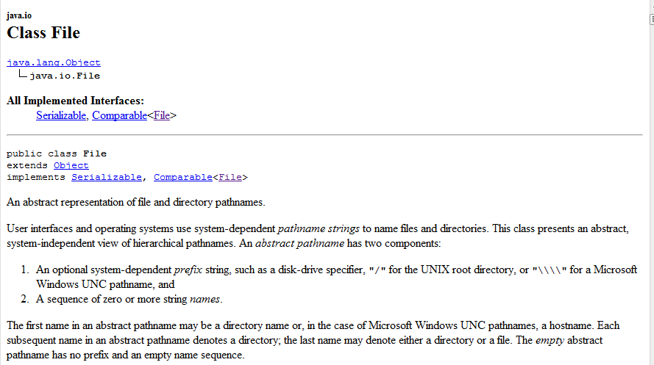

Slide 30
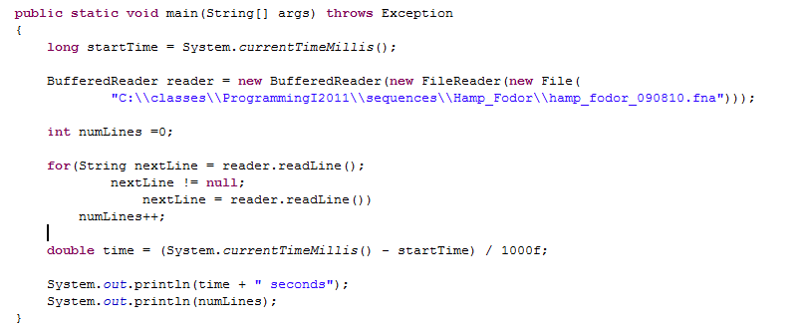
Forgot to close the reader! reader.close() here is good form
We make a new File with a String argument and use that as an argument to the
FileReader constructor which is used as an argument to the BufferedReader constructor
readLine() is a method in the BufferedReader that returns a String that represents the nextLine
(or null if the end of the file has been reached)..

Slide 31
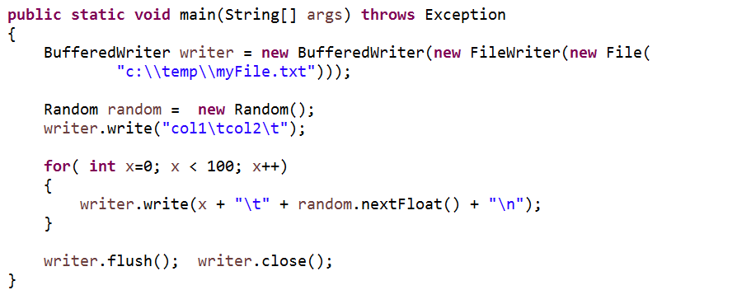
Likewise, to write a file, we have BufferedWriter, FileWriter and File
This example outputs 100 random numbers.
Note the double back slashes for windows
Note that it is your responsibility to call flush or the data file may not
be completely output (this is a common bug)

Slide 32
static methods and variables
String, StringBuffer and string concatenation performance
BufferedReader, FileReader and File
How much slower is Java than C/Optimize last
From Arrays to Lists

Slide 33
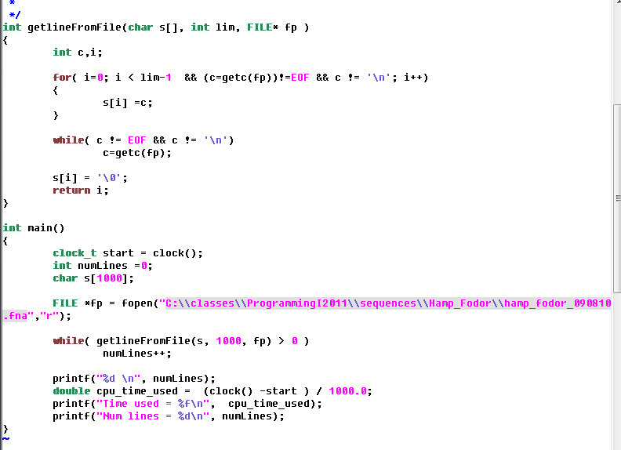

So how much slower is Java than C…
Here is a C version of code counts the number of lines in a text file.
Note that we don’t have to make~1.2 million strings here because the string is mutable
More portable to use
((float)CLOCKS_PER_SEC)
instead of 1000.0 here
This takes ~11 to 12 seconds…

Slide 34

In Java, we will use our new Reader class but it will have to create ~1.2 million String objects…
Java is ~20 times faster than C.
This is because the JVM is heavily optimized for windows and the
Cygwin environment (where gcc lives) is very slow on Windows…

Slide 35
On Linux (where gcc is native)
C code ~0.8 seconds
Java code ~0.4 seconds.
It is hard to predict ahead of time what will be faster…

Slide 36
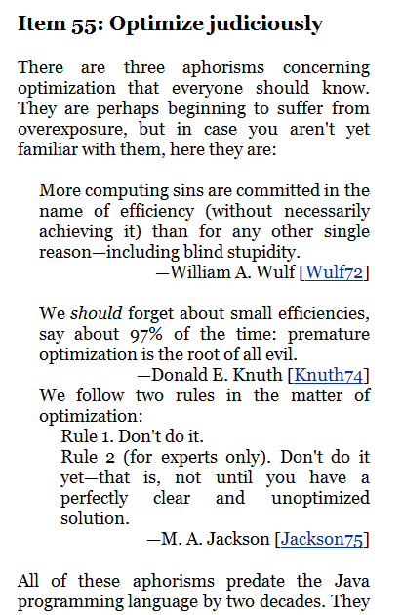
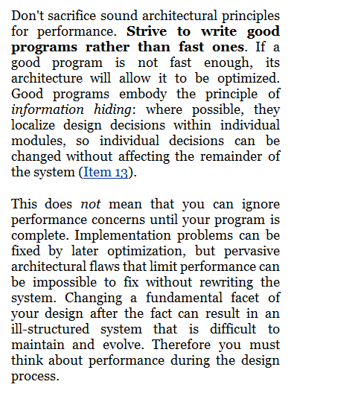
Bloch – “Optimize last”

Slide 37
static methods and variables
String, StringBuffer and string concatenation performance
BufferedReader, FileReader and File
How much slower is Java than C/Optimize last
From Arrays to Lists

Slide 38
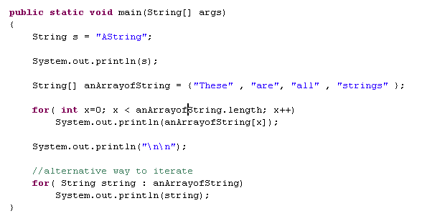
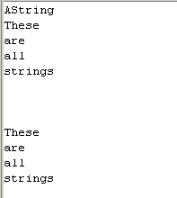
In C, pointers and arrays are hopelessly entangled with each other.
char** is a pointer to a char * pointer (or a String).
As we know, this is pretty confusing.
In Java, Strings and arrays are (thankfully) separate

Slide 39
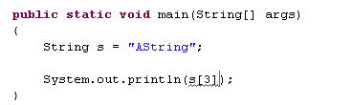

Strings and arrays are not interchangeable

Slide 40
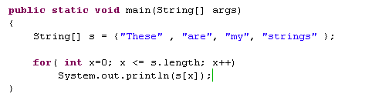
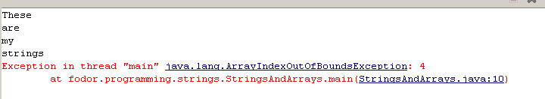
Java gives us stack tracks (easy to fix) rather than the dreaded “segmentation fault”.
Also, note that Java is managing the length of the Array.
You can call s.length to get the length (as opposed to C where the length of the array is not associated with the array data structure)
Because Java knows the length of the array, it does bound checking to see if your call is
within that length. (As opposed to C that gives you direct access to the memory)

Slide 41
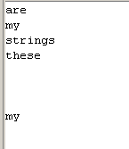
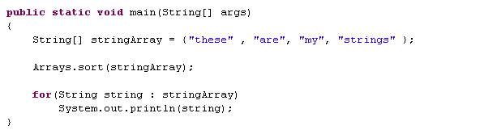
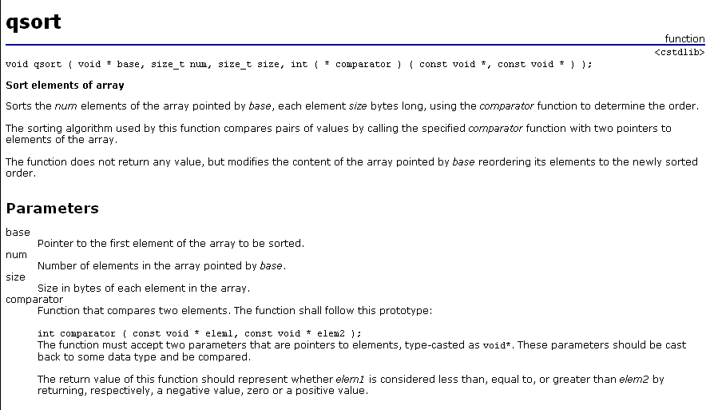
Because Java knows the length of the array and the kinds of objects in
the array, the sort interface is much cleaner…
Much easier than the C sort…

Slide 42
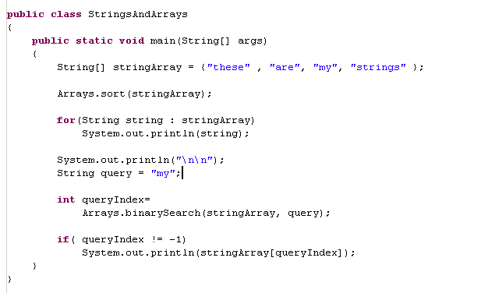
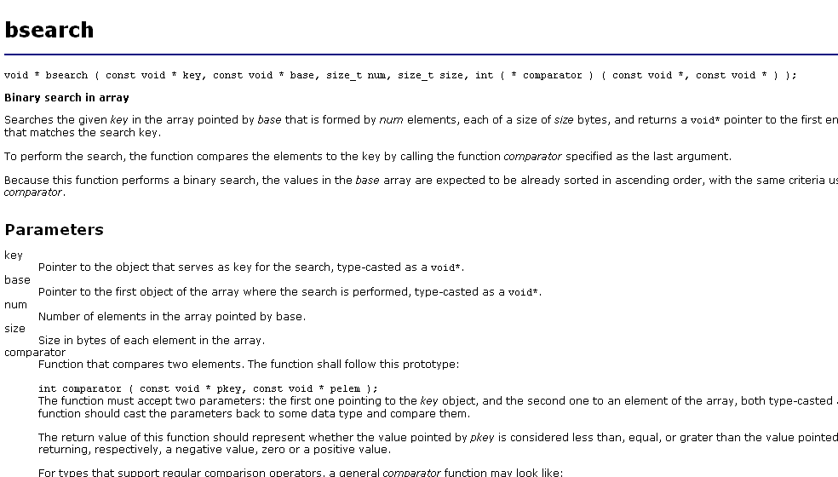
Likewise, binary search is much easier to implement
Again, much easier than C’s
bsearch(….)

Slide 43
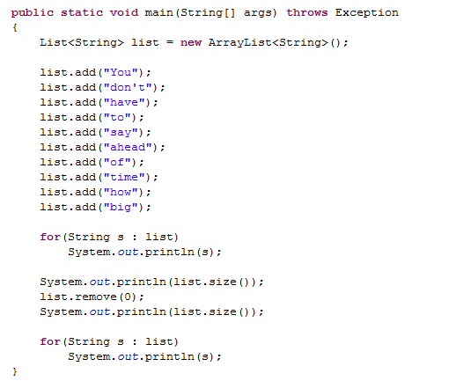

Arrays are a fixed size.
Java also provides a List interface that will finally allow us to dynamically grow a data structure
(no more having to specify ahead of time how much memory to reserve)

Slide 44
List is an interface; a set of function names
ArrayList is an implementation of that interface.
Much more on this later.

Slide 45
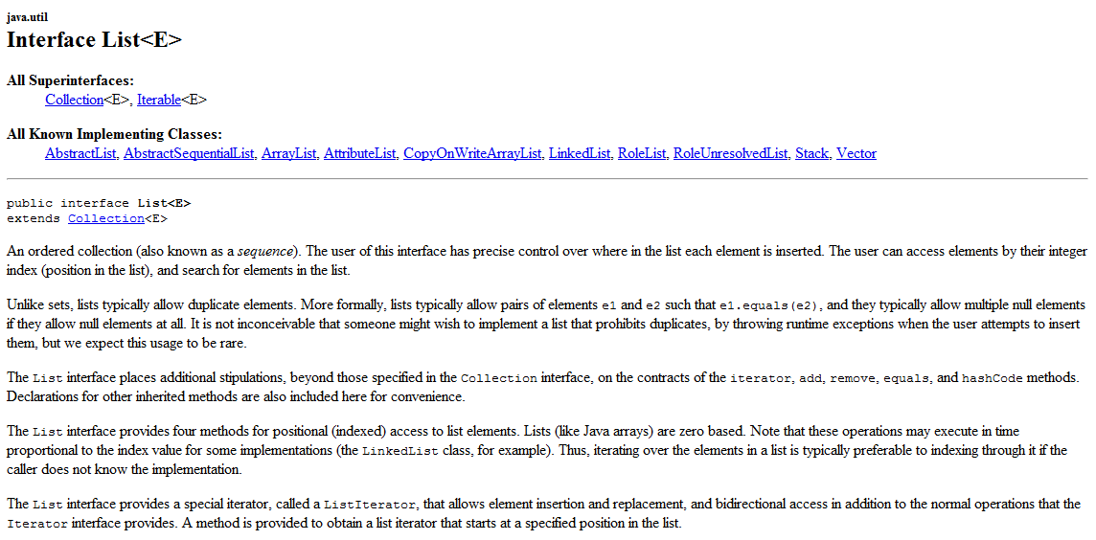
The javadoc for the List interface

Slide 46
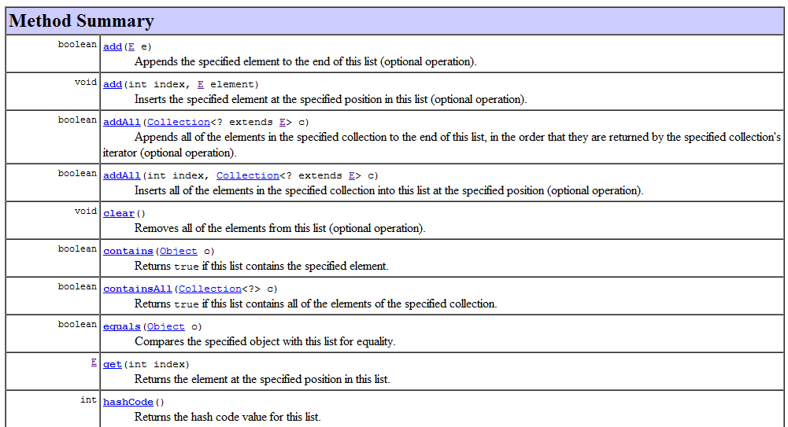
(Some of) the methods you can call on a List…

Slide 47
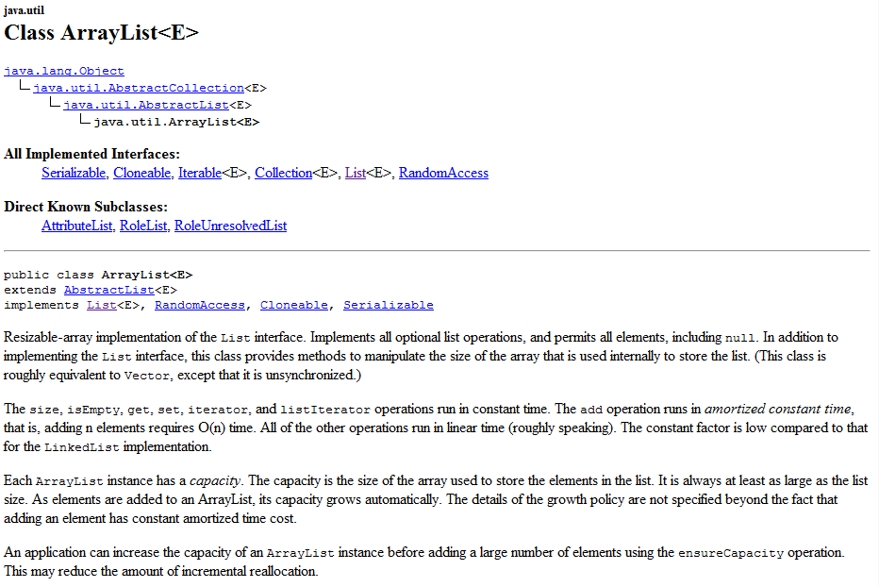
An ArrayList is an implementation of the List interface
The E is the type of Java object that is held in the List (much more on this later)

Slide 48
Coming up:
Inheritance, interfaces and abstract classes…

