Slide 1
One more PCA Example
Fitting linear models by Maximum Likelihood
The independence assumption expressed via the variance-covariance matrix
Relaxing the independence assumption for hierarchical, grouped data
Mixed linear models

Slide 2
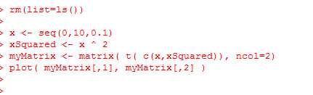
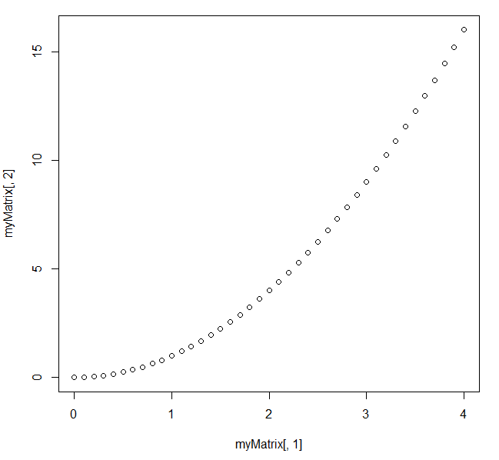
Consider the relationship between x and x ^ 2
https://github.com/afodor/metagenomicsTools/blob/master/src/machineLearningExamples/pcaRotation.txt

Slide 3
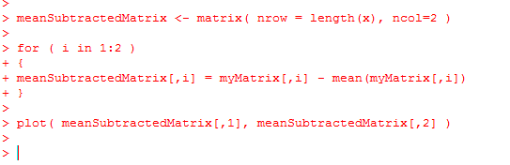
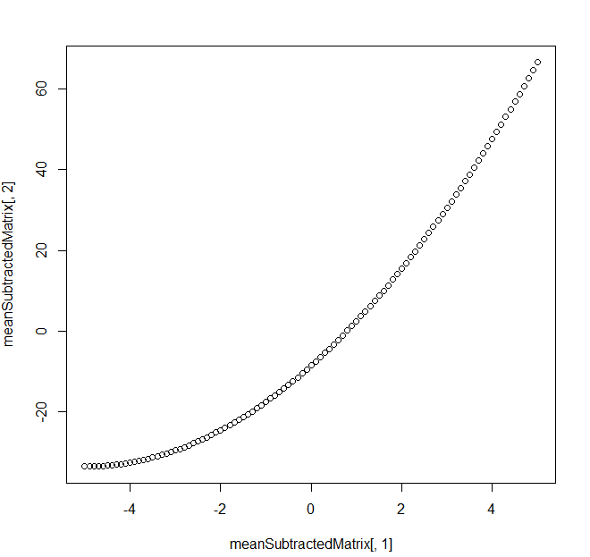
Mean subtracting doesn’t much change the basic shape…
https://github.com/afodor/metagenomicsTools/blob/master/src/machineLearningExamples/pcaRotation.txt

Slide 4
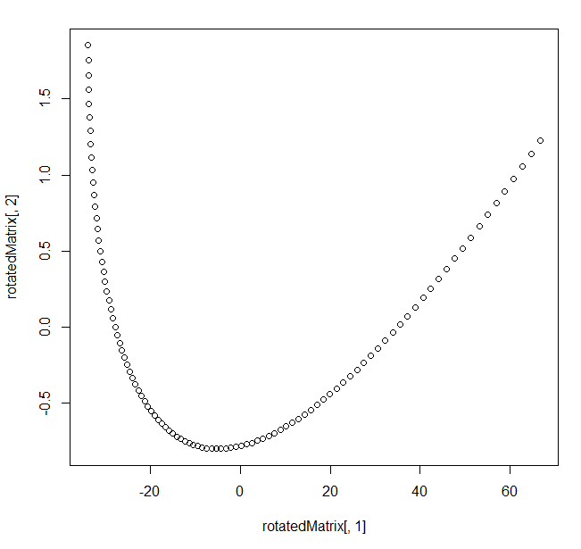
We can perform the PCA via Eigen value rotation
[200, 2] * [2,2] = [200,2]
https://github.com/afodor/metagenomicsTools/blob/master/src/machineLearningExamples/pcaRotation.txt

Slide 5
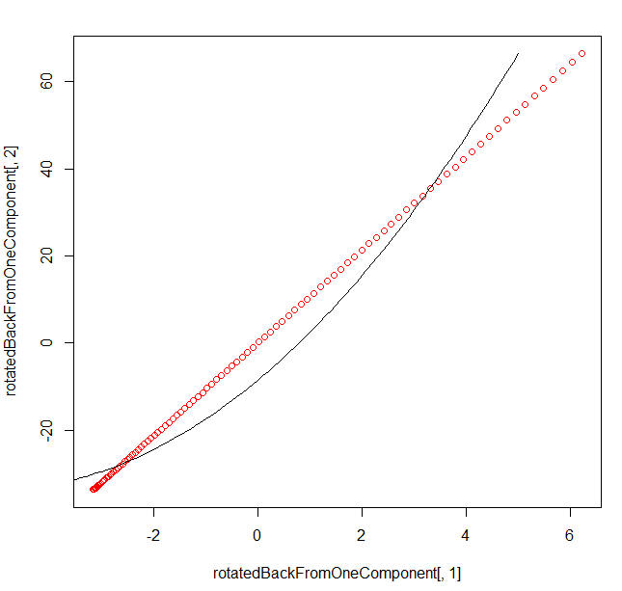
Here, we rotate it back but only use the first PCA component
[200 * 1]
[ 1 * 2 ]
= [200 * 2]
In one linear component,
we can only hold linear
Information…
https://github.com/afodor/metagenomicsTools/blob/master/src/machineLearningExamples/pcaRotation.txt

Slide 6
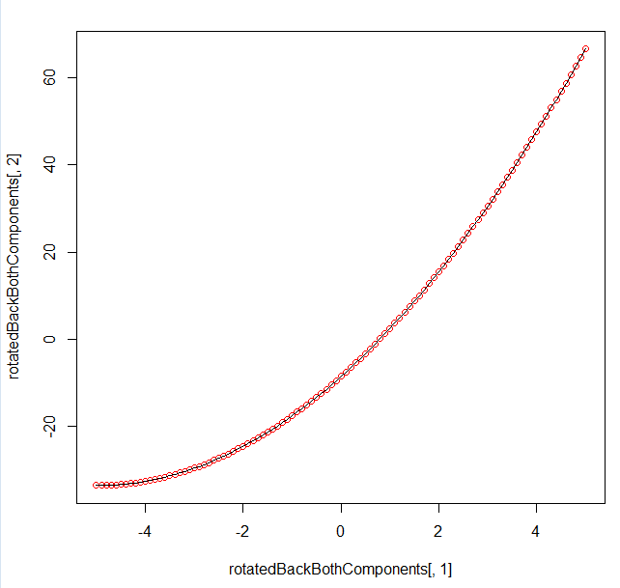
Of course, if we use both components, we can get the original data back…
[200 * 2] * [2,2] = [200 * 2]
https://github.com/afodor/metagenomicsTools/blob/master/src/machineLearningExamples/pcaRotation.txt

Slide 7
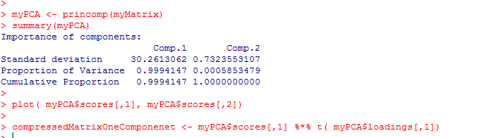
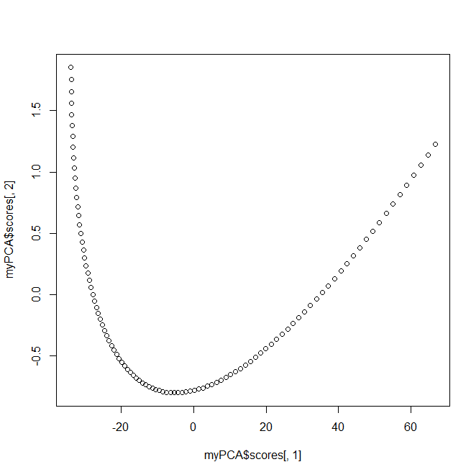
With alternative syntax (but identical results…)
https://github.com/afodor/metagenomicsTools/blob/master/src/machineLearningExamples/pcaRotation.txt

Slide 8
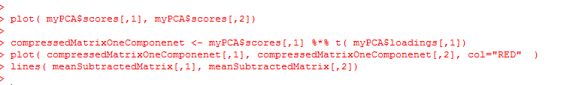
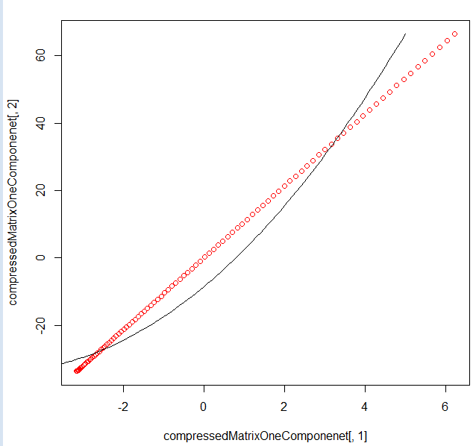
With alternative syntax (but identical results…)
https://github.com/afodor/metagenomicsTools/blob/master/src/machineLearningExamples/pcaRotation.txt

Slide 9
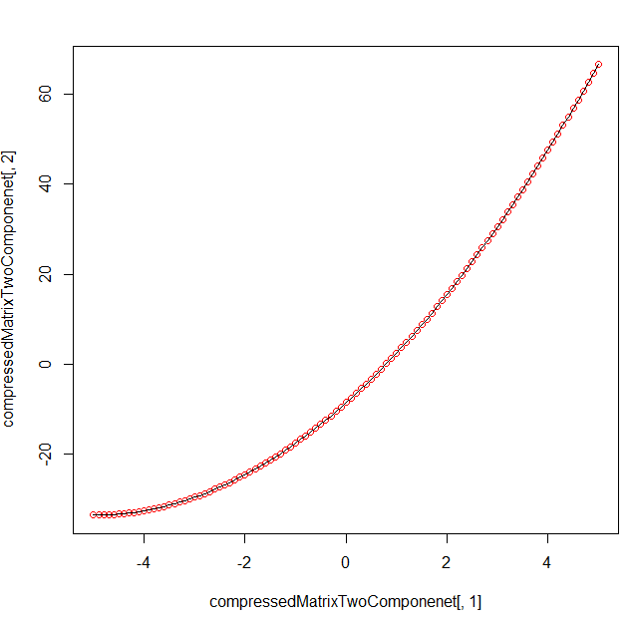
With alternative syntax (but identical results…)
https://github.com/afodor/metagenomicsTools/blob/master/src/machineLearningExamples/pcaRotation.txt

Slide 10
One more PCA Example
Fitting linear models by Maximum Likelihood
The independence assumption expressed via the variance-covariance matrix
Relaxing the independence assumption for hierarchical, grouped data
Mixed linear models

Slide 11
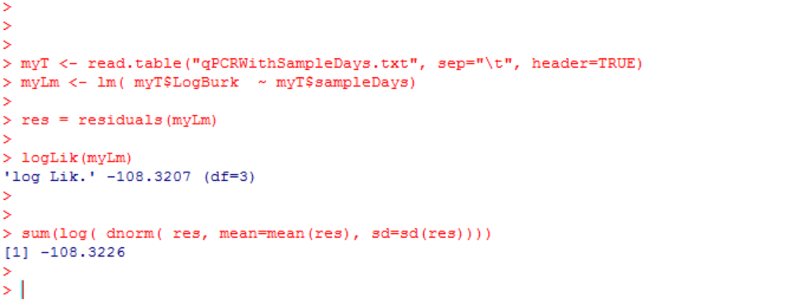
Previously, we defined the log-likelihood for a standard linear regression
We can, as an alternative to least squares fit, find parameters that maximize this value

Slide 12
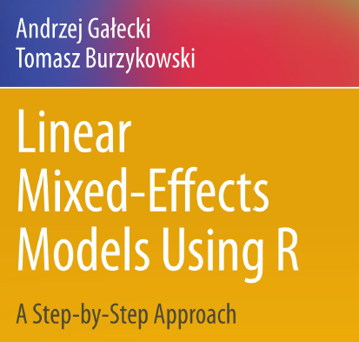
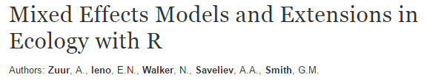

Here we follow two books (both can be downloaded from campus via springer links):
http://link.springer.com/
This book is more mathematical and very thorough;
a good reference
This book is more accessible and covers a broader
range of topics (beyond mixed-models)

Slide 13
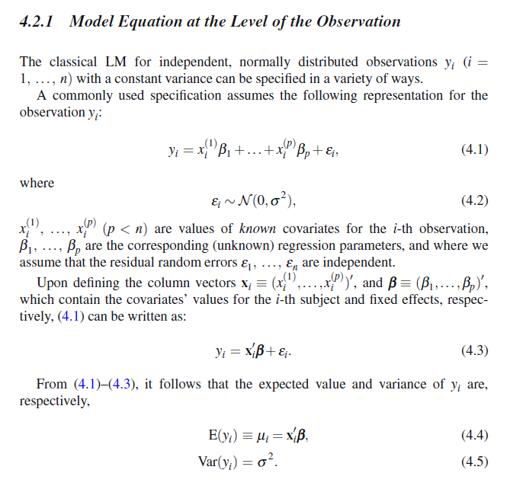
From Galecki a summary of our linear regression model:

Slide 14
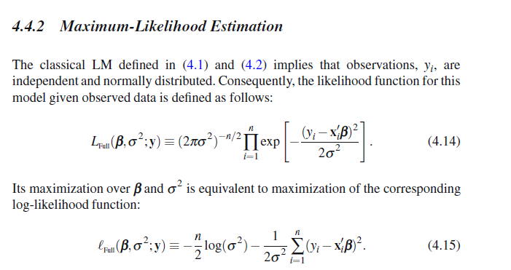
Maximum likelihood is an alternative to least squares for finding parameters

Slide 15

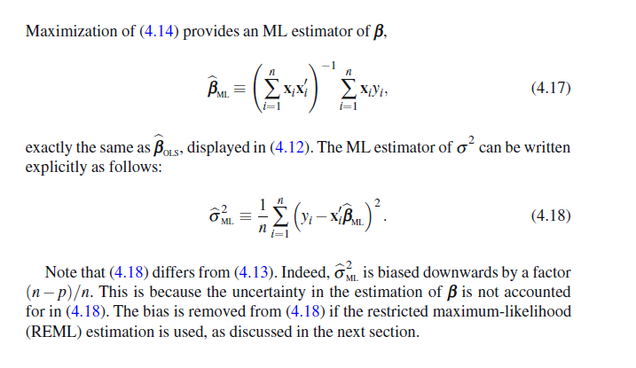
For simple linear models, the two methods largely converge
Least-squares
matrix form
The variance estimate is the same except the d.f. is n not (n-2)
The REML corrects the d.f. (we will skip the mathematical details but see
Chapter 4 in Galecki or Chapter 5 in Zuur)

Slide 16
One more PCA Example
Fitting linear models by Maximum Likelihood
The independence assumption expressed via the variance-covariance matrix
Relaxing the independence assumption for hierarchical, grouped data
Mixed linear models

Slide 17
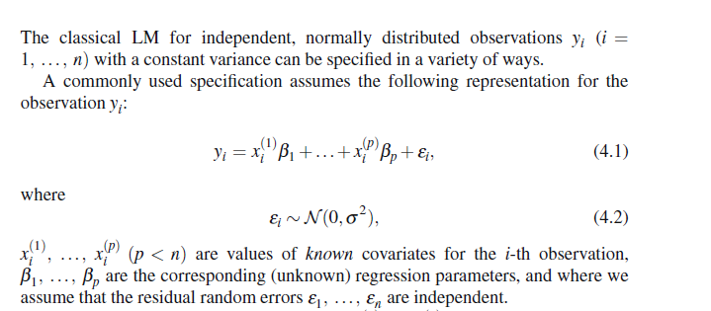
Our standard linear model has assumptions of independence and equal variance
We can express this assumption of independence as a
variance-covariance matrix…

Slide 18
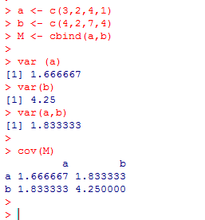
Consider a simple matrix
a <- c(3,2,4,1)
b <- c(4,2,7,4)
M <- cbind(a,b)
var (a)
var(b)
var(a,b)
cov(M)
The diagonals has the variance for each sample.
The off diagonals has the covariance

Slide 19
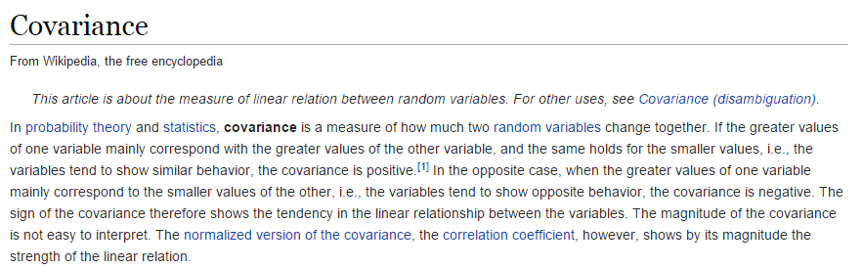
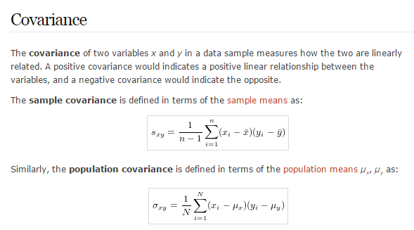
http://en.wikipedia.org/wiki/Covariance
http://www.r-tutor.com/elementary-statistics/numerical-measures/covariance

Slide 20
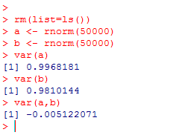
If two variables are independent the covariance approaches zero..

Slide 21
We can express the assumption of independence of the residuals as an N * N
variance-covariance matrix with diagonal values of σ and off- diagonal values of 0 where
N is the sample size
σ² | 0 | 0 | 0 | 0
0 | σ² | 0 | 0 | 0
0 | 0 | σ² | 0 | 0
0 | 0 | 0 | σ² | 0
0 | 0 | 0 | 0 | σ²
If we were to sample at each x location
an infinite # of times, we would see a
SD of σ. (from the assumption of constant
variance across all x positions)
If we were to sample at 2 different x
locations an infinite number of times,
we would see a co-variance of
Zero (from the assumption of independence)

Slide 22
One more PCA Example
Fitting linear models by Maximum Likelihood
The independence assumption expressed via the variance-covariance matrix
Relaxing the independence assumption for hierarchical, grouped data
Mixed linear models

Slide 23
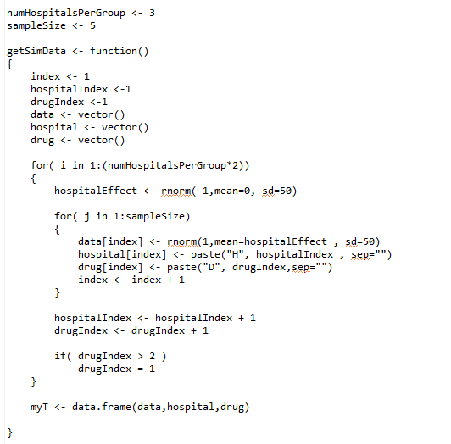
Our first example of thing that can go horribly wrong in linear models,
we here examine nested confounders…
Consider hospitals in a clinical trial
Each hospital is assigned a drug 1 or a drug 2
We make a simulation where the null hypothesis with regards to drug is always true…
Each hospital has its own effect
The data are not dependent on the drug
https://github.com/afodor/metagenomicsTools/blob/master/src/mixedModelSims/mixedSims.txt

Slide 24
myT <- getSimData()
plot( myT$data ~ myT$hospital)
plot( myT$data ~ myT$drug)
Drug 1
Drug 2
Drug 1
Drug 2
Drug 1
Drug 2
Drug 1
Drug 2
It looks like there is a difference between Drug 1 and Drug 2, but this is
because there are differences between hospitals (and only 6 hospitals in our simulation)

Slide 25
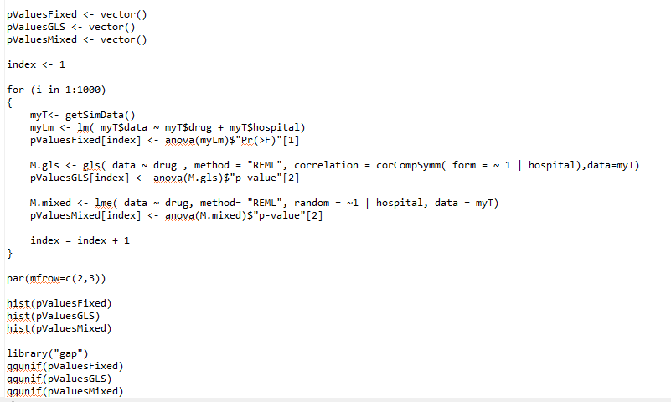
Because drug and hospital co-vary (there is a combination of hospitals that has the
same information as drug) a standard linear model is numerically unstable and the
results are unreliable…
Our “standard” linear model, but drug and hospital
are not linearly independent
https://github.com/afodor/metagenomicsTools/blob/master/src/mixedModelSims/mixedSims.txt

Slide 26
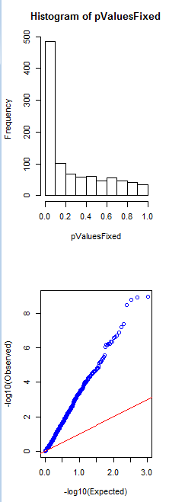
Our linear model reports significant results
for drug!!
Even thought the null hypothesis is always
true!
Complete disaster!
We need a better way to tell our linear model
the lack of independence between our samples!

Slide 27
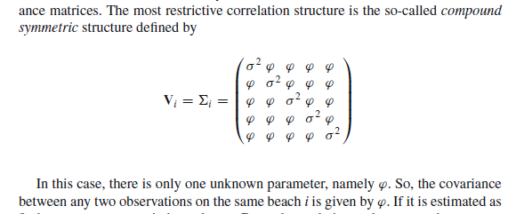
Here we follow Chapter 5 (section 5.5) in Zuur…
We want our variance-covariance matrix (within each hospital) to look like this…
Consider data within two hospitals X and Y
X X X X X
Data
Error
Y Y Y Y Y
Error
Model estimate for a drug
The covariance between different datapoints within a hospital is not 0;
If you know the error for one datapoint within a hospital, depending on the
size of parameter ψ, you know something about the other measurements as well..

Slide 28
So we add a parameter to our model to allow the error within each hospital
to be correlated (errors across hospitals is still zero…)
So our variance-covariance matrix for each hospital goes from something that looks like this….
σ² | 0 | 0 | 0 | 0
0 | σ² | 0 | 0 | 0
0 | 0 | σ² | 0 | 0
0 | 0 | 0 | σ² | 0
0 | 0 | 0 | 0 | σ²
To something that looks like this….
(the full covariance-variance matrix across all hospitals will have 0’s for any two samples
from different hospitals)

Slide 29


We state without proof….
When we switch to this new variance-covariance matrix,
the least likelihood equation we want to maximize goes from something like this
(for a standard linear model):
To something like this (for a mixed linear model)
Where V is the full variance-covariance matrix of the residuals for all the data..
This allows us to express the possibility of correlated measures within hospitals
(without actually having to explicitly estimate the mean response from each hospital!)

Slide 30
There is a simple syntax that allows us to tell R that we want a different
Covariance-variance matrix (see chapter 10 of Galecki for much more information
on different covariance-matrices that you can specify!)
We express this in R
using the gls function in the
nlme package
https://github.com/afodor/metagenomicsTools/blob/master/src/mixedModelSims/mixedSims.txt

Slide 31
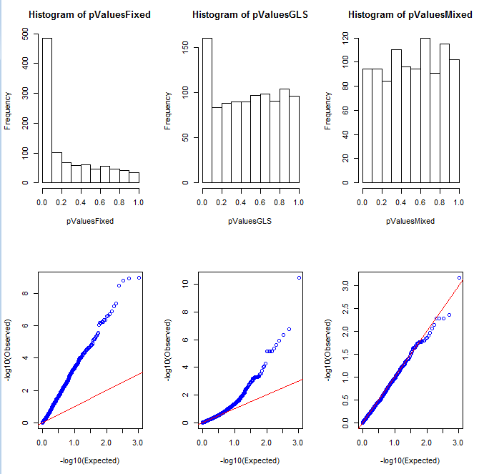
This model gets us a lot closer to the correct null P-values!

Slide 32
Fitting linear models by Maximum Likelihood
The independence assumption expressed via the variance-covariance matrix
Relaxing the independence assumption for hierarchical, grouped data
Mixed linear models

Slide 33
An alternative (surprisingly, equivalent!) formulation of our nested experimental design.
Y = drug + (hospital) + error
Fixed Effects
Random Effects
Assumptions
Random effects are i.i.d.
Variance in groups are equal (homoscedasticity)
Hospital effects are normally distributed with a mean of 0
In effect, each hospital adds some value to the fixed effects and this
value is normally distributed with a mean of 0…
The fixed effect part is just a standard linear model (like we’ve seen the last few weeks)

Slide 34
We express this in R
using the lme function in the
nlme package
(see chapter 5 in Zuur and
Chapter 13 in Galecki)
https://github.com/afodor/metagenomicsTools/blob/master/src/mixedModelSims/mixedSims.txt

Slide 35
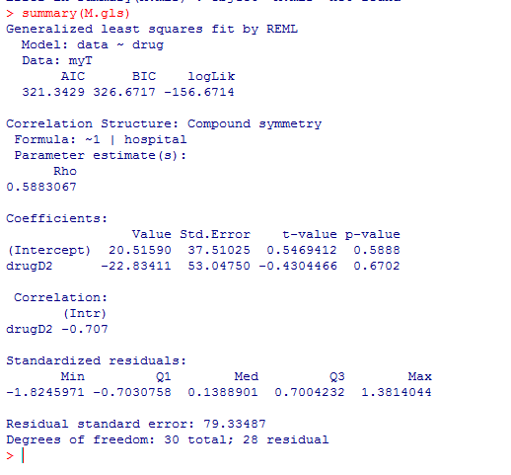
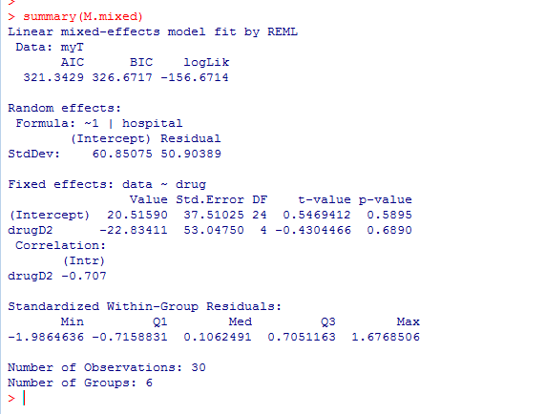
The gls and mixed models are mathematically essentially identical
(see Chapter 5 (section 5.5) in Zuur for more details)
The models have the same likelihoods, F and T values but disagree on the degrees of freedom…
(and hence disagree on the p-values)

Slide 36
The degrees of freedom from the mixed linear model seem to get us closer to a uniform distribution…

Slide 37
X X X X X
Data
Error
Y Y Y Y Y
Error
Model estimate for a drug
Degrees of freedom is tricky;
are there 10 independent datapoints here or 2?

Slide 38
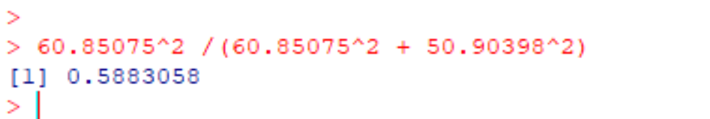
A useful metric (related to the degrees of freedom) is what Zuur calls the
intraclass correlation coefficient (what R is calling rho in the M.gls model)
ψ In our co-variance matrix
σ In our co-variance matrix
ψ²/(ψ² + σ ²)
Rho can be thought of as a Pearson co-efficient describing the strength of
correlations within each group. As it approaches 0, the hospital effect disappears. As it approaches 1, all data within each hospital is more perfectly correlated.

Slide 39
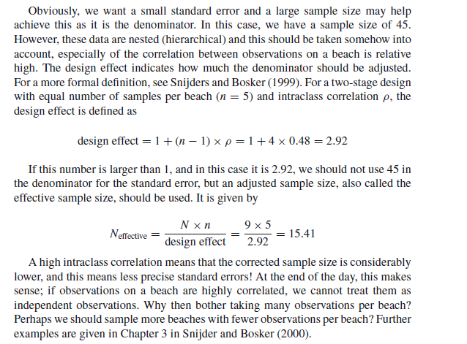
The Zuur text argues that at this values goes towards 1, the effective sample size goes
towards the number of hospitals (not the number of patients…)
(Zuur section 5.4.1)

Slide 40
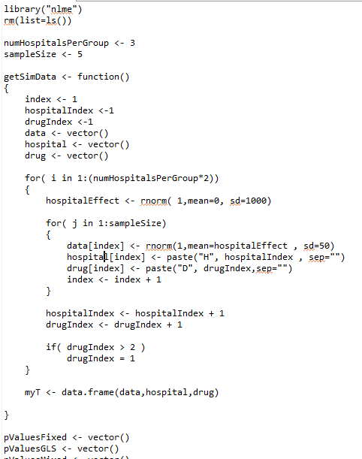
Changing our model parameters obviously changes rho…
We make the hospital effect much bigger than
the variance associated with the drug effect

Slide 41
Now the hospital effect dominates….
plot( myT$data ~ myT$hospital)

Slide 42
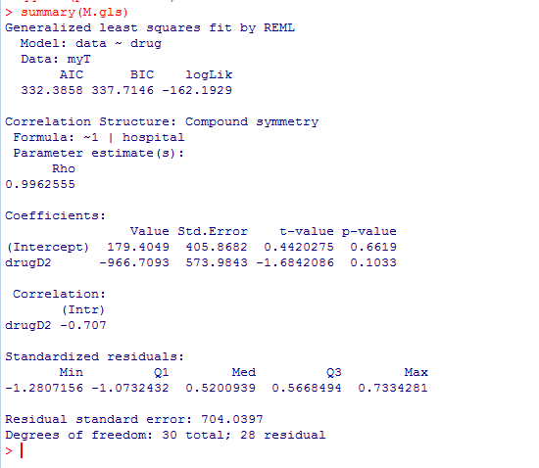
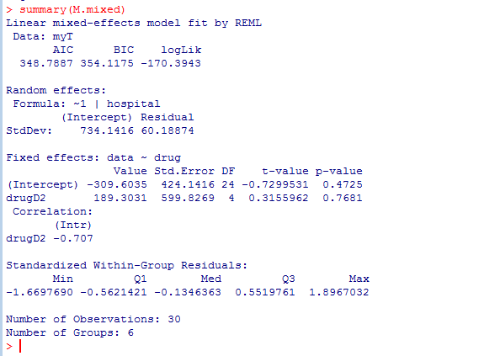
Here rho = 0.996 because the hospital effect dominates…

Slide 43
We see pretty similar inference results… (although our fixed model starts to behave very badly!)

Slide 44
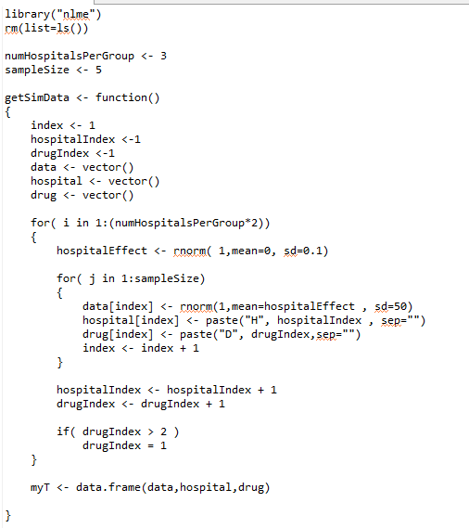
We make the hospital effect small
compared to the drug effect…

Slide 45
plot(myT$data ~ myT$hospital)
Here rho will trend towards zero…

Slide 46
Now our mixed model gets conservative (not necessarily a bad thing, but not uniform anymore)

Slide 47
We conclude:
Mixed models are useful, but a bit fragile.
We should approach their p-values with some caution…

