Slide 1
R commands for t-test, linear regression and one-way ANOVA
False discovery rate (FDR)
See also lectures 10 and 16 (with video lectures from last years class)
https://fodorclasses.github.io/classes/stats2020/stats2020.html

Slide 2
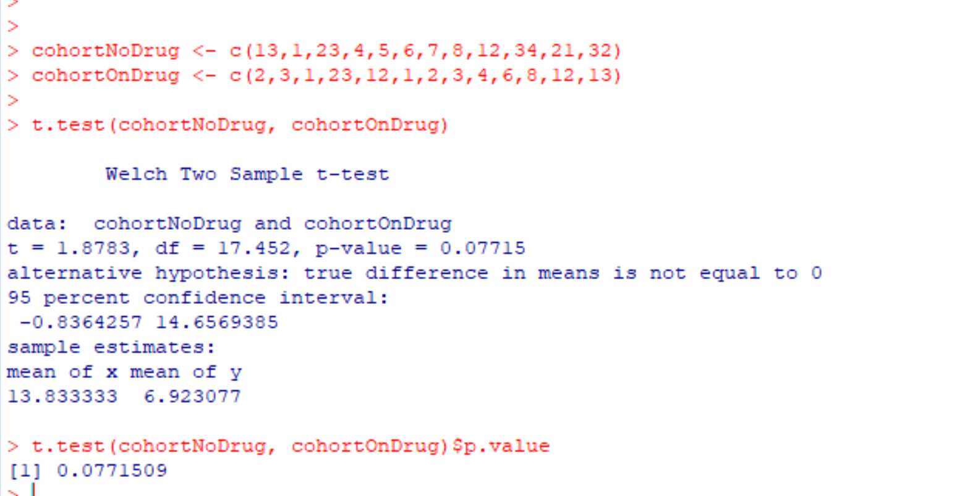
We will go over these “classic” frequentist tests in great detail as the semester progresses ,
but many of you will need them now to start working on your independent projects.
So here we quickly review the syntax of the t-test and basic linear models.
Say you have two sets of patients, one on a drug and one not on a drug.
You want to know if there is a difference between the two patient populations.
The t-tests compares the two populations with a null hypothesis that the mean of the two populations
is the same…

Slide 3
Simple ( “univariate”) linear models can provide inference where
the dependent variable is continuous, and the independent variable is continuous ( linear regression )
or
the dependent variable is continuous, and the independent variable is categorical (one-way ANOVA)

Slide 4
the dependent variable is continuous, and the independent variable is categorical (one-way ANOVA)
Consider a measurements (e.g. weight) for three genotypes
A/A A/a a/a
4.3
2.3
4.5
5.6
4.2
3.9
2.8
2.7
2.3
1.9
1.3
1.2
1.8
2.1
1.6
0.9
1.1
1.2
2.1
0.5
0.9
AA <- c(4.3,2.3,4.5,5.6,4.2,3.9,2.8)
Aa <- c(2.7,2.3,1.9,1.3,1.2,1.8,2.1)
aa <- c(1.6,0.9,1.1,1.2,2.1,0.5,0.9)
myData <- c(AA,Aa,aa)
genotypes <- c( rep("AA",length(AA)), rep("Aa",length(Aa)), rep("aa",length(aa)))
genotypes <- factor(genotypes)
myLm <- lm( myData ~ genotypes, x=TRUE)
anova(myLm)
myLm$x

Slide 5
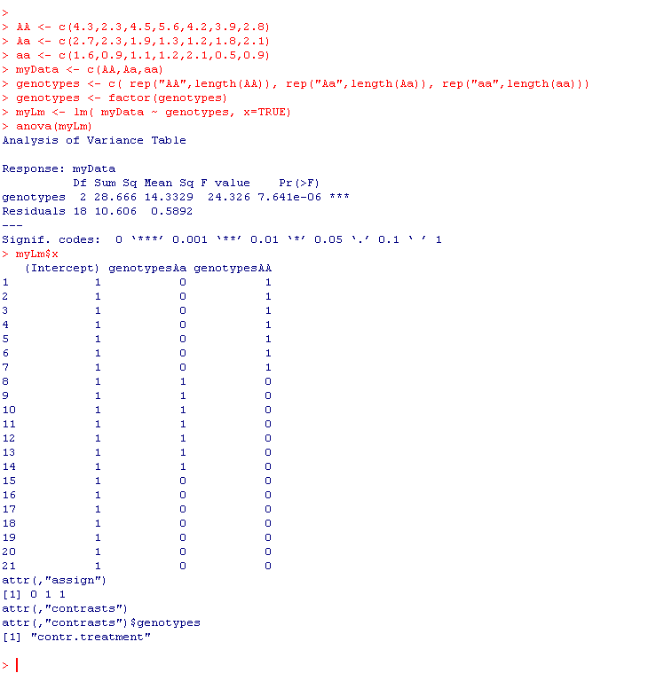


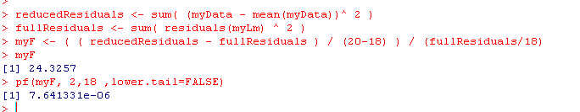
Full model:
weight = intercept + Aa + AA + E
(aa is background)
Residuals for full model is 10.6057
With 18 d.f. (n=21 – 3 parameters)
Reduced model:
weight = mean + E
20 D.F. (n=21 – 1 parameter)

Slide 6
This p-value tests the null hypothesis
that µ_{AA} = µ_{Aa} = µ_{aa}
It doesn’t tell us which of these
individual means are different.
So it evaluates that genotype makes a difference
But doesn’t tell us if, for example, µ_{AA} = µ_{aa}
These are “dummy variables” –

Slide 7
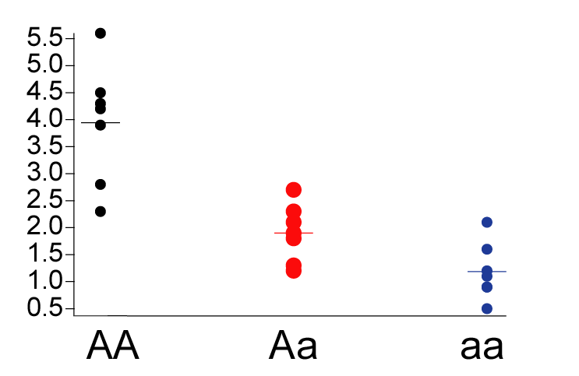
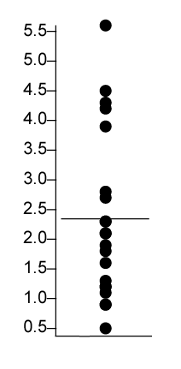
Full model: With three means
weight = intercept + Aa + AA + E
Reduced model: With one means
weight = B0 + e
ANOVA test: do we reduce the error by a significant amount by adding
the additional parameters?

Slide 8
the dependent variable is continuous, and the independent variable is continuous ( linear regression )
Define gene “dose” (does of the “a” allele):
AA = 0
Aa = 1
aa =2
Then this view of the data……
Becomes…

Slide 9
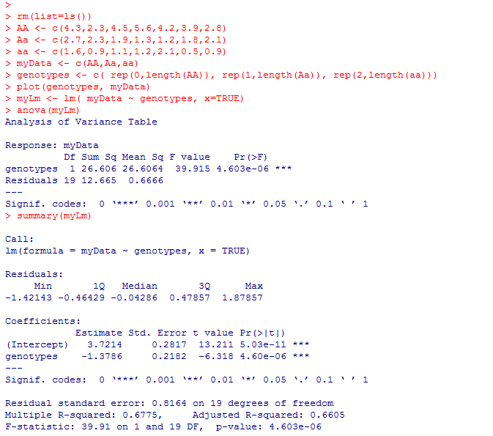
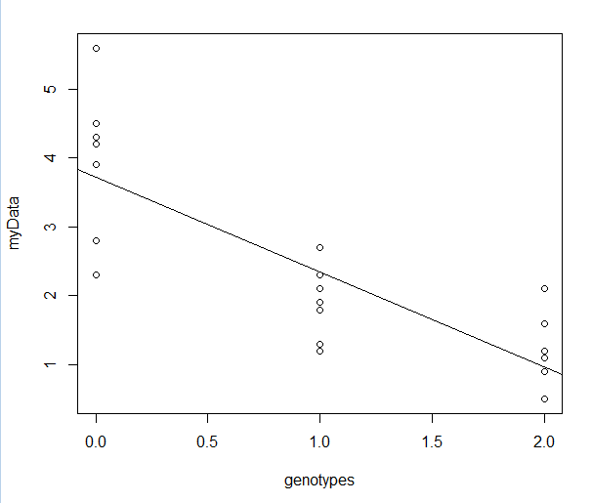

The linear regression view!

Slide 10
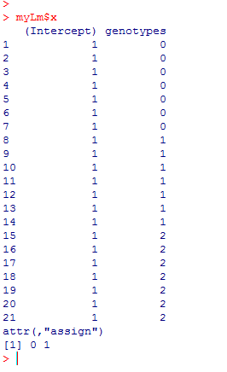

We’ve gained one degree of freedom as now our model has just two parameters
Y = B0 + B1*genotype + error
However, the Matrix form of our equation has not changed:
We can still use the ANOVA to determine the significance of both parameters

Slide 11
R commands for t-test, linear regression and one-way ANOVA
False discovery rate (FDR)
See also lectures 10 and 16 (with video lectures from last years class)
https://fodorclasses.github.io/classes/stats2020/stats2020.html

Slide 12
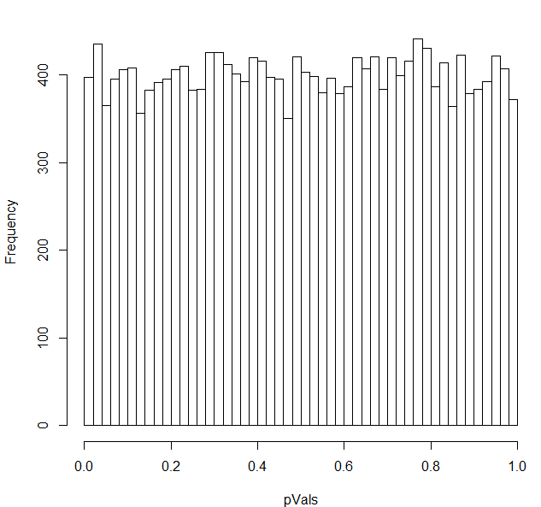

You have 20,000 genes in an rna-seq experiment.
You have two conditions (A) and (B).
You run them through DeSeq (or any other stats package).
If the null hypothesis is always true (no difference between A and B),
the p-values will be uniformly distributed…
We can model this pretty simply:

Slide 13
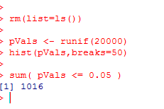
If we use a simple threshold of significance of 0.05, we would
expect about 1,000 genes to be called significant even if the null
hypothesis were always true..
There are 1,016 genes that have p-values <0.05
in this case where the p-values are uniform

Slide 14
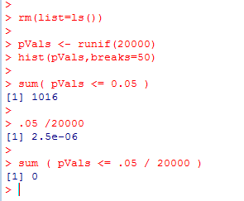

One alternative:
Use as a p-value threshold Bonferroni correction.
The desired threshold / number of tests.
In this case 0.05 / 20000 = 2.5e-06
None of our p-vals reach this threshold..
At this threshold, there is a 5% chance of any false positives

Slide 15
Bonferroni correction is sometimes considered too conservative for genomics experiments.
At small sample sizes, you might have few genes with p-values smaller than the
Bonferroni thresholds.
A less conservative alternative, false discovery rate.
At a 5% false discovery rate, we expect 5% of our hits to be false positives.
This is less conservative than Bonferroni correction, where there is a 5% chance
that any of our hits are false positives.

Slide 16
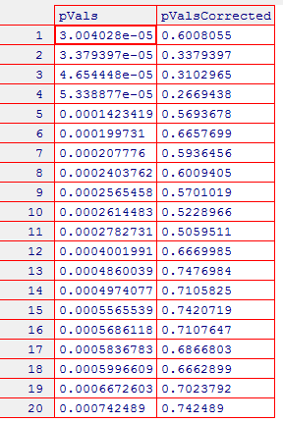
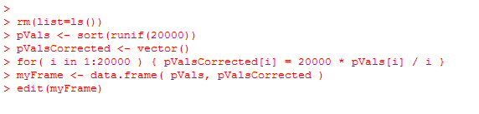
One straight-forward approach to finding genes at a given false-discovery rate
Benjamini and Hochberg FDR
1. Rank all the p-values (smallest first). The rank of each value = K
2. Calculate N * p / k
where N = the # of hypotheses that you are testing
p = the “raw” (uncorrected) p-value.
3. Start at the top of the list. Go down to N * p / k > threshold
(e.g. 0.10 for 10% FDR).
N * p = # of expected false positives at a given p-value
k = # of genes actually observed at that p-value

Slide 17
Note that for the first hit (smallest p-value),
Bonferroni correction is the same as BH FDR.
(Since if k=1,
N * p / K = N * p
which is the same as multiplying the p-value by the number of hypotheses to
do the correction)

Slide 18
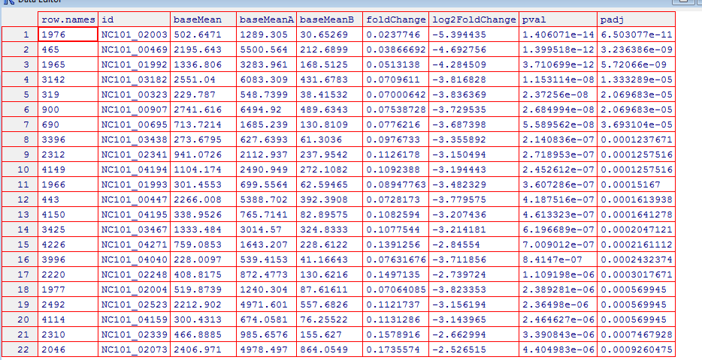
So in DeSeq…
FDR adjusted
p-values..
Raw p-values

