Slide 1
Git and Github

Slide 2
Reading:
You will not be tested on this.
But if you are not using source control, you should be.
If you use git, a few hours with this book is highly recommended so you know what you are doing!
Read up through the “basics” and “branching” chapters in the “Pro Git” book.
https://git-scm.com/book/en/v2

Slide 3
What Problem Does Git Solve?
Multiple versions of files
Accidental overwrites
Collaboration conflicts
No way to go back
Easy way to work in teams

Slide 4
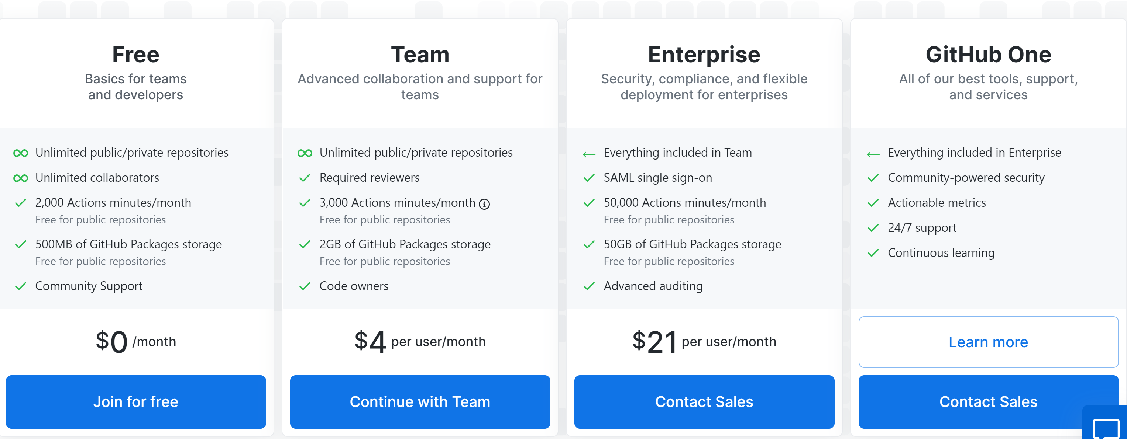
Set up a GitHub account…
https://github.com/join
Presumably most of you will “join for free”.
You can make a private repository (and invite me)
or if you are ok with the world seeing your code, you can make public repositories

Slide 5
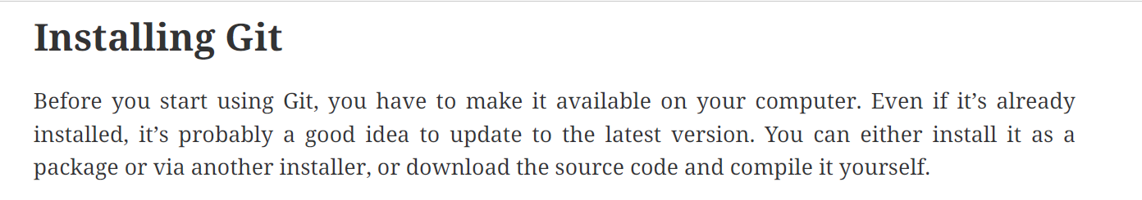
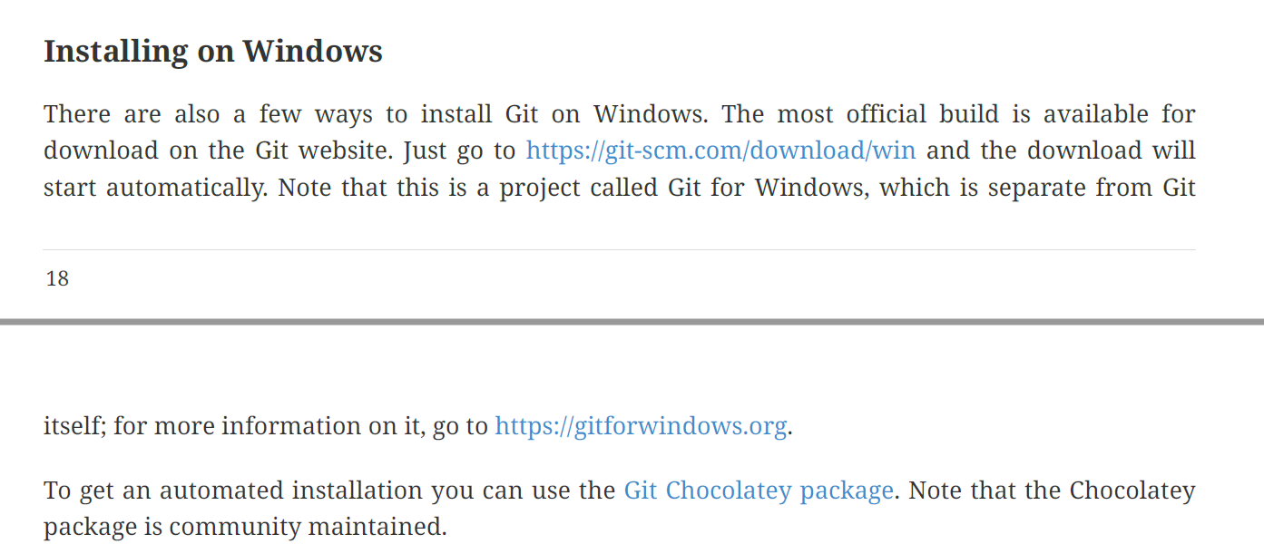
Download GIT for your local OS (Google git and your OS )
(if you are running linux it might already be there; type “git”)
Follow the instructions in the “Pro Git” book (and let me know if you run into problems…)
https://git-scm.com/book/en/v2

Slide 6
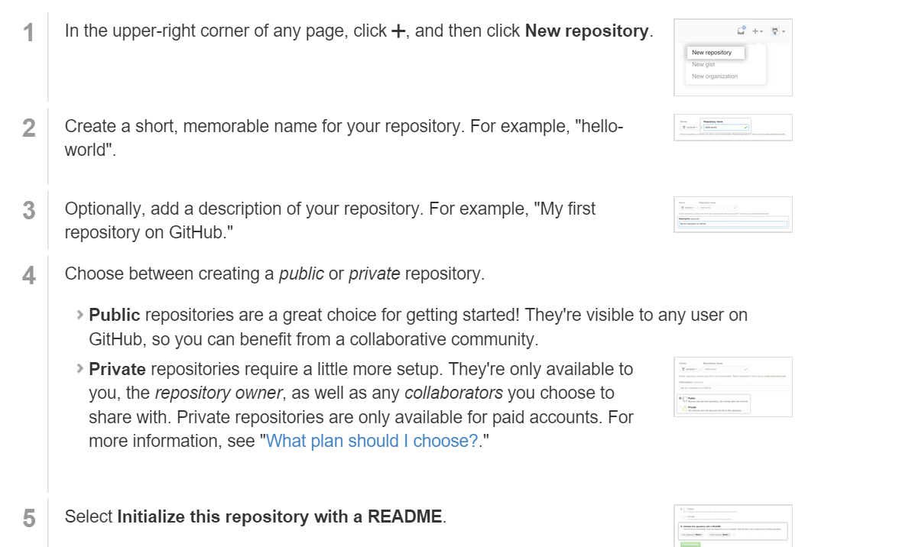
Create a github repository
(

Slide 7
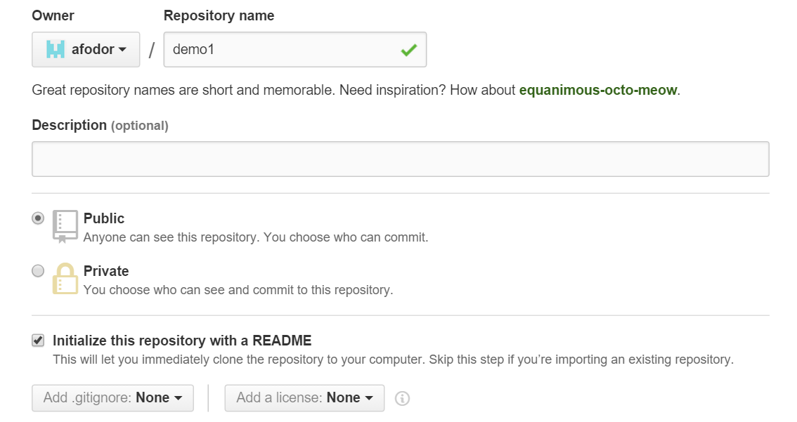
Give your repository a catchy name

Slide 8
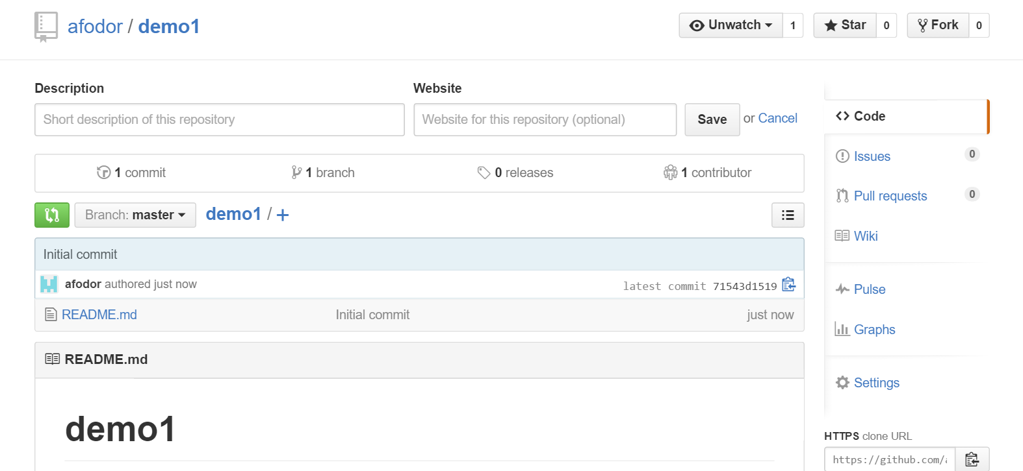
After you create your repository, it will have its own web page at GitHub

Slide 9
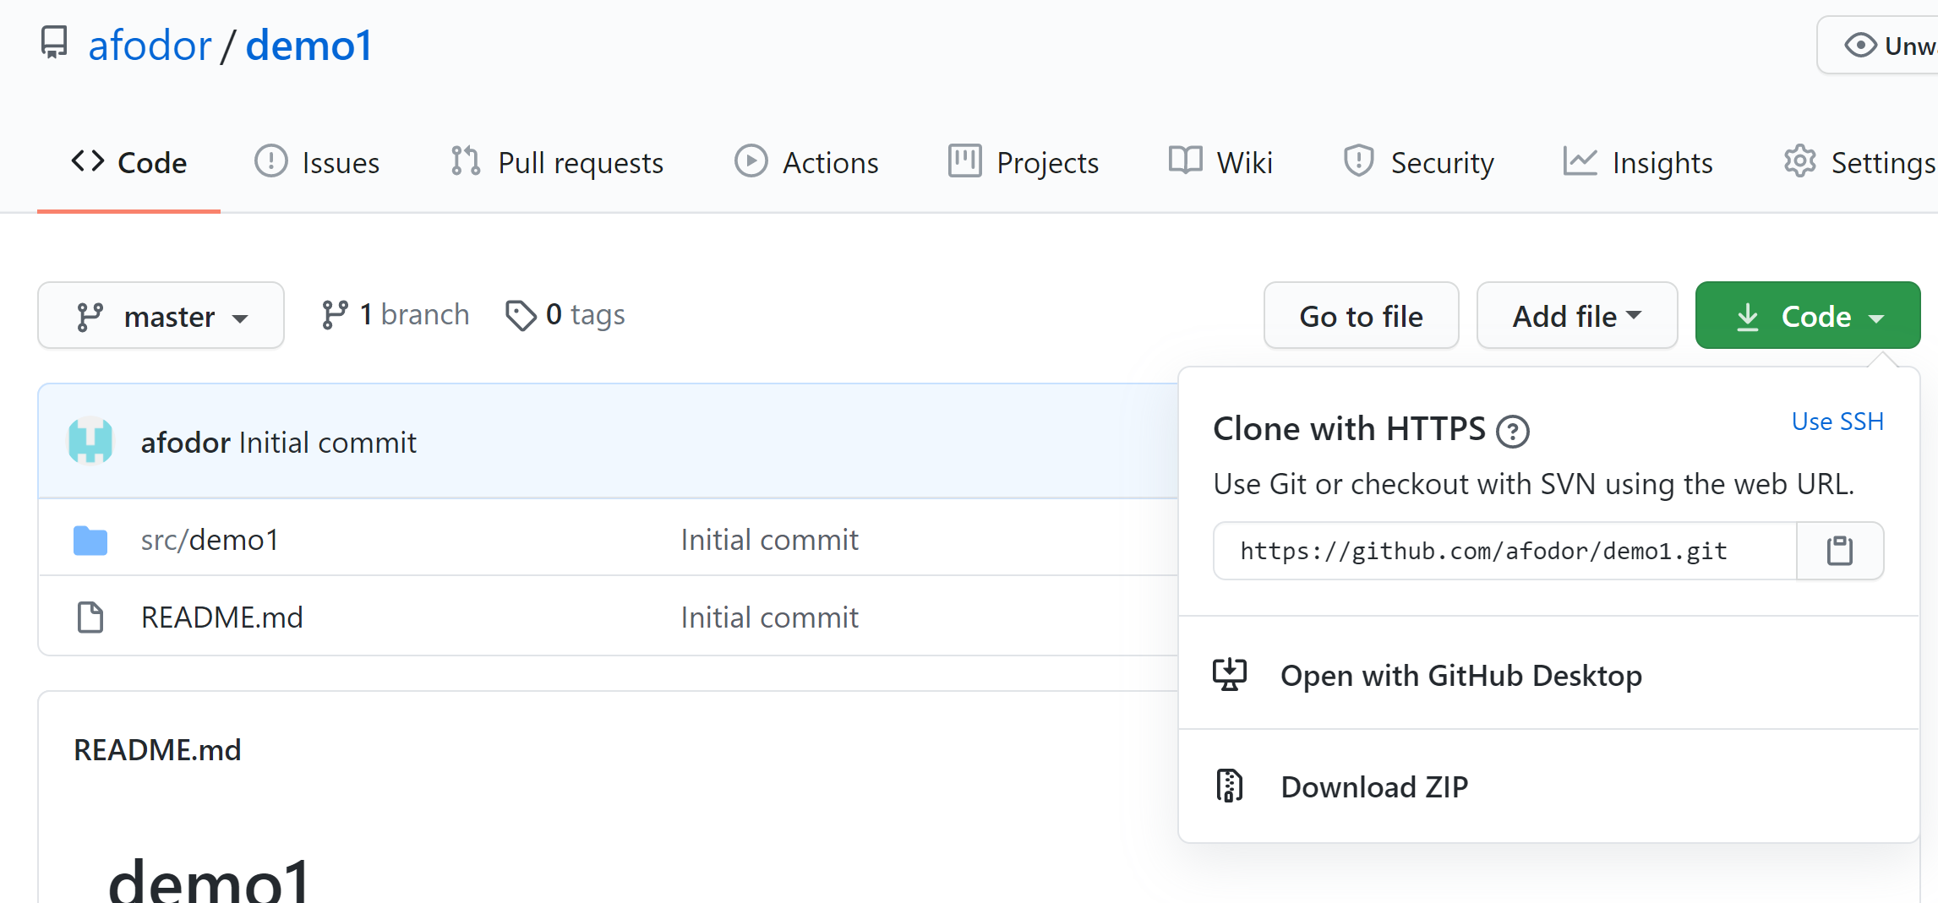
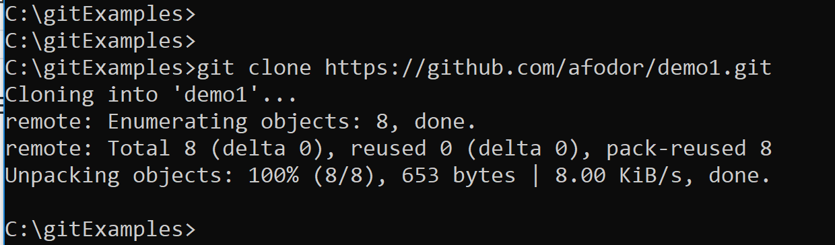
Once you have a git repository on git hub you can use “git clone” to copy the repository onto your local machine
Chose “code”
and then copy the
URL to you clipboard
git clone copies the entire repository to
your computer

Slide 10
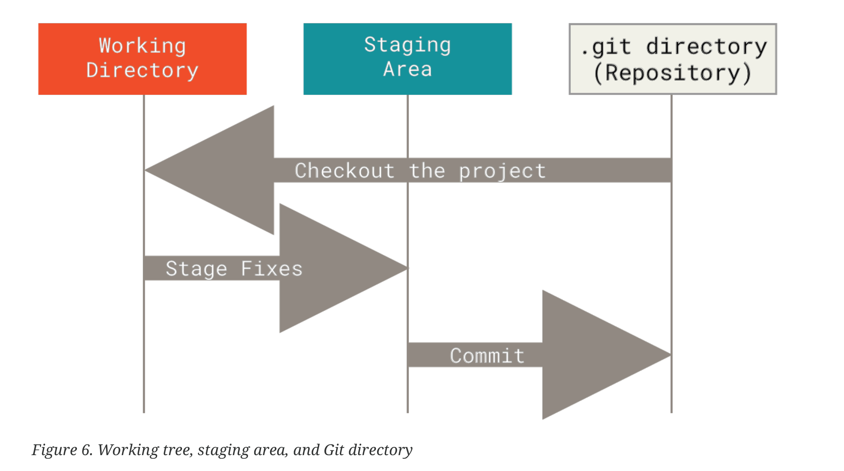
A git repository (what you just copied to your machine) has three parts

Slide 11
State Transitions (The Arrows)
git add → stage changes
git commit → save locally
git push → send to GitHub (or another remote server)
Notes:
Bind commands explicitly to arrows. This reduces panic later.

Slide 12
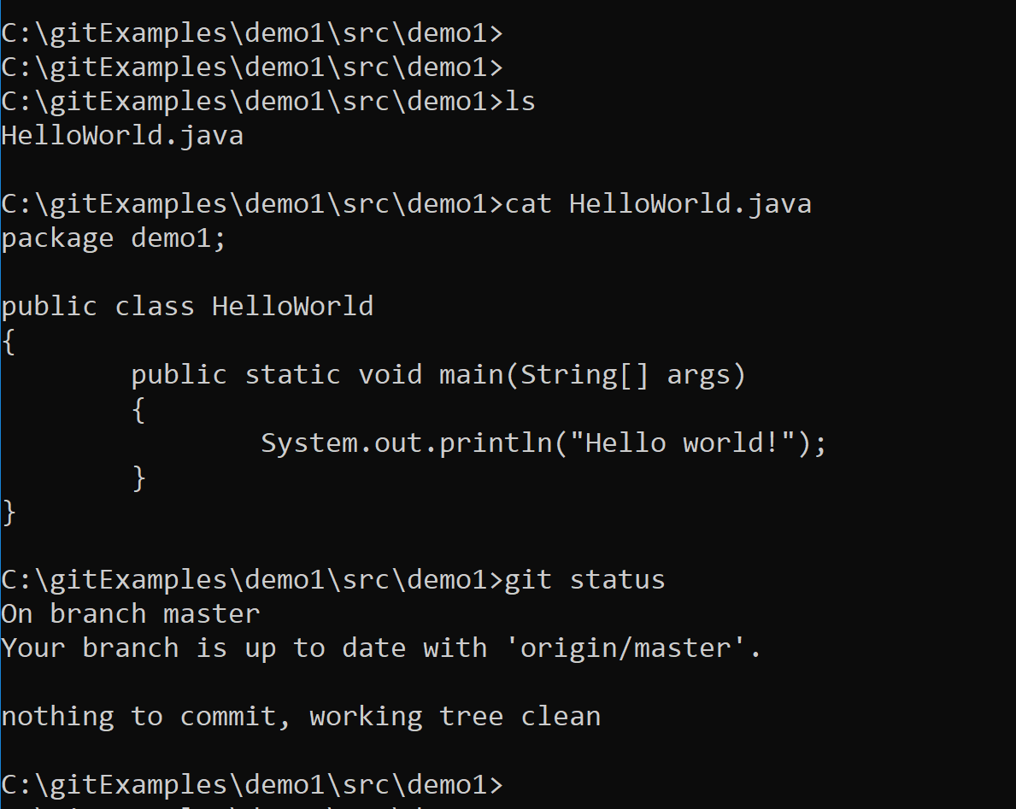
The working directory is what your operating systems sees.
In this case, there is a file called “HelloWorld.java” in a /src directory
When we type “status”,
Git tells us that what is in our
working directory is up to date with
the local git database.

Slide 13
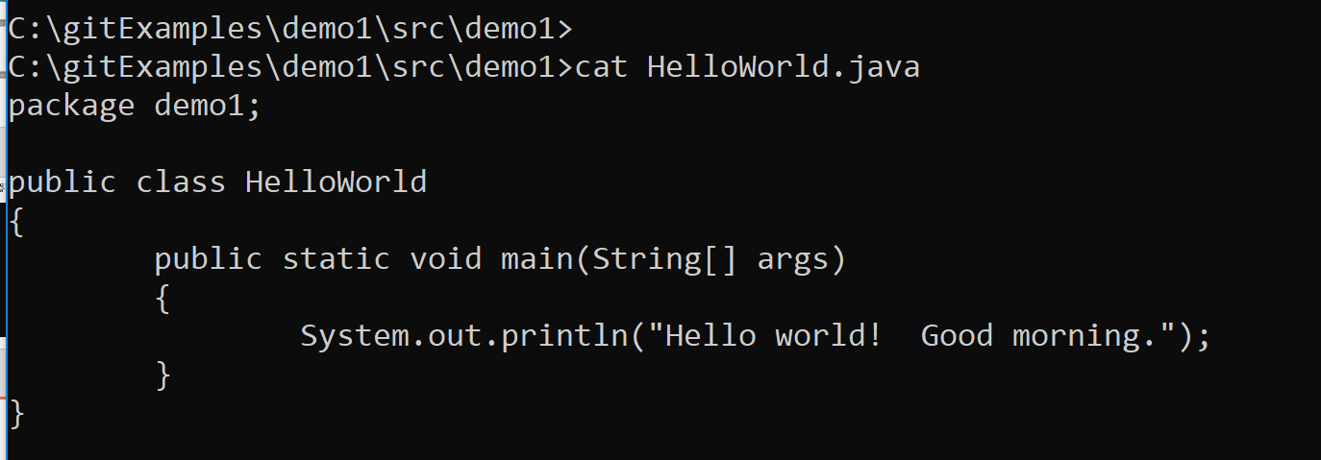
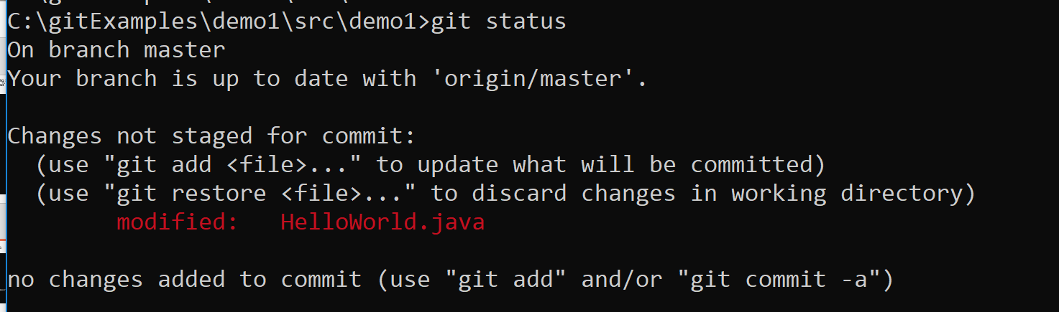
Let’s say we use a text editor to change our Java code
Git status sees the changed file in our working directory but the changes have not yet been staged

Slide 14
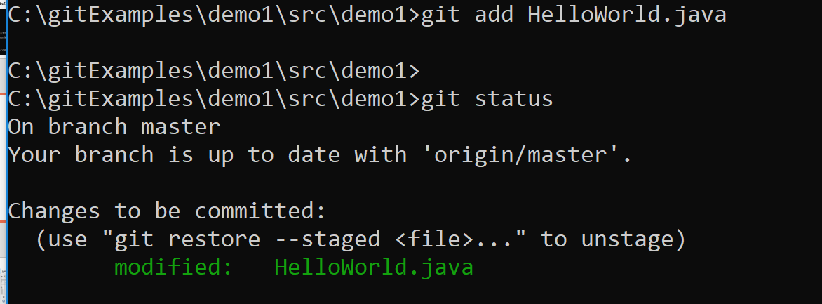
We can stage the change to file by typing git add
The change to the file is now staged, but has not yet been committed to the database.

Slide 15
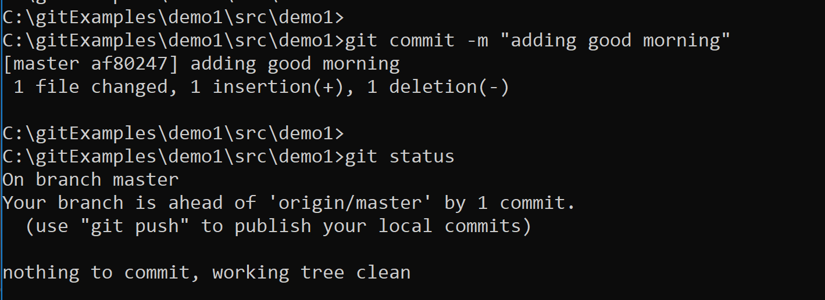
To commit the changes to our local copy of the git repository we use git commit

Slide 16
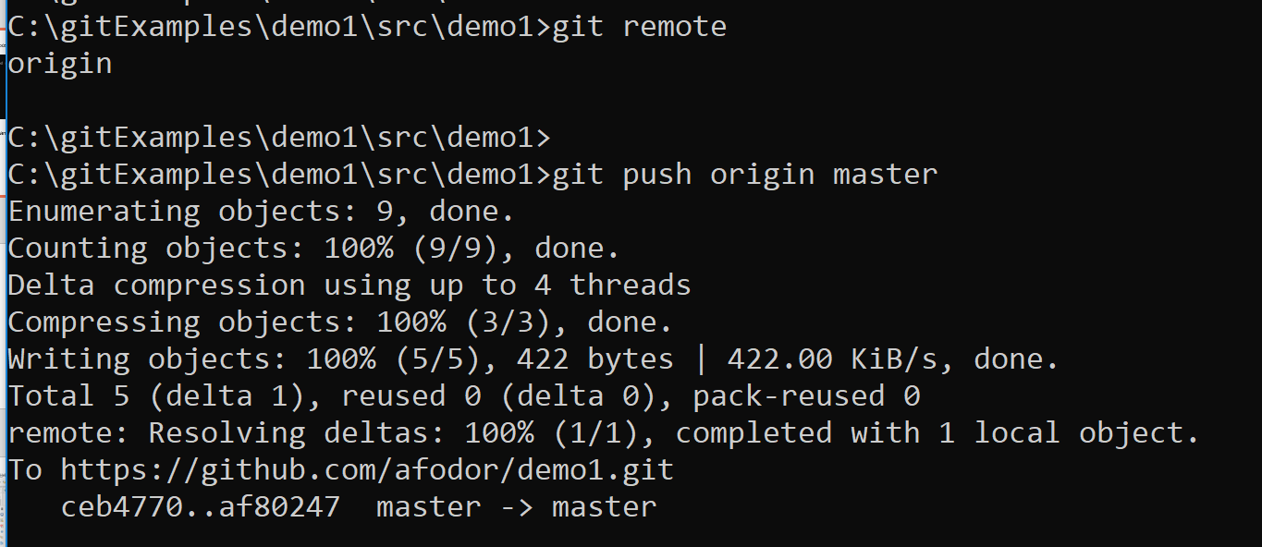
However, the changes are not yet on github where we can see them.
To push the changes to github we use
git remote gives us a list of remote repositories
(there can be more than one)
origin - the name of the remote repository (currently the only remote repository)
master – the name of the remote branch (currently the only branch)

Slide 17
A further complication is that your password is not your password from the website.
You have to generate a “temporary” password (or “token”) from the website…
Go to settings-> Developer Settings ->Personal Access Tokens -> Generate New Token
This is a bit
tedious from
the command line
If you use
“git config --global credential.helper store”
you won’t have to keep reentering
the password but this stores your
password in plain text.
I usually
just click
everything…
See https://stackoverflow.com/questions/35942754/how-can-i-save-username-and-password-in-git

Slide 18
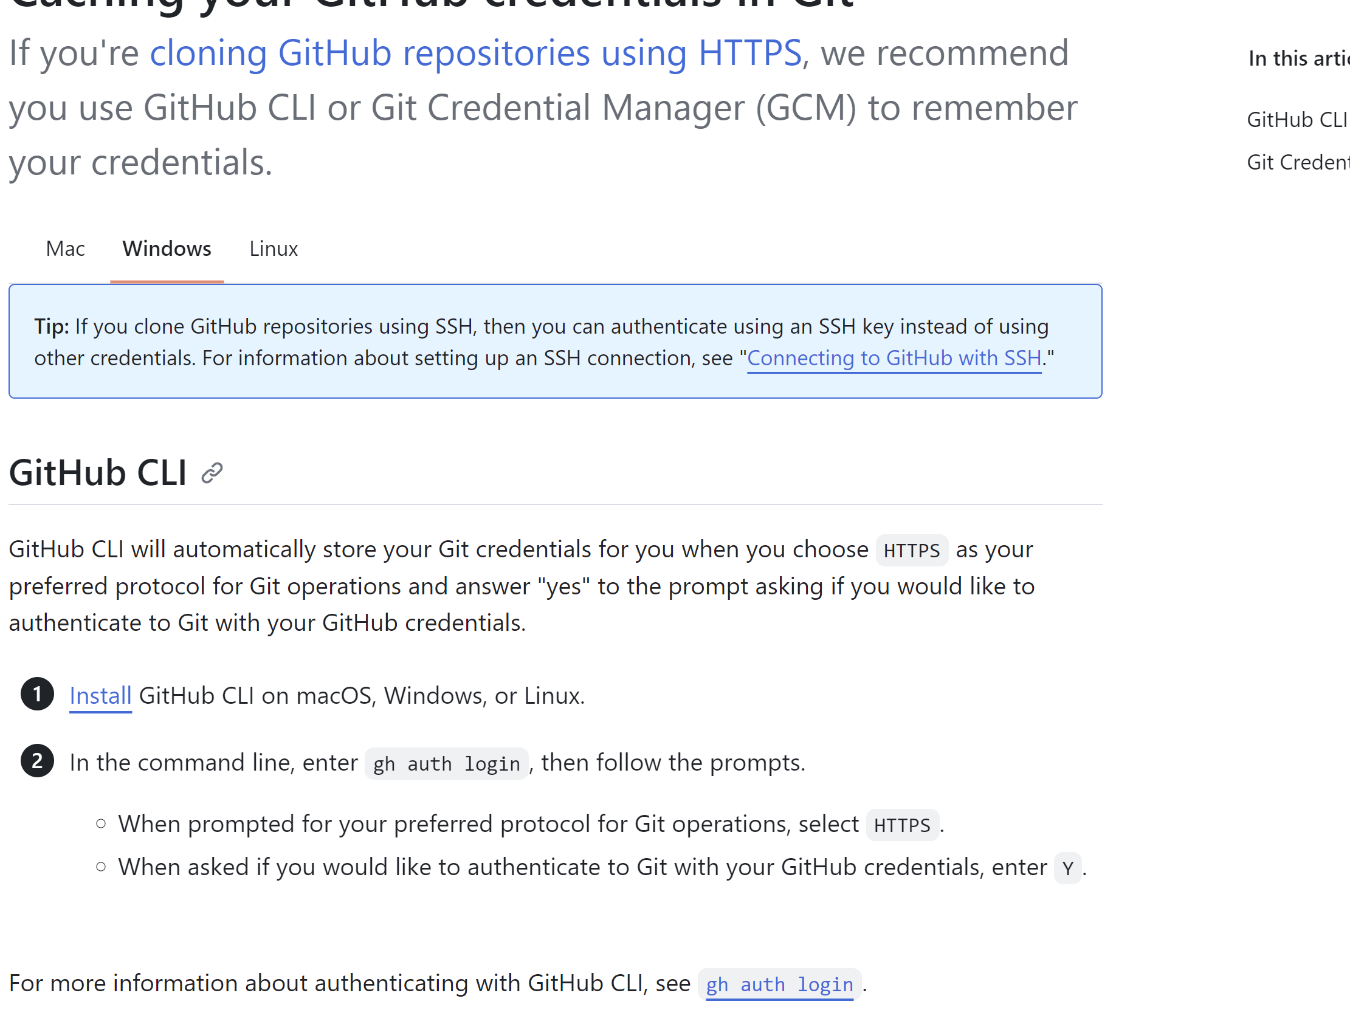
Sometimes, the easiest way to deal with permissions from github is to download GitHUB credential manager
https://docs.github.com/en/get-started/getting-started-with-git/caching-your-github-credentials-in-git

Slide 19
After October 2020, the default branch will be “main” instead of master.
So for new repositories, the command is
git push origin main
For older repositories:
git push origin master

Slide 20
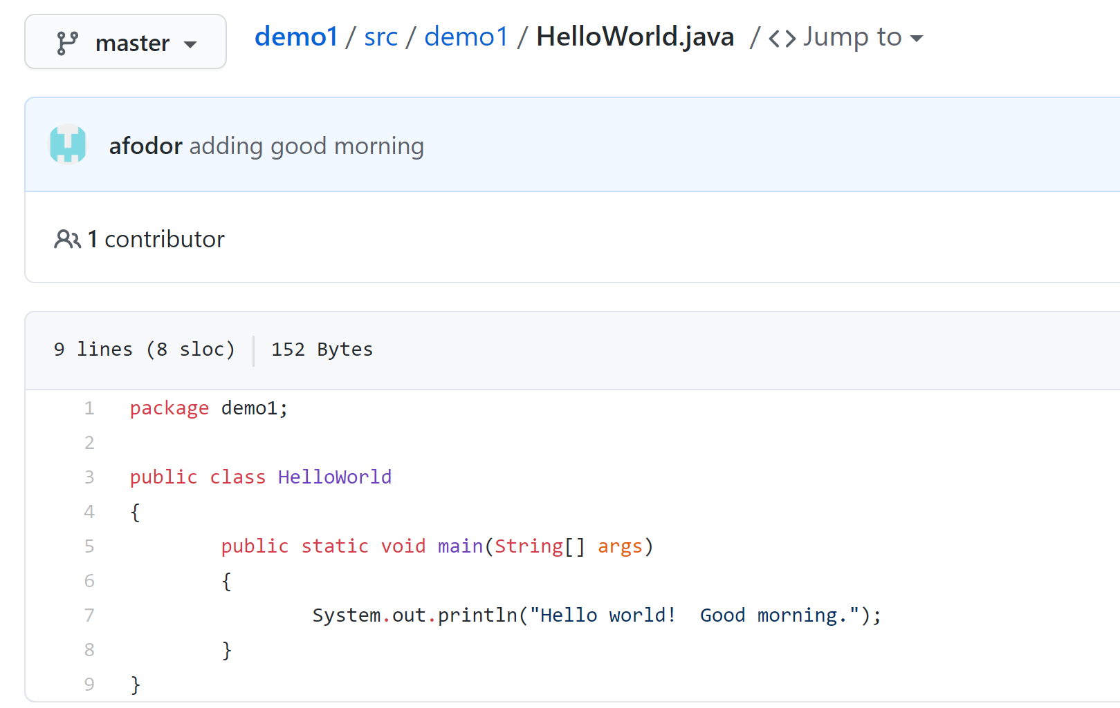
Our changes are now visible at github (where the world can see them since this is a public repository)

Slide 21
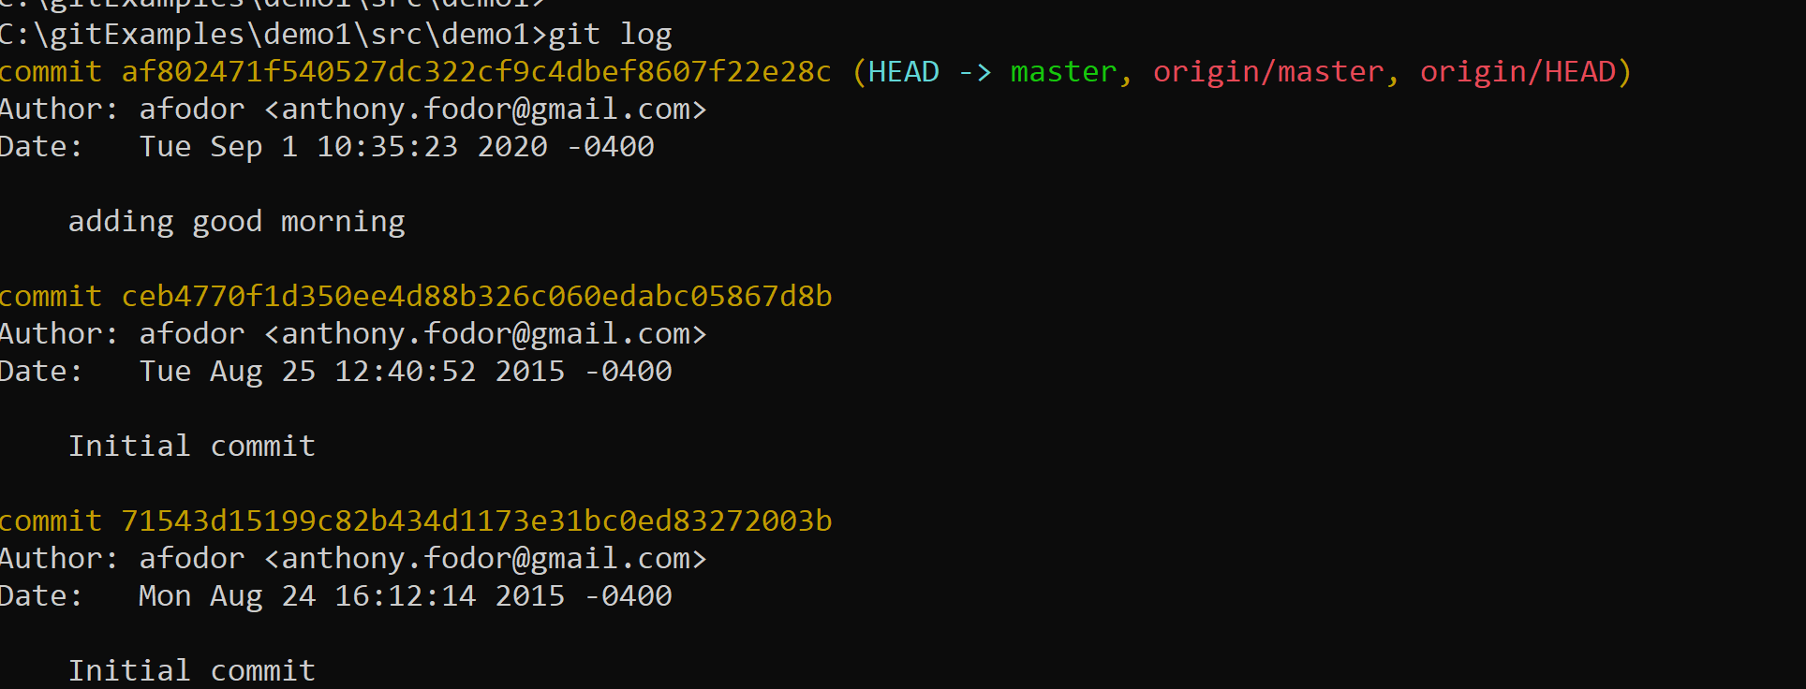
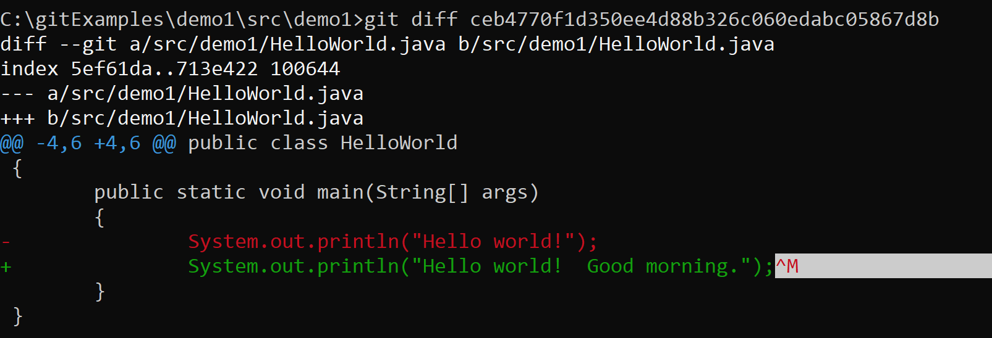
git log will give us a history of our commits and git diff allows us to compare the current checkout commit with any
other commit…

Slide 22
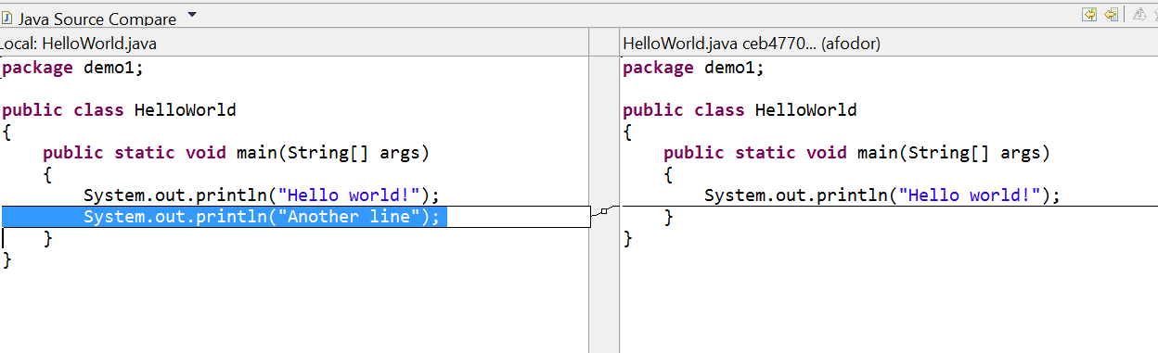
Eclipse (my IDE) will give us much prettier
results from git diff than the command line git diff (but we will get there next week…)

Slide 23
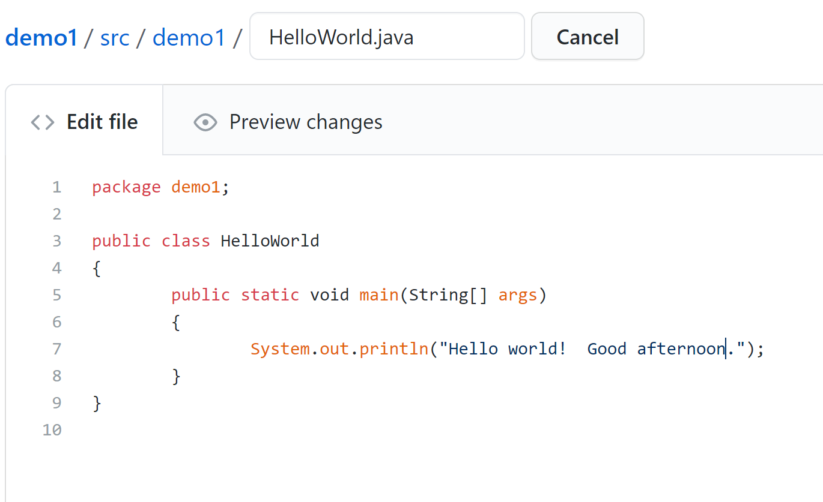
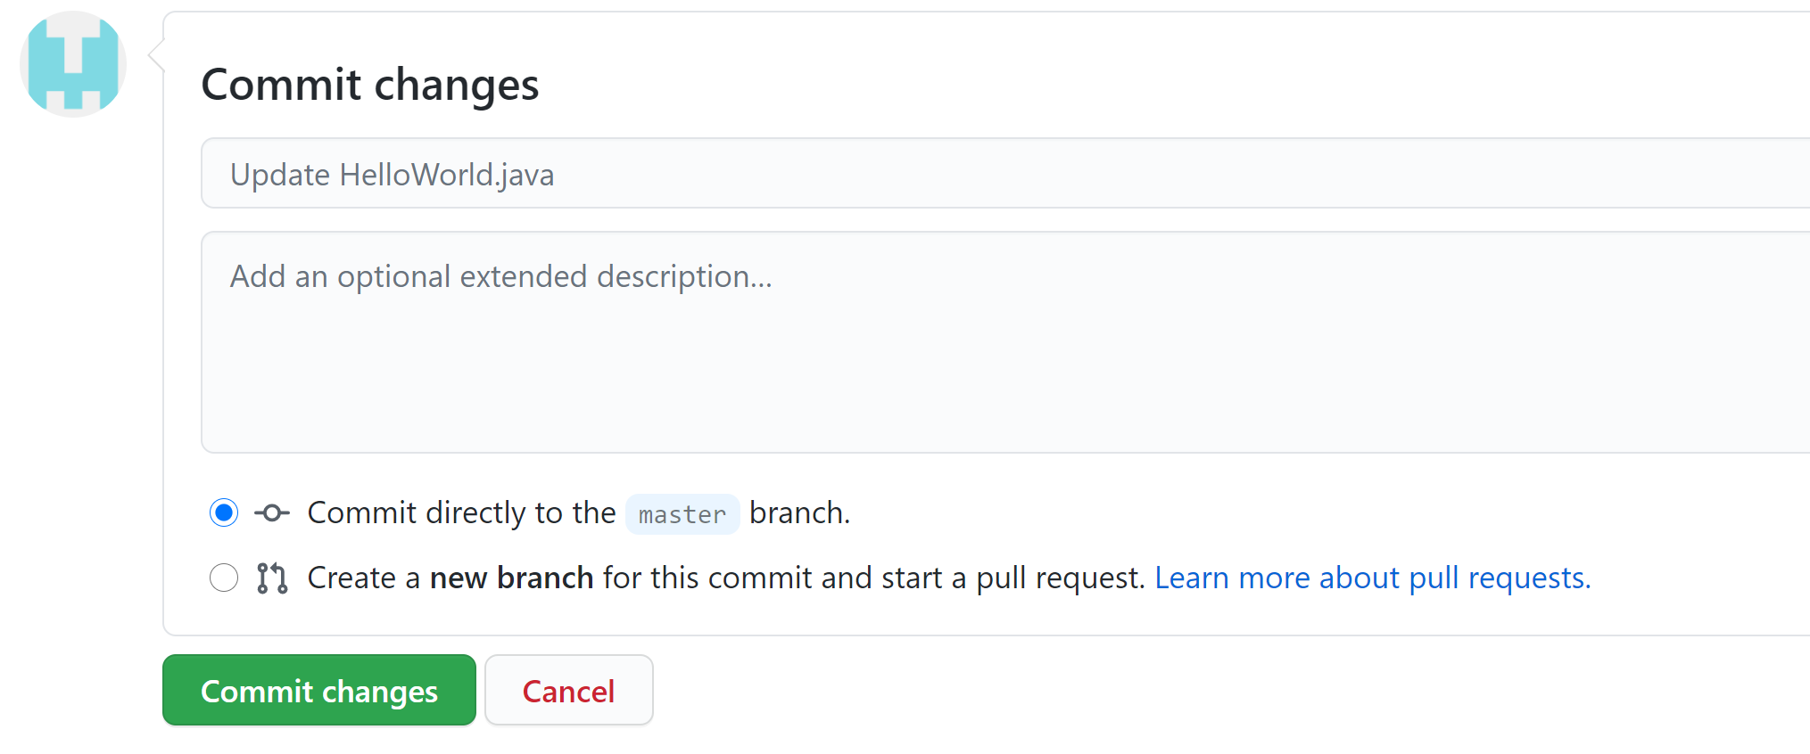
You can actually directly edit the remote repository on github…

Slide 24
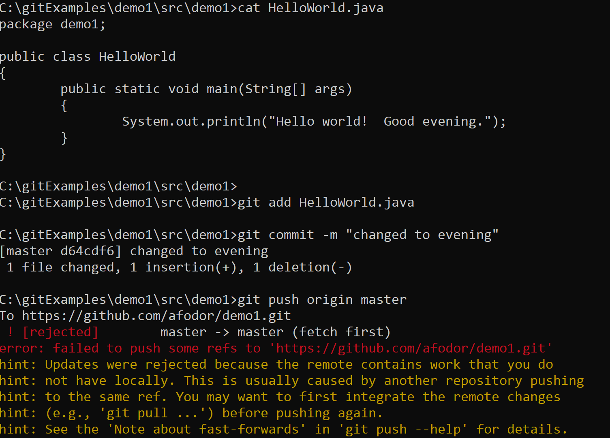
Now if we try and make a local change and commit it to github we will have a conflict,
that we will need to resolve…
Fine. Stage our change to
the local git db
Fine. Commit to our local db.
No. There are changes to the
remote database that we will
need to resolve..

Slide 25
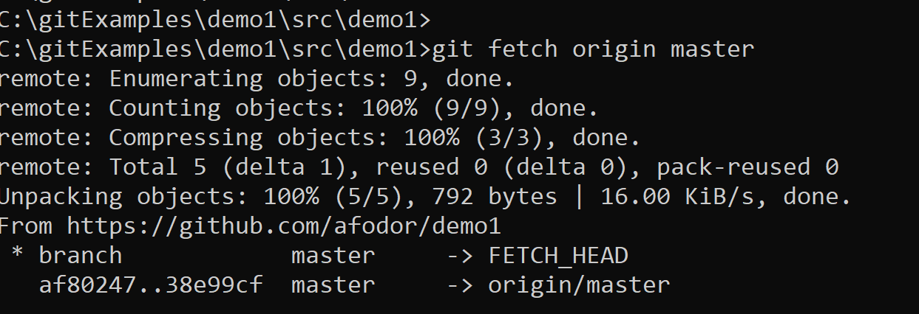
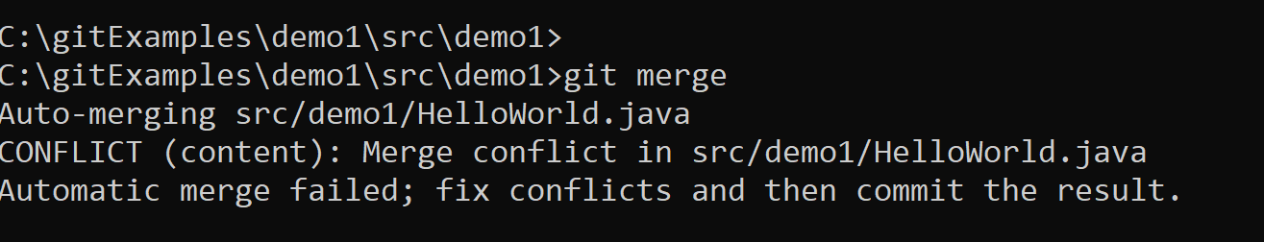
git fetch grabs the latest commits from the remote database but does not merge them into our work.
git merge here tries to merge, but we will have to deal with the conflict first

Slide 26
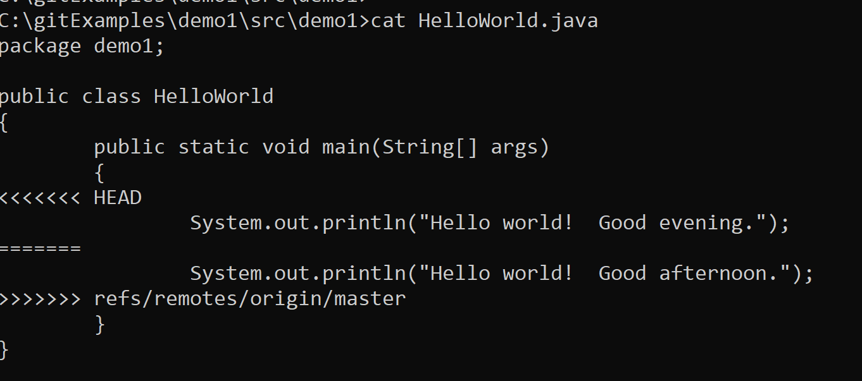
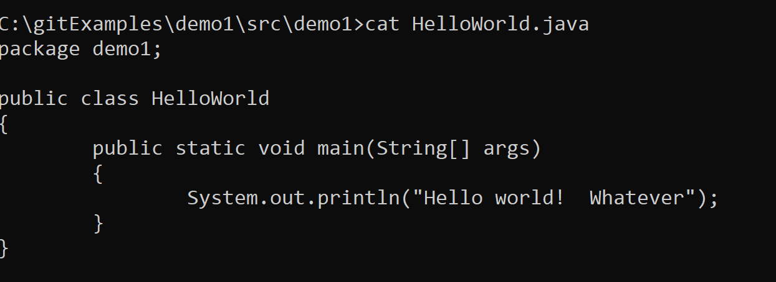
Git indicates to us where the conflict is…
We use a text editor to resolve the conflict

Slide 27
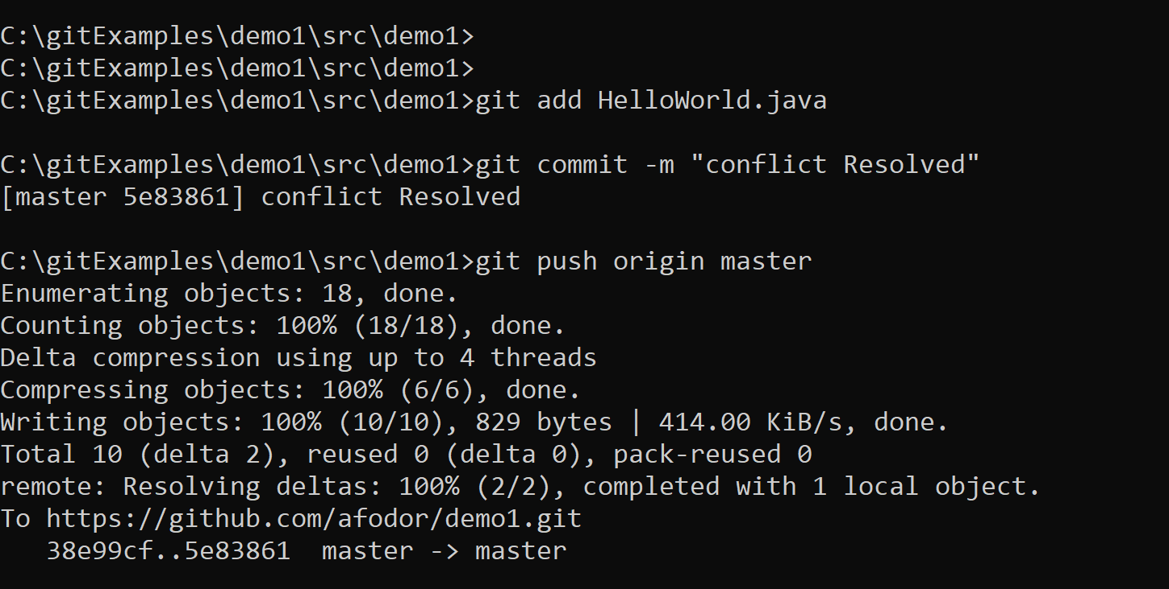
With the conflict resolved, we stage (with git add), commit to the local repository (with git commit)
and finally push to the remote repository…

Slide 28
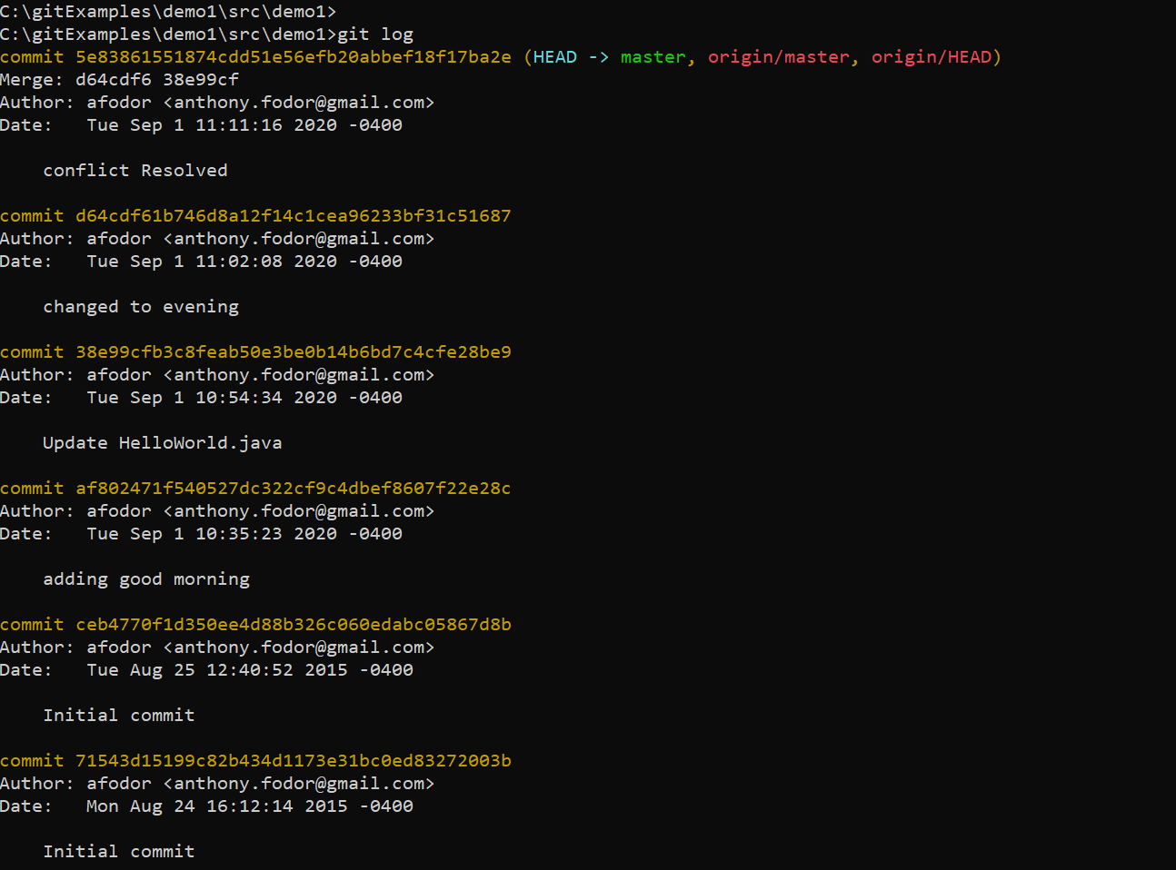
Git log shows the
entire history of commits
(both local and remote)

Slide 29
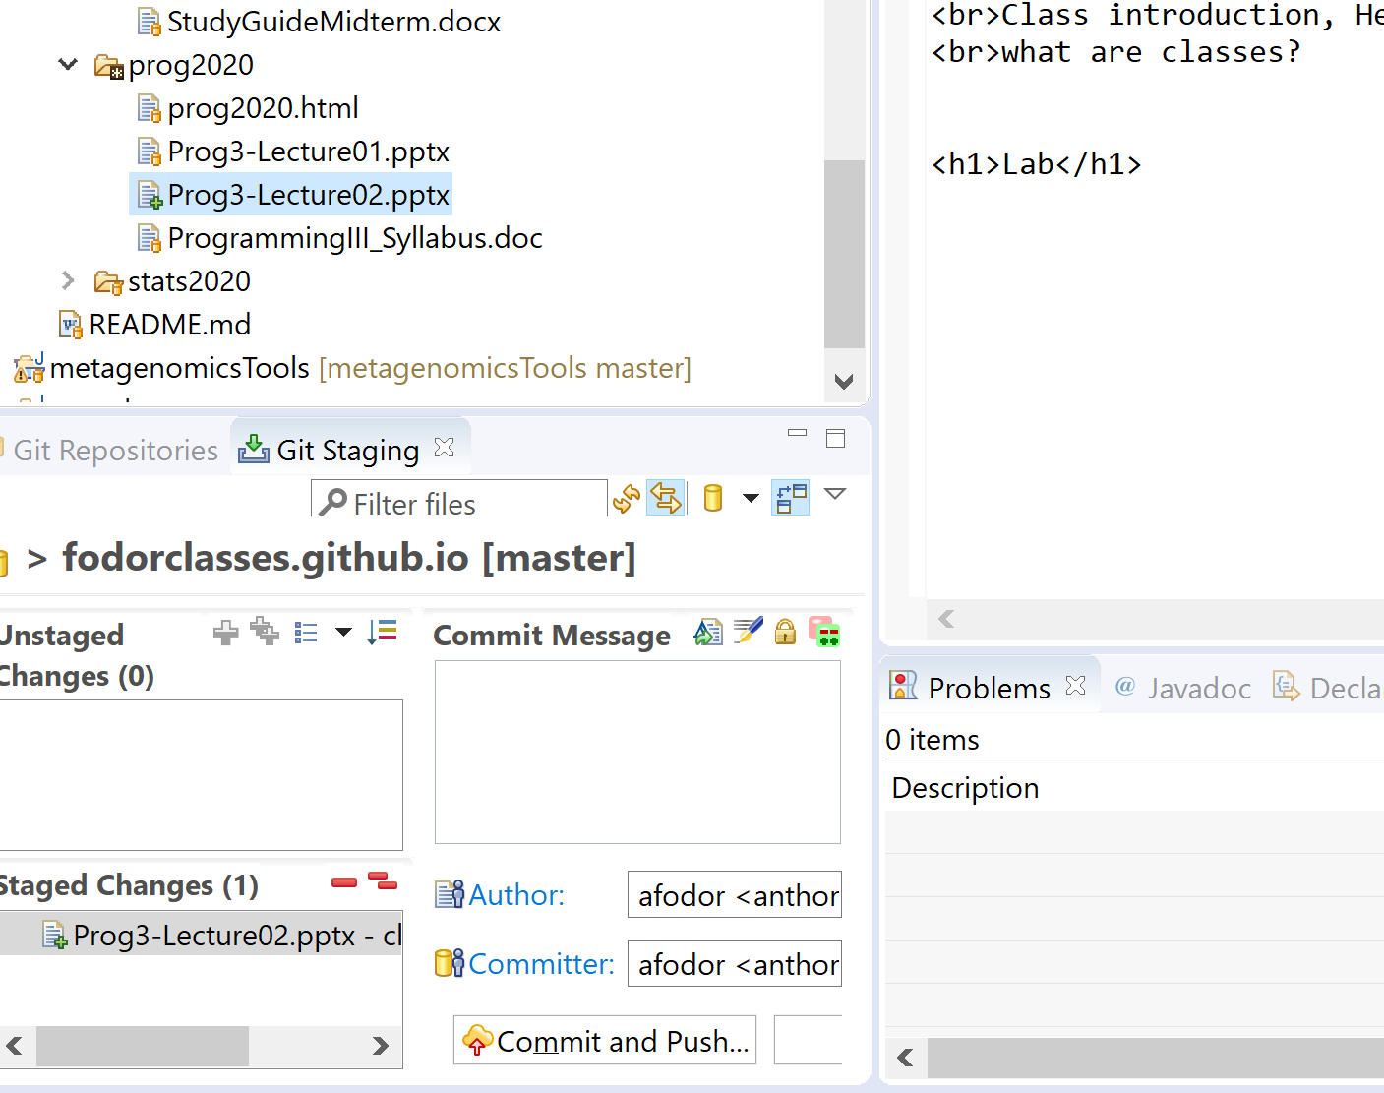
Eclipse will allow us to do a lot of these interactions via GUI, where in some ways it is
easier to see what is going on, but it is also easier to make a mistake.
Within the same repository, you can switch back and forth between Eclipse and the
command line (Eclipse just executes command line instructions).
I am about to
push this lecture
to github via the
Eclipse gui

Slide 30
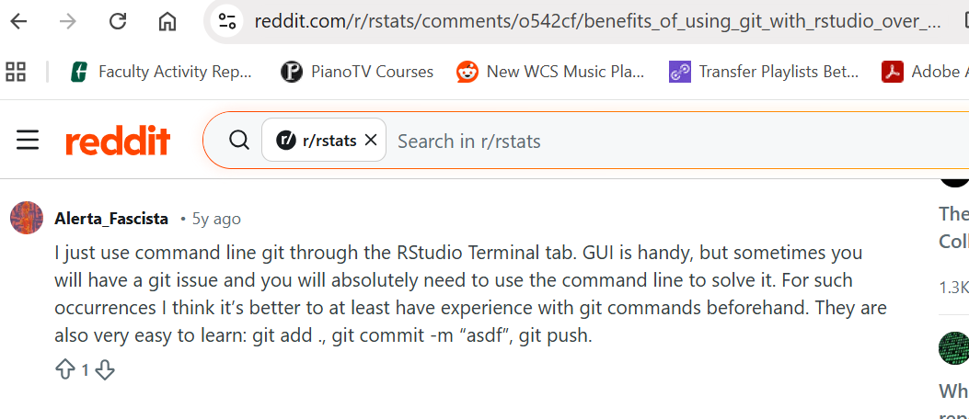
There is direct support for git in R-Studio, but I would encourage you to learn the command line as well!

