Slide 1
Lab #7: GUI to do something slow in a background thread
(for example, find prime numbers)
Two week assignment (due Dec. 2nd)
Make a GUI with the following properties:
(1) It does a slow calculation (for example finding prime numbers up to some large number) in a
single-background thread.
(2) It reports on the results (for example how many primes have been found)
every few seconds or so.
(3) It has a cancel button that can cancel the operation.
(4) At the end of the calculation, or if the user hits cancel, the
results are shown (and the amount of time it took to do the calculation).
Your next assignment (not to worry about yet) will be to extend this program so
the calculation is done in multiple threads (to see how much of a speed up there is).

Slide 2
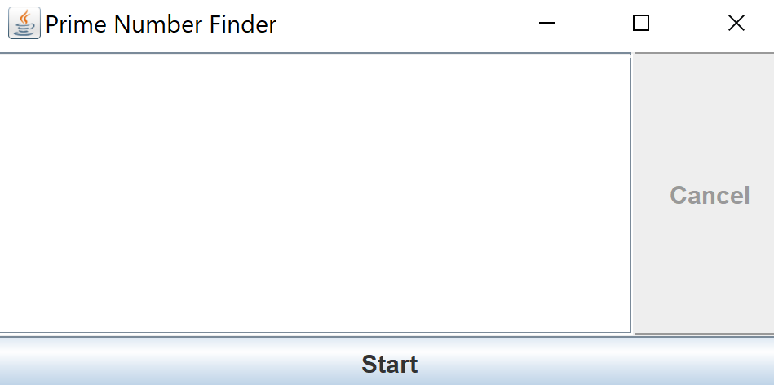
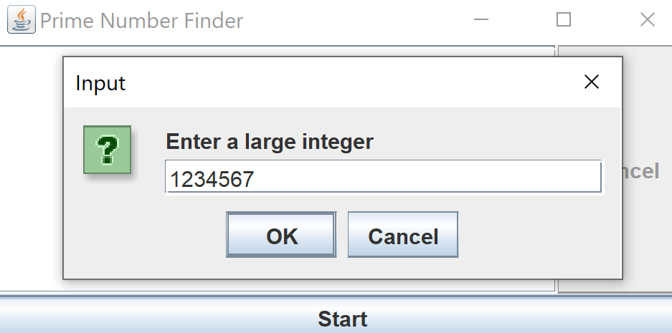
Here is an example (you can – and should - design your GUI to look different and probably better)
User hits start and is asked to input a number
User enters the number;
Program will find all the primes between
1 and this #

Slide 3
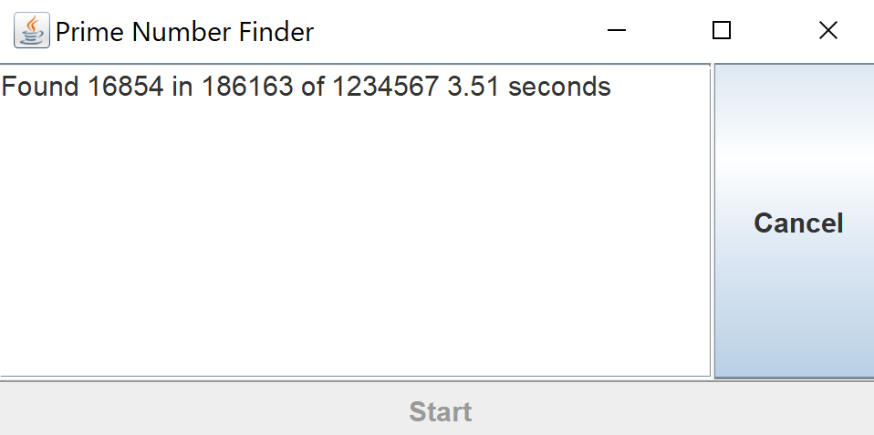
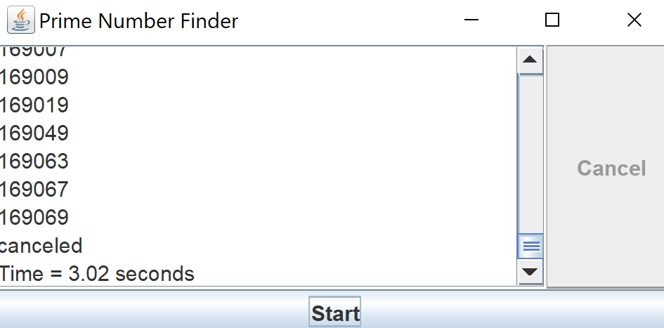
While the program is running, the user is updated on the status
At the end of the calculation (or if the user hits cancel),
the results are shown and the time is shown.
(This is a JScrollPane wrapping a JTextArea)
In this assignment, we will have a single background thread (plus the AWT thread).
In the next assignment, we will have multiple background threads and measure the speed up (if any)

