Slide 1
Approaches to column normalization

Slide 2
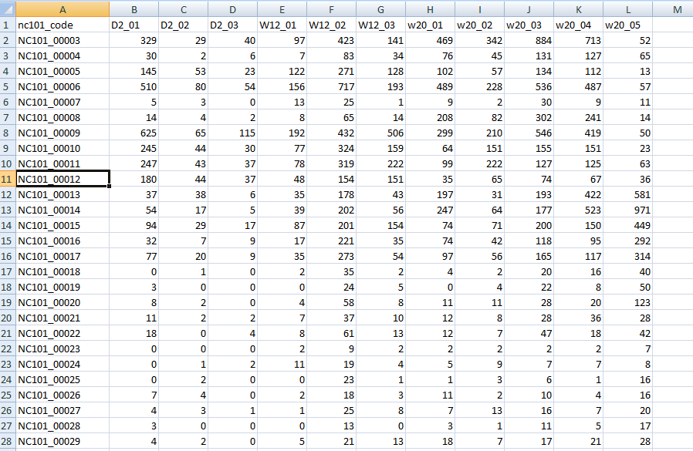
From lecture 9A…
http://afodor.github.io/classes/stats2015/longitdunalRNASeqData.zip
File = nc101_scaff_dataCounts.txt

Slide 3
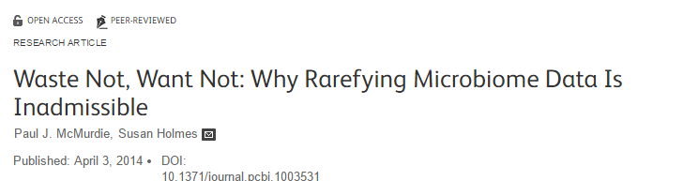
Normalization is an early step in bioinformatics pipeline…
Each sample in our spreadsheet has a different number of sequences.
We need to correct for this (so that we don’t just reflect in our p-values
that there were more sequences in one sample).
This is a highly controversial and complex question that we will
touch on repeatedly over the semester…

Slide 4
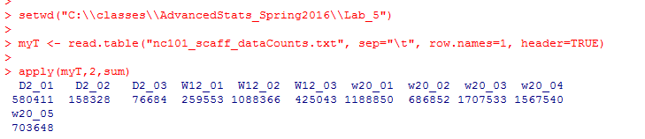
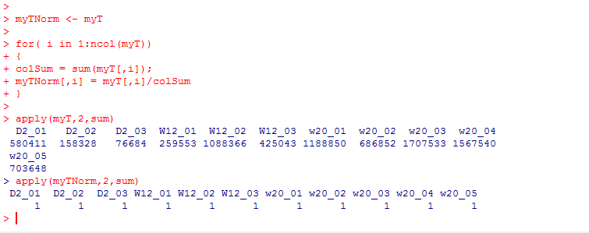
These few lines of code give us the # of sequences in each sample….
“apply” sum to the columns of myT
(if the 2nd parameter were 1, it would be applied to the rows)
One simple normalization scheme is to divide each cell by the sum in the column.
This converts each gene to relative abundance…
https://github.com/afodor/metagenomicsTools/blob/master/src/classExamples/compareNormalizations.txt

Slide 5
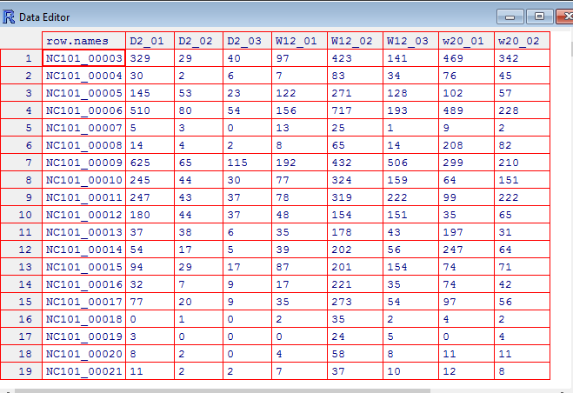
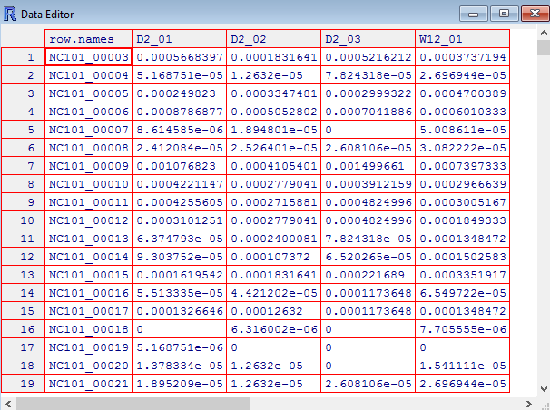
Relative abundance changes counts to fractions (that sum to 1 in each sample)
edit(myT)
edit(myTNorm)

Slide 6
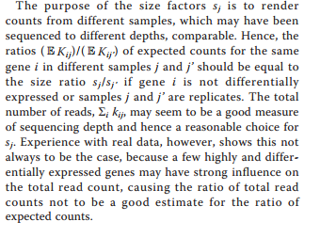

Many people have problems with relative abundance normalization, including the deseq authors
j is an index for samples (columns in our spreadsheet)
i is an index for genes (rows in our spreasheet)
K_{ij} is the # of counts in each cell
They are concerned that outliers may cause problems…
There is also the compositionality problem (which we may talk about more later…)
https://www.nature.com/articles/npre.2010.4282.2

Slide 7
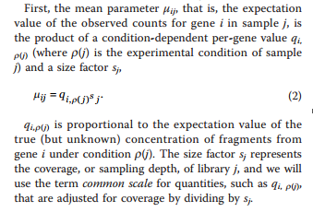
The DeSeq paper formalism describes a “true” expression level and a scaling factor…
q is the true fraction of gene expression under condition p(j)
(in our spreadsheet, p(j) gives us the time 2 weeks, 12, or 20 weeks)
S_{j} is the scaling factor – a normalization factor that will be different for different samples
j is an index for samples (columns in our spreadsheet)
i is an index for genes (rows in our spreasheet)

Slide 8
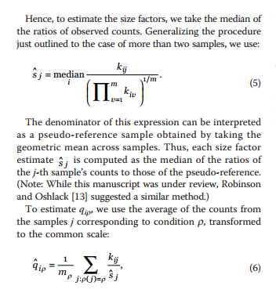
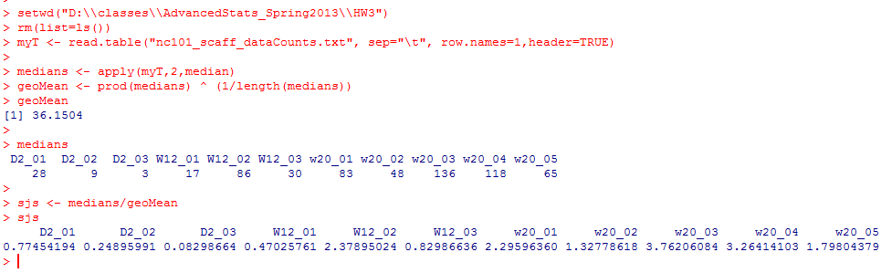
DeSeq proposes an alternative to simple relative abundance….
Geometric mean is sometimes
considered a more robust alternative
to average
To estimate S_{j}, we take the median of each column (and divide by some normalizing constant)

Slide 9
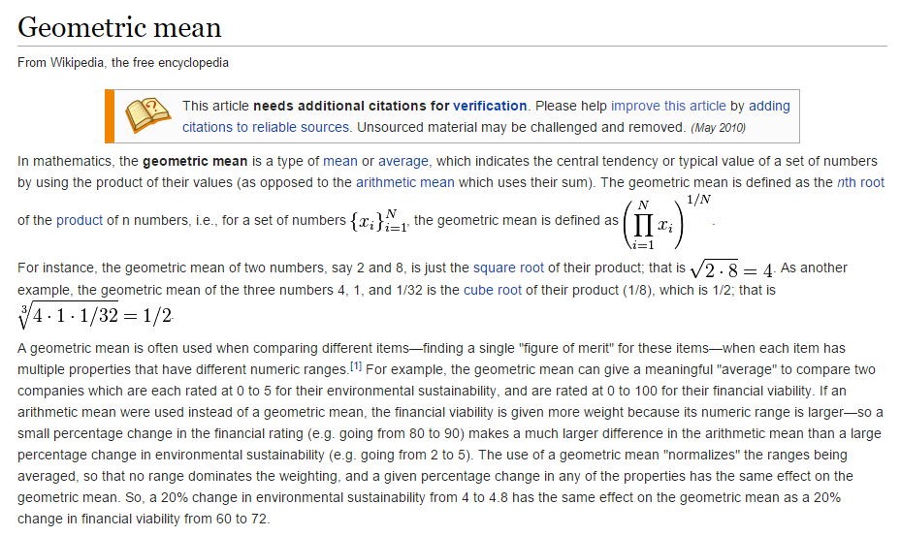

Slide 10
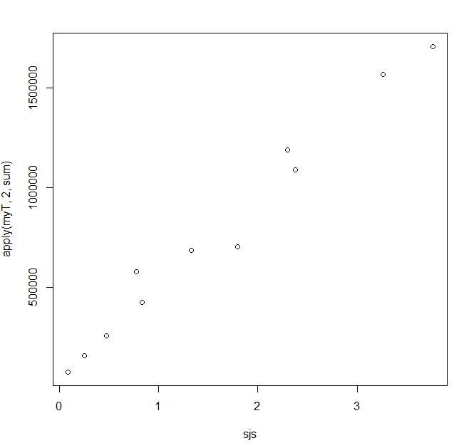
Despite the extra terms, Deseq’s sjs are closely related to the more simple metric
of sequencing depth
plot( sjs, apply(myT,2,sum))
# of replicates in each condition
So in practice (at least for this dataset), dividing by Sj is not that different from
simple relative abundance…

Slide 11
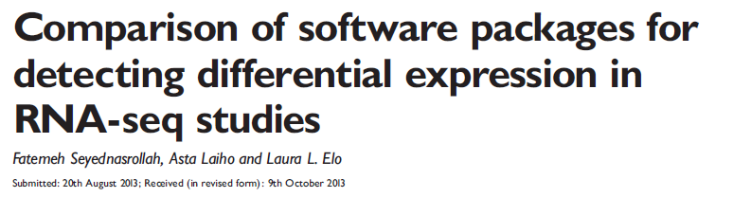
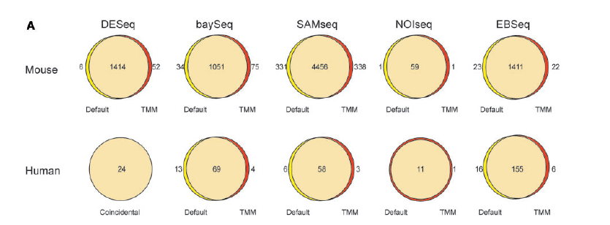
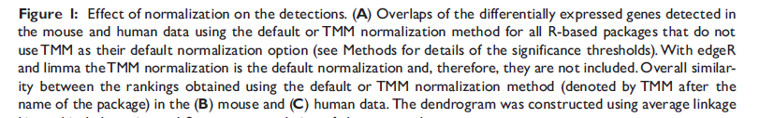

Slide 12
We can use the DeSeq formalism to take weighted averages across our three timepoints
(2 days, 12 weeks and 18 weeks)
q_{ip}
will be our estimate of expression, normalized by scaling factor
The times (the p(…) ) in our spreadsheet can be defined by columns…

Slide 13

rm(list=ls())
twoDays <- 1:3
twelveWeeks <- 4:6
eighteenWeeks <- 7:11
myT <- read.table("nc101_scaff_dataCounts.txt", sep="\t", row.names=1,header=TRUE)
myT <- myT + 1
medians <- apply(myT,2,median)
geoMean <- prod(medians) ^ (1/length(medians))
sjs <- medians/geoMean
getQsVals <- function( myT, sjs, range )
{
qs <- vector(length=nrow(myT))
for( i in 1:nrow(myT) )
{
sum = 0;
for ( j in range)
{
sum = sum + myT[i,j] / sjs[j]
}
qs[i] = sum / length(range);
}
return(qs)
}
qsForTwoDays <- getQsVals(myT,sjs, twoDays)
qsForTwelveWeeks <- getQsVals(myT,sjs, twelveWeeks)
qsForEighteenWeeks <- getQsVals(myT,sjs, eighteenWeeks)
params <- data.frame(qsForTwoDays , qsForTwelveWeeks , qsForEighteenWeeks)

Slide 14
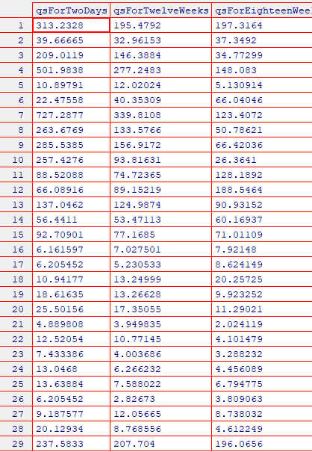
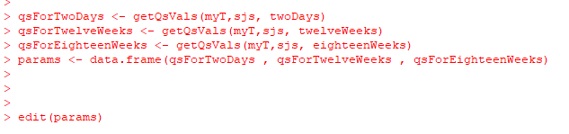

Slide 15
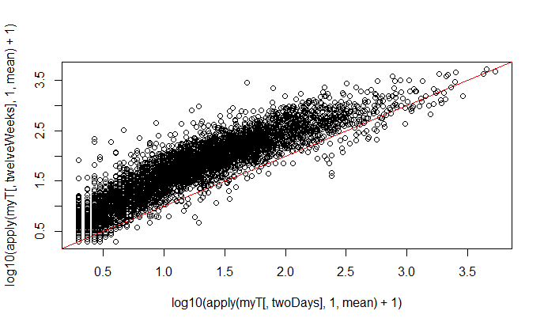

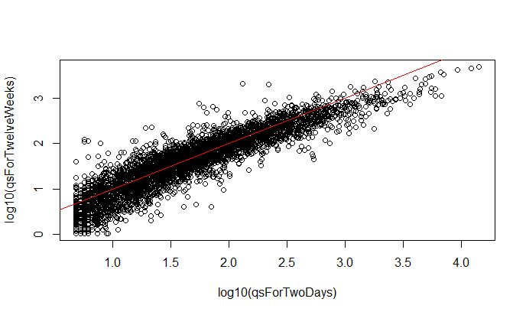
Our normalization makes the different samples more directly comparable…
Without normalization
You can see a local
regression might
have done better!
With normalization

Slide 16
What about the variance?
You might think the variance within a condition would just be something like…
varTwelveWeeks <- apply( myT[,twelveWeeks], 1, var )
That is just canonical variance defined within each category
There are going to be numerous reasons why this will not be the variance used in DeSeq

Slide 17
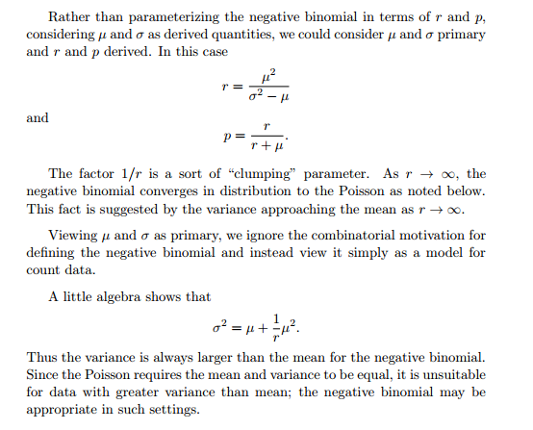
One problem is that the negative binomial distribution is not defined when the variance <= mean!
So if we are going to use the negative binomial, we have to define
the variance as the mean plus something…
http://www.johndcook.com/negative_binomial.pdf

Slide 18

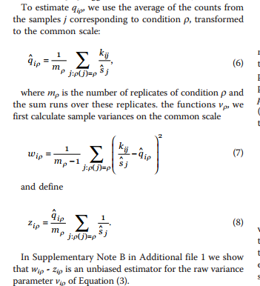
So if we are going to use the negative binomial, we have to define
the variance as the mean plus something…
What the variance would
Be under the poisson
The extra variance
associated with the
negative binomial
Weighted canonical variance
Weighted mean
Raw variance = weighted canonical variance (wip) – weighted mean (zip)
We will see that DeSeq never quite settles on a single way to measure the variance…

