Slide 1
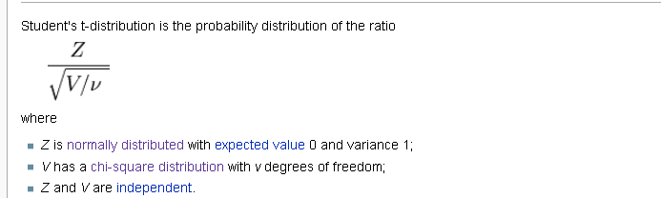
Assumptions of the t-test:
Independence
Normality
Equal Variance ( or not )
How can we evaluate these assumptions?
We must meet the assumption of independence, because our test statistic is
built from an independent sum of the square of independent, normal variables.
But the numerator and denominator are built on an assumption of normality.
We can relax the assumption of equal variance, but not the other two or our
calculations of p-values don’t have much meaning…

Slide 2
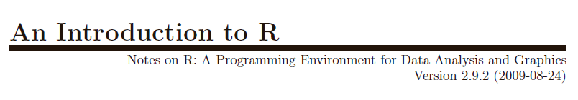
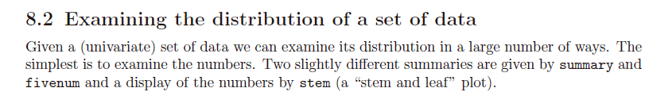
http://cran.r-project.org/doc/manuals/R-intro.pdf

Slide 3

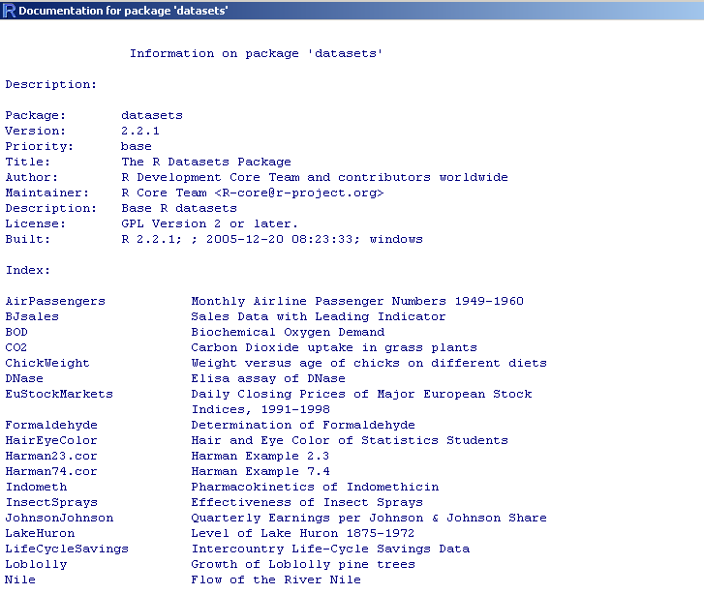
R has built in practice datasets to play with….

Slide 4

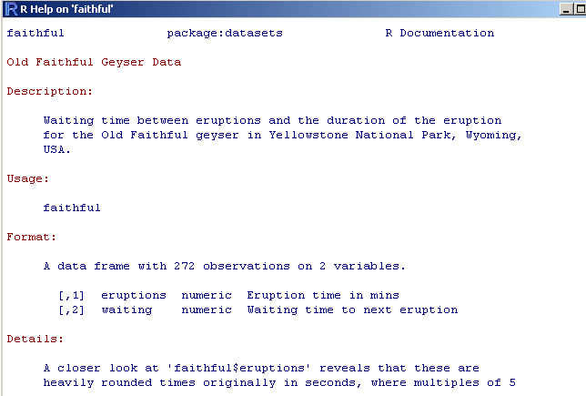

Slide 5
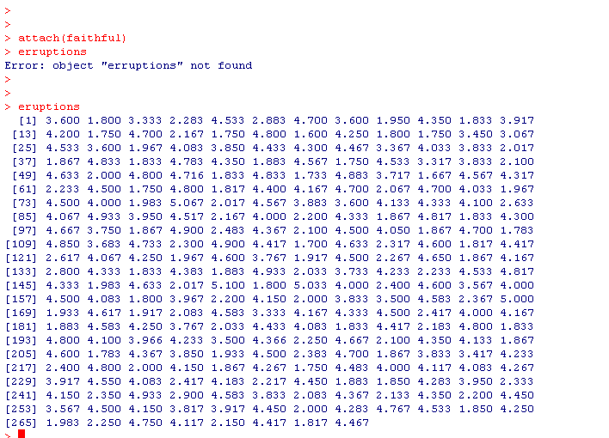

Slide 6
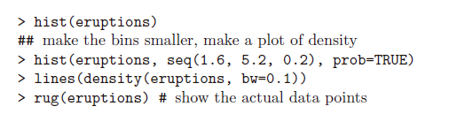
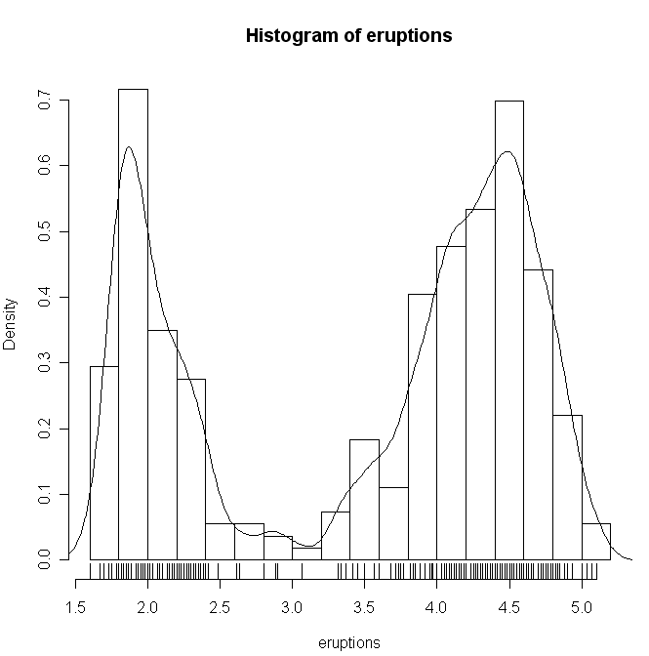
R has lots and lots of way to see if a distribution is normal….
Scales the y-axis in probability space
Show the raw data on the histogram
Obviously this is not normal…
(An introduction to R; section 8.3)

Slide 7
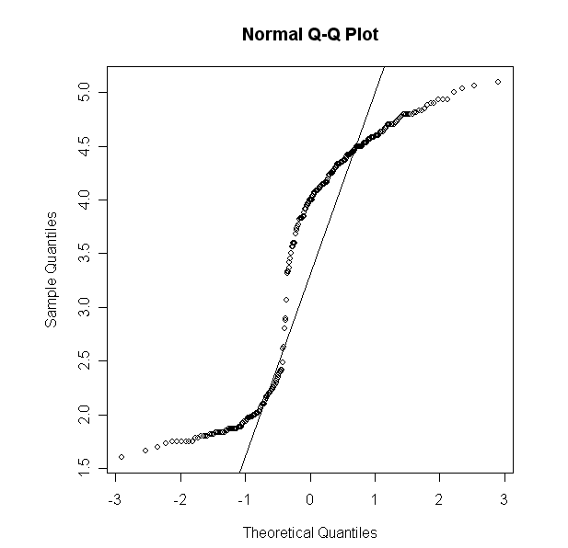

We can, of course, use qqnorm to visually
test for normality…

Slide 8
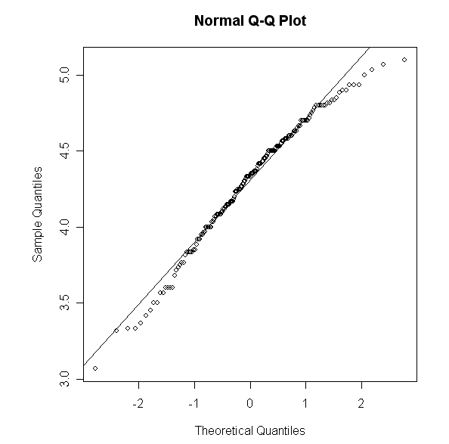
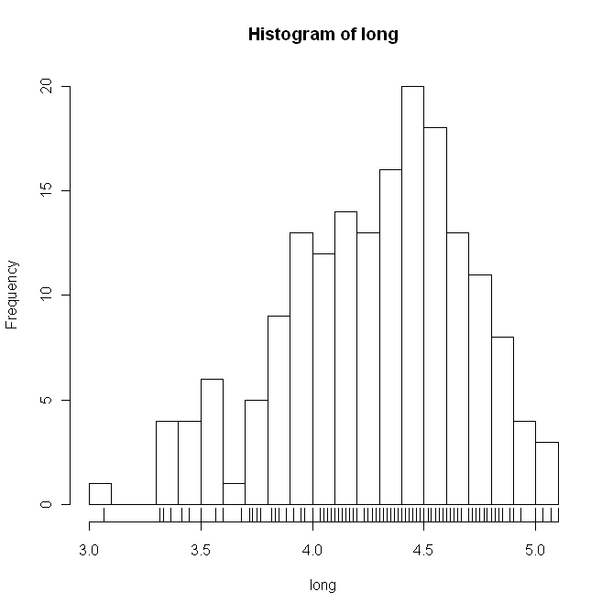
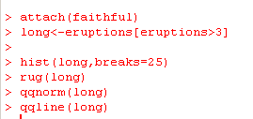
What about just the long eruptions?
Not too far off…
We would like a statistical test that tells us if this is normal or not…
We could use the chi-square test…

Slide 9
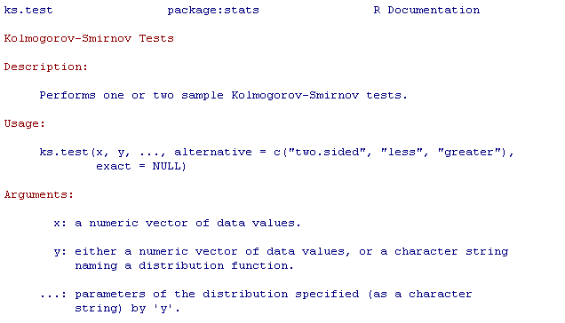
Or, alternatively,
?ks.test

Slide 10
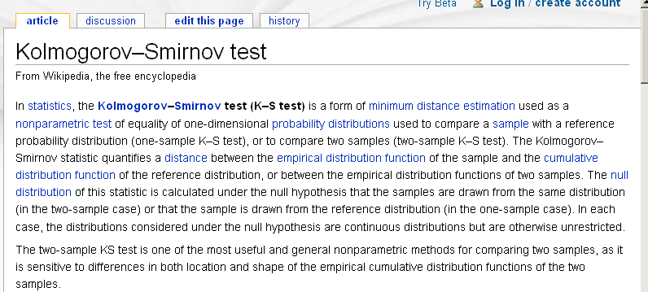

Slide 11
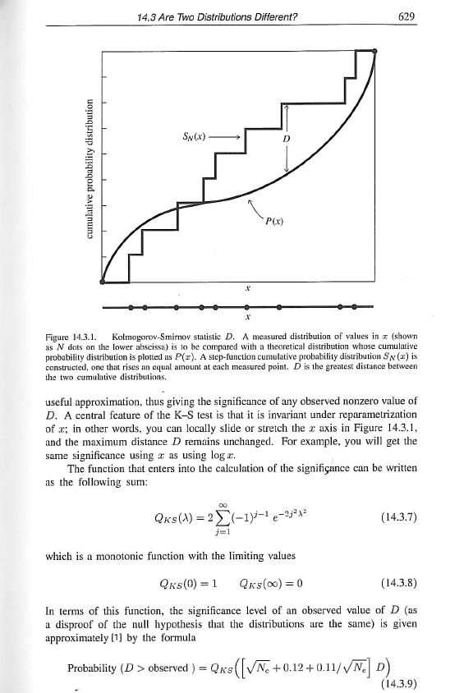
From the numerical recipes book…
We are going to have to take
their word for this!
(i.e. we won’t prove this works)

Slide 12
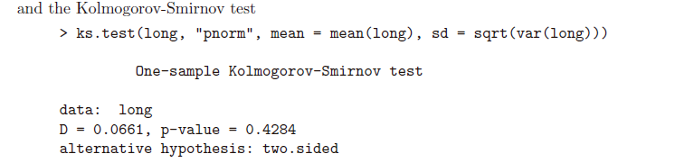
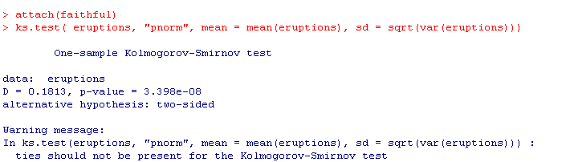
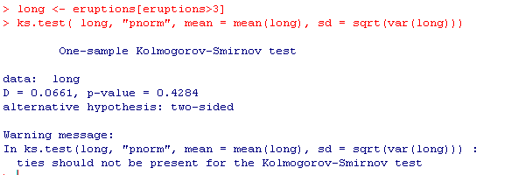
We reject a null hypothesis that the
second eruption data is non-normal
Albeit with some warnings
(that we will ignore)

