Slide 1
Semaphore
BlockingQueue
CountDownLatch
Callable, Future, FutureTask
Cancellation

Slide 2
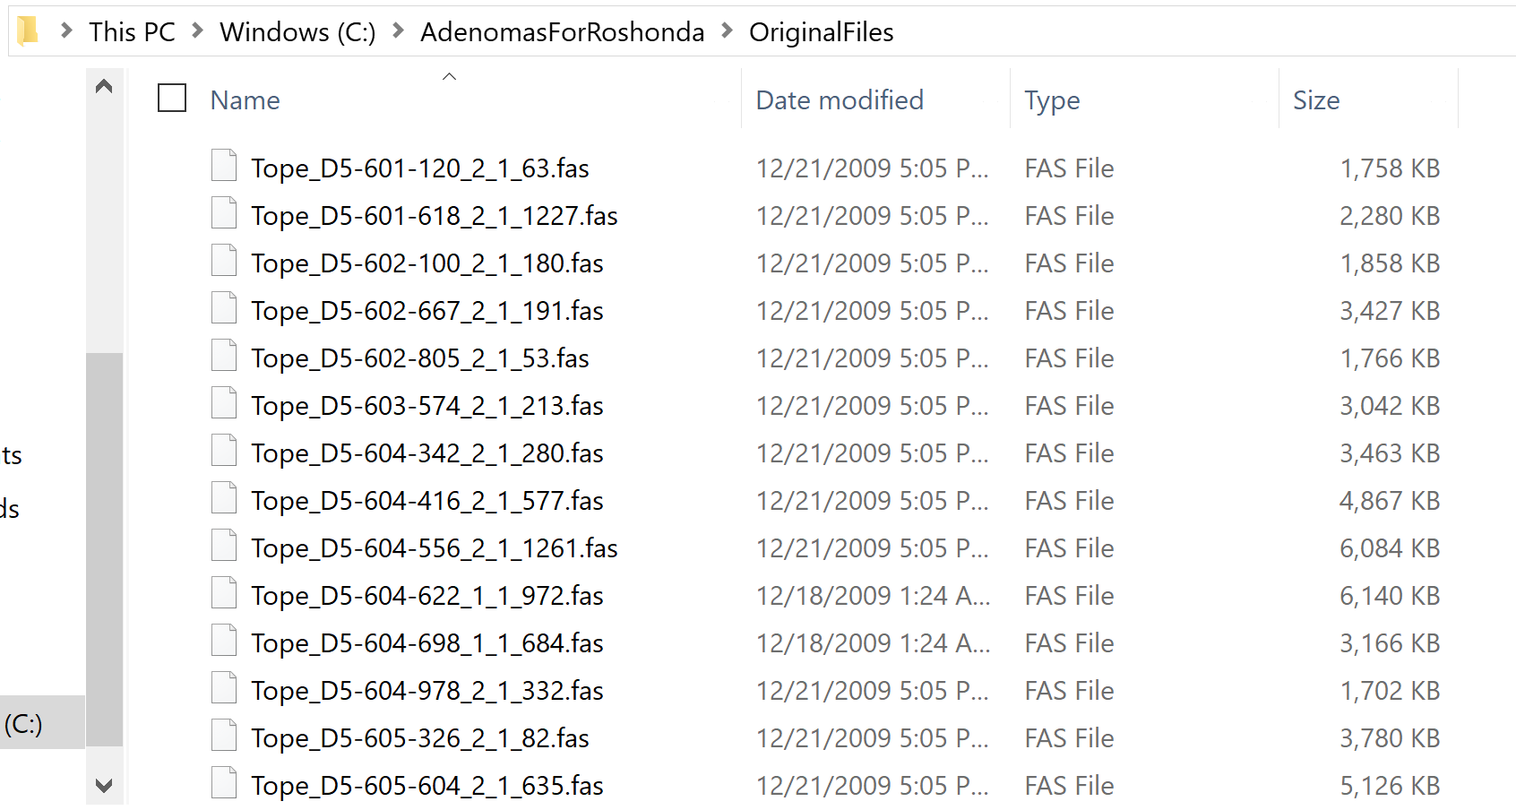
Consider simple code to collect all GC content over a series of Fasta files..
I have some directory of Fasta files..

Slide 3
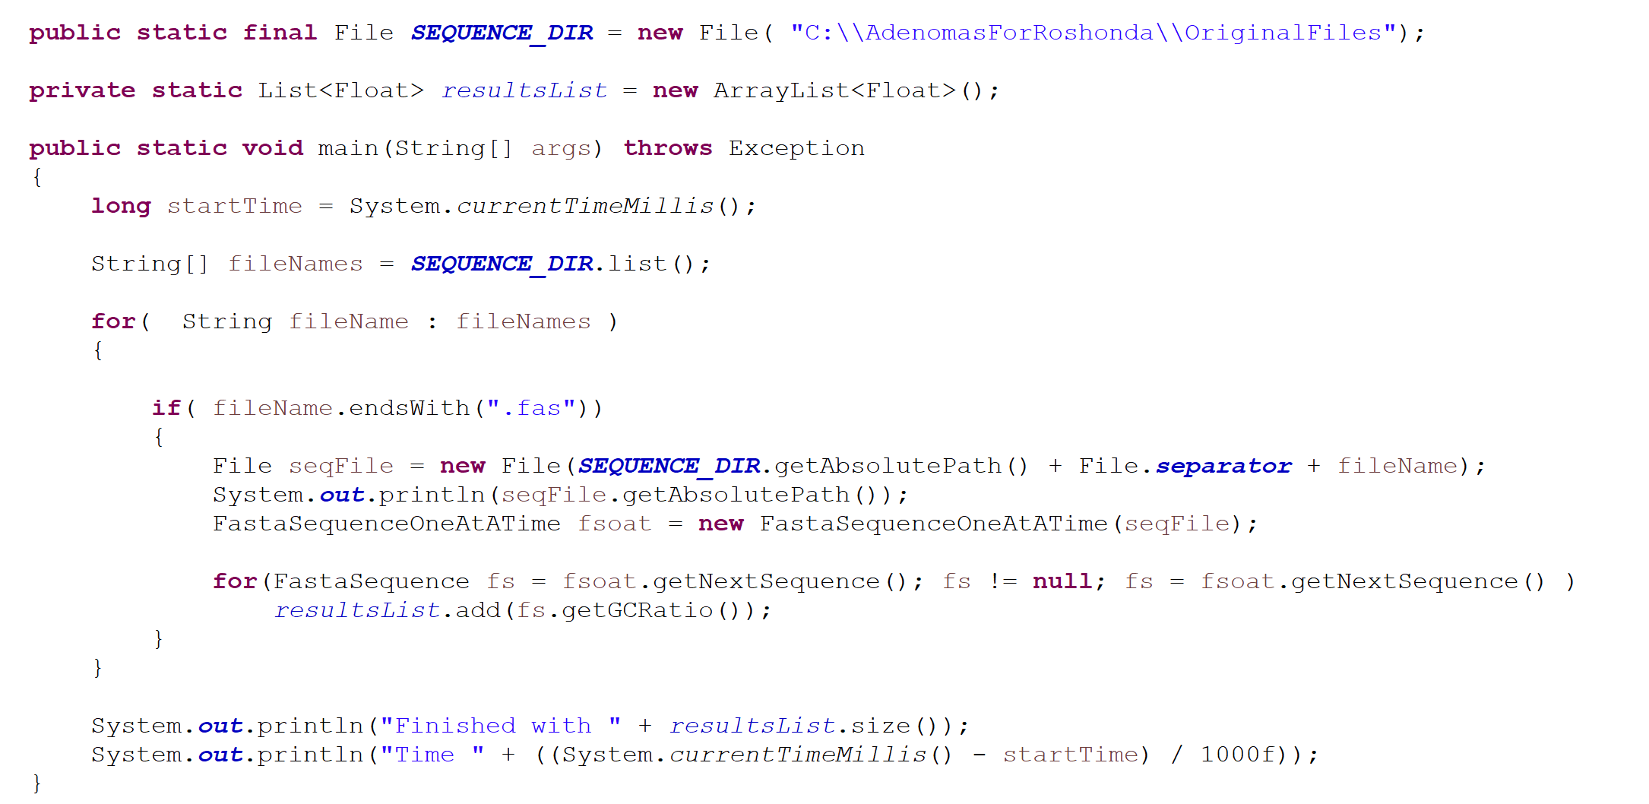
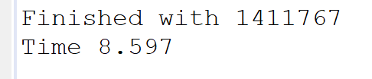
Let’s say my goal is to have all of the GC contents in a list…
At this point in the semester, this is not difficult to achieve in a single-threaded matter..
On a 4-core laptop (on battery power on an airplane) this takes about ~8.5 secs for
~ 1.4 million sequences
https://github.com/afodor/metagenomicsTools/blob/master/src/classExamples/semaphoreAndBlockingQueues/GatherAllGCSingleThread.java

Slide 4
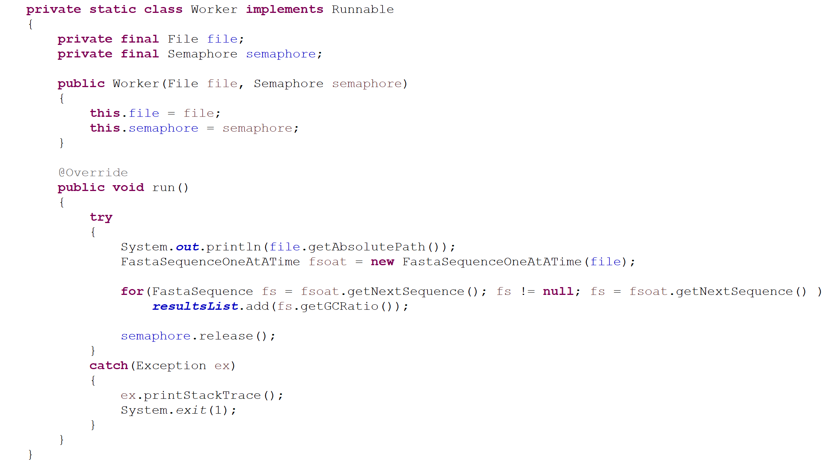
We’ve already seen how we can use the Semaphore to co-ordinate multiple threads.
Here we use a synchronized list (so we will grab and release the lock on the list
~1.4 million times)
Define # of
threads
Switch to a synchronized list
https://github.com/afodor/metagenomicsTools/blob/master/src/classExamples/semaphoreAndBlockingQueues/GatherAllCSSSimpleSemaphore.java

Slide 5
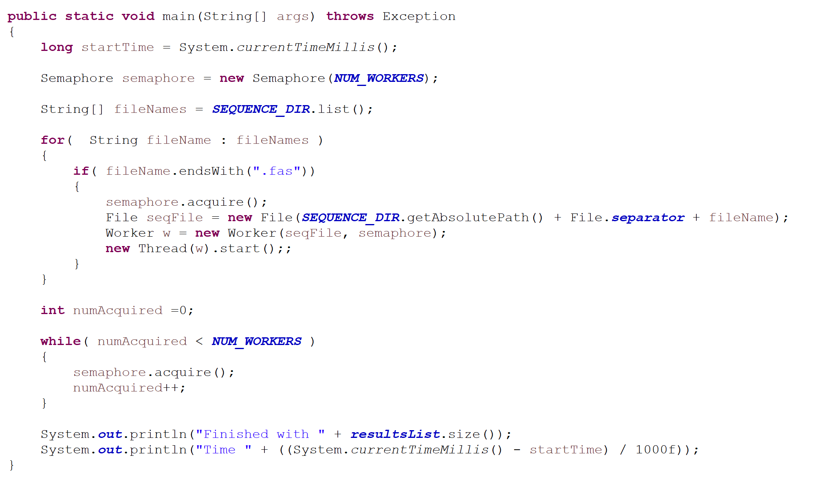

Our main method then just kicks off waits for the workers…
This buys about a factor of two on our four-core box…
(so the parallel parsing gained us more time than the 1.4 million lock requests on the list)

Slide 6
Semaphore
BlockingQueue
CountDownLatch
Callable, Future, FutureTask
Cancellation

Slide 7
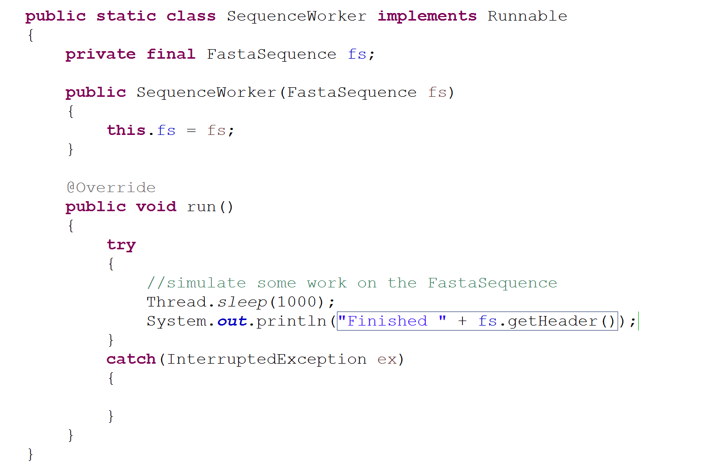
An alternative to a Semaphore is a Blocking Queue
How do we control how many threads do work on our Fasta Sequences?

Slide 8
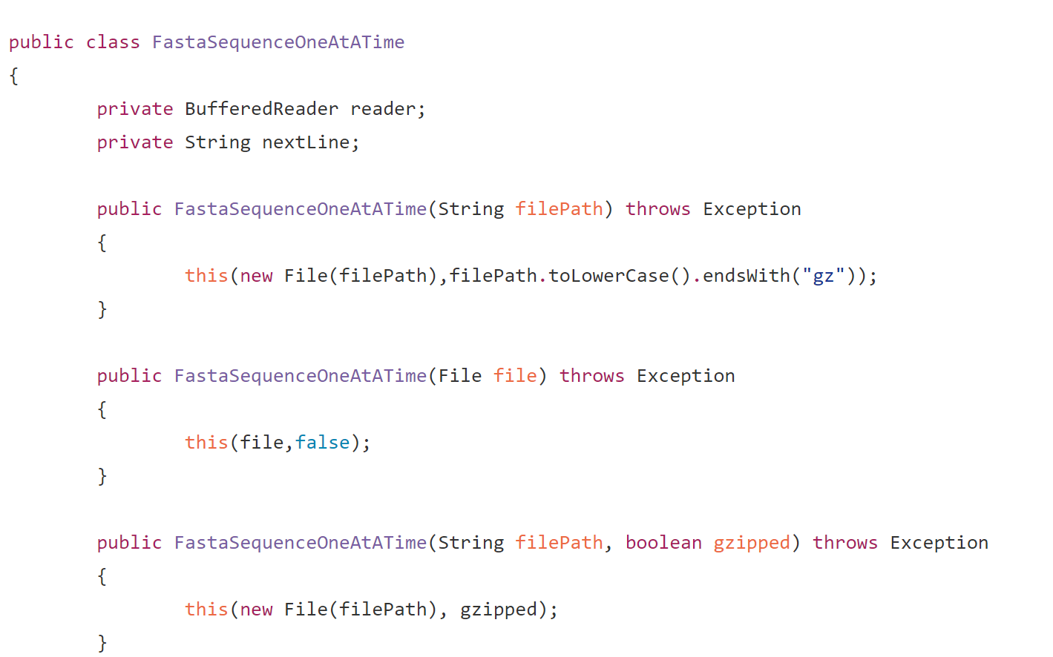
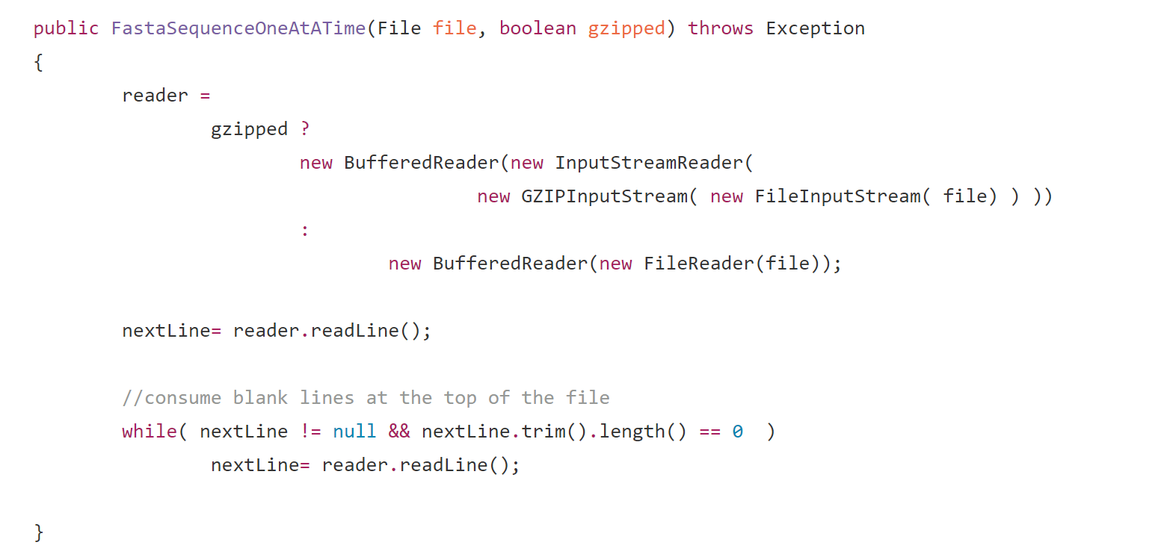
We make a class that can stream Fasta Sequences from the hard disk
https://github.com/afodor/metagenomicsTools/blob/master/src/parsers/FastaSequenceOneAtATime.java

Slide 9
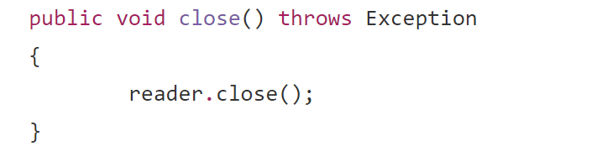
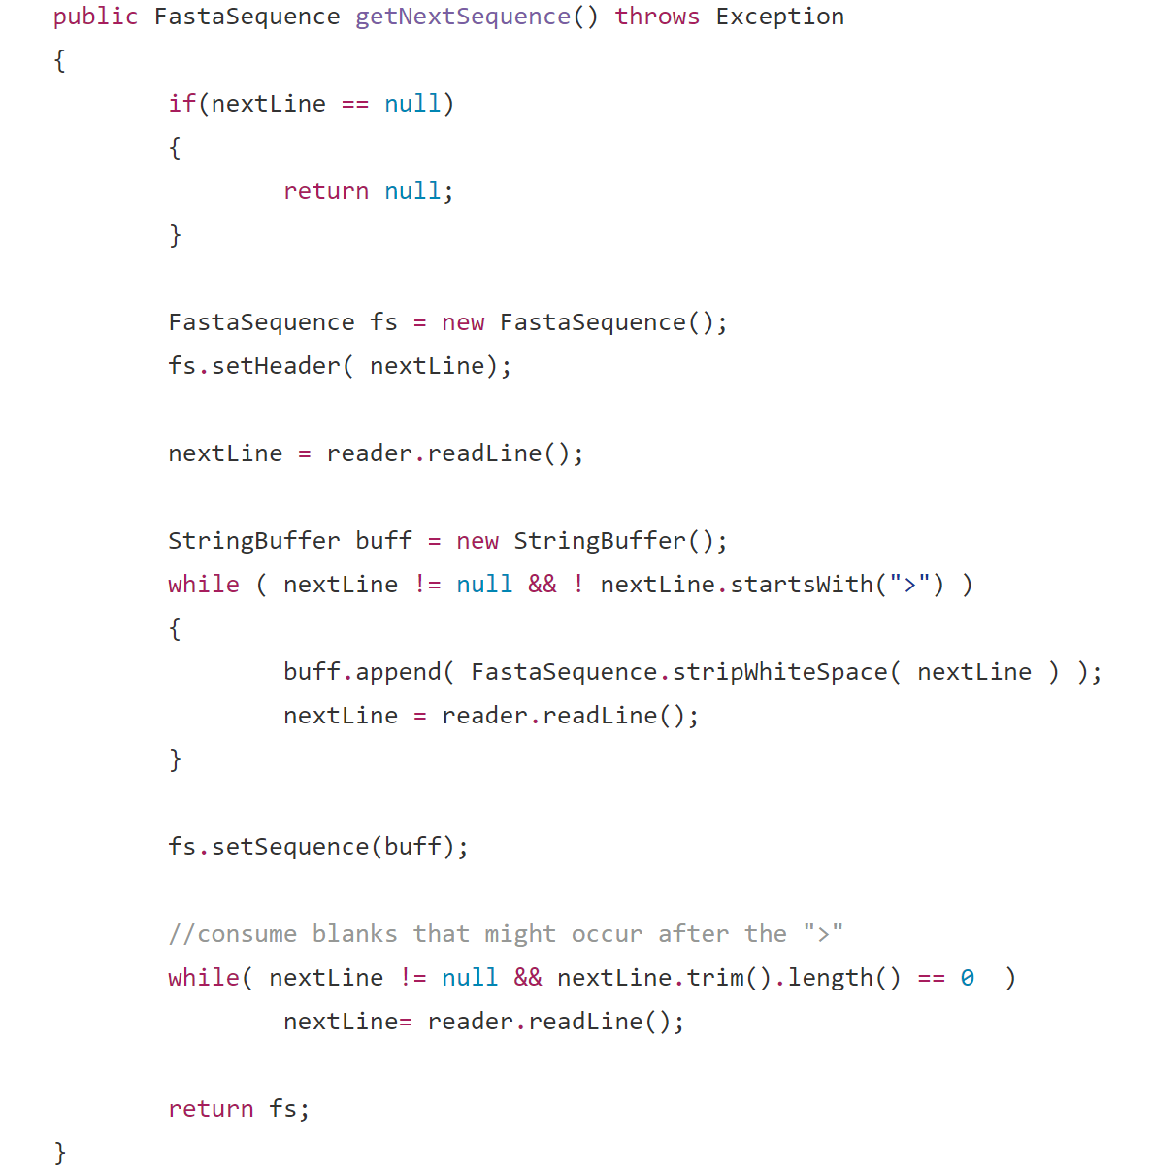
FastaSequenceOneAtATime (cont.)
https://github.com/afodor/metagenomicsTools/blob/master/src/parsers/FastaSequenceOneAtATime.java

Slide 10
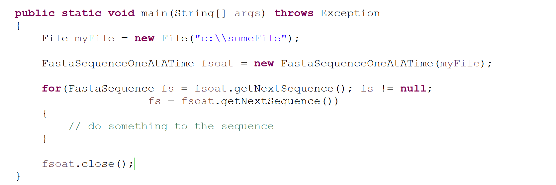
We can use our FastaSequenceOneAtATime to stream sequences (one at a time).
In this code, we do work in a single threaded way…

Slide 11
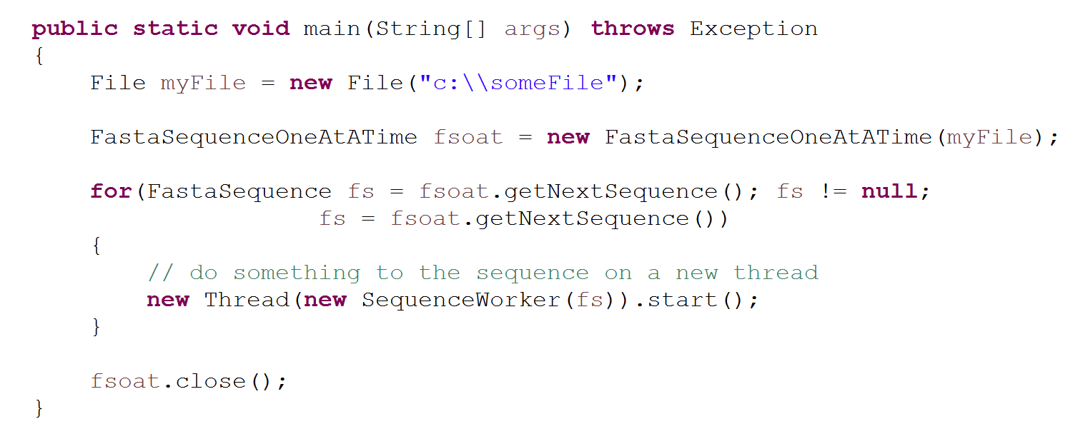
We can potentially kick off one thread per sequence,
but this has the potential to crash our system!!!
One thread will start per sequence

Slide 12
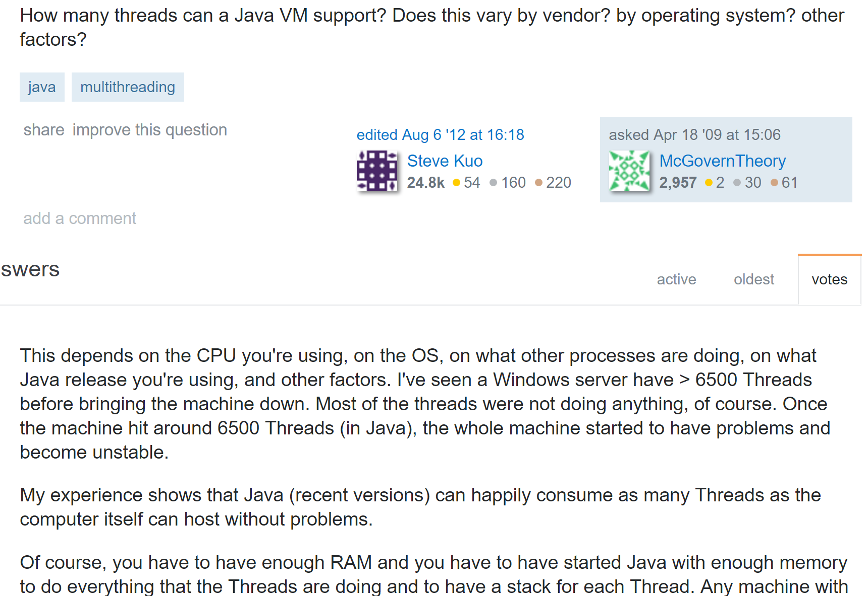
http://stackoverflow.com/questions/763579/how-many-threads-can-a-java-vm-support

Slide 13
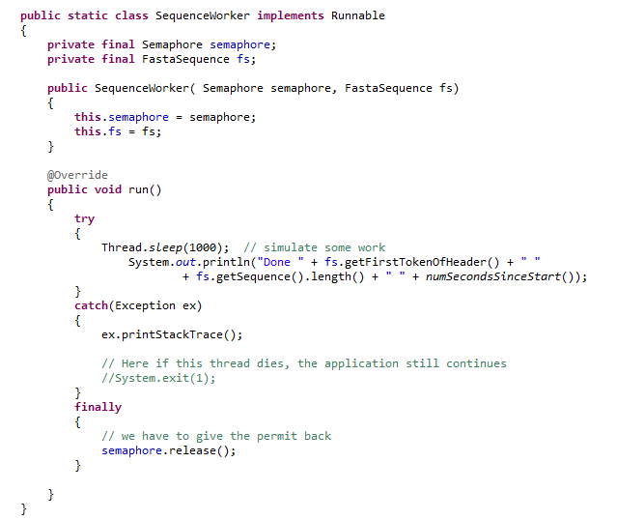
We’ve seen that one option to limit the # of threads is the Semaphore…

Slide 14
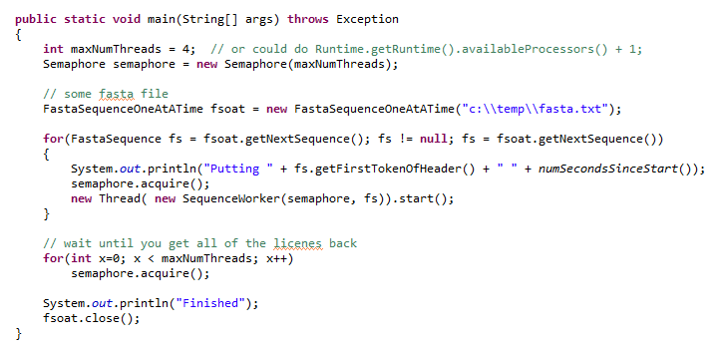
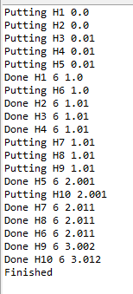
Our main method now spawns a set number of Threads at a time

Slide 15
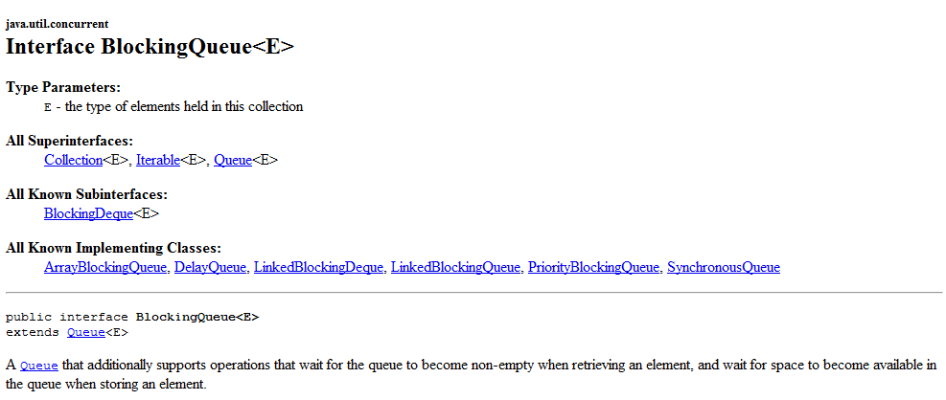
Another option to control how the work is managed is the BlockingQueue

Slide 16
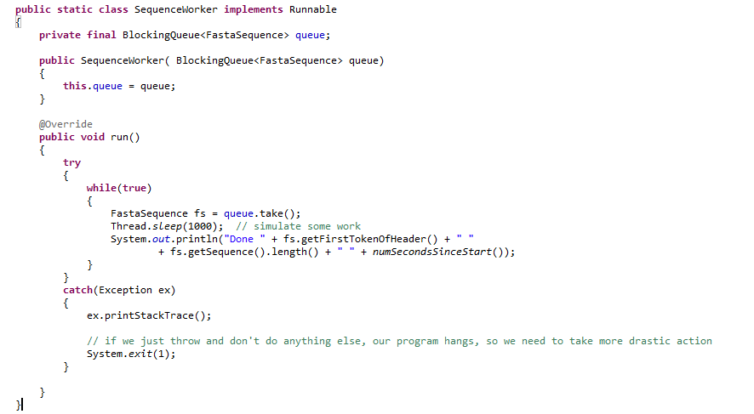
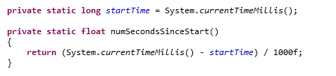
We modify our worker so that it takes a BlockingQueue instead of a FastaSequence

Slide 17
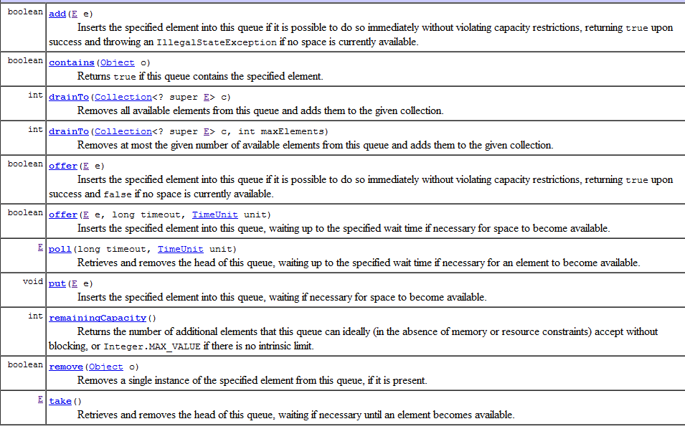

Slide 18
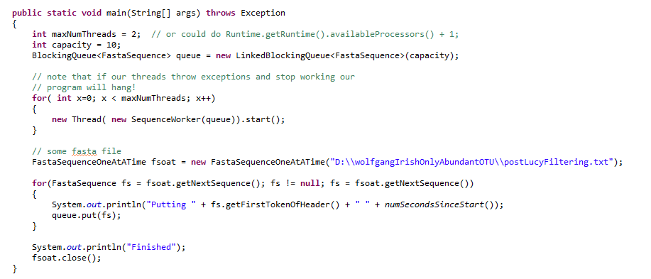
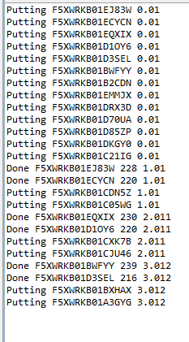
In our main method, we feed sequences one at a time into our BlockingQueue

Slide 20
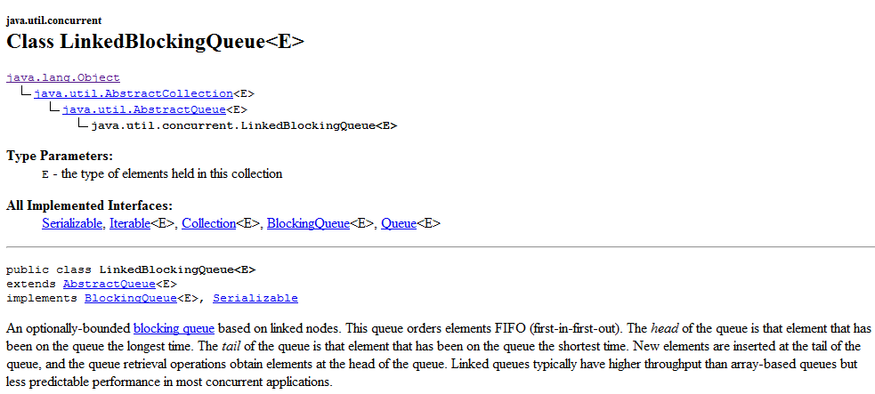
We have a number of implementations of BlockingQueue that control how the work gets
done…
We can change how the work is done by just instantiating a different BlockingQueue

Slide 21
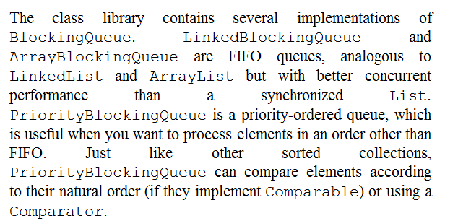
We can change how the work is done by just instantiating a different BlockingQueue

Slide 22
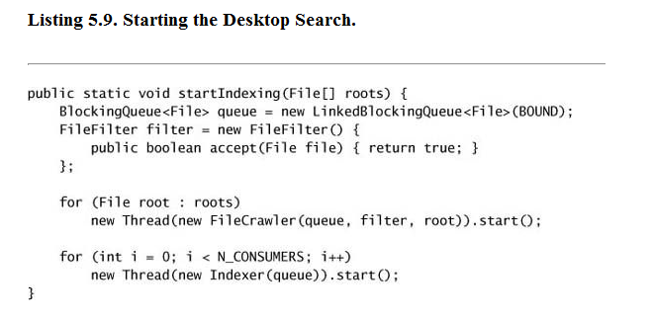
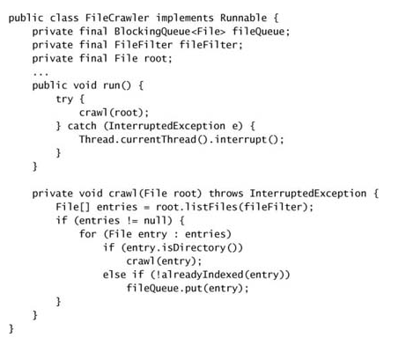
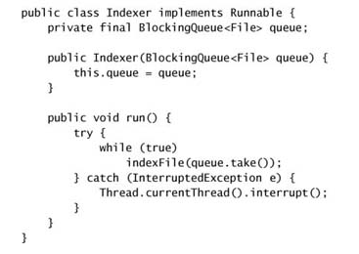
The textbook example, a search engine indexer…

Slide 23
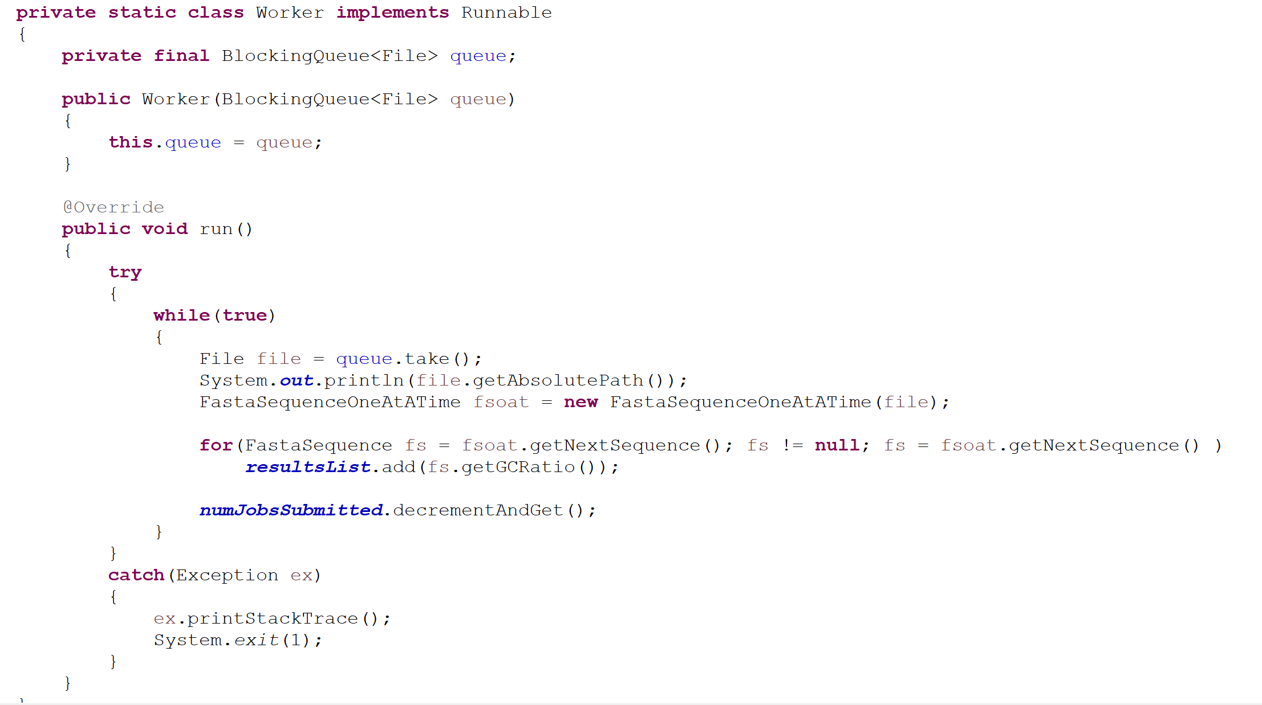
We can modify our one file at a time code to take a blocking queue
https://github.com/afodor/metagenomicsTools/blob/master/src/classExamples/semaphoreAndBlockingQueues/GatherAllGCBlockingQueue.java

Slide 24
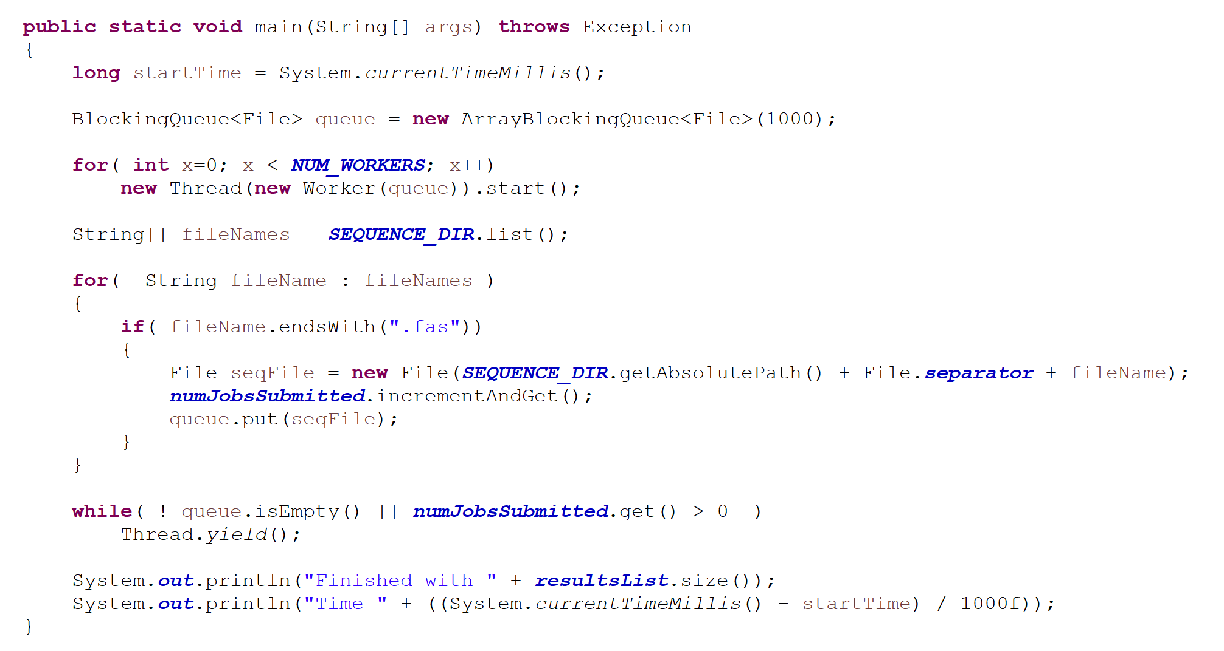

Our main method now starts workers, who all share a BlockingQueue…
Not surprisingly, this yields about the same performance as our Semaphore solution..

Slide 25
Semaphore
BlockingQueue
CountDownLatch
Callable, Future, FutureTask
Cancellation

Slide 26
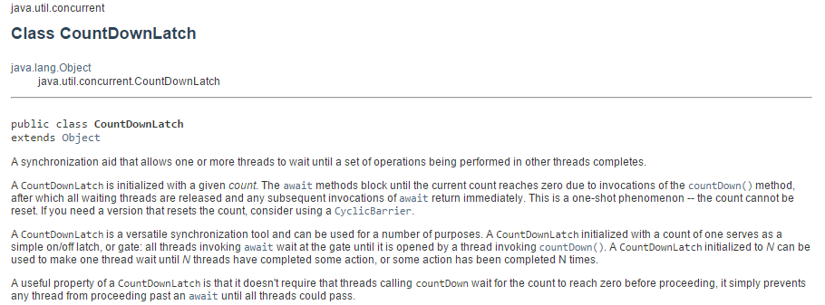
CountDownLatch is very useful (and easy to use)
new CountDownLatch( … ) is called with the number of threads.
.await() blocks until .countDown() is called the correct number of times..
If you know you want x number of threads to run and then move on when they are all
done, the CountDownLatch works nicely…

Slide 27
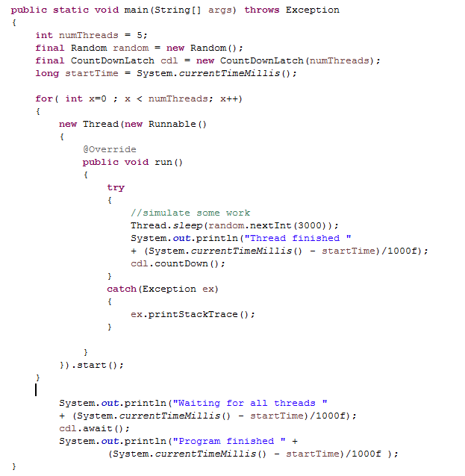
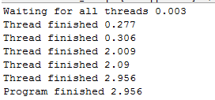
We’ve already seen examples of CountDownLatch this semester..
Very useful and easy to use way to coral your threads…

Slide 28
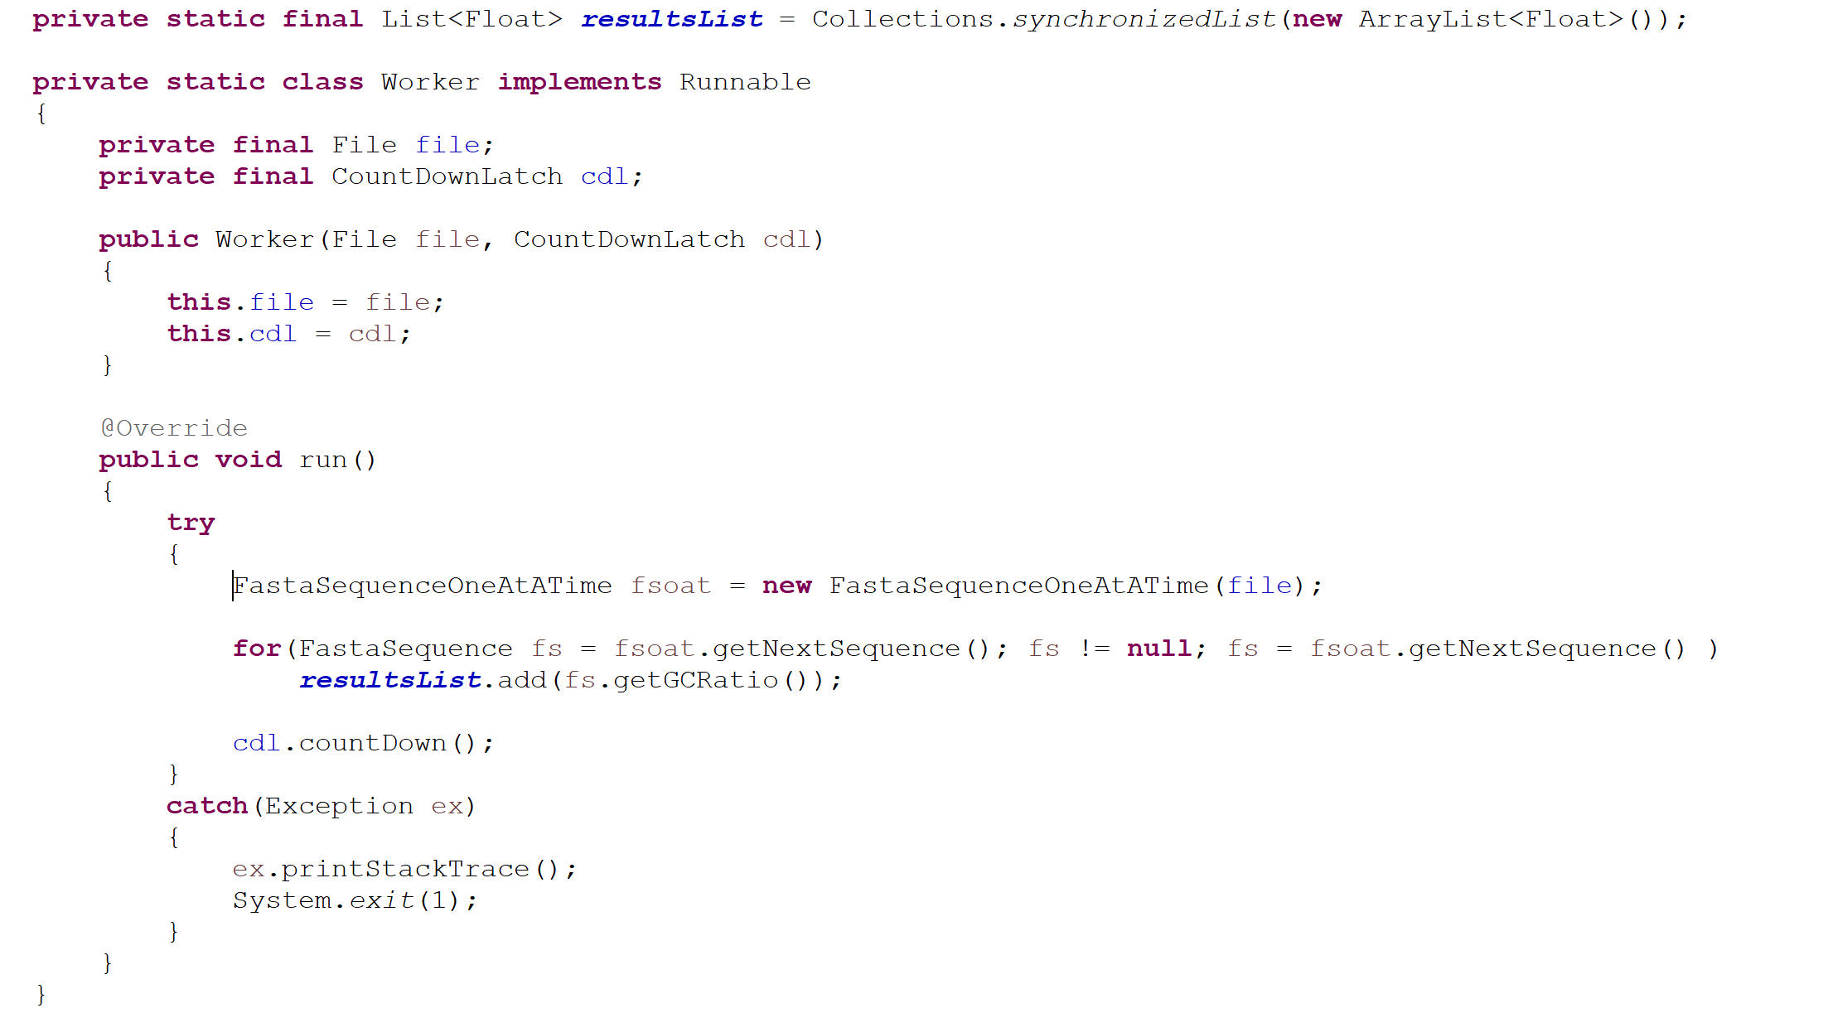
We can use the CountDownLatch to launch one thread per file
(this works surprisingly well…)
Our worker now takes the CountDownLatch in the constructor
https://github.com/afodor/metagenomicsTools/blob/master/src/classExamples/semaphoreAndBlockingQueues/GatherAllCSSCountdownLatch.java

Slide 29
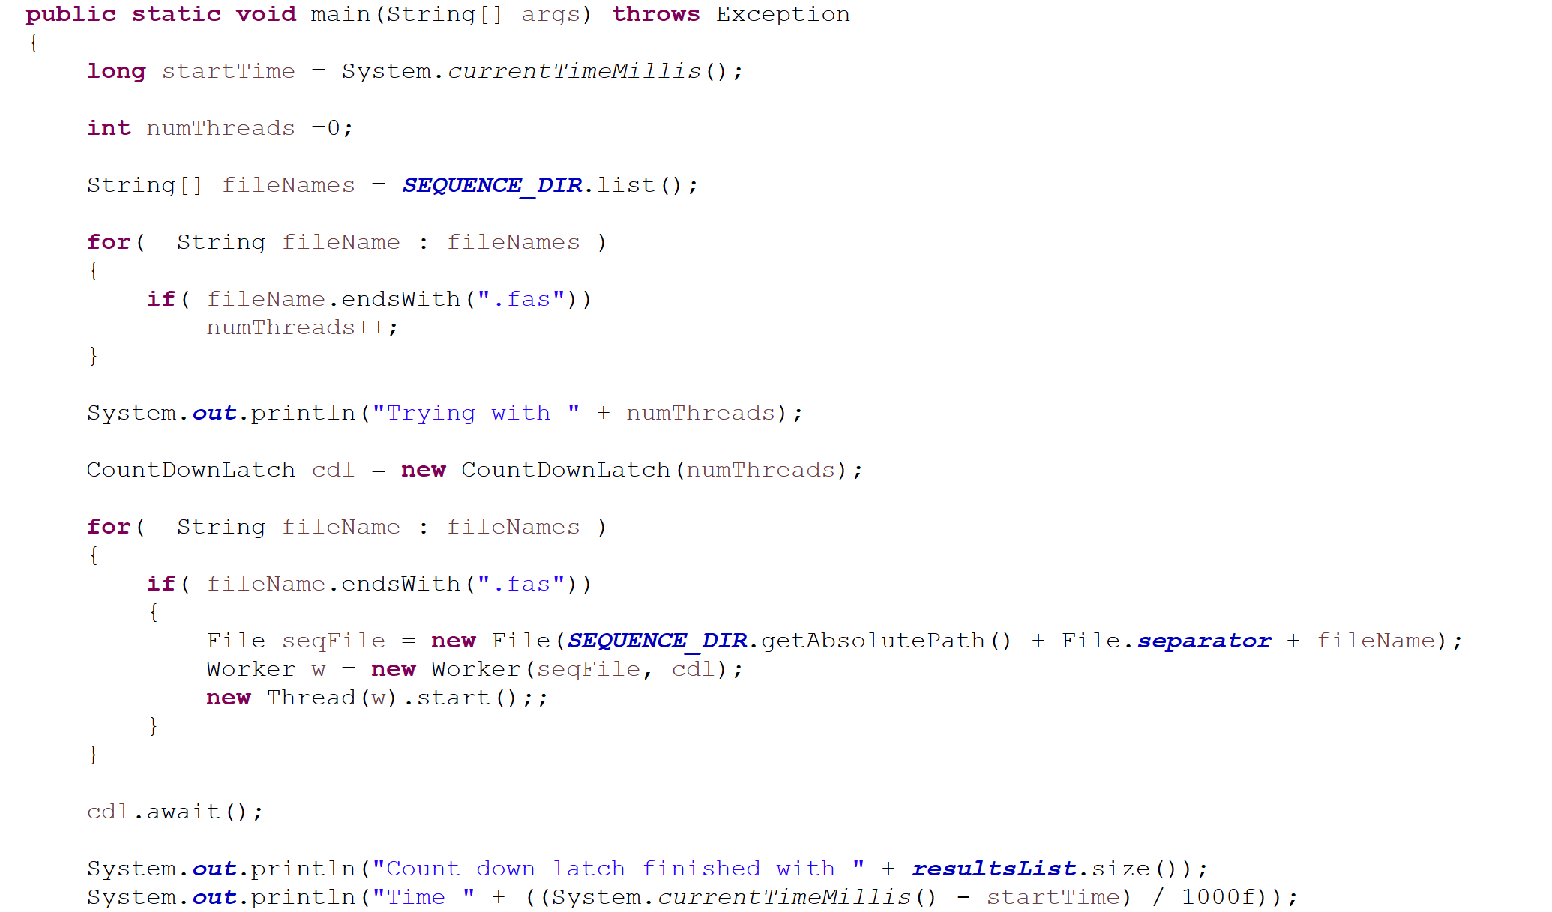
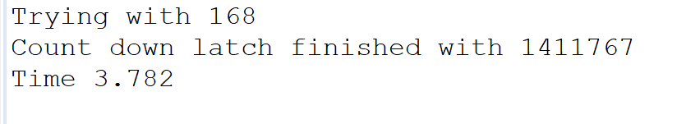
Our main method now calculates the required number of threads and initiates
168 threads works surprisingly well

Slide 30
BlockingQueues
A Peak calling example with semaphore
CountDownLatch
Callable, Future, FutureTask
Cancellation

Slide 31
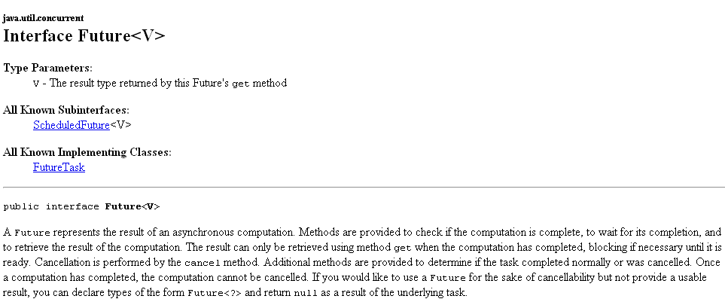
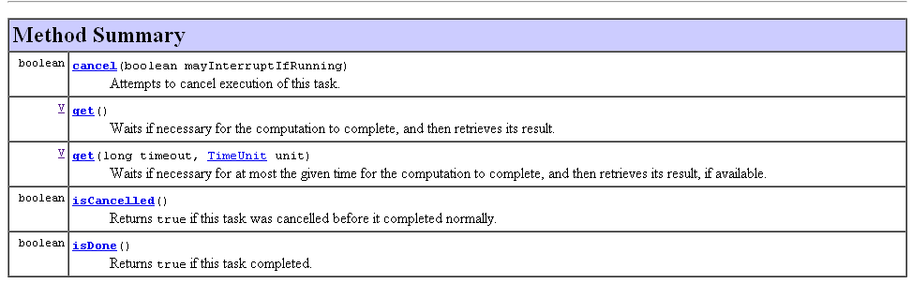
Future – Holds the results of some calculation

Slide 32
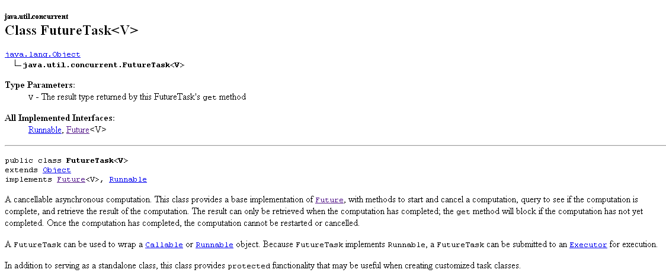
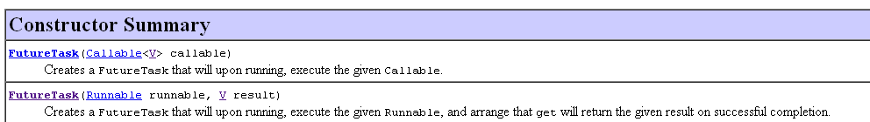
A FutureTask is an implementation of Future that we can use
When you construct, you need to pass in a Runnable or a Callable

Slide 33
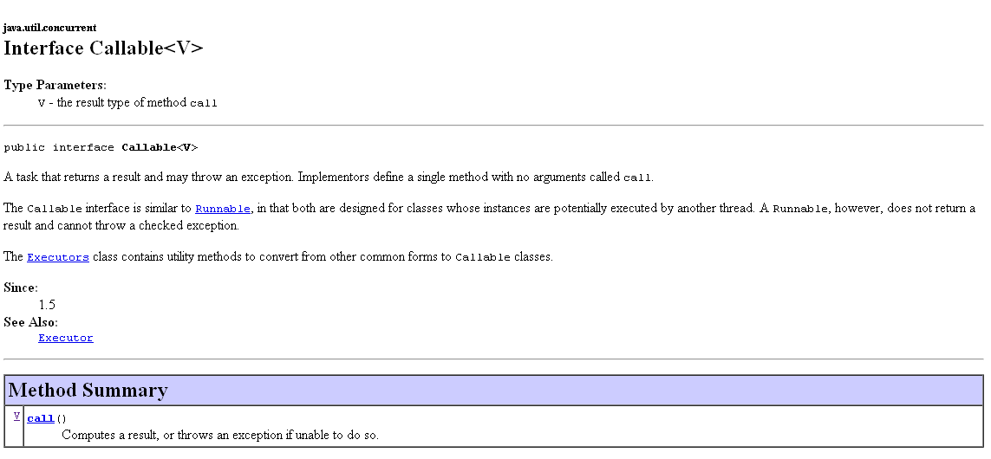
A Callable is like a Runnable, except it has a return type V
(and can throw an Exception, which is very nice)

Slide 34
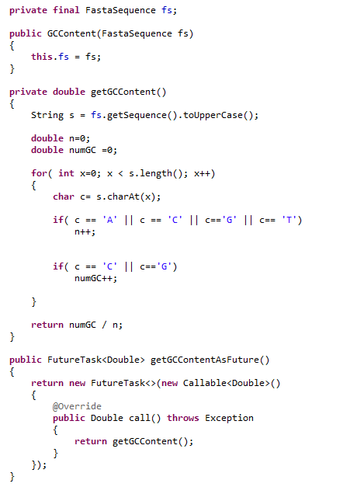
This class calculates GC content
in a background thread.
We can either getGContent()
now ( which will run in the
current thread)
Or get an object that will
allow the calculation of GC
content to run in a background
thread (but invoking
getGCContentAsFuture() will
return instantly).

Slide 35
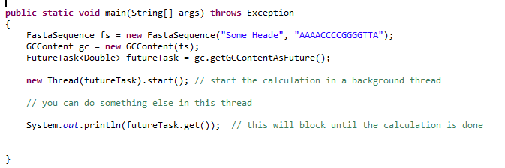
In this method, we spawn a calculation in a background thread…

Slide 36
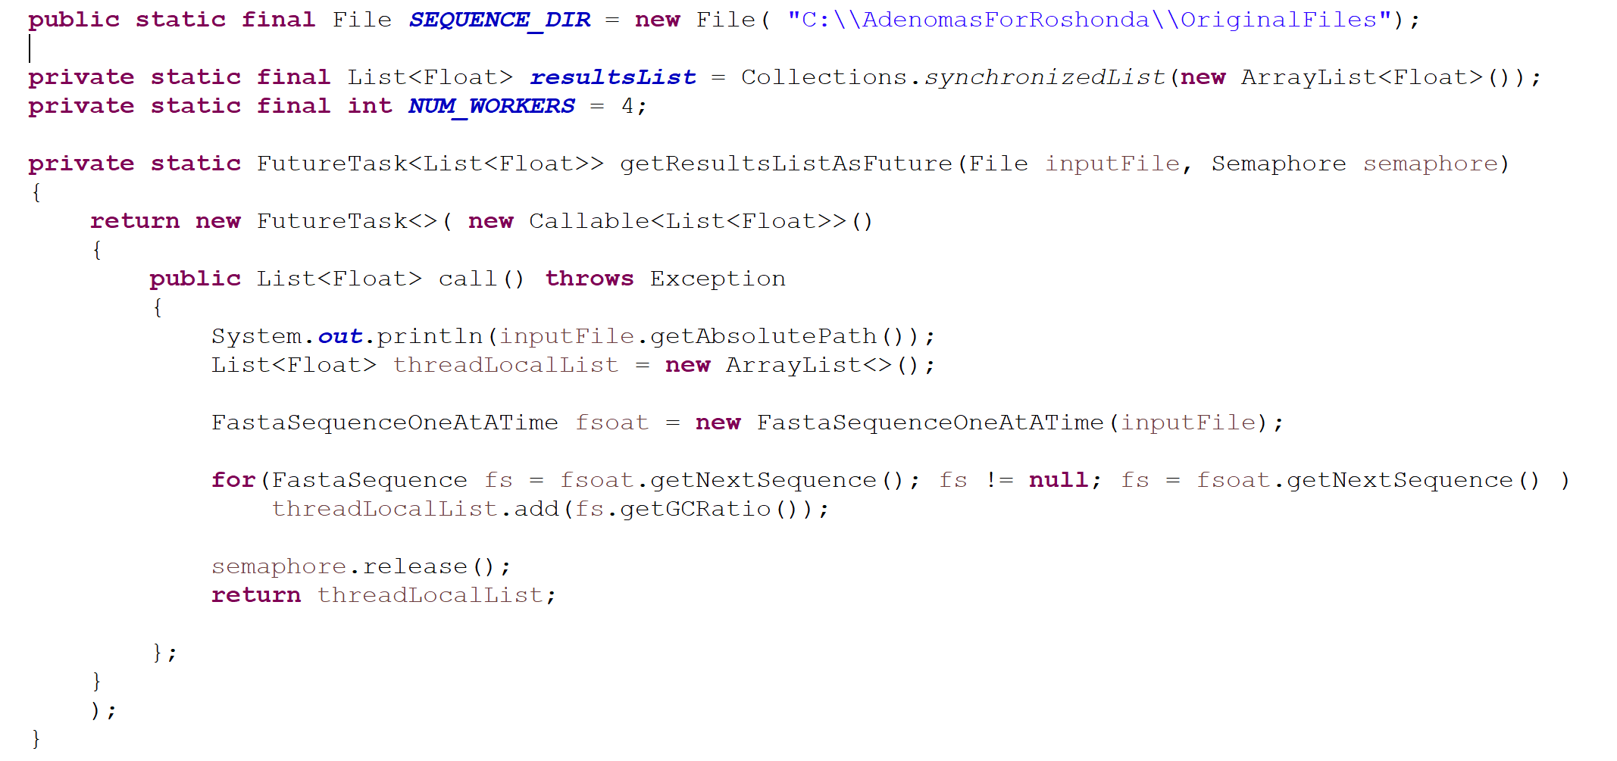
We can combine semaphore and FutureTask
Our worker gets replaced with a function that returns a FutureTask
https://github.com/afodor/metagenomicsTools/blob/master/src/classExamples/semaphoreAndBlockingQueues/GatherAllCSSSemaphoreAndFutureTask.java

Slide 37
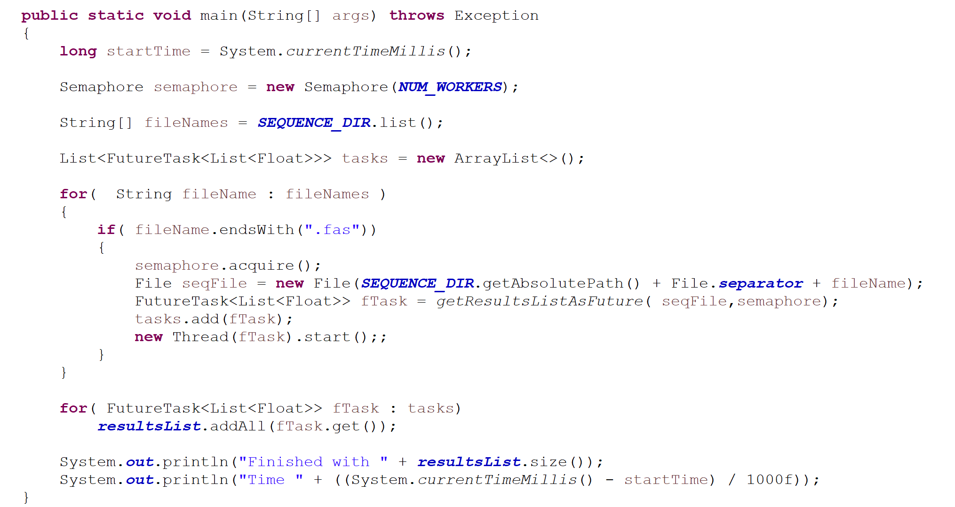
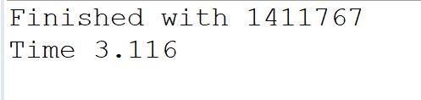
Our main method calls these FutureTasks 4 at a time (if NUM_WORKERS is set to 4)
Will block until last Callable finishes
This approach yields comparable performance
to our other multi-threaded approaches

Slide 38
BlockingQueues
A Peak calling example with semaphore
CountDownLatch
Callable, Future, FutureTask
Cancellation

Slide 39
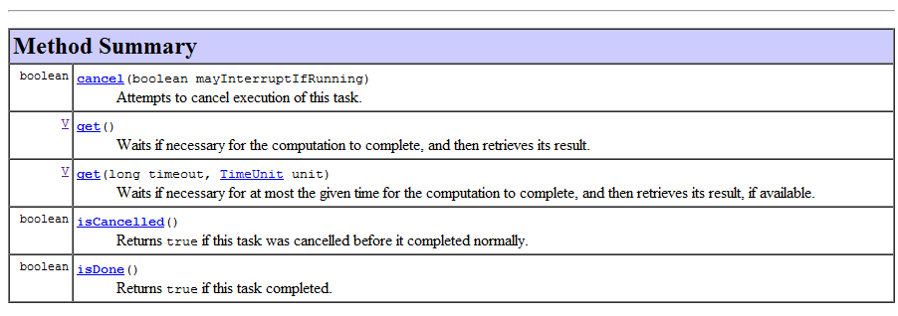
Future also supports cancellation, but this is dependent upon the co-operation of the
running threads…

Slide 40
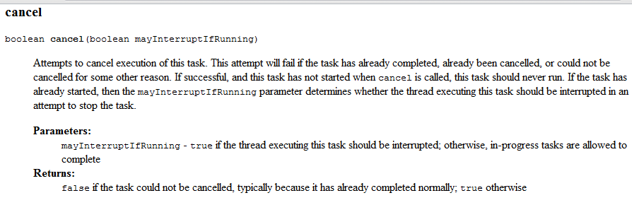
Thread.sleep and nearly all other Java blocking methods support cancellation.
If your code is working on something, it is up to you to check for cancellation
(which means checking for interruption).
More on this on Chapter 7.

Slide 41
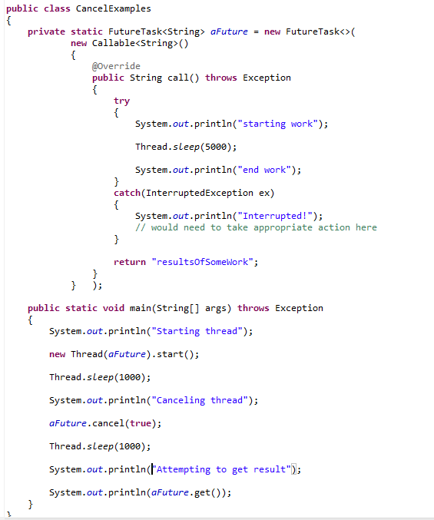
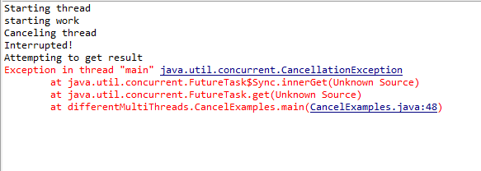
Calling cancel causes an Interruption flag to be set.
Thread.sleep(..) checks that interruption flag and
If it is set throws InterruptedException.
Calling get() after cancel, throws a CancellationException

Slide 42
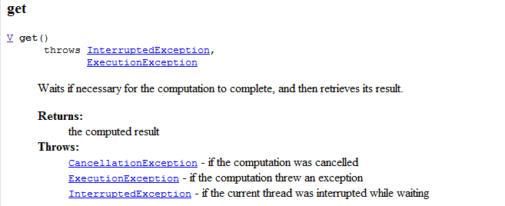

Slide 43


If you are not using one of Java’s blocking methods (like Thread.sleep()) that supports interruption, it is up to you to check for cancellation.
We don’t check for cancellation
Our thread continued to work after cancellation
get still throws!

Slide 44


Our cancellation now works
The thread is successfully cancelled. “end work” is not reached

Slide 45



If we throw a normal
Exception (not InterruptedException)…
Then get re-throws that Exception

Slide 46
Next: Deadlock…

