Slide 1
Matrix form of Linear Regression
The F distribution
ANOVA approach to Linear Regression

Slide 2





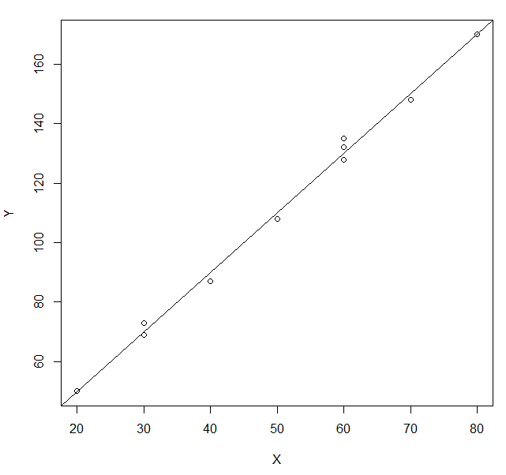
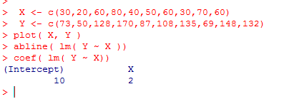
X <- c(30,20,60,80,40,50,60,30,70,60)
Y <- c(73,50,128,170,87,108,135,69,148,132)
B₀
+
B₁
+
=
Linear least square fit finds B0 and B1 to guarantee that
residual sum-square is a minimum
Y = B₀ + B₁X + e

Slide 3
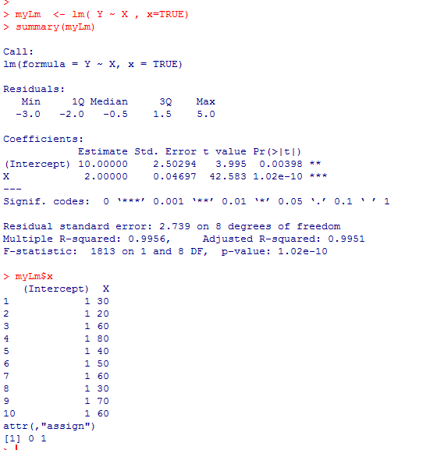
By setting “x=true”, we can keep R’s version of the
matrices used to find the parameters

Slide 4
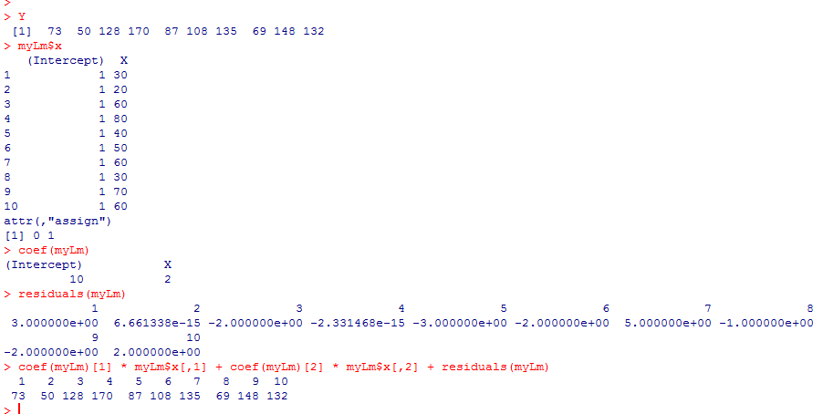
We can get R to give us all of the pieces used in the fit…
Y = B₀ + B₁X + e

Slide 5
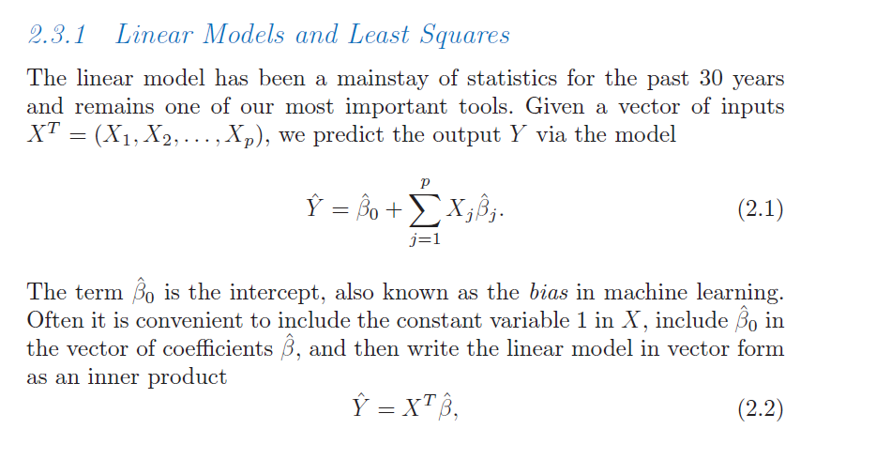
We can make this even more concise…
Hastie et al: The elements of Statistical Learning
http://www-stat.stanford.edu/~tibs/ElemStatLearn/download.html

Slide 6
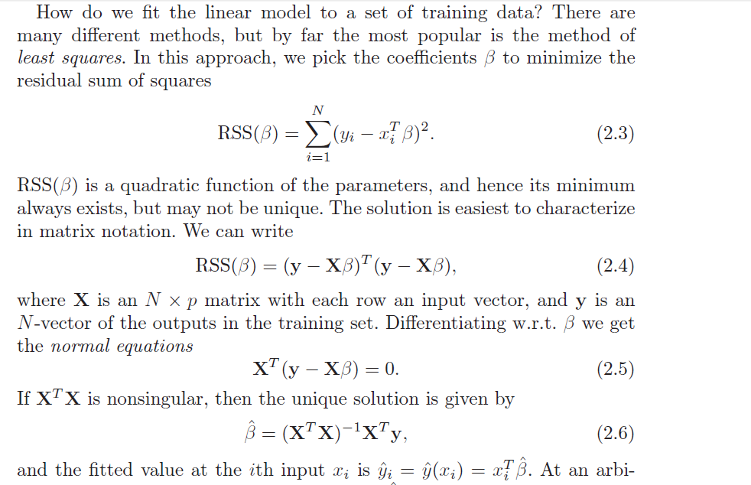

Slide 7
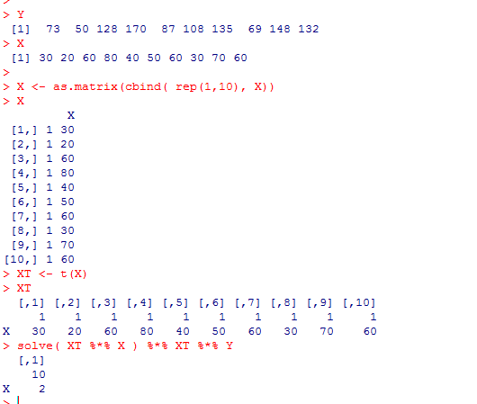
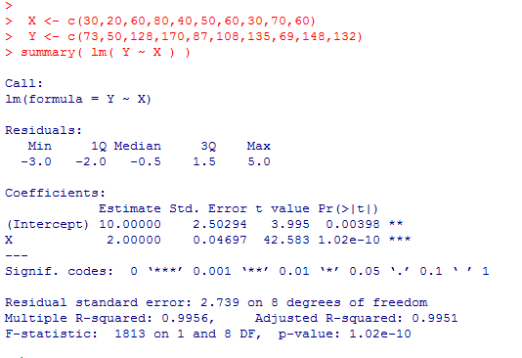

So we can find least square parameters easily with a few line of
matrix manipulation

Slide 8
Matrix form of Linear Regression
The F distribution
ANOVA approach to Linear Regression

Slide 9
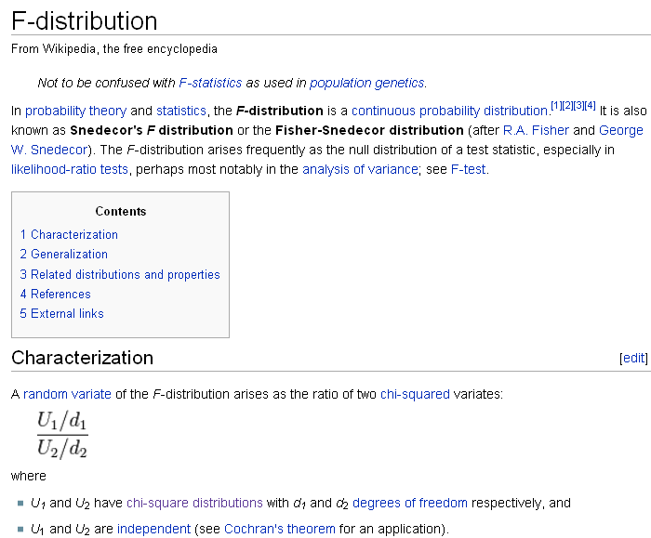

Slide 10
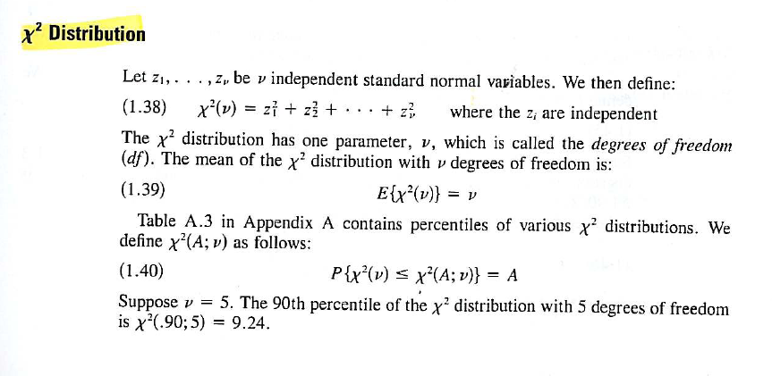
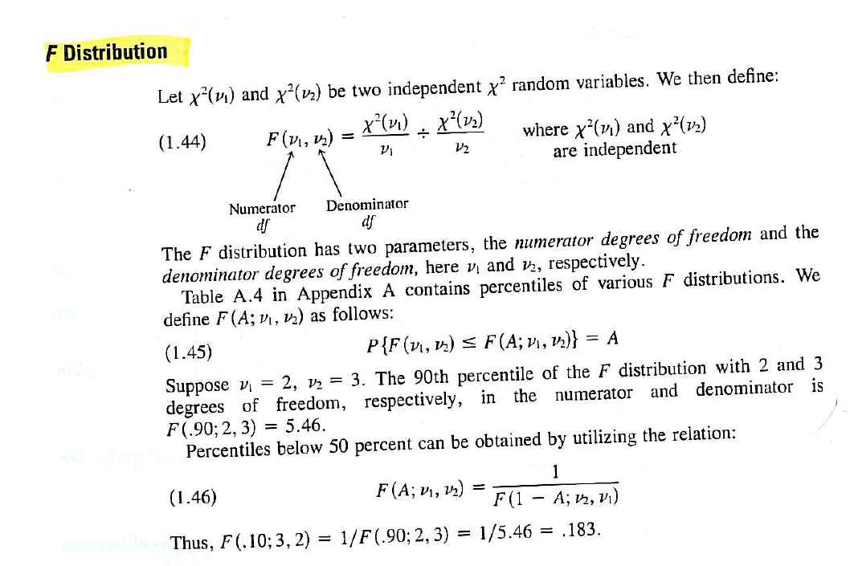
The F distribution is built on the Chi-square distribution…
Neter et al - Applied Linear Statistical Models

Slide 11
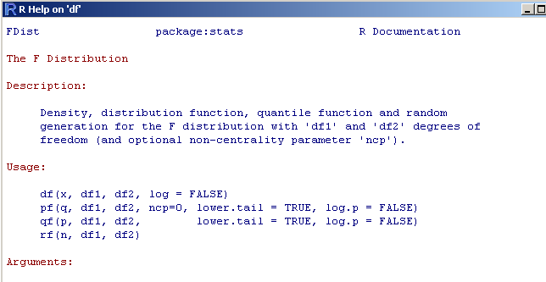
As usual df, pf, qf, rf….

Slide 12
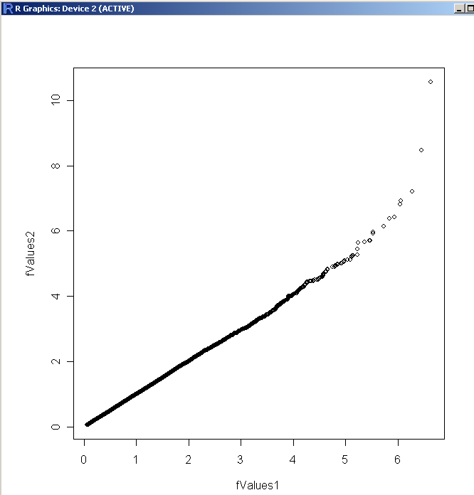
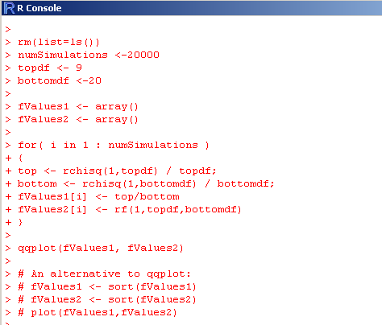
You can guess how to use these methods without looking at the documentation…
Here is a demonstration that the definition of F is correct…

Slide 13
Matrix form of Linear Regression
The F distribution
ANOVA approach to Linear Regression

Slide 14
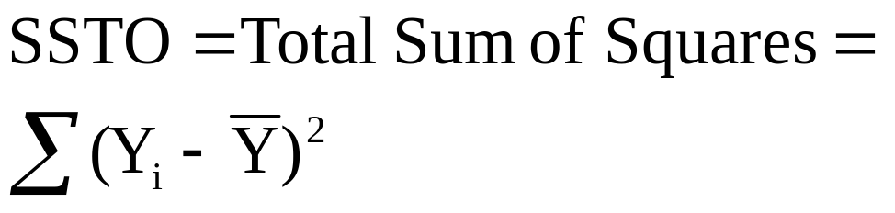
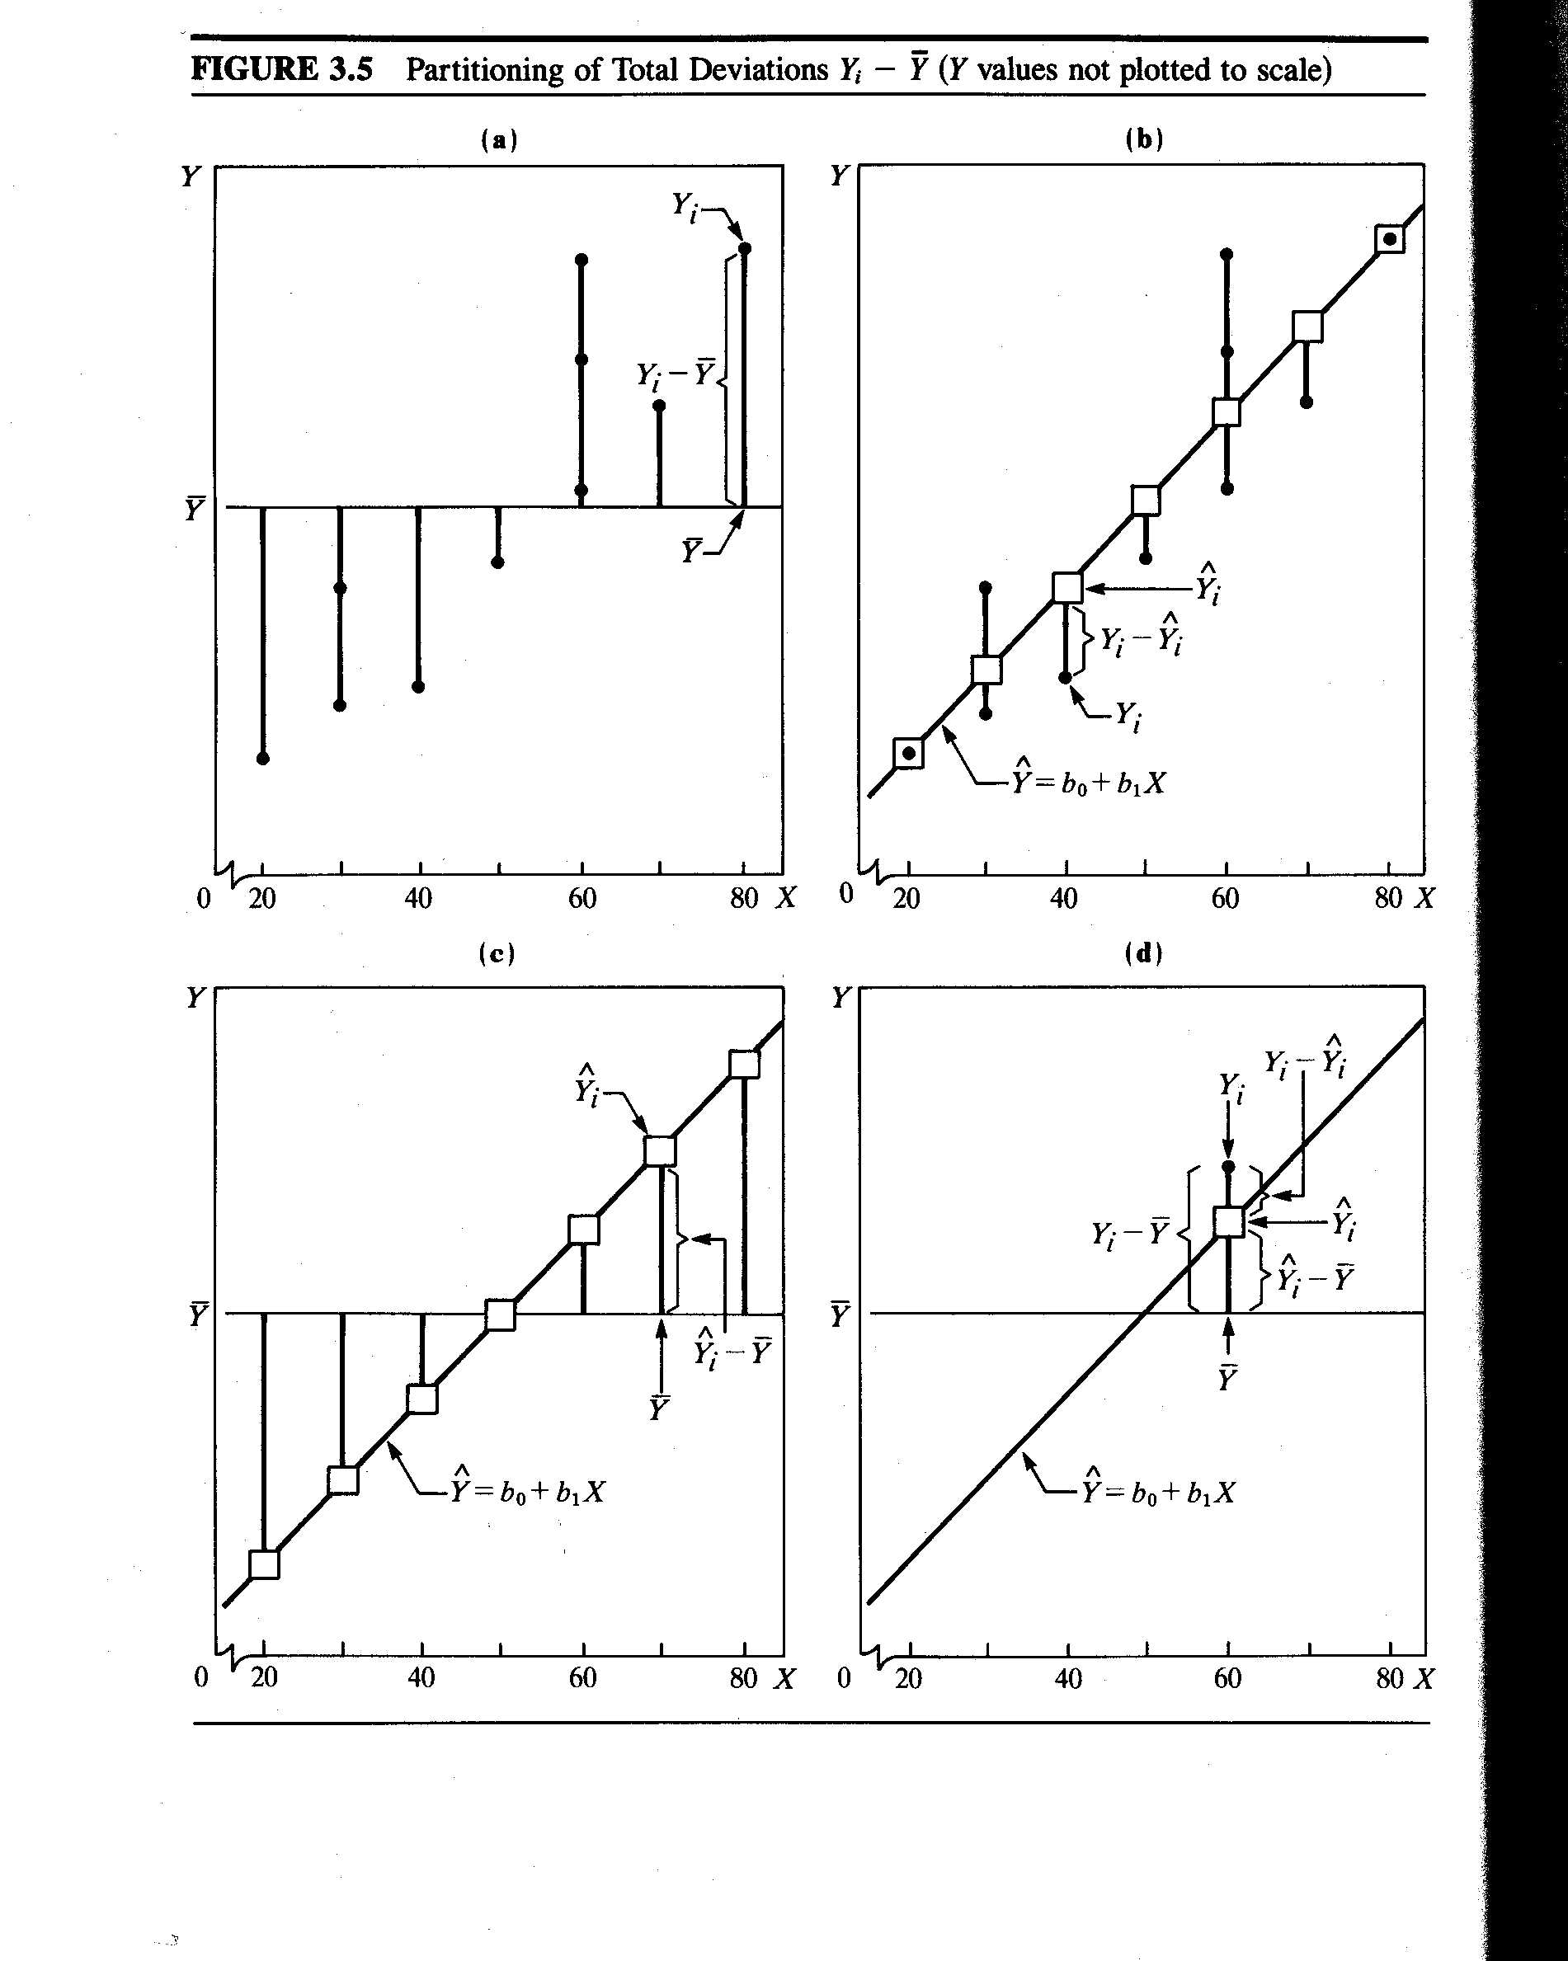
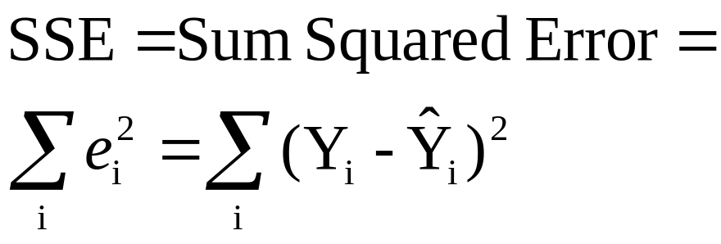
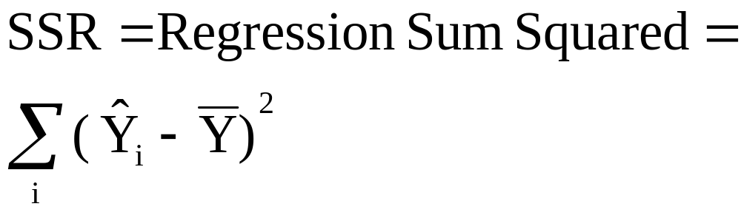
There is another path to inference based on ANOVA…
SSTO = SSE + SSR
ANOVA test partitions the “good”
variance SSR vs.
the “bad” variance SSE.

Slide 15
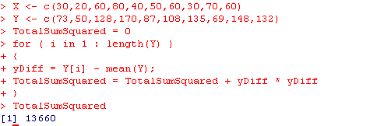

Total Sum of Squares in R
or

Slide 16
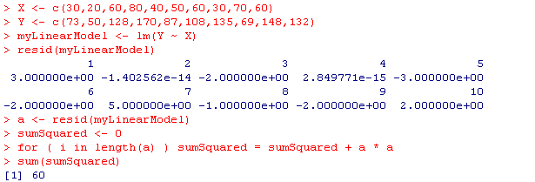
Sum squared error in R

Slide 17
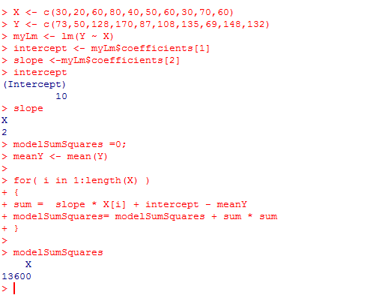
Regression squared sum in R:

Slide 18
SSTO = SSE + SSR
13600 = 60 + 13000
ANOVA test partitions the “good” variance SSR vs.
the “bad” variance SSE.

Slide 19
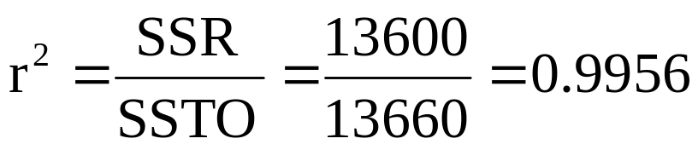
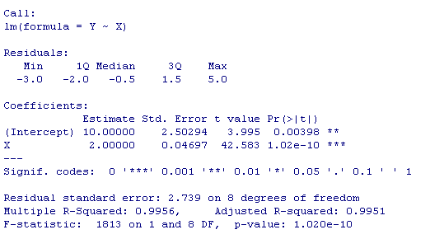
Define r-squared
Alternatively…
> cor(Y,X) * cor(Y,X)
[1] 0.9956076

Slide 20
We have
Y = B₀ + B₁X + e
We want to know if B1 is significantly different than 0.
In the previous lecture, we saw how to do this with the t-distribution.
That’s what R gives us when we type summary()

Slide 21



Alternatively, we can compare the error of the full model:
Y = B₀ + B₁X + e
8 d.f. associated with this model (there are 2 parameters with 10 data points)
How much error would we have if B1 is equal to 0 in the reduced model?
Y = B₀ + e
The value of B₀ that minimizes the error is just the mean.
So the sum squared error is
There are 9 d.f. associated with this model
(there is 1 parameter with n=10)

Slide 22

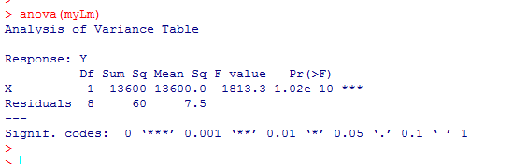
Our ANOVA statistic is:
(reduced error – full error)/ (reduced DF – full DF)
(Full error)/ (full DF)
( 13660 – 60 ) / (9-8 )
(13600) / 1
=
=
1813.3
(60)/ (8)
7.5
If the parameter didn’t make much of a difference,
the full and reduced error would be similar….
In this case, the extra parameter makes a huge difference
We say, this is F distributed with df = (1,8)
This is what R does when we type ANOVA (lm)
Zeros out the parameters and asks whether
the error changes by a significant amount

Slide 23
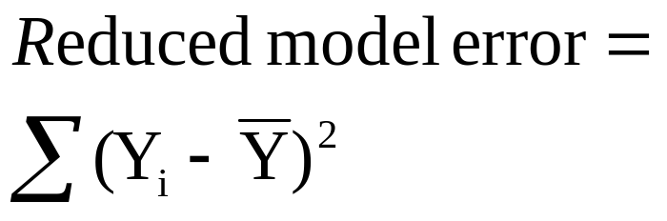
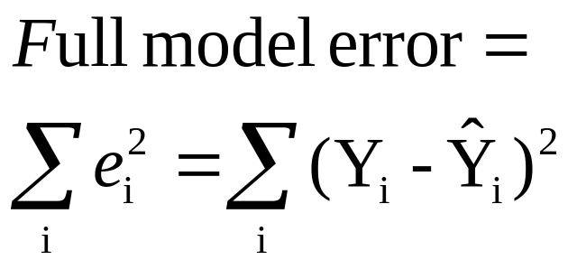
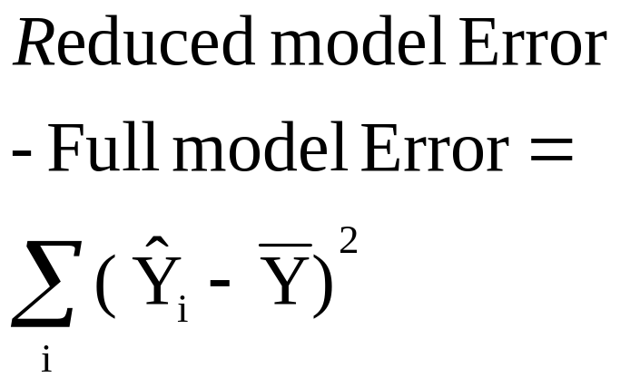
Visually
Neter et al - Applied Linear Statistical Models

