Slide 1
RNA-seq Dataset for the labs

Slide 2
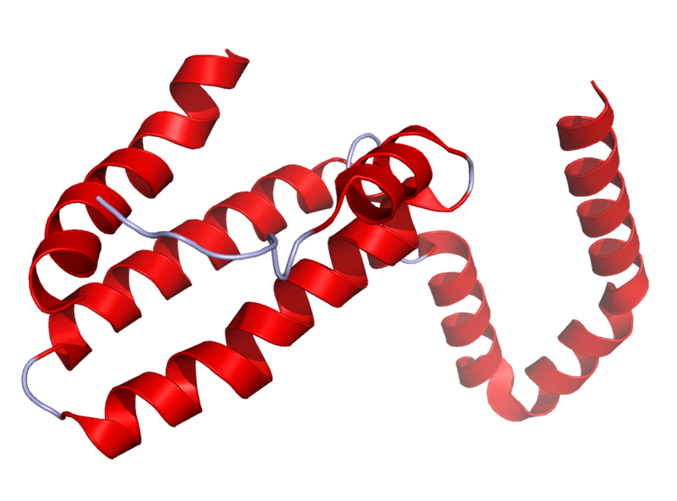
Il10^{-\-} Mouse Model
Il10 is an anti-inflammatory cytokine.
Inhibits pro inflammatory cytokines
Acts as an immunoregulator in the GI tract.
Lamblin, C., et al.,The Journal of allergy and clinical immunology, 2001.
http://en.wikipedia.org/wiki/Interleukin_10
Il10-\-
Il10^{-\-} mice are prone to inflammation with commensal tolerated by WT mice.
Knoch, B., et al.,Microbiology-Sgm, 2010
Established model for investigating disease phenotypes associated with inflammation

Slide 3
Sterile IL10-/- Mice
Inoculated with E. Coli
day 2, 12 weeks, 18 weeks
Mouse fecal samples
RNA-seq on E. Coli transcripts
Assign each gene by mapping to known E. Coli genes

Slide 4
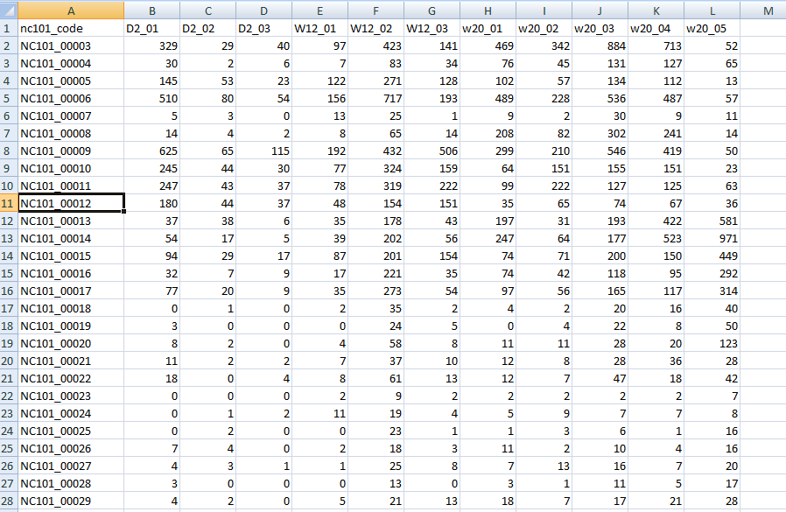
The dataset is at github…
http://afodor.github.io/classes/stats2015/longitdunalRNASeqData.zip
File = nc101_scaff_dataCounts.txt

Slide 5
The dataset is at github…
Day 2
Week 12
Week 18
File = nc101_scaff_dataCounts.txt

Slide 6
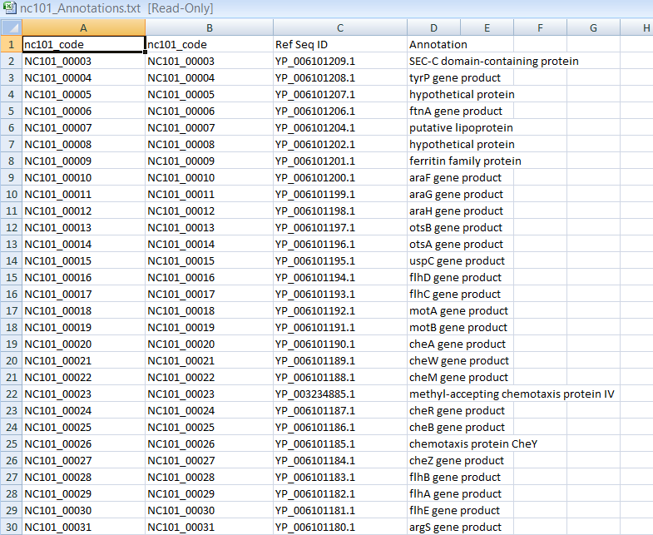
In case you care what these genes are…
File = nc101_Annotations.txt

Slide 7
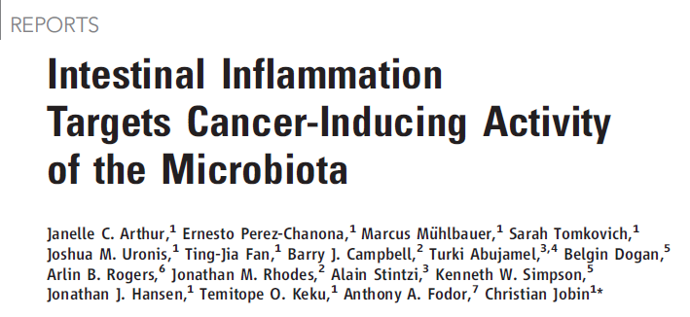

Two papers that describe this experimental system….
http://www.sciencemag.org/content/338/6103/120.full.pdf
https://www.nature.com/articles/ncomms5724

Slide 8
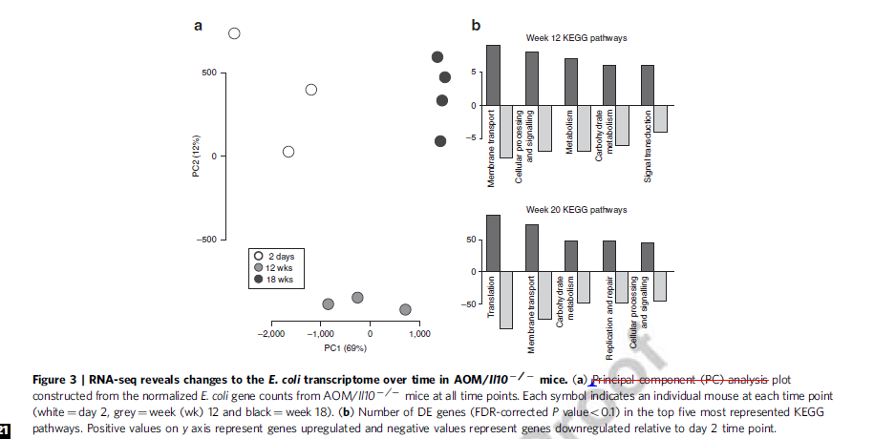
Fig.3 in the 2nd paper is the dataset you have…

Slide 9
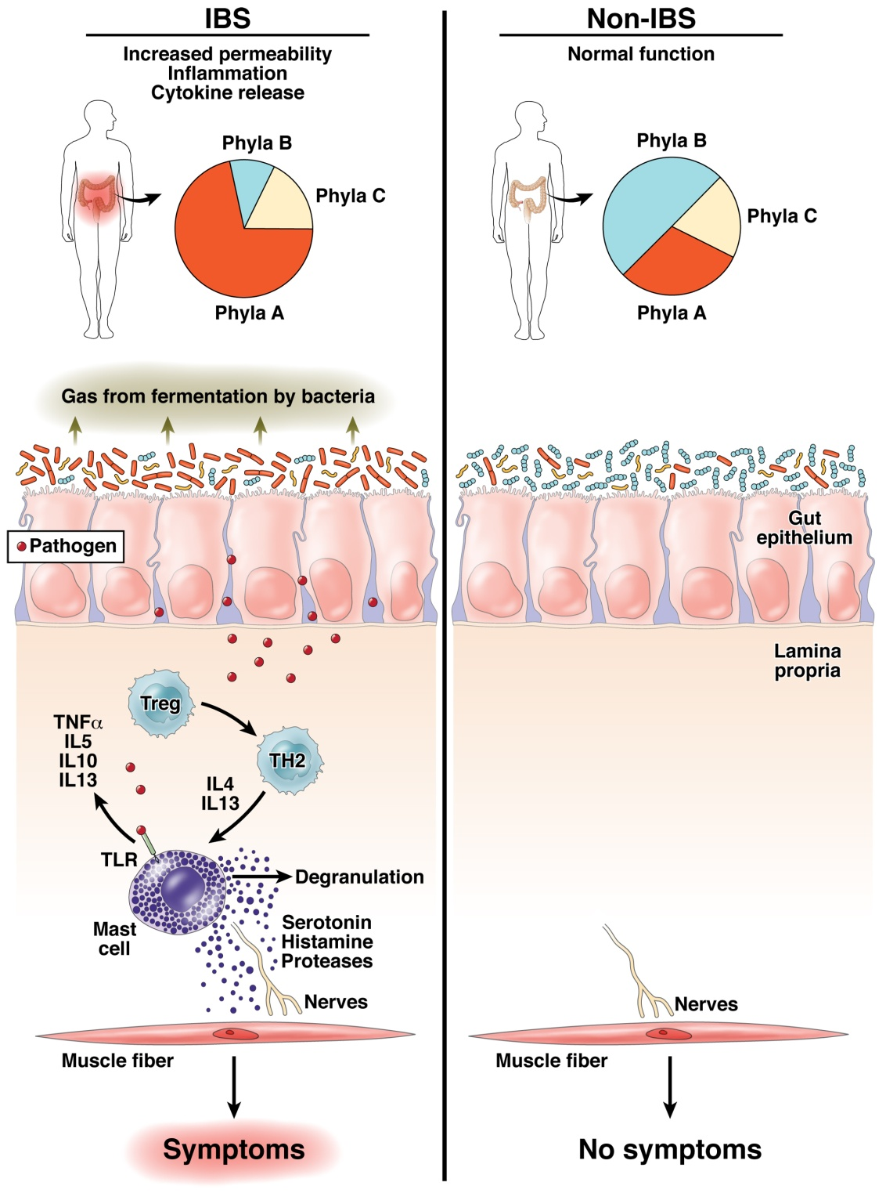
The “dysbiosis” hypothesis linking risk for inflammation related diseases to the microbiome
Fodor & Talley. Gastroenterology. 2011

Slide 10
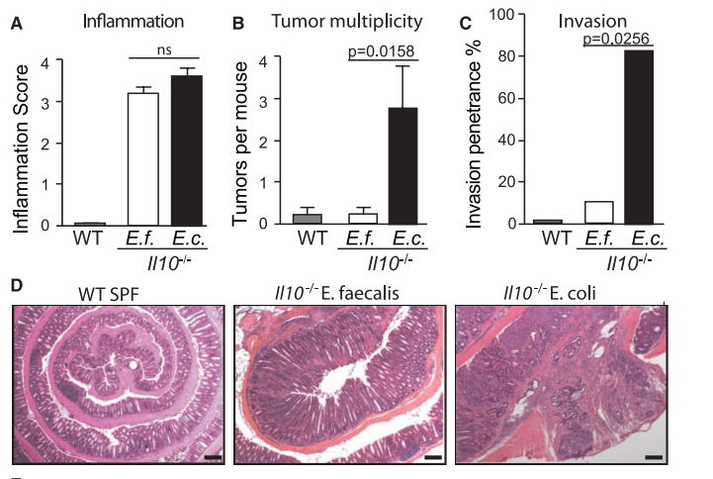
Some bugs, but not others, can cause inflammation to progress to cancer…
Arthur et al, Science, 2012

Slide 11
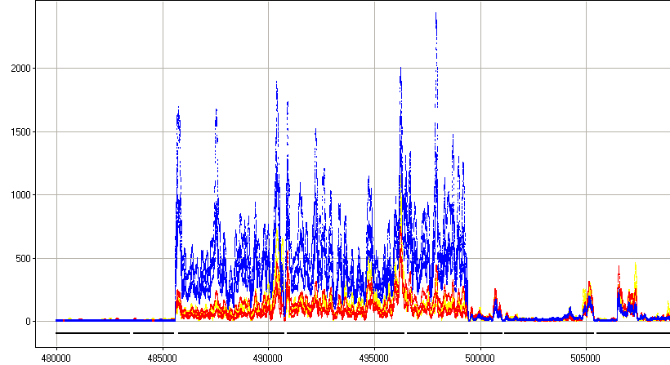



rna-seq shows us gene expression of host-associated E. Coli
Sterile mice
Inoculate with E. Coli
RNA from fecal samples characterized
by RNA-seq on the Illumina platform
2 days
12 weeks (inflammation)
18 weeks (cancer)
Normalized Read Count
Position along the genome
30S ribosomal protein
50S ribosomal protein
preprotein translocase subunit
DNA-directed RNA polymerase subunit

Slide 12
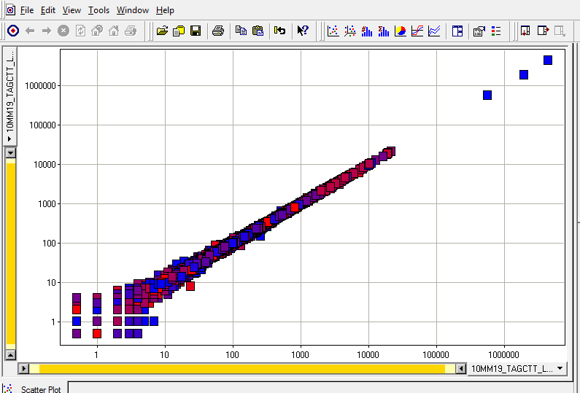
Features of the dataset:
Paired ends are nearly exactly the same
rRNA
unmapped
In your spreadsheet for the homework, we simply merged the paired ends…

Slide 13
One potential problem with this dataset.
Most of the sequences were 16S and 23S rRNA
(Bacteria do not have a poly-A tail on their mRNA )
(We used a bead capture method to remove the rRNA signature with limited success)
rRNA
unmapped

Slide 14
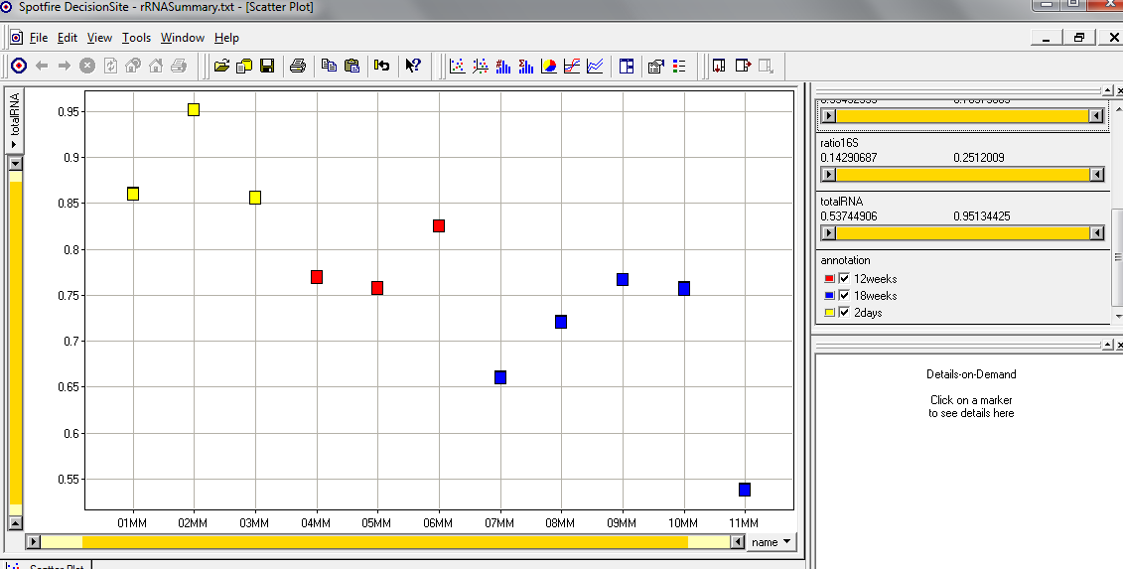
The fraction of 16S rRNA was correlated with time!
(The ribosomal machinery changes with the state of the bug?)
A potentially confounding variable…
16s rRNA reads + 23s rRNA reads
Sample names
In your spreadsheet, we removed the 16S and 23S rRNA sequences
and we will do normalization on the resulting counts…

