Slide 1


Introduction to
Software Processes and
Change Management

Slide 2
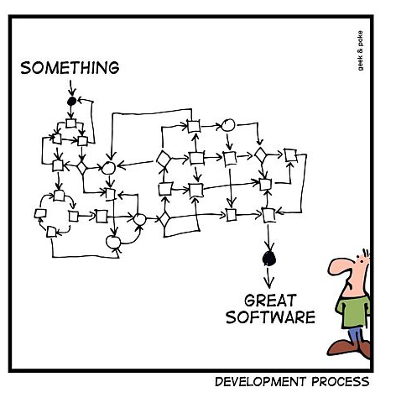
Why is Software Development such a hard Task?
Complex
Invisible
Changeable
Conformance
Discontinuous
Technology

Slide 3
Why is Software Development such a hard Task?
Typical Problems
Misunderstandings
Changes everywhere
Unclear status
Unstable software

Slide 4
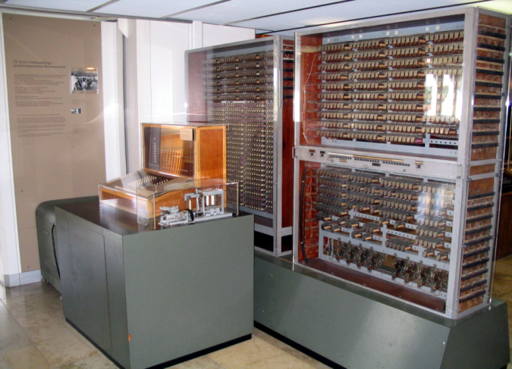
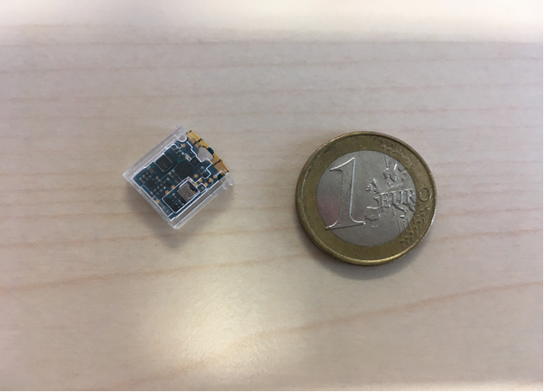
A little Bit of History
Bigger* Computers, bigger Software, bigger Problems…
Zuse Z3 (1941)
  5-10 Hz
  64 Words of Memory (22 bit)
  2000 Relays
Fomu (2019)
  48 MHz
  128 + 16 kB of Memory
  5280 4-input LUTs
* in terms
of „gates“

Slide 5
A little Bit of History
How “Programming” became “Software Development“
Agile / Lean / DevOps
Iterative
V-Model
Waterfall
Code & Fix

Slide 6
Exemplary Software Methodologies
Classical Sequential Approach (aka: Waterfall)
Analyze
Unfortunately, software development does not work this way…
Design
Construct
Evaluate
Deploy &
Maintain

Slide 7
Exemplary Software Methodologies
Modern Approaches
Design
Aiming for short iterations / frequent releases to achieve early feedback!
Initial Idea
Plan /
Analyze
Construct
Deploy
Evaluate
User
Feedback

Slide 8
Change Management
Makes sure that results of the software development activities are managed in
a safe, traceable, and reproducible way!
It helps to answer typical questions such as:
  Where is the code?
  How do I build and test the software?
  Who is working on feature XYZ?
  When is the next release scheduled
  and what will it deliver?
Goals:
Keep control over changes
Ensure quality
Improve productivity
Keep status transparent

Slide 9
WANTED: A Change Process fitting your Needs!
Daily Work:
make audit
git add/commit/push
???
Finished when:
Build “green”
Review
???
Iteration
planning
Assigned
Task
Design
Coding
Testing
Resolved
Task
Prepare work:
git clone …
???
Iteration
closing

Slide 10
How do you develop Software?
Please think about a concrete software that you develop (alone or with others):
  Please describe the context (e.g., how many developers, their availability, etc.).
  Please visualize the change process:
    Which steps are performed to get a change into a usable software version?
    Which tools and practices do you use?
    Are there any automatic checks / reviews / feedback steps involved?
  Which aspects of the change process work well and which of them could require improvements?
Notes:
Complement results with:
There is no „right“ process
Develop the process step-by-step
Experiment, actively look for feedback and improvements
Make sure to achieve agreement among the team members
Use practices (e.g., code review, pair programming, test-driven development, etc.) and tools (e.g., Git, GitLab, testing frameworks, static code analyzers, etc.) and practices to support your process

Slide 11
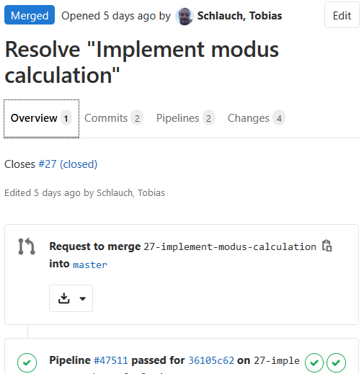
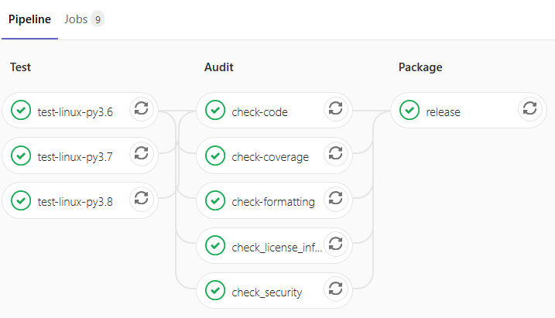
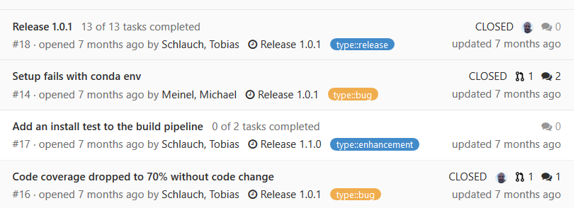
In this Workshop: Demonstrate an exemplary
Change Process supported by Git and GitLab
Shared Git
repository
Merge Requests
Build Pipeline
Development
Team
Issue Tracker

Slide 12
Key Points
Software development processes lay out the general phases and activities performed during software development
Change management helps to:
  Keep control over changes
  Ensure quality
  Improve productivity
  Keep status transparent
Make sure to establish a practical change process supporting your team!

Slide 13
Image Credits
All content is licensed under Attribution 4.0 International (CC BY 4.0) with the following exceptions:
  HIFIS logos / slide layout, © Helmholtz Association of German Research Centres. All rights reserved.
  DLR logo, slide 1, © German Aerospace Center. All rights reserved.
  Development process, slide 2, image by Oliver Widder, CC BY 3.0, source: http://geek-and-poke.com/geekandpoke/2012/1/28/simply-explained.html
  Zuse Z3, slide 3, image by Venusianer, CC BY-SA 3.0, source: https://commons.wikimedia.org/wiki/File:Z3_Deutsches_Museum.JPG

