Slide 1


Example Project

Slide 2
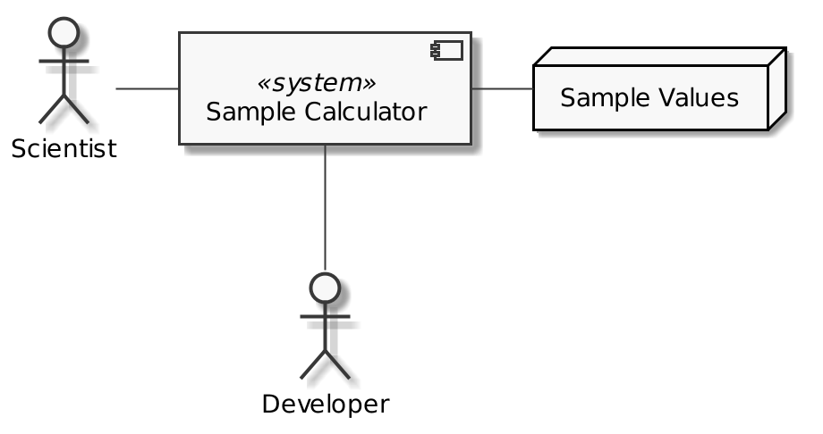
Welcome to the Development of Sample Calculator!
Usage as command line tool
Sample values from different sources
Integration as programming library

Slide 3
Welcome to the Development of Sample Calculator!
Requirements and Constraints
Functional requirements
  Implement reading sample values from console and files (CSV format)
  Implement calculation of average, variance, standard deviation (and other)
  Implement logging of all relevant steps (console output, log files)
Quality requirements
  Easily extensible with regard to calculations
  Easily extensible with regard to input methods
Constraints
  Python >= 3.9, no additional dependencies for usage
  Iterative development approach

Slide 4

Welcome to the Development of Sample Calculator!
Iteration 1:
Prototype
Iteration 2:
Initial Design
Iteration 3:
Release 1.0.0

Slide 5
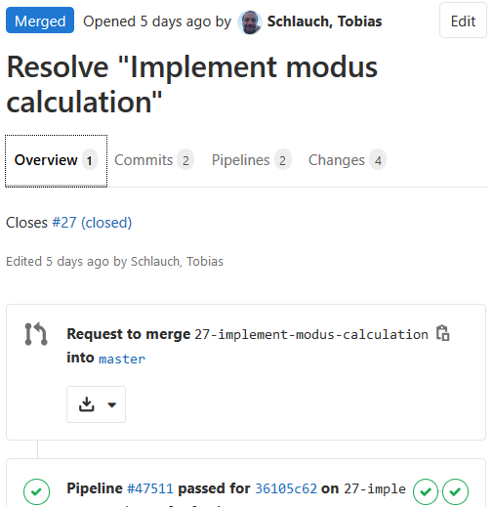
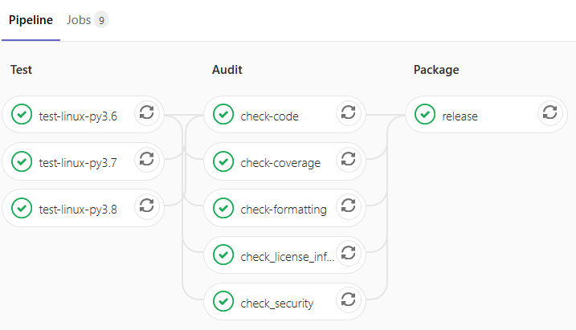
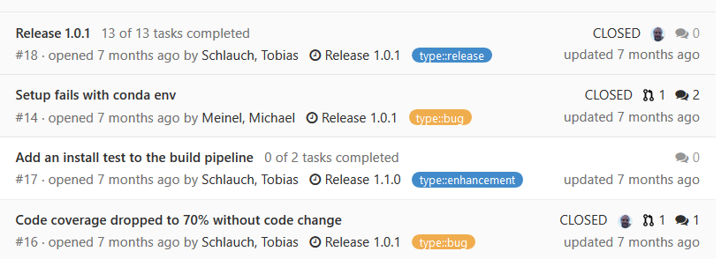
Tools used during Development
Mainline
Feature Branching
Reviewed Commits
Release / Hotfix Branch
Shared Git
repository
Merge Requests
Build Pipeline
Development
Team
Issue Tracker

Slide 6
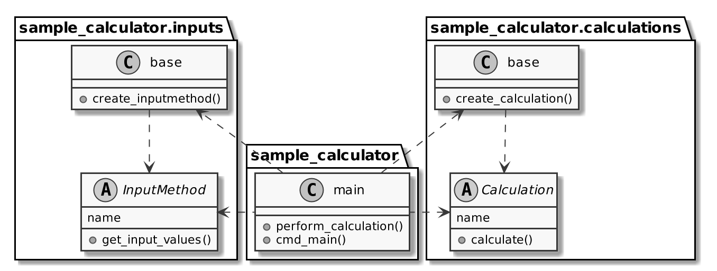

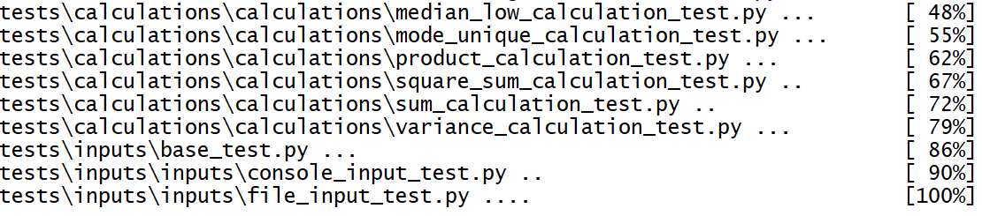
Iteration 2
Goals and Current Status
Our Tasks:
Set up issue tracker
Set up build pipeline
Iteration
planning
Assigned
Task
Design
Coding
Testing
Resolved
Task
Iteration
closing

Slide 7
Envisioned Change Process
Daily Work:
git add/commit/push
make audit
Integration build
Finished when:
Integration build passed
Merged into main
Iteration
planning
Assigned
Task
Design
Coding
Testing
Resolved
Task
Prepare work:
Create merge
request
Pull new branch
Iteration
closing

Slide 8
Live Coding: Set up the Issue Tracker

Slide 9
Live Coding: Set up the Build Pipeline

Slide 10
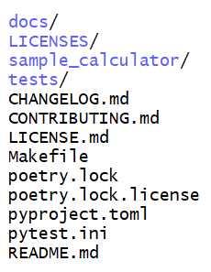
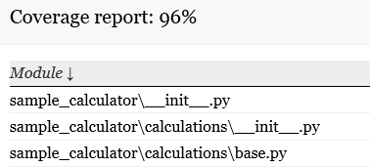
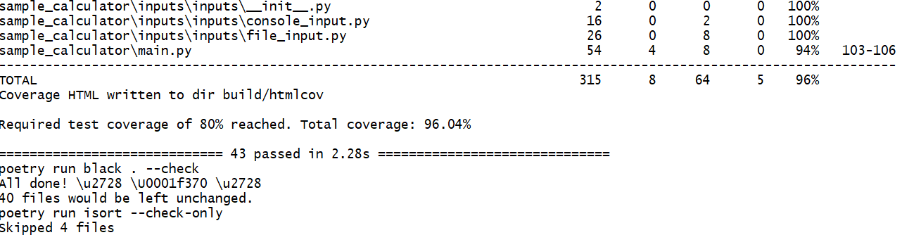
Build Script
make audit
Included Tools:
pytest for testing
coverage.py for code coverage
flake8 for static code analysis
black/isort for code formatting
bandit for security checking
reuse for license metadata checking
Sphinx for docs
Poetry for dependencies

Slide 11
Build Script vs. Build Pipeline
3) Start integration build
2) Trigger
Build Pipeline
Build Script
Remote Git
1) Commit & Push
4) Return result
5) Notification
Development
Team

Slide 12
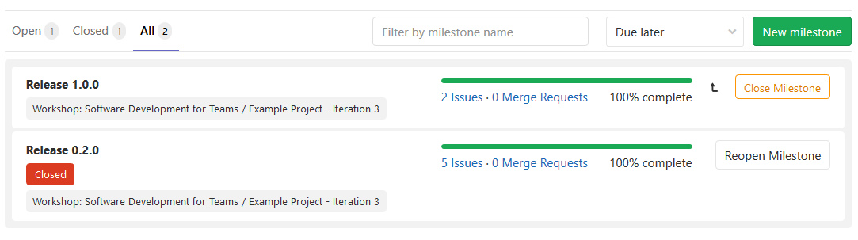
Live Coding: Close Iteration 2

Slide 13
Iteration 3
Goals and Current Status
Iteration 1:
Prototype
Iteration 2:
Initial Design
Iteration 3:
Release 1.0.0
Features:
  Implementation of missing calculations
  File input
  Logging
Change process:
  Release process and
  release build job
  Code reviews

Slide 14
Extended Change Process
Finished when:
Integration build & code review passed
Merged into main
Daily Work:
git add/commit/push
make audit
Integration build
Iteration
planning
Assigned
Task
Design
Coding
Testing
Resolved
Task
Prepare work:
Create merge
request
Pull new branch
Iteration
closing

Slide 15

Let us start ☺

Slide 16

Review Meeting
Check all tasks
Check latest snapshot build
Download latest snapshot artifacts and check it locally
Are we ready to release it?

Slide 17
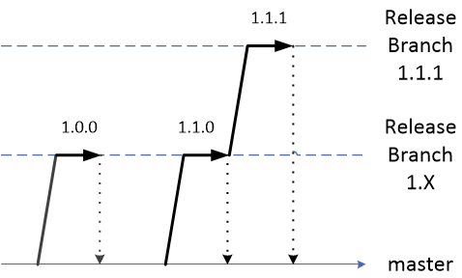
Live Demonstration: Release Version 1.0.0

Slide 18

Release 1.0.0 is now available!

Slide 19
Live Demonstration: Bugfix Releases using
Release Branches and Tags

Slide 20
Image Credits
All content is licensed under Attribution 4.0 International (CC BY 4.0) with the following exceptions:
  HIFIS logos / slide layout, © Helmholtz Association of German Research Centres. All rights reserved.
  DLR logo, slide 1, © German Aerospace Center. All rights reserved.
  OK Button, slides 3/4/11, CC0 1.0, source: https://freesvg.org/ok-button
  Women On Laptops Around Table, CC0 1.0, source:
  https://www.piqsels.com/en/public-domain-photo-zbfba
  Under Review, slide 14, CC0 1.0, source: https://commons.wikimedia.org/w/index.php?curid=54697126
  Philae landing on comet 67 P/Churyumov-Gerasimenko, slide 16, image by DLR, CC BY 3.0

